Slide 1
Communicating with Data – Text
Dr. Ab Mosca (they/them)
Slides based off slides courtesy of Jordan Crouser (https://jcrouser.github.io/)

Slide 2
Plan for Today
What is text data?
Why visualize text?
Techniques
Activity

Slide 3

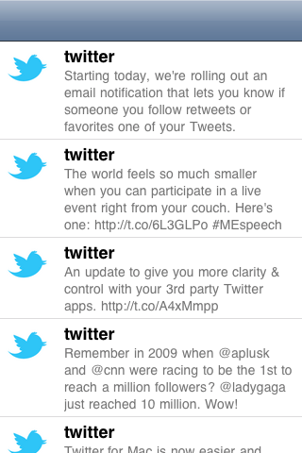
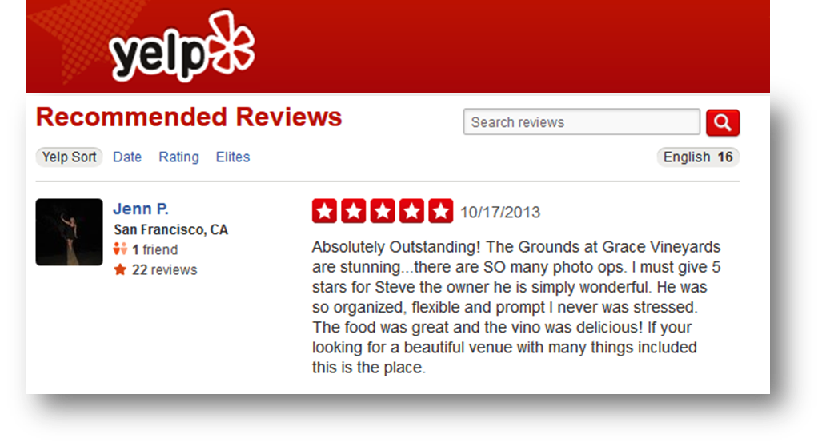
What is text data?
Documents
Articles, books and novels
E-mails, web pages, blogs
Text snippets
Tweets, SMS messages
Tags, comments, profiles
And more...
Computer programs, logs
Collections of documents
This slide!

Slide 4
Overview
Question: what are some characteristics of text data?
Answer:
Often high dimensional (over 228,000 words in OED)
Packed with meaning and relationships:
Correlations: Hong Kong, San Francisco, Bay Area
Order: April, February, January, June, March, May
Membership: Tennis, Running, Swimming, Hiking, Piano
Hierarchy, antonyms & synonyms, entities, …

Slide 5
Understand – read a document
Summarize – get the “gist” of a document
Cluster – group together similar contents
Quantify – convert to numerical measures
Correlate – compare patterns in text to those in other data, e.g., test scores with conversations on social media
Why visualize text data?

Slide 6
How can we quantitatively analyze text data?

Slide 7
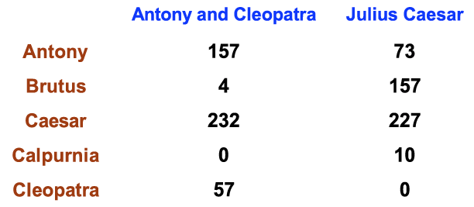
Ignore ordering relationships within the text
A document ≈ vector of term weights
Each dimension corresponds to a term (10,000+)
Each value represents the relevance
For example, simple term counts
Aggregate into a document-term matrix
“Bag of words” model

Slide 8

Example: health care reform
Recent history
Initiatives by President Clinton
Overhaul by President Obama
Text data
News articles
Speech transcriptions
Legal documents
What questions might you want to answer?

Slide 9
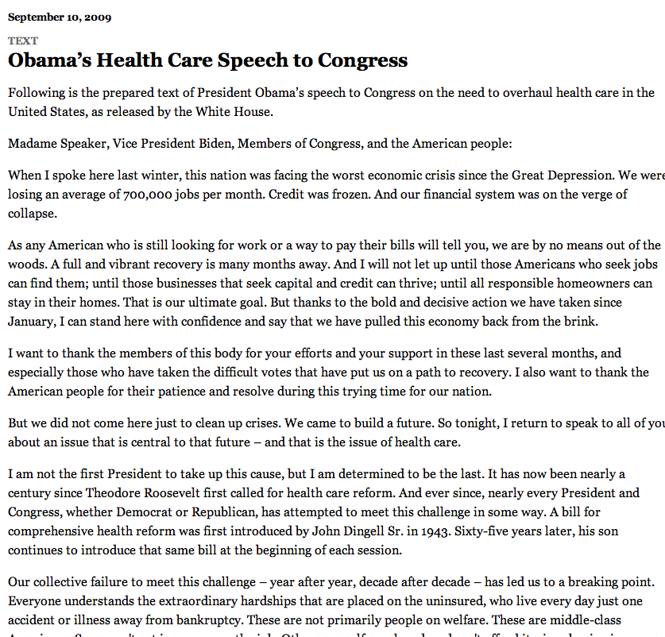
A concrete example

Slide 10

New York Times: Obama 2009
economix.blogs.nytimes.com/2009/09/09/obama-in-09-vs-clinton-in-93

Slide 11
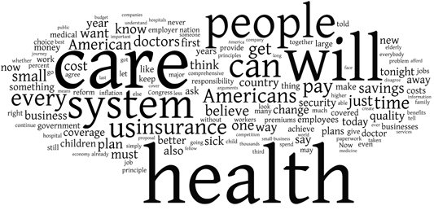
New York Times: Clinton 1993
economix.blogs.nytimes.com/2009/09/09/obama-in-09-vs-clinton-in-93

Slide 12
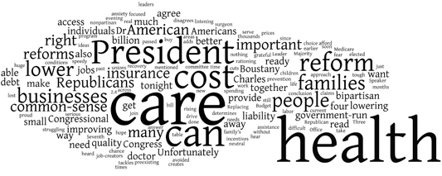
Obama 2009
Clinton 1993
Comparison
Rep. Charles Boustany of Louisiana 2009
economix.blogs.nytimes.com/2009/09/09/obama-in-09-vs-clinton-in-93

Slide 13
Word clouds
Strengths
Familiar to many people
Can help with “gisting” and initial query formation
Weaknesses
Does not show the structure of the text
Sub-optimal visual encoding (position is not meaningful)
Inaccurate size encoding (long words are bigger)
May not facilitate comparison (unstable layout)
Term frequency may not be meaningful

Slide 14
Flashback
Obama 2009
Clinton 1993
economix.blogs.nytimes.com/2009/09/09/obama-in-09-vs-clinton-in-93

Slide 15
Weighting words
Term Frequency
tf_{td} = # of times term t appears in document d
TF-IDF: Term Frequency by Inverse Document Frequency
tf-idf_{td} = # of times term t appears in document d
# of times term t appears in all documents

Slide 16
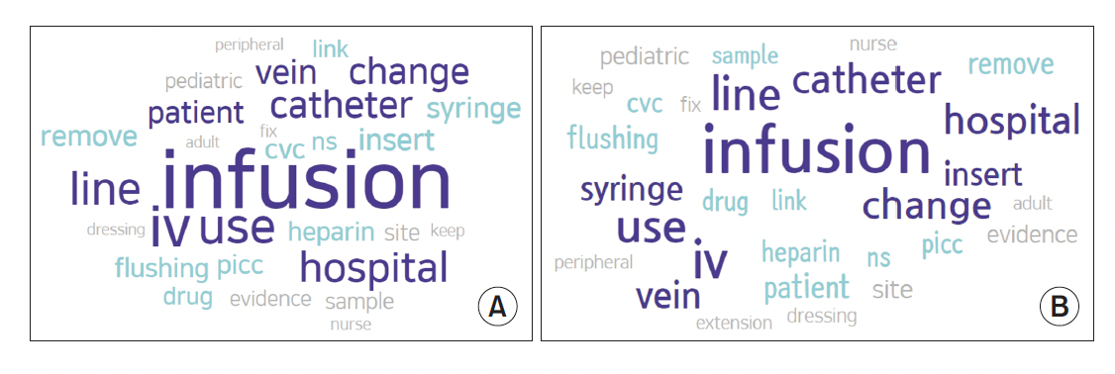
Frequency example
Keyword Network Analysis of Infusion Nursing
from Posts on the Q&A Board in the Intravenous
Nurses Caf.

Slide 17
TF-IDF example
Keyword Network Analysis of Infusion Nursing
from Posts on the Q&A Board in the Intravenous
Nurses Caf.

Slide 18
Often favors frequent (TF) or rare (IDF) terms
Still not clear that these provide best description
A “bag of words” ignores additional information
Grammar / part-of-speech
Position within document
Recognizable entities
Typically focus on unigrams (single terms)
Limitations of frequency statistics

Slide 19
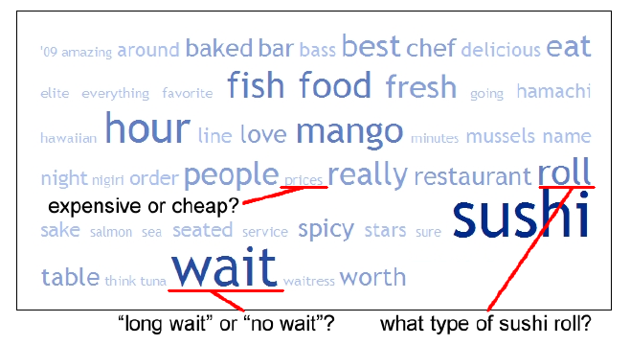
Example: Yelp reviews
Yatani 2011

Slide 20
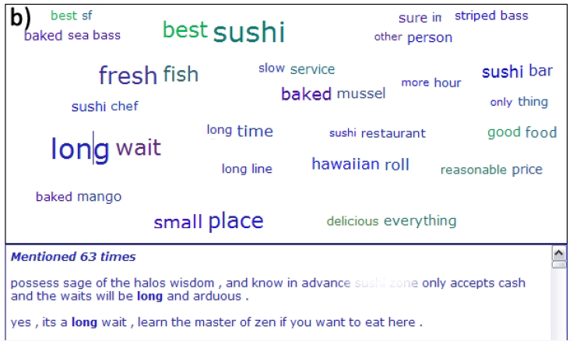
Example: Yelp reviews
Yatani 2011
Notes:
Pairs of words

Slide 21
Discussion
What are some other ways we might
visualize text data?

Slide 22
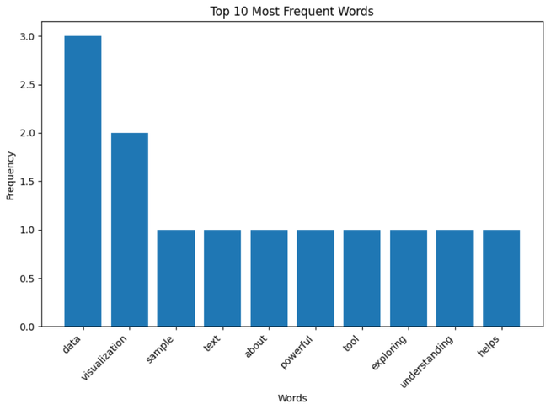
Bar Charts
https://www.geeksforgeeks.org/visualizing-text-data-techniques-and-applications/
Notes:
Bar charts can be used to visualize the frequency of specific words or phrases in a text dataset. They provide a clear and precise comparison of word frequencies.
Use Cases:
Comparing the frequency of keywords in different documents.
Analyzing the distribution of topics in a dataset.
Used to show the frequency of specific terms or categories within the text.

Slide 23
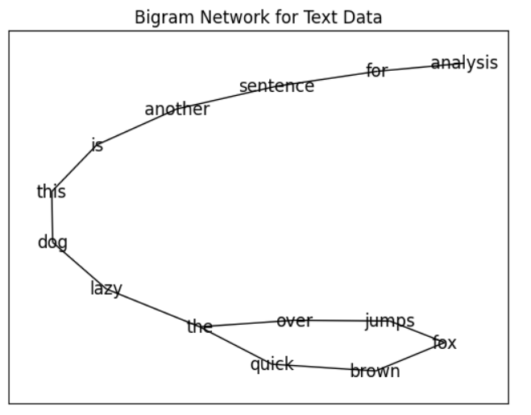
Bigram Network
https://www.geeksforgeeks.org/visualizing-text-data-techniques-and-applications/
Notes:
A Bigram Network is a visualization technique used to illustrate the relationships between pairs of words (bigrams) in a text dataset. This network graphically represents the most frequent pairs of words that appear consecutively in the text, with nodes representing words and edges representing the connections between them.
Use Cases:
Understanding the contextual relationship between words in large text datasets.
Analyzing patterns in customer feedback or social media posts to identify common themes or issues.
Exploring text data from research articles, books, or any large corpus to discover hidden connections.

Slide 24
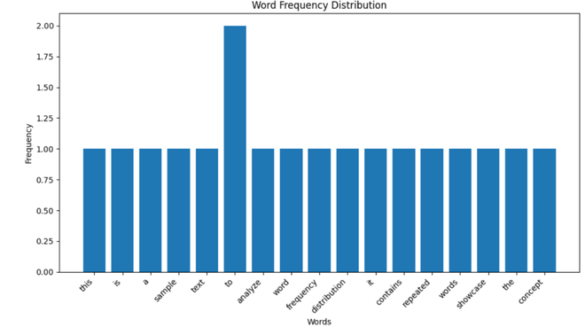
Word Frequency Distribution Plot
https://www.geeksforgeeks.org/visualizing-text-data-techniques-and-applications/
Notes:
A Word Frequency Distribution Plot is a graphical representation that shows how frequently different words appear in a text dataset. It typically displays words on the x-axis and their corresponding frequencies on the y-axis. This plot helps in understanding the distribution of words in the text, identifying the most common words, and observing the overall frequency pattern.
Use Cases:
Analyzing the vocabulary usage in a text dataset.
Identifying the most important words in customer feedback or social media posts.
Comparing word frequencies across different texts or corpora.

Slide 25
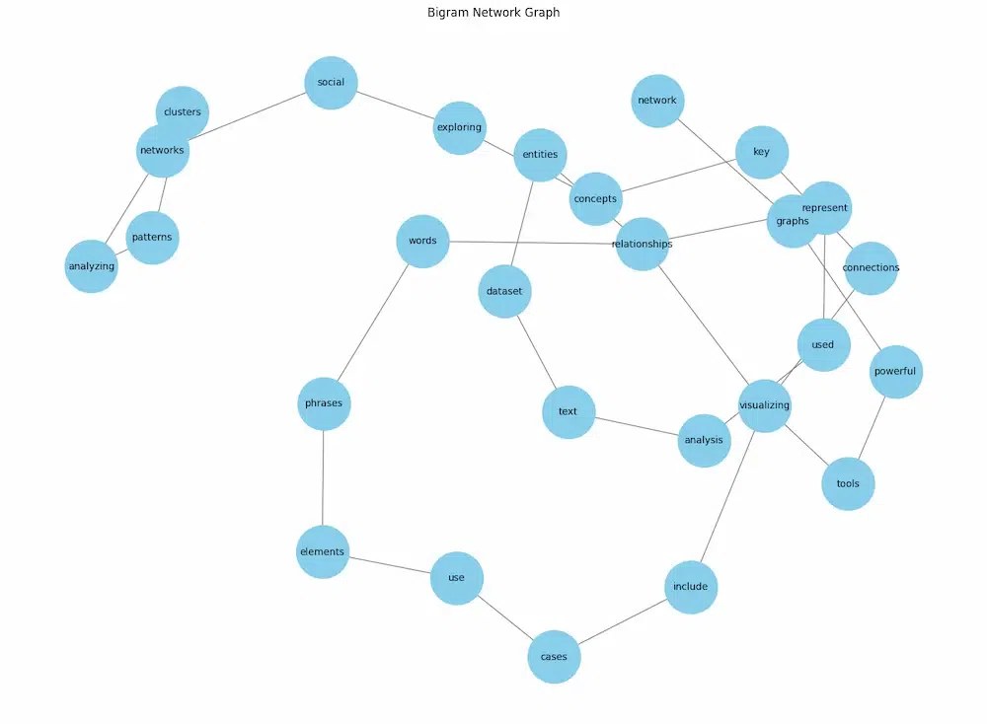
Network Graphs
https://www.geeksforgeeks.org/visualizing-text-data-techniques-and-applications/
Notes:
Network graphs visualize the relationships between words or entities in a text dataset. Nodes represent words or entities, and edges represent the relationships between them.
Use Cases:
Analyzing co-occurrence of words in a text.
Exploring relationships between entities in a document.

Slide 26
Explore other visualization options. Find one of interest to you, and be ready to share it with the class.
Some places to look:
https://public.tableau.com/app/discover/viz-of-the-day
https://observablehq.com/@d3/gallery
https://r-graph-gallery.com/
https://informationisbeautiful.net/
https://python-graph-gallery.com/best-python-chart-examples/
https://www.census.gov/dataviz/
https://www.tableau.com/viz-gallery
Anywhere you want to look!
Activity

