Slide 1
Visual Analytics– Time Varying Data
Dr. Ab Mosca (they/them)
Slides based off slides courtesy of Jordan Crouser (https://jcrouser.github.io/)

Slide 2
Homework Note
Please submit only the required deliverables on Gradescope (no binary files and no data files)
Please assume the data folder I give you with the assignment is saved in the same directory as your scripts, and set them up to run as such

Slide 3
Plan for Today
What is time varying data?
Lab

Slide 4
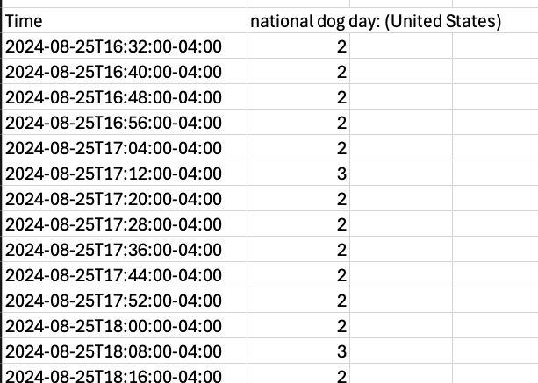
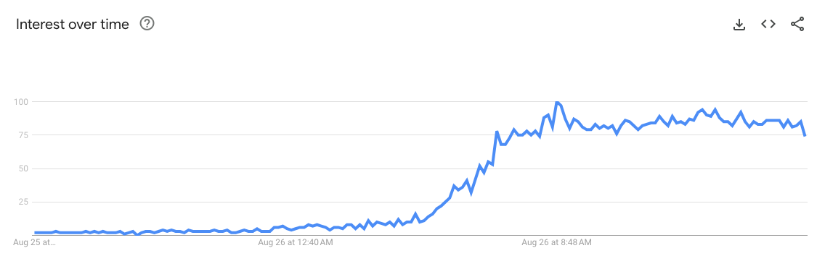
Time Varying Data
Are these variables dependent or independent?

Slide 5
Lab
Find instructions for today’s lab on the course website

