Slide 1
Visual Analytics– Time Varying Data
Dr. Ab Mosca (they/them)
Slides based off slides courtesy of Jordan Crouser (https://jcrouser.github.io/)

Slide 2
Plan for Today
What is time varying data?
Lab

Slide 3
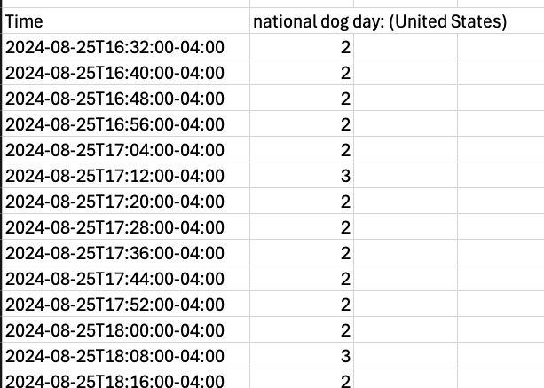
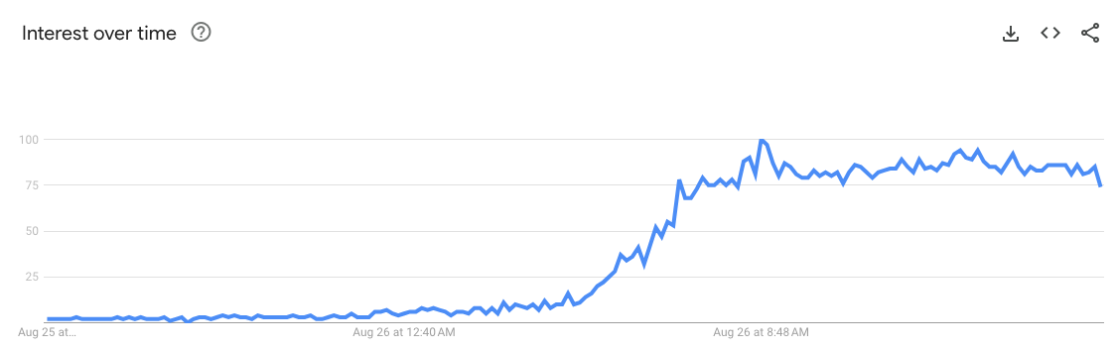
Time Varying Data
Are these variables dependent or independent?

Slide 4
Lab
Find instructions for today’s lab on the course website

