Slide 1
Visual Analytics– Communicating Uncertainty
Dr. Ab Mosca (they/them)
Slides based off Medium articles by Jessica Hullman and Matthew Kay (https://medium.com/multiple-views-visualization-research-explained/uncertainty-visualization-explained-67e7a73f031b )

Slide 2
Plan for Today
What is it?
How do we show it?

Slide 3
What we mean when we say Uncertainty
In visualization we’re talking about the different values the data could possibly be
Ex. We have some value we want to know about some population (parameter in stats), but we must estimate that value through a sample of the population

Slide 4
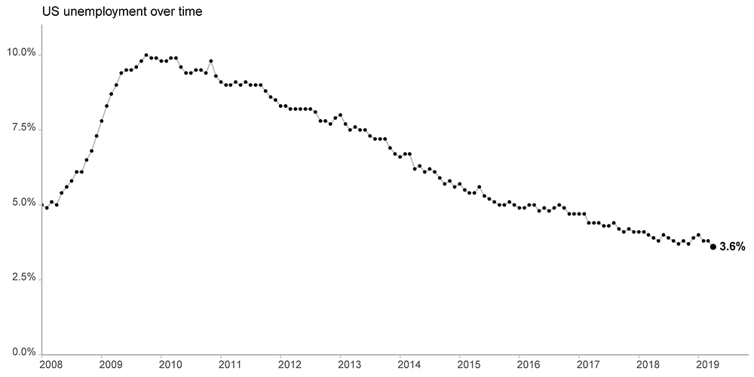
What we mean when we say Uncertainty
In visualization we’re talking about the different values the data could possibly be
Ex. We have some value we want to know about some population (parameter in stats), but we must estimate that value through a sample of the population
How did they get each value?
Notes:
monthly jobs figures, as shown in this visualization based on data from the Bureau of Labor Statistics (BLS):
At first glance, we might interpret the values in the chart as the outcome of asking every person in the country if they are unemployed, or perhaps some proxy we imagine would capture that information, like the proportion of workers in the U.S. on unemployment insurance. In reality, the government relies on the Current Population Survey (CPS), which is a survey of 60,000 eligible households — roughly 110,000 people — that are selected to be representative of the U.S. population. Employment information from this sample is weighted by demographics to give an estimate of the unemployment rate in the U.S. population at large

Slide 5
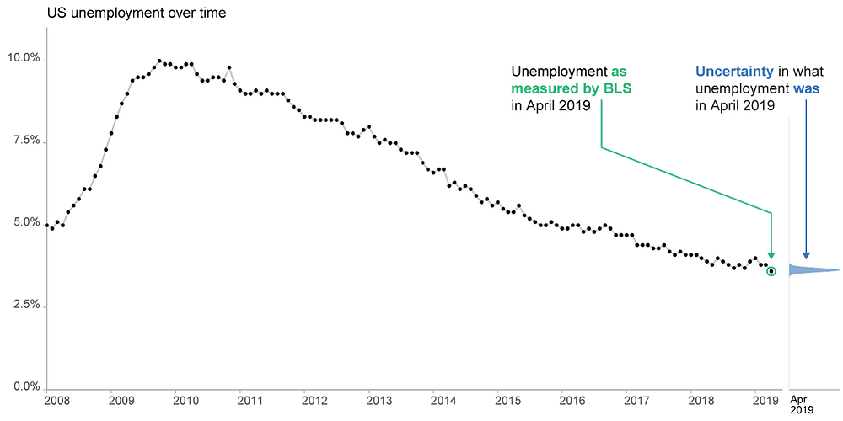
Estimated Values
A statistical model is used to estimate a parameter
The model quantifies the uncertainty around the estimate by considering all values it could be (and how likely each is)
Hence, a parameter’s uncertainty can be characterized by a probability distribution

Slide 6
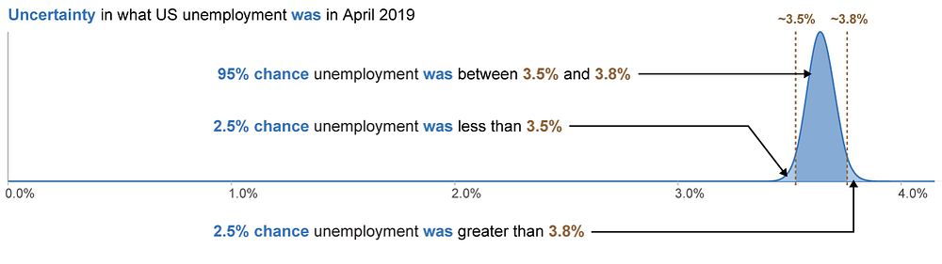
Probability Distributions
Notes:
For the sake of explaining uncertainty, we created a statistical model that allows us to point to intervals, like 3.5% — 3.8%, and say that there is 95% chance that the interval contains the true unemployment value. Unfortunately, many intervals that we see, including from the BLS, are not so easily interpreted: the 95% instead refers to a property of the process used to construct the interval, not the chance that it contains the true value

Slide 7
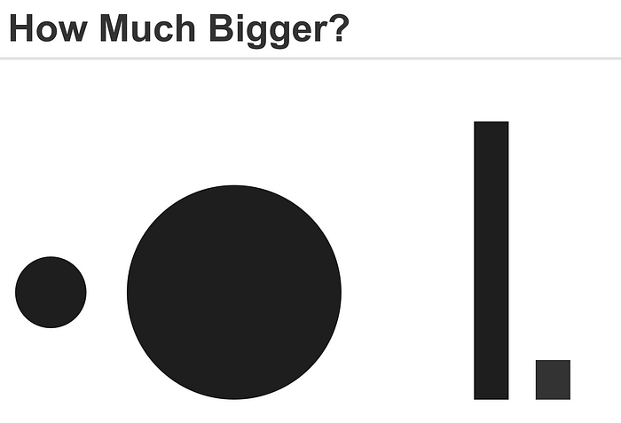
Communicating Uncertainty
Imprecise ways to communicate uncertainty:
Rounding
Choosing a visualization technique that is harder for people to read
Why is this imprecise? (Hint: think about perception)

Slide 8
“Apparent” magnitude
Attentive processing
Length
estimate
correctly
Area
under-
estimate
Actual
perfect correspondence
Volume
way under-
estimate
Perceived
http://makingmaps.net/2007/08/28/perceptual-scaling-of-map-symbols/

Slide 9
Communicating Uncertainty
Imprecise ways to communicate uncertainty:
Rounding
Choosing a visualization technique that is harder for people to read
What drawbacks do you see to these methods?
Notes:
First, there’s no guarantee that any individual viewer’s error will be proportional to the amount of uncertainty that is intended. Even if a designer chooses an encoding based on estimates of average error from graphical perception experiments, individual differences in accuracy can mean that one viewer’s estimate nearly perfectly matches the true value, while another viewer’s is even further off than the intended amount of error. Since we usually evaluate visualization designs based on how well they perform for individual users, it’s hard to rationalize a design choice that depends heavily on results averaged across viewers. Second, there’s no guarantee that a viewer will recognize that the visual encoding is less effective, and therefore lower their confidence in their estimate of the value: they might feel very confident about a bad estimate.

Slide 10

Communicating Uncertainty
Subtle ways to communicate uncertainty:
Can you see the uncertainty estimate?

Slide 11
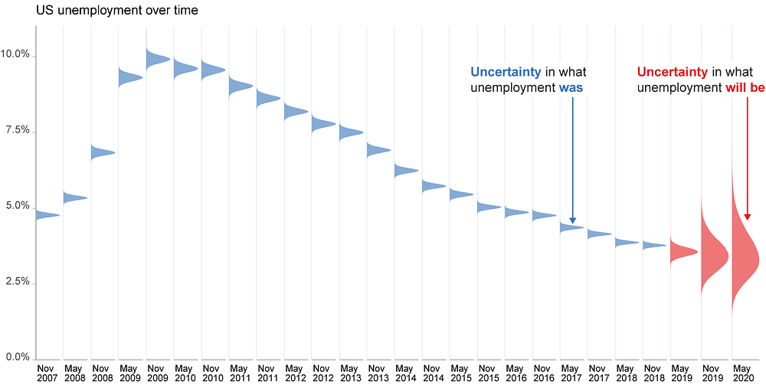
Communicating Uncertainty
Direct ways to communicate uncertainty:
Map probability density to a visual channel

Slide 12
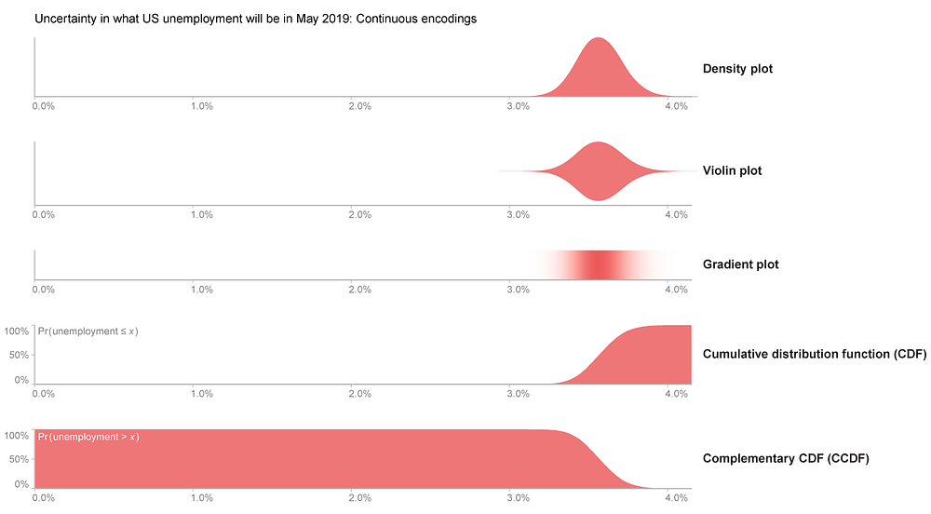
Communicating Uncertainty
Direct ways to communicate uncertainty:
Map probability density to a visual channel

Slide 13
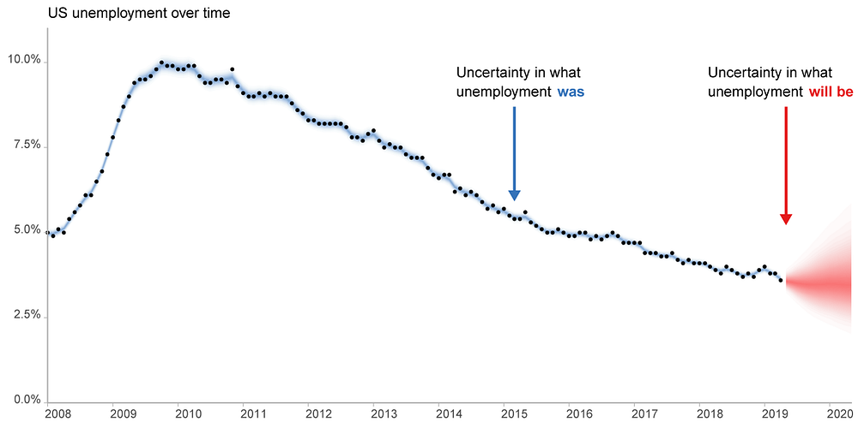
Communicating Uncertainty
Direct ways to communicate uncertainty:
Map probability density to a visual channel

Slide 14
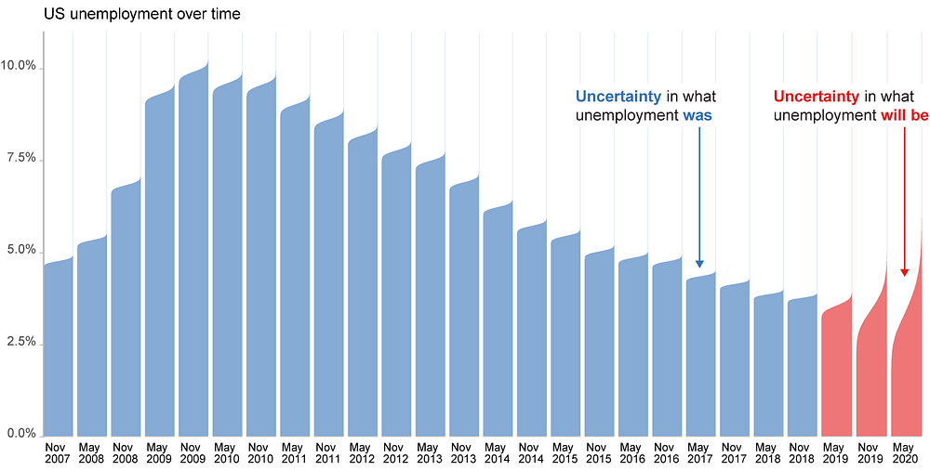
Communicating Uncertainty
Direct ways to communicate uncertainty:
Map probability density to a visual channel

Slide 15
Communicating Uncertainty
How should we decide between encodings?
Notes:
if the goal is simply to convey a coarse sense of uncertainty, a gradient plot might suffice. If the goal is for the user to be able to compare the relative amounts of probability density to make decisions, a density plot is more appropriate.

Slide 16
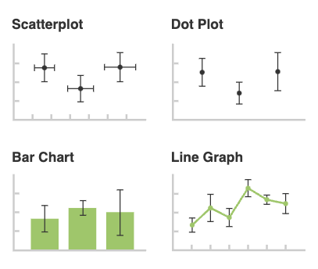
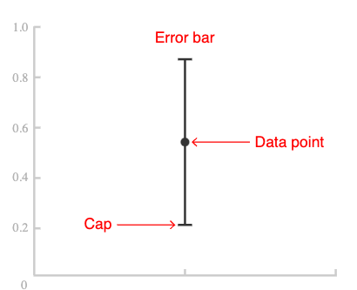
Communicating Uncertainty
Direct ways to communicate uncertainty:
Error Bars
Proceed with caution! How do you think readers might misinterpret error bars?
https://datavizcatalogue.com/methods/error_bars.html
Notes:
animated visualizations in which each frame presents a draw from a distribution one wishes to convey, whether univariate or multivariate

Slide 17
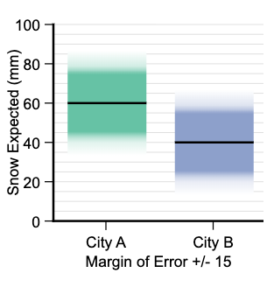
Communicating Uncertainty
Direct ways to communicate uncertainty:
Gradient Plots
What advantage does this encoding have over error bars?

Slide 18
Communicating Uncertainty
Direct ways to communicate uncertainty:
Show animated visualizations where each frame is a draw from the probability distribution
Ex. Hypothetical Outcome Plots (HOPs)
Notes:
animated visualizations in which each frame presents a draw from a distribution one wishes to convey, whether univariate or multivariate

Slide 19
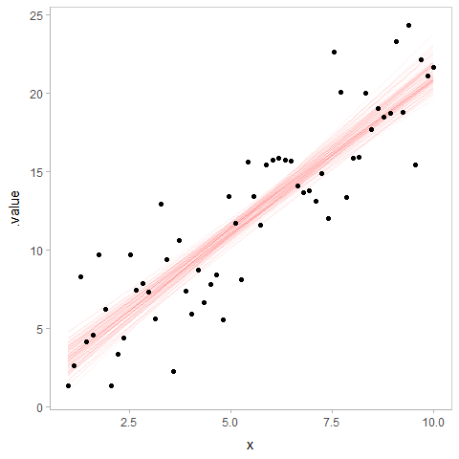
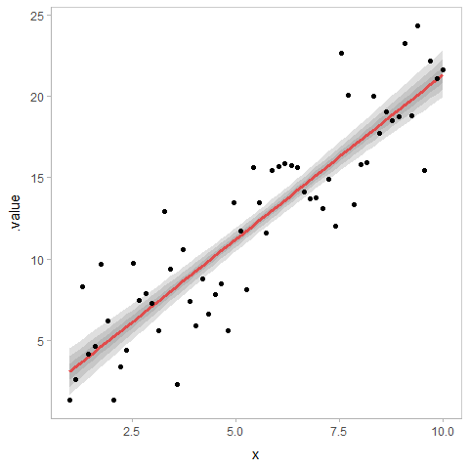
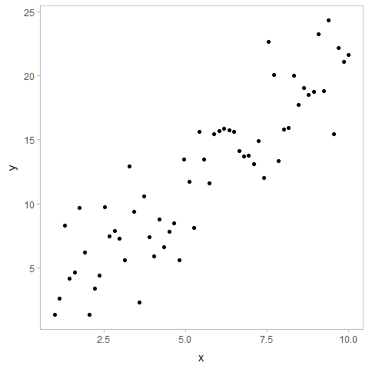
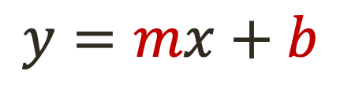
Linear Regression
$$y=mx+b$$
https://github.com/mjskay/uncertainty-examples/blob/master/linear-regression.md
Notes:
animated visualizations in which each frame presents a draw from a distribution one wishes to convey, whether univariate or multivariate

Slide 20
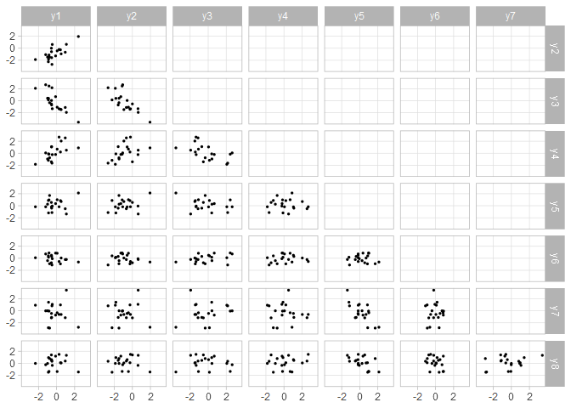
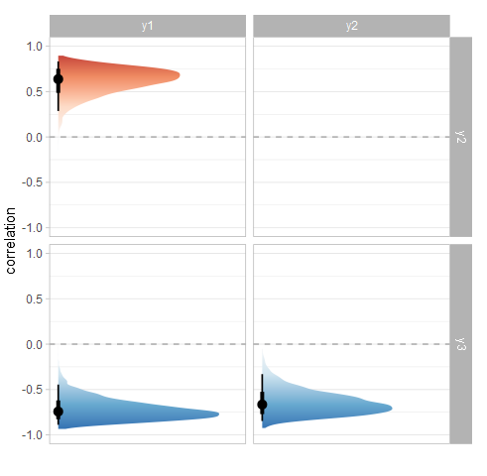
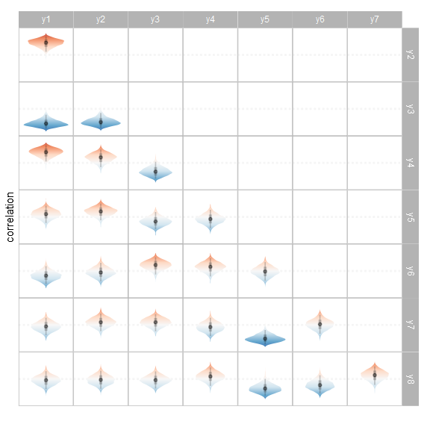
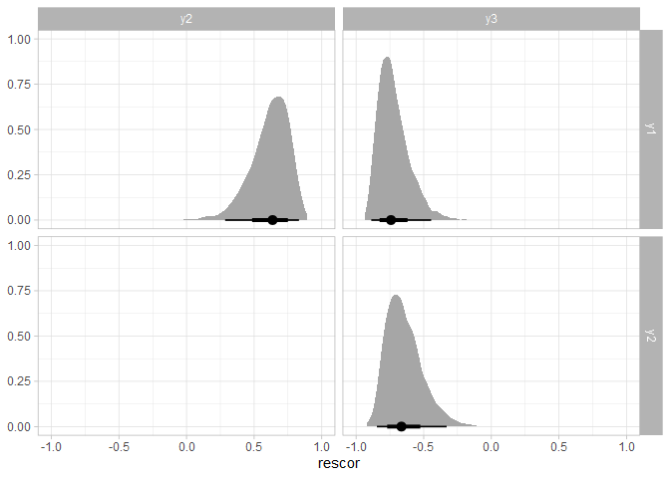
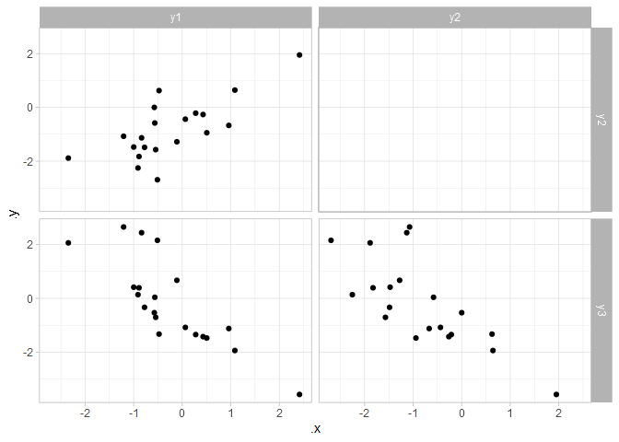
Multivariate Regression
https://github.com/mjskay/uncertainty-examples/blob/master/linear-regression.md
Notes:
Residual correlation from the model (are the residuals correlated)

Slide 21
Demos
R and Python Uncertainty Visualization Demos are on the course website. Work through one with a partner

