Slide 1
LECTURE 05:
THE ROLE OF INTERACTION
March 4, 2021
CSC/SDS 235
Visual Analytics

Slide 2
About Data Challenge 1 teams
Teams created on Moodle, a few late-breaking adjustments last night / this morning
If you didn’t request a team, I’ve assigned you to one subject to the following (my best guess in some cases):
Minimize time zone spread
Maximize diversity of major
Avoid odd-person-out (4 on-campus+1 off, 4 first year+1 senior, etc.)
Feel free to use Slack to communicate, or any other mechanism that works for your team
Questions / concerns? DM @jordan

Slide 3
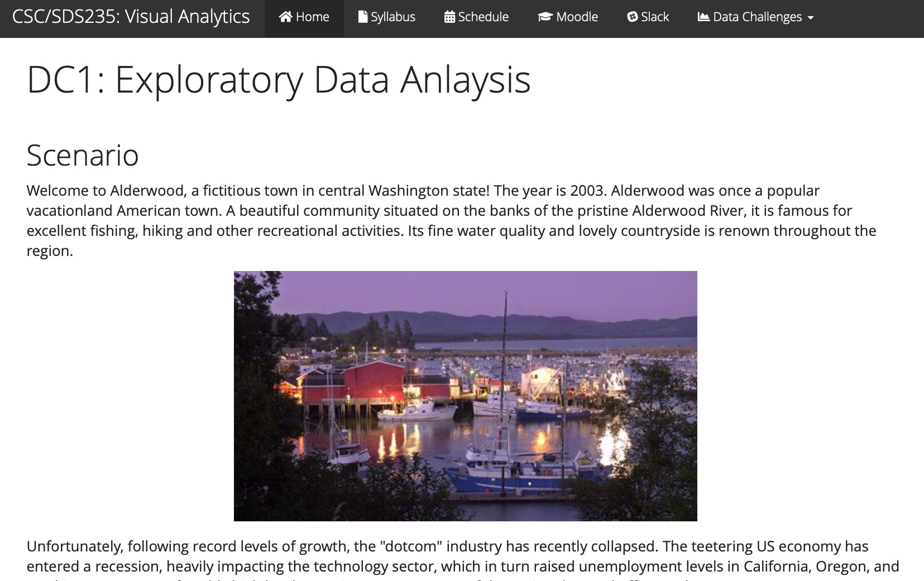
Data Challenge 1: Exploratory Data Analysis

Slide 4
Outline
DC1 check in
Interaction and Analysis
Definition
Interaction with data and problem space
Interaction with visual interfaces
Demo: plotly

Slide 5



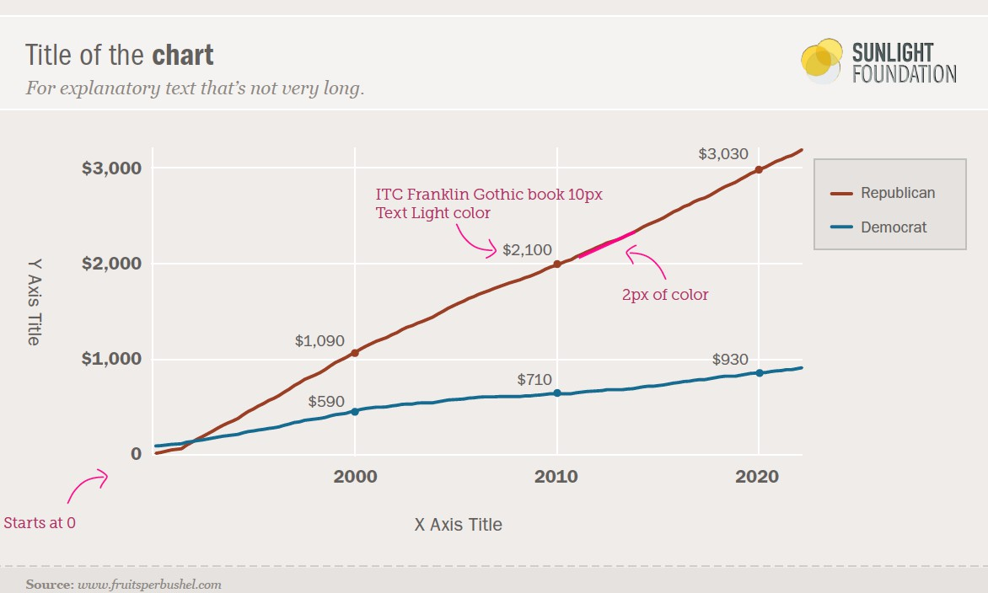
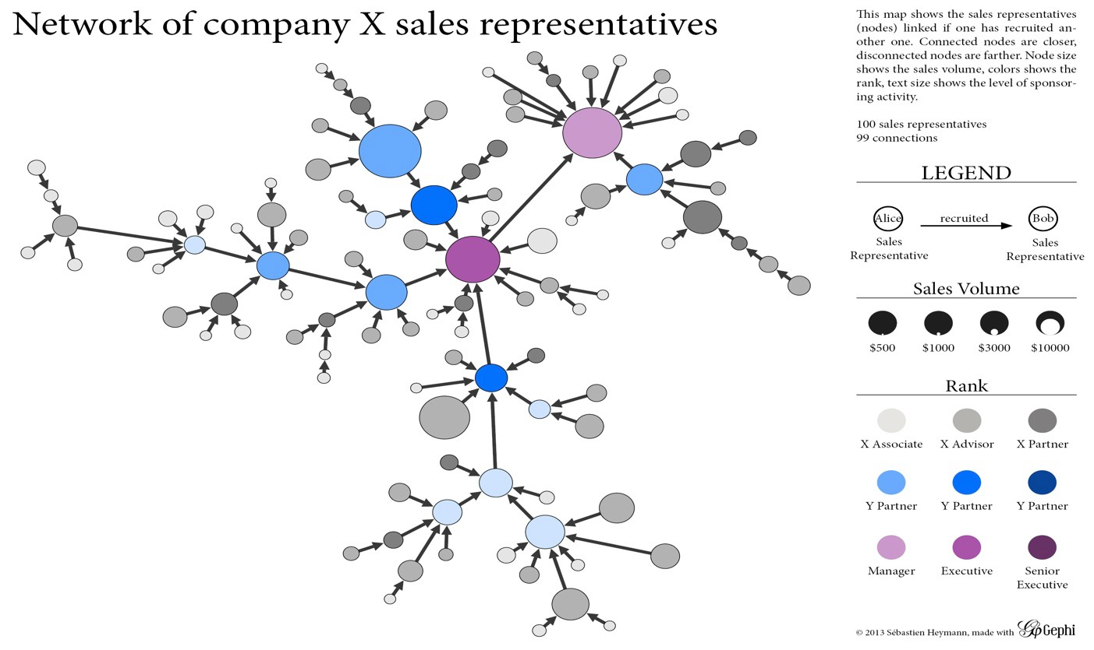
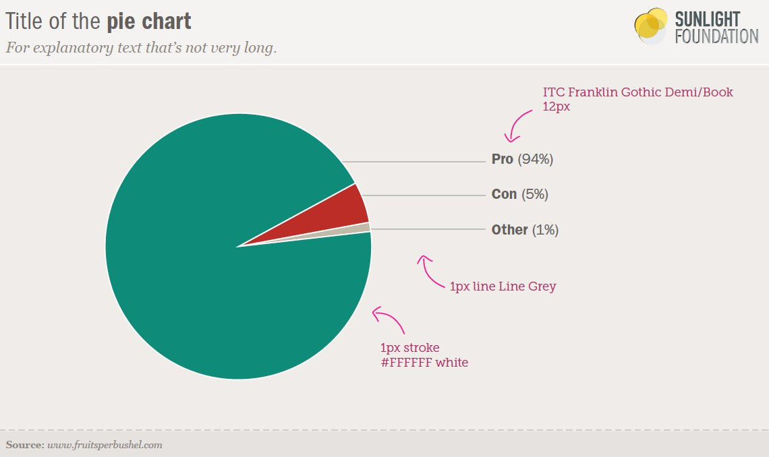



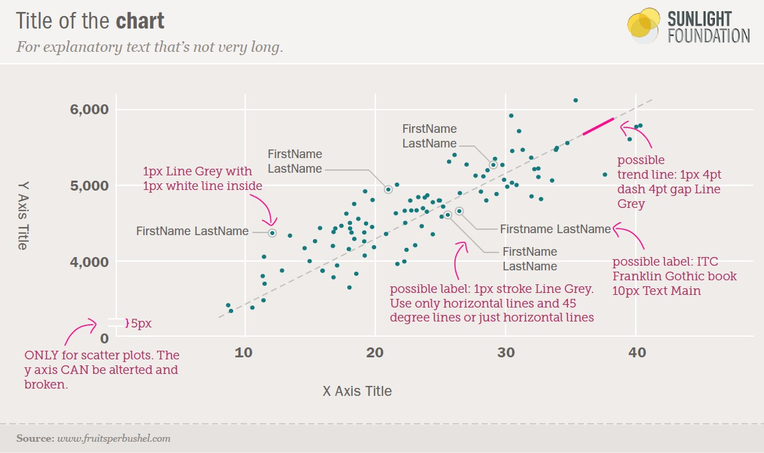
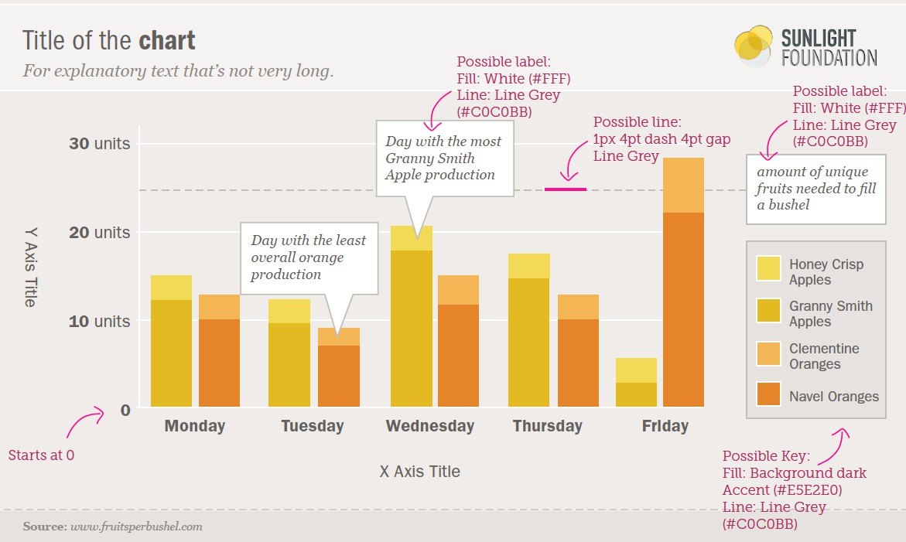
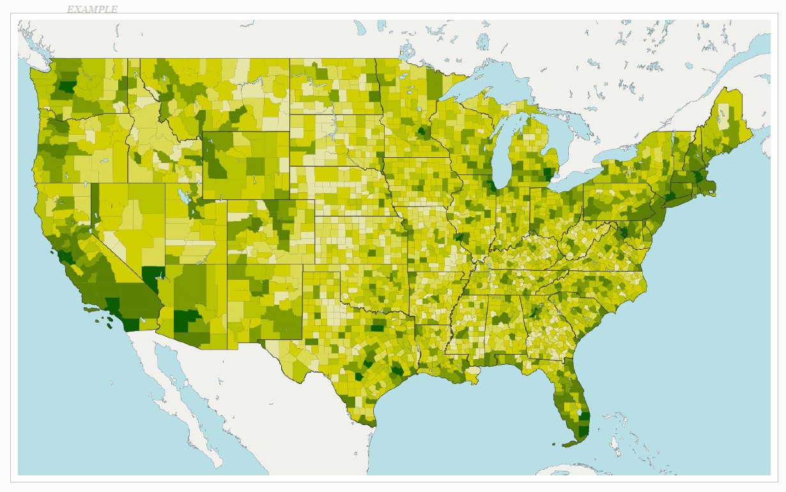
So far: Information Visualization

Slide 6

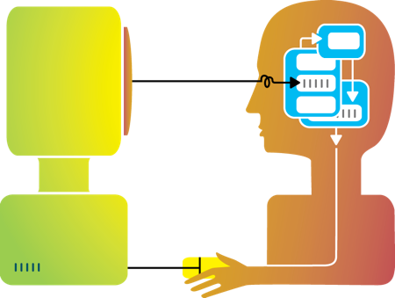
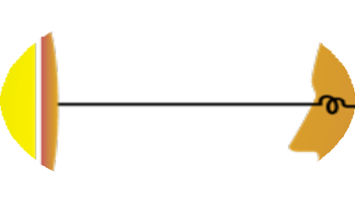


Rewind: about this class
Visualization
Interaction Design

Slide 7
Interaction (def.)
Methods by which humans create knowledge through the manipulation of an interface
Low level: between human and interface
the set of operations available
the relationship between the human and the visualization
High level: between human and problem space
a cognitive act enabled by the tool
does not need to take place exclusively within them
might be distributed across multiple tools

Slide 8
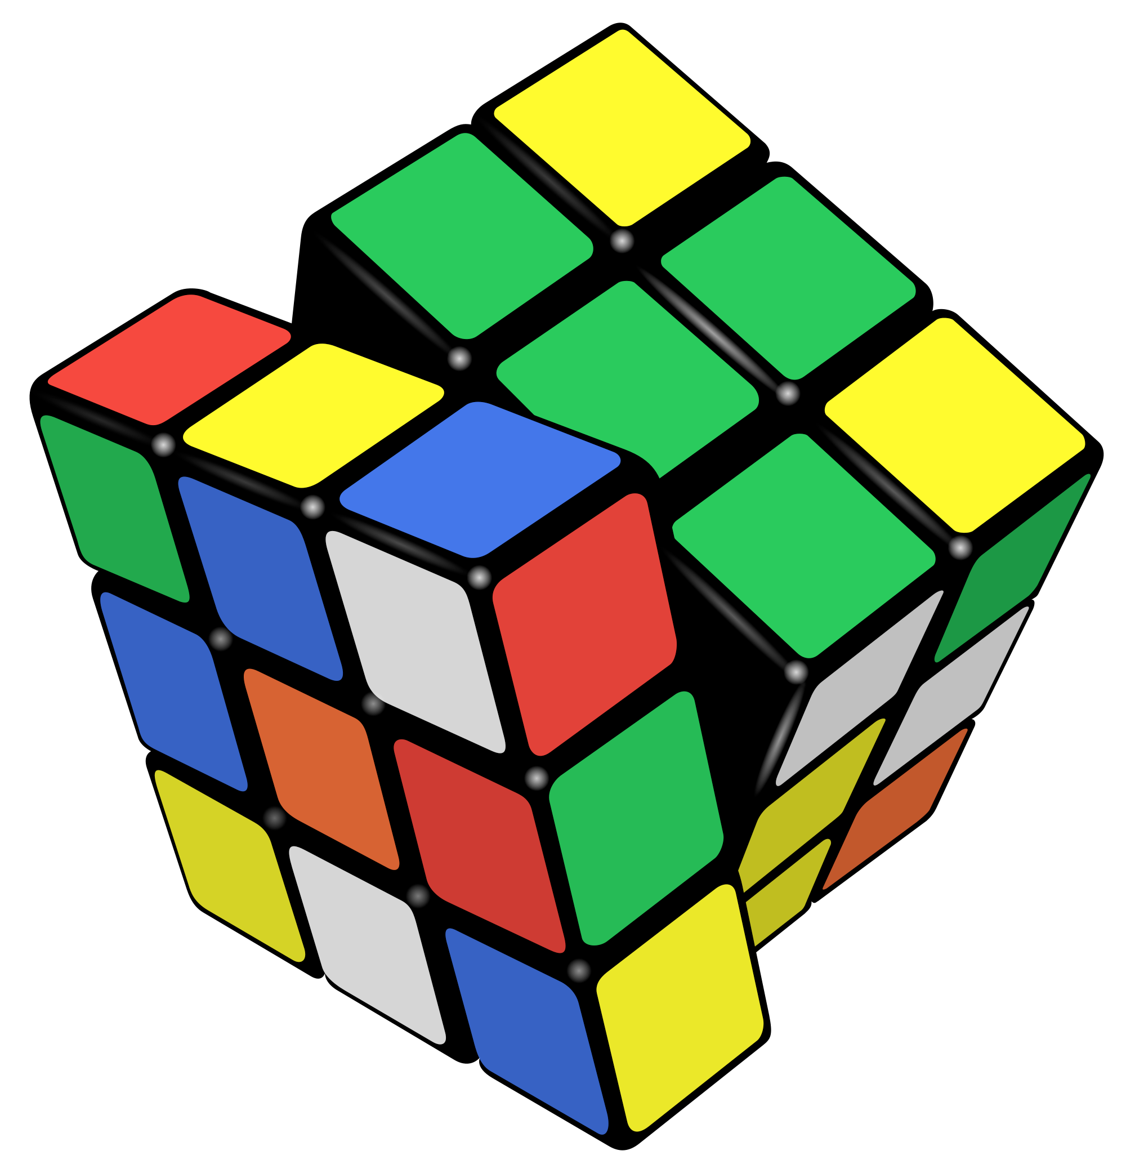
Example: Rubik’s Cube
What low-level interactions can you have?
What high-level interactions can you have?

Slide 9
Interaction and Analysis
Interaction is the observable result of a cognitive process: “an externalization of thought”
In visual analytics, there is a growing belief that interaction and analysis are one in the same
Analytic discourse: the idea that knowledge is constructed, tested, refined, and shared through the interactive manipulation of a visual interface¹
¹Pike, W. A., Stasko, J., Chang, R., & O'Connell, T. A. (2009).
The science of interaction. Information Visualization, 8(4), 263-274.

Slide 10
Part I: High Level
Interaction with Data / Problem Space

Slide 11
Interaction as a Reasoning Aid
Interaction is situated in the context of a problem or goal-directed activity
This context helps the human identify relevant concepts and link them into appropriate structures
Interaction brings together background contexts and current observations
This is known as “situated cognition”

Slide 12
Reality Check
Hypothesis: the more ways a user can ‘touch’ their data (by changing their form or exploring them from different perspectives), the more insight will accumulate.

Slide 13

Interaction as Distributed Cognition
Visualization is often used as a tool to “offload” storage or computation from the human’s brain
In order for this to be useful, we have to be able to “reload” parts of the data and operate on it
Internal (in your head) vs.
external (on the screen) representations
Consider the impact of the affordances
of the interface

Slide 14
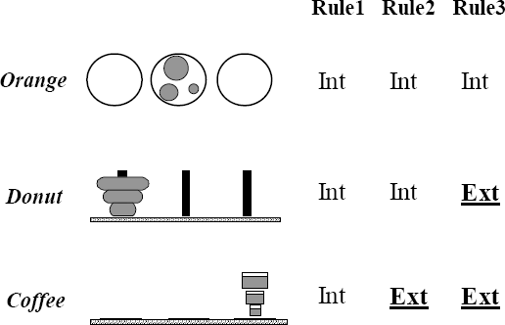
Example: Tower of Hanoi
Only one disk can be transferred at a time.
A disk can only be transferred to a pole on which it will be the largest.
Only the largest disk on a pole can be transferred to another pole.

Slide 15
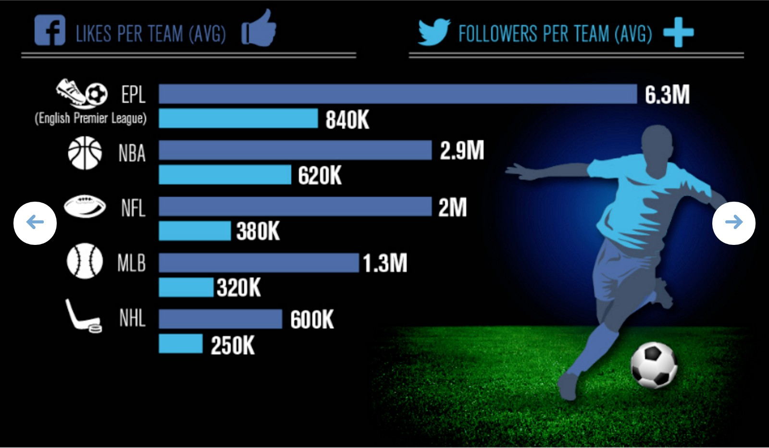
Example
What representations are internal vs. external?

Slide 16
Pragmatic vs. Epistemic Action
Pragmatic actions move a person and their analysis closer to the desired destination.
Epistemic actions enable humans to leverage environmental structures to link internal structures.
The purpose of some actions is not for the effect they have on the environment but for the effect they have on the humans.

Slide 17
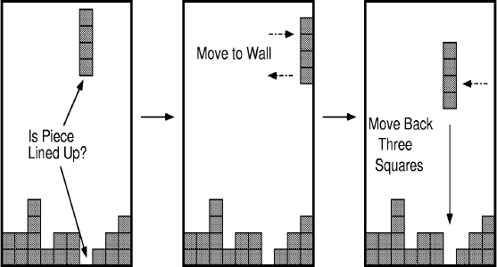
Example: Tetris

Slide 18
Part II
Interaction with a Visual Interface

Slide 19

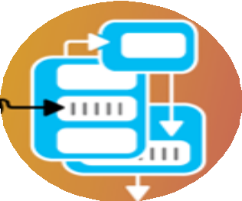
So far…
Visualization

Slide 20

Recall: interaction as a reasoning aid
Interaction is situated in the context of a problem or goal- directed activity
Question: what kinds of things might someone want to do using a visualization?

Slide 21
Yi, Kang, Stasko and Jacko (2007)
Select: mark something as interesting
Explore: show me something else
Reconfigure: show me a different arrangement
Encode: show me a different representation
Abstract/Elaborate: show me more or less detail
Filter: show me something conditionally
Connect: show me related items
Yi, J. S., ah Kang, Y., Stasko, J. T., & Jacko, J. A. (2007). Toward a deeper understanding of the role of interaction in information visualization. Visualization and Computer Graphics, IEEE Transactions on, 13(6), 1224-1231.

Slide 22
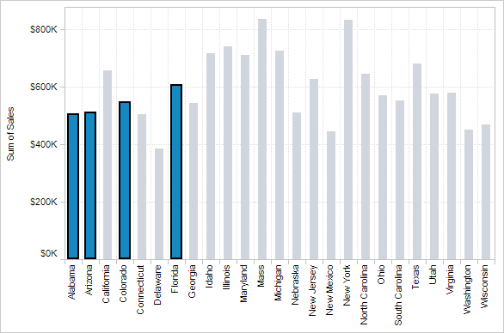
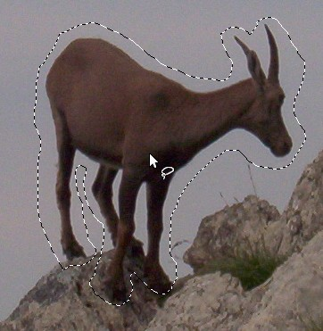

1. Select
Mark something as interesting

Slide 23


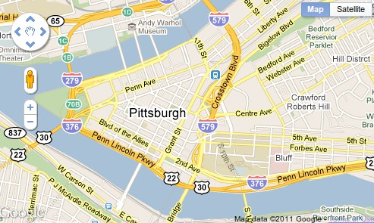
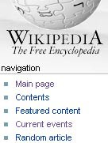
2. Explore
Show me something else
Scroll bars
Panning
Direct-Walk (e.g. hyperlink traversal)

Slide 24
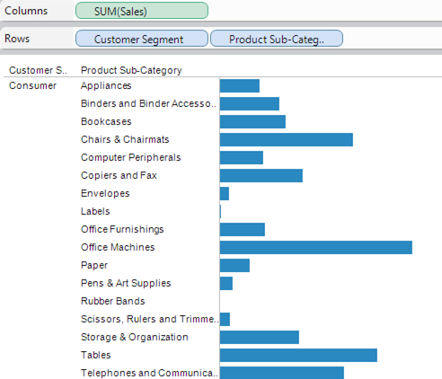
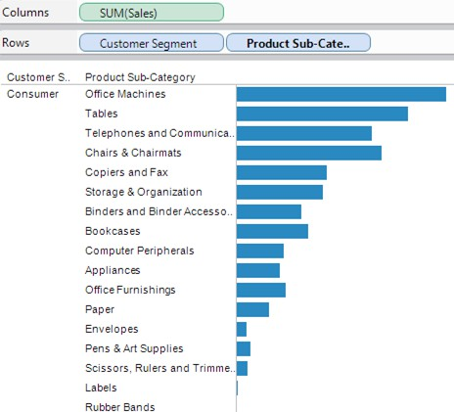
3. Reconfigure
Show me a different arrangement: sorting

Slide 25
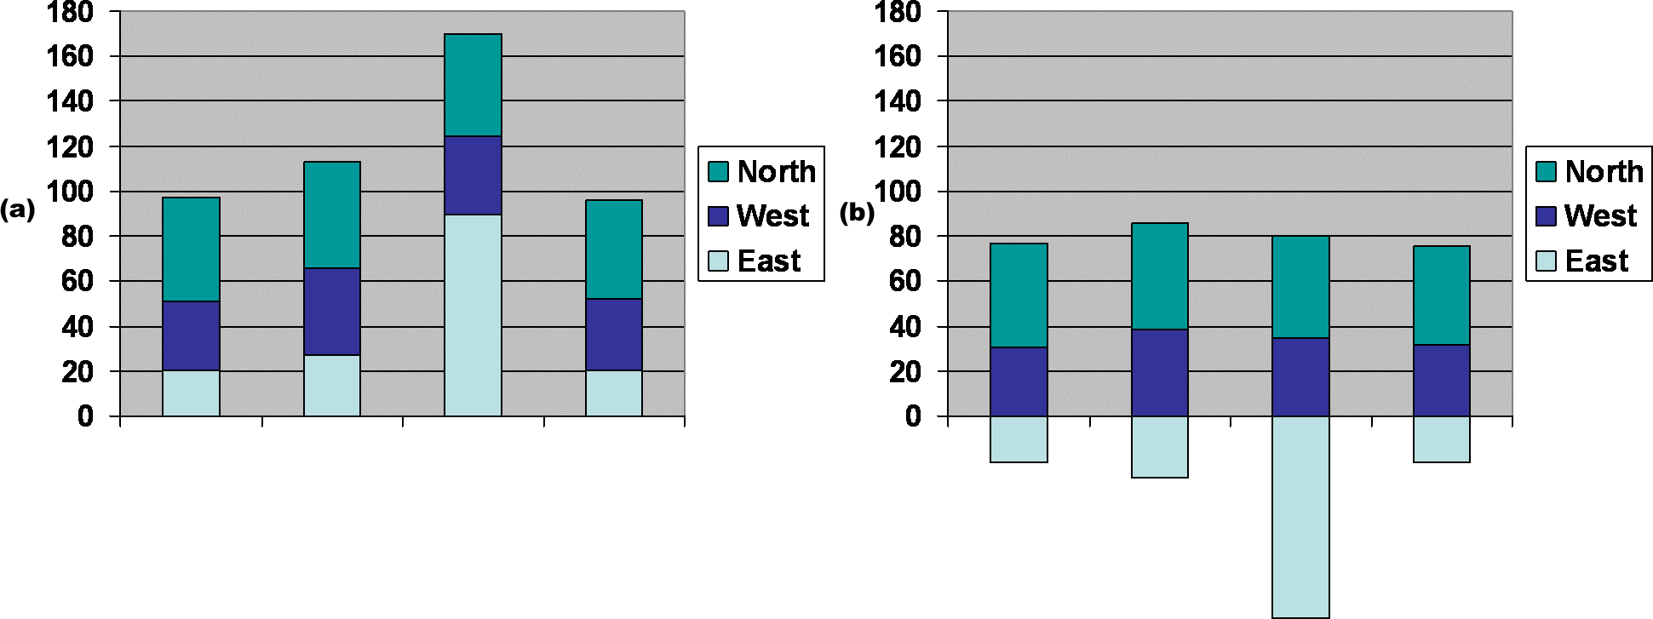
3. Reconfigure
Show me a different arrangement: baseline adjustment

Slide 26
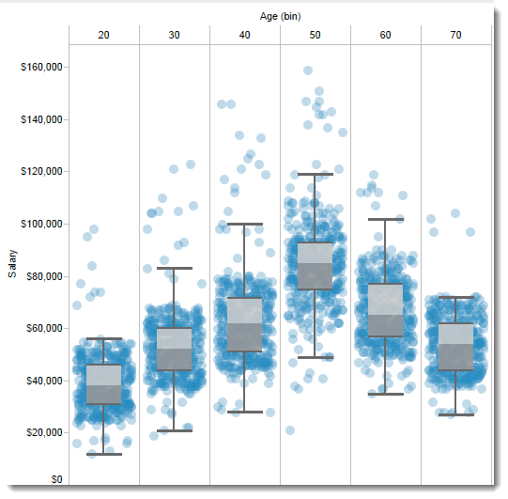
3. Reconfigure
Show me a different arrangement: reduce occlusion (jitter)

Slide 27
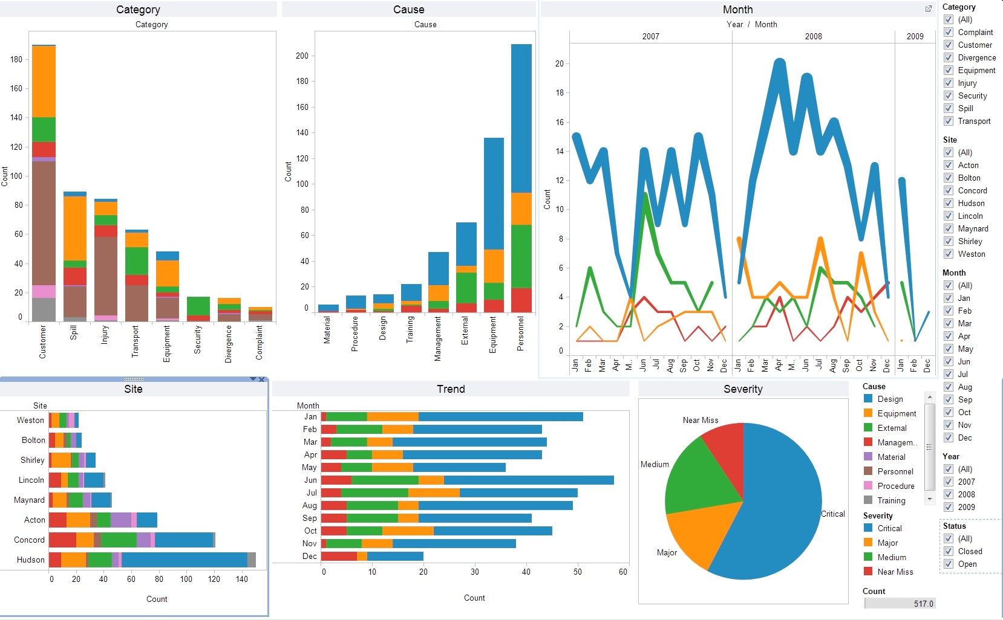
4. Encode
Show me a different representation: visualization type, color, size, orientation, etc.

Slide 28
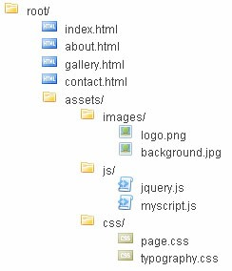
5. Abstract / Elaborate
Show me more or less detail: drill up/down

Slide 29
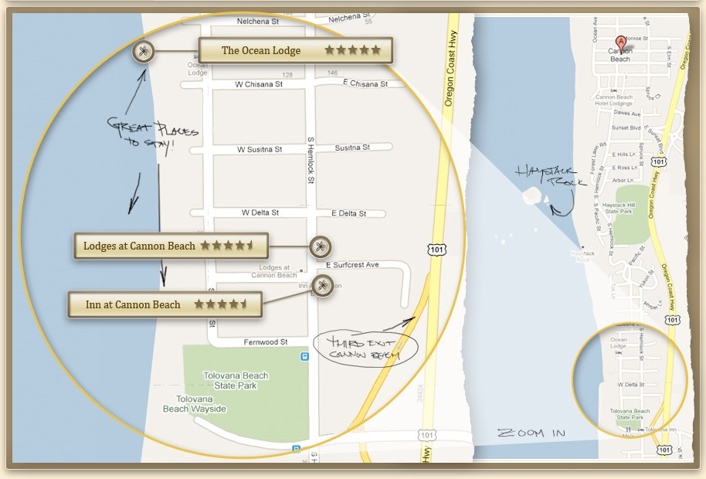
5. Abstract / Elaborate
Show me more or less detail: zooming

Slide 30
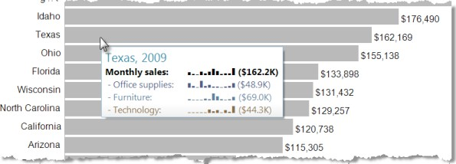
5. Abstract / Elaborate
Show me more or less detail: tooltips

Slide 31
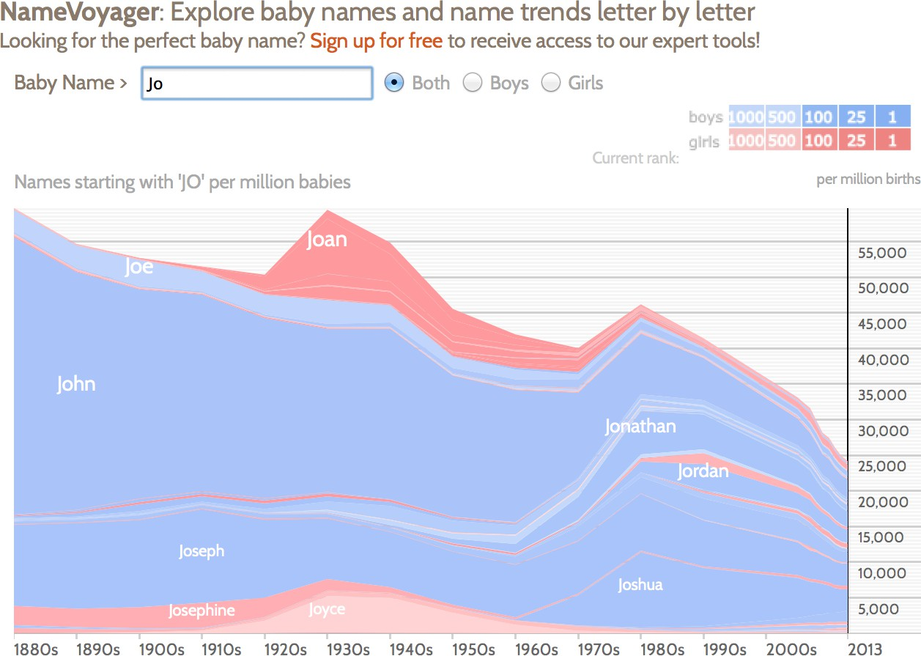
6. Filter
Show me something conditionally

Slide 32

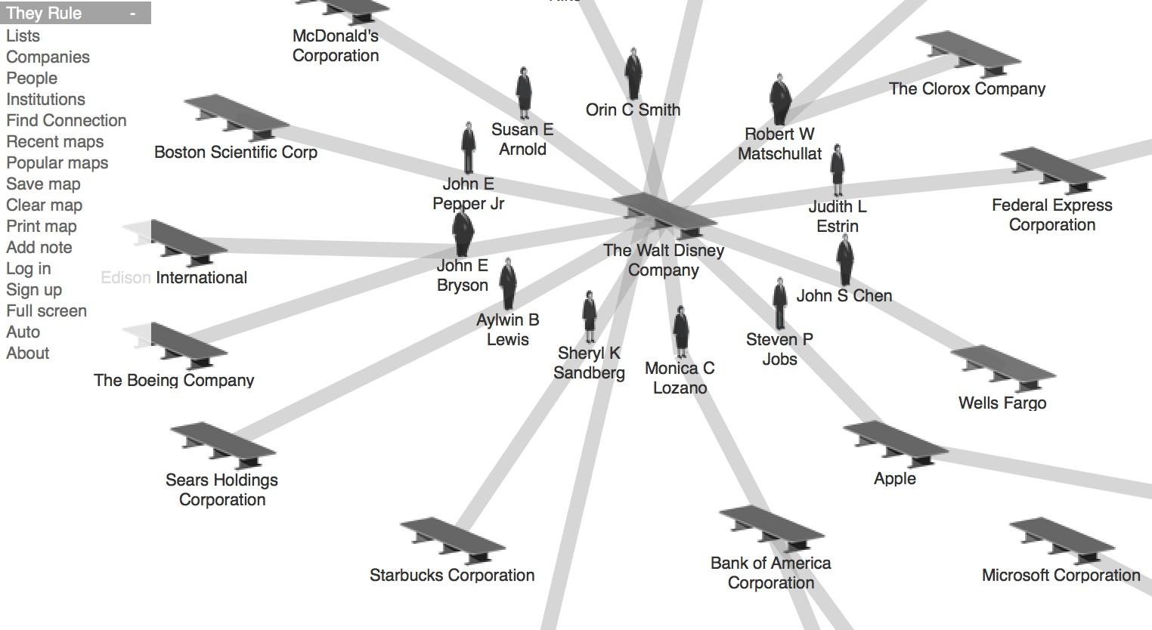
7. Connect
Show me related items: build-out

Slide 33
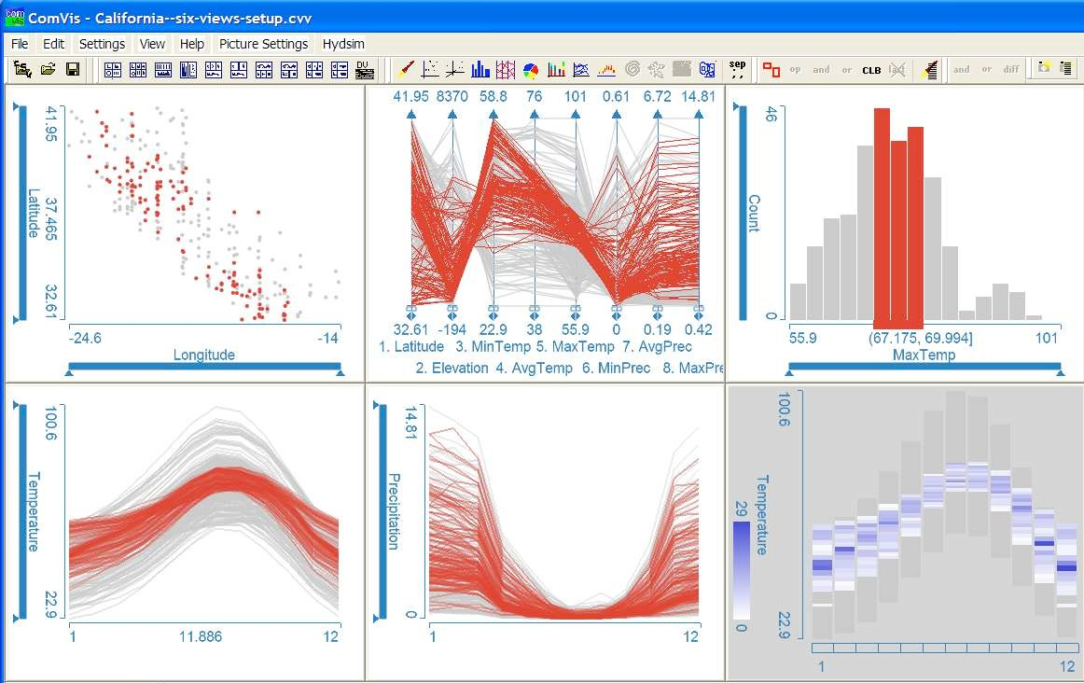
7. Connect
Show me related items: coordinated multiple views (CMV)

Slide 34
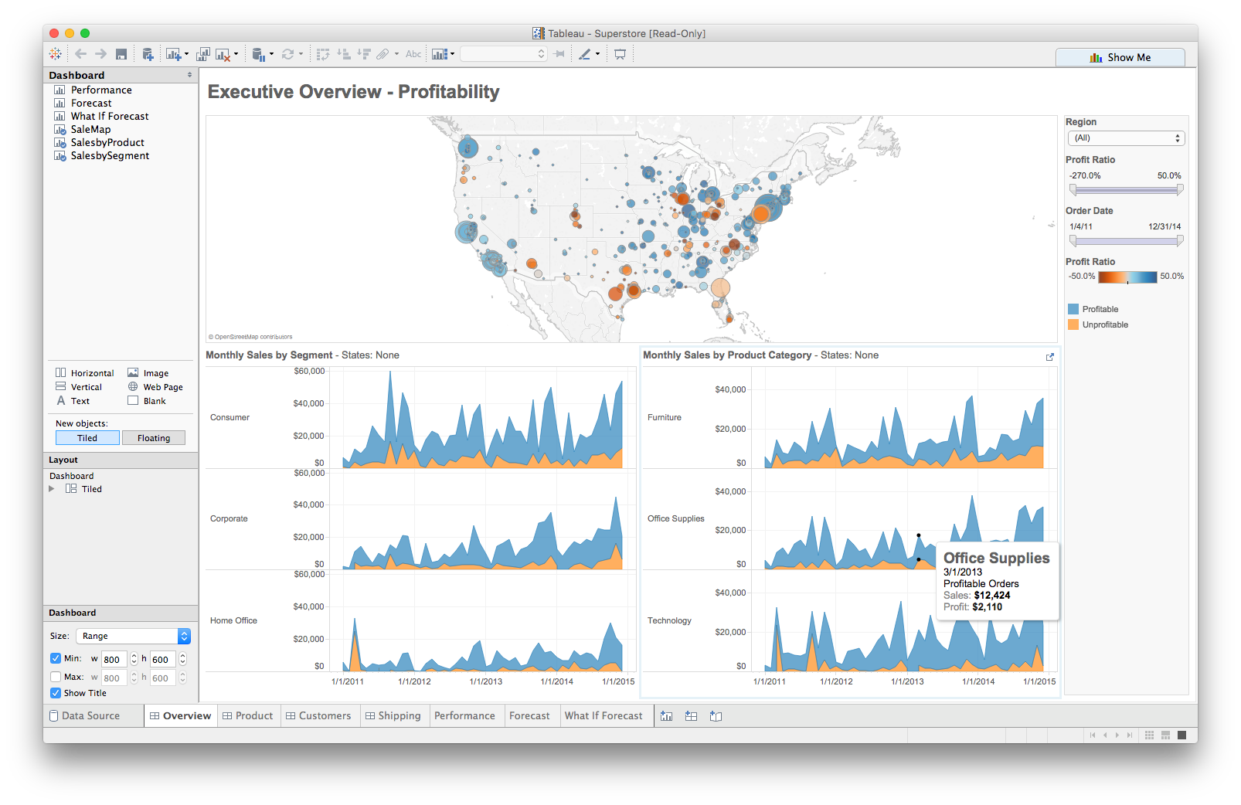




Foreshadowing: multiple views
Different representations
Different data
Systems that use two or more distinct views
to support the exploration of a single concept or domain

Slide 35
Discussion
What would we need to make this work?

Slide 36
Questions to ask when designing
What is the goal of the analysis?
Decision-making
Better understand a domain or a problem
Identify the trends of a phenomenon
Forecast the future
…etc.
What kinds of operations do we need to enable?
How can the visualization support those operations?

