Slide 1
LECTURE 06:
COORDINATED MULTIPLE VIEWS
March 9, 2021
CSC/SDS 235
Visual Analytics

Slide 2
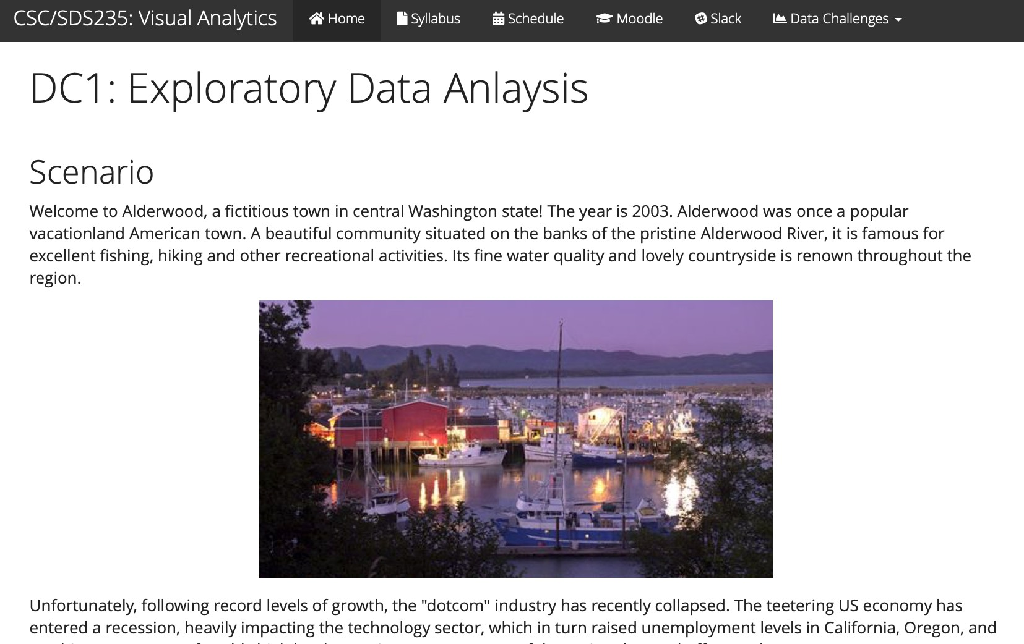
Data Challenge 1: Exploratory Data Analysis

Slide 3
Outline
DC1 check in
Interaction as context-preserver
Coordinated multiple views (CMV)
Brushing and linking
Demo: plotly

Slide 4
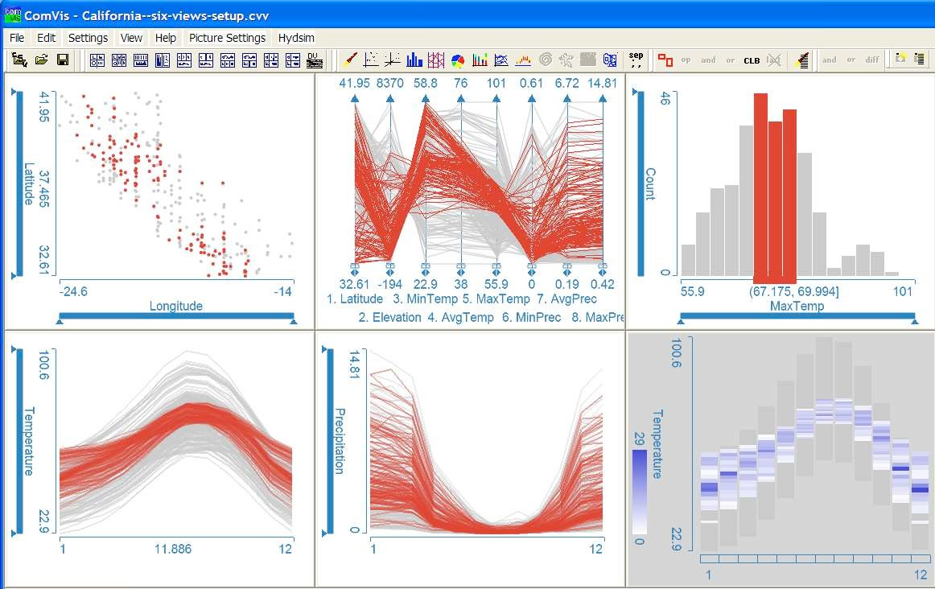
7. Connect (recap)
Show me related items: coordinated multiple views (CMV)

Slide 5
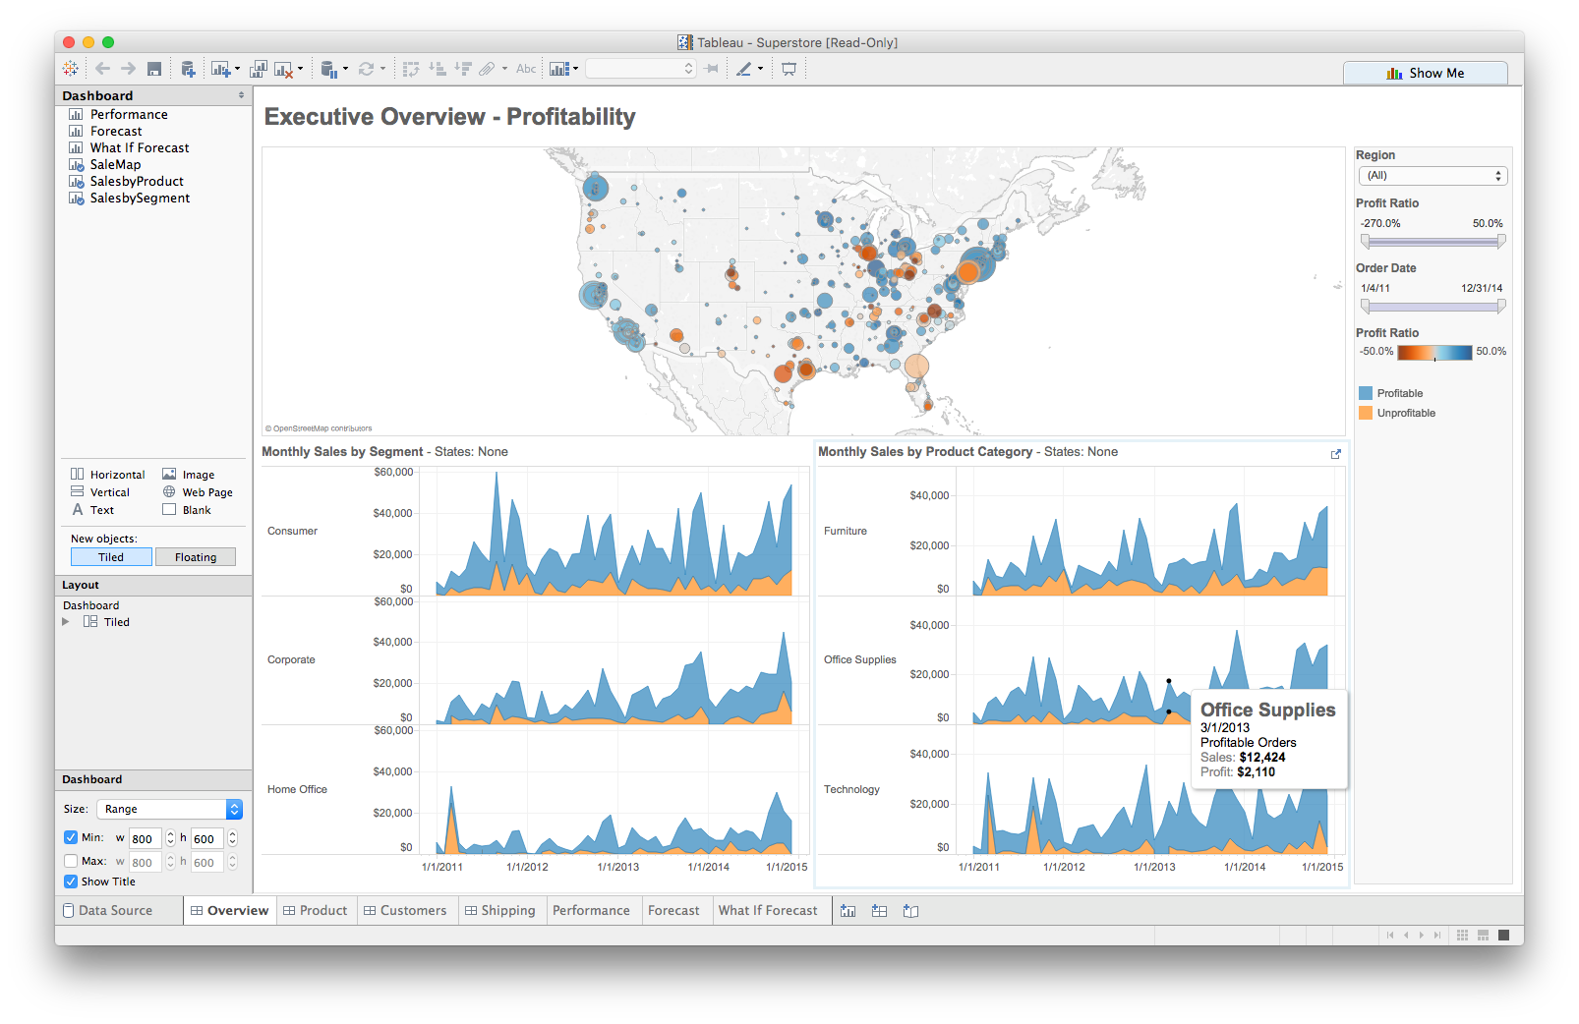




Multiple views
Different representations
Different data
Systems that use two or more distinct views
to support the exploration of a single concept or domain

Slide 6
When to use multiple views?
The data is too big
Lots of attributes
Lots of observations
The data is too complicated
Lots of data sources
Lots of data types
The data has several interesting parts, but no one visualization highlights them all

Slide 7
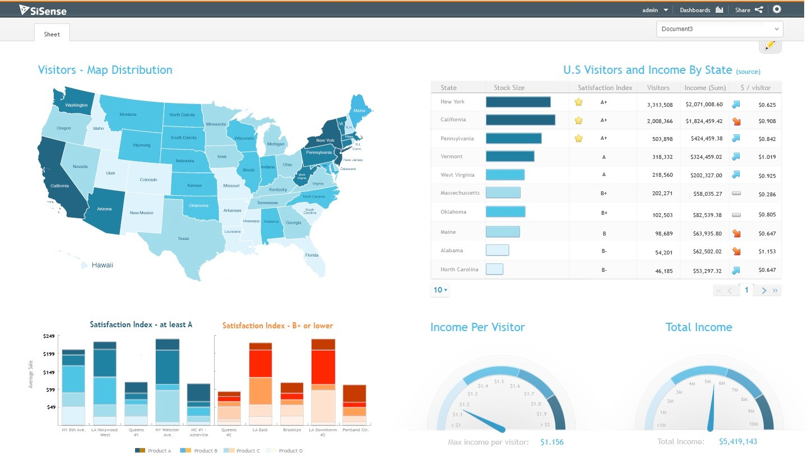
Need to think about: resource optimization

Slide 8
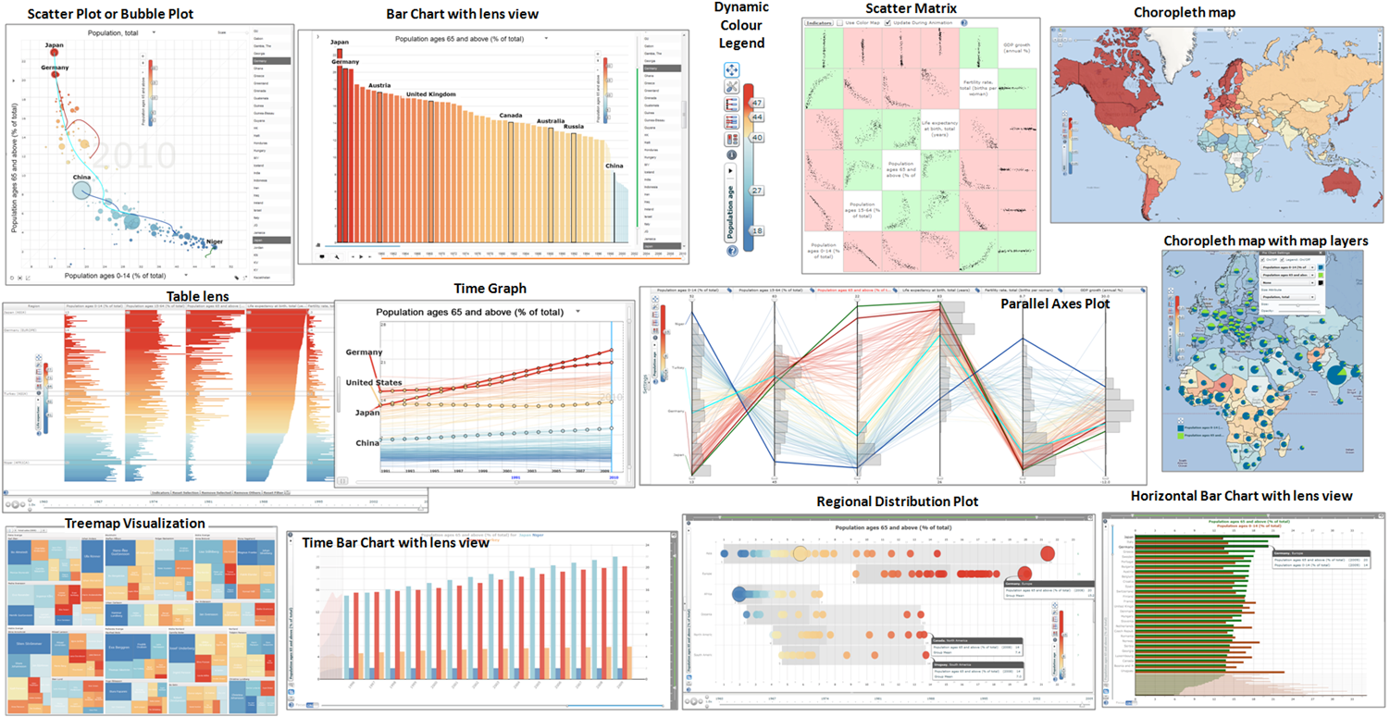
Need to think about: resource optimization

Slide 9
Guidelines for multiple views
Balance the costs of presenting multiple views with the
benefits of using the views
Split complex data into multiple views to create
manageable chunks
Use views that are complimentary, bringing out
correlations and/or disparities
Use perceptual cues to:
make relationships more apparent to the reader
focus the reader’s attention on the right view at the right time

Slide 10
Coordination: brushing and linking
Big idea: actions in the real world have ripple effects; actions on a visualization should too
Brushing: the visualization responds (usually through highlighting) as a person “brushes past” data points
Linking: the visualization connects related data points across multiple views

Slide 11

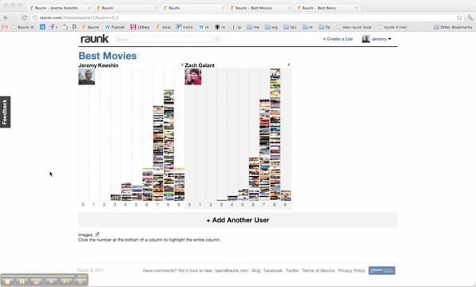
Coordination: brushing and linking

Slide 12

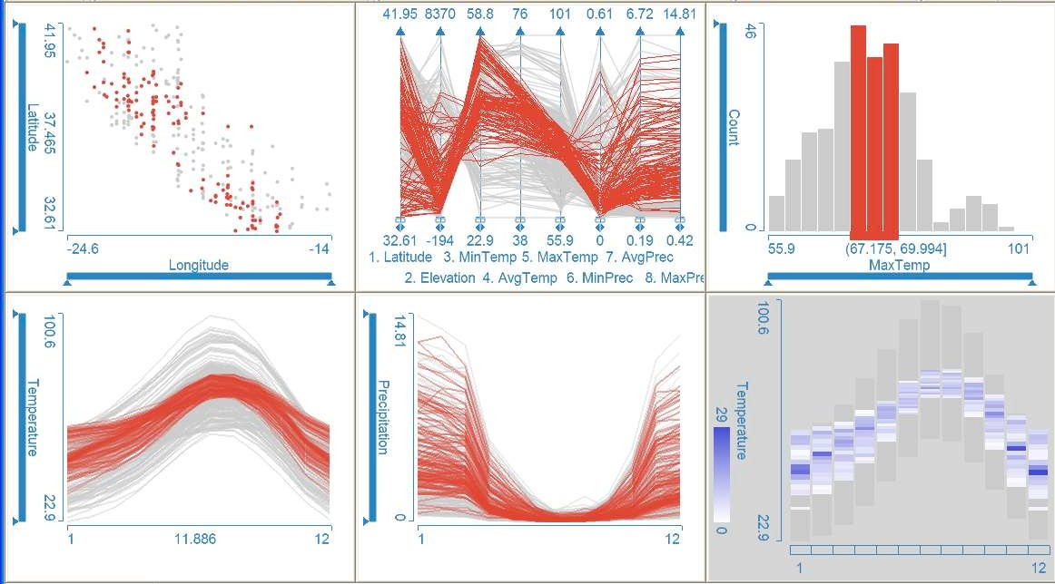
Coordinated multiple views
Multiple views + brushing and linking
Big idea: propagate interaction from one view to all others, respond as appropriate

Slide 13

Discussion
What would we need to make this work?

Slide 14


Slide 15



Introduction to plot_ly() and ggplotly()
Case Study –
Housing Sales in Texas
with plot_ly()
with ggplotly()
with htmlwidgets
with shiny
with subplot(…)
Combining views
Demo modeled on
“The Plotly Cookbook” chapter of the Plotly for R Masterclass by Carson Sievert.

Slide 16
Important distinction
2 main ways to initiate a plotly object in R:
plot_ly() function transforms data into a plotly object
ggplotly() function transforms a ggplot object into a plotly
object (Wickham 2009, Sievert et al. 2016)
Both result in an interactive web-based visualization with tooltips, zooming, and panning enabled by default
Let’s play…

Slide 17
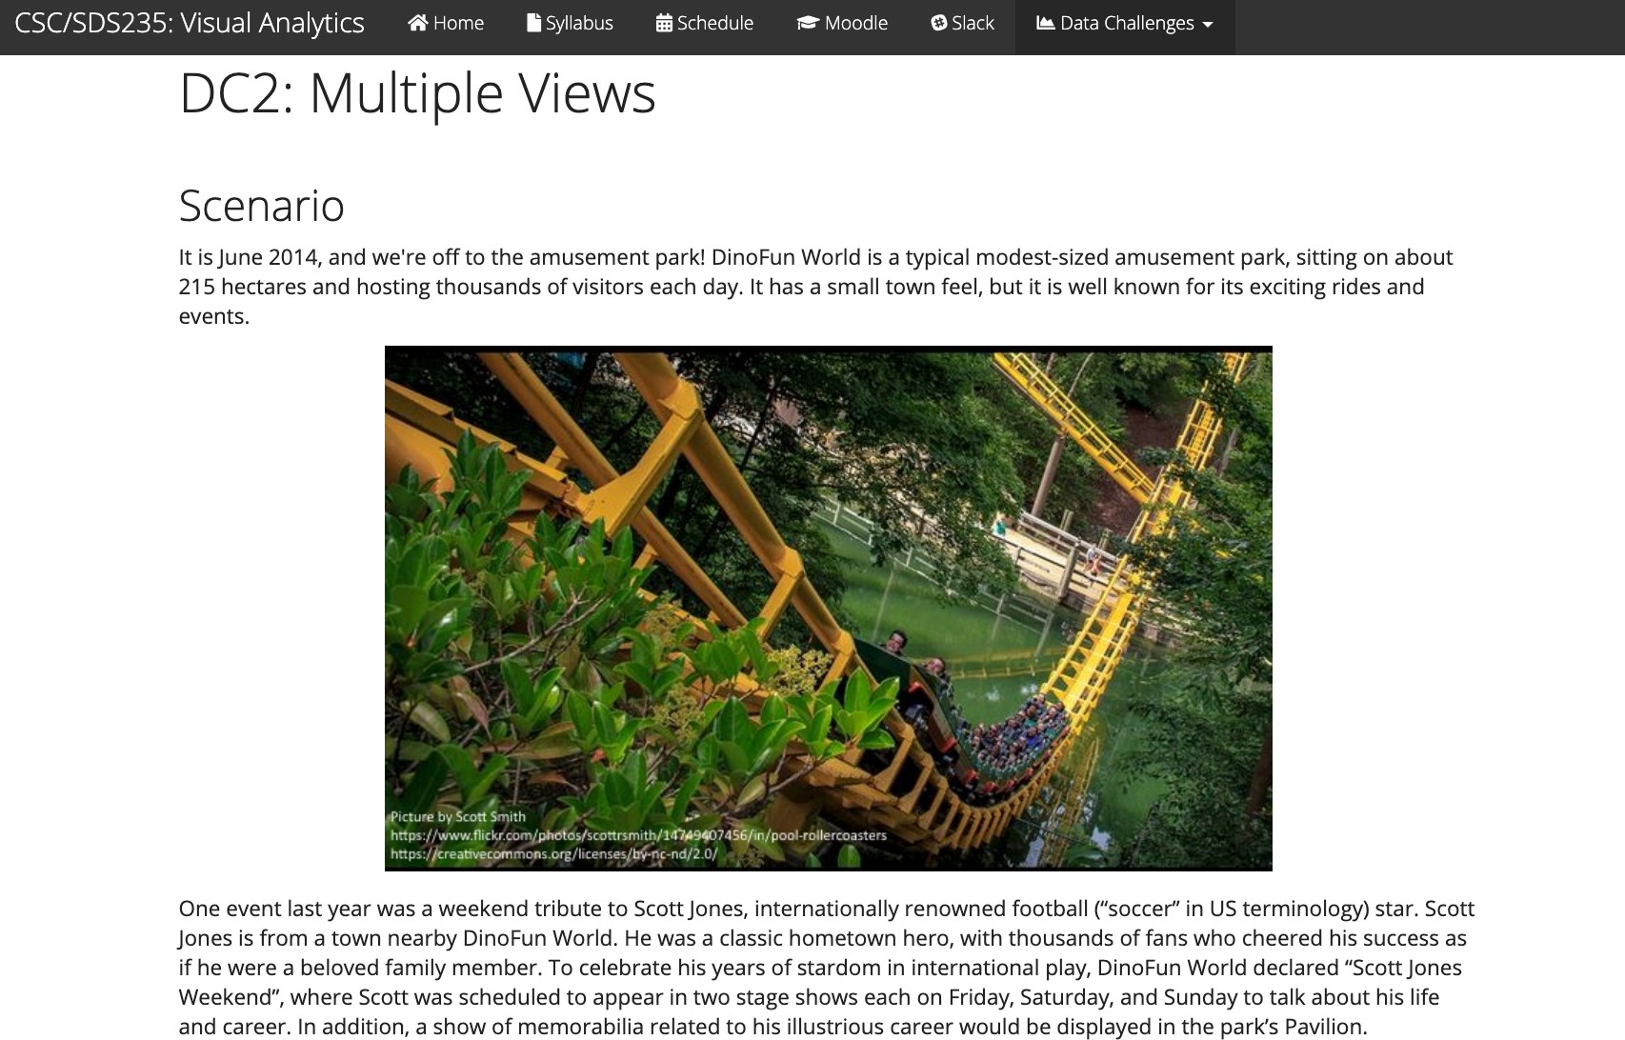
Data Challenge 2: Coordinated Views

