Slide 1
(Mini) Lecture 15:
USER-CENTERED DESIGN
(and other tools for making your project go a bit more smoothly)
April 27, 2021 CSC/SDS235:
Visual Analytics

Slide 2






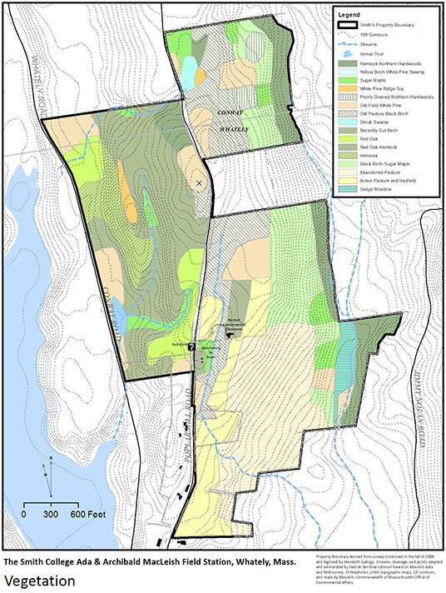
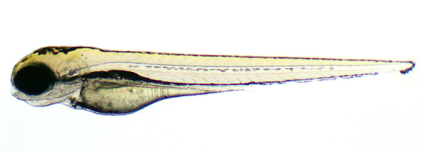





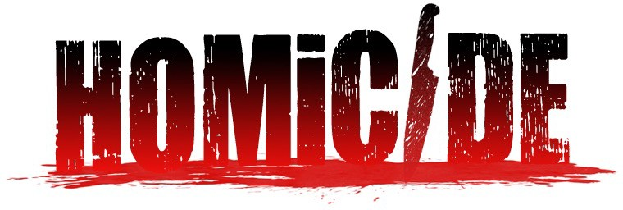

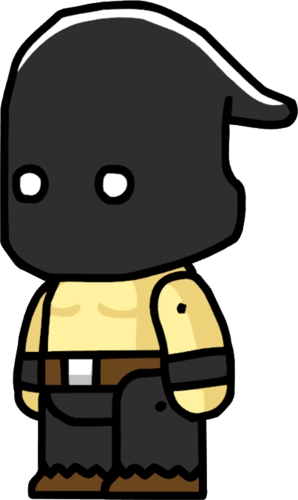

Announcements
Many of you have already started discussing final project topics: awesome ideas!
Fill out the FP form posted to Slack
If you haven’t found a team
and you want one, let me know

Slide 3

Overview
As you start making design choices about your final project, how do you know you’re building the right thing?
Slides adapted from D. Staheli, MITLL

Slide 4
Outline
User-centered design
What it is
Why do it
Ways to do it
Tip #1: paper prototypes
Tip #2: architecture diagrams

Slide 5
Overview
As you start making design choices about your final project, how do you know you’re building the right thing?
Slides adapted from D. Staheli, MITLL

Slide 6
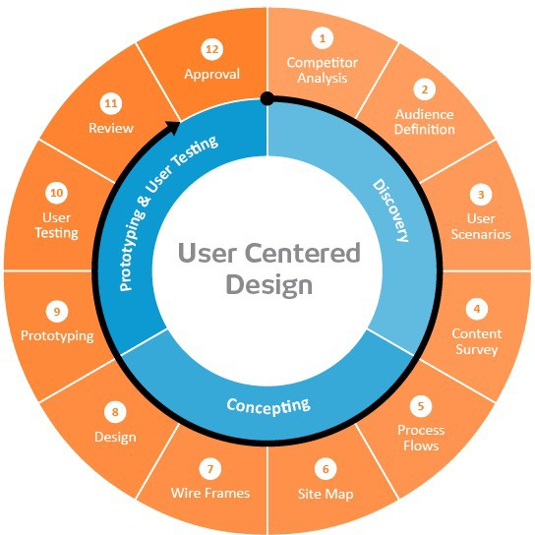

User-centered design framework
Discovery
Learning about your users
Modeling your users
Analyzing your users’ tasks
Eliciting and defining clear product requirements
2) Concepting Phase
Developing conceptual models
Solving design problems through ideation
Detailed design activities
Users
3) Prototyping + User Testing
Delivery of a high-quality product that meets users’ needs and is easy to learn and use
http://www.uxmatters.com/mt/archives/2010/07/design-is-a-process-not-a-methodology.php

Slide 7
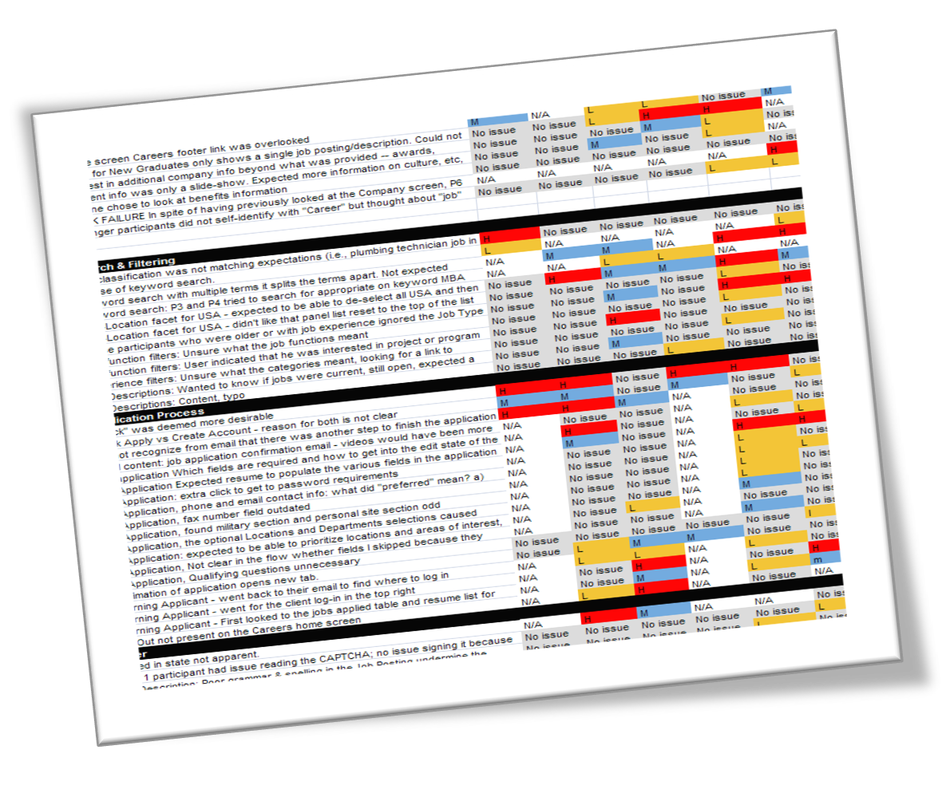
Competitive review
Why?
If you look at what already exists, you might be able to identify potential issues in advance
Also helps establish your unique contribution
How?
Literature or product review
Analysis
What are the existing tools?
What is their purpose?
What audience are they aiming for?
What kinds of strategies are they using?
What functionality do they contain?
What are their strengths and shortcomings?
Identify opportunities and design constraints

Slide 8
Defining your audience
Learning about their problem
Semi-structured interview
Analyzing their tasks
Hierarchical task analysis
Modeling users
Personas

Slide 9
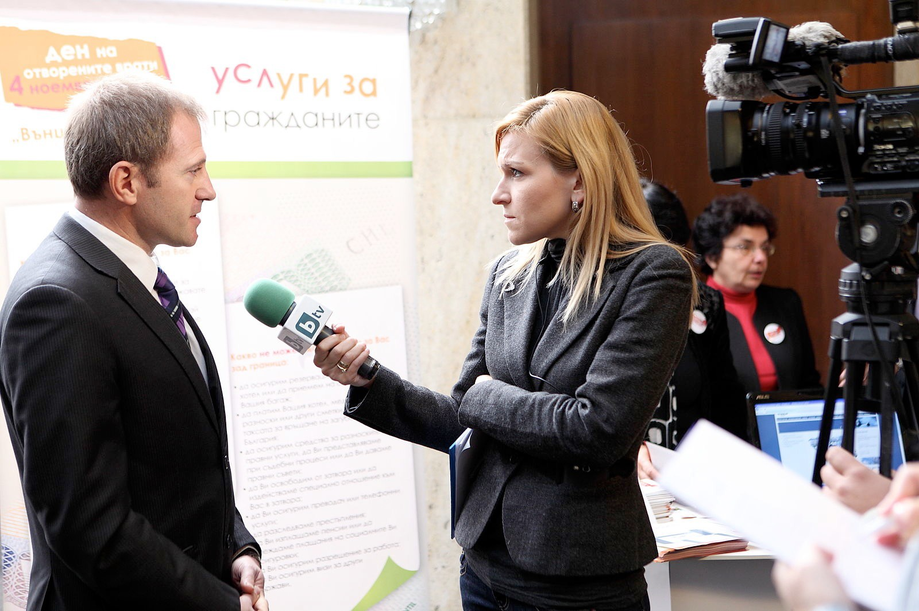
Semi-structured interviews
Why?
gather qualitative data about users to understand the problem
can help identify key differences between designer and target user
How?
ask open-ended questions
bring along a “cheat sheet” to ensure that you gather all the
information you need
Some tips:
establish trust at the beginning
participant engagement will vary
be flexible, but make sure you get what you came for
consider recording or note-taking to help with recall
Wood, L. E. (1997). Semi-structured interviewing for user-centered design. interactions, 4(2), 48-61.

Slide 10
Defining your audience
Learning about their problem
Semi-structured interview
Analyzing their tasks
Hierarchical task analysis
Modeling users
Personas

Slide 11
Hierarchical task analysis
Why?
Understand user workflow
Identify pain points and areas for optimization
How?
Decompose tasks into 4-8 sequential steps
Identify patterns, sequences and skips in the tasks
An example:
Hackos, J. & Redish, J. (1998). User and Task Analysis for Interface Design. Chichester: Wiley.

Slide 12
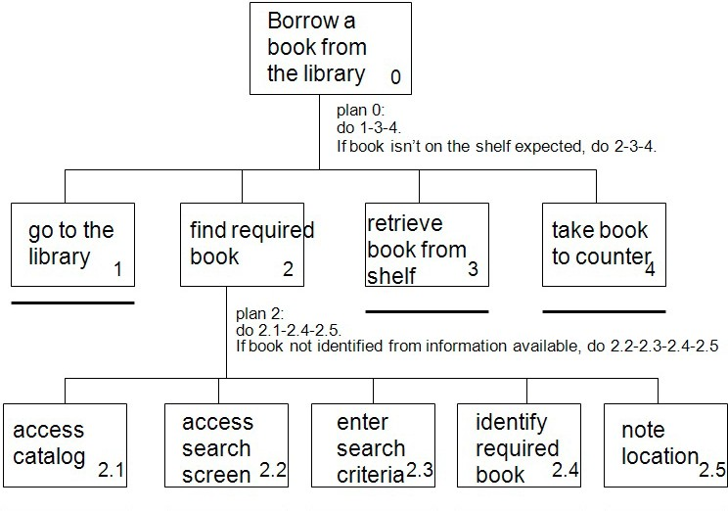
Task analysis example
http://i1206241.blogspot.com/2013/01/task-descriptions-hierarchical-task.html

Slide 13
Defining your audience
Learning about your users
Semi-structured interview
Contextual inquiry
Analyzing users’ tasks
Hierarchical task analysis
Modeling users
Personas

Slide 14

Personas
Why?
mechanism for reasoning about user needs
model behavioral characteristics of target users
doesn’t require access to ACTUAL users
How?
fictionalization
narrative, goals, needs, “pain points”
attributes specific to the problem space
data-driven method* using info from interviews
mapping persona to software features

Slide 15


Tip #1: personas
Goal: come up with 3 personas that characterize people who might be interested in your project

Slide 16

Discussion
Now that we’ve got some end users in mind, what would a prototype look like?

Slide 17
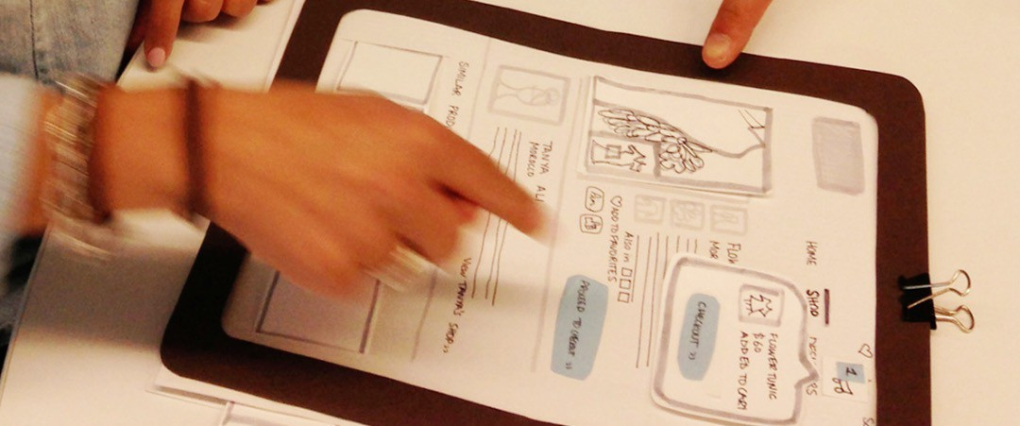
Tip #2: “Paper prototyping”
Big idea:
Not sure whether or not an idea will work?
Making a paper version of an interface is a lot faster and easier than coding a working prototype – start there!

Slide 18
“Paper prototyping” goals
Generate lots of ideas
Engage other people in the design process
Identify potential problems before you waste time coding
Get feedback quickly, from lots of different people
Some tips:
Focus on the big picture, don’t worry about the details
Think about what you want it to do, rather than what you know how to implement (we’ll worry about that later)
Not so into arts and crafts? It doesn’t have to be actual paper… Whiteboard / PowerPoint / Keynote will also do the trick!

Slide 19
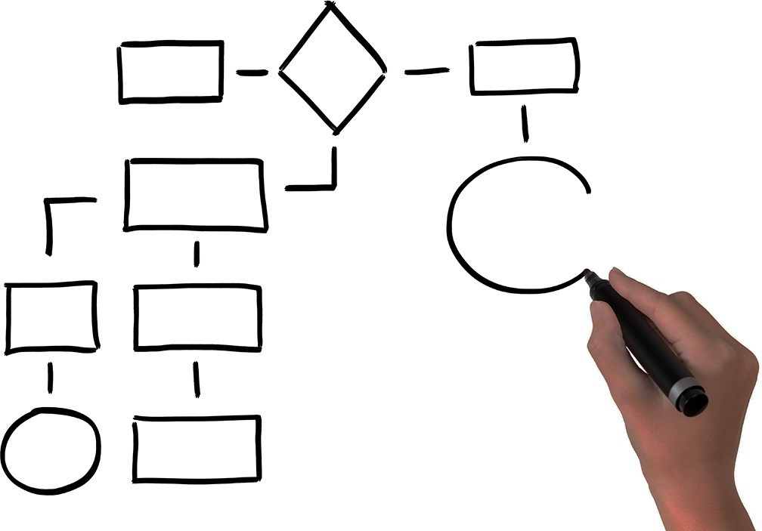
Tip #3: “Architecture diagrams”
Big idea:
Now that you’ve got an idea of what your interface might look like, break that down into manageable pieces so you can get started
This can happen at several levels of detail

Slide 20
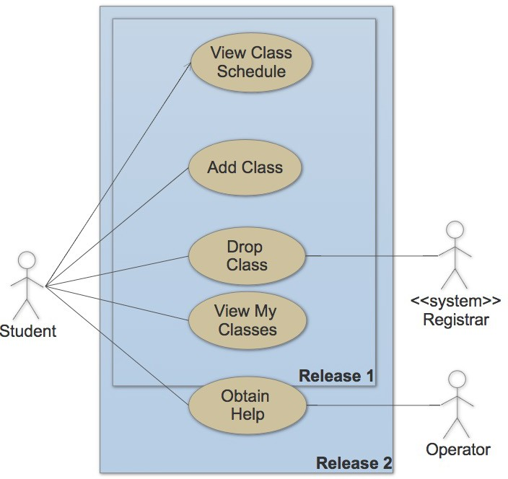
Example: use case diagram (high level)

Slide 21
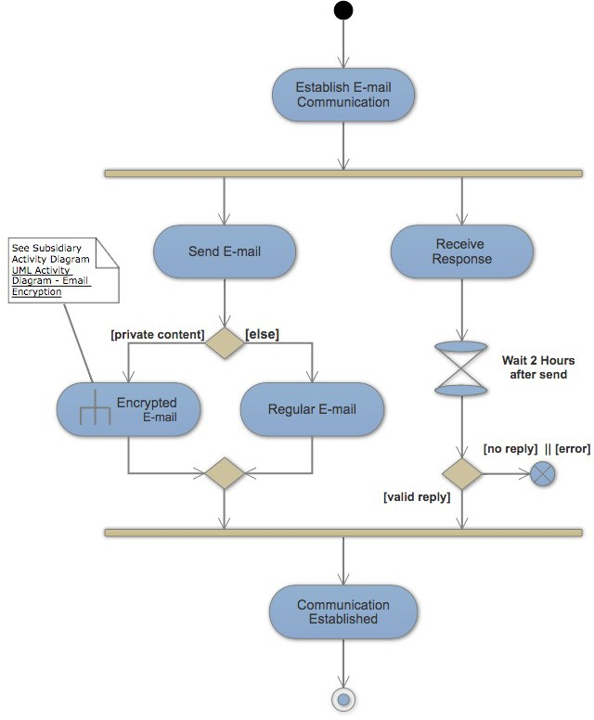
Example: activity diagram (mid level)

Slide 22
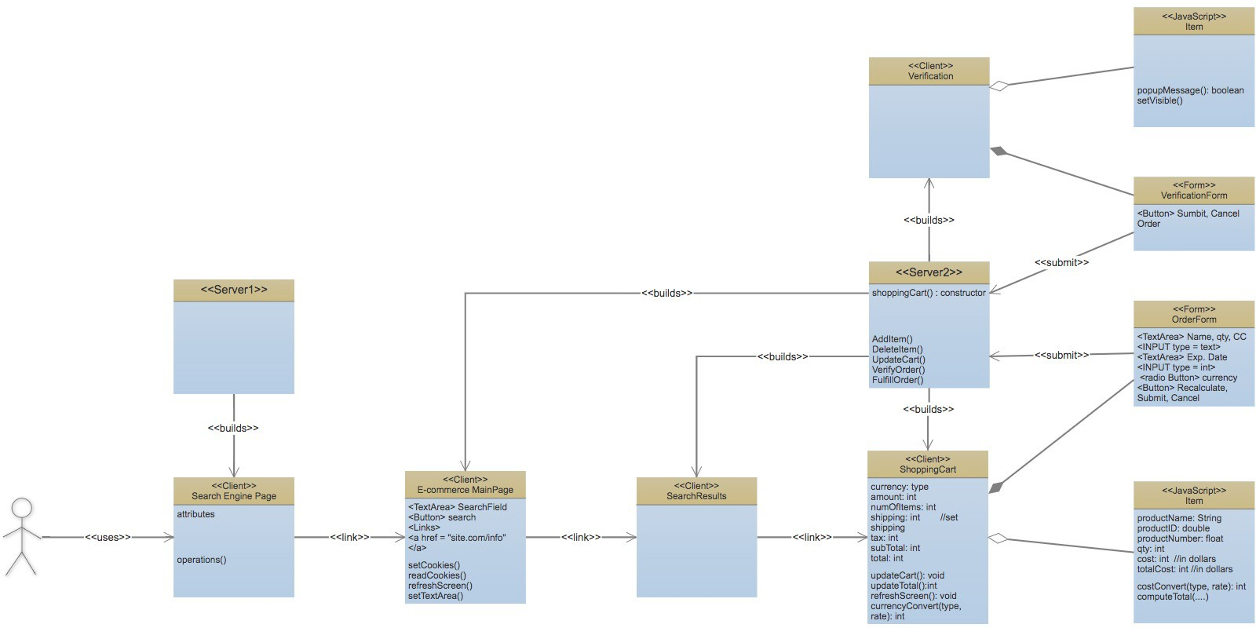
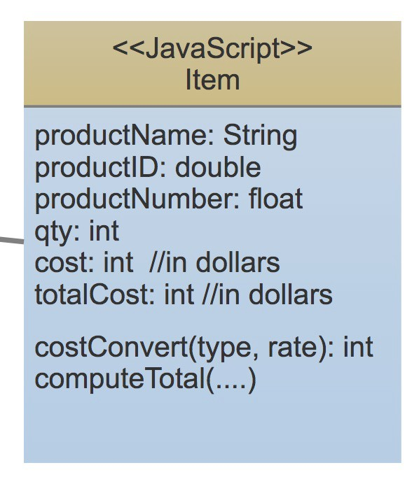
Example: class diagram (low level)

Slide 23
Takeaways
Thinking about your end user early ➔ you’re more likely to build something that actually solves the problem
“Low-fidelity” prototyping saves time and energy by helping identify problems before you commit to code
Architecture diagrams help you plan out your implementation so you don’t run out of time
Also, the process is kinda fun…

Slide 24


















Deliverables
FP1: Prototype I – due Tuesday May 4th at 5pm
a persona
a “paper” prototype of your project
an annotated architecture diagram
FP2: Prototype II – due Tuesday May 11th at 5pm
Snapshot of codebase (ZIP + README or git release)
Revised annotated diagram
FP3: Final Release – due Wednesday May 19th at 5pm
Snapshot of codebase (ZIP + README or git release)
Documentation / writeup
5min demo video

