Slide 1
LECTURE 16:
EVALUATION TECHNIQUES
April 29, 2021
CSC/SDS 235
Visual Analytics

Slide 2

Discussion
How do we measure the effectiveness
of a visualization system?

Slide 3


Tufte, 1983
“Above all else, show the data.”

Slide 4
Tufte, 1983
Data-ink
Data-ink ratio =
Total ink used to print the graphic
= proportion of a graphic's ink devoted to the non-redundant display of data-information
= 1 - proportion of a graphic that can be erased

Slide 5
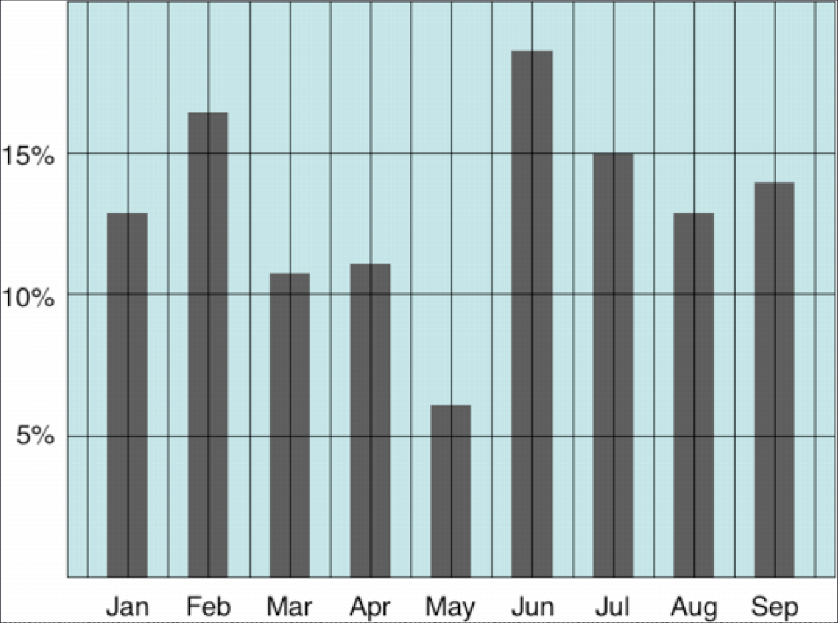
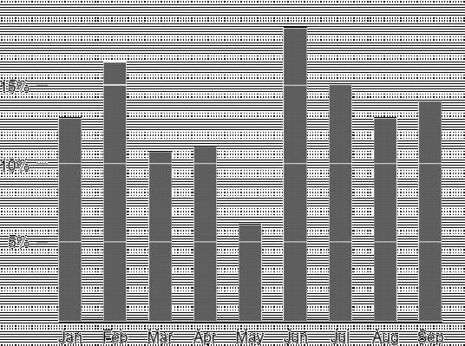
Examples

Slide 6
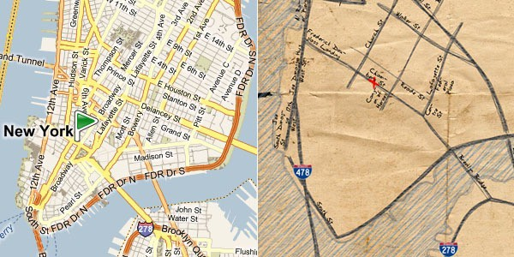
Examples

Slide 7
Discussion
What do you think of the Data-Ink Ratio?
Consider ways to maximize the ratio…

Slide 8
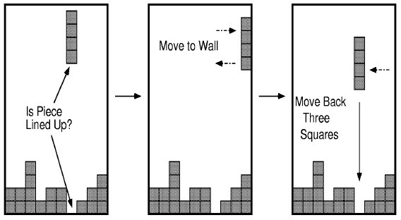
Flashback: Epistemic Action
The purpose of some actions is not the effect they have on the environment but the effect they have on the humans.

Slide 9
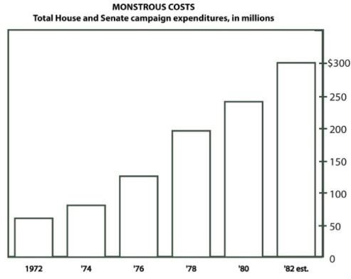
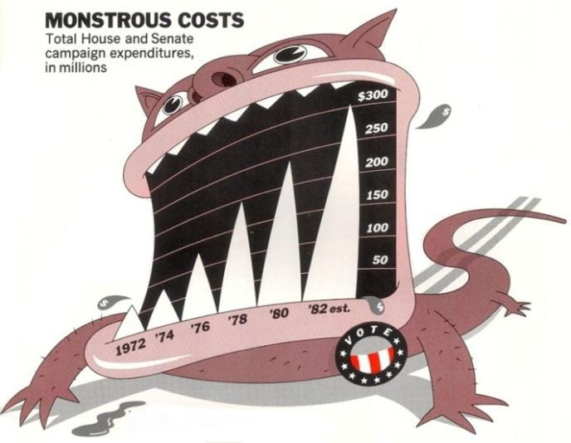
ChartJunk and Recall
Bateman et al. “Useful Junk? The Effects of Visual Embellishment on Comprehension and Memorability of Charts”, CHI 2010

Slide 10
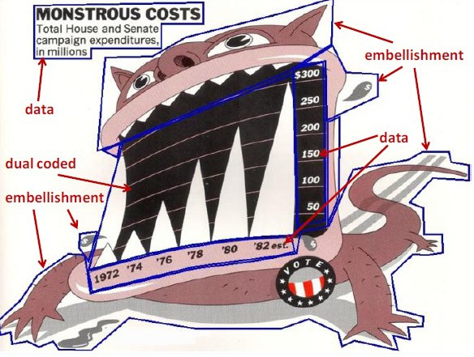
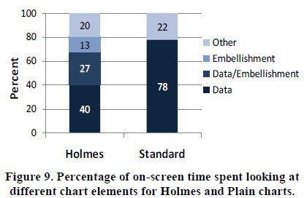
ChartJunk and Eye Gaze

Slide 11
Discussion
Know any compelling examples of visual embellishment?
Tragic ones?
What’s the right balance between Tufte and ChartJunk?

Slide 12
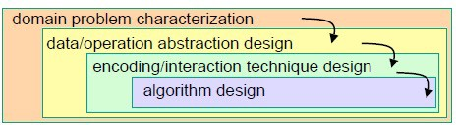
Nested Model of VIS Design (Munzner, 2009)
Munzner, Tamara. "A nested model for visualization design and validation." Visualization and Computer Graphics, IEEE Transactions on 15.6 (2009): 921-928.

Slide 13
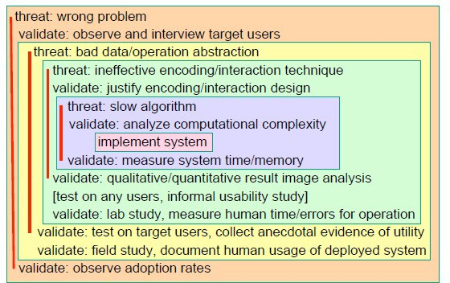
Threats

Slide 14
Evaluation “threats”
Mismatch: a common problem in evaluating VIS systems
Examples:
the value a new visual encoding can’t be measured using a quantitative timing of the algorithm
mischaracterized task can’t be addressed in a formal lab study

Slide 15
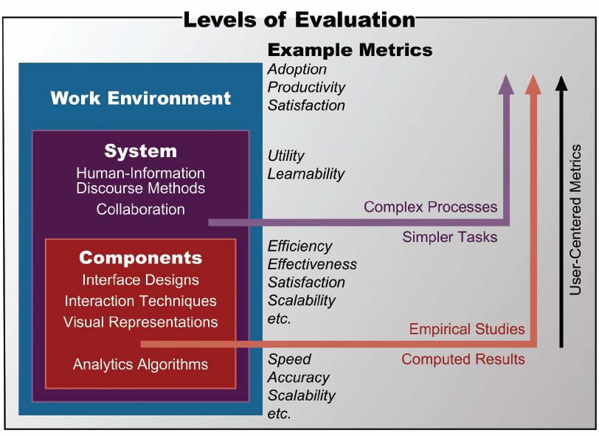
Matching methods and metrics

Slide 16

Insight-based evaluation (North et. al, 2005)
Measure the usefulness of a visualization by counting the number of insights
a person generated while using it

Slide 17
Insight-Based Evaluation Method
No “benchmark tasks”
Training on data and visualization for 15 minutes
Participants list questions that they would like to pursue
Asked to examine the data for as long as necessary until
no new insights can be gained
During analysis, participants are asked to comment on their observations, inferences, and conclusions

Slide 18
Evaluating the Results
Tally up the number of insights:
Insights: distinct observations about the data
Baseline: all insights generated by all participants
Various quantitative statistics on insight generation (time spent, time to first insight, etc.)

Slide 19
Discussion
What does insight-based evaluation address?

Slide 20
Problem: defining “insight”
North’s definition:
“[Insight is] an individual observation about the data by the participant, a unit of discovery. It is straightforward to recognize insight occurrences in a think-aloud protocol as any data observation that the user mentions is considered an insight.”

Slide 21

Example 1
“Our tool allows the biologists to interactively visualize and explore the whole set of trees, providing insight into the overall distribution and possible conflicting hypothesis”
Insight = knowledge about the overall distribution

Slide 22

Example 2
“The analyst determined the answers to these questions, but also came up with further insights that she shared with people from other administrative units. She used the discovered information to advise other administrators of certain previously unknown relationships in their data”
Insight = information about previously unknown relationships

Slide 23


Cognitive science definition
Something measurable in the frontal and temporal lobes (superior temporal gyrus).
Spontaneous insight vs. model-building insight

Slide 24
Disambiguating “Insight”
Knowledge-building insight:
Discovering insight, gaining insight, and providing insight
Insight as a substance, that accumulates over time and could be measured/quantified
Spontaneous insight:
Experiencing insight, having an insight, or a moment of insight
Insight as a discrete event, that occurs at a specific moment in time and could be observed

Slide 25
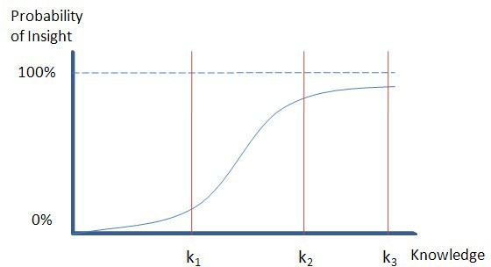
Discussion
Can we measure knowledge-building insight?
Can we measure spontaneous insight?
Are they related?

Slide 26
MILCs – Shneiderman and Plaisant (2006)
Multi-dimensional In-depth Long-term Case studies
Hypothesis: the efficacy of tools can be assessed by documenting:
Usage (observations, interviews, surveys, logging, etc.)
How successful the users are in achieving their professional goals

Slide 27
Definition
Multi-dimensional: using observations, interviews, surveys, and loggers
In-Depth: intense engagement of the researchers with the expert users to the point of becoming a partner or assistant
Long-term: longitudinal studies that begin with training in use of a specific tool through proficient usage that leads to strategy changes for the expert users.
Case studies: detailed reporting about a small number of individuals working on their own problems, in their own environment

Slide 28
Discussion
What do MILCs address?

Slide 29
Motivation
MILCs have been embraced by a small community of researchers interested in studying creativity support
Challenges:
Cannot control for the users
Cannot control for the tasks
Toy problems in laboratories are not indicative of real-world problems and environments

Slide 30
Execution issues with MILCs
Duration is always a problem
Number of participants has to be small
Familiarities are difficult
Understand organization policies and work culture
Gain access and permission to observe or interview
Observe users in their workplace, and collect subjective and objective quantitative and qualitative data.
Compile data of all types in all dimensions
Interpret the results
Isolate factors
Need to repeat the process

Slide 31
Learning-based evaluation (Chang, 2010)
Working assumption: “the goal of visualization is to gain insight and knowledge”
Big idea: maybe we should evaluate a visualization based on whether or not the user actually gains insight or knowledge after using a visualization

Slide 32
Much like learning in education…
How would an instructor choose between two textbooks for a course?
We could:
Ask the students which book they prefer
Issue: they might like a book because its cover is pretty
Ask colleagues what book they prefer
Issue: different students in different environments
Ask the students to find some information in the book and measure how quickly they can perform the task
Issue: this only demonstrates how well the book is organized

Slide 33
Metaphor for visualization evaluation
In a best case scenario, we would:
Ask half of the class to use book one to learn a subject
Ask the other half to use another book to learn the same subject
Then we give the two groups the same test, and whichever scores higher “wins”

Slide 34
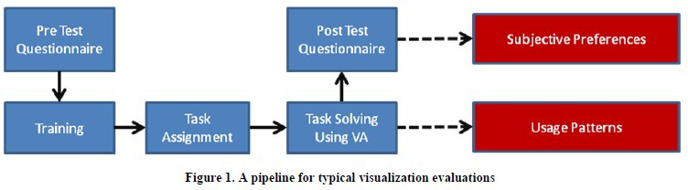
Traditional LBE

Slide 35
Discussion
Potential problems with this method?

Slide 36
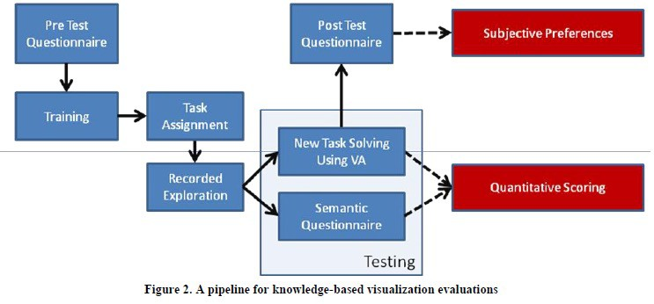
Single-system LBE

Slide 37
Discussion
How should we evaluate your final projects?

Slide 38













Reminders / Administrivia
By Friday 5pm EST: submit FP team / topic form
So far: 13 teams (52 of 87 enrolled students ≈ 60%)
FP1: Prototype I – due Tuesday May 4th at 5pm
a persona
a “paper” prototype of your project
an annotated architecture diagram
FP2: Prototype II – due Tuesday May 11th at 5pm
Snapshot of codebase (ZIP + README or git release)
Revised annotated diagram
FP3: Final Release – due Wednesday May 19th at 5pm
Snapshot of codebase (ZIP + README or git release)
Documentation / writeup
5min demo video

