Slide 1
FINAL PROJECT WORKSHOP:
PEER FEEDBACK AND DISCUSSION
May 4, 2021
CSC/SDS235: Visual Analytics

Slide 2

Recap: Discussion
How should we evaluate your final projects?

Slide 3

Peer feedback

Slide 4
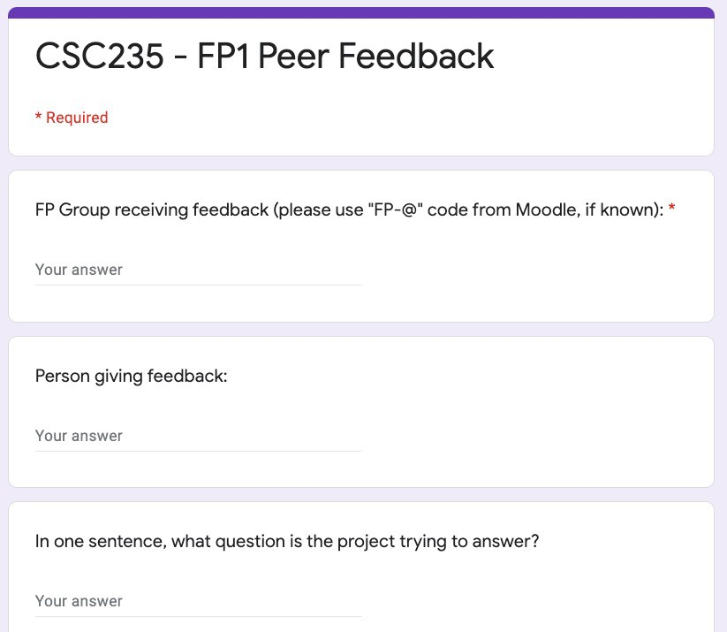
Peer feedback and discussion
bit.ly/CSC235-Peer-Feedback

Slide 5
Some points on giving effective feedback
Before you speak, know the goals
Good and bad != what you like or don’t like (but both are valuable)
Talk as much about what it is, as what it isn’t

Slide 6
Some points on receiving feedback graciously
Start by just listening
Ask clarifying questions
Refer back to your goals
Ask about specific changes you can make that will satisfy the critique

Slide 7
Discussion: eye-openers
What did you learn from your discussion?

Slide 8
Discussion: major concerns?
9 days remaining in the semester
Anyone have concerns about scope?
If you’re considering scaling back, how do you decide what to cut?
If you’re planning to scale up, what support do you need to get it done?

Slide 9
Closing remarks
Lots of extra office hours available by appointment this week and next; if you’re stuck, come talk it through!
May 13th guest lecture: Kris Cook, PNNL (founder of the field of Visual Analytics)
You don’t want to miss this class!

