Slide 1
Visual Analytics– Coordinated Multiple Views
Dr. Ab Mosca (they/them)
Slides based off slides courtesy of Jordan Crouser (https://jcrouser.github.io/)

Slide 2
Plan for Today
Interaction as context-preserver
Coordinated multiple views (CMV)
Brushing and linking
Demo: plotly

Slide 3
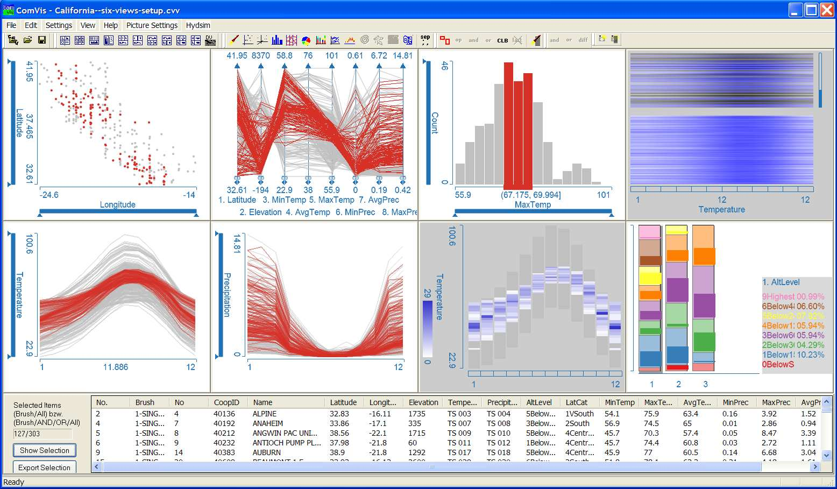
Show me related items: coordinated multiple views (CMV)
Recap:
7. Connect

Slide 4
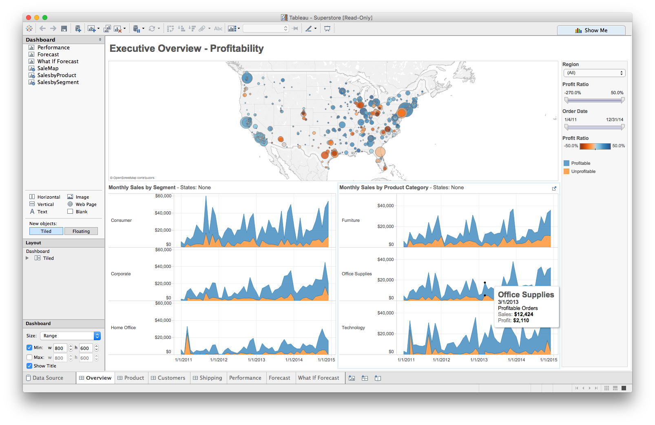
Multiple views
Different
representations
Different
data
Systems that use two or more distinct views
to support the exploration of a single concept or domain

Slide 5
When to use multiple views?
The data is too big
Lots of attributes
Lots of observations
The data is too complicated
Lots of data sources
Lots of data types
The data has several interesting parts, but no one visualization highlights them all

Slide 6
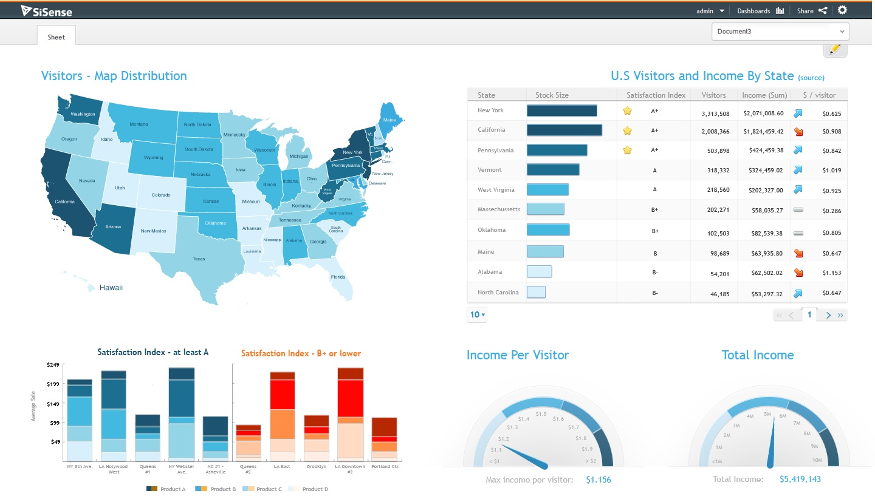
Need to think about: resource optimization

Slide 7
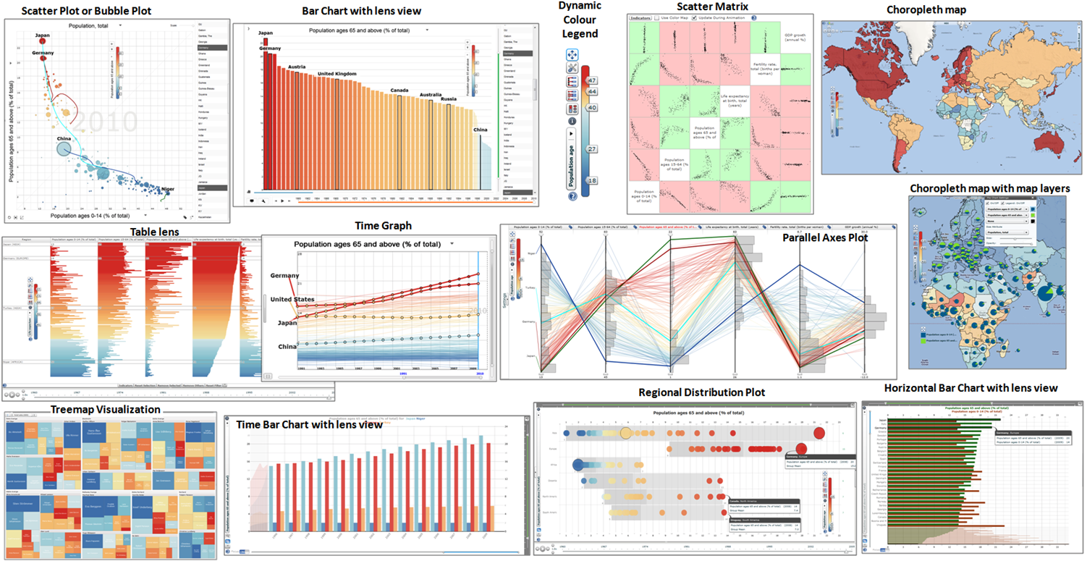
Need to think about: resource optimization

Slide 8
Balance the costs of presenting multiple views with the benefits of using the views
Split complex data into multiple views to create manageable chunks
Use views that are complimentary, bringing out correlations and/or disparities
Use perceptual cues to:
make relationships more apparent to the reader
focus the reader’s attention on the right view at the right time
Guidelines for multiple views

Slide 9
Coordination: brushing and linking
Big idea: actions in the real world have ripple effects; actions on a visualization should too
Brushing: the visualization responds (usually through highlighting) as a person “brushes past” data points
Linking: the visualization connects related data points across multiple views

Slide 10
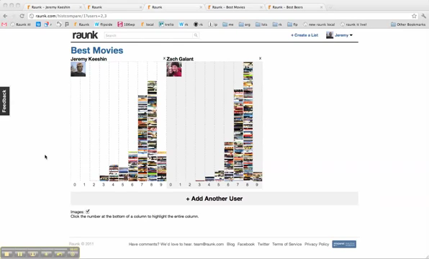
Coordination: brushing and linking

Slide 11
Multiple views + brushing and linking
Big idea: propagate interaction from one view to all others, respond as appropriate
Coordinated multiple views

Slide 12




Introduction to plot_ly() and ggplotly()
Case Study –
Housing Sales in Texas
with plot_ly()
with ggplotly()
with htmlwidgets
with shiny
with subplot(…)
Combining views
Demo modeled on
“The Plotly Cookbook” chapter of the Plotly for R Masterclass by Carson Sievert.

Slide 13
Important distinction
2 main ways to initiate a plotly object in R:
plot_ly() function transforms data into a plotly object
ggplotly() function transforms a ggplot object into a plotly object (Wickham 2009, Sievert et al. 2016)
Both result in an interactive web-based visualization with tooltips, zooming, and panning enabled by default
Let’s play…

Slide 14
Practice
Find instructions for today’s lab on the course website

