Slide 1
Visual Analytics– Time Varying Data
Dr. Ab Mosca (they/them)
Slides based off Tableau Learn (https://www.tableau.com/learn/articles/time-series-analysis)

Slide 2
Homework Note
Please submit only the required deliverables on Gradescope (no binary files and no data files)
Please assume the data folder I give you with the assignment is saved in the same directory as your scripts, and set them up to run as such

Slide 3
Homework 2
How is it going?
Questions?

Slide 4
Another Note!
Class on Thursday will be held in the Spatial Analysis Lab (SAL) in Sabin-Reed 104
We’ll have a guest lecture all about (geo)spatial data analysis

Slide 5
Plan for Today
What is time varying data?
Practice

Slide 6
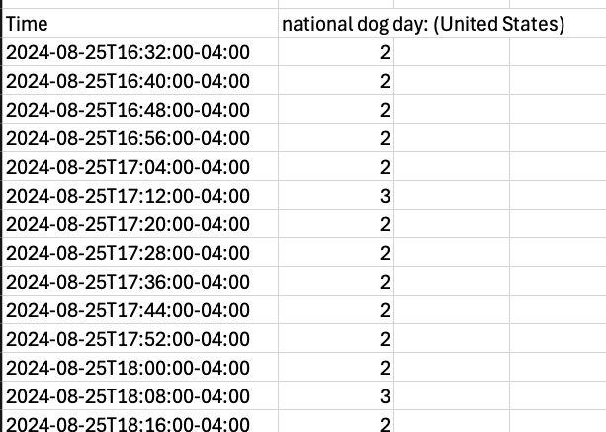
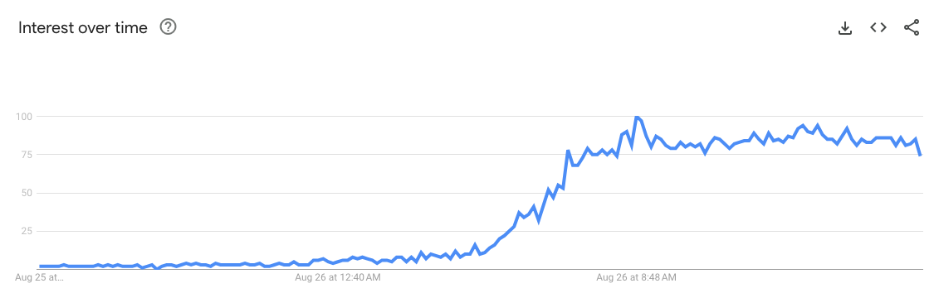
Time Varying Data
Are these variables dependent or independent?

Slide 7
Time Varying Data
What examples of time-varying data can you think of?
Notes:
Weather data
Rainfall measurements
Temperature readings
Heart rate monitoring (EKG)
Brain monitoring (EEG)
Quarterly sales
Stock prices
Automated stock trading
Industry forecasts
Interest rates

Slide 8
Time Series Analysis
Specific way of analyzing a sequence of data points collected over an interval of time
Time series data is collected at specific, consistent time intervals
Allows us to see how variables change over time
Datasets are typically very large
Data can be unruly
Can be used for predictions (time series forecasting)

Slide 9
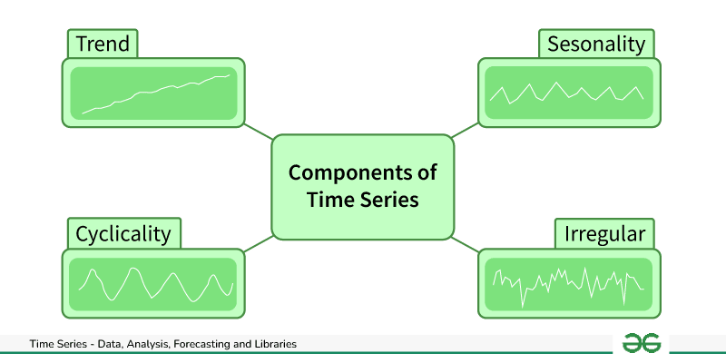
Time Series Analysis
Extra resources
https://www.itl.nist.gov/div898/handbook/pmc/section4/pmc4.htm (analytic techniques)
https://www.geeksforgeeks.org/time-series-analysis-and-forecasting/ (visualization examples)
https://www.geeksforgeeks.org/time-series-analysis-and-forecasting/
Notes:
Components of Time Series DataTrend: Trend represents the long-term movement or directionality of the data over time. It captures the overall tendency of the series to increase, decrease, or remain stable. Trends can be linear, indicating a consistent increase or decrease, or nonlinear, showing more complex patterns.
Seasonality: Seasonality refers to periodic fluctuations or patterns that occur at regular intervals within the time series. These cycles often repeat annually, quarterly, monthly, or weekly and are typically influenced by factors such as seasons, holidays, or business cycles.
Cyclic variations: Cyclical variations are longer-term fluctuations in the time series that do not have a fixed period like seasonality. These fluctuations represent economic or business cycles, which can extend over multiple years and are often associated with expansions and contractions in economic activity.
Irregularity (or Noise): Irregularity, also known as noise or randomness, refers to the unpredictable or random fluctuations in the data that cannot be attributed to the trend, seasonality, or cyclical variations. These fluctuations may result from random events, measurement errors, or other unforeseen factors. Irregularity makes it challenging to identify and model the underlying patterns in the time series data.

Slide 10
Lab
Find instructions for today’s lab on the course website

