Slide 1
Visual Analytics– Evaluation Techniques
Dr. Ab Mosca (they/them)
Slides based off slides courtesy of Jordan Crouser (https://jcrouser.github.io/)

Slide 2
Plan for Today
Final Project Check-in
Evaluation of visual analytic systems

Slide 3
Final Project
What ideas did you come up with?
Any questions?
Reminder: Paper prototype testing in class next week!

Slide 4
Discussion
How do we measure the effectiveness
of a visualization system?

Slide 5
datavoyager: https://vega.github.io/voyager/
Pair up and toy around with datavoyager to get a sense of the tool
Try to do a mini exploratory data analysis with it
Example Visual Analysis Tool

Slide 6

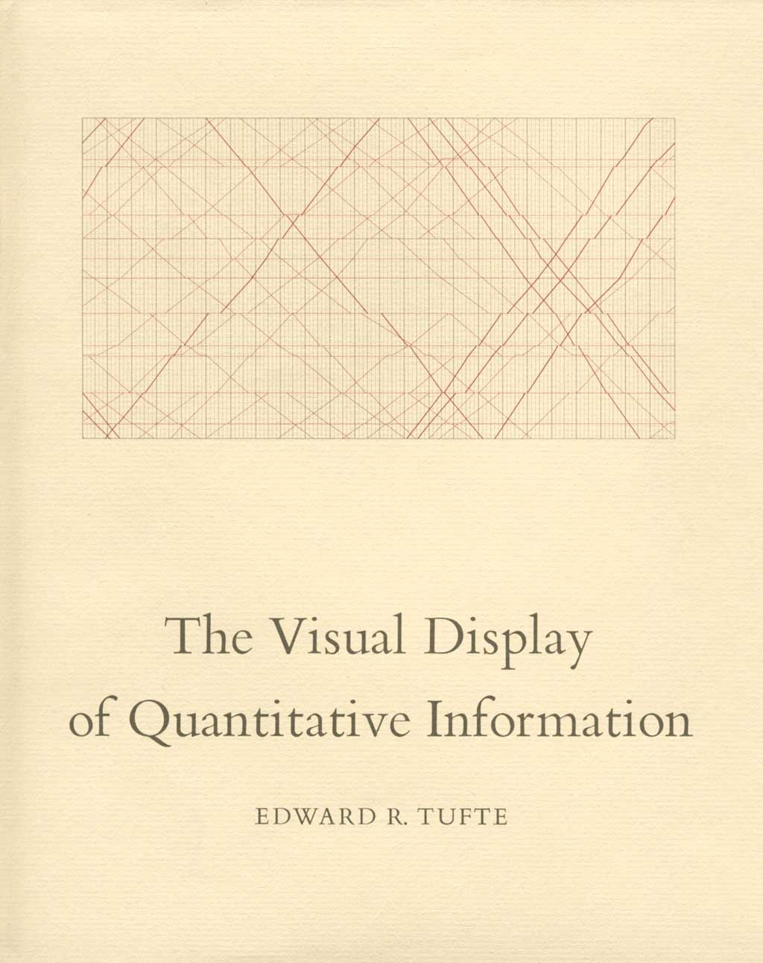
Evaluation via Design Guidelines
“Above all else, show the data.”
Notes:
Kind of old news

Slide 7
Tufte, 1983
Data-ink
Data-ink ratio =
Total ink used to print the graphic
= proportion of a graphic's ink devoted to the non-redundant display of data-information
= 1 - proportion of a graphic that can be erased

Slide 8
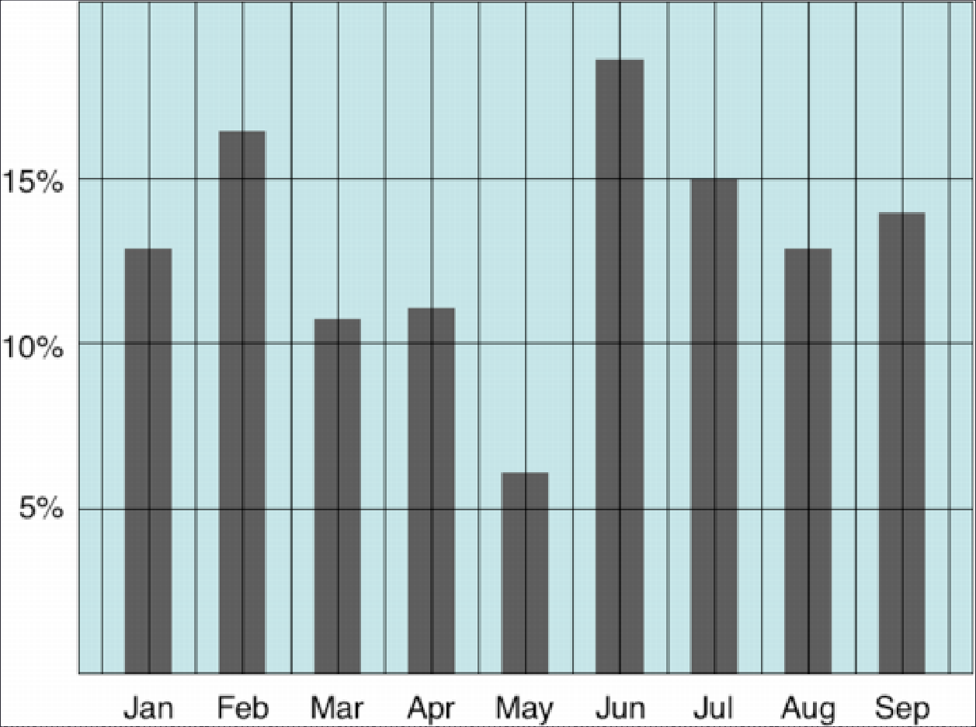
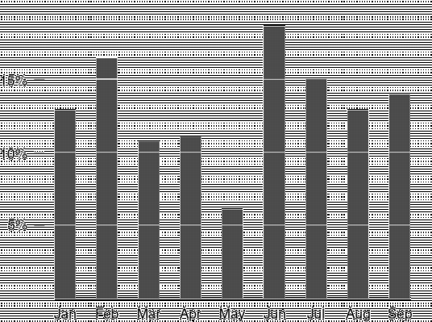

Tufte: maximize the data-ink ratio

Slide 9
Discussion
Evaluate datavoyager in terms of data-ink ratio
What are the pros and cons of using data-ink ratio to evaluate visual analytic tools?

Slide 10
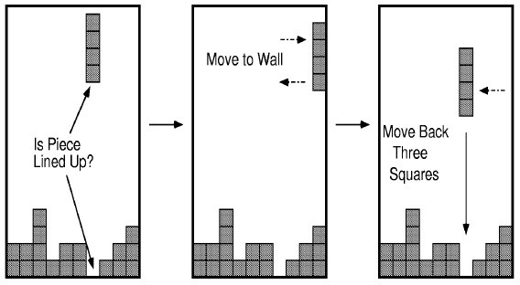
Flashback: Epistemic Action
The purpose of some actions is not the effect they have on the environment but the effect they have on the humans.

Slide 11
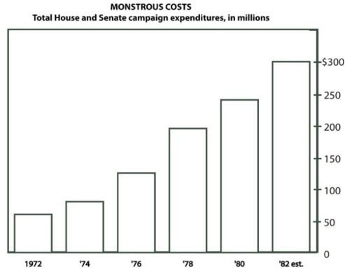
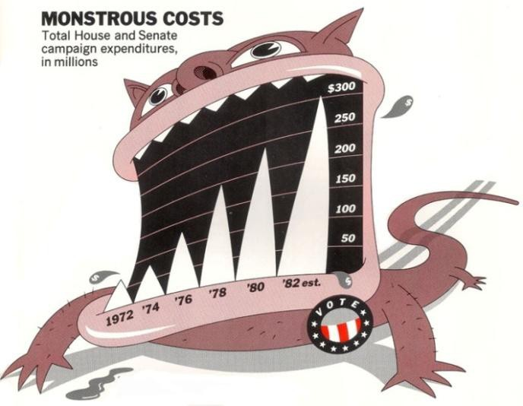

A caveat to Tufte: “chart junk” and recall
Bateman et al. “Useful Junk? The Effects of Visual Embellishment on Comprehension and Memorability of Charts”, CHI 2010

Slide 12
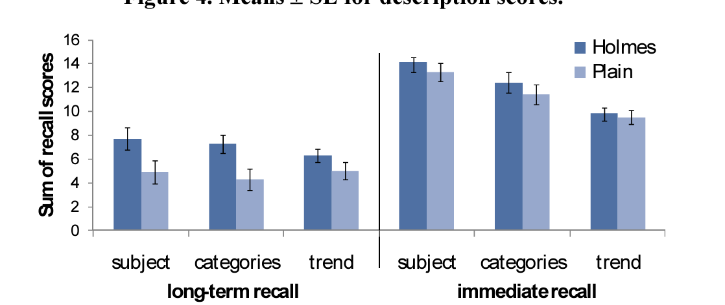
A caveat to Tufte: “chart junk” and recall
Bateman et al. “Useful Junk? The Effects of Visual Embellishment on Comprehension and Memorability of Charts”, CHI 2010

Slide 13
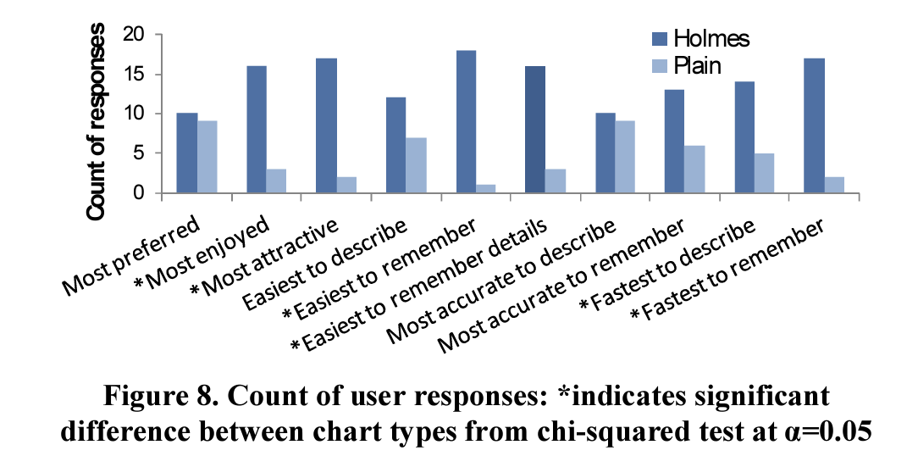
A caveat to Tufte: “chart junk” and preference
Bateman et al. “Useful Junk? The Effects of Visual Embellishment on Comprehension and Memorability of Charts”, CHI 2010

Slide 14
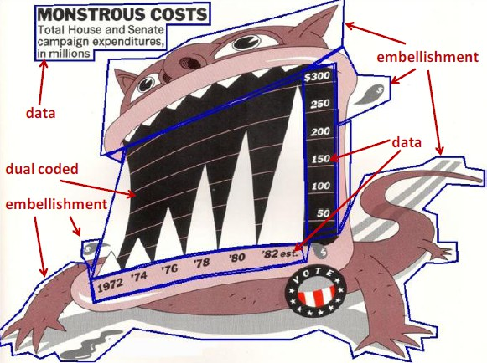
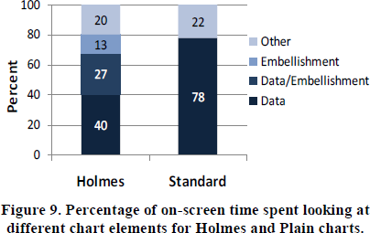
Chart junk and eye gaze
Notes:
Although 40% of users’ time was spent looking at embellishments for Holmes charts, this did not result in a longer time to describe the charts.

Slide 15
Discussion
Know any compelling examples of visual embellishment?
Tragic ones?
What’s the right balance between Tufte and ChartJunk?

Slide 16
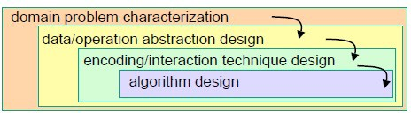
Evaluation Via Design Guidelines:
Nested Model of VIS Design, Munzner
Munzner, Tamara. "A nested model for visualization design and validation." Visualization and Computer Graphics, IEEE Transactions on 15.6 (2009): 921-928.

Slide 17
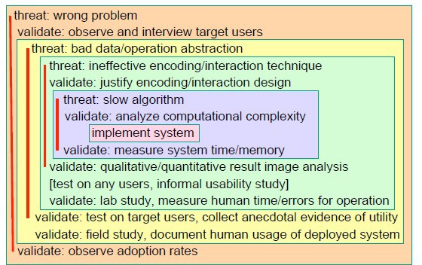
Nested Model of VIS Design, Munzner
Notes:
Threats

Slide 18
How would you evaluate datavoyager following Munzner’s Nested Model?
Discussion

Slide 19
Nested Model of VIS Design, Munzner
Mismatch: a common problem in evaluating VIS systems
Examples:
the value of a new visual encoding can’t be measured using a quantitative timing of the algorithm
mischaracterized task can’t be addressed in a formal lab study

Slide 20
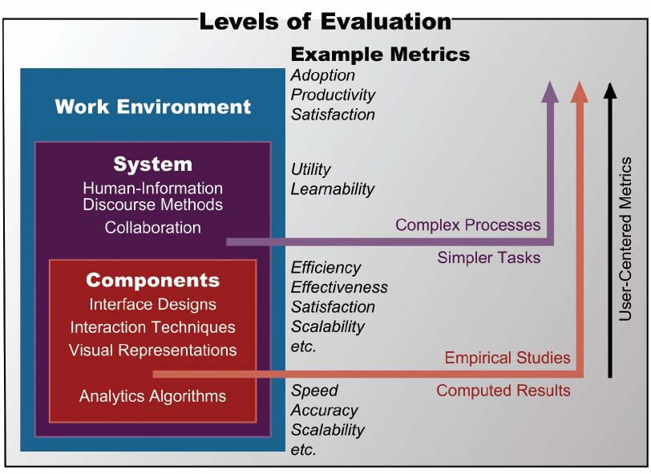
Matching methods and metrics

Slide 21

Evaluation Via Insights: Insight-based evaluation, North et. al
Measure the usefulness of a visualization by counting the number of insights
a person generated while using it

Slide 22
Insight-Based Evaluation Method
No “benchmark tasks”
Training on data and visualization for 15 minutes
Participants list questions that they would like to pursue
Asked to examine the data for as long as necessary until
no new insights can be gained
During analysis, participants are asked to comment on their observations, inferences, and conclusions

Slide 23
Tally up the number of insights:
Insights: distinct observations about the data
Baseline: all insights generated by all participants
Various quantitative statistics on insight generation (time spent, time to first insight, etc.)
Evaluating the Results

Slide 24
Discussion
What does insight-based evaluation address?

Slide 25
Design an insight-based evaluation of datavoyager. Be sure to include a data collection and analysis plan.
What is challenging about this type of evaluation?
Discussion

Slide 26
Problem: defining “insight”
North’s definition:
“[Insight is] an individual observation about the data by the participant, a unit of discovery. It is straightforward to recognize insight occurrences in a think-aloud protocol as any data observation that the user mentions is considered an insight.”

Slide 27

Example 1
“Our tool allows the biologists to interactively visualize and explore the whole set of trees, providing insight into the overall distribution and possible conflicting hypothesis”
Insight = knowledge about the overall distribution

Slide 28

Example 2
“The analyst determined the answers to these questions, but also came up with further insights that she shared with people from other administrative units. She used the discovered information to advise other administrators of certain previously unknown relationships in their data”
Insight = information about previously unknown relationships

Slide 29


Cognitive science definition
Something measurable in the frontal and temporal lobes (superior temporal gyrus).
Spontaneous insight vs. model-building insight

Slide 30
Disambiguating “Insight”
Knowledge-building insight:
Discovering insight, gaining insight, and providing insight
Insight as a substance, that accumulates over time and could be measured/quantified
Spontaneous insight:
Experiencing insight, having an insight, or a moment of insight
Insight as a discrete event, that occurs at a specific moment in time and could be observed

Slide 31
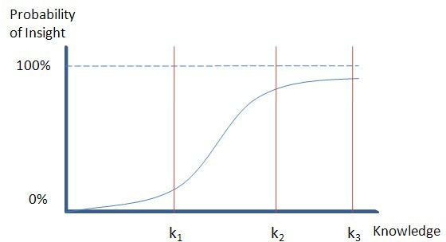
Discussion
Can we measure knowledge-building insight?
Can we measure spontaneous insight?
Are they related?

Slide 32
Evaluation Via Case Studies: MILCs – Shneiderman and Plaisant (2006)
Multi-dimensional In-depth Long-term Case studies
Hypothesis: the efficacy of tools can be assessed by documenting:
Usage (observations, interviews, surveys, logging, etc.)
How successful the users are in achieving their professional goals

Slide 33
Definition
Multi-dimensional: using observations, interviews, surveys, and loggers
In-Depth: intense engagement of the researchers with the expert users to the point of becoming a partner or assistant
Long-term: longitudinal studies that begin with training in use of a specific tool through proficient usage that leads to strategy changes for the expert users.
Case studies: detailed reporting about a small number of individuals working on their own problems, in their own environment

Slide 34
Discussion
What do MILCs address?

Slide 35
Design an MILC evaluation of datavoyager. Be sure to include a data collection and analysis plan.
What is challenging about this type of evaluation?
Discussion

Slide 36
Challenges
MILCs have been embraced by a small community of researchers interested in studying creativity support
Challenges:
Cannot control for the users
Cannot control for the tasks
Toy problems in laboratories are not indicative of real-world problems and environments

Slide 37
Duration is always a problem
Number of participants has to be small
Formalities are difficult
Understand organization policies and work culture
Gain access and permission to observe or interview
Observe users in their workplace, and collect subjective and objective quantitative and qualitative data.
Compile data of all types in all dimensions
Interpret the results
Isolate factors
Need to repeat the process
Execution issues with MILCs

Slide 38
Evaluation Via Learning: Learning-based evaluation (Chang, 2010)
Working assumption: “the goal of visualization is to gain insight and knowledge”
Big idea: maybe we should evaluate a visualization based on whether or not the user actually gains insight or knowledge after using a visualization

Slide 39
Much like learning in education…
How would an instructor choose between two textbooks for a course?
We could:
Ask the students which book they prefer
Issue: they might like a book because its cover is pretty
Ask colleagues what book they prefer
Issue: different students in different environments
Ask the students to find some information in the book and measure how quickly they can perform the task
Issue: this only demonstrates how well the book is organized

Slide 40
Metaphor for visualization evaluation
In a best case scenario, we would:
Ask half of the class to use book one to learn a subject
Ask the other half to use another book to learn the same subject
Then we give the two groups the same test, and whichever scores higher “wins”

Slide 41
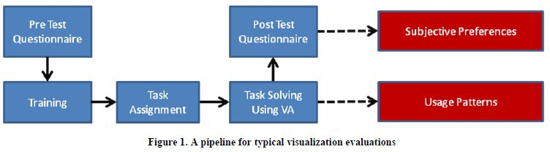
Traditional LBE

Slide 42
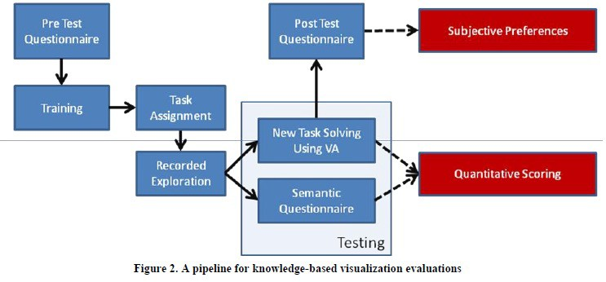
Single-system LBE
Notes:
Test transfer of skills from exploration to actual task

Slide 43
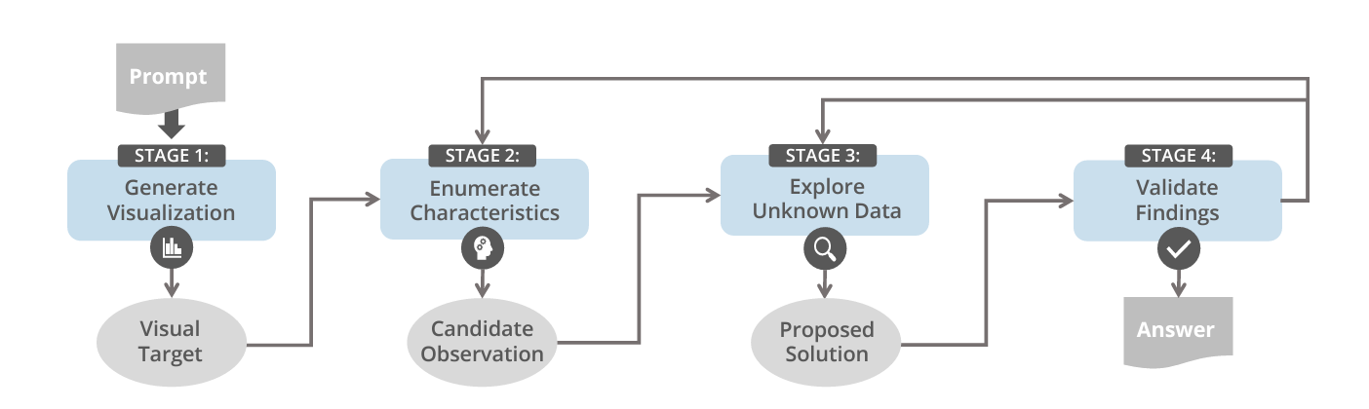
Inferential tasks require evaluation participants to construct knowledge by inferring relations between learned concepts and new observations
Evaluation Via Inferential Tasks Suh et al. 2022
Notes:
Inferential learning

Slide 44
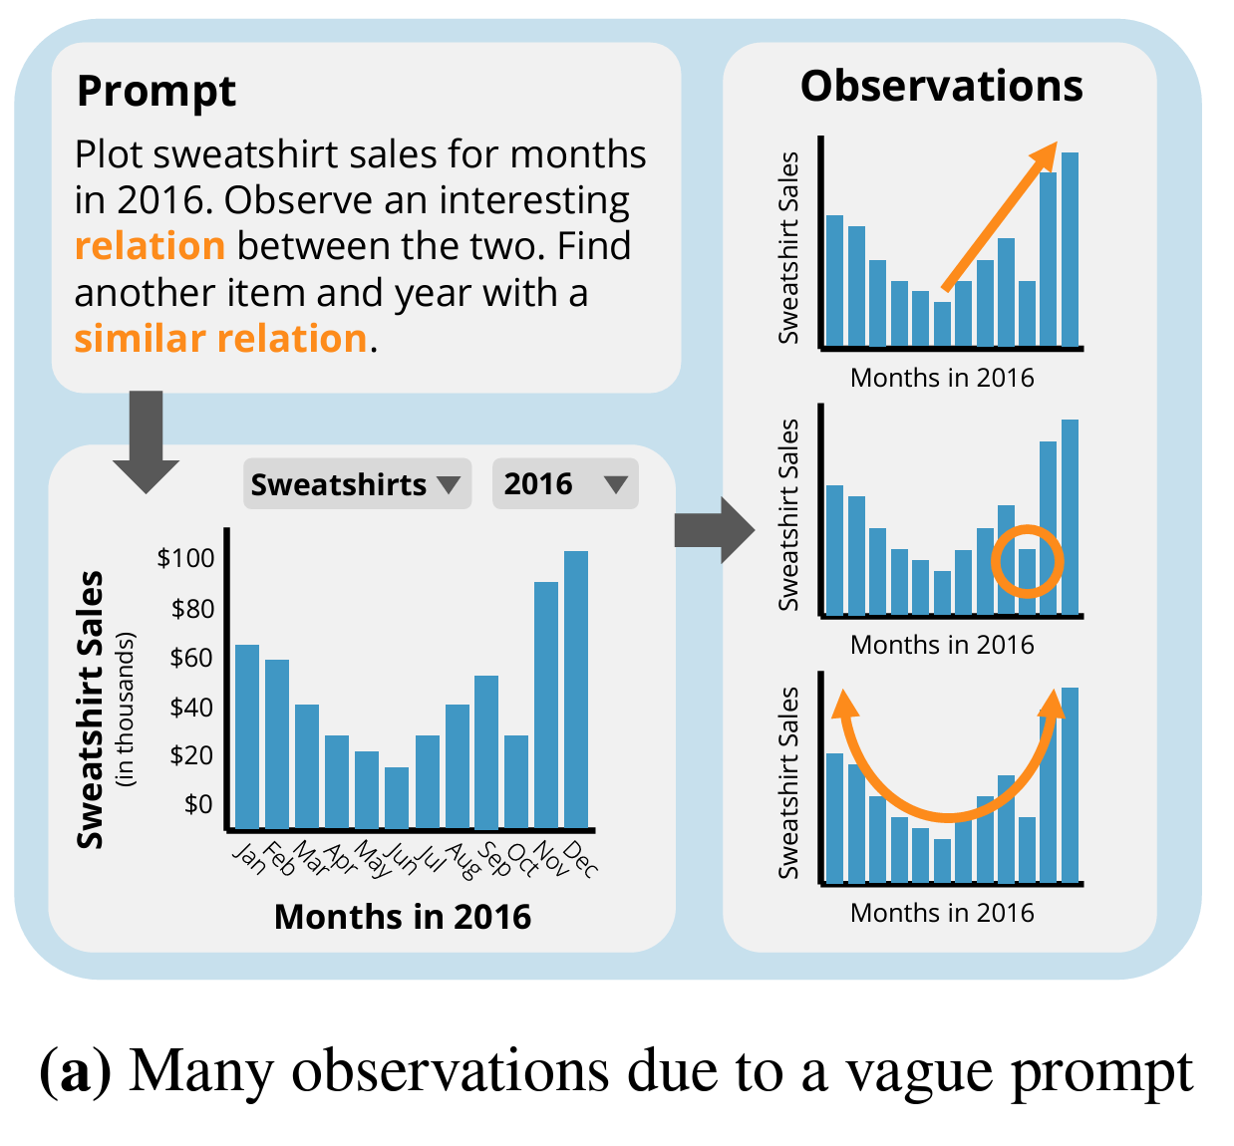
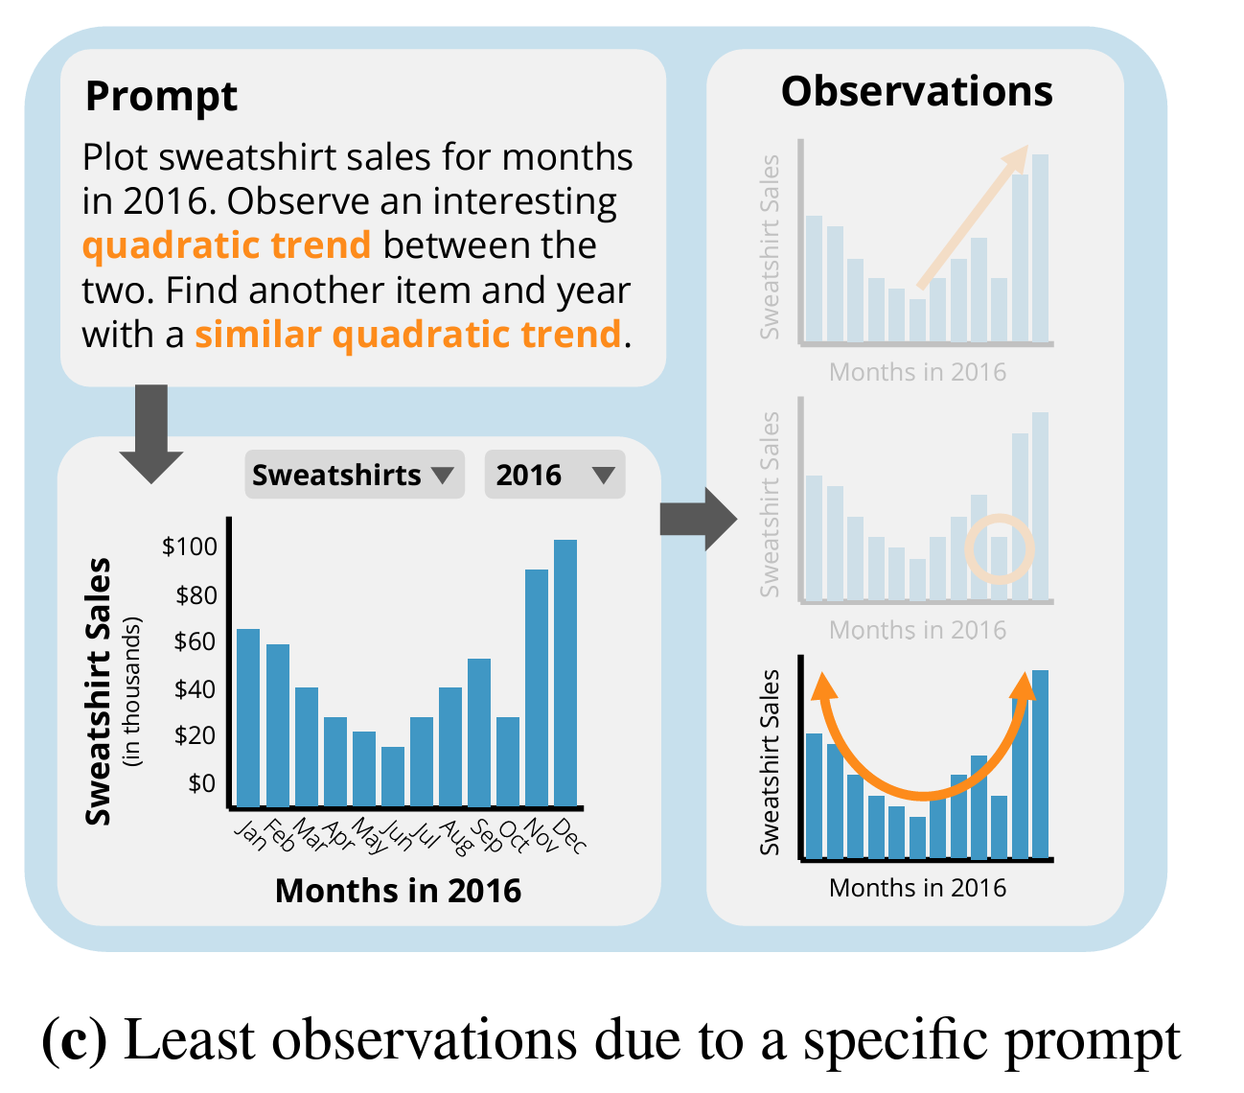
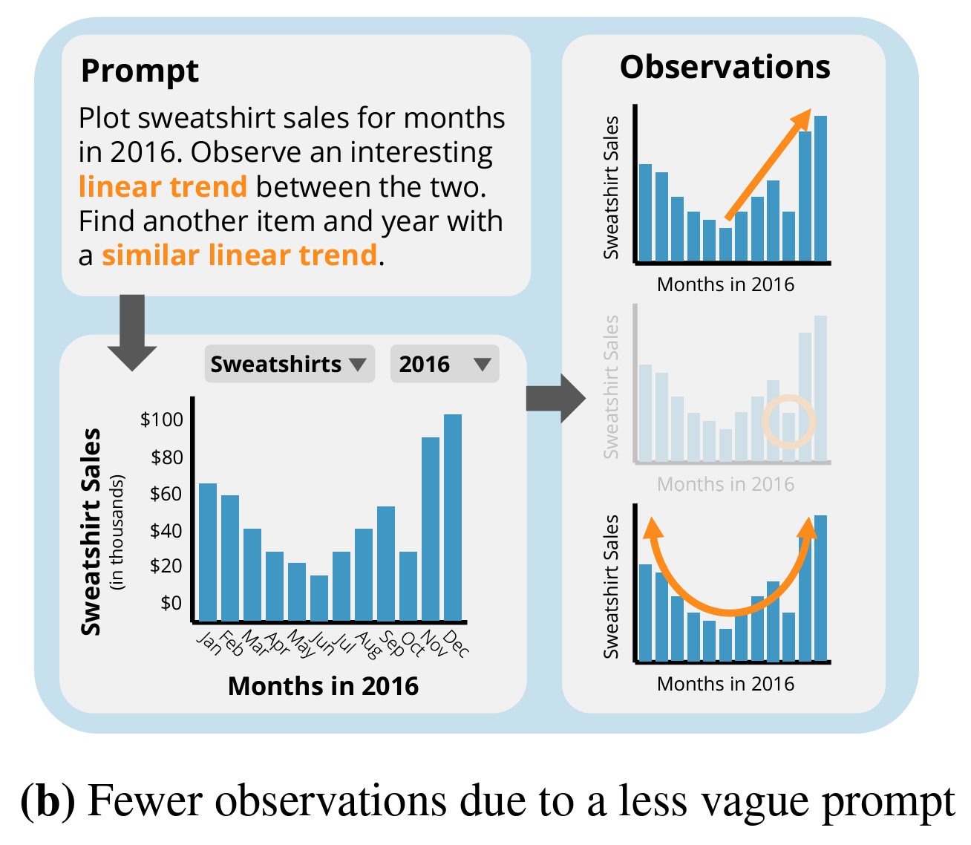
Evaluation Via Inferential Tasks Suh et al. 2022
Notes:
Inferential learning

Slide 45
Design an LBE evaluation of datavoyager. Be sure to include a data collection and analysis plan.
What part of Munzner’s Nested Model does this evaluate?
Discussion

Slide 46
Takeaways
Evaluation is complex and requires creativity
The best method depends on which part of the tool you want to evaluate, and resources available

