Slide 1
Visual Analytics– Dealing with Big Data: Dimensionality Reduction
Dr. Ab Mosca (they/them)
Slides based off slides courtesy of Jordan Crouser (https://jcrouser.github.io/)

Slide 2
Reminder
Be prepared for prototype testing in class on Thursday!

Slide 3
Plan for Today
Dimension Reduction Techniques
PCA
MDS
t-SNE
UMAP

Slide 4
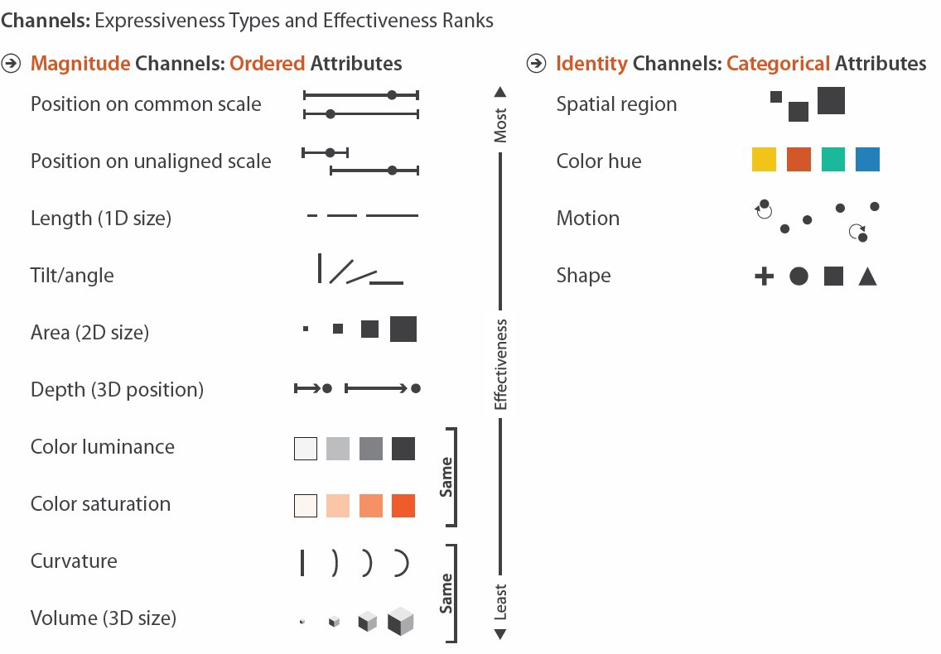
What we’ve been (mostly) worried about
What if dim(data) >> #channels?

Slide 5
Ideas?

Slide 6
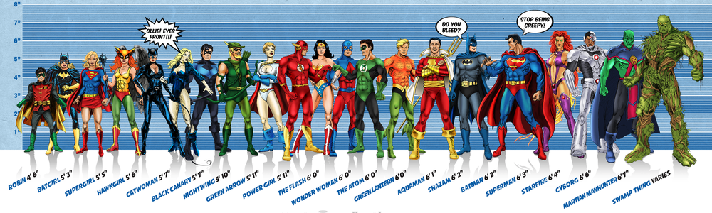



Toy example
Image credit: Ming Malaykham

Slide 7


Estimating Height
Notes:
Drax
Gamora
Rocket Racoon
Starlord / Peter Quill
Groot

Slide 8
Estimate for β
When we try to estimate coefficients using OLS, we get the following:
Notice the (relatively) big difference between actual and estimated coefficients.
6
estimated
true
4
i
2
0
-2
i

Slide 9
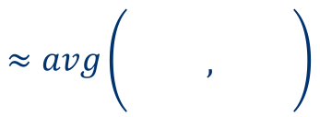
What’s going on here?
$$≈avg\left(\begin{matrix} & & \\ & , & \\ & & \end{matrix}\right)$$
Some dimensions are redundant
Little information in 3rd dimension not captured by the first two
In linear regression, redundancy causes noise to be amplified

Slide 10
Dealing with Many Dimensions
Current situation: our data live in p-dimensional space where p >> # visual channels
Odds are not all dimensions are equally useful
→ we can reduce the number of dimensions without loosing too much valuable information

Slide 11
Dimension reduction
Approach #1: Feature Elimination (i.e. Subset Selection)
Throw out less useful/useless dimensions
Pros:
Relatively simple
Preserve interpretability
Cons:
Don’t gain any information from features you drop
Pros? Cons?

Slide 12
Dimension reduction
Approach #2: Feature Extraction
Create new features (dimensions) that are combinations of the old ones
Pros:
Since new features are all combinations of old features, we are not totally dropping data
Cons:
Less interpretable, especially to non-experts
Pros? Cons?

Slide 13
Feature Extraction
Principal Component Analysis
Project data into a smaller space composed of most important (informative) components

Slide 14
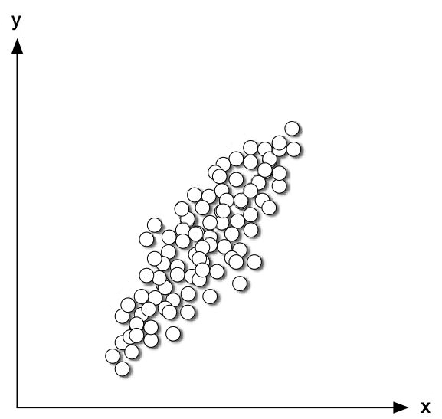
Projection

Slide 15
Projection
SMOOSH!
SMOOSH!

Slide 16
Projection

Slide 17
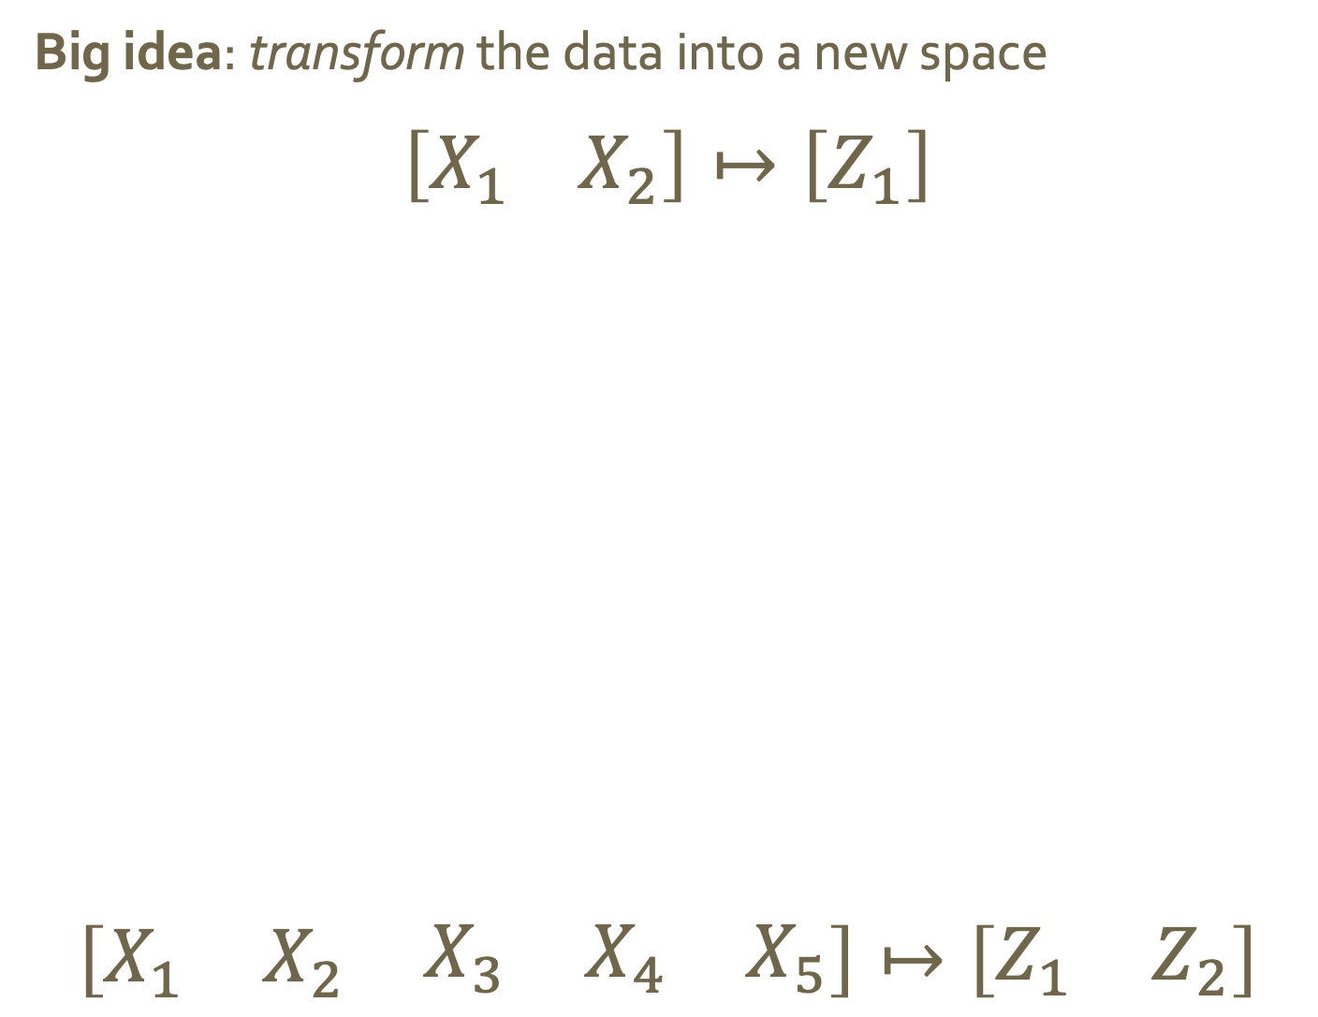



Projection
Big idea: transform the data into a new space
$$\left[X_{1} X_{2}\right]↦\left[Z_{1}\right]$$
$$\left[\begin{matrix}X_{1} & X_{2} & \begin{matrix}X_{3} & X_{4} & X_{5}\end{matrix}\end{matrix}\right]↦\left[\begin{matrix}Z_{1} & Z_{2}\end{matrix}\right]$$
$$X_{2}$$
$$Z_{1}$$
$$X_{1}$$

Slide 18
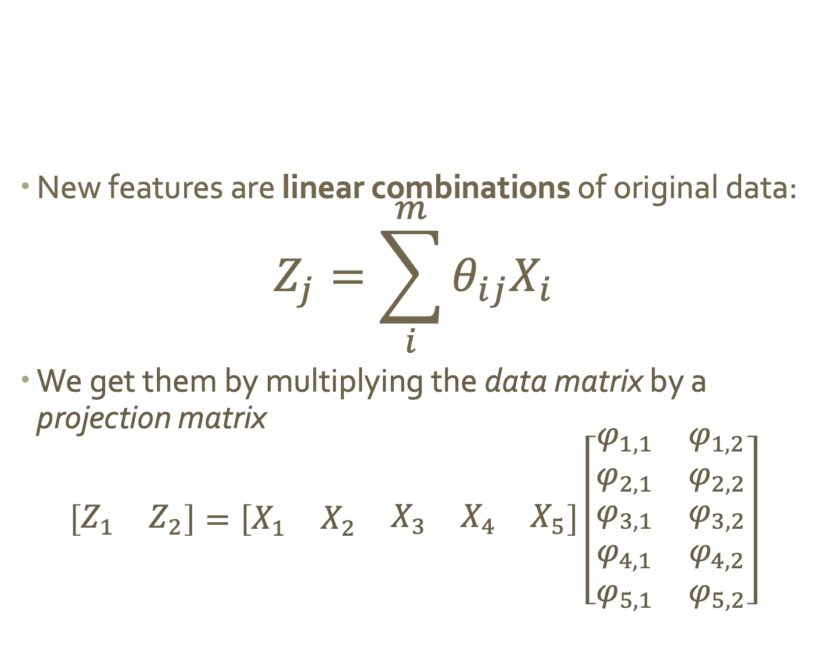
Linear projection
New features are linear combinations of original data:
$$Z_{j}=\sum_{i}^{m}{θ_{ij}X_{i}}$$
We get them by multiplying the data matrix by a projection matrix
$$\left[\begin{matrix}Z_{1} & Z_{2}\end{matrix}\right]=\left[\begin{matrix}X_{1} & X_{2} & \begin{matrix}X_{3} & X_{4} & X_{5}\end{matrix}\end{matrix}\right]\left[\begin{matrix}\begin{aligned}φ_{1,1} \\ φ_{2,1}\end{aligned} & \begin{aligned}φ_{1,2} \\ φ_{2,2}\end{aligned} \\ \begin{aligned}φ_{3,1} \\ φ_{4,1} \\ φ_{5,1}\end{aligned} & \begin{aligned}φ_{3,2} \\ φ_{4,2} \\ φ_{5,2}\end{aligned}\end{matrix}\right]$$

Slide 19
Why is projection helpful?
Data can be rotated, scaled, and translated without changing the underlying relationships
This means you’re allowed to look at the data from whatever angle makes your life easier…
Because new dimensions are combinations of old ones, we do not lose any data!

Slide 20
Flashback: why did we pick this line?

Slide 21
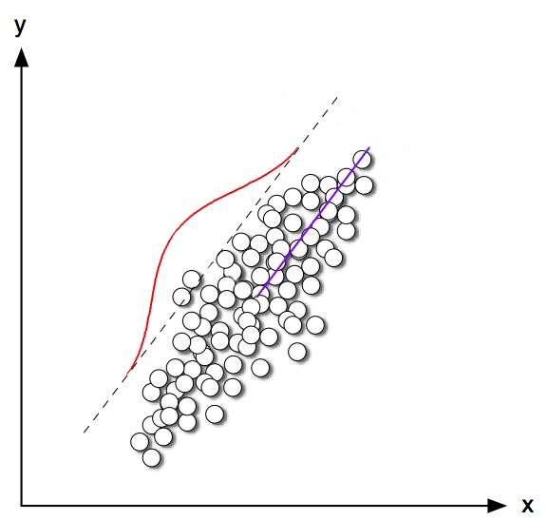
Explains the most variance in the data
Most variance

Slide 22
Imagine this line as a new dimension…
Most variance

Slide 23
“Principal component”
Most variance

Slide 24
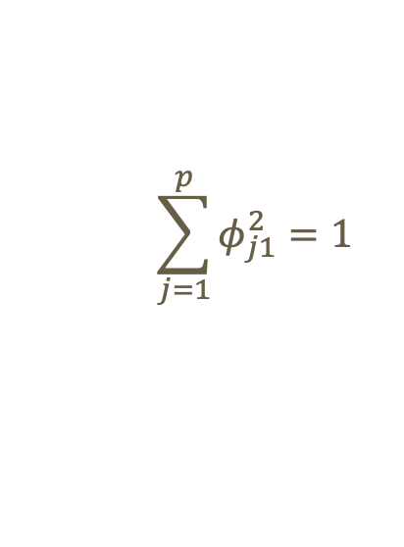
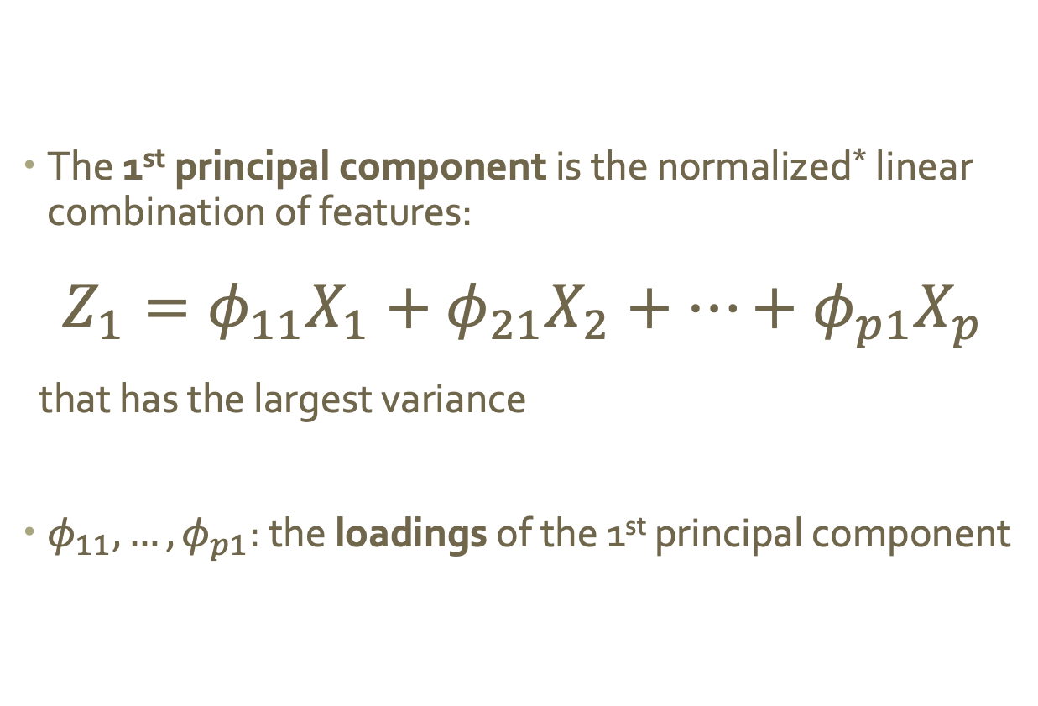
Mathematically
The 1st principal component is the normalized* linear combination of features:
$$Z_{1}=φ_{11}X_{1}+φ_{21}X_{2}+…+φ_{p1}X_{p}$$
that has the largest variance
$φ_{11},…,φ_{p1}$: the loadings of the 1st principal component
$$\sum_{j=1}^{p}{φ_{j1}^{2}=1}$$
* By normalized we mean:

Slide 25
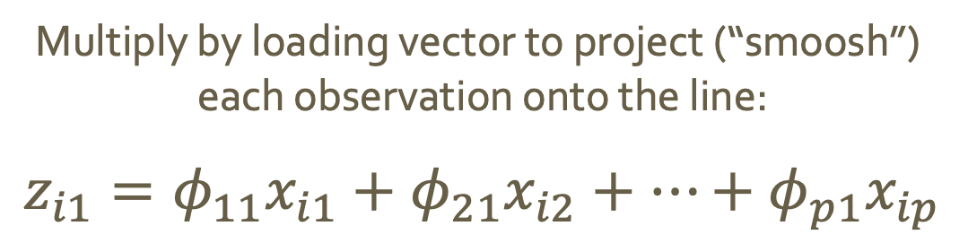
Using loadings to project
Multiply by loading vector to project (“smoosh”)
each observation onto the line:
$$z_{i1}=φ_{11}x_{i1}+φ_{21}x_{i2}+…+φ_{p1}x_{ip}$$
These values are called the scores
of the 1st principal component

Slide 26
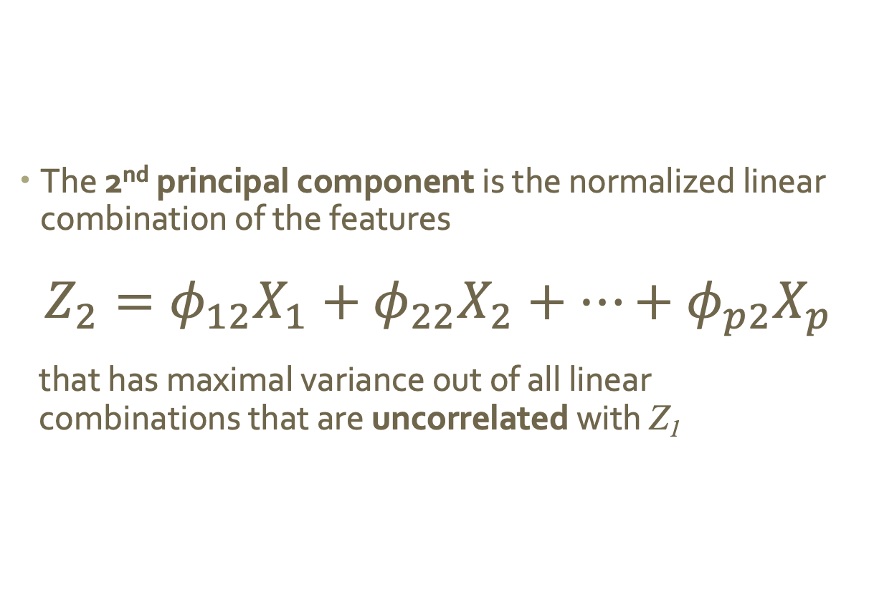
Additional principal components
The 2nd principal component is the normalized linear combination of the features
$$Z_{2}=φ_{12}X_{1}+φ_{22}X_{2}+…+φ_{p2}X_{p}$$
that has maximal variance out of all linear combinations that are uncorrelated with Z₁
Notes:
We want uncorrelated because we’re trying to reduce redundancy!!!

Slide 27
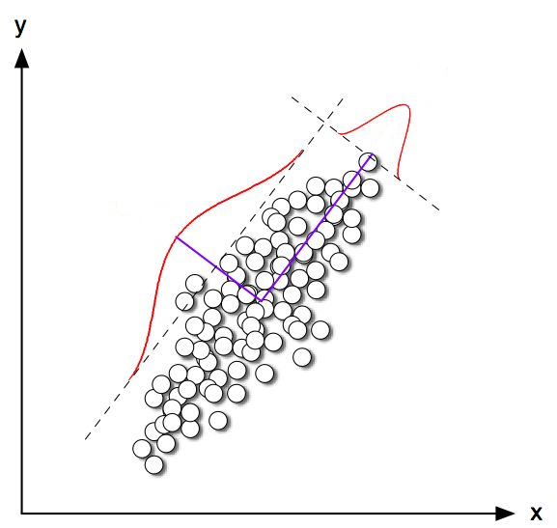
Principal components are orthogonal
2nd most variance

Slide 28
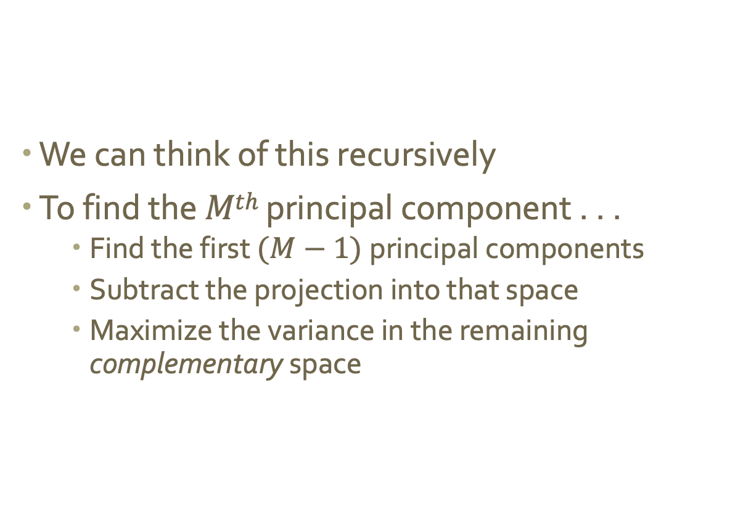
Generating additional principal components
We can think of this recursively
To find the $Mth$ principal component . . .
Find the first $(M−1)$principal components
Subtract the projection into that space
Maximize the variance in the remaining complementary space

Slide 29
Principal Component Analysis
Conduct analysis using n principal components instead of the original data
How do we choose n?
https://towardsdatascience.com/a-one-stop-shop-for-principal-component-analysis-5582fb7e0a9c

Slide 30
Principal Component Analysis
Conduct analysis using n principal components instead of the original data
Choosing n:
Option 1: Arbitrarily choose
Ex. Will your audience only understand 2-d data?
Option 2: Choose a proportion of data variance that must be captured by your principal components. Keep adding principal components until the threshold is hit.
Option 3: Plot cumulative proportion of data variance captured by your principle components. Look for “elbow” where reduction in variance drops off.
https://towardsdatascience.com/a-one-stop-shop-for-principal-component-analysis-5582fb7e0a9c

Slide 31
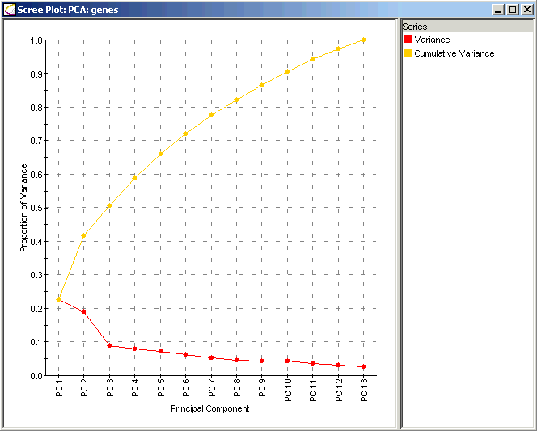
Principal Component Analysis
Option 3: Plot cumulative proportion of data variance captured by your principle components. Look for “elbow” where reduction in variance drops off.
https://towardsdatascience.com/a-one-stop-shop-for-principal-component-analysis-5582fb7e0a9c

Slide 32
PCA Exploration
Take 10 minutes to explore using this applet:
https://setosa.io/ev/principal-component-analysis/

Slide 33
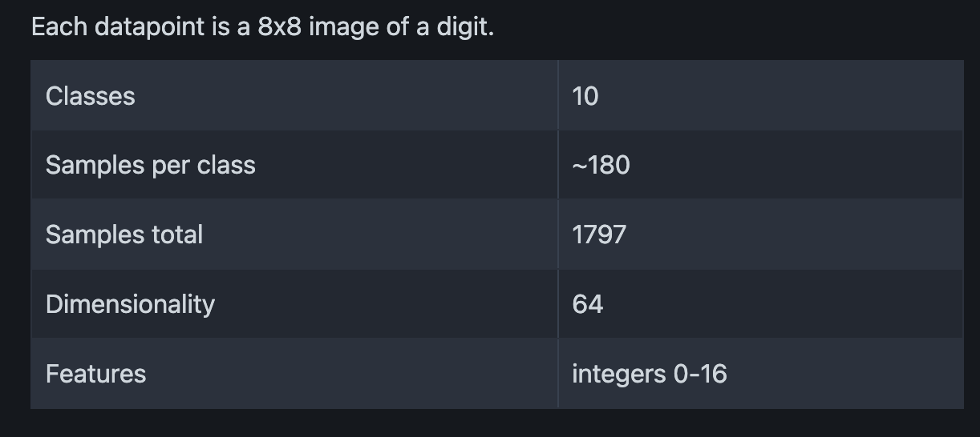
Example
Digits Dataset
Notes:
The data set contains images of hand-written digits: 10 classes where each class refers to a digit.

Slide 34
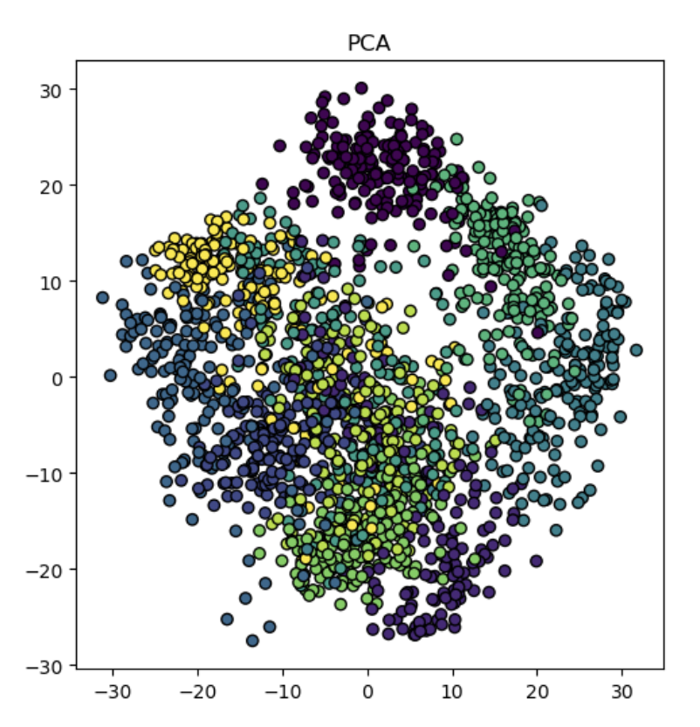
Example: 1st two PCs from PCA
https://medium.com/@conniezhou678/unveiling-dimensionality-reduction-a-comparative-analysis-of-9-methods-part-10-8594f8cd4336
Notes:
Less mixed color == more bunching of the clusters
Some gradiations, but need another component

Slide 35
Potential issues with PCA?
Notes:
Only linear transformations
Doesn’t preserve pairwise distance in hi dimensions
High run time

Slide 36
New idea
Preserve high-dimensional pairwise distance in projection
“similar” stuff stays close together
“different” stuff can move apart

Slide 37
MDS (Multidimensional Scaling)
Choose a good distance metric
Compute a pairwise distance matrix
Find a 2D embedding that preserves those distances- (the distance matrix kind of acts like a stress tensor, so you can think of MDS kind of like a “force directed” layout but without visible edges)
Fun (but also sad) fact:
PCA is just a special case of MDS (if we use Euclidean distance and choose the 1st two components)

Slide 38
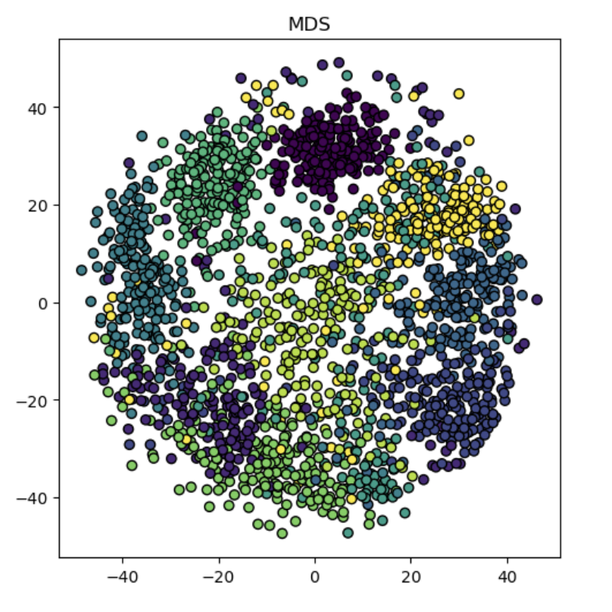
Example: 1st two PCs from MDS
https://medium.com/@conniezhou678/unveiling-dimensionality-reduction-a-comparative-analysis-of-9-methods-part-10-8594f8cd4336
Notes:
Less mixed color == more bunching of the clusters

Slide 39
Example: 1st two PCs from PCA vs MDS
https://medium.com/@conniezhou678/unveiling-dimensionality-reduction-a-comparative-analysis-of-9-methods-part-10-8594f8cd4336
Notes:
Less mixed color == more bunching of the clusters

Slide 40
Potential issues with general MDS?
Notes:
Pro: clear visual representation
Can handle non-linear relationships
Relatively intuitive interpretation bc of distance preservation
Cons: Sensitive to distance measure
Computationally expensive
Can struggle with noisy / missing data

Slide 41
t-SNE (t-Distributed Stochastic Neighbor Embedding)
Same objective: preserve pairwise distances
Different approach:
Similarity of points is determined by a probability distribution (t-distribution) and the conditional probability the point A will pick point B as it’s “neighbor”
Density of points is taken into account via “perplexity”
Stochastic process (element of randomness)

Slide 42
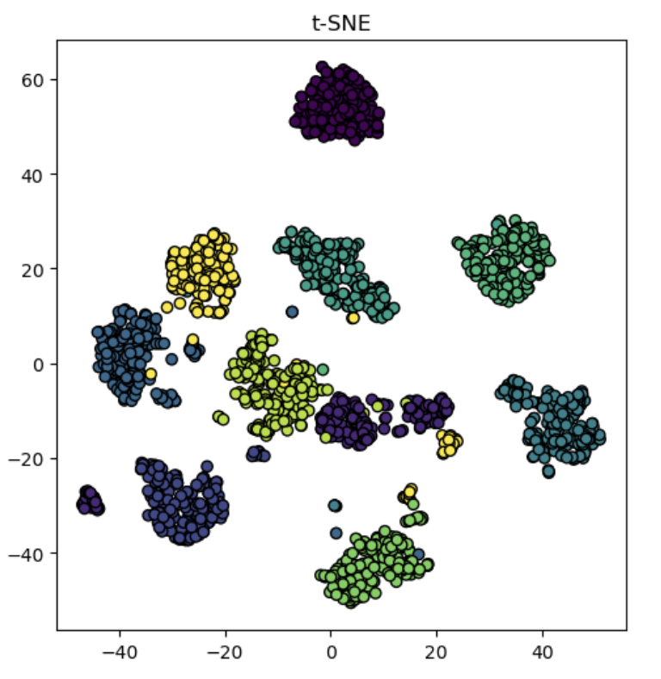
Example: 1st two PCs from t-SNE
https://medium.com/@conniezhou678/unveiling-dimensionality-reduction-a-comparative-analysis-of-9-methods-part-10-8594f8cd4336

Slide 43
Potential issues with t-SNE?
Notes:
Pro: Non-linear method
Con: stochastic, so we can get different results with the same hyperparameters

Slide 44
LDA (Linear Discriminant Analysis)
Prioritizes class separability
From a dataset of d independent features, extracts k new independent features that separate the classes the most
Note: you need to know classes to use LDA
Algorithm is similar to PCA, but with the added constraints of minimizing inter-class spread and maximizing intra-class spread

Slide 45
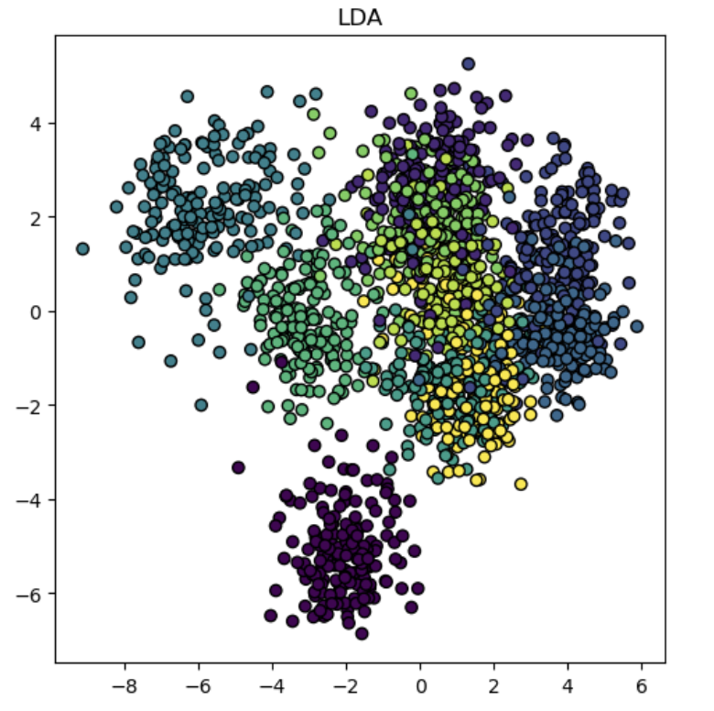
Example: 1st two PCs from LDA
https://medium.com/@conniezhou678/unveiling-dimensionality-reduction-a-comparative-analysis-of-9-methods-part-10-8594f8cd4336

Slide 46
Potential issues with LDA?
Notes:
Won’t work if dimensions are not independent; assumes linearity
Assumes multi-variate normal distribution (otherwise will not work)
BUT fast to compute and pretty accurate

Slide 47
https://medium.com/@conniezhou678/unveiling-dimensionality-reduction-a-comparative-analysis-of-9-methods-part-10-8594f8cd4336

Slide 48
Takeaways
There’s no “one right answer”
Each technique has benefits and drawbacks:
MDS (or PCA) is great if you eventually need to be able to relate the result back to the original dimensions
t-SNE does a great job preserving local similarity, but sometimes at the expense of global structure (and it can get really slow)
LDA is fast and relatively accurate

