Slide 1
Visual Analytics– Dimensionality Reduction
Dr. Ab Mosca (they/them)
Slides based off slides courtesy of Jordan Crouser (https://jcrouser.github.io/)

Slide 2
Plan for Today
Dimension Reduction Techniques
PCA
MDS
t-SNE
UMAP

Slide 3
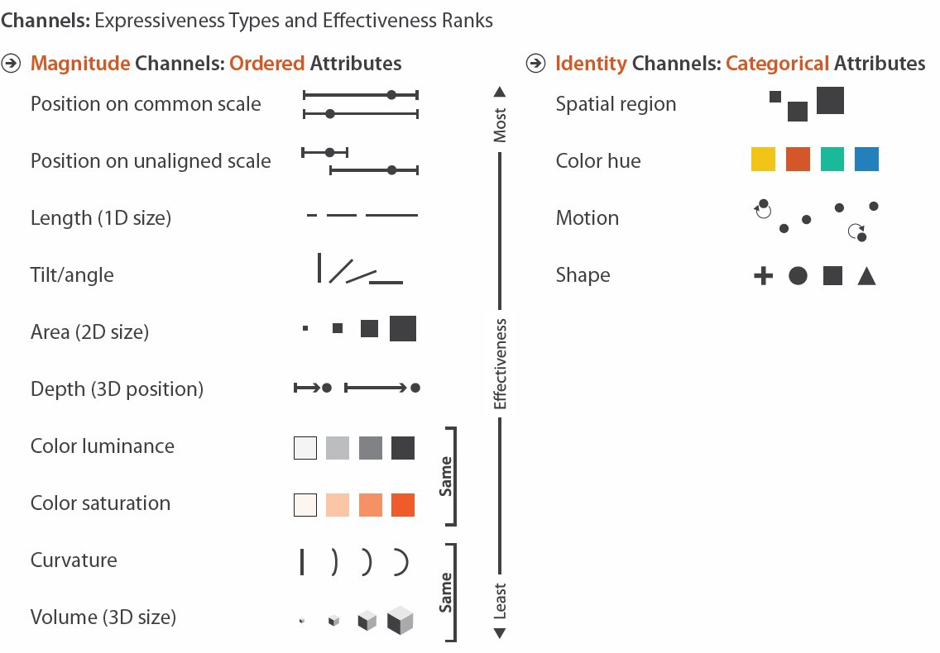
What we’ve been (mostly) worried about
So… what happens if dim(data) >> #channels?

Slide 4
Ideas?

Slide 5
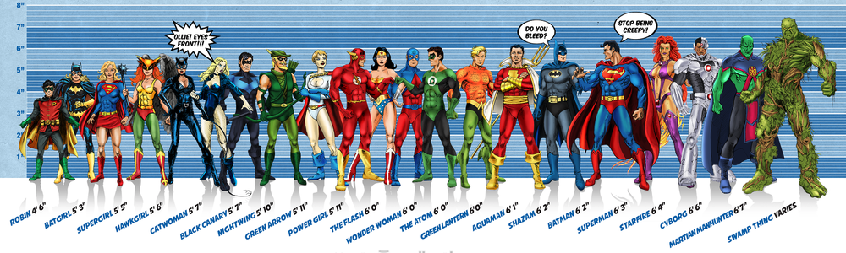



Toy example
Image credit: Ming Malaykham

Slide 6
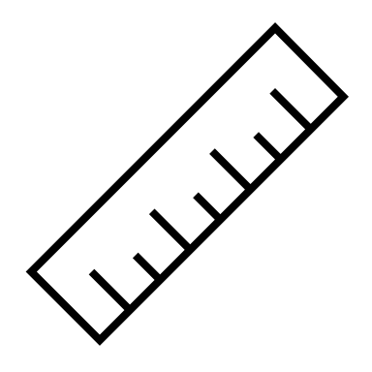

Estimating Height
Notes:
Drax
Gamora
Rocket Racoon
Starlord / Peter Quill
Groot

Slide 7
Estimate for β
When we try to estimate coefficients using OLS, we get the following:
Notice the (relatively) big difference between actual and estimated coefficients.
6
estimated
true
4
i
2
0
-2
i

Slide 8
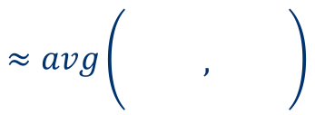
What’s going on here?
$$≈avg\left(\begin{matrix} & & \\ & , & \\ & & \end{matrix}\right)$$
Some dimensions are redundant
Little information in 3rd dimension not captured by the first two
In linear regression, redundancy causes noise to be amplified

Slide 9
Dimension reduction
Current situation: our data live in p-dimensional space, but not all p dimensions are equally useful
Subset selection: throw some out
Pro: pretty easy to do
Con: lose some information

Slide 10
Dimension reduction
Current situation: our data live in p-dimensional space, but not all p dimensions are equally useful
Subset selection: throw some out
Pro: pretty easy to do
Con: lose some information
Alternate approach: create new features that are combinations of the old ones

Slide 11
Dimension reduction
Current situation: our data live in p-dimensional space, but not all p dimensions are equally useful
Subset selection: throw some out
Pro: pretty easy to do
Con: lose some information
Alternate approach: create new features that are combinations of the old ones
In other words: We can project the data into a new feature space to reduce variance in the estimate of coefficients

Slide 12
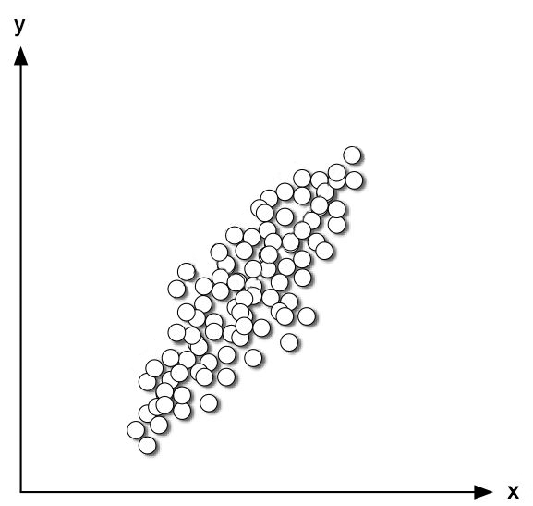
Projection

Slide 13
Projection
SMOOSH!
SMOOSH!

Slide 14
Projection

Slide 15
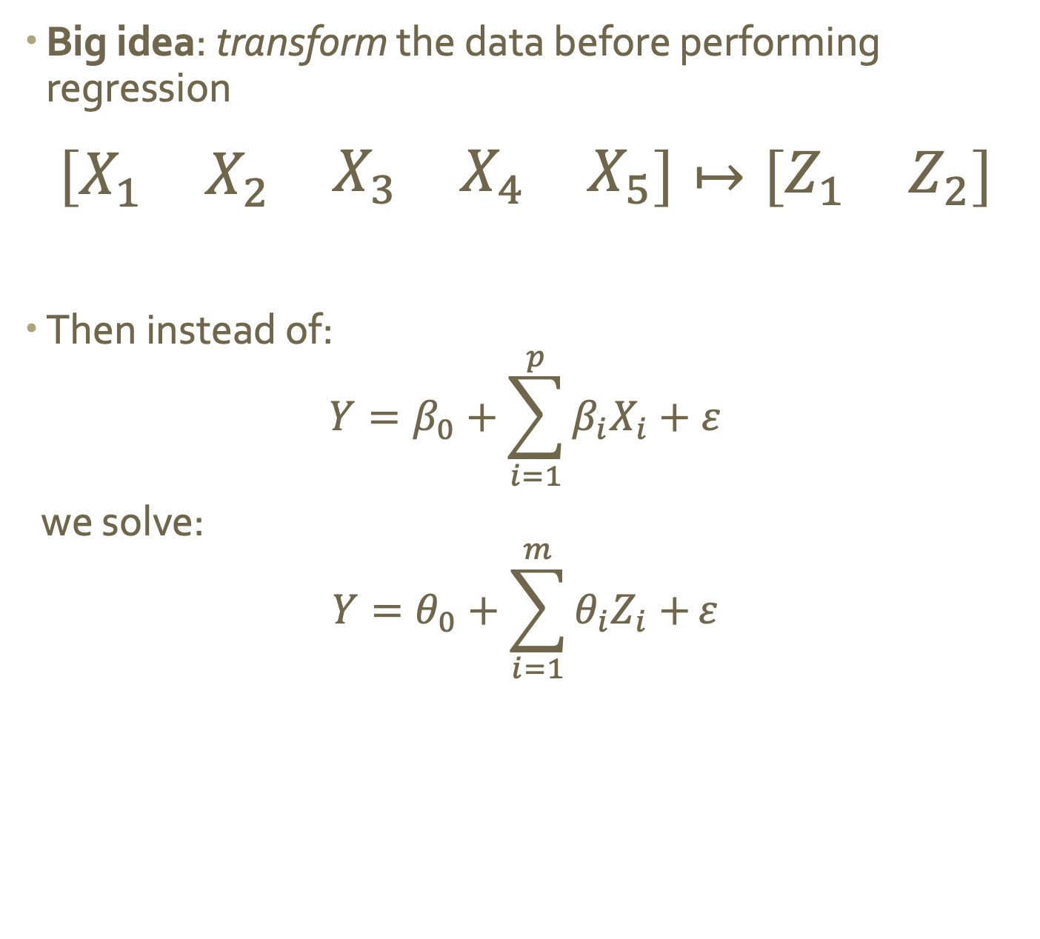
Dimension reduction via projection
Big idea: transform the data before performing regression
$$\left[\begin{matrix}X_{1} & X_{2} & \begin{matrix}X_{3} & X_{4} & X_{5}\end{matrix}\end{matrix}\right]↦\left[\begin{matrix}Z_{1} & Z_{2}\end{matrix}\right]$$
Then instead of: $Y=β_{0}+\sum_{i=1}^{p}{β_{i}X_{i}}+ε$
we solve:
$$Y=θ_{0}+\sum_{i=1}^{m}{θ_{i}Z_{i}+}ε$$

Slide 16
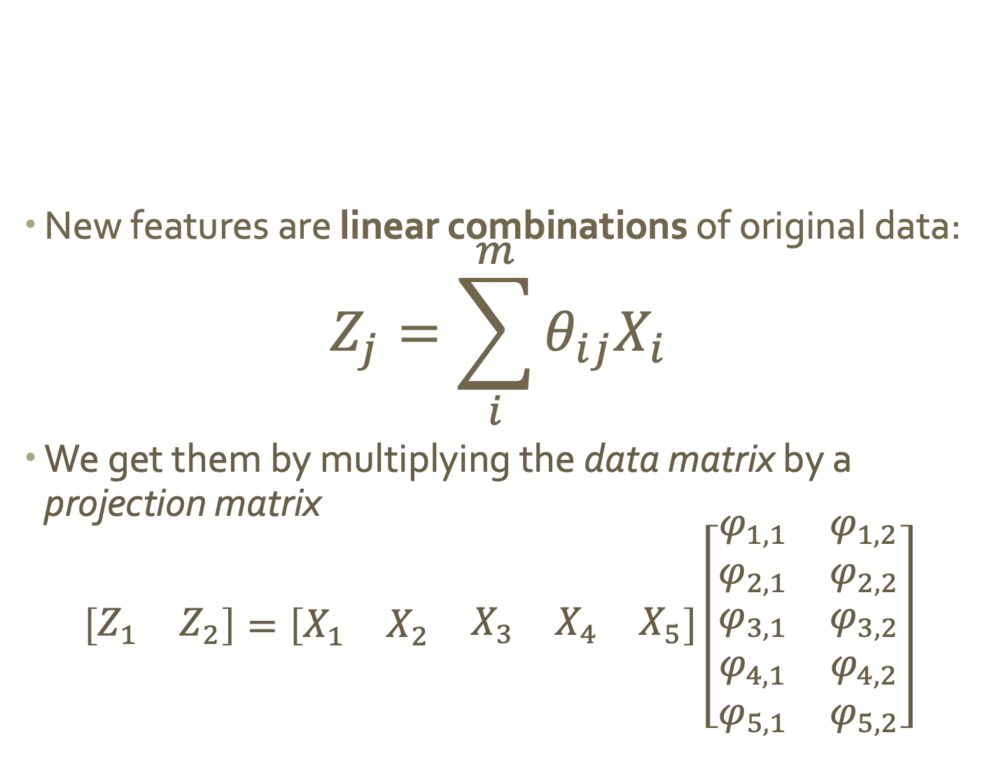
Linear projection
New features are linear combinations of original data:
$$Z_{j}=\sum_{i}^{m}{θ_{ij}X_{i}}$$
We get them by multiplying the data matrix by a projection matrix
$$\left[\begin{matrix}Z_{1} & Z_{2}\end{matrix}\right]=\left[\begin{matrix}X_{1} & X_{2} & \begin{matrix}X_{3} & X_{4} & X_{5}\end{matrix}\end{matrix}\right]\left[\begin{matrix}\begin{aligned}φ_{1,1} \\ φ_{2,1}\end{aligned} & \begin{aligned}φ_{1,2} \\ φ_{2,2}\end{aligned} \\ \begin{aligned}φ_{3,1} \\ φ_{4,1} \\ φ_{5,1}\end{aligned} & \begin{aligned}φ_{3,2} \\ φ_{4,2} \\ φ_{5,2}\end{aligned}\end{matrix}\right]$$

Slide 17
What’s the deal with projection?
Data can be rotated, scaled, and translated without changing the underlying relationships
This means you’re allowed to look at the data from whatever angle makes your life easier…

Slide 18
Flashback: why did we pick this line?

Slide 19
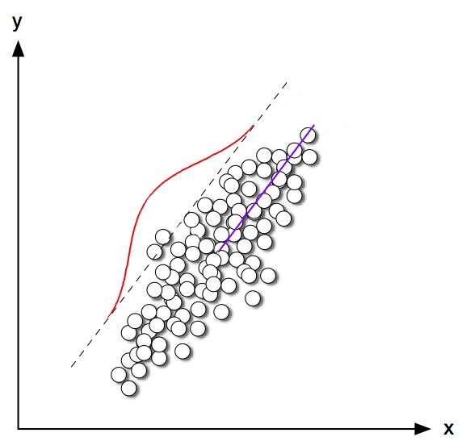
Explains the most variance in the data
Most variance

Slide 20
Imagine this line as a new dimension…
Most variance

Slide 21
“Principal component”
Most variance

Slide 22
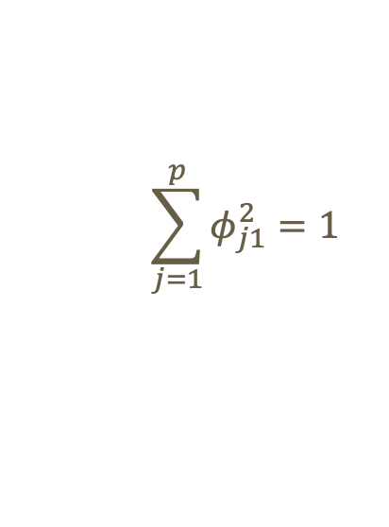
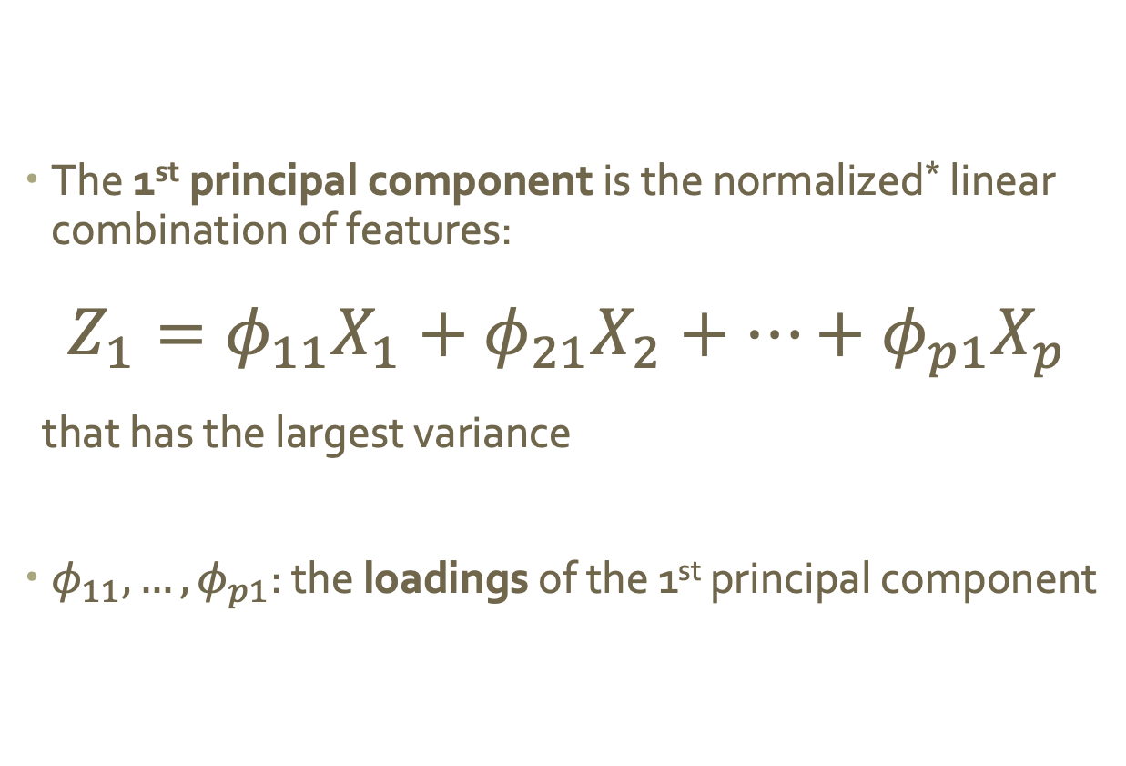
Mathematically
The 1st principal component is the normalized* linear combination of features:
$$Z_{1}=φ_{11}X_{1}+φ_{21}X_{2}+…+φ_{p1}X_{p}$$
that has the largest variance
$φ_{11},…,φ_{p1}$: the loadings of the 1st principal component
$$\sum_{j=1}^{p}{φ_{j1}^{2}=1}$$
* By normalized we mean:

Slide 23
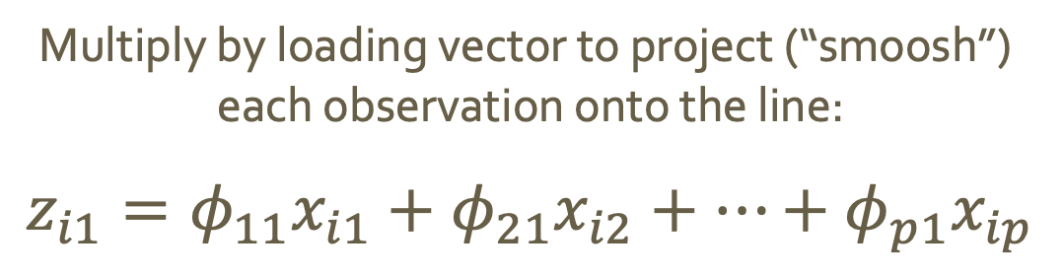
Using loadings to project
Multiply by loading vector to project (“smoosh”)
each observation onto the line:
$$z_{i1}=φ_{11}x_{i1}+φ_{21}x_{i2}+…+φ_{p1}x_{ip}$$
These values are called the scores
of the 1st principal component

Slide 24
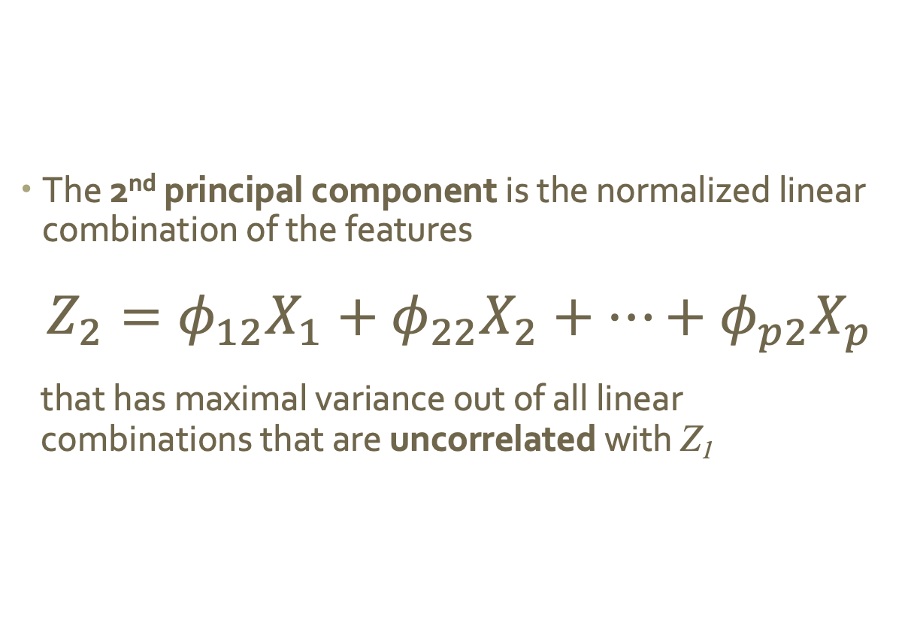
Additional principal components
The 2nd principal component is the normalized linear combination of the features
$$Z_{2}=φ_{12}X_{1}+φ_{22}X_{2}+…+φ_{p2}X_{p}$$
that has maximal variance out of all linear combinations that are uncorrelated with Z₁
Notes:
We want uncorrelated because we’re trying to reduce redundancy!!!

Slide 25
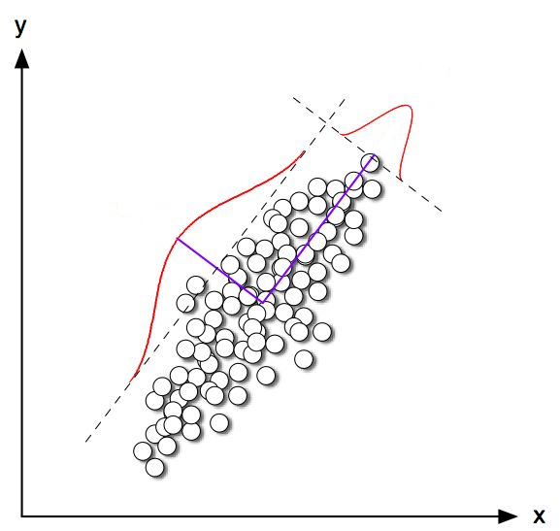
Principal components are orthogonal
2nd most variance

Slide 26
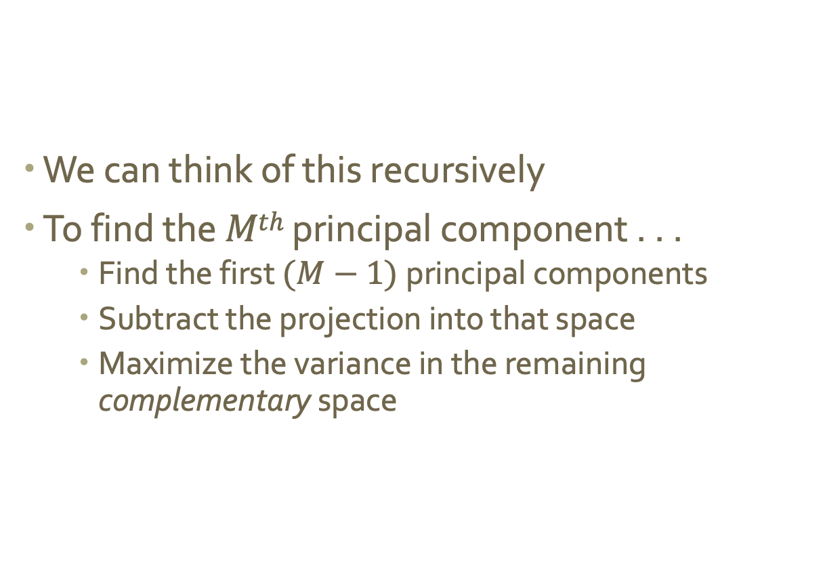
Generating additional principal components
We can think of this recursively
To find the $Mth$ principal component . . .
Find the first $(M−1)$principal components
Subtract the projection into that space
Maximize the variance in the remaining complementary space

Slide 27
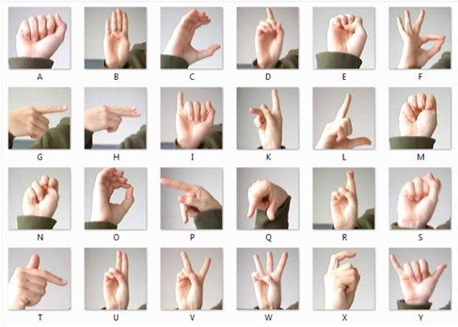
Example
Sign-Language-MNIST (27,455 examples of 26 letters)
Example credit: Sivakar Sivarajs, Towards Data Science

Slide 28
Example
Sign-Language-MNIST (27,455 examples of 26 letters)
Example credit: Sivakar Sivarajs, Towards Data Science

Slide 29
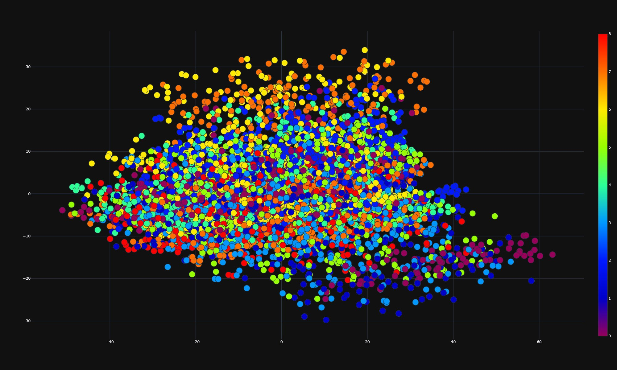
Example: 1st two PCs
Example credit: Sivakar Sivarajs, Towards Data Science

Slide 30
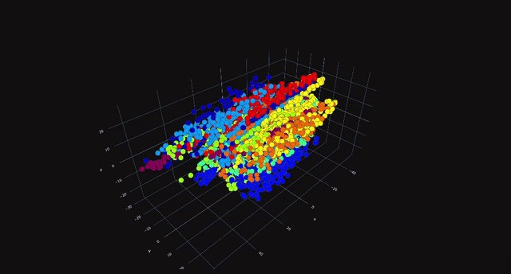
Example: 1st three PCs
Example credit: Sivakar Sivarajs, Towards Data Science

Slide 31
Potential issues with PCA?

Slide 32
New idea
What if we could use any distance metric, and took that into account when finding new dimensions?
Goal: preserve hi-dim pairwise distance in projection
“similar” stuff stays close together
“different” stuff can move apart

Slide 33
MDS (Multidimensional Scaling)
Choose a good distance metric
Compute a pairwise distance matrix
Find a 2D embedding that preserves those distances
(the distance matrix kind of acts like a stress tensor, so you can think of MDS kind of like a “force directed” layout but without visible edges)
Fun (but also sad) fact:
PCA is just a special case of MDS (if we use Euclidean distance and choose the 1st two components)

Slide 34
Potential issues with general MDS?

Slide 35
t-SNE (t-Distributed Stochastic Neighbor Embedding)
Same objective: preserve pairwise distances
Different approach: instead of eigenanalysis on the pairwise distance matrix, use field approximation (which is iterative and stochastic, in addition to nonparametric)

Slide 36

Example: t-SNE
Example credit: Cyrille Rossant

Slide 37
Example: 1st two PCs
Example credit: Sivakar Sivarajs, Towards Data Science

Slide 38
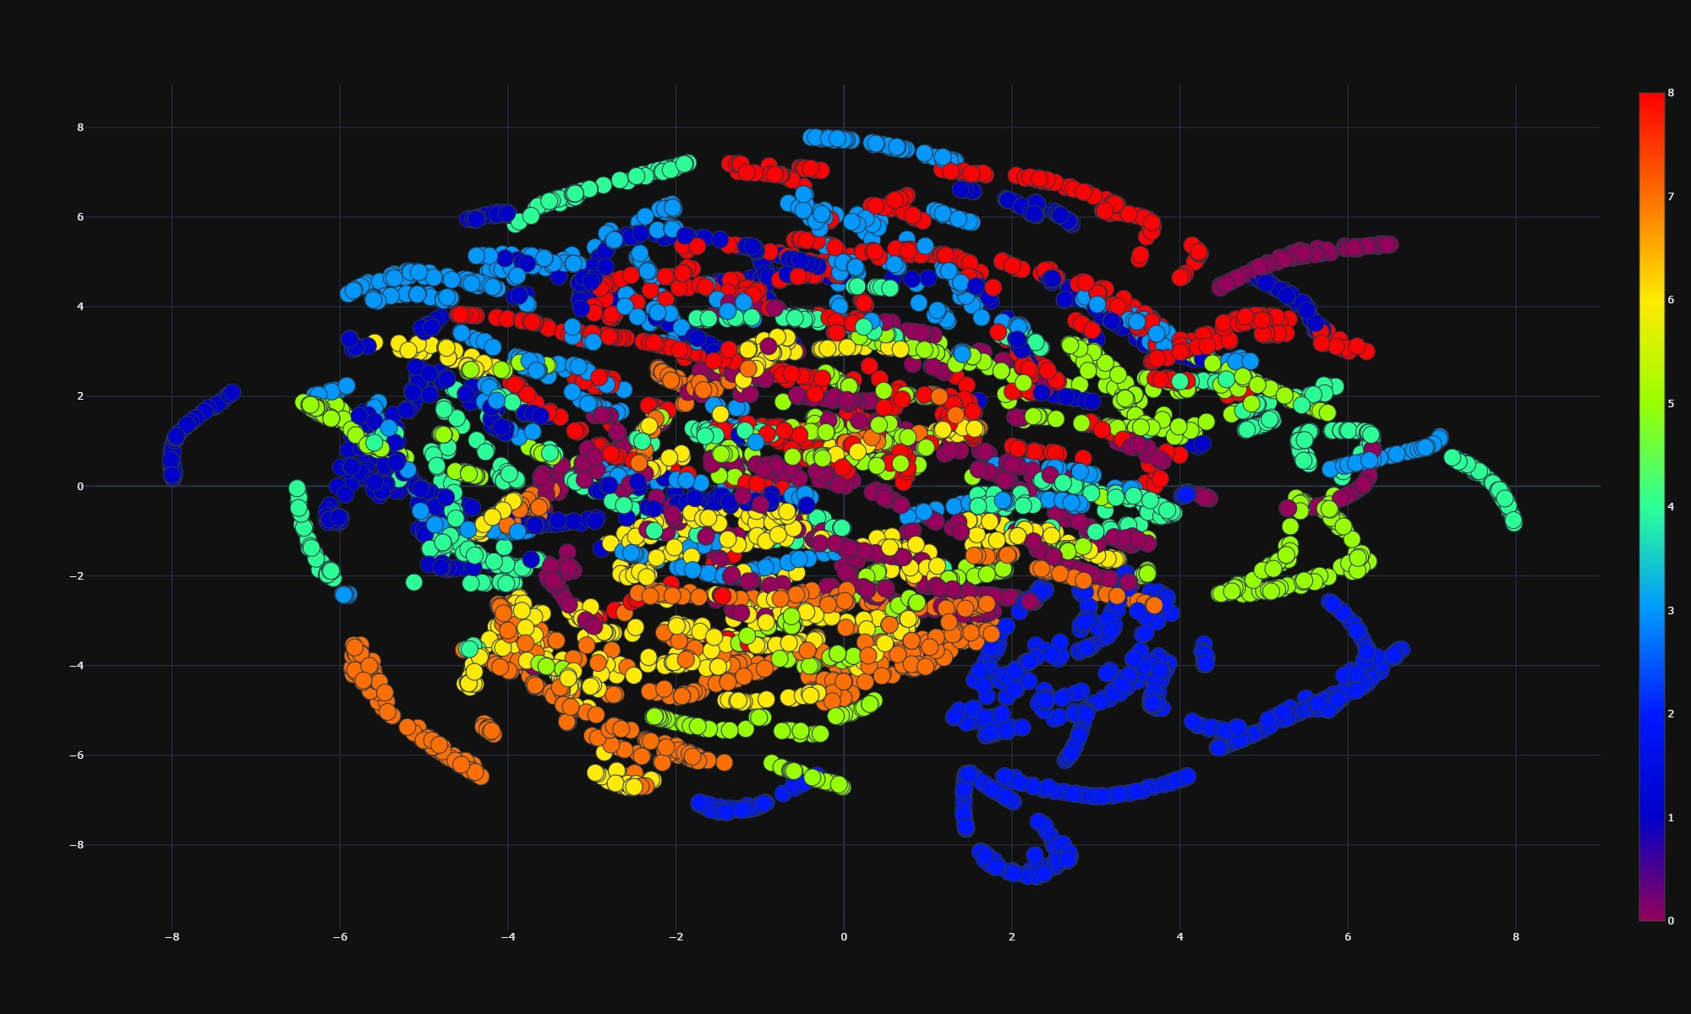
Example: t-SNE
Example credit: Sivakar Sivarajs, Towards Data Science

Slide 39
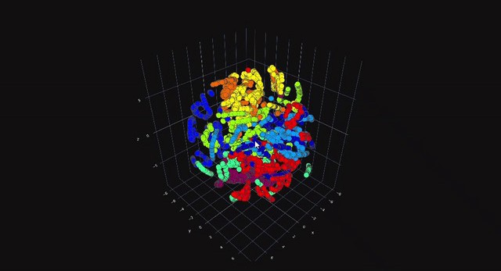
Example: 3D
Example credit: Sivakar Sivarajs, Towards Data Science

Slide 40
Potential issues with t-SNE?

Slide 41
UMAP (Uniform Manifold Approximation and Projection)
Same objective: preserve pairwise distances
Added constraint: make it scale
Different approach: probability and topology!
(use mathematical magic to find a locally-connected manifold)
Key differences:
Data doesn’t need to be normalized first, because we’re working with a probability distribution (which is already scaled to [0,1])
Initial assignment isn’t random (→ more stable across runs)
We can control the balance between local and global structure preservation by manipulating hyperparameters (such as how many neighbors are considered, etc.)

Slide 42
Example: 1st two PCs
Example credit: Sivakar Sivarajs, Towards Data Science

Slide 43
Example: t-SNE
Example credit: Sivakar Sivarajs, Towards Data Science

Slide 44
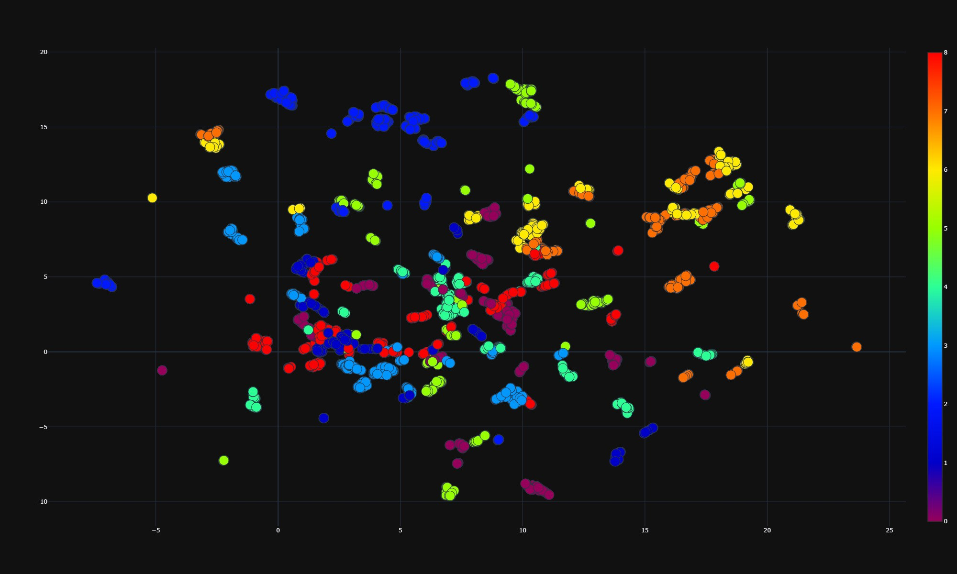
Example: UMAP
Example credit: Sivakar Sivarajs, Towards Data Science

Slide 45

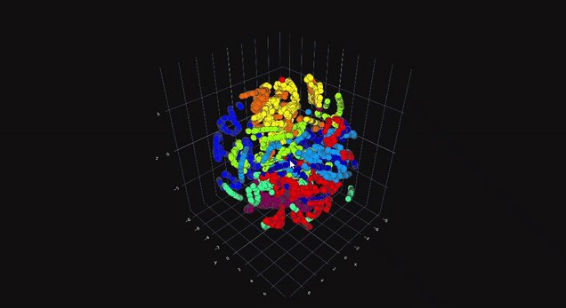
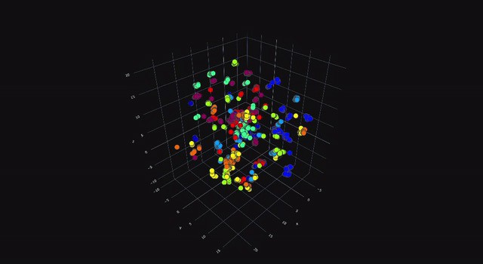
Example: 3D
Example credit: Sivakar Sivarajs, Towards Data Science

Slide 46
Takeaways
There’s no “one right answer”
Each technique has benefits and drawbacks:
MDA (or PCA) is great if you eventually need to be able to relate the result back to the original dimensions
t-SNE does a great job preserving local similarity, but sometimes at the expense of global structure (and it can get really slow)
UMAP is much faster, but you have to tune the hyperparameters so your clusters are neither to dense nor too spread out

