Slide 1
Communicating with Data – Physical Visualizations & Visualization Accessibility
Dr. Ab Mosca (they/them)

Slide 2
Plan for Today
Intro to physical visualization
  Examples
  Benefits
Visualization accessibility
  For various groups
  Assessing accessibility

Slide 3
Brainstorm
Have you ever encountered a physical visualization? What was it?
What might be the benefits of a physical visualization?

Slide 4
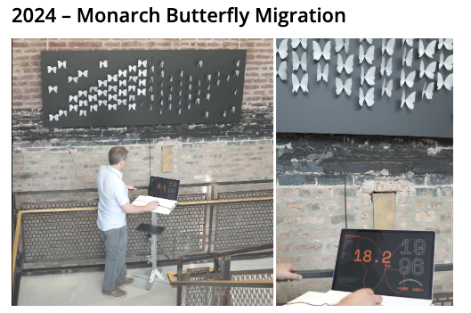
Example
https://www.instagram.com/p/C8ckPxkP8VK/

Slide 5

Example
https://datavisualizationstudio.com/climaticbracelet/en

Slide 6
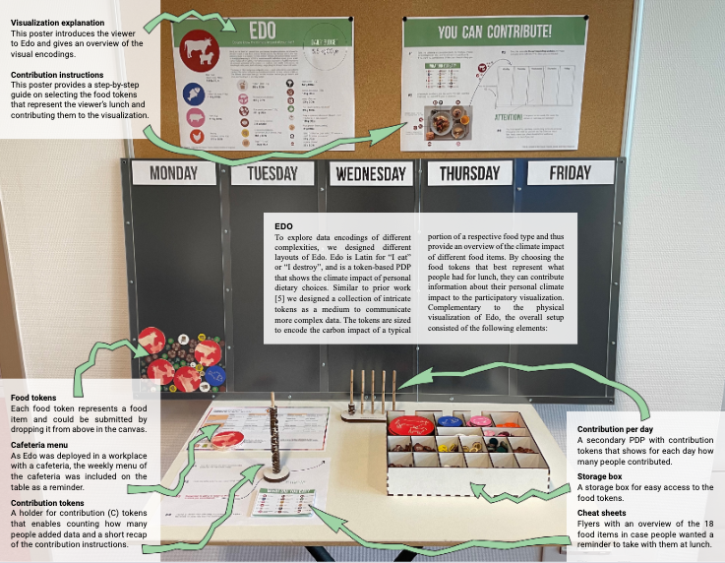
Example
https://vimeo.com/818729202?fl=pl&fe=sh

Slide 7
Example
https://datavandals.com/
https://youtube.com/shorts/25mtFbsQsbU?si=HbXA46ZjfkPZY5dG

Slide 8
Physical Visualization
A data physicalization is a physical artifact whose geometry or material properties encode data
Benefits:
Exploit active perception skills (perception related to movement)
Leverage spatial perception skills
All senses can participate in information gathering
Increased accessibility for visually-impaired people
A large body of evidence from educational psychology suggests manipulable physical representations facilitate understanding and learning
Anecdotal evidence suggests physicalizations may aid individuals in engaging with and communicating information to others more effectively than with digital representations
Yvonne Jansen, et al.. 2015. Opportunities and Challenges for Data Physicalization. In Proceedings of the 33rd Annual ACM CHI '15. Association for Computing Machinery, New York, NY, USA, 3227–3236. https://doi.org/10.1145/2702123.2702180
Notes:
Spatial perception: Since physical objects give rich cues of shape and volume, 3D data can be perceived with less effort and more accuracy on physicalizations than on computer displays
All senses: data physicalization follows an intermodal approach that guarantees cohesive and realistic multisensory experiences

Slide 9
Accessible Visualization

Slide 10
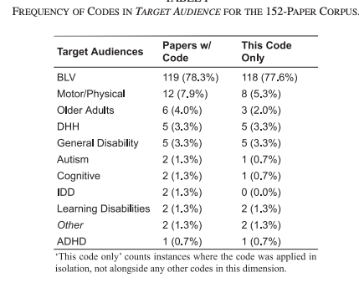
Accessible Visualization
Efforts to augment accessibility in data representations have been predominately directed towards individuals from blind or low-vision (BLV) communities
B. L. Wimer, et al., "Beyond Vision Impairments: Redefining the Scope of Accessible Data Representations," in IEEE Transactions on Visualization and Computer Graphics, vol. 30, no. 12, pp. 7619-7636, Dec. 2024, doi: 10.1109/TVCG.2024.3356566

Slide 11
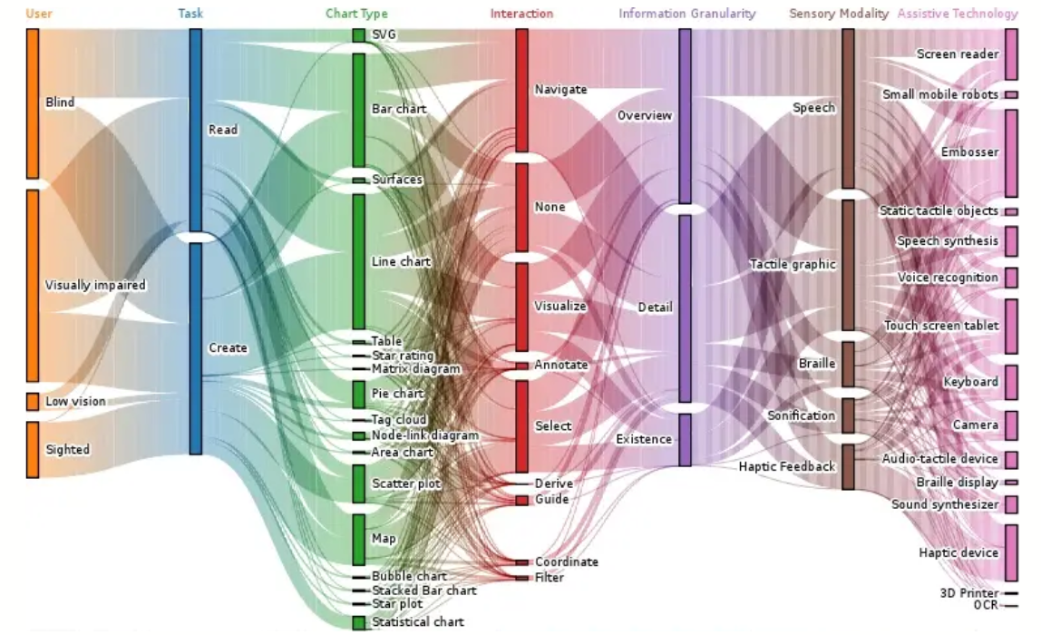
Accessible Visualization
BVL Accessibility
Design space
Kim, N.W., Joyner, S.C., Riegelhuth, A. and Kim, Y. (2021), Accessible Visualization: Design Space, Opportunities, and Challenges. Computer Graphics Forum, 40: 173-188. https://doi.org/10.1111/cgf.14298

Slide 12
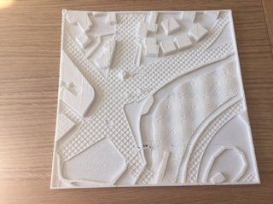
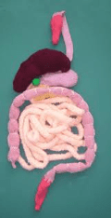
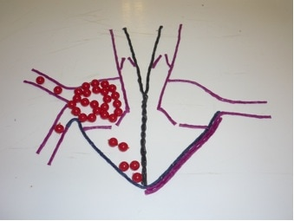
Accessible Visualization
BVL Accessibility
Convert visual encoding into auditory or tactile encoding
https://www.perkins.org/resource/tactile-models-tactile-graphics/

Slide 13
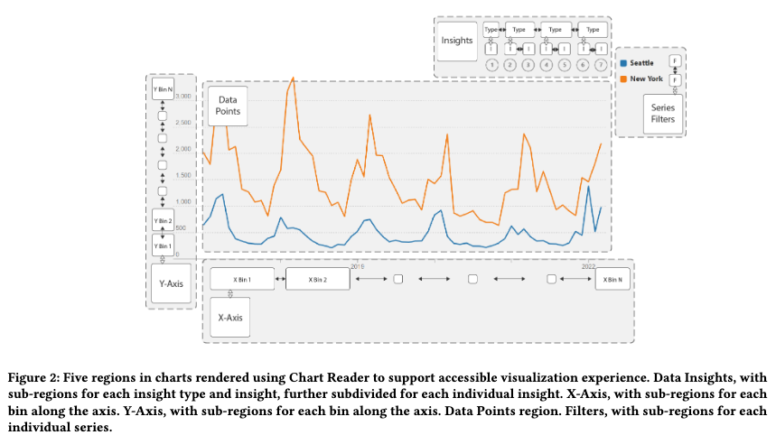
Accessible Visualization
BVL Accessibility
Enhance visualization compatibility with screen readers
  Ex. Chart Reader
John R Thompson, et al.. 2023. Chart Reader: Accessible Visualization Experiences Designed with Screen Reader Users. In Proceedings of the 2023 CHI Conference on Human Factors in Computing Systems (CHI '23). Association for Computing Machinery, New York, NY, USA, Article 802, 1–18. https://doi.org/10.1145/3544548.3581186
Notes:
Adds sonification to enable comparison, “hearing the data” etc..

Slide 14
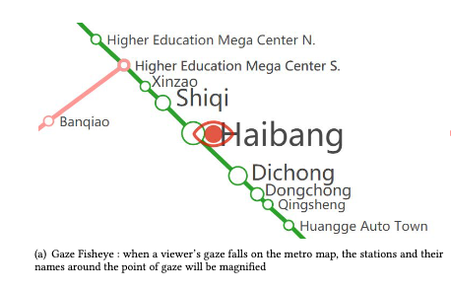
Accessible Visualization
Motor Disability Accessibility
Gaze-based input
Y. Xie, et al., “GazeMetro: A gaze-based interactive system for metro map,” in Proc. 23rd Int. ACM SIGACCESS Conf. Comput. Accessibility, New York, NY, USA: Association for Computing Machinery, 2021, doi: 10.1145/3441852.3476569.

Slide 15
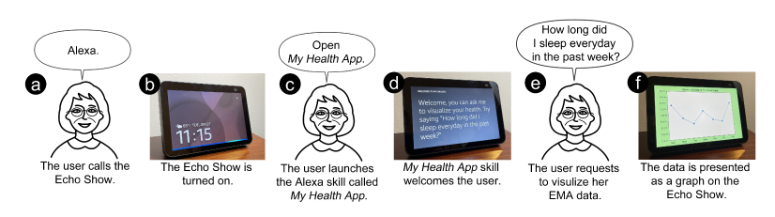
Accessible Visualization
Motor Disability Accessibility
Voice-activated conversational user interfaces
Yichen Han,et al. 2022. Towards Visualization of Time–Series Ecological Momentary Assessment (EMA) Data on Standalone Voice–First Virtual Assistants. In Proceedings of the 24th International ACM SIGACCESS Conference on Computers and Accessibility (ASSETS '22). Association for Computing Machinery, New York, NY, USA, Article 60, 1–4. https://doi.org/10.1145/3517428.3550398

Slide 16
Accessible Visualization
Neurodiverse Accessibility
Very little research on ADHD accessibility in visualization
  So far, no solid design guidelines
B. L. Wimer, et al., "Beyond Vision Impairments: Redefining the Scope of Accessible Data Representations," in IEEE Transactions on Visualization and Computer Graphics, vol. 30, no. 12, pp. 7619-7636, Dec. 2024, doi: 10.1109/TVCG.2024.3356566

Slide 17
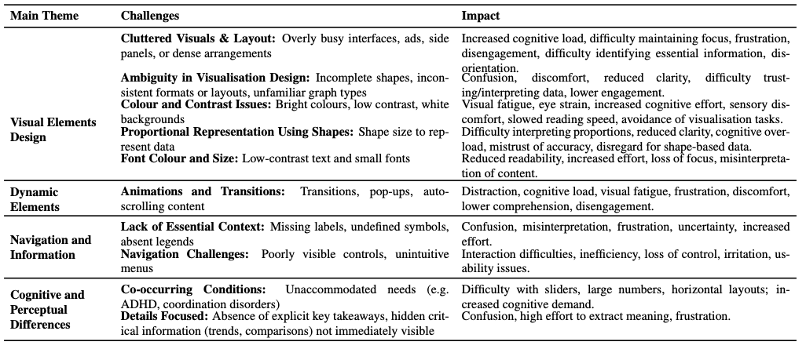
Accessible Visualization
Neurodiverse Accessibility
Little, but some research on accessibility to autistic users
M. Alzahrani, et al., "Exploring Data Visualisation Barriers and Needs of Autistic Adults," 2025 IEEE Workshop on Accessible Data Visualization (AccessViz), Vienna, Austria, 2025, pp. 10-13, doi: 10.1109/AccessViz68666.2025.00007

Slide 18
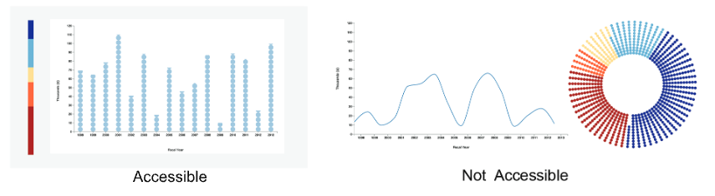
Accessible Visualization
IDD Accessibility
Avoid pie charts, use familiar metaphors, manage visual complexity, use discrete encodings for axis-aligned representations
K. Wu, et al.. Understanding Data Accessibility for People with Intellectual and Developmental Disabilities. In Proceedings of the 2021 CHI Conference on Human Factors in Computing Systems, pp. 1–16. ACM, Yokohama Japan, May 2021. doi: 10.1145/3411764.3445743 1
Notes:
Avoid pie charts: Experts consistently indicated that they avoid pie charts when designing accessible materials. Our results directly support this intuition: people with IDD struggled to estimate quantities with pie charts and were more than twice as accurate with stacked bar charts and treemaps.
Use familiar metaphors: People with IDD often mentally reasoned about data through analogs to real world objects, such as stairs and pizzas. They preferred using chart types whose structures evoked real world shapes, and, for time series, these structures appear to scaffold reasoning about data in ways that significantly improve performance.
Manage visual complexity: while icons were quicker to use, they introduced performance gaps over other methods in identifying extrema. Participants noted that while visual embellishments could add interest and increase engagement, that they could also overwhelm. Collectively, these observations suggest that simple, meaningful imagery has the potential to support data access; however, such additions should be used intentionally and sparingly and in consultation with the target user group.
Use discrete encodings for axis-aligned representations: Despite a preference for continuous encodings for proportion data, discrete encodings improved accuracy and response times for people with IDD, signifcantly reducing disparities with the control group. Unlike the control group, participants strongly preferred discrete bar charts, especially abstract bars. They found that being able to count the points in bars with close values helped them com-pare values that were further apart.

Slide 19
Evaluating Accessibility
Chartability
An accessibility evaluation system specific to data visualizations and interfaces which aims to help practitioners answer the question, “how accessible is my data visualization?”
Organizes knowledge from disparate bodies of work into testable heuristics based on the functional accessibility principles POUR (Perceivable, Operable, Understandable, and Robust) and 3 novel principles CAF (Compromising, Assistive, and Flexible)
Elavsky, Frank & Bennett, Cynthia & Moritz, Dominik. (2022). How accessible is my visualization? Evaluating visualization accessibility with Chartability. Computer Graphics Forum. 41. 57-70. 10.1111/cgf.14522.

Slide 20
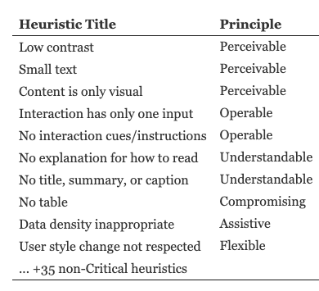
Evaluating Accessibility
Chartability
Critical heuristics
Elavsky, Frank & Bennett, Cynthia & Moritz, Dominik. (2022). How accessible is my visualization? Evaluating visualization accessibility with Chartability. Computer Graphics Forum. 41. 57-70. 10.1111/cgf.14522.

Slide 21
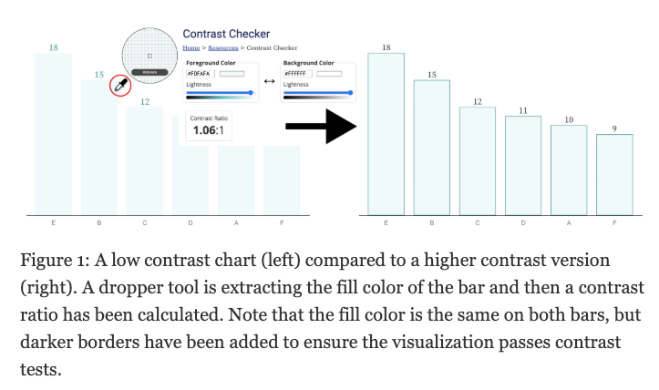
Evaluating Accessibility
Chartability
Elavsky, Frank & Bennett, Cynthia & Moritz, Dominik. (2022). How accessible is my visualization? Evaluating visualization accessibility with Chartability. Computer Graphics Forum. 41. 57-70. 10.1111/cgf.14522.

Slide 22
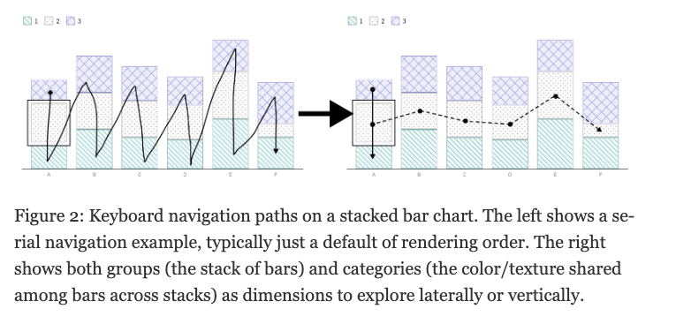
Evaluating Accessibility
Chartability
Elavsky, Frank & Bennett, Cynthia & Moritz, Dominik. (2022). How accessible is my visualization? Evaluating visualization accessibility with Chartability. Computer Graphics Forum. 41. 57-70. 10.1111/cgf.14522.

Slide 23
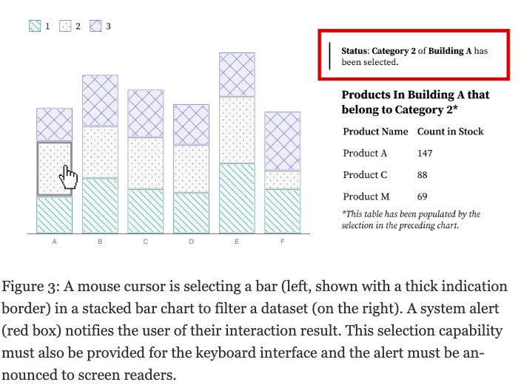
Evaluating Accessibility
Chartability
Elavsky, Frank & Bennett, Cynthia & Moritz, Dominik. (2022). How accessible is my visualization? Evaluating visualization accessibility with Chartability. Computer Graphics Forum. 41. 57-70. 10.1111/cgf.14522.

Slide 24
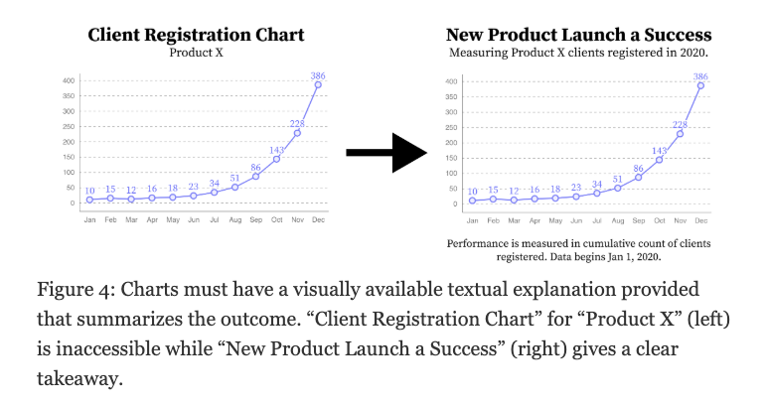
Evaluating Accessibility
Chartability
Elavsky, Frank & Bennett, Cynthia & Moritz, Dominik. (2022). How accessible is my visualization? Evaluating visualization accessibility with Chartability. Computer Graphics Forum. 41. 57-70. 10.1111/cgf.14522.

Slide 25
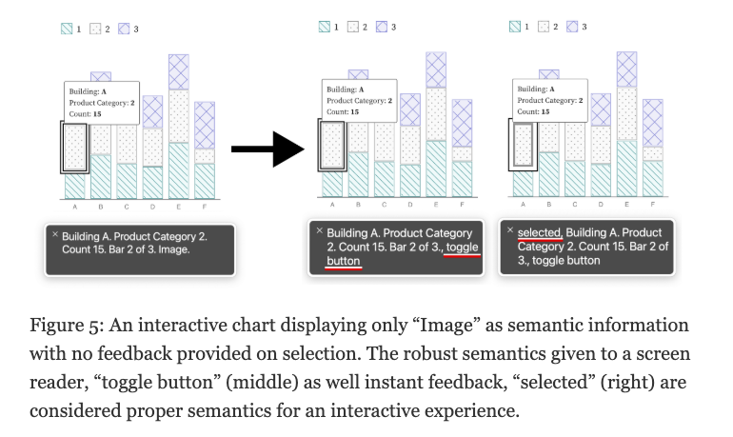
Evaluating Accessibility
Chartability
Elavsky, Frank & Bennett, Cynthia & Moritz, Dominik. (2022). How accessible is my visualization? Evaluating visualization accessibility with Chartability. Computer Graphics Forum. 41. 57-70. 10.1111/cgf.14522.

Slide 26
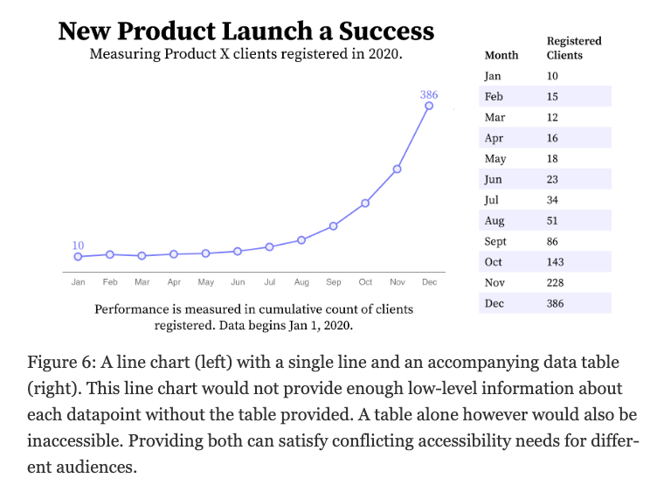
Evaluating Accessibility
Chartability
Elavsky, Frank & Bennett, Cynthia & Moritz, Dominik. (2022). How accessible is my visualization? Evaluating visualization accessibility with Chartability. Computer Graphics Forum. 41. 57-70. 10.1111/cgf.14522.

Slide 27
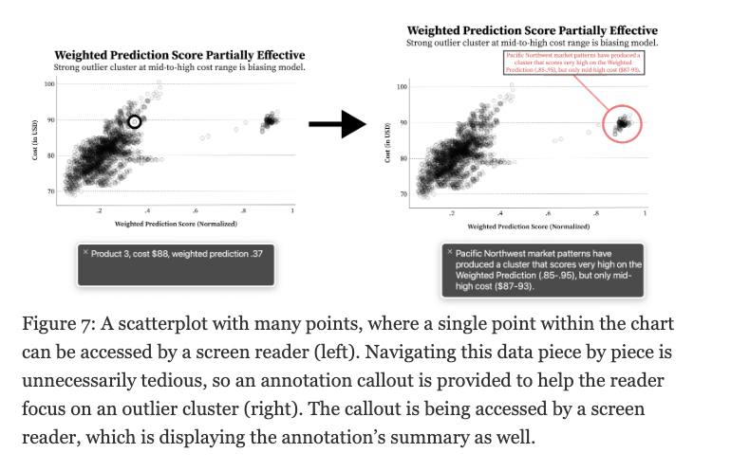
Evaluating Accessibility
Chartability
Elavsky, Frank & Bennett, Cynthia & Moritz, Dominik. (2022). How accessible is my visualization? Evaluating visualization accessibility with Chartability. Computer Graphics Forum. 41. 57-70. 10.1111/cgf.14522.

Slide 28
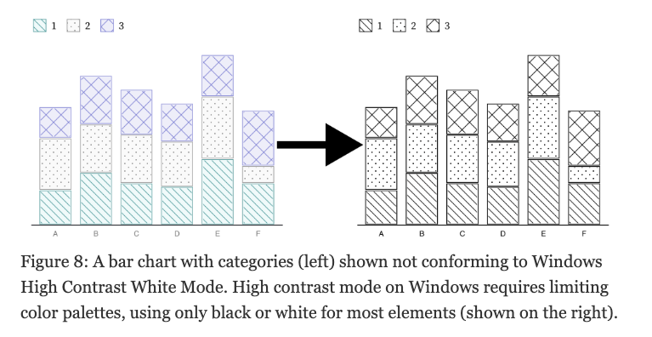
Evaluating Accessibility
Chartability
Elavsky, Frank & Bennett, Cynthia & Moritz, Dominik. (2022). How accessible is my visualization? Evaluating visualization accessibility with Chartability. Computer Graphics Forum. 41. 57-70. 10.1111/cgf.14522.

Slide 29
Your Turn!
Find a visualization of interest to you.
Evaluate its accessibility via Chartability heuristics.
How would you re-design it to make it more accessible?

