Slide 1
Communicating with Data – Visual Encoding
Dr. Ab Mosca (they/them)
Slides based off slides courtesy of Jordan Crouser (https://jcrouser.github.io/)

Slide 2
Plan for Today
Mental models: how we process information
Visualization building blocks
Mapping data to visuals
Practice

Slide 3
Checking in
Are you on Slack?
All communication will be through Slack (see syllabus for details)
Are you on Gradescope?
Have you reviewed the syllabus?

Slide 4
Looking forward
a1 is released today! (Due next week)
Find instructions on the course website under the “Assignments” tab
Questions? Come to office hours: T 10:30-12:00, 13:30-15:30, and by appointment

Slide 5

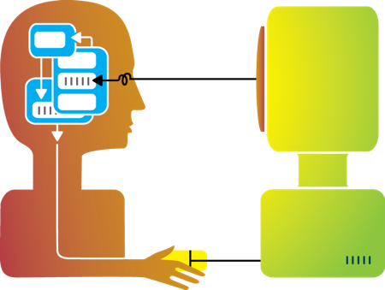
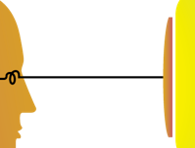

Visualization
Visualization helps shape mental models

Slide 6
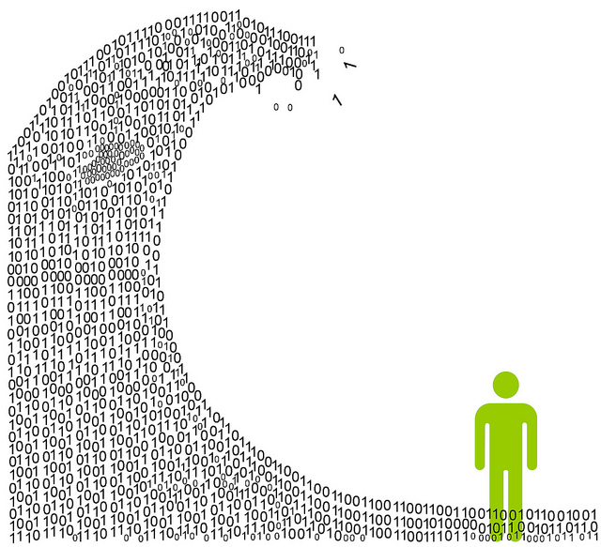
We are exposed to huge amounts of information all the time
So much, in fact, that we can’t process it all fast enough
Information overload

Slide 7

To cope, we construct mental models: abstracted, simplified versions of the world that are more manageable
Mental models

Slide 8

Task 1: Connect all 9 dots using only straight lines
The 9-dot problem

Slide 9
Task 2: Connect all 9 dots using 4 straight lines
The 9-dot problem

Slide 10
Task 3: Connect all 9 dots using 3 straight lines
The 9-dot problem

Slide 11
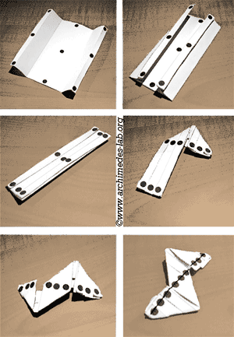
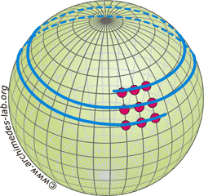
Task 4: Connect all 9 dots using 1 straight line
The 9-dot problem

Slide 12



Mental Models: a Sketch

Slide 13
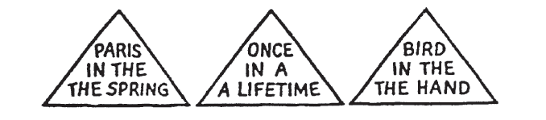
1. We tend to see what we expect to see
Mental models are built from prior experience
We expect new input to “fit” the existing model
Updates are expensive: given input that almost fits, we’ll distort information to avoid re-fitting the model
Expectation is at least as strong as perception
Mental Models
Heuer, R. J. (1999). Psychology of intelligence analysis. Center for the Study of Intelligence.

Slide 14
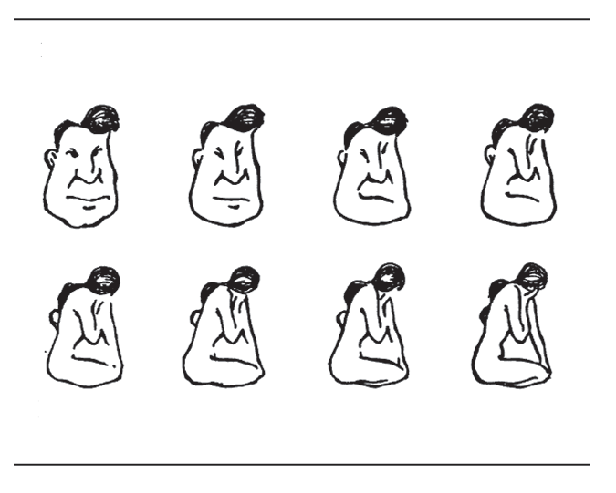
2. Mental models form quickly, & update slowly
“First impressions matter”
Early information can have the highest impact
The order in which we present pieces of information can shape how a person understands the whole
Once a mental model is formed, it takes effort to alter it
Mental Models
Heuer, R. J. (1999). Psychology of intelligence analysis. Center for the Study of Intelligence.

Slide 15
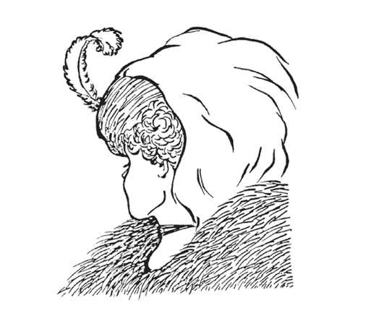
3. New information gets incorporated into the existing model
Integrating competing perspectives is challenging
Switching between multiple perspectives is also difficult (visually or mentally)
Tricky part: real-world problem often require such perspective switching
Mental Models
Heuer, R. J. (1999). Psychology of intelligence analysis. Center for the Study of Intelligence.
Notes:
Old woman or young? Can you see whichever was not immediately obvious to you?
Te old woman’s nose, mouth, and eye are, respectively, the young woman’s chin, necklace, and ear. Te old woman is seen in profle looking left. Te young woman is also looking left, but we see her mainly from behind so most facial features are not visible. Her eyelash, nose, and the curve of her cheek may be seen just above the old woman’s nose.

Slide 16




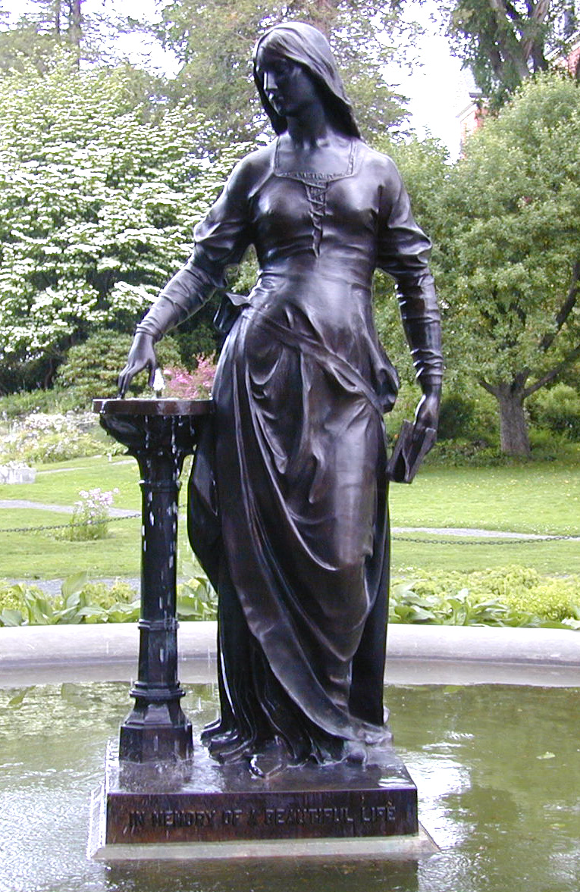

4. Initial exposure interferes with accurate perception
Longer exposure to ambiguous data makes people more confident in their initial model
This is true even if new data presents strong evidence that their model is wrong!
Important: need to be intentional when we design, because incremental information can be misleading
Mental Models
Heuer, R. J. (1999). Psychology of intelligence analysis. Center for the Study of Intelligence.
Notes:
Te initial projection was blurred in varying degrees, and the pictures were then brought into focus slowly to determine at what point test subjects could identify them correctly.
Tis experiment showed two things. First, those who started viewing the pictures when they were most out of focus had more difculty identifying them when they became clearer than those who started viewing at a less blurred stage. In other words, the greater the initial blur, the clearer the picture had to be before people could recognize it. Second, the longer people were exposed to a blurred picture, the clearer the picture had to be before they could recognize it.

Slide 17
The good:
Well-tuned mental models let us process information quickly
Frees up more processing power to synthesize information
The bad:
People (esp. experts) tend not to notice information that contradicts their mental model
A “fresh pair of eyes” can be beneficial
The ugly:
Mental models are unavoidable: everyone has them, and they’re all different
Key: be aware of how mental models form, how they shape perception, and how to support (or challenge) them
Mental Models

Slide 18
So what do we have to work with?

Slide 19
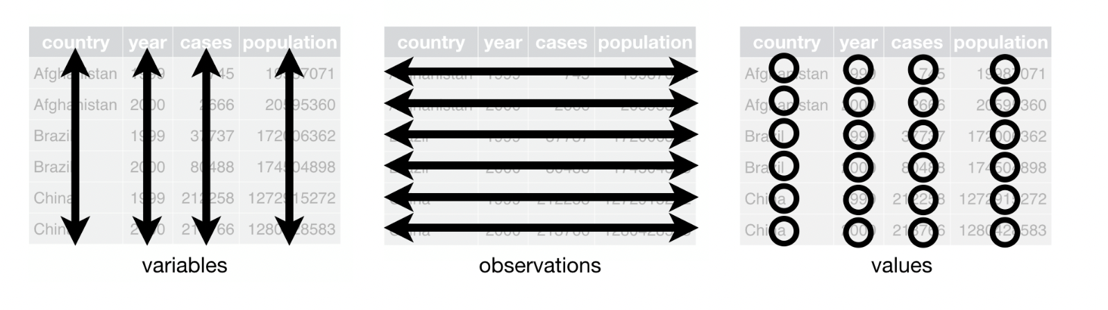
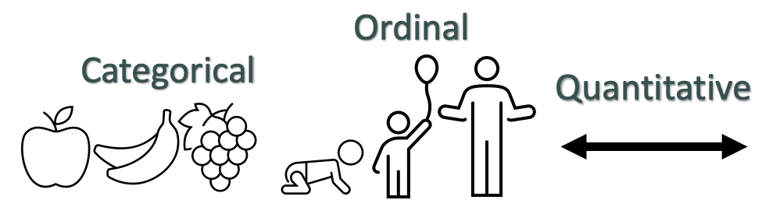
Data
Remember…
Nominal

Slide 20
Data → Visuals
Remember…
Big idea behind visualization
Data have dimensions
Visualizations have dimensions, too
To build good visualizations, we need to map data dimensions to visual dimensions in a principled way
Nominal

Slide 21
Data → Visuals
Remember…
Big idea behind visualization
Data have dimensions
Visualizations have dimensions, too
To build good visualizations, we need to map data dimensions to visual dimensions in a principled way
Nominal

Slide 22
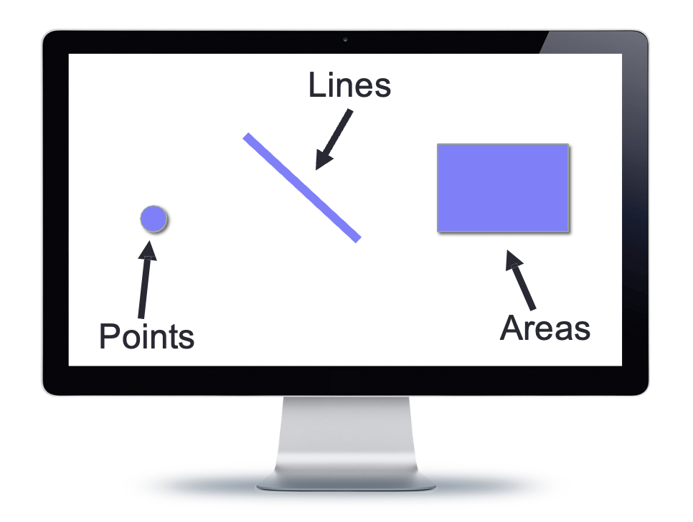
Data → Visuals
Data
Visuals
Marks
The “ink”
Nominal

Slide 23
Data → Visuals
Data
Visuals
Marks
The “ink”
Channels or dimensions
How the marks show up on the page
Nominal

Slide 24
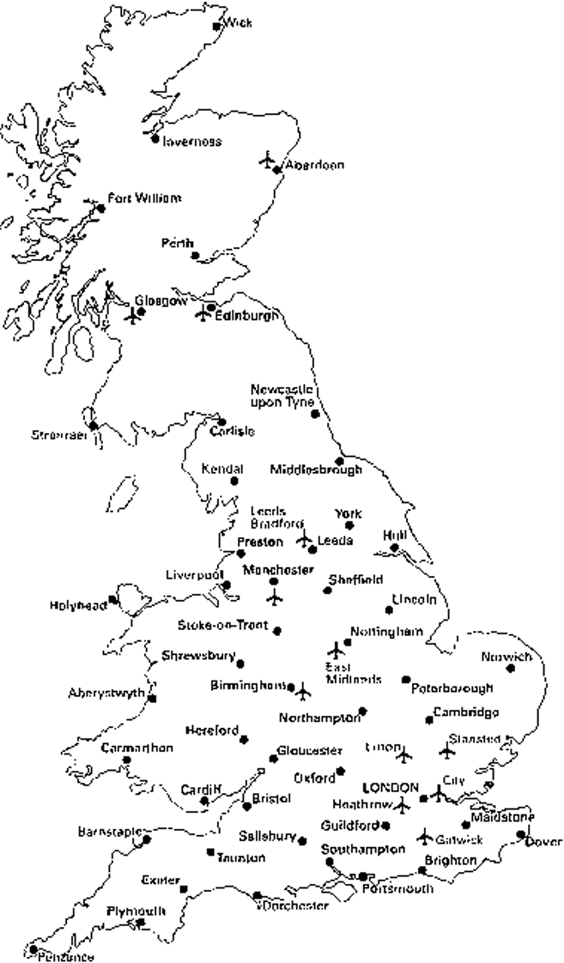
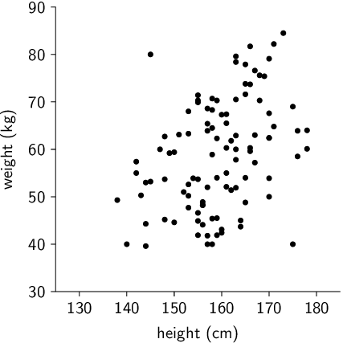
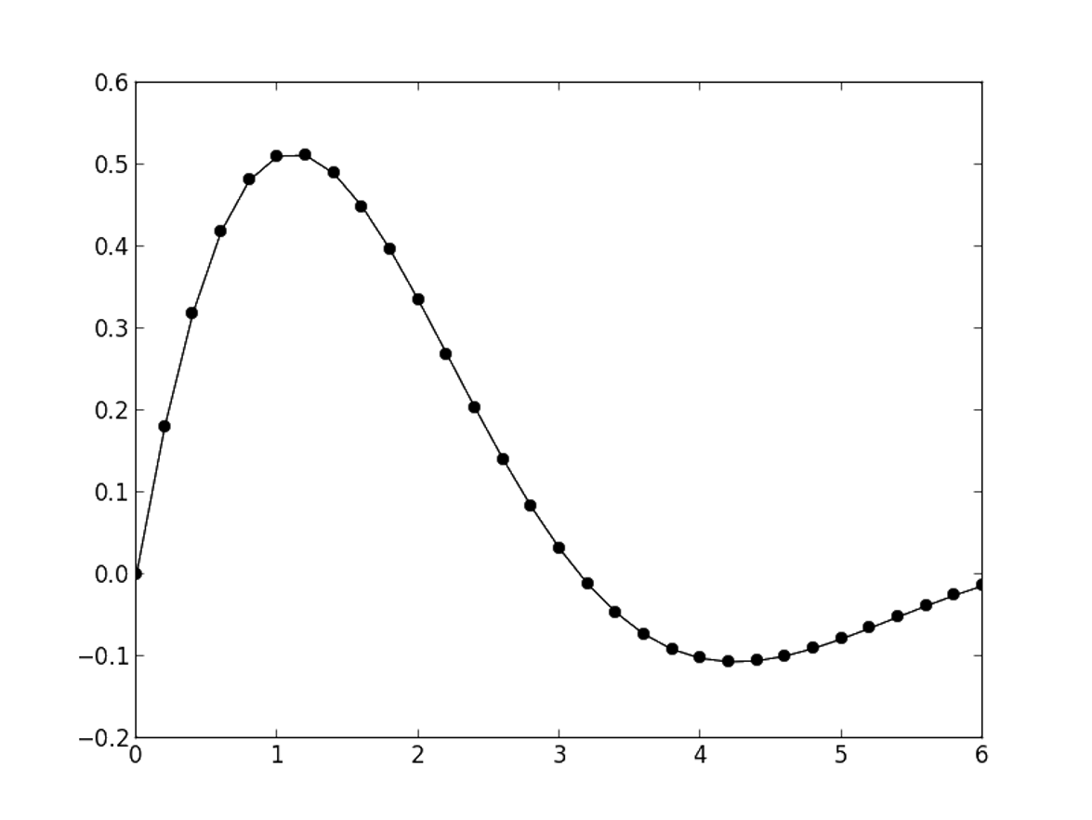
Visual Channels / Dimensions
Position
Encode information using where mark is drawn
Ex.
along a common scale
spatial region

Slide 25
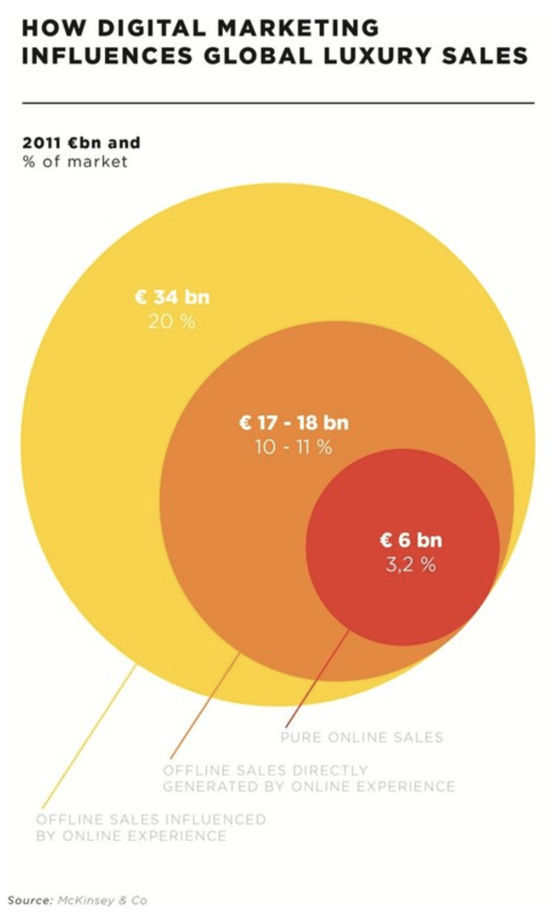
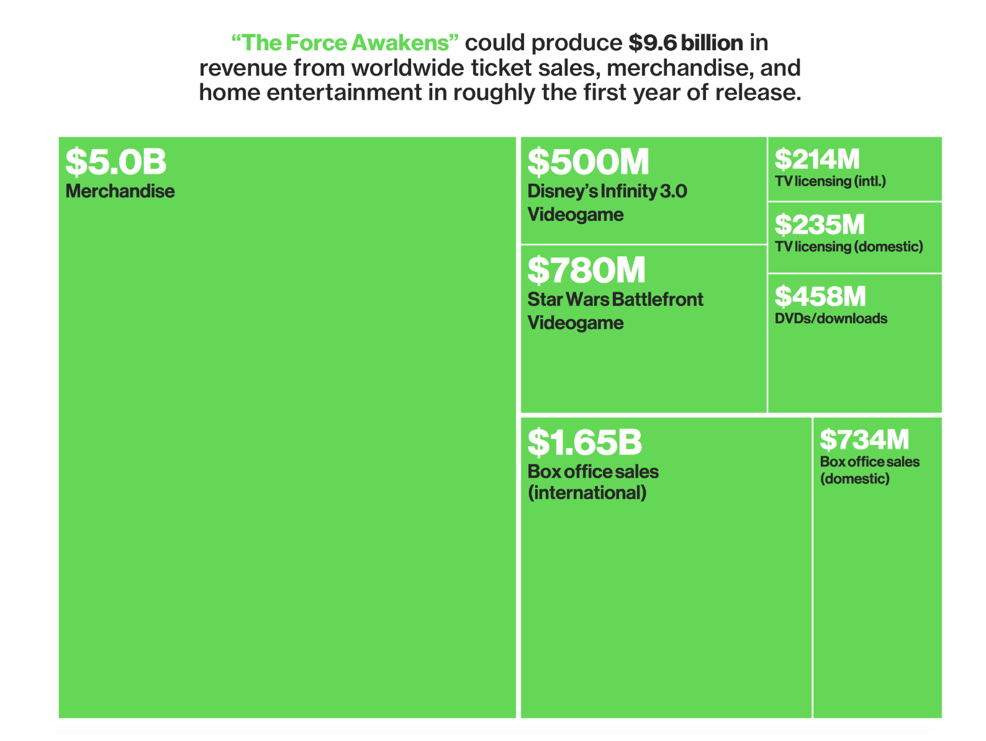
Visual Channels / Dimensions
Size / Area
Encode information using how big mark is drawn
Ex.

Slide 26
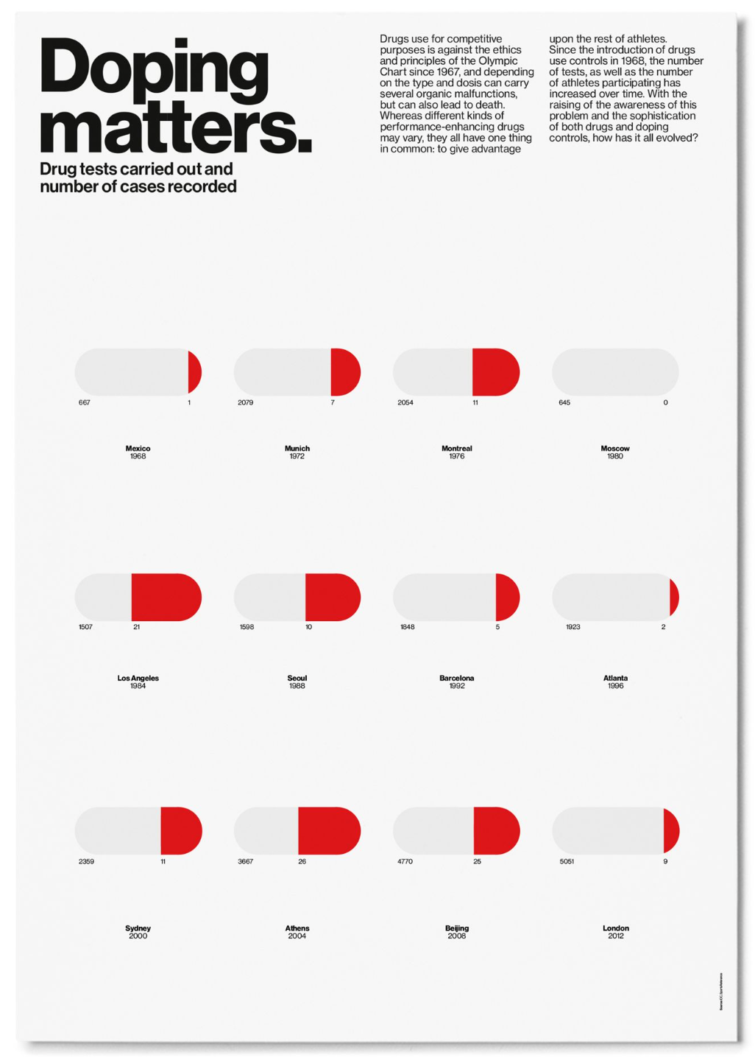
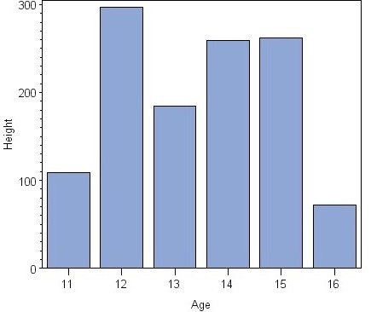
Visual Channels / Dimensions
Length
Encode information using how long mark is drawn
Ex.

Slide 27
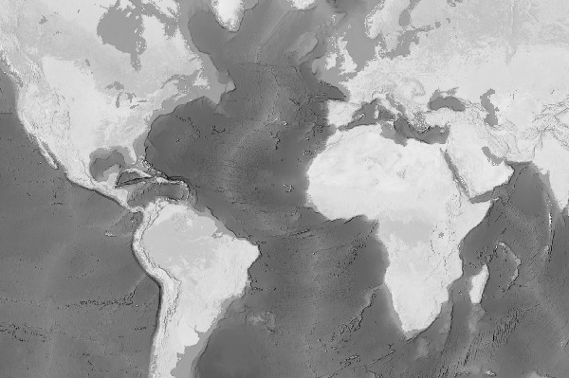
Visual Channels / Dimensions
Color: Luminance
Encode information using how dark mark is drawn
Ex.
Notes:
Elevation

Slide 28
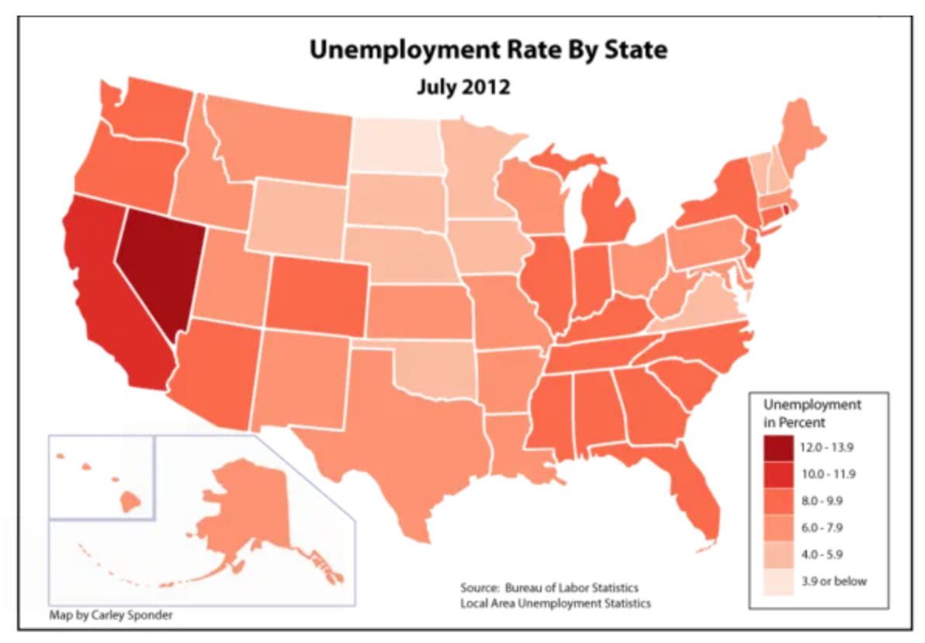
Visual Channels / Dimensions
Color: Saturation
Encode information using how much color mark has
Ex.

Slide 29
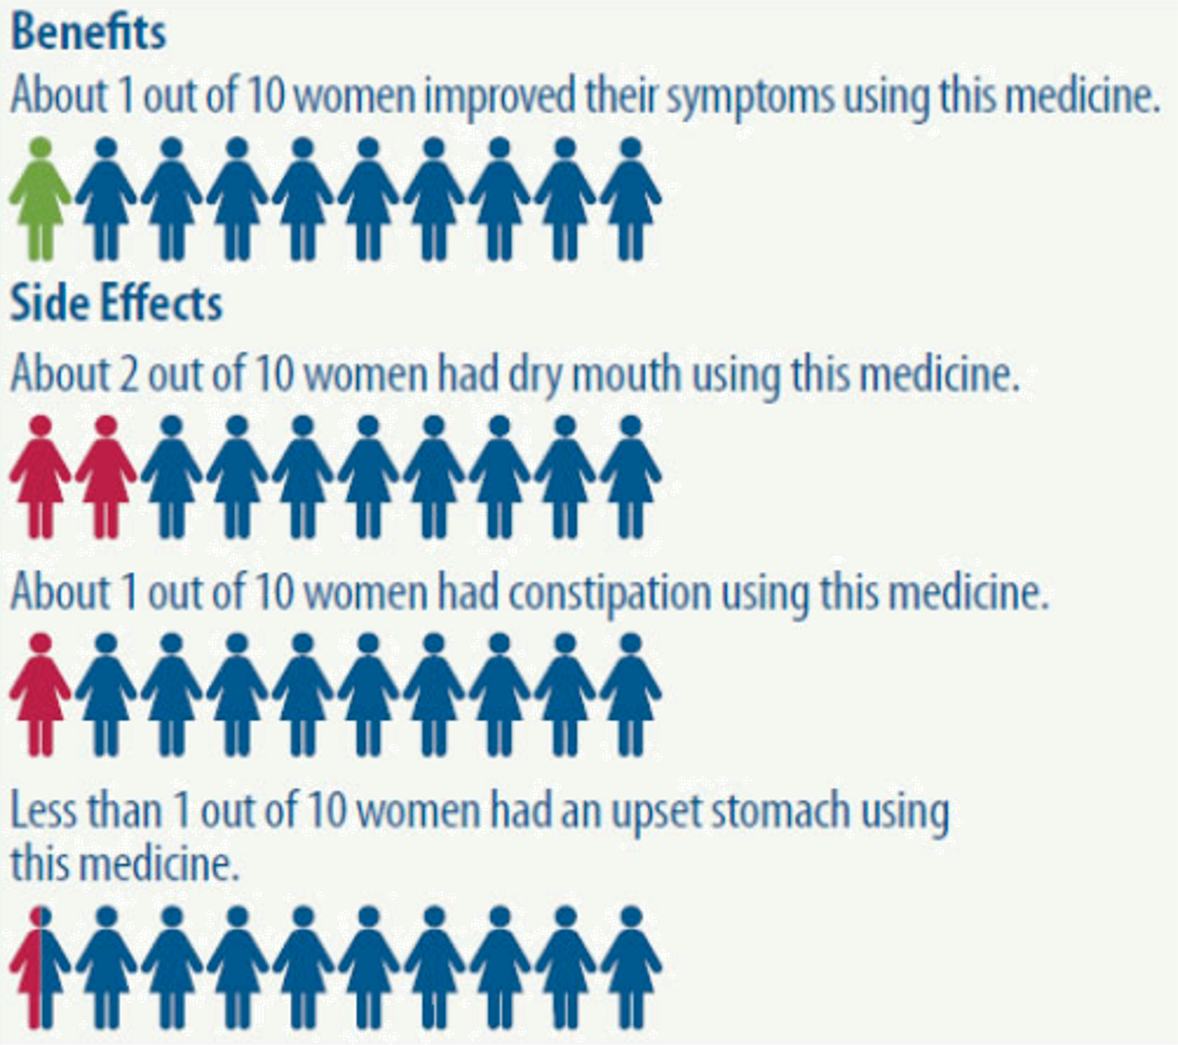
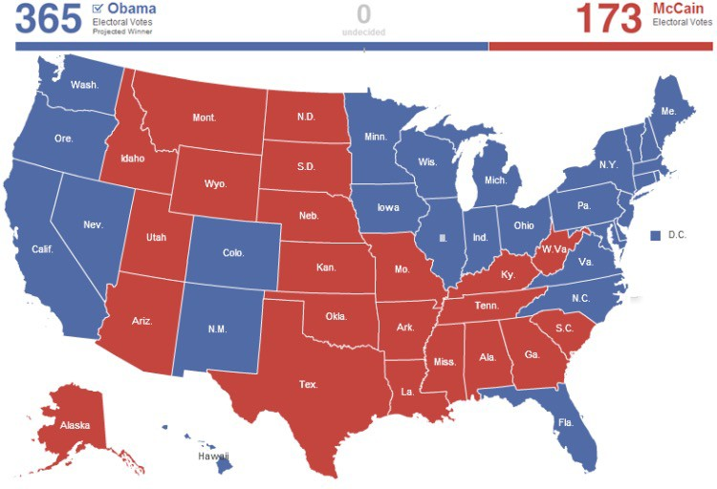
Visual Channels / Dimensions
Color: Hue
Encode information using hue of mark
Ex.

Slide 30
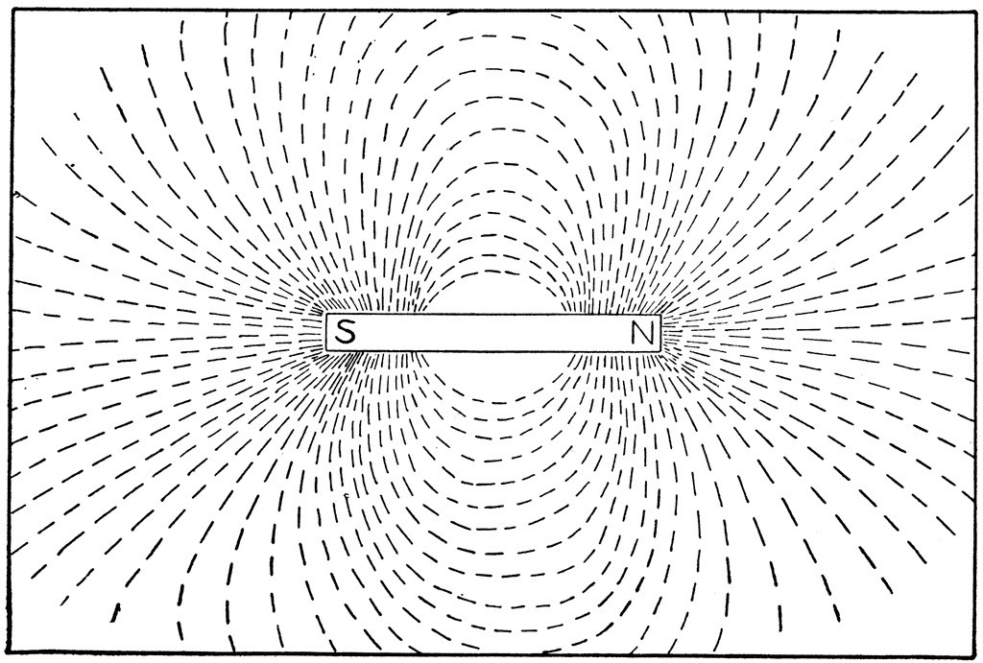
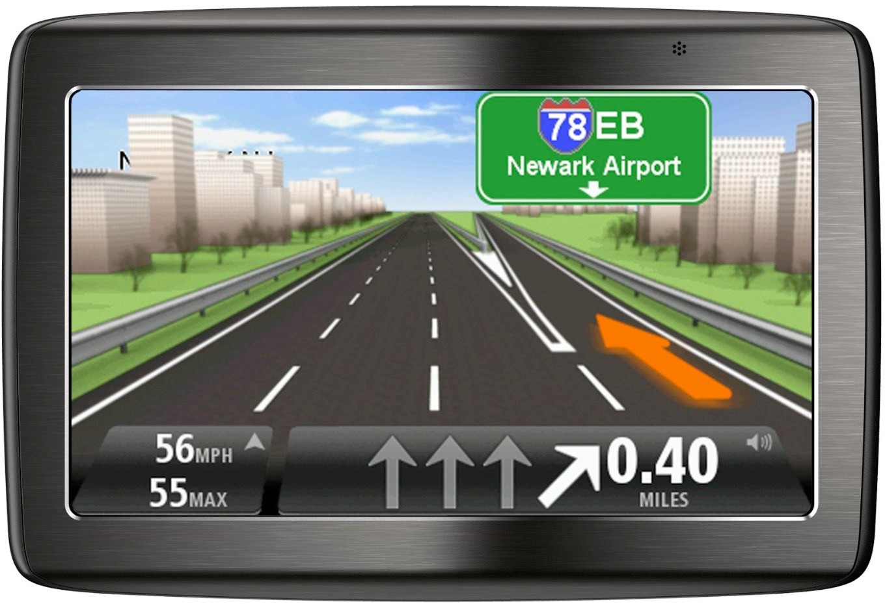
Visual Channels / Dimensions
Orientation / Tilt / Angle
Encode information using how mark is rotated
Ex.

Slide 31



Visual Channels / Dimensions
Shape
Encode information using how mark is shaped
Ex.

Slide 32
Data → Visuals
Remember… Big idea behind visualization
Visual Encoding: Map data dimensions to visual dimensions in a principled way

Slide 33
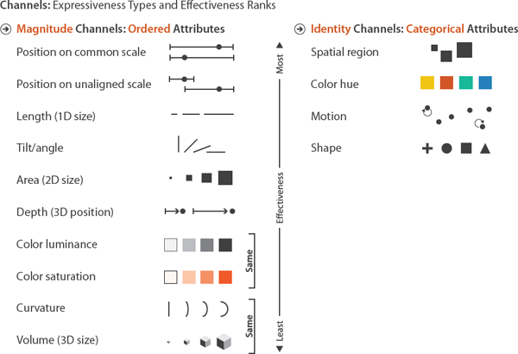
Data → Visuals
Remember… Big idea behind visualization
Visual Encoding: Map data dimensions to visual dimensions in a principled way

Slide 34
Data → Visuals
Remember… Big idea behind visualization
Visual Encoding: Map data dimensions to visual dimensions in a principled way
Let’s experiment. Form 7 groups and find a spot on the board.

Slide 35
Data → Visuals
Work with your group to represent each observation in this dataset as a point (mark) styled only using the visual channel you were assigned.
You goal is for other groups to easily infer which point represents which observation.
Name
blueberry
asparagus
pumpkin
pea
watermelon
long bean

Slide 36
Data → Visuals
Work with your group to represent each observation in this dataset as a point (mark) styled using the visual channel you were assigned.
You goal is for other groups to easily infer which point represents which observation.
Peak
July
April
October
June
August
September

Slide 37
Data → Visuals
Work with your group to represent each observation in this dataset as a point (mark) styled using the visual channel you were assigned.
You goal is for other groups to easily infer which point represents which observation.
Price (per lb)
6.45
4.99
0.24
7.00
3.65
3.64

Slide 38
Data → Visuals
What type of variable is Name?
Name
blueberry
asparagus
pumpkin
pea
watermelon
long bean

Slide 39
Data → Visuals
What type of variable is Peak?
Peak
July
April
October
June
August
September

Slide 40
Data → Visuals
What type of variable is Price?
Price (per lb)
6.45
4.99
0.24
7.00
3.65
3.64

Slide 41
Data → Visuals
Remember… Big idea behind visualization
Visual Encoding: Map data dimensions to visual dimensions in a principled way
Insight 1: Not all visual dimensions can represent all data types
Nominal

Slide 42
Data → Visuals
Remember… Big idea behind visualization
Visual Encoding: Map data dimensions to visual dimensions in a principled way
Insight 1: Not all visual dimensions can represent all data types
Munzner, T. (2015). Visualization analysis & design (Vol. 1). Boca Raton: CRC press.

Slide 43
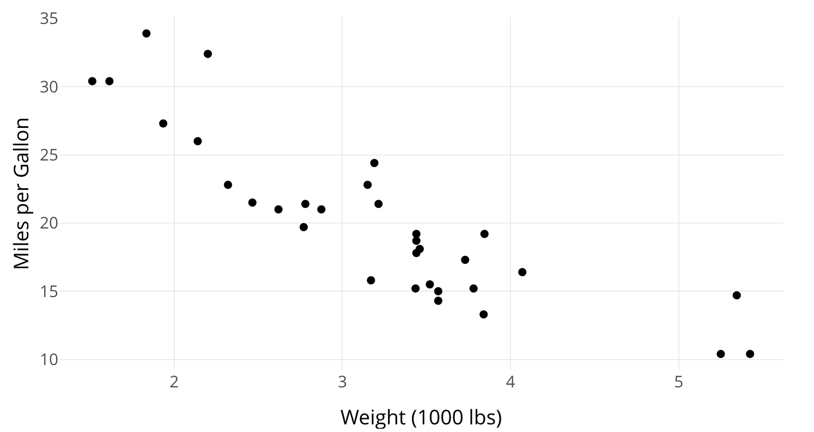
Practice
What are the marks in this visualization?
What variables are shown?
What visual channel(s) encode(s) each variable?
Based on data type and channel type, is the encoding appropriate?

Slide 44
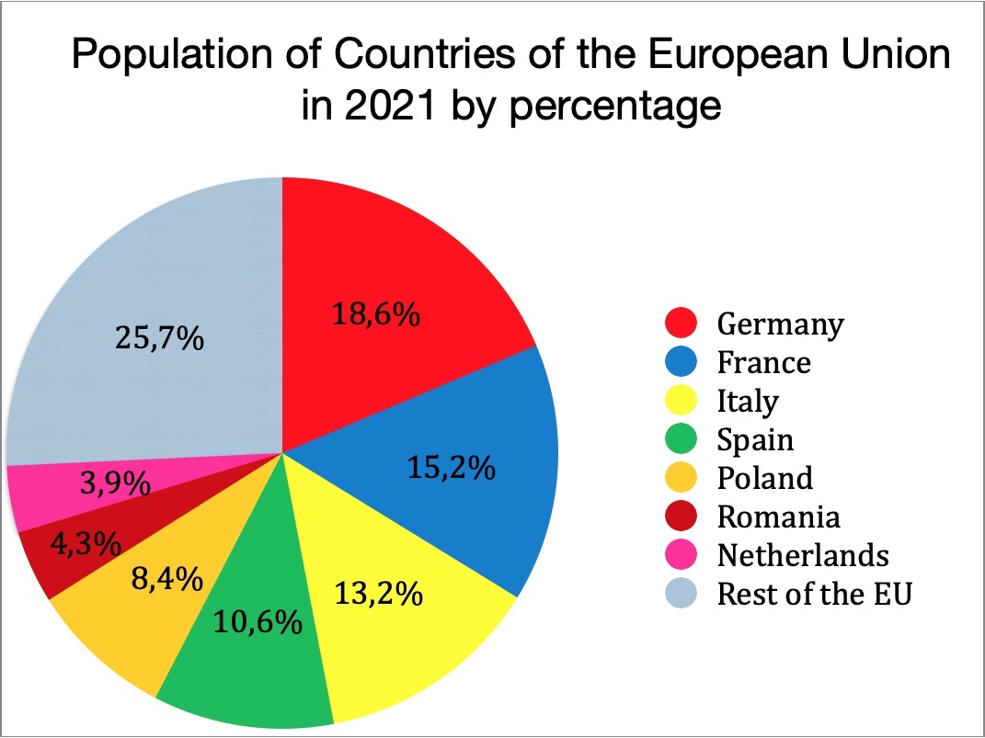
Practice
What are the marks in this visualization?
What variables are shown?
What visual channel(s) encode(s) each variable?
Based on data type and channel type, is the encoding appropriate?

Slide 45
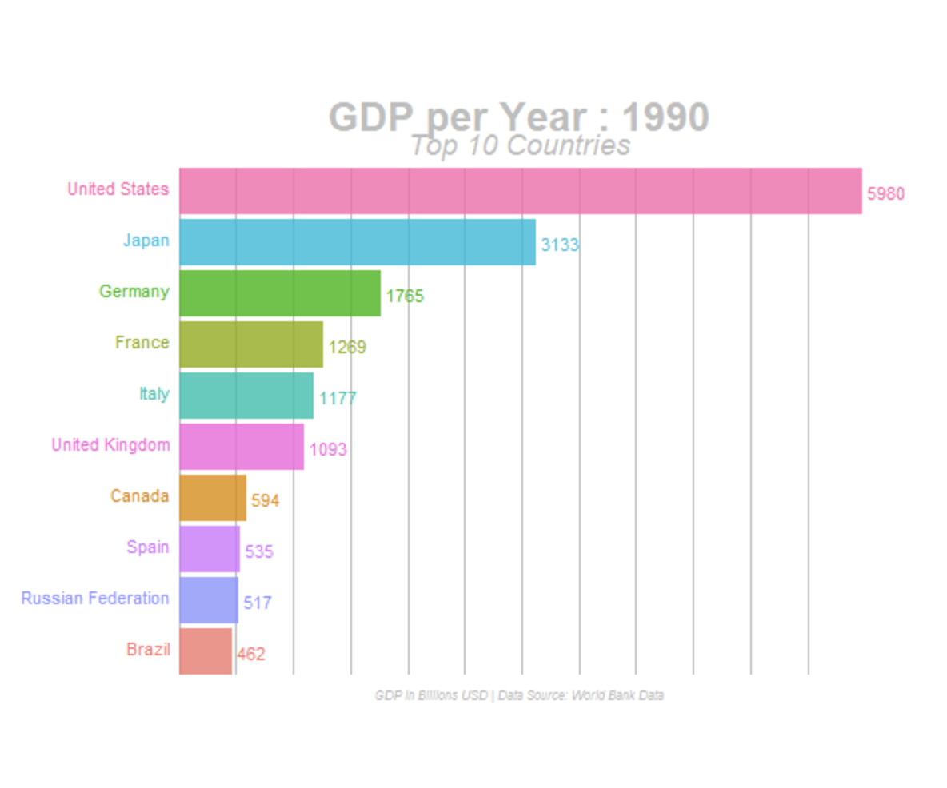
Practice
What are the marks in this visualization?
What variables are shown?
What visual channel(s) encode(s) each variable?
Based on data type and channel type, is the encoding appropriate?
Dual (or double) encoding == encoding one variable via more than one channel
Notes:
Double encoding – good or bad?

Slide 46
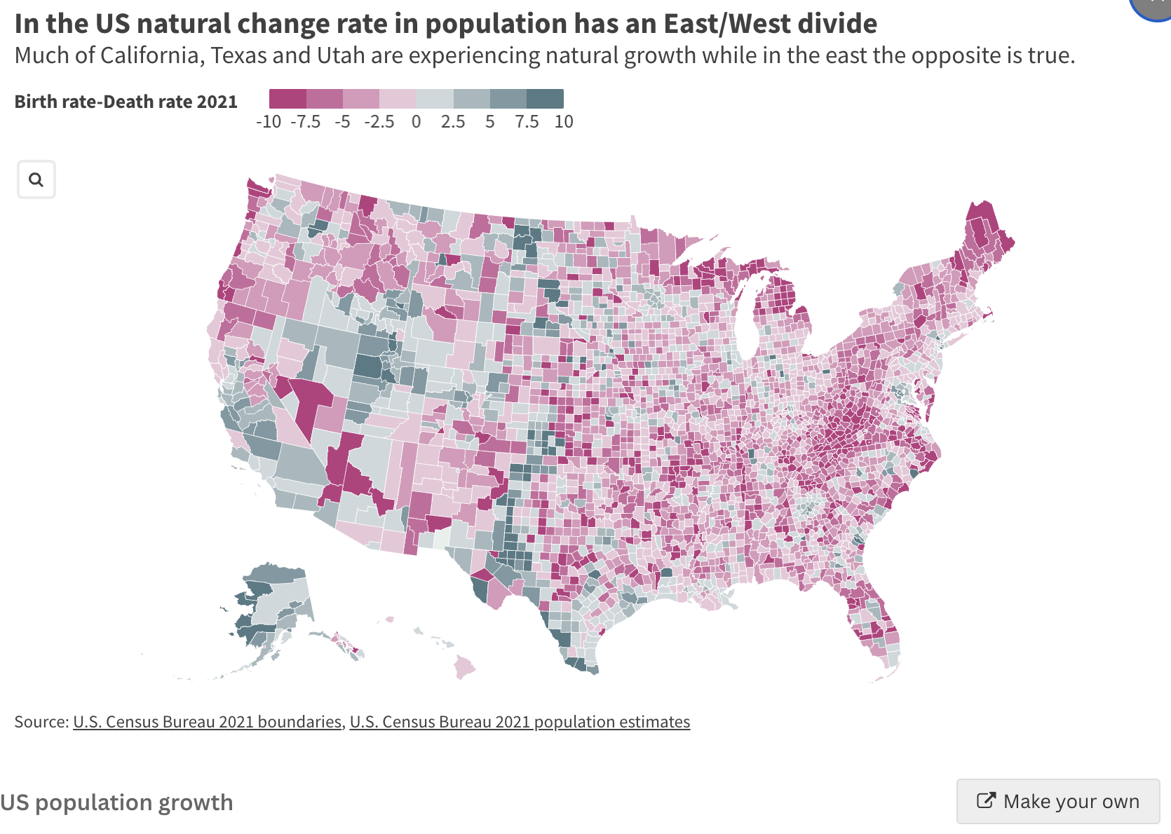
Practice
What are the marks in this visualization?
What variables are shown?
What visual channel(s) encode(s) each variable?
Based on data type and channel type, is the encoding appropriate?
https://flourish.studio/examples/?Industry=Featured

Slide 47
Practice
How could you visually represent the following data? Sketch your idea
Total Time (minutes)
51
30
54
30
30
30
80
30
60
40
30

Slide 48
Practice
How could you visually represent the following data? Sketch your idea
Total Time (minutes) | Number of Squirrels
51 | 12
30 | 24
54 | 16
30 | 15
30 | 28
30 | 34
80 | 11
30 | 16
60 | 25
40 | 51
30 | 59

Slide 49
Practice
How could you visually represent the following data? Sketch your idea
Total Time (minutes) | Number of Squirrels | Weather
51 | 12 | 43 degrees, sunny
30 | 24 | cold, clear
54 | 16 | 43 degrees
30 | 15 | 43 degrees, clear
30 | 28
30 | 34 | 42 degrees, clear
80 | 11 | 43 degrees, sunny
30 | 16 | 40 degrees, sunny
60 | 25 | 45 degrees, sunny
40 | 51 | 45 degrees, sunny with shade spots
30 | 59

