Slide 1
Communicating with Data – Understanding Data
Dr. Ab Mosca (they/them)

Slide 2
Plan for today
Recap/Last bits from last class
Power structures in data science
Importance of context & documentation

Slide 3
Discussion
What is the origin of data science?
Where does it come from?
When did it start?
Who started it?

Slide 4
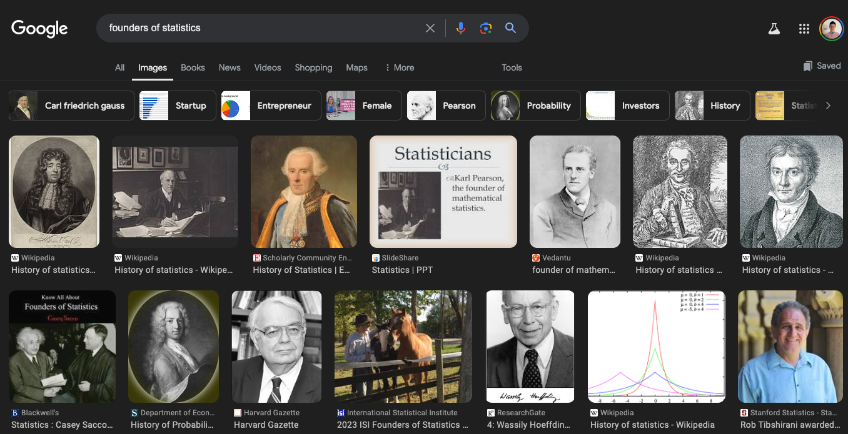
https://data-feminism.mitpress.mit.edu/

Slide 5
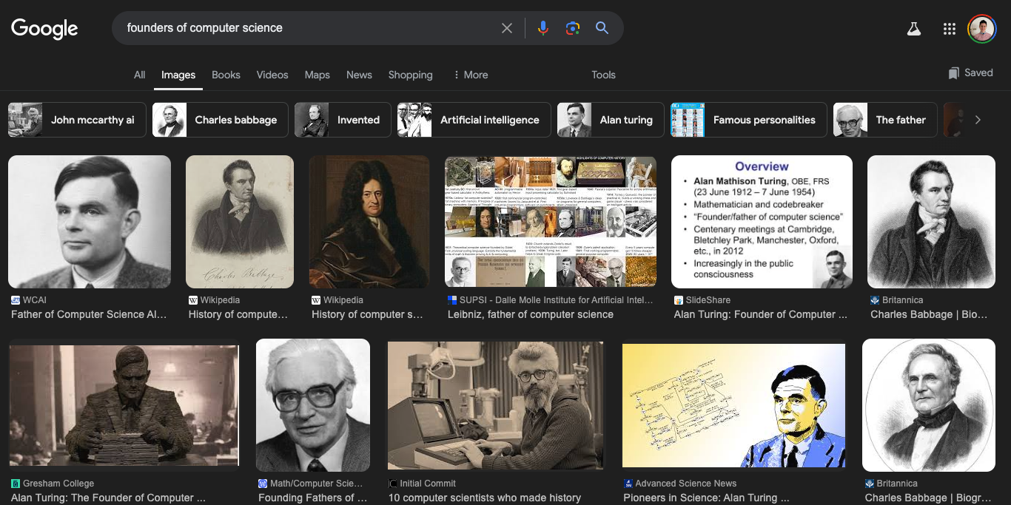
https://data-feminism.mitpress.mit.edu/

Slide 6
Data Science & Power
Hmmm….. Seems like data science is born from white cis males
Fun fact: this is not actually true if you dig deeper! But that’s for another class
https://data-feminism.mitpress.mit.edu/

Slide 7
Data Science & Power
Data Capitalism (Meyers West 2019)
History is full of examples of data being used to control
West argues, data as a commodity "enables an asymmetric redistribution of power that is weighted toward the actors who have access and the capability to make sense of information."
Bhargava, R. (2023). Teaching Data That Matters: History and Practice

Slide 8
Data Science & Power
Data as Power
In South American Andean cultures, Khipus are elaborate assemblages of knotted string used for millennia to record extracted numerical data such as tax records and military obligations of the populace (Medrano & Urton, 2018).
From 2500BC the ancient Egyptian cultures were creating census datasets in order to determine how much labor force could be conscripted into the construction of pyramids for their pharaohs (Census-Taking in the Ancient World, 2016)
Bhargava, R. (2023). Teaching Data That Matters: History and Practice

Slide 9
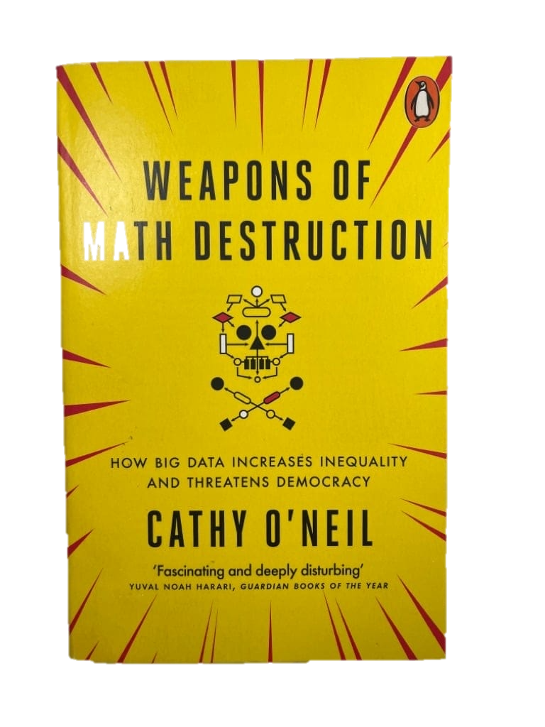

Data Science & Power
Algorithms as Power
Cathy O’Neil
https://www.youtube.com/watch?v=heQzqX35c9A

Slide 10
Data Science & Power
The “Big Data” revolution argues that with enough data we can make unbiased decisions
However, data science:
Lacks transparency
Employs extractive collection
Leverages technological complexity
Controls impact
Bhargava, R. (2023). Teaching Data That Matters: History and Practice
Notes:
Lack of Transparency: The data about people’s interactions with the world is generally collected with only token approval, if any at all, from the user. This denies the subject awareness that their actions are being recorded at the time the actions occur.
Extractive Collection: The data is collected by third parties and is not meant for observation or consumption by the people it is collected from (or about). This denies the subject agency in the data collection mechanism and interaction opportunities with the collector.
Technological Complexity: The data is analyzed with a variety of advanced algorithmic techniques, and discussed with highly technical jargon. This denies the subject an understanding of how any results were achieved, and how they might be critiqued.
Control of Impact: The data is used by the collector to make decisions that have consequences for the subject(s). This denies the subject participation and agency in decisions that affect them.

Slide 11
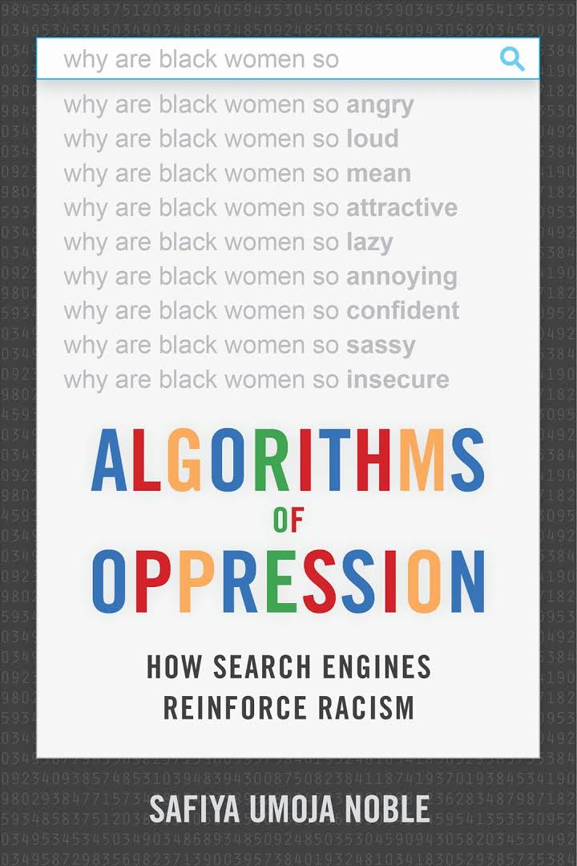

Example: Search Engines
Dr. Safiya Noble
https://youtu.be/iRVZozEEWlE?si=qzRtPmQzxl9KDxR2

Slide 12
Example: Search Engines
Search engine algorithms are largely based on:
Profit
Historical data
Predictive analytics
What are downstream real-life impacts of this search engine bias?

Slide 13

Example: Facial Recognition
Dr. Joy Buolamwini
https://youtu.be/UG_X_7g63rY?si=qDMmUX5VjpaJYURe
https://data-feminism.mitpress.mit.edu/

Slide 14
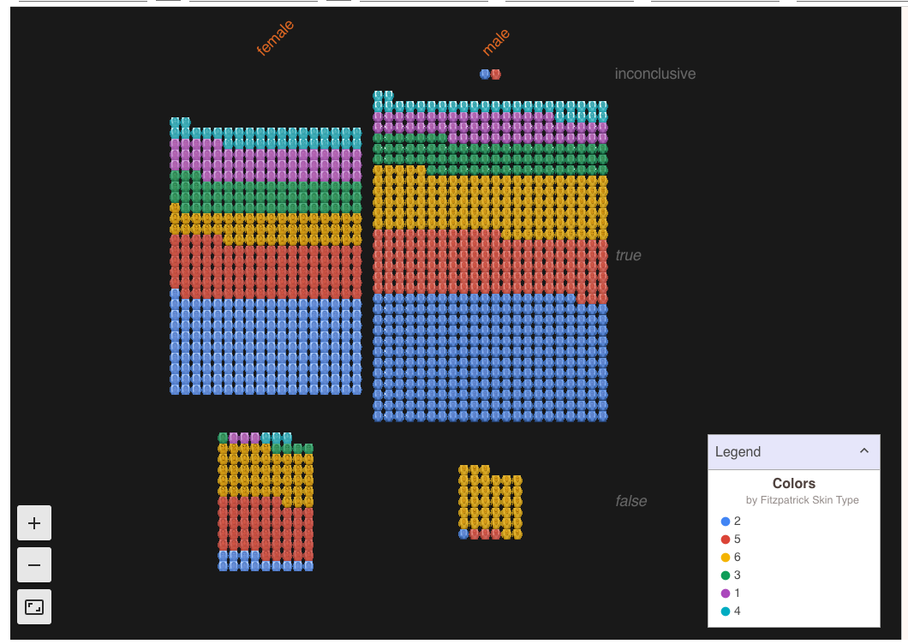
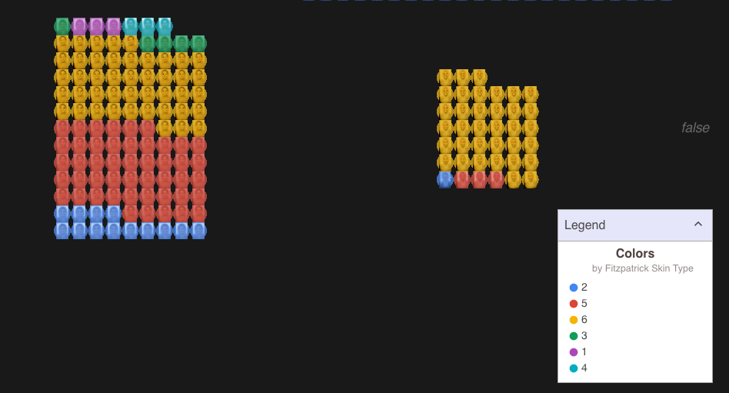
Example: Facial Recognition
https://data-feminism.mitpress.mit.edu/

Slide 15
Example: Facial Recognition
Training dataset used for most facial recognition systems contains
78% male faces
84% white faces
Only 4% were women and dark-skinned
What are downstream real-life impacts of this algorithmic bias?
https://data-feminism.mitpress.mit.edu/

Slide 16
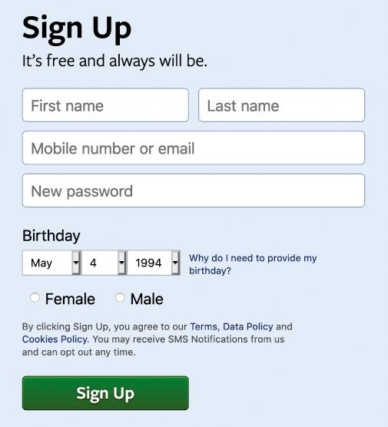
“What gets counted counts”
Data is often used to inform policy and allocate resources
What is not counted in that data collection can become invisible
Ex. Expansive gender
https://data-feminism.mitpress.mit.edu/

Slide 17

“What gets counted counts”
Data is often used to inform policy and allocate resources
What is not counted in that data collection can become invisible
Ex. US Census

Slide 18
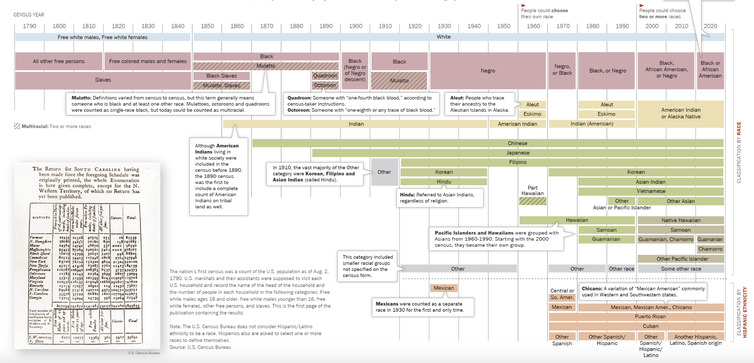
“What gets counted counts”
Data is often used to inform policy and allocate resources
What is counted is considered important
Ex. US Census & Race
https://www.pewresearch.org/social-trends/feature/what-census-calls-us/
https://www.pewresearch.org/wp-content/uploads/2020/02/PH_15.06.11_MultiRacial-Timeline.pdf

Slide 19
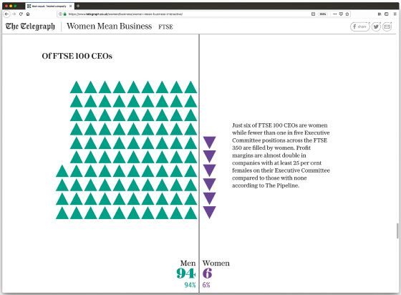
Subverting Power
Subvert norms
https://data-feminism.mitpress.mit.edu/

Slide 20
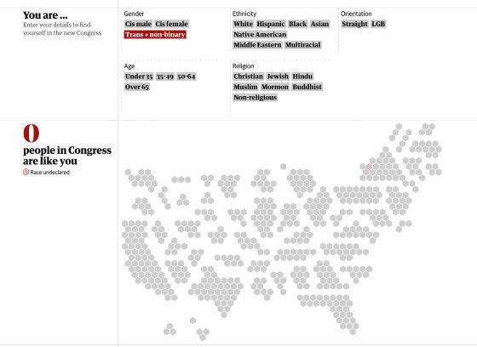
Subverting Power
Highlight missing categories
https://data-feminism.mitpress.mit.edu/

Slide 21
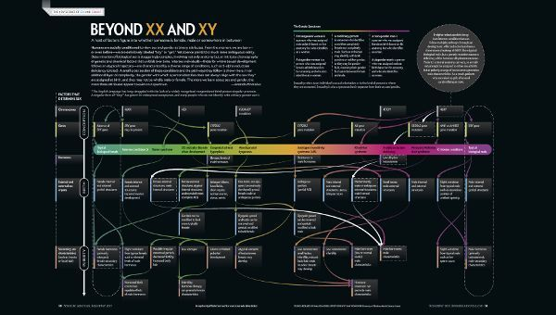
Subverting Power
Educate
https://data-feminism.mitpress.mit.edu/

Slide 22
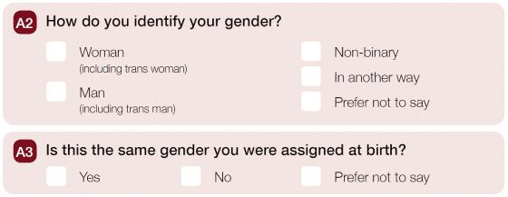
Subverting Power
Rethink data collection
https://data-feminism.mitpress.mit.edu/

Slide 23
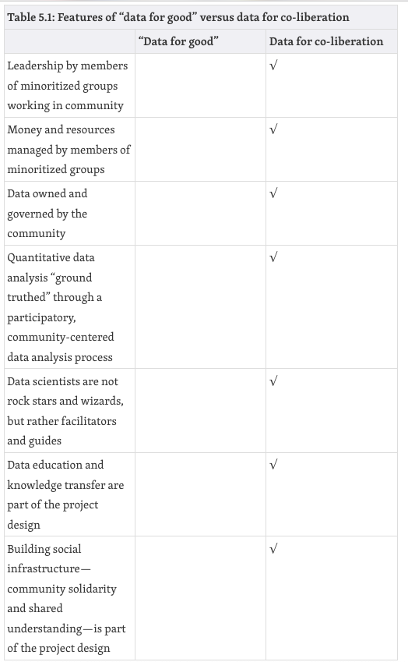
Subverting Power
Add transparency
Avoid extractive approaches
Follow the lead of the community
https://data-feminism.mitpress.mit.edu/
Notes:
Think about collecting data for co-liberation; not just good!

Slide 24

Subverting Power
Acknowledge context
What is the historical context of the data?
Where did the data come from? Who collected it?
Why was the data collected?
How was the data collected?
How is the data used?
What’s in the data?
What “counts” as a data point?
What data is missing?
How is uncertainty handled?
https://www.responsible-datasets-in-context.com/datasets.html
What biases or ethical issues could the answers to these questions reveal that would otherwise be hidden?

Slide 25
In-class Activity:
Go to the course website to find instructions for lab 01
Be prepared to share your findings!

