Slide 1
Communicating with Data – Choosing Visual Channels
Dr. Ab Mosca (they/them)
Slides based off slides courtesy of Jordan Crouser (https://jcrouser.github.io/)

Slide 2

Reminder
Download before class on Thursday 09/18
Use the activation code from instructions in slide deck 03
Need help? Ping me on Slack, or come to office hours

Slide 3
Plan for Today
Recap data-visual mapping
Expressiveness & effectiveness of visual channels
A sampling of visualization techniques

Slide 4
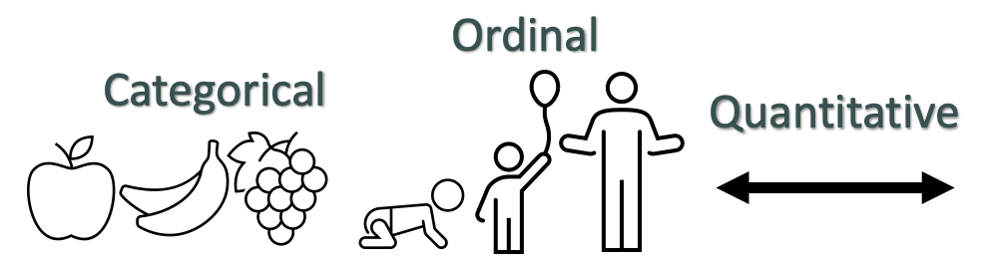
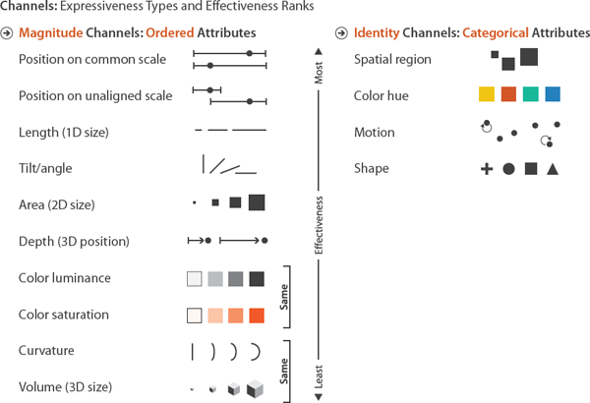

Recall: Data → Visuals
Remember… Big idea behind visualization
Map data dimensions to visual dimensions in a principled way
Nominal

Slide 5
Visual Encoding
Remember… Big idea behind visualization
Map data dimensions to visual dimensions in a principled way
The process of representing variables via visual channels is called encoding
Visual encoding is another term for a visualization
One way we will often analyze visualizations is by inspecting their data-visual mapping (i.e. encoding)

Slide 6
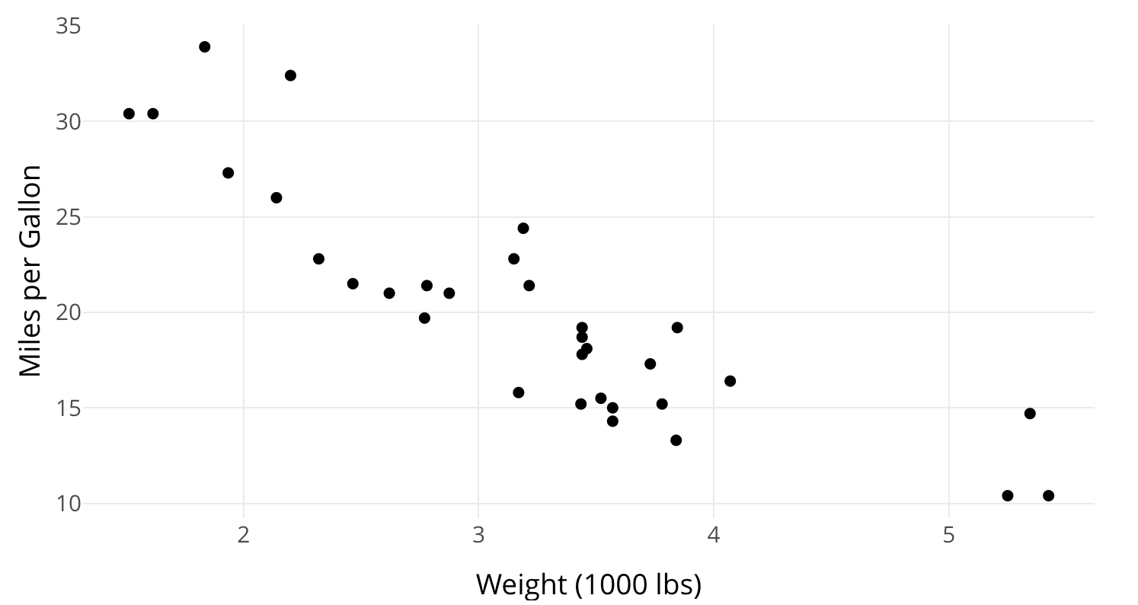
Ex. Data-Visual Mapping
What are the marks in this visualization?
What variables are shown?
What visual channel(s) encode(s) each variable?
Based on data type and channel type, is the encoding appropriate?

Slide 7
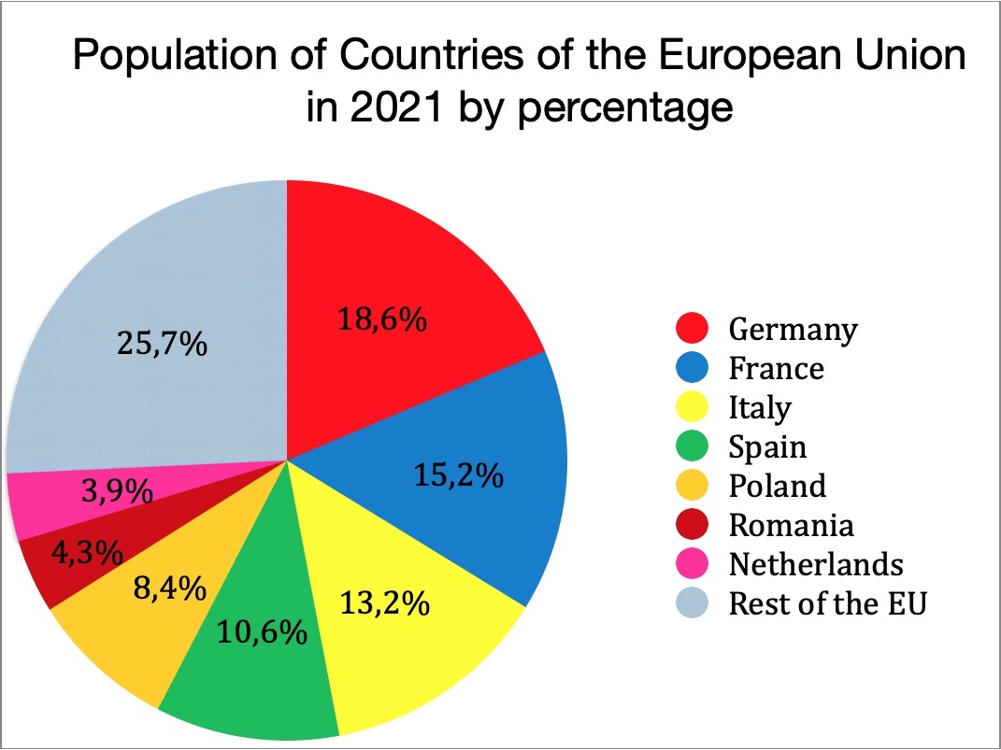
Ex. Data-Visual Mapping
What are the marks in this visualization?
What variables are shown?
What visual channel(s) encode(s) each variable?
Based on data type and channel type, is the encoding appropriate?

Slide 8
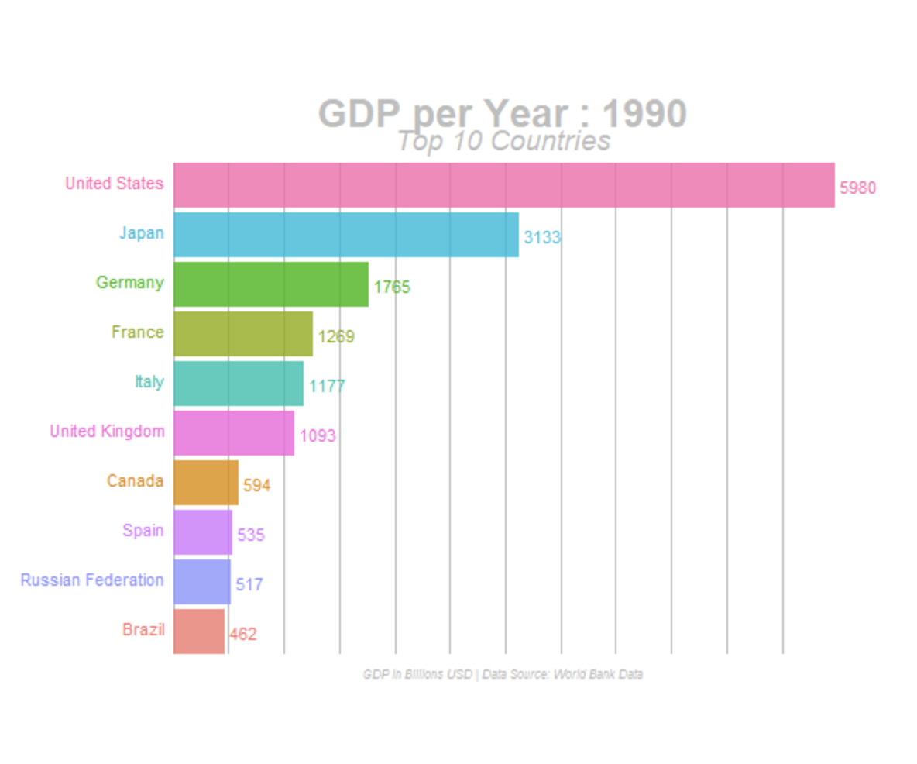
Ex. Data-Visual Mapping
What are the marks in this visualization?
What variables are shown?
What visual channel(s) encode(s) each variable?
Based on data type and channel type, is the encoding appropriate?
Dual (or double) encoding == encoding one variable via more than one channel
Notes:
Double encoding – good or bad?

Slide 9
Ranking Visual Channels
Using the correct visual channel type for the correct variable type is called expressiveness
We also consider effectiveness to choose visual channels

Slide 10
Ranking Visual Channels
More important attributes should be encoded with more effective channels.
Effectiveness refers to how well a channel supports:
Accuracy
Discriminability
Separability
Visual popout
Grouping

Slide 11
Accuracy
Definition: how close human perceptual judgement is to an objective measurement of the stimulus

Slide 12
Accuracy
Definition: how close human perceptual judgement is to an objective measurement of the stimulus
How much longer is the second bar?

Slide 13
Accuracy
Definition: how close human perceptual judgement is to an objective measurement of the stimulus
How much longer is the second bar?
2X

Slide 14
Accuracy
Definition: how close human perceptual judgement is to an objective measurement of the stimulus
How much bigger is the second square?

Slide 15
Accuracy
Definition: how close human perceptual judgement is to an objective measurement of the stimulus
How much bigger is the second square?
4X

Slide 16
Accuracy
Definition: how close human perceptual judgement is to an objective measurement of the stimulus
How much bigger is the second box?

Slide 17
Accuracy
Definition: how close human perceptual judgement is to an objective measurement of the stimulus
How much bigger is the second box?
27X

Slide 18
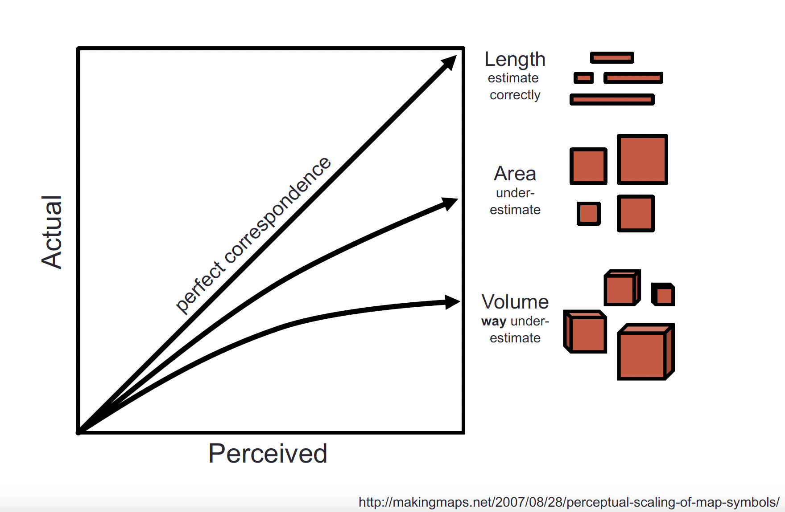
Accuracy
Definition: how close human perceptual judgement is to an objective measurement of the stimulus

Slide 19
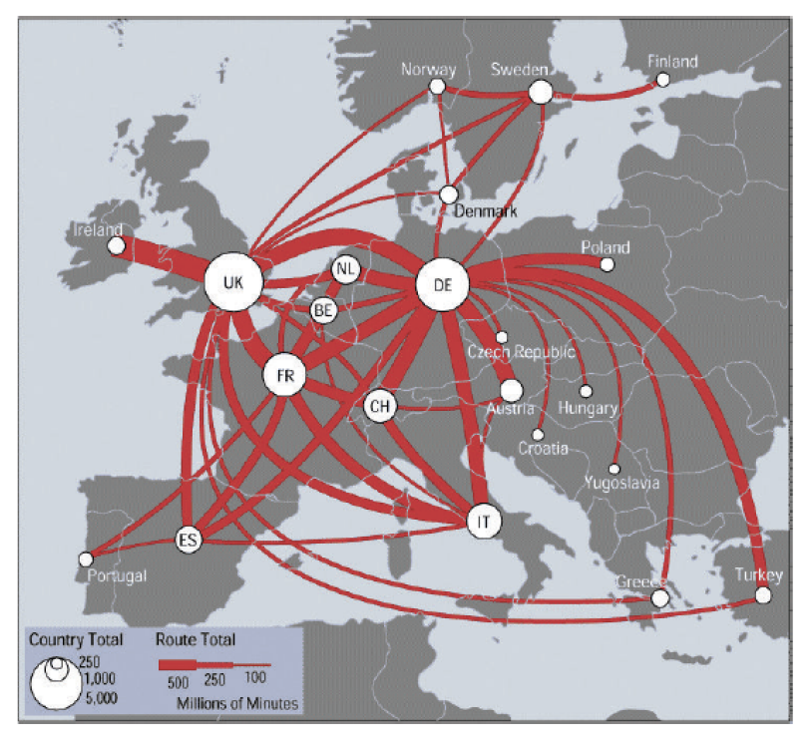
Discriminability
Definition: how differentiable levels of the channel are
https://web.cse.ohio-state.edu/~shen.94/Melbourne/Slides/TamaraChp5.pdf

Slide 20
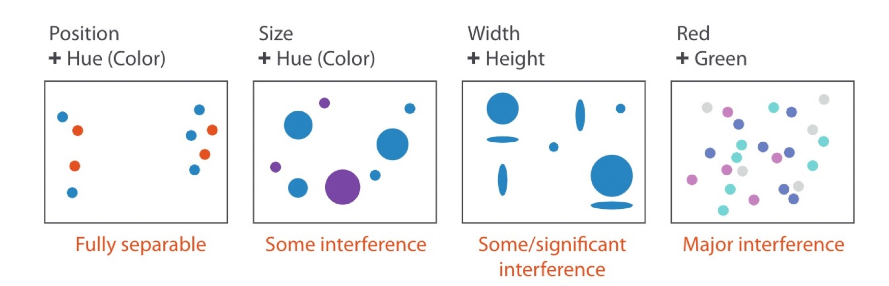
Separability
Definition: whether channels exist independently or integrally with others
(saturation)

Slide 21
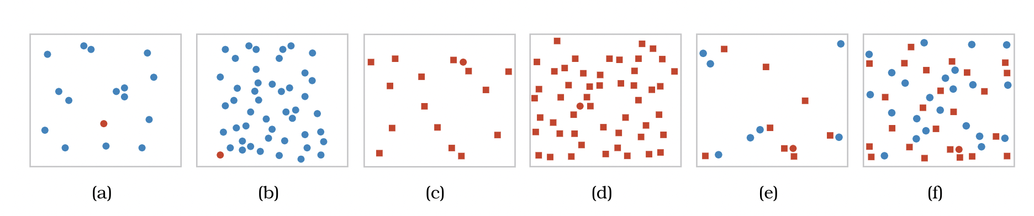
Visual Popout
Definition: how well a distinct item stands out from others

Slide 22
Visual Popout
Definition: how well a distinct item stands out from others
Color is a good channel for this

Slide 23
Visual Popout
Definition: how well a distinct item stands out from others

Slide 24
Visual Popout
Definition: how well a distinct item stands out from others
Shape is not as helpful

Slide 25
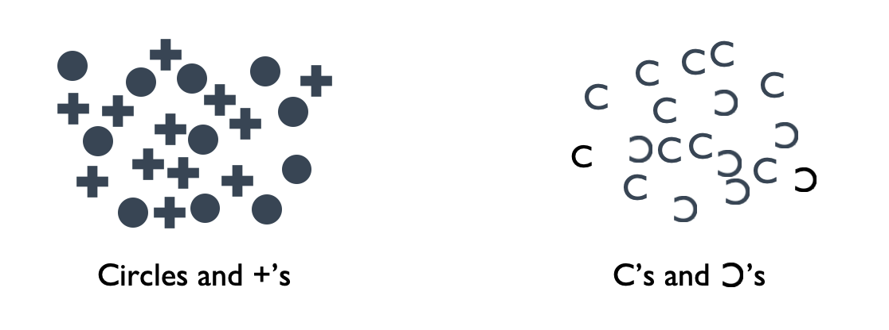
Grouping
Definition: how likely people are to infer differences as representing distinct groups

Slide 26
Ranking Visual Channels
Design takeaway: Prioritize most effective channels for most important data

Slide 27
Your Turn!
Find someone (or two) to work with
Choose a visualization from https://informationisbeautiful.net/
What variables does the visualization show?
What visual channel(s) encode each variable?
Does the visualization follow the principles of effectiveness and expressiveness?

Slide 28
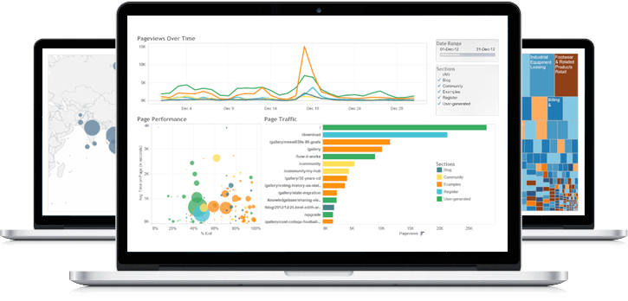
A sampling of visualization techniques

Slide 29
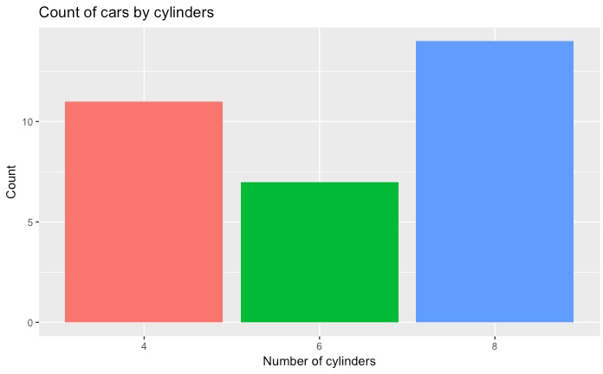
Used to show quantitative variable distributed across a nominal or ordinal variable
Compares quantitative values for different categories
Highlights relative amounts
Grouped/stacked bars can break each category into sub-groups
Bar chart

Slide 30
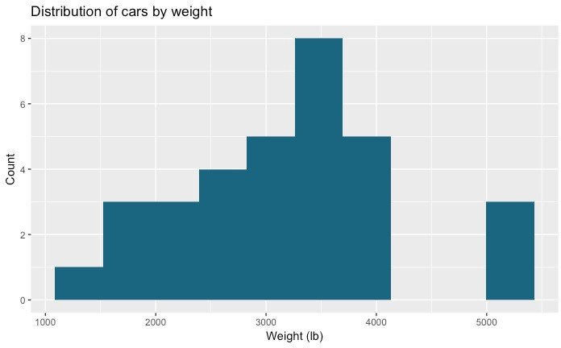
Used for one quantitative variable
Looks like a bar chart… but the x-axis consists of equal size ranges (bins) for the quantitative variable
Y-axis shows count or relative frequency
Highlights distribution
Note: bin size makes a big difference!
Histogram
10-14
25-29
45-49
50-54
20-24
30-34
40-44
15-19
35-39

Slide 31
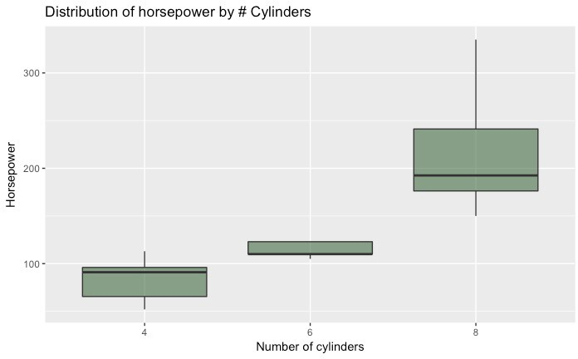
Used for one quantitative variable (sometimes) distributed across a nominal or ordinal variable
Also useful for highlighting distribution across categories
Calls out key values:
median
1st & 3rd quartiles
“fences”
outliers
Boxplot
“fence” (1.5IQR)
₃rd quartile
outlier
median
₁st quartile

Slide 32
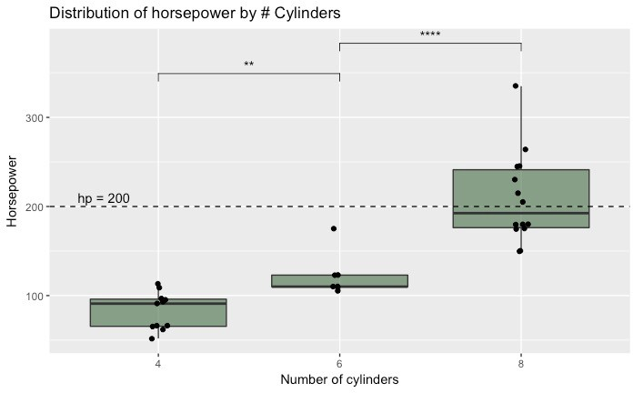
Use “jitter” to show actual values
Reference lines can help provide context
Can use annotations to show statistical significance
Boxplot

Slide 33
Used to show one quantitative variable X one quantitative variable
Shows the relationship between the two variables
Each point in the plot represents an observation
Scatterplot

Slide 34
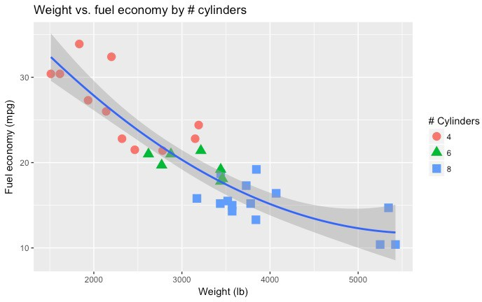
Can use color or symbol to show one quantitative variable X one quantitative variable X one nominal variable
This highlights groups
Sometimes useful to show a trend line (regression)
Scatterplot

Slide 35
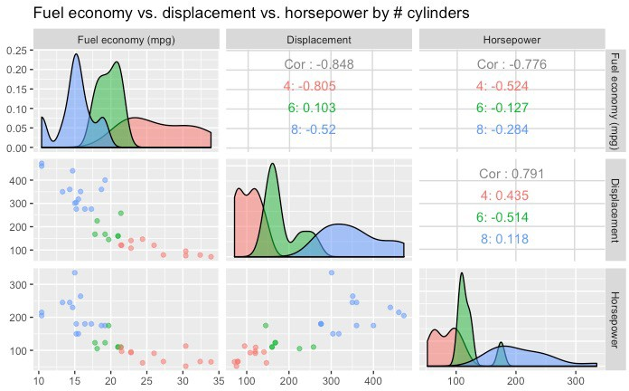
Can use to show many combinations of one quantitative variable X one quantitative variable
Combines multiple scatterplots into a matrix to show additional relationships
Scatterplot matrix (SPLOM)

Slide 36
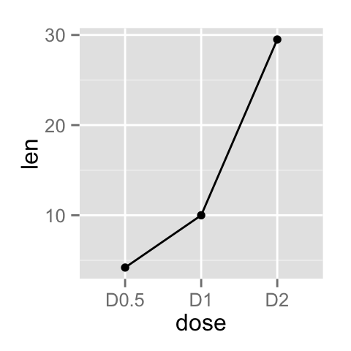
Shows the trend of one quantitative variable over time
Line chart

Slide 37
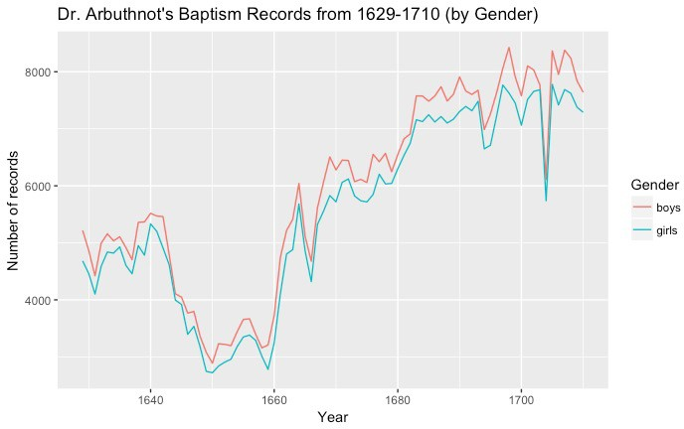
Multiple lines allow comparison of trends across categories
Could alternatively show multiple quantitative variables (if they have the same scale)
Highlights “position switches”
Line chart

Slide 38
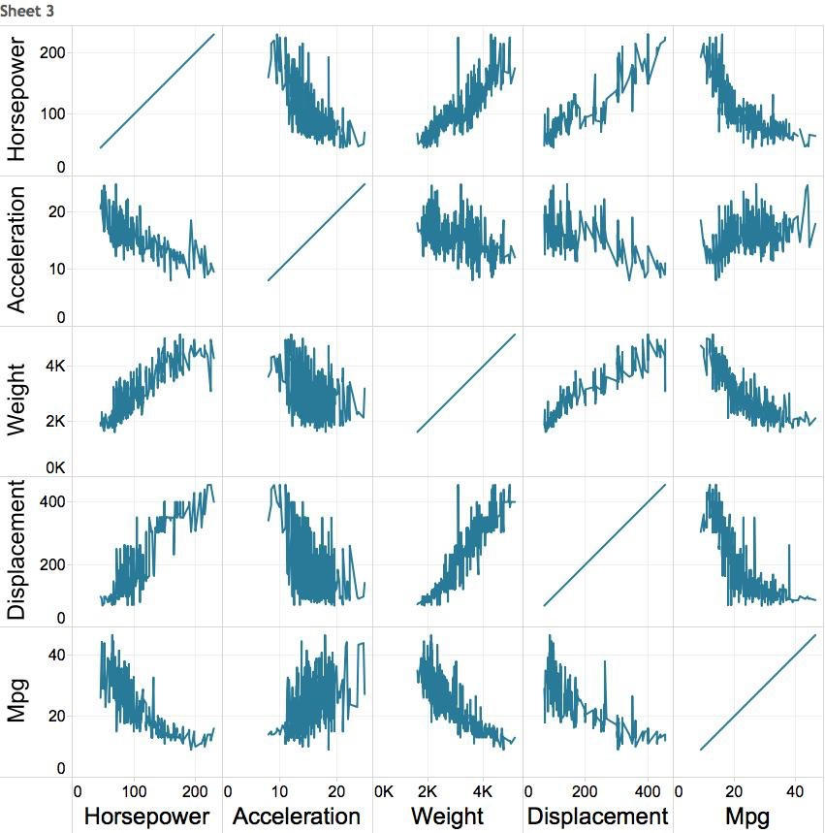

Multiple variables: line chart matrix?

Slide 39
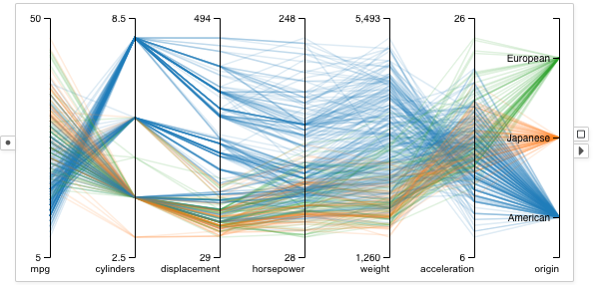
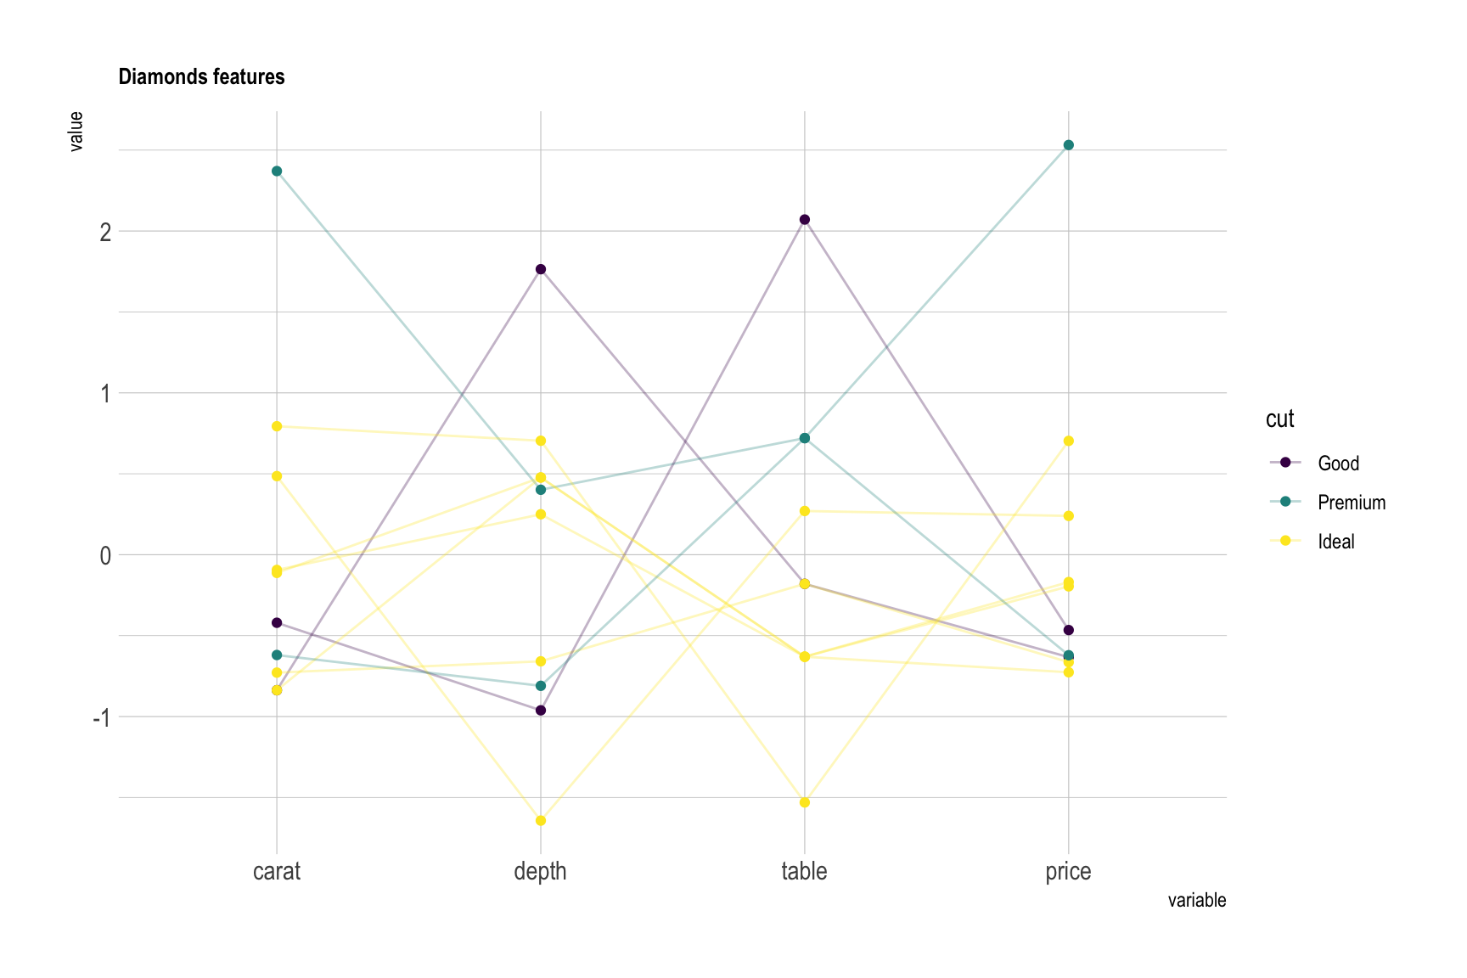
Supports (pairwise) comparison of a collection of quantitative variables
Each axis represents one variable
They may have different scales, typically you normalize them
Each line represents one observation (connecting the associated values along each axis)
Axis order matters!
Parallel Coordinates Plot
https://visflow.org/node/visualization/parallel-coordinates.html
https://www.data-to-viz.com/graph/parallel.html

Slide 40
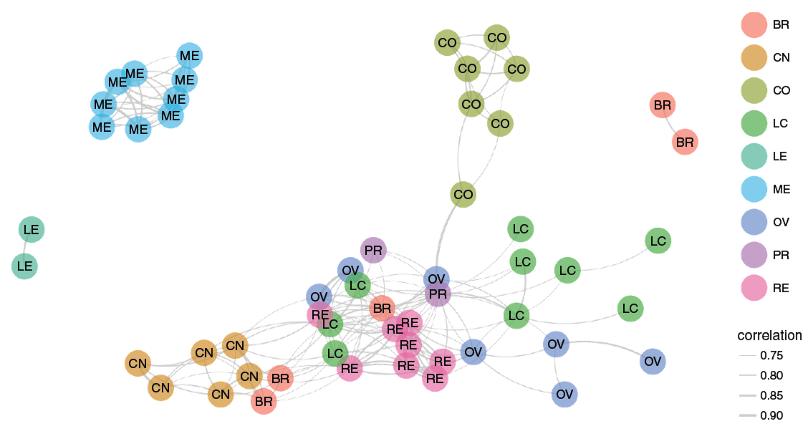
Shows network (graph) data
Useful for showing the relationships between entities
Can use color, size, etc. to encode additional information
Caveat: network diagrams quickly become hairballs for large, dense data
Network

Slide 41
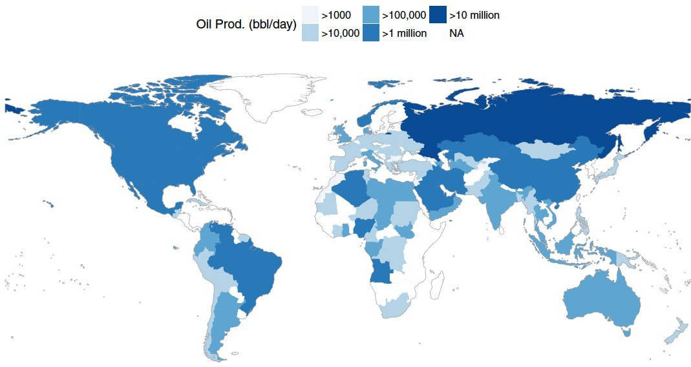
Shows geographic (spatial) data
Useful for analysis with a strong geographic component
Filled maps (choropleth) vs. points
Remember: color scale comparisons are harder for humans than size comparisons!
Map

Slide 42
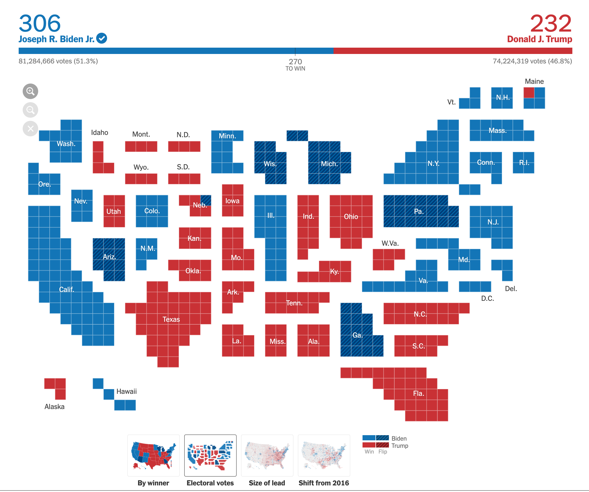
Remember to map the correct data to your visual channels
Map

Slide 43
Find someone (or two) to work with
Choose a visual encoding from https://datavizproject.com/ that you have not previously encountered
What variable types is your visual encoding good for?
What types of data questions do you think this visual encoding would be good for answering?
Find an example of the visual encoding with real data. What is one interesting thing the visualization shows?
Your Turn!

