Slide 1
Communicating with Data – Text Visualization
Dr. Ab Mosca (they/them)
Slides based off slides courtesy of Jordan Crouser (https://jcrouser.github.io/)

Slide 2
Plan for Today
What is text data?
Why visualize text?
Techniques
Activity (time permitting)

Slide 3

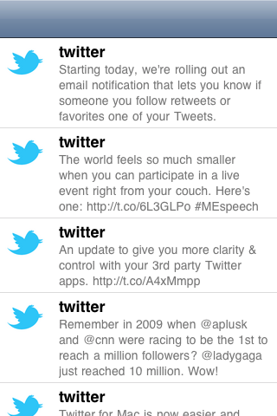
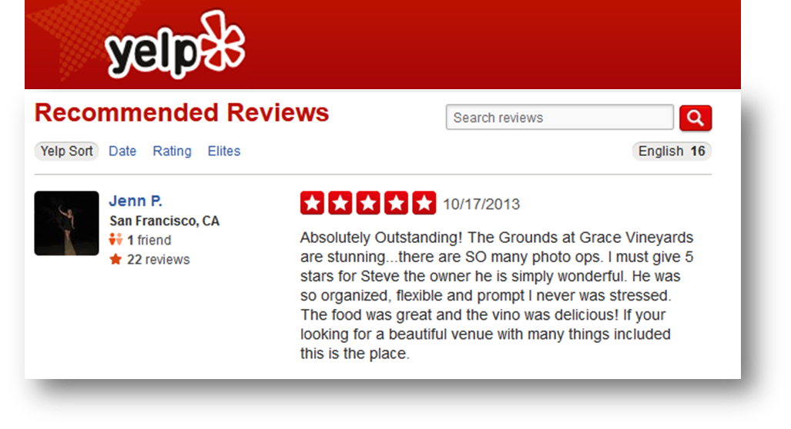
What is text data?
Documents
  Articles, books and novels
  E-mails, web pages, blogs
Text snippets
  Tweets, SMS messages
  Tags, comments, profiles
And more...
  Computer programs, logs
  Collections of documents
  This slide!

Slide 4
Overview
Question: what are some characteristics of text data?
Answer:
  Often high dimensional (over 228,000 words in OED)
  Packed with meaning and relationships:
    Correlations: Hong Kong, San Francisco, Bay Area
    Order: April, February, January, June, March, May
    Membership: Tennis, Running, Swimming, Hiking, Piano
    Hierarchy, antonyms & synonyms, entities, …

Slide 5
Understand – read a document
Summarize – get the “gist” of a document
Cluster – group together similar contents
Quantify – convert to numerical measures
Correlate – compare patterns in text to those in other data, e.g., test scores with conversations on social media
Why visualize text data?

Slide 6
How can we quantitatively analyze text data?

Slide 7
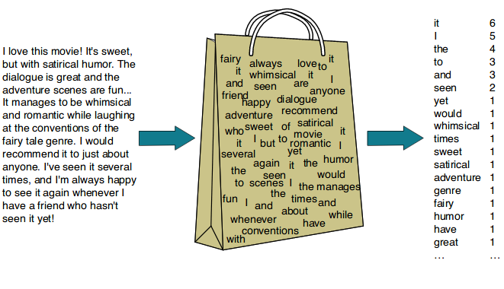
Ignore ordering relationships within the text
Document is represented as a vector of terms and weights
Grammar, context, and order are ignored
“Bag of words” model
https://nachi-keta.medium.com/nlp-explain-bag-of-words-3b9fc4f211e8

Slide 8
Comparing documents → comparing vectors
Process:
  Identify vocabulary, i.e. set of all words in all documents
  For each document, create a vector of counts of each vocabulary word
  Compare vectors
Ex.
  Sentence 1: “I love cats.”
  Sentence 2: “I love dogs.”
  Vocabulary: [“I”, “love”, “cats”, “dogs”]
  Sentence 1 vector: [1, 1, 1, 0]
  Sentence 2 vector: [1, 1, 0, 1]
“Bag of words” model
https://nachi-keta.medium.com/nlp-explain-bag-of-words-3b9fc4f211e8

Slide 9
Comparing documents → comparing vectors
Process:
  Identify vocabulary, i.e. set of all words in all documents
  For each document, create a vector of counts of each vocabulary word
  Compare vectors
Ex.
  Sentence 1: “I love cats.”
  Sentence 2: “I love dogs.”
  Sentence 3: “I love cats and dogs.”
  Vocabulary: [“I”, “love”, “cats”, “dogs”, ”and”]
  Sentence 1 vector: [1, 1, 1, 0, 0]
  Sentence 2 vector: [1, 1, 0, 1, 0]
  Sentence 3 vector: [1, 1, 1, 1, 1]
“Bag of words” model

Slide 10

Example: health care reform
Recent history
  Initiatives by President Clinton
  Overhaul by President Obama
Text data
  News articles
  Speech transcriptions
  Legal documents

Slide 11
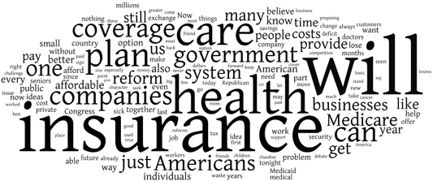
New York Times: Obama 2009
economix.blogs.nytimes.com/2009/09/09/obama-in-09-vs-clinton-in-93

Slide 12
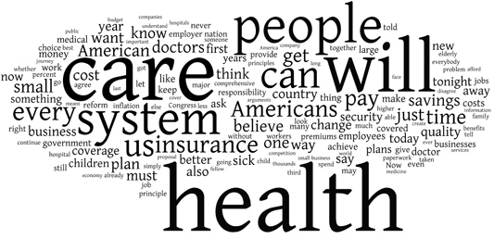
New York Times: Clinton 1993
economix.blogs.nytimes.com/2009/09/09/obama-in-09-vs-clinton-in-93

Slide 13
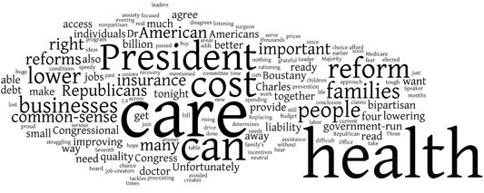
Obama 2009
Clinton 1993
Comparison
Rep. Charles Boustany of Louisiana 2009
economix.blogs.nytimes.com/2009/09/09/obama-in-09-vs-clinton-in-93

Slide 14
Word clouds
Strengths
  Familiar to many people
  Can help with “gisting” and initial query formation
Weaknesses
  Does not show the structure of the text
  Sub-optimal visual encoding (position is not meaningful)
  Inaccurate size encoding (long words are bigger)
  May not facilitate comparison (unstable layout)
  Term frequency may not be meaningful

Slide 15
Flashback
Obama 2009
Clinton 1993
economix.blogs.nytimes.com/2009/09/09/obama-in-09-vs-clinton-in-93

Slide 16
Weighting words
Term Frequency
tf_{td} = # of times term t appears in document d
TF-IDF: Term Frequency by Inverse Document Frequency
tf-idf_{td} = # of times term t appears in document d
# of times term t appears in all documents

Slide 17
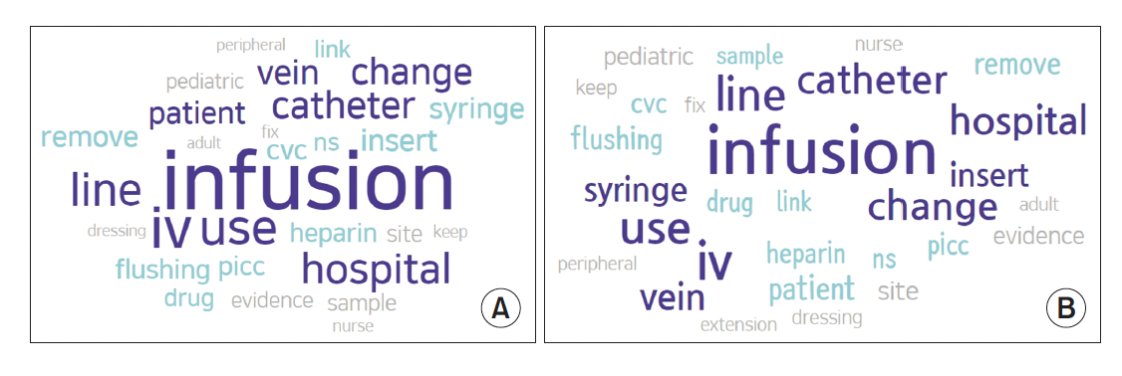
Frequency example
Keyword Network Analysis of Infusion Nursing
from Posts on the Q&A Board in the Intravenous
Nurses Caf.

Slide 18
TF-IDF example
Keyword Network Analysis of Infusion Nursing
from Posts on the Q&A Board in the Intravenous
Nurses Caf.

Slide 19
Often favors frequent (TF) or rare (IDF) terms
  Still not clear that these provide best description
A “bag of words” ignores additional information
  Grammar / part-of-speech
  Position within document
  Recognizable entities
Typically focus on unigrams (single terms)
Limitations of frequency statistics

Slide 20
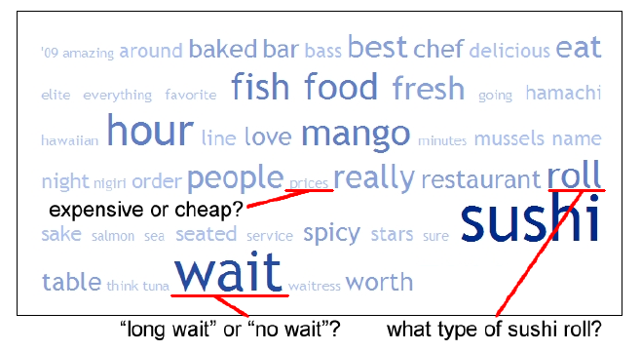
Example: Yelp reviews
Yatani 2011

Slide 21
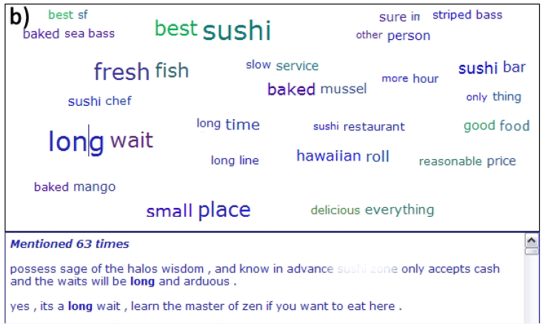
Example: Yelp reviews
Yatani 2011
Notes:
Pairs of words

Slide 22
Discussion
What are some other ways we might
visualize text data?

Slide 23
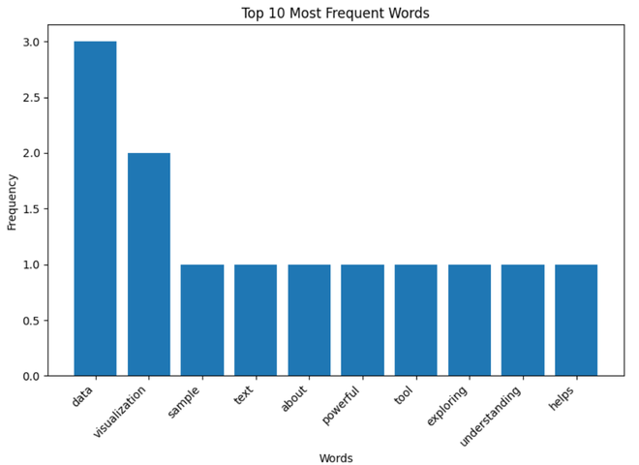
Bar Charts
https://www.geeksforgeeks.org/visualizing-text-data-techniques-and-applications/
Notes:
Bar charts can be used to visualize the frequency of specific words or phrases in a text dataset. They provide a clear and precise comparison of word frequencies.
Use Cases:
Comparing the frequency of keywords in different documents.
Analyzing the distribution of topics in a dataset.
Used to show the frequency of specific terms or categories within the text.

Slide 24
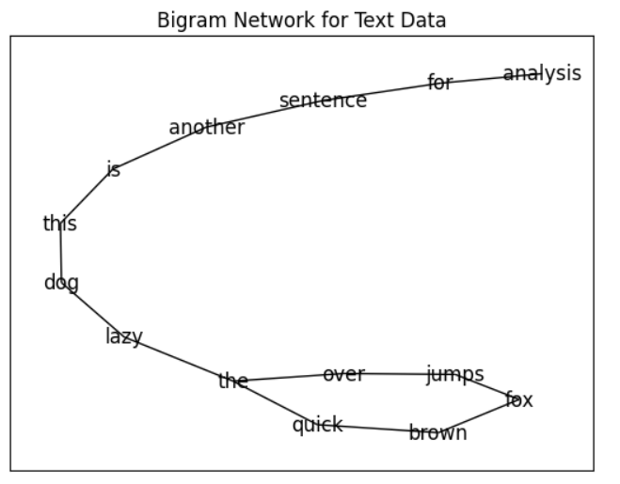
Bigram Network
https://www.geeksforgeeks.org/visualizing-text-data-techniques-and-applications/
Notes:
A Bigram Network is a visualization technique used to illustrate the relationships between pairs of words (bigrams) in a text dataset. This network graphically represents the most frequent pairs of words that appear consecutively in the text, with nodes representing words and edges representing the connections between them.
Use Cases:
Understanding the contextual relationship between words in large text datasets.
Analyzing patterns in customer feedback or social media posts to identify common themes or issues.
Exploring text data from research articles, books, or any large corpus to discover hidden connections.

Slide 25
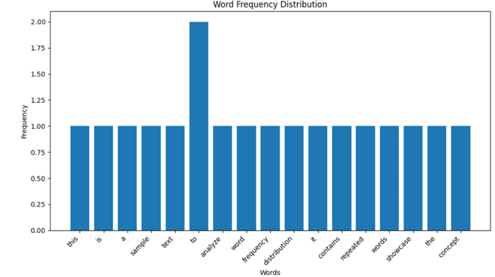
Word Frequency Distribution Plot
https://www.geeksforgeeks.org/visualizing-text-data-techniques-and-applications/
Notes:
A Word Frequency Distribution Plot is a graphical representation that shows how frequently different words appear in a text dataset. It typically displays words on the x-axis and their corresponding frequencies on the y-axis. This plot helps in understanding the distribution of words in the text, identifying the most common words, and observing the overall frequency pattern.
Use Cases:
Analyzing the vocabulary usage in a text dataset.
Identifying the most important words in customer feedback or social media posts.
Comparing word frequencies across different texts or corpora.

Slide 26
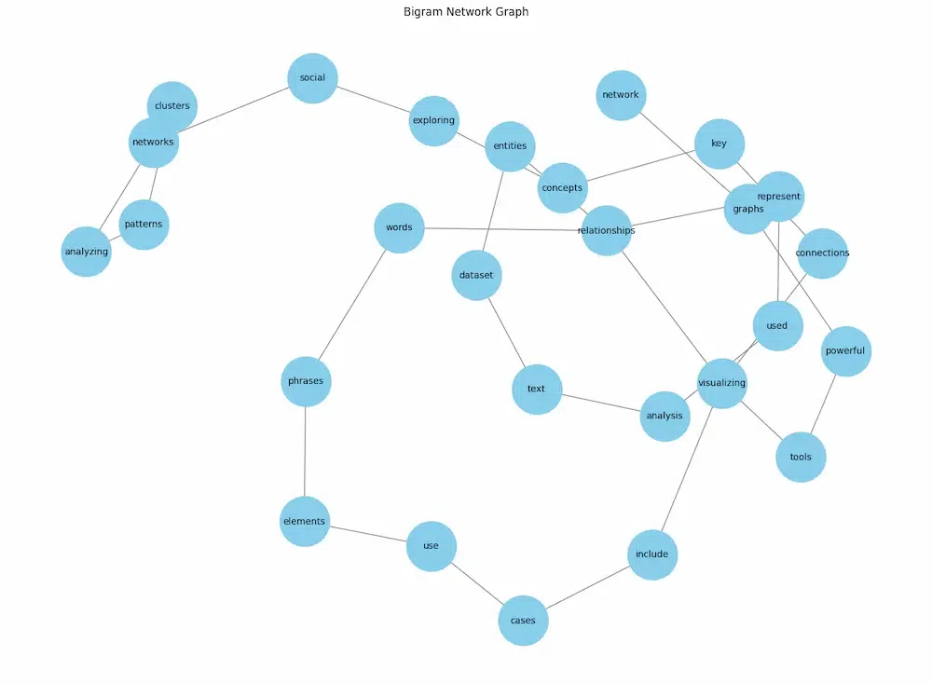
Network Graphs
https://www.geeksforgeeks.org/visualizing-text-data-techniques-and-applications/
Notes:
Network graphs visualize the relationships between words or entities in a text dataset. Nodes represent words or entities, and edges represent the relationships between them.
Use Cases:
Analyzing co-occurrence of words in a text.
Exploring relationships between entities in a document.

Slide 27
Explore other visualization options. Find one of interest to you, and be ready to share it with the class.
Some places to look:
  https://public.tableau.com/app/discover/viz-of-the-day
  https://observablehq.com/@d3/gallery
  https://r-graph-gallery.com/
  https://informationisbeautiful.net/
  https://python-graph-gallery.com/best-python-chart-examples/
  https://www.census.gov/dataviz/
  https://www.tableau.com/viz-gallery
  Anywhere you want to look!
Your Turn!

