Slide 1
Communicating with Data – Persuasive Vis
Dr. Ab Mosca (they/them)

Slide 4
Plan for Today
Visualization Rhetoric
Persuasive Visualization Activity

Slide 5
Editorial Choices
Visualizations are created by human beings
In that process editorial choices must be made

Slide 6
Editorial Choices
Visualizations are created by human beings
In that process editorial choices must be made
What aspects of a person’s mental model of the world might influence the editorial choices they make?

Slide 7
Editorial Choices
Visualizations are created by human beings
In that process editorial choices must be made
What aspects of a person’s mental model of the world might influence the editorial choices they make?
What is the difference between bias and subject matter expertise??

Slide 8
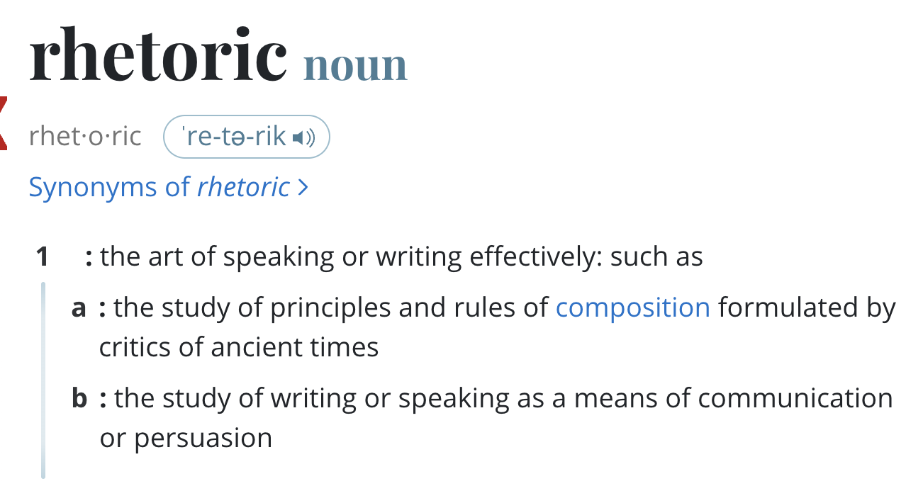
Rhetoric
Notes:
We demonstrate visualization rhetoric as an analytical framework for understanding how design techniques that prioritize particular interpretations in visualizations that “tell a story” can significantly affect end-user interpretation

Slide 9
Visualization Rhetoric
An analytical framework for understanding how design techniques that prioritize particular interpretations in visualizations that “tell a story” can significantly affect end-user interpretation.
Visualization Rhetoric: Framing Effects in Narrative Visualization; Hullman and Diakopoulos
Notes:
We demonstrate visualization rhetoric as an analytical framework for understanding how design techniques that prioritize particular interpretations in visualizations that “tell a story” can significantly affect end-user interpretation

Slide 10
Visualization Rhetoric
Editorial Layers
The Data
Visual Representation
Textual Annotations
Interactivity
ID one editorial decision to be made in each layer. How might that decision affect the takeaway message of the visualization?
Visualization Rhetoric: Framing Effects in Narrative Visualization; Hullman and Diakopoulos
Notes:
four editorial layers that can be used to convey meaning
A given rhetorical technique might be applied to some layers more easily than others. Yet omissions, emphases, and ambiguity can be accomplished at each level.
a narrative visualization represents a sequence of choices to either add information (such as by adding suggestions of an intended message using textual annotations) or omit information (such as by omitting some variables or interactivity features).
DATA
creator of a visualization makes choices about the data source to represent, including
-what variables to include and which to leave out
-removing outliers, scaling, or aggregating values
-Both lead to loss of information in the final representation, yet are necessary choices in the act of visualization design
VISUAL REPRESENTATION
choices made about how the data will be mapped to the visual domain
Mapping is lossy (JND)
TEXTUAL ANNOTATIONS
Direct the user’s attention
INTERACTIVITY
constrain a user’s interaction in ways that lead her to explore certain subsets of data.
This can occur through navigation menus that limit the number of views of the data set that are possible, or linked search suggestions that likewise encourage the user to explore particular views over others

Slide 11
Visualization Rhetoric Techniques
Information Access Rhetoric
Omission
  Neglecting to cite data sources
  Defining variables ambiguously
  Knowledge assumptions of the end-user
  Thresholding values
  Omitting exceptional cases
  Thresholding axes
  Filtering
Metonymy (techniques the require part-to-whole relationships)
  Selection of variables
  Averaging
  Textual and visual summaries
  Categorizing, binning, or aggregating
Visualization Rhetoric: Framing Effects in Narrative Visualization; Hullman and Diakopoulos

Slide 12
Visualization Rhetoric Techniques
Provenance Rhetoric
Data provenance
  Citing and/or linking...
    Data sources
    Additional references
    Methodological choices
    Relevant facts
  Annotating exceptions and corrections
Representing uncertainty
  Error bars
  Descriptions of inferential limits (ex. CI)
  “leap-of-faith” or forecast annotations
  Expressions of doubt
Identification
  Author bios or personal anecdotes
Visualization Rhetoric: Framing Effects in Narrative Visualization; Hullman and Diakopoulos
Notes:
Forecast annotations == show where interpolation starts

Slide 13
Visualization Rhetoric Techniques
Mapping Rhetoric
Obscuring
  Gratuitous third dimension
  Sizing transformations
  Discriminability limits
  Oversizing
  Neglect to map information to most salient visual judgement types
  False cause-and-effect
  Double-axis
Visual metaphor and metonymy
  Suggestive spatial mappings (ex. Left = past)
  Typographical mappings
  Color mappings
  Visual noise
Visualization Rhetoric: Framing Effects in Narrative Visualization; Hullman and Diakopoulos
Notes:
Mapping rhetoric refers to manipulating the information presentation via the data-to-visual transfer function, the constraints that determine how a piece of information will be translated to a visual feature

Slide 14
Visualization Rhetoric
Mapping Rhetoric
Contrast
  Visual contrasts
  Variable splices
Classification
  Grouping by size, position, or color
  Consistent typographic manipulations
  Equations of significance
Redundancy
  Disaggregating homogenous values or visual marks
  Visual noise
Visualization Rhetoric: Framing Effects in Narrative Visualization; Hullman and Diakopoulos
Notes:
Mapping rhetoric refers to manipulating the information presentation via the data-to-visual transfer function, the constraints that determine how a piece of information will be translated to a visual feature

Slide 15
Visualization Rhetoric Techniques
Linguistic-Based Rhetoric
Typographic emphases
  Bolding
  Italicizing
Irony
  Rhetorical questions (ex. Titles)
  Quotation marks
  Deliberate understatement
Visualization Rhetoric: Framing Effects in Narrative Visualization; Hullman and Diakopoulos

Slide 16
Visualization Rhetoric Techniques
Linguistic-Based Rhetoric
Similarity
  Contrast
  Analogy
  Metaphoric statements
  Parallelism
  Simile
  Double entendre
Individualization
  Apostrophe
  Sorting and filtering
  Phrasing or imagery framed from an individual-citizen level view
Visualization Rhetoric: Framing Effects in Narrative Visualization; Hullman and Diakopoulos

Slide 17
Visualization Rhetoric Techniques
Procedural Rhetoric
Anchoring
  Default views
  Fixed comparisons
  Spatial ordering
  Animations
  Partial animation
  Search suggestions
  Goal suggestions
Filtering
Visualization Rhetoric: Framing Effects in Narrative Visualization; Hullman and Diakopoulos
Notes:
"Procedural rhetoric" is based in an artifact’s procedural mode of representation, in other words, the expression of meanings through rule-based representations and interactive functions

Slide 18
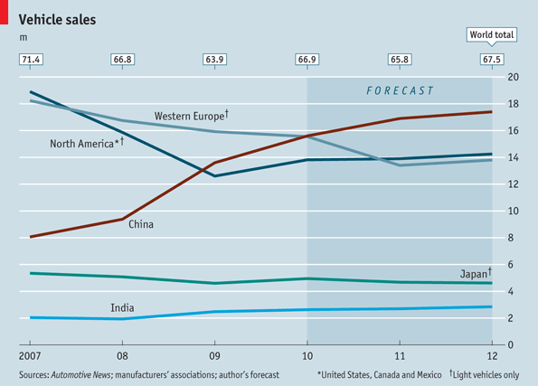
What forms of Visualization Rhetoric do you see here?
Visualization Rhetoric: Framing Effects in Narrative Visualization; Hullman and Diakopoulos
Notes:
Information access – metonymy -- Categorizing, binning, or aggregating values can be used to make an intended effect more apparent. An Economist graph on car sales [47] (Fig. 2) depicts only ‘light vehicles’ for some countries’ data, yet all sales for other countries
Provenance – representing uncertainty -- expressions of doubt regarding potential conclusions (see Fig. 2, tag line below title)
Mapping – obscuring -- double-axis, which experts have noted are difficult to decode even when properly used [50], (see Fig. 2 ‘Vehicle Sales’ [47] and Fig. 7 ‘Poll Dancing’ [29]

Slide 19
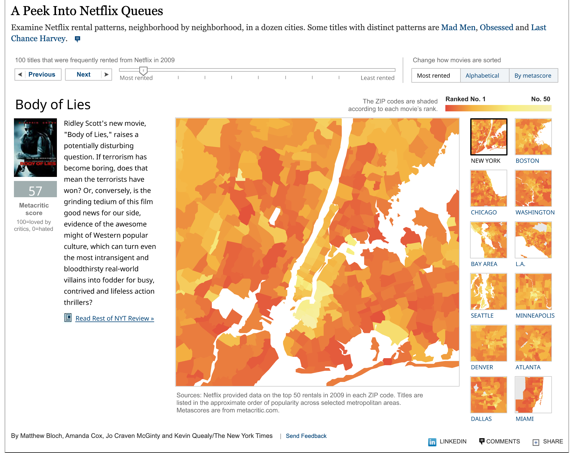
What forms of Visualization Rhetoric do you see here?
Visualization Rhetoric: Framing Effects in Narrative Visualization; Hullman and Diakopoulos
Notes:
Mapping – contrast -- An example can be found in the NYT interactive visualization entitled ‘A Peek Into Netflix Queues’ [5] (Fig. 4). The title and two variables of rental lists and movie rank variables are mapped to the important visual dimensions of spatial position and color. These mappings imply an overall message organized around geographic patterns in top rentals. However, a choice was made to include the less obviously relevant critic metascores for each movie, along with a sample NYT review of each, to the left of the map frame. The result is an implication that this information may generate further insight through comparisons with the geographic patterns

Slide 20
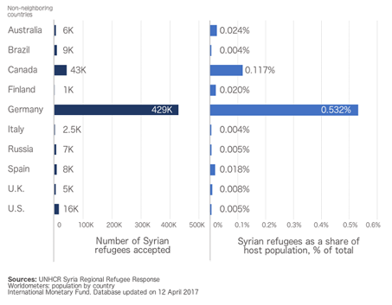
Visualization Rhetoric in Action
U.S. has accepted a lower percentage of Syrian refugees than the U.K., Spain, Finland, and Australia
U.S. has accepted more Syrian refugees than the U.K., Italy, Russia, and Finland combined
Frames and Slants in Titles of Visualizations on Controversial Topics; Kong et al.
What is the takeaway message of this visualization?
Notes:
Two visualizations on popular foreign policies that show two variables supporting opposite sides of the policy.
shows the number of Syrian refugees accepted in each country and Syrian refugees as a share of host population
Policy: The United States should increase the number of Syrian refugees admitted.
Supporting title: U.S. has accepted a lower percentage of Syrian refugees than the U.K., Spain, Finland, and Australia
Non-supporting title: U.S. has accepted more Syrian refugees than the U.K., Italy, Russia, and Finland combined
b) shows the U.S. defense budget in the last 50 years in constant fiscal year 2015 dollars and as a percentage of GDP
Policy: The United States should increase its military budget to fight ISIS.
Supporting title: Defense budget on a steady decrease as a percentage of GDP over the past 50 years
Non-supporting title: Defense budget on an increase in constant dollars heading towards $500 billion by 2019

Slide 21
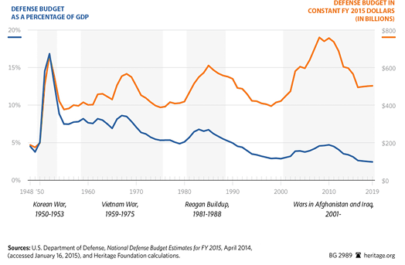
Visualization Rhetoric in Action
Defense budget on a steady decrease as a percentage of GDP over the past 50 years
Defense budget on an increase in constant dollars heading towards $500 billion by 2019.
Frames and Slants in Titles of Visualizations on Controversial Topics; Kong et al.
What is the takeaway message of this visualization?
Notes:
Two visualizations on popular foreign policies that show two variables supporting opposite sides of the policy.
shows the number of Syrian refugees accepted in each country and Syrian refugees as a share of host population
Policy: The United States should increase the number of Syrian refugees admitted.
Supporting title: U.S. has accepted a lower percentage of Syrian refugees than the U.K., Spain, Finland, and Australia
Non-supporting title: U.S. has accepted more Syrian refugees than the U.K., Italy, Russia, and Finland combined
b) shows the U.S. defense budget in the last 50 years in constant fiscal year 2015 dollars and as a percentage of GDP
Policy: The United States should increase its military budget to fight ISIS.
Supporting title: Defense budget on a steady decrease as a percentage of GDP over the past 50 years
Non-supporting title: Defense budget on an increase in constant dollars heading towards $500 billion by 2019

Slide 22
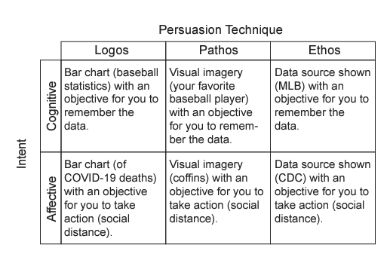
Persuasion Techniques vs. Intent
Affective Learning Objectives for Communicative Visualizations; Lee-Robins and Adar
Notes:
Examples of persuasion techniques (logos, pathos, ethos) used to achieve intents (cognitive, affective).

Slide 23
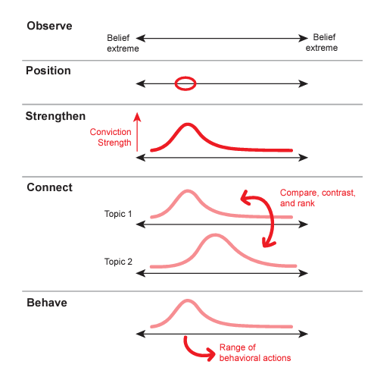
Affective Intents
Affective Learning Objectives for Communicative Visualizations; Lee-Robins and Adar
Notes:
The affective intents start at observe the range of beliefs, then to position oneself within that range of beliefs, then to strengthen one’s belief, then to connect and compare several beliefs with each other, and finally to behave consistent with that belief (see Figure 3).
In observe, the intent is simply to make the viewer aware of the range of beliefs
position, is when the designer intends to point out a specific place along the range of beliefs where they would like the viewer to be
strengthen, is when the designer tries to increase the strength of an attitude
connect, is when the designer wants the audience to compare two of their beliefs
behave, is when the designer wants the audience to act in ways consistent with the desired belief

Slide 24
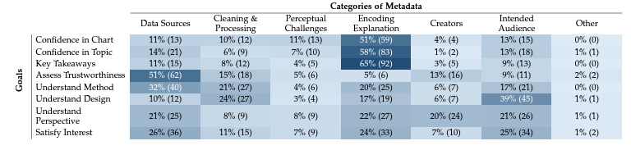
Impact of Metadata
From Invisible to Visible: Impacts of Metadata in Communicative Data Visualization; Burns et al.
Notes:
In Experiment 1, participants selected which kind of metadata they would most want to see when provided one of the eight goals. This table provides the number and percentages of times each metadata category (columns) was selected per goal (rows). Participants most frequently requested in Encoding Explanation metadata, followed by Data Sources. Percentages are rounded up to the next integer; rows may not sum to 100.

Slide 25
Activity
Form groups, each will be assigned one of the following datasets:
  Human Development Indicators
  Climate Change Indicators
  Abortion Data by U.S. State from the Guttmacher Institute
Explore your dataset and devise a proposition about it: a statement that asserts a judgement or opinion about the trends you might have uncovered
  Your proposition can be contentious but cannot be dehumanizing or demeaning
Split into two subgroups to design two persuasive visualizations; one for each side of your proposition. If you use deception, it should not be immediately obvious.
Be prepared to share your visualizations with the class
Adapted from: https://vis-society.github.io/assignments/A4.html

