Slide 1
Communicating with Data – Perception
Dr. Ab Mosca (they/them)
Slides based off slides courtesy of Jordan Crouser (https://jcrouser.github.io/)

Slide 2




Slide 4
Plan for Today
Recap last class
What is perception?
Pre-attentive processing
Using perception to rank visual channels
Gestalt
Caveats
Note: I’m going to flash a bunch of slides quickly today. If that doesn’t work for you, you are welcome to step out, close your eyes, etc.. (none of us will be offended and I will fill you in on anything crucial you missed!)

Slide 5
Recap
Work in small groups
White a checklist guide to decomposing a visual encoding (we’ve been using the same 4 steps in our examples, what are they?)

Slide 6
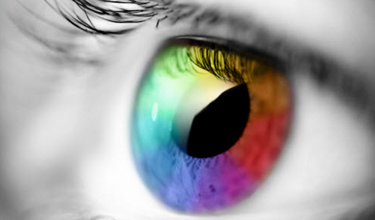
What is perception?

Slide 7

Visual perception (def.)
the (sometimes imperfect)
process by which we
detect and interpret
visual signals

Slide 8
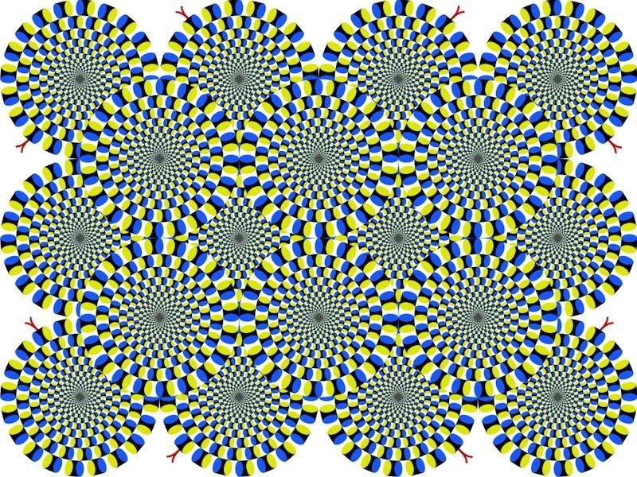
Do you see movement?

Slide 9
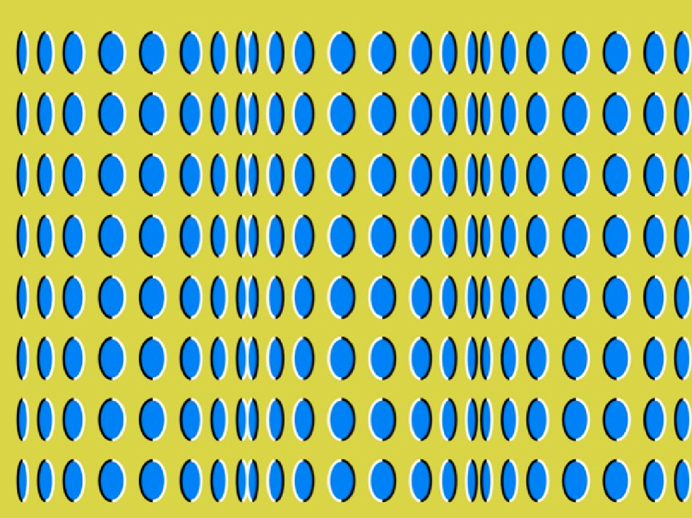
Do you see movement?

Slide 10
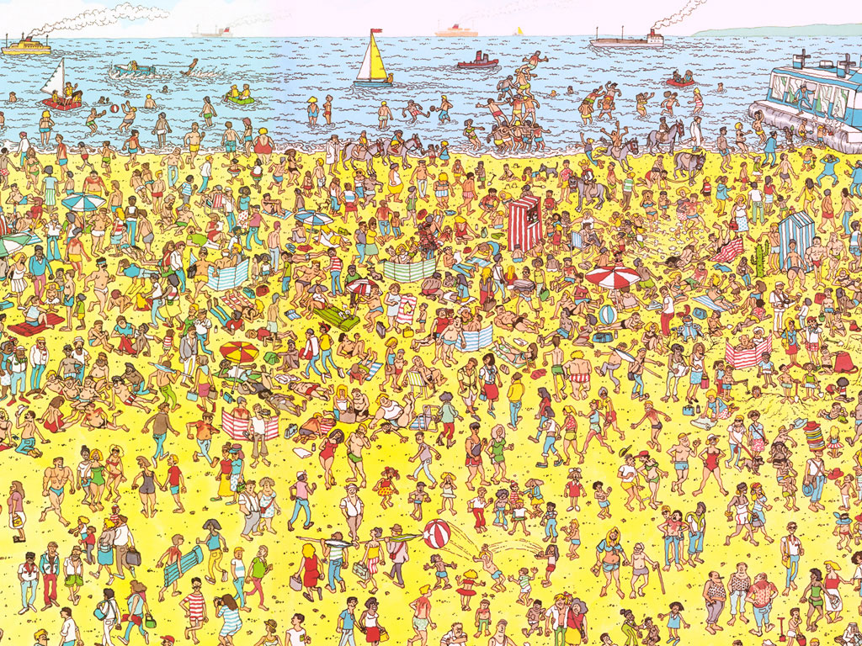
Some things are processed slowly
Visual perception

Slide 11
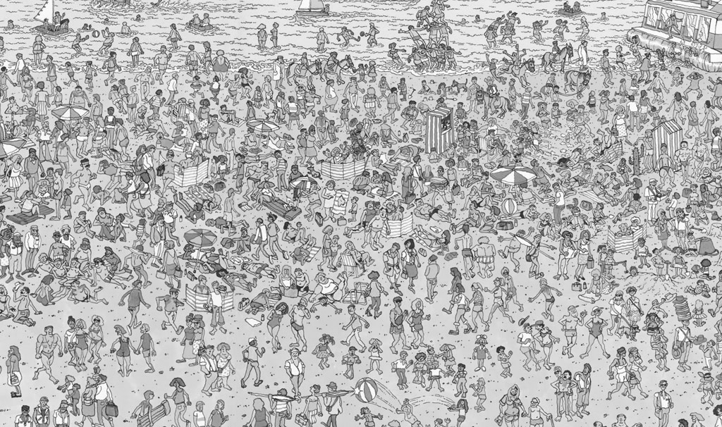
Others are incredibly fast
Visual perception

Slide 12
Fast = “pre-attentive processing”
Pre-attentive processing
Things that happen in <200ms of visual stimulation
Performed in parallel across the entire visual field
Example…
C. Healey and J. Enns, "Attention and Visual Memory in Visualization and Computer Graphics," in IEEE Transactions on Visualization and Computer Graphics, vol. 18, no. 7, pp. 1170-1188, July 2012, doi: 10.1109/TVCG.2011.127.
Notes:
Flash image on next screen

Slide 13
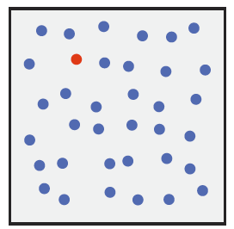
Pre-attentive processing
C. Healey and J. Enns, "Attention and Visual Memory in Visualization and Computer Graphics," in IEEE Transactions on Visualization and Computer Graphics, vol. 18, no. 7, pp. 1170-1188, July 2012, doi: 10.1109/TVCG.2011.127.
Notes:
Different hue

Slide 14
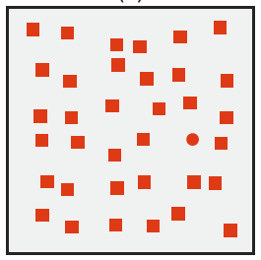
Pre-attentive processing
C. Healey and J. Enns, "Attention and Visual Memory in Visualization and Computer Graphics," in IEEE Transactions on Visualization and Computer Graphics, vol. 18, no. 7, pp. 1170-1188, July 2012, doi: 10.1109/TVCG.2011.127.
Notes:
Different curvature

Slide 15
Fast = “pre-attentive processing”
Pre-attentive processing
Things that happen in <200ms of visual stimulation
Performed in parallel across the entire visual field
A target with a unique visual property (ex. hue, curvature) “pops out” of a display; it can be easily detected
C. Healey and J. Enns, "Attention and Visual Memory in Visualization and Computer Graphics," in IEEE Transactions on Visualization and Computer Graphics, vol. 18, no. 7, pp. 1170-1188, July 2012, doi: 10.1109/TVCG.2011.127.
Notes:
Flash image on next screen

Slide 16
Pre-attentive processing
How do you think we as visualization designers can leverage pre-attentive processing?
C. Healey and J. Enns, "Attention and Visual Memory in Visualization and Computer Graphics," in IEEE Transactions on Visualization and Computer Graphics, vol. 18, no. 7, pp. 1170-1188, July 2012, doi: 10.1109/TVCG.2011.127.
Notes:
Flash image on next screen

Slide 17
Pre-attentive processing
On the next slide count how many zeros you see as fast as you can. Raise your hand (do not shout the number) when you have the answer.
Notes:
Now I’m going to flash an image on the screen

Slide 18
Attentive counting
1281768756138976546984506985624982826762
9809858458224519856458945098459985943585
9891330249945959595772564675750678974567
8845789819821677654876364968560912949686
How many zeros are there?
Notes:
Same on next slide but threes

Slide 19
Attentive counting
We’ll do the same on the next slide for threes.
Notes:
Same on next slide but threes

Slide 20
Pre-attentive counting
1281768756138976546984506985604982826762
9809858458224509856458945098450980943585
9091030209905959595772564675050678904567
8845789809821677654876364908560912949686
How many threes are there?

Slide 21
Pre-attentive processing
Can we combine pre-attentive visual features to make something ”pop out” even more?
C. Healey and J. Enns, "Attention and Visual Memory in Visualization and Computer Graphics," in IEEE Transactions on Visualization and Computer Graphics, vol. 18, no. 7, pp. 1170-1188, July 2012, doi: 10.1109/TVCG.2011.127.
Notes:
Flash image on next screen

Slide 22
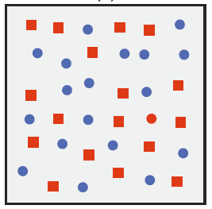
Pre-attentive processing
C. Healey and J. Enns, "Attention and Visual Memory in Visualization and Computer Graphics," in IEEE Transactions on Visualization and Computer Graphics, vol. 18, no. 7, pp. 1170-1188, July 2012, doi: 10.1109/TVCG.2011.127.
Notes:
Flash image on next screen

Slide 23
A conjunction search (multiple visual features that are each present in distractors) is not pre-attentive
Hue returns squares and
the red circle
Curvature returns blue
circles and the red circle
In both cases, you have to
search the set returned
Pre-attentive processing
C. Healey and J. Enns, "Attention and Visual Memory in Visualization and Computer Graphics," in IEEE Transactions on Visualization and Computer Graphics, vol. 18, no. 7, pp. 1170-1188, July 2012, doi: 10.1109/TVCG.2011.127.
Notes:
Flash image on next screen

Slide 24
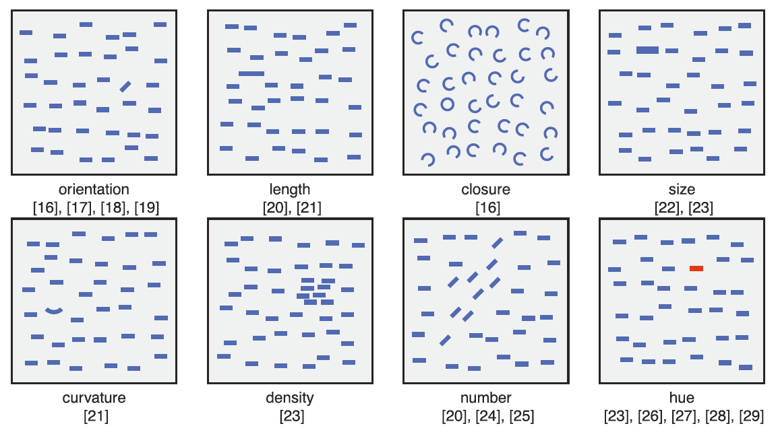
Some pre-attentive features
Pre-attentive processing
C. Healey and J. Enns, "Attention and Visual Memory in Visualization and Computer Graphics," in IEEE Transactions on Visualization and Computer Graphics, vol. 18, no. 7, pp. 1170-1188, July 2012, doi: 10.1109/TVCG.2011.127.
Notes:
Flash image on next screen

Slide 25
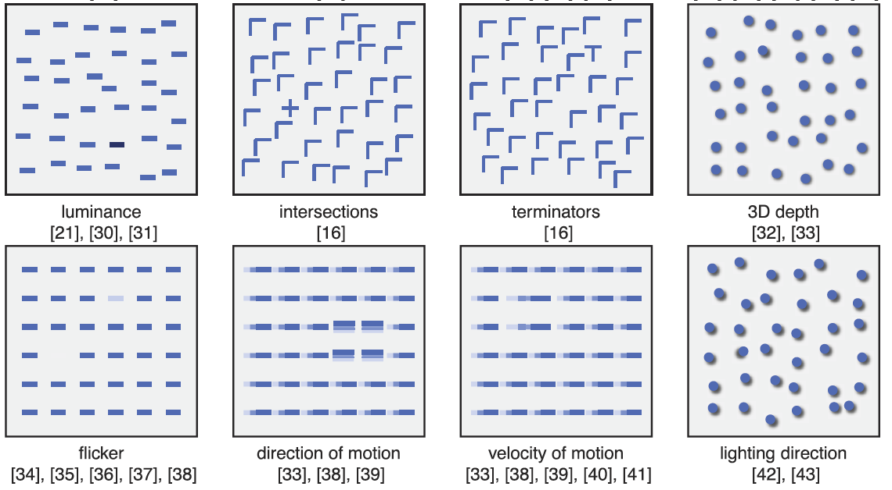
Some pre-attentive features
Pre-attentive processing
C. Healey and J. Enns, "Attention and Visual Memory in Visualization and Computer Graphics," in IEEE Transactions on Visualization and Computer Graphics, vol. 18, no. 7, pp. 1170-1188, July 2012, doi: 10.1109/TVCG.2011.127.
Notes:
Flash image on next screen

Slide 26
Pre-attentive features have been shown to support:
  Target detection
    Viewers detect a target element with a unique visual feature within a field of distractor elements
  Boundary detection
    Viewers detect a texture boundary between two groups of elements, where all of the elements in each group have a common visual property
  Region tracking
    Viewers track one or more elements with a unique visual feature as they move in time and space
  Counting and estimation
    Viewers count the number of elements with a unique visual feature
Pre-attentive processing
C. Healey and J. Enns, "Attention and Visual Memory in Visualization and Computer Graphics," in IEEE Transactions on Visualization and Computer Graphics, vol. 18, no. 7, pp. 1170-1188, July 2012, doi: 10.1109/TVCG.2011.127.
Notes:
Flash image on next screen

Slide 27
Pre-attention focuses on what draws the eye.
Visual memory asks, what do people remember from a glance?
Visual Expectation and Memory
C. Healey and J. Enns, "Attention and Visual Memory in Visualization and Computer Graphics," in IEEE Transactions on Visualization and Computer Graphics, vol. 18, no. 7, pp. 1170-1188, July 2012, doi: 10.1109/TVCG.2011.127.
Notes:
Flash image on next screen

Slide 28
Pre-attention focuses on what draws the eye.
Visual memory asks, what do people remember from a glance?
What are your hypotheses?
Visual Expectation and Memory
C. Healey and J. Enns, "Attention and Visual Memory in Visualization and Computer Graphics," in IEEE Transactions on Visualization and Computer Graphics, vol. 18, no. 7, pp. 1170-1188, July 2012, doi: 10.1109/TVCG.2011.127.
Notes:
Flash image on next screen

Slide 29
Visual processing is a dynamic process.
Your visual system is constantly building short-lived models of the external works that are specifically designed for your current visually guided tasks.
There does not appear to be any general purpose vision. What we “see” when confronted with a new scene depends as much on our goals and expectations as it does on the light that enters our eyes.
What is the implication here for visualization?
Visual Expectation and Memory
C. Healey and J. Enns, "Attention and Visual Memory in Visualization and Computer Graphics," in IEEE Transactions on Visualization and Computer Graphics, vol. 18, no. 7, pp. 1170-1188, July 2012, doi: 10.1109/TVCG.2011.127.
Notes:
Flash image on next screen

Slide 30
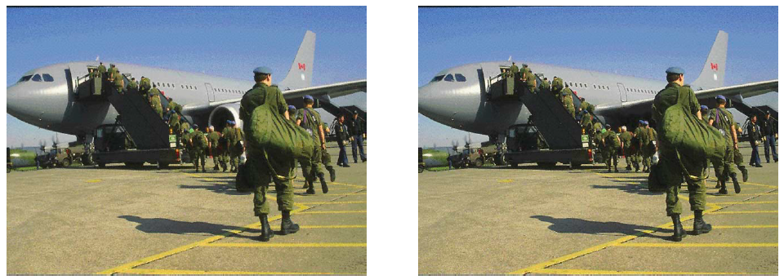
Things to look out for: Change Blindness
An interruption in what is being seen—a blink, an eye saccade, or a blank screen—renders us “blind” to significant changes that occur in the scene during the interruption.
Visual Expectation and Memory
C. Healey and J. Enns, "Attention and Visual Memory in Visualization and Computer Graphics," in IEEE Transactions on Visualization and Computer Graphics, vol. 18, no. 7, pp. 1170-1188, July 2012, doi: 10.1109/TVCG.2011.127.
Notes:
jet on wing of plane added/removed

Slide 31
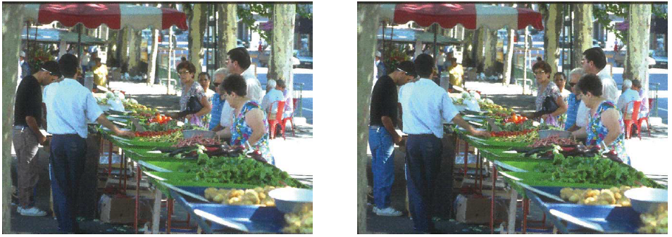
Things to look out for: Change Blindness
An interruption in what is being seen—a blink, an eye saccade, or a blank screen—renders us “blind” to significant changes that occur in the scene during the interruption.
Visual Expectation and Memory
C. Healey and J. Enns, "Attention and Visual Memory in Visualization and Computer Graphics," in IEEE Transactions on Visualization and Computer Graphics, vol. 18, no. 7, pp. 1170-1188, July 2012, doi: 10.1109/TVCG.2011.127.
Notes:
color change (pants)

Slide 32
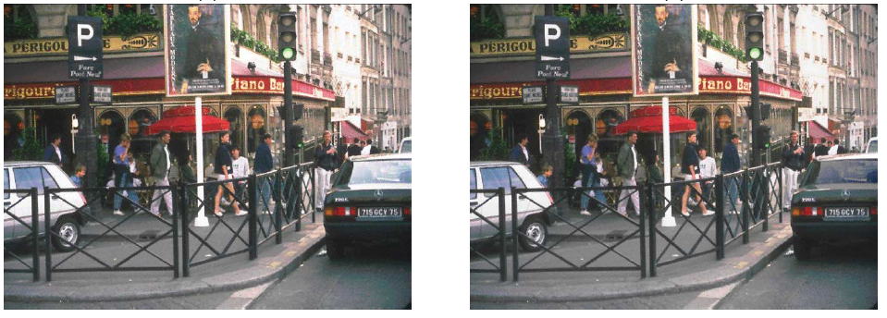
Things to look out for: Change Blindness
An interruption in what is being seen—a blink, an eye saccade, or a blank screen—renders us “blind” to significant changes that occur in the scene during the interruption.
Visual Expectation and Memory
C. Healey and J. Enns, "Attention and Visual Memory in Visualization and Computer Graphics," in IEEE Transactions on Visualization and Computer Graphics, vol. 18, no. 7, pp. 1170-1188, July 2012, doi: 10.1109/TVCG.2011.127.
Notes:
luminance of car window on right

Slide 33
Things to look out for: Inattentional Blindness
Viewers can completely fail to perceive visually salient objects or activities when attending elsewhere
https://www.youtube.com/watch?v=vJG698U2Mvo
Visual Expectation and Memory
C. Healey and J. Enns, "Attention and Visual Memory in Visualization and Computer Graphics," in IEEE Transactions on Visualization and Computer Graphics, vol. 18, no. 7, pp. 1170-1188, July 2012, doi: 10.1109/TVCG.2011.127.

Slide 34
Things to look out for: Attentional Blink
When two targets are presented in rapid succession, the second of the two targets cannot be detected or identified when it appears within approximately 100-500 msec following the first target
https://www.youtube.com/watch?v=kVvzpviOB7o
Visual Expectation and Memory
C. Healey and J. Enns, "Attention and Visual Memory in Visualization and Computer Graphics," in IEEE Transactions on Visualization and Computer Graphics, vol. 18, no. 7, pp. 1170-1188, July 2012, doi: 10.1109/TVCG.2011.127.

Slide 35
Visual Expectation and Memory
What are the implications of Change blindness, Inattentional Blindness, and Attentional Blink for visualization?
C. Healey and J. Enns, "Attention and Visual Memory in Visualization and Computer Graphics," in IEEE Transactions on Visualization and Computer Graphics, vol. 18, no. 7, pp. 1170-1188, July 2012, doi: 10.1109/TVCG.2011.127.
Notes:
Significant changes in the data may be missed if attention is
fully deployed or focused on a specific location in a
visualization. Attending to data elements in one frame of
an animation may render us temporarily blind to what
follows at that location. These issues must be considered
during visualization design.

Slide 36
Ranking Visual Channels
Leveraging the perceptual system for visualization goes beyond understanding pre-attention and visual memory
It is also a means for ranking visual channels.

Slide 37
Recall
Flashback–
What three types of data do we use in visualization?
What two major categories do we use for visual channels?
Name 7 visual channels.

Slide 38
Ranking Visual Channels
Using the correct visual channel type for the correct variable type is called expressiveness
  Ex. A Magnitude channel, like luminance, for a quantitative or ordinal variable
  Ex. An identity channel, like shape, for a nominal variable
We also consider effectiveness to choose visual channels
Munzner, T. (2014). Visualization Analysis and Design (1st ed.). A K Peters/CRC Press. https://doi.org/10.1201/b17511

Slide 39
Ranking Visual Channels
More important attributes should be encoded with more effective channels.
Effectiveness refers to how well a channel supports:
  Accuracy
  Discriminability
  Separability
  Visual popout
  Grouping
Munzner, T. (2014). Visualization Analysis and Design (1st ed.). A K Peters/CRC Press. https://doi.org/10.1201/b17511

Slide 40
Accuracy
Definition: how close human perceptual judgement is to an objective measurement of the stimulus

Slide 41
Accuracy
Definition: how close human perceptual judgement is to an objective measurement of the stimulus
How much longer is the second bar?

Slide 42
Accuracy
Definition: how close human perceptual judgement is to an objective measurement of the stimulus
How much longer is the second bar?
2X

Slide 43
Accuracy
Definition: how close human perceptual judgement is to an objective measurement of the stimulus
How much bigger is the second square?

Slide 44
Accuracy
Definition: how close human perceptual judgement is to an objective measurement of the stimulus
How much bigger is the second square?
4X

Slide 45
Accuracy
Definition: how close human perceptual judgement is to an objective measurement of the stimulus
How much bigger is the second box?

Slide 46
Accuracy
Definition: how close human perceptual judgement is to an objective measurement of the stimulus
How much bigger is the second box?
27X

Slide 47
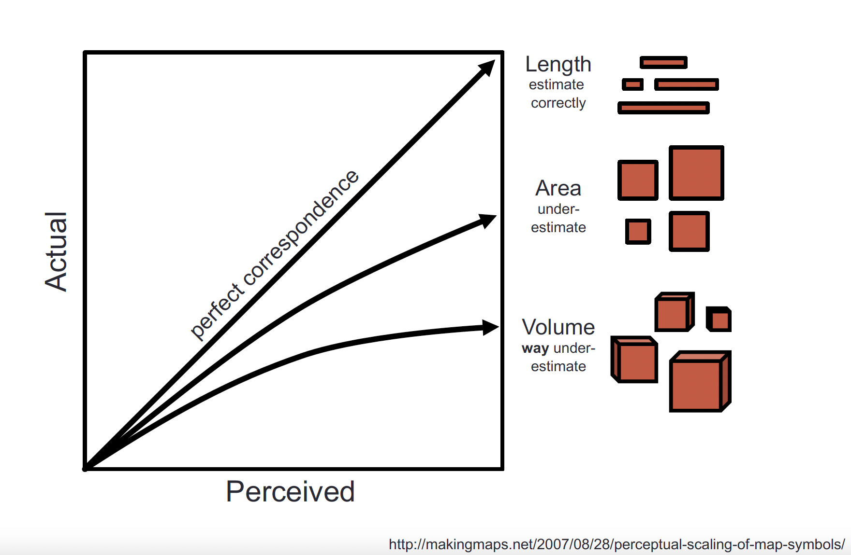
Accuracy
Definition: how close human perceptual judgement is to an objective measurement of the stimulus

Slide 48
Accuracy
Will a 2D or 3D bar chart result in better perceptual judgements? Why?

Slide 49
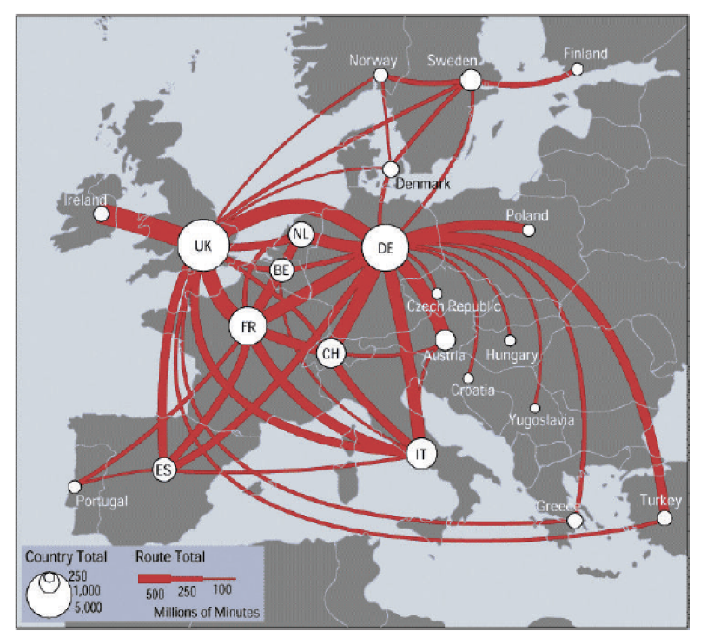
Discriminability
Definition: how differentiable levels of the channel are
https://web.cse.ohio-state.edu/~shen.94/Melbourne/Slides/TamaraChp5.pdf

Slide 50
Discriminability
Could a different visual encoding make differences more clear? What might you try?
https://web.cse.ohio-state.edu/~shen.94/Melbourne/Slides/TamaraChp5.pdf

Slide 51
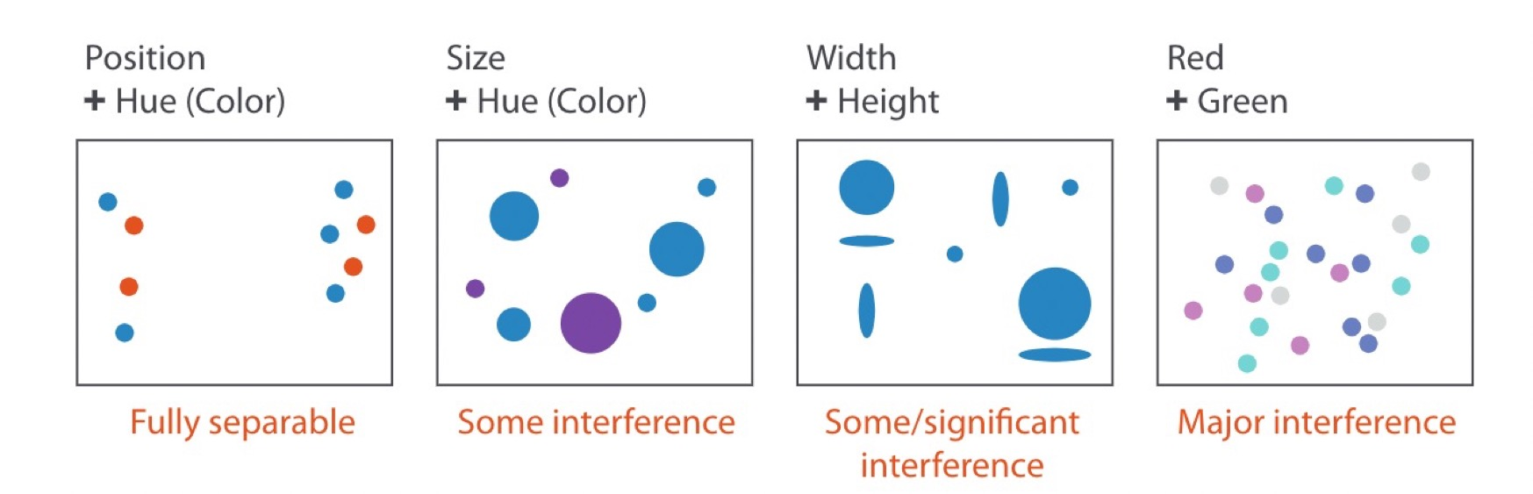
Separability
Definition: whether channels exist independently or integrally with others
(saturation)
Munzner, T. (2014). Visualization Analysis and Design (1st ed.). A K Peters/CRC Press. https://doi.org/10.1201/b17511

Slide 52
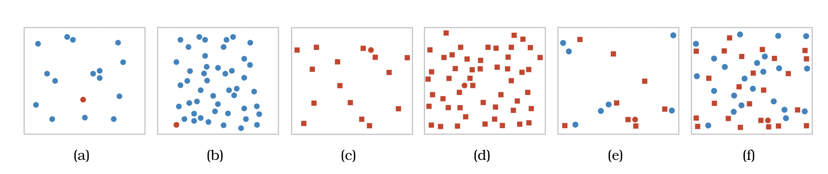
Visual Popout
Definition: how well a distinct item stands out from others
Munzner, T. (2014). Visualization Analysis and Design (1st ed.). A K Peters/CRC Press. https://doi.org/10.1201/b17511

Slide 53
Visual Popout
Definition: how well a distinct item stands out from others
Color is a good channel for this
Munzner, T. (2014). Visualization Analysis and Design (1st ed.). A K Peters/CRC Press. https://doi.org/10.1201/b17511

Slide 54
Visual Popout
Definition: how well a distinct item stands out from others
Munzner, T. (2014). Visualization Analysis and Design (1st ed.). A K Peters/CRC Press. https://doi.org/10.1201/b17511

Slide 55
Visual Popout
Definition: how well a distinct item stands out from others
Shape is not as helpful
Munzner, T. (2014). Visualization Analysis and Design (1st ed.). A K Peters/CRC Press. https://doi.org/10.1201/b17511

Slide 56
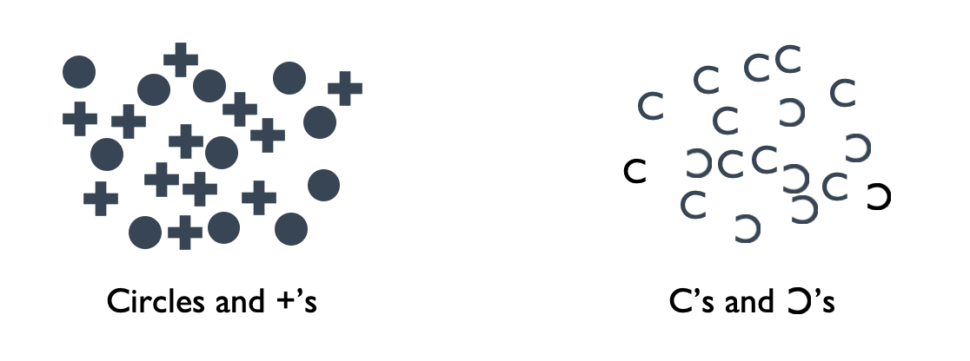
Grouping
Definition: how likely people are to infer differences as representing distinct groups
Munzner, T. (2014). Visualization Analysis and Design (1st ed.). A K Peters/CRC Press. https://doi.org/10.1201/b17511

Slide 57
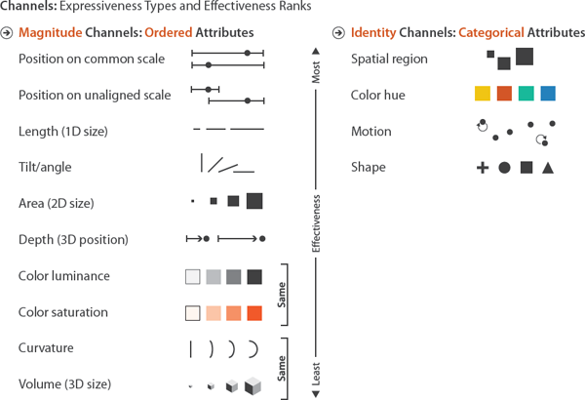
Ranking Visual Channels
Design takeaway: Prioritize most effective channels for most important data
Munzner, T. (2014). Visualization Analysis and Design (1st ed.). A K Peters/CRC Press. https://doi.org/10.1201/b17511

Slide 58
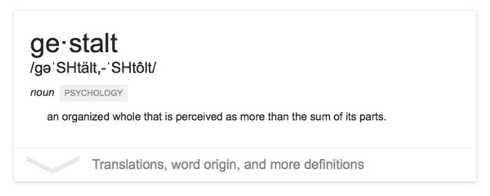
The “gestalt effect”
Our brain’s ability to generate whole forms, instead of just collections of unrelated elements

Slide 59
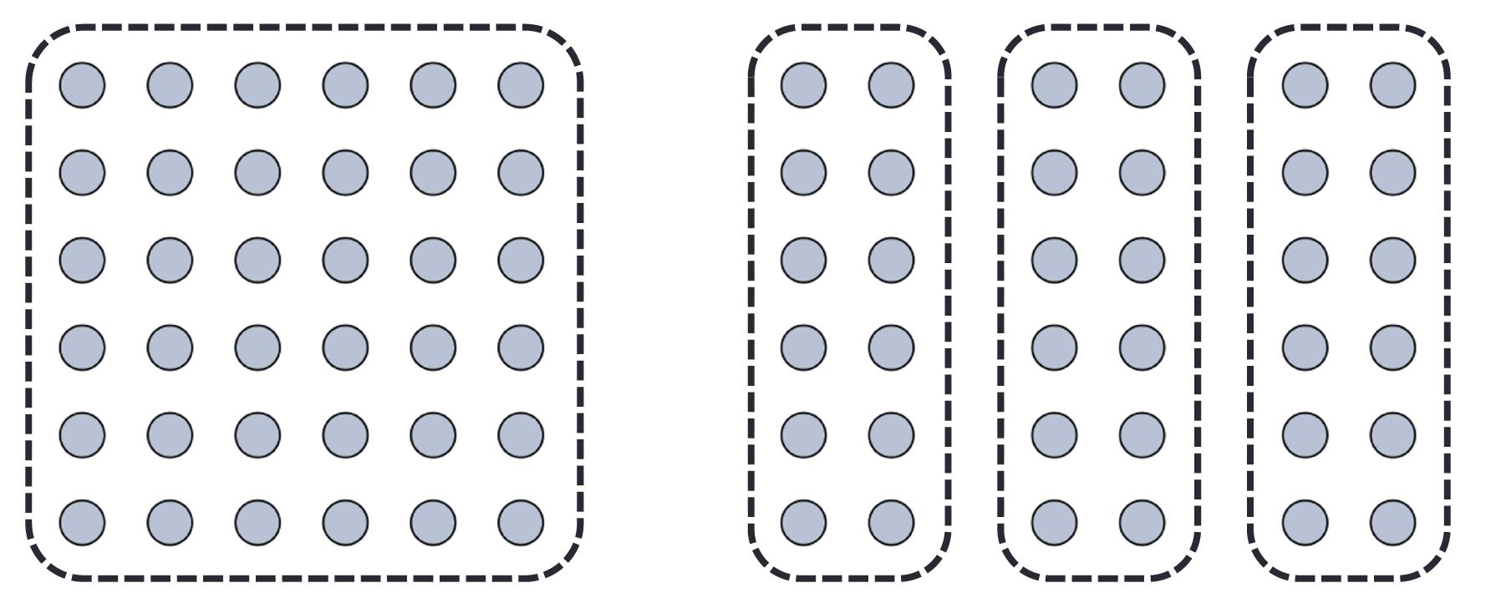
We interpret objects that are close to each other as a group
Law of Proximity
Wagemans, J., Elder, J. H., Kubovy, M., Palmer, S. E., Peterson, M. A., Singh, M., & von der Heydt, R. (2012). A century of Gestalt psychology in visual perception: I. Perceptual grouping and figure-ground organization. Psychological bulletin, 138(6), 1172–1217. https://doi.org/10.1037/a0029333
Notes:
How many groups and what are they?

Slide 60
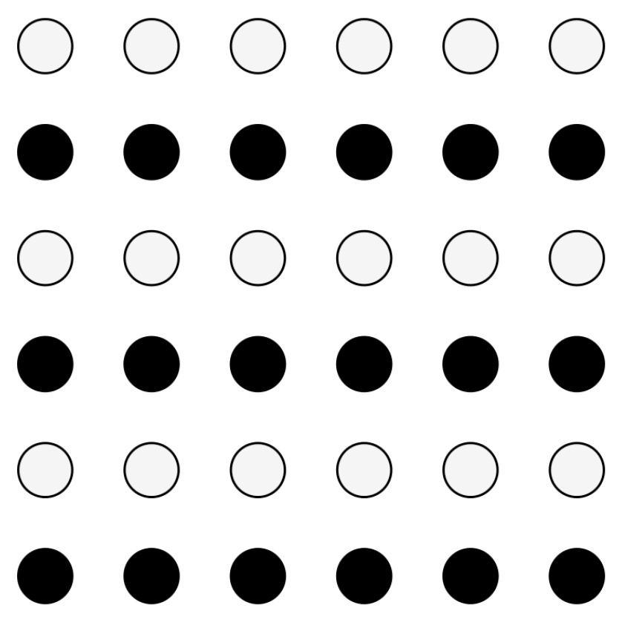
We interpret objects that are visually similar to each other as a group
Law of Similarity
“grey dots”
“black dots”
Wagemans, J., Elder, J. H., Kubovy, M., Palmer, S. E., Peterson, M. A., Singh, M., & von der Heydt, R. (2012). A century of Gestalt psychology in visual perception: I. Perceptual grouping and figure-ground organization. Psychological bulletin, 138(6), 1172–1217. https://doi.org/10.1037/a0029333

Slide 61

When parts of a picture are missing, we fill in the visual gap
Law of Closure
Wagemans, J., Elder, J. H., Kubovy, M., Palmer, S. E., Peterson, M. A., Singh, M., & von der Heydt, R. (2012). A century of Gestalt psychology in visual perception: I. Perceptual grouping and figure-ground organization. Psychological bulletin, 138(6), 1172–1217. https://doi.org/10.1037/a0029333

Slide 62
Law of Symmetry
We perceive objects as being symmetrical, arranged around a center point
law of proximity
[ ] { } [ ]
law of symmetry + law of similarity
Wagemans, J., Elder, J. H., Kubovy, M., Palmer, S. E., Peterson, M. A., Singh, M., & von der Heydt, R. (2012). A century of Gestalt psychology in visual perception: I. Perceptual grouping and figure-ground organization. Psychological bulletin, 138(6), 1172–1217. https://doi.org/10.1037/a0029333

Slide 63
We group objects that we perceive to be moving along the same path
Law of Common Fate
Wagemans, J., Elder, J. H., Kubovy, M., Palmer, S. E., Peterson, M. A., Singh, M., & von der Heydt, R. (2012). A century of Gestalt psychology in visual perception: I. Perceptual grouping and figure-ground organization. Psychological bulletin, 138(6), 1172–1217. https://doi.org/10.1037/a0029333

Slide 64
We tend to group objects along the smoothest path
Law of Continuity
Wagemans, J., Elder, J. H., Kubovy, M., Palmer, S. E., Peterson, M. A., Singh, M., & von der Heydt, R. (2012). A century of Gestalt psychology in visual perception: I. Perceptual grouping and figure-ground organization. Psychological bulletin, 138(6), 1172–1217. https://doi.org/10.1037/a0029333

Slide 65
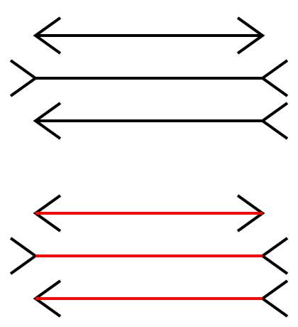
Sometimes gestalt & pre-attention compete
Pre-attentive processing for visualization: The downsides
Gregory R. L. (1997). Knowledge in perception and illusion. Philosophical transactions of the Royal Society of London. Series B, Biological sciences, 352(1358), 1121–1127. https://doi.org/10.1098/rstb.1997.0095
Notes:
Lines seem different sizes

Slide 66

Sometimes gestalt & pre-attention compete
Pre-attentive processing for visualization: The downsides
Gregory R. L. (1997). Knowledge in perception and illusion. Philosophical transactions of the Royal Society of London. Series B, Biological sciences, 352(1358), 1121–1127. https://doi.org/10.1098/rstb.1997.0095
Notes:
All right angles

Slide 67
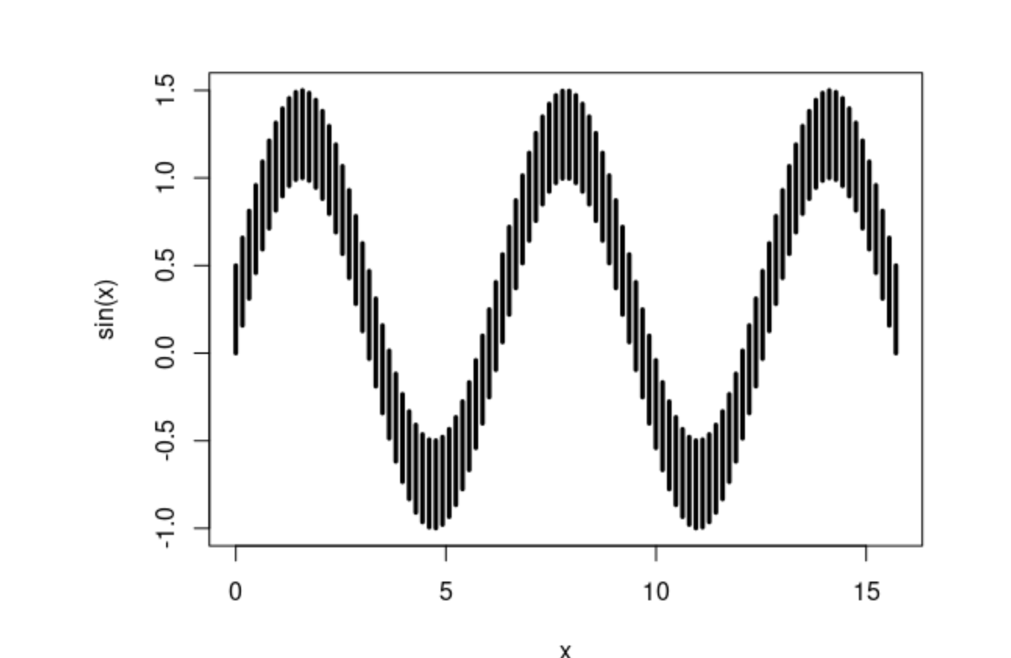
Sometimes gestalt & pre-attention compete
Pre-attentive processing for visualization: The downsides
Notes:
All same length or different?

Slide 68
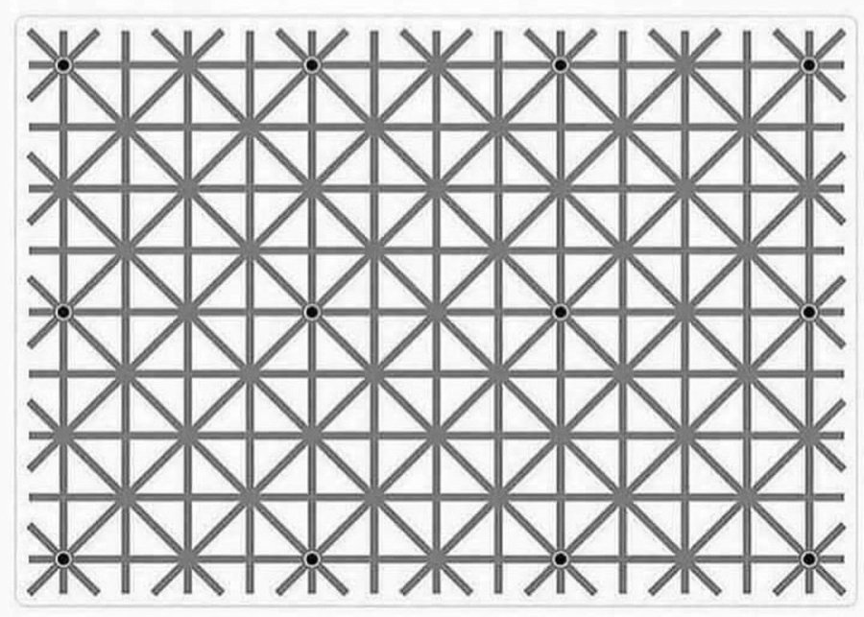
Short term “working” memory is limited
Attentive processing
https://homepage.divms.uiowa.edu/~luke/classes/STAT4580/percep.html
Notes:
Can you see all 12 black dots?

