Slide 1
Communicating with Data – Embellishment
Dr. Ab Mosca (they/them)
Slides based off slides courtesy of Jordan Crouser (https://jcrouser.github.io/)

Slide 2
Recall
What is one caveat to keep in mind when encoding data via color (hue, or saturation)?

Slide 3
Plan for Today
What is embellishment for visualization?
Chart Junk
Definition
Benefits and Drawbacks

Slide 4
Brainstorm
What do you think embellishment for a visualization is?

Slide 5
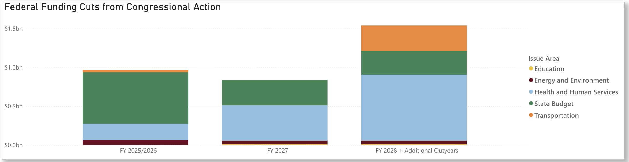
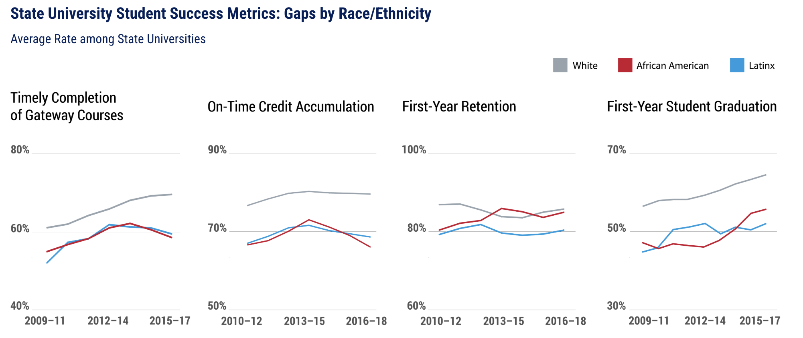
Brainstorm
How might you embellish these visualizations?
https://www.mass.gov/info-details/impact-of-trump-administration-and-congressional-cuts-on-massachusetts
https://www.mass.edu/datacenter/pmrs/reports/2019/Success-Completion.asp

Slide 6

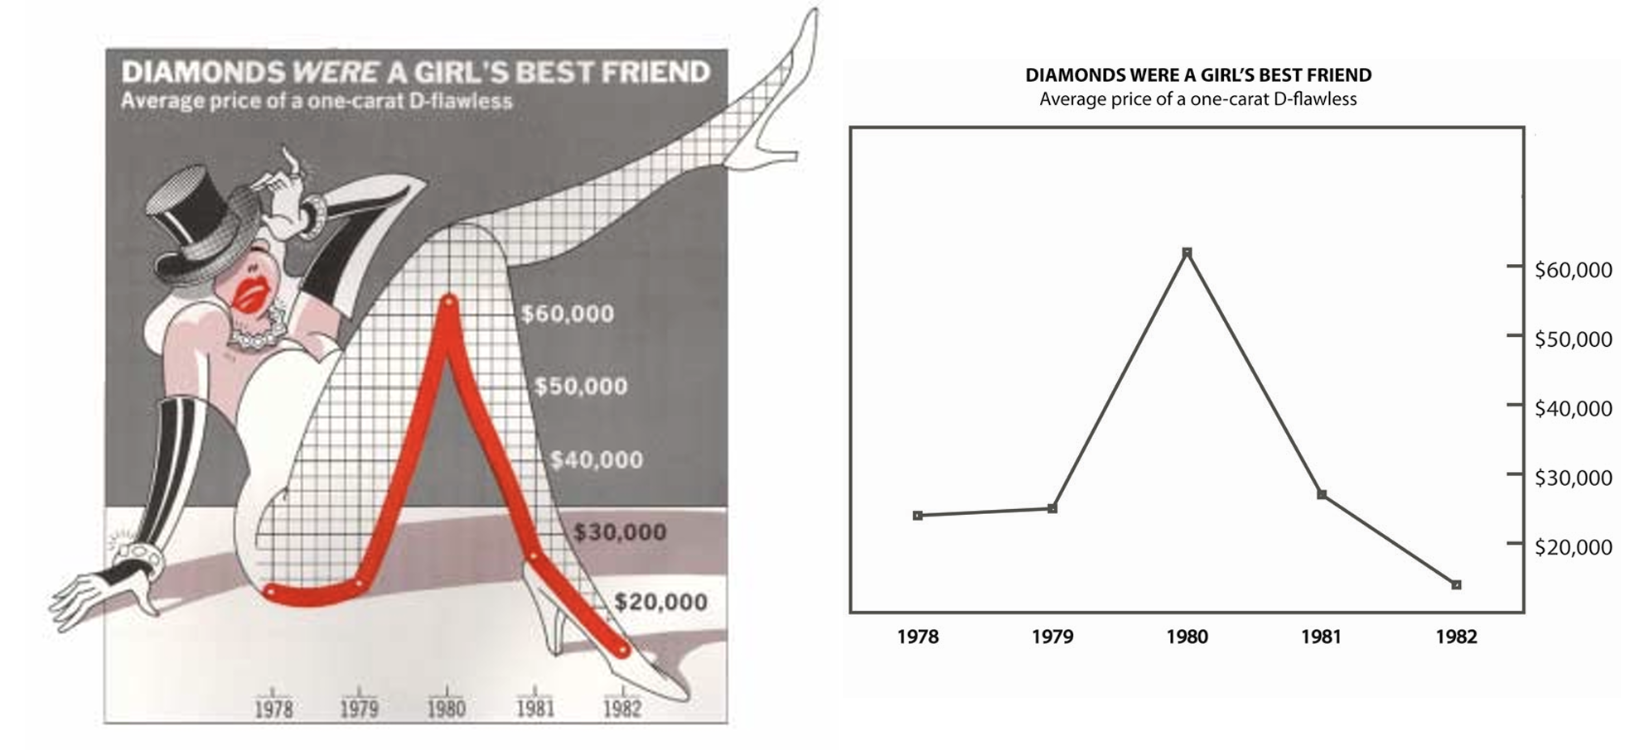
Brainstorm
Are these embellished? Why or why not?
https://www.mass.edu/datacenter/equityspotlight-latinomales.asp
Scott Bateman, Regan L. Mandryk, Carl Gutwin, Aaron Genest, David McDine, and Christopher Brooks. 2010. Useful junk? the effects of visual embellishment on comprehension and memorability of charts. https://doi.org/10.1145/1753326.1753716

Slide 7
Chart Junk
Edward Tufte
Data-Ink == Ink on the page that displays data
Chart Junk ==
  Non-data ink
  Purely style elements
Tufte, E. R. (1983). The Visual Display of Quantitative Information. Cheshire, CT: Graphics Press

Slide 8
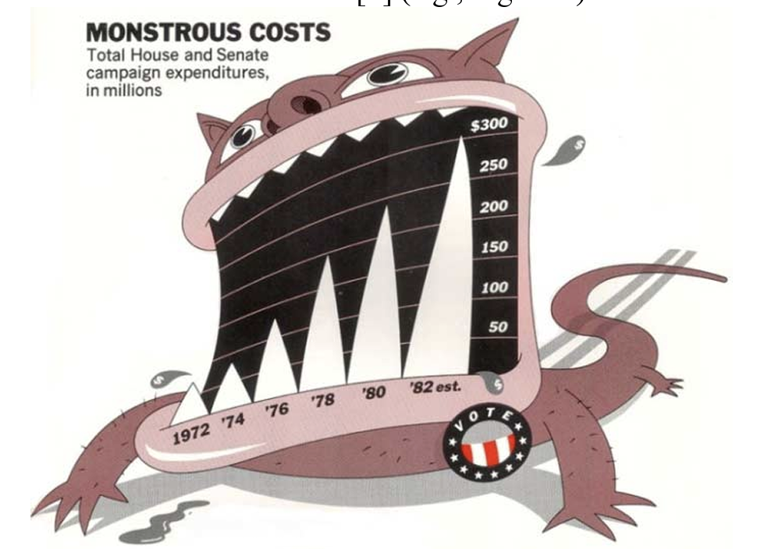
Chart Junk
Redraw the following without chart junk
Scott Bateman, Regan L. Mandryk, Carl Gutwin, Aaron Genest, David McDine, and Christopher Brooks. 2010. Useful junk? the effects of visual embellishment on comprehension and memorability of charts. https://doi.org/10.1145/1753326.1753716

Slide 9
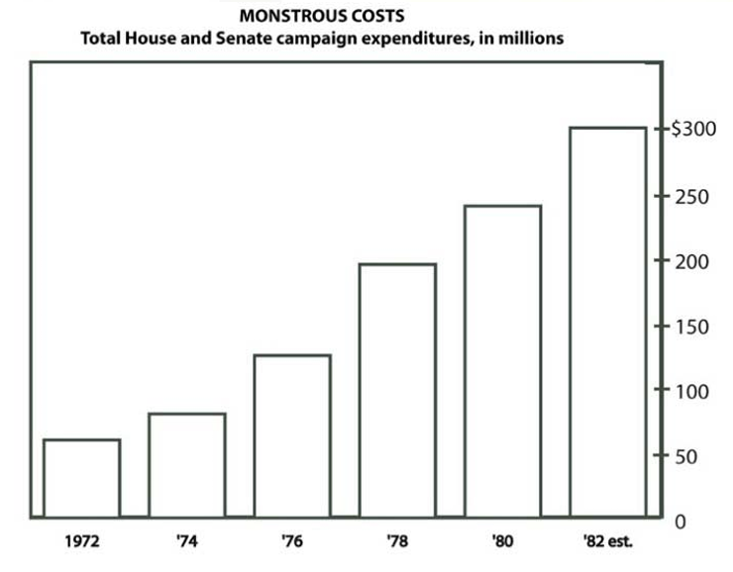
Chart Junk
Redraw the following without chart junk
Scott Bateman, Regan L. Mandryk, Carl Gutwin, Aaron Genest, David McDine, and Christopher Brooks. 2010. Useful junk? the effects of visual embellishment on comprehension and memorability of charts. https://doi.org/10.1145/1753326.1753716

Slide 10
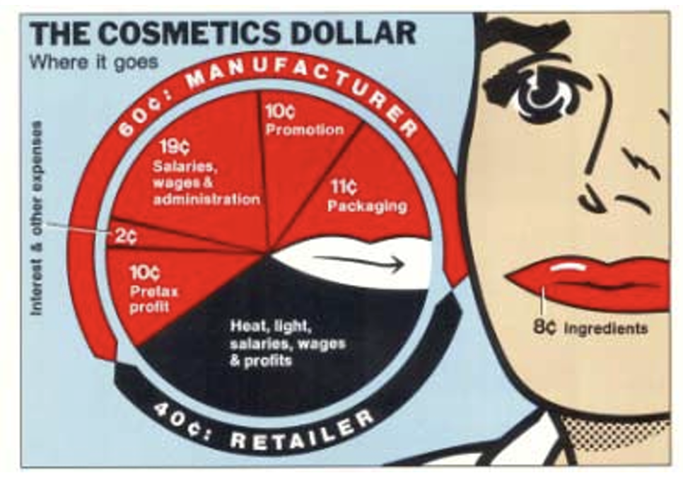
Chart Junk
Redraw the following without chart junk
Scott Bateman, Regan L. Mandryk, Carl Gutwin, Aaron Genest, David McDine, and Christopher Brooks. 2010. Useful junk? the effects of visual embellishment on comprehension and memorability of charts. https://doi.org/10.1145/1753326.1753716

Slide 11
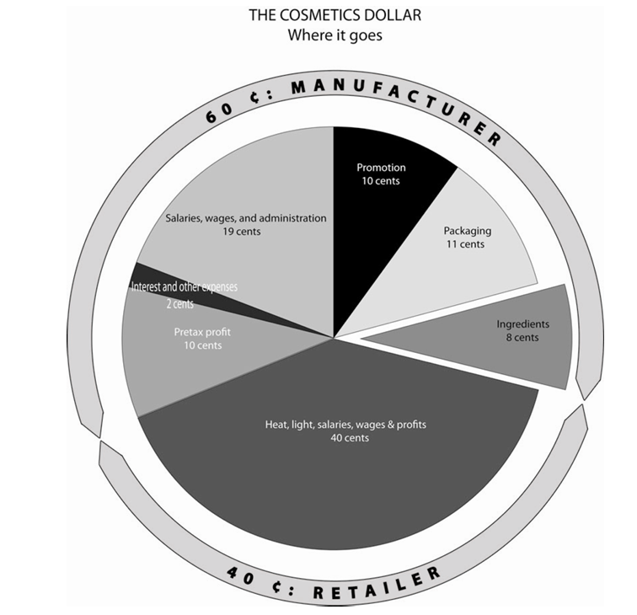
Chart Junk
Redraw the following without chart junk
Scott Bateman, Regan L. Mandryk, Carl Gutwin, Aaron Genest, David McDine, and Christopher Brooks. 2010. Useful junk? the effects of visual embellishment on comprehension and memorability of charts. https://doi.org/10.1145/1753326.1753716

Slide 12
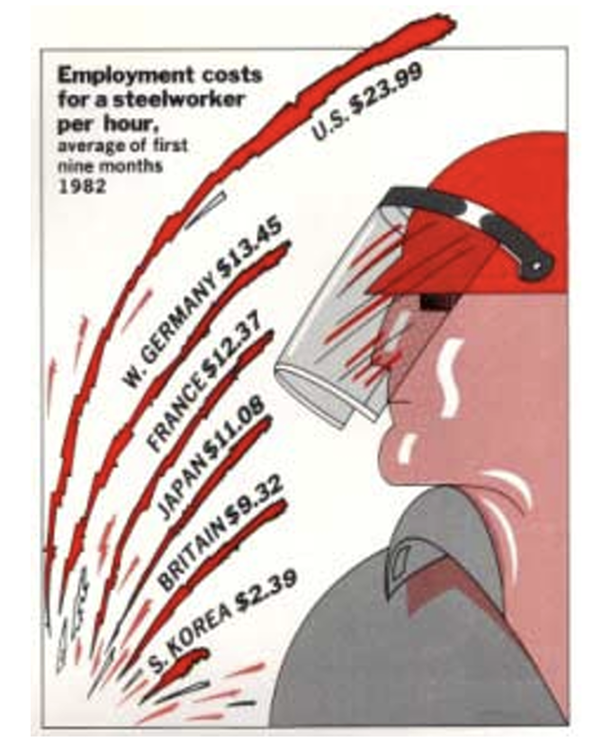
Chart Junk
Redraw the following without chart junk
Scott Bateman, Regan L. Mandryk, Carl Gutwin, Aaron Genest, David McDine, and Christopher Brooks. 2010. Useful junk? the effects of visual embellishment on comprehension and memorability of charts. https://doi.org/10.1145/1753326.1753716

Slide 13
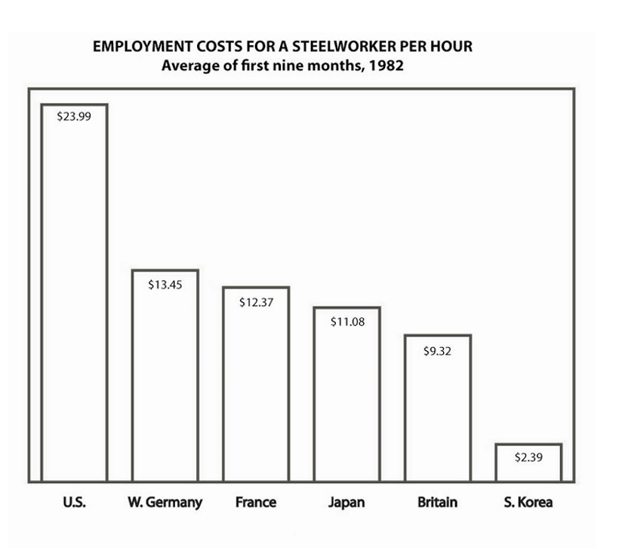
Chart Junk
Redraw the following without chart junk
Scott Bateman, Regan L. Mandryk, Carl Gutwin, Aaron Genest, David McDine, and Christopher Brooks. 2010. Useful junk? the effects of visual embellishment on comprehension and memorability of charts. https://doi.org/10.1145/1753326.1753716

Slide 14
Chart Junk
Edward Tufte
Data-Ink == Ink on the page that displays data
Chart Junk ==
  Non-data ink
  Purely style elements
Tufte’s take: the best visualizations minimize chart junk and focus explicitly on representing data
Do you agree?
Tufte, E. R. (1983). The Visual Display of Quantitative Information. Cheshire, CT: Graphics Press

Slide 15
Definition
When we say embellishment in a visualization context, we’re referring to graphical elements that do not directly display data, or that are added for stylistic reasons to a chart.
You can think of embellishment as chart junk. Like anything, there are benefits and drawbacks…

Slide 16
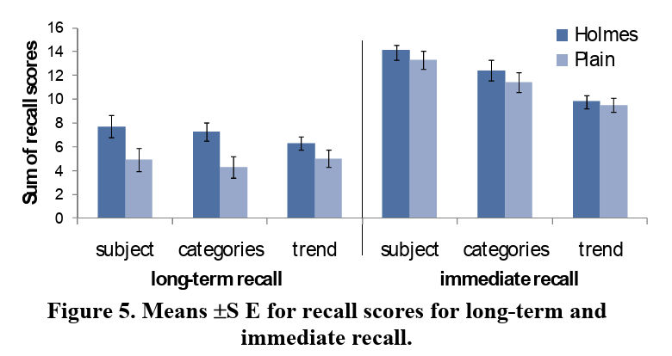
Embellishment and Recall / Memorability
Short-term recall of chart subject, categories shown, and trend appears unaffected by embellishment
Long-term recall of chart subject, categories shown, and trend appear affected by embellishment
Scott Bateman, Regan L. Mandryk, Carl Gutwin, Aaron Genest, David McDine, and Christopher Brooks. 2010. Useful junk? the effects of visual embellishment on comprehension and memorability of charts. https://doi.org/10.1145/1753326.1753716

Slide 17
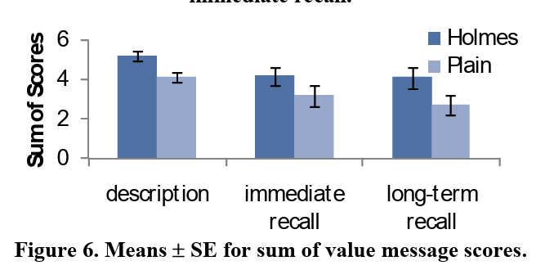
Embellishment and Recall / Memorability
Short- and long-term recall of a chart’s value message are affected by embellishment
Scott Bateman, Regan L. Mandryk, Carl Gutwin, Aaron Genest, David McDine, and Christopher Brooks. 2010. Useful junk? the effects of visual embellishment on comprehension and memorability of charts. https://doi.org/10.1145/1753326.1753716

Slide 18
Embellishment and Recall / Memorability
What readers recall about visualizations is not hindered by pictograms. In other words, with pictograms the message of the visualization is correctly recalled (and in fact, often better)
However, pictograms can hurt the understanding of a visualization. Any time people spend on a pictogram is time not spent on the data or the message (unless the pictogram contains part of the data or message), and if the link between the data/message and the pictogram is not clear, people may misunderstand and/or misrecall what the visualization was about
M. A. Borkin et al., "Beyond Memorability: Visualization Recognition and Recall," in IEEE Transactions on Visualization and Computer Graphics, vol. 22, no. 1, pp. 519-528, 31 Jan. 2016, doi: 10.1109/TVCG.2015.2467732

Slide 19
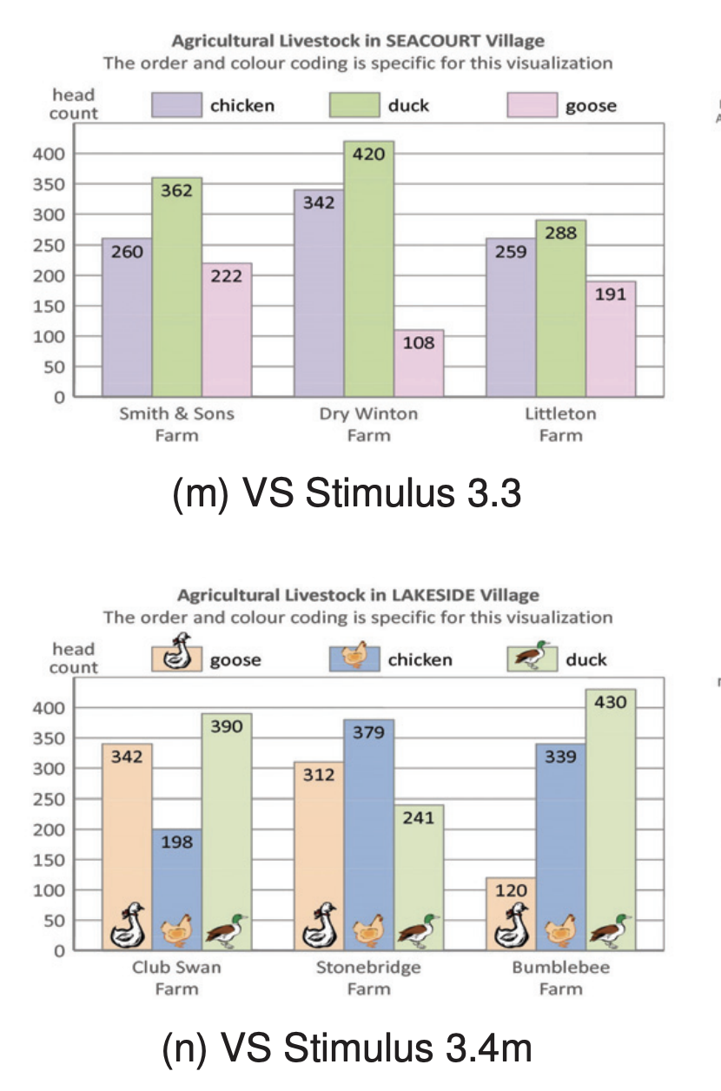
Embellishment and Cognition
When visual embellishments relate to information to be remembered (ex. groups), they improve working memory
In other words, visual embellishments can help free up cognitive space for other tasks
R. Borgo et al., "An Empirical Study on Using Visual Embellishments in Visualization," in IEEE Transactions on Visualization and Computer Graphics, vol. 18, no. 12, pp. 2759-2768, Dec. 2012, doi: 10.1109/TVCG.2012.197.
M. Alebri, E. Costanza, G. Panagiotidou and D. P. Brumby, "Embellishments Revisited: Perceptions of Embellished Visualisations Through the Viewer's Lens" in IEEE Transactions on Visualization & Computer Graphics, vol. 30, no. 01, pp. 1424-1434, Jan. 2024, doi: 10.1109/TVCG.2023.3326914.

Slide 20
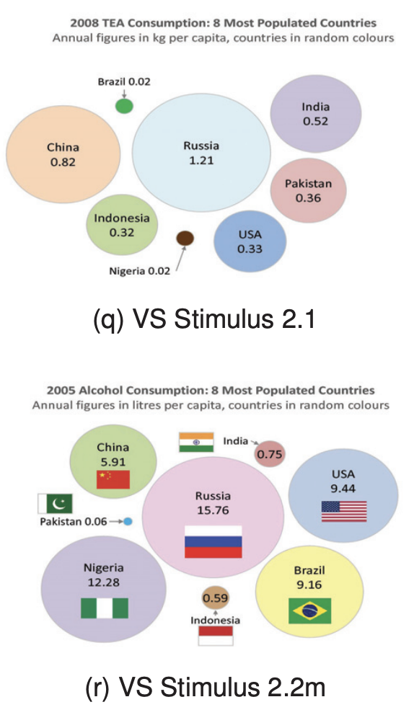
Embellishment and Cognition
Visual embellishment can negatively impact visual search, by distracting from the search target
R. Borgo et al., "An Empirical Study on Using Visual Embellishments in Visualization," in IEEE Transactions on Visualization and Computer Graphics, vol. 18, no. 12, pp. 2759-2768, Dec. 2012, doi: 10.1109/TVCG.2012.197.

Slide 21
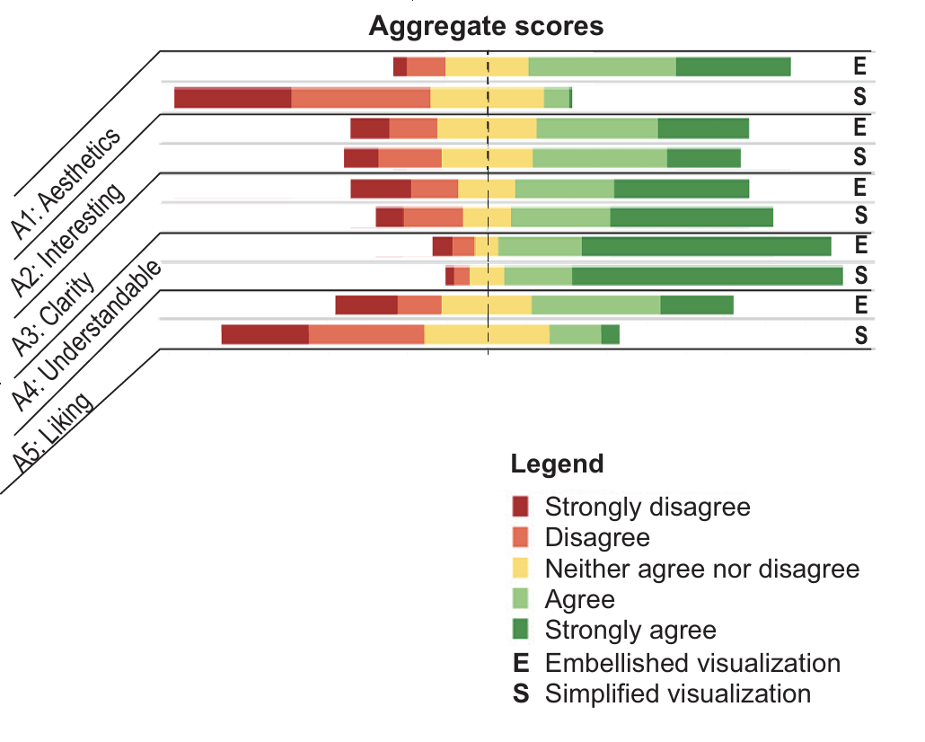
Embellishment and Reader Preference
Readers tend to rate embellished charts as preferable
Tiffany Andry, Christophe Hurter, François Lambotte, Pierre Fastrez, and Alexandru Telea. 2021. Interpreting the Effect of Embellishment on Chart Visualizations. In Proceedings of the 2021 CHI Conference on Human Factors in Computing Systems (CHI '21). Association for Computing Machinery, New York, NY, USA, Article 613, 1–15. https://doi.org/10.1145/3411764.3445739

Slide 22
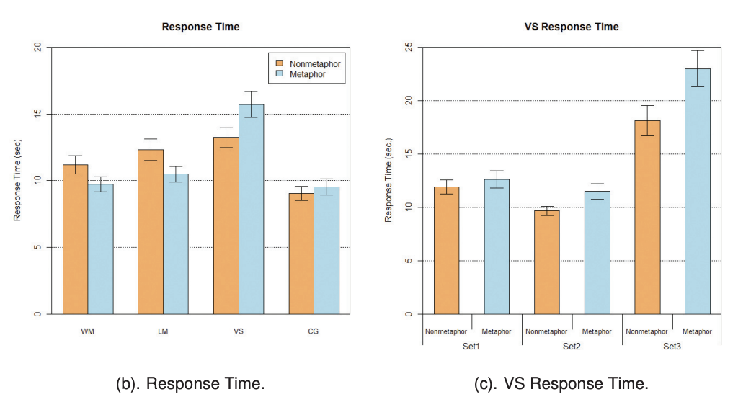
Embellishment and Time
Embellishment affects response time
When might longer response time be positive vs. negative?
R. Borgo et al., "An Empirical Study on Using Visual Embellishments in Visualization," in IEEE Transactions on Visualization and Computer Graphics, vol. 18, no. 12, pp. 2759-2768, Dec. 2012, doi: 10.1109/TVCG.2012.197.

Slide 23
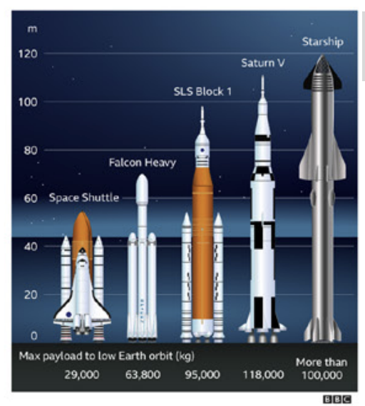
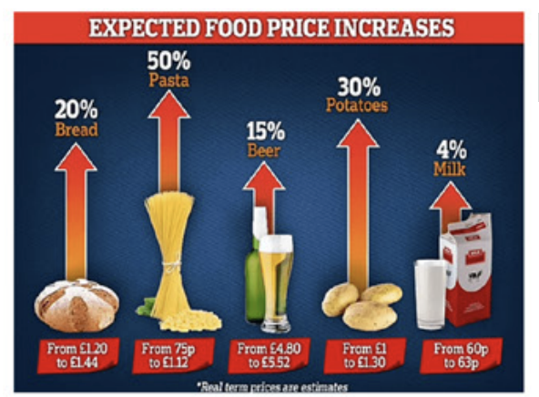
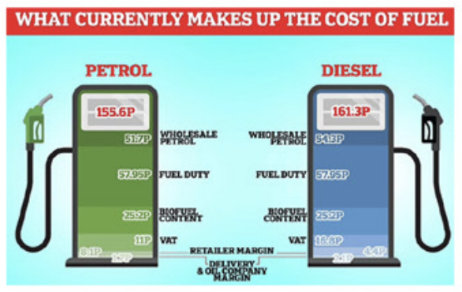
Embellishment and Engagement
When engagement is measured via insights, embellished and simple charts are found to have similar levels
Interviews show embellishment is associated with enticement, and people like visualizations that look “picture-like”
M. Alebri, E. Costanza, G. Panagiotidou and D. P. Brumby, "Embellishments Revisited: Perceptions of Embellished Visualisations Through the Viewer's Lens" in IEEE TVCG, vol. 30, no. 01, pp. 1424-1434, Jan. 2024, doi: 10.1109/TVCG.2023.3326914.
V. Braun and Victoria Clarke. Thematic Analysis A Practical Guide. Sage, first ed., 2021. doi: 10.1177/1035719X21105825
A. Vande Moere, M. Tomitsch, C. Wimmer, B. Christoph, and T. Grechenig. Evaluating the Effect of Style in Information Visualization. IEEE TVCG, 18(12):2739– 2748, 2012. doi: 10.1109/TVCG.2012.221

Slide 24
Embellishment and Seriousness
Some viewers feel that embellished visualizations underestimate their ability to read a visualization and are patronizing
M. Alebri, E. Costanza, G. Panagiotidou and D. P. Brumby, "Embellishments Revisited: Perceptions of Embellished Visualisations Through the Viewer's Lens" in IEEE Transactions on Visualization & Computer Graphics, vol. 30, no. 01, pp. 1424-1434, Jan. 2024, doi: 10.1109/TVCG.2023.3326914.

Slide 25
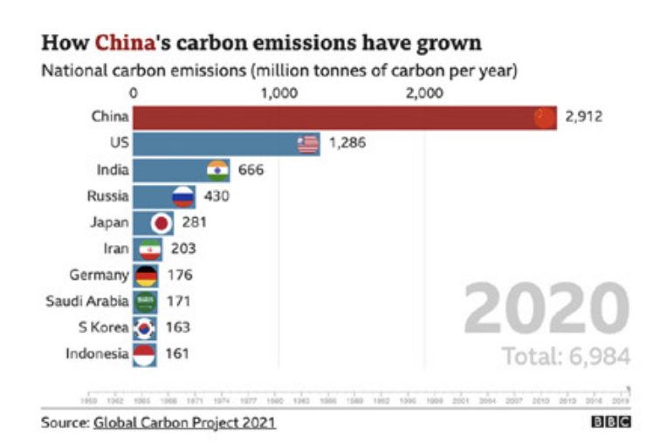
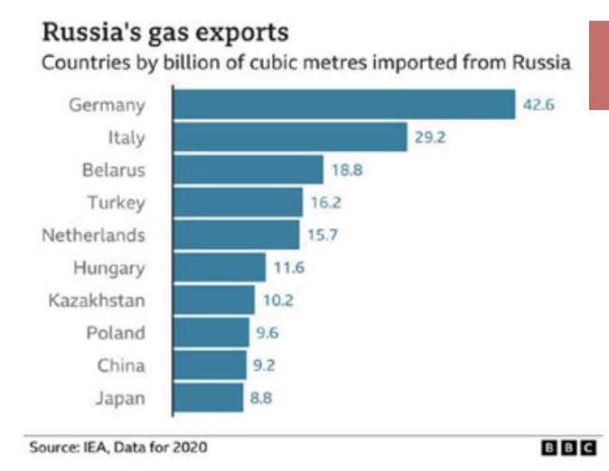
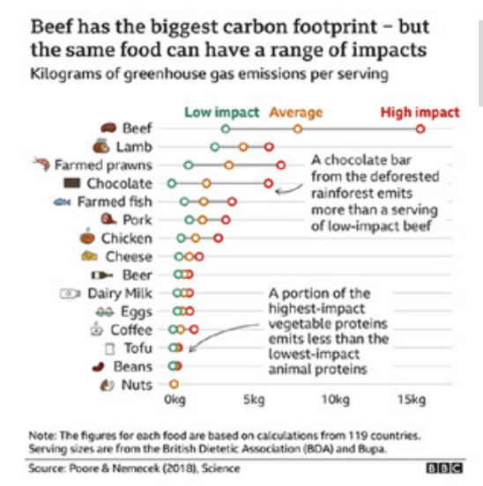
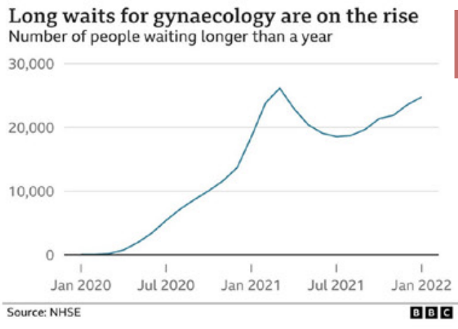
Embellishment and Trust
Embellishment can erode trust; some viewers associate it with tabloid or sensational reporting
Less Trustworthy
More Trustworthy
M. Alebri, E. Costanza, G. Panagiotidou and D. P. Brumby, "Embellishments Revisited: Perceptions of Embellished Visualisations Through the Viewer's Lens" in IEEE Transactions on Visualization & Computer Graphics, vol. 30, no. 01, pp. 1424-1434, Jan. 2024, doi: 10.1109/TVCG.2023.3326914.

Slide 26
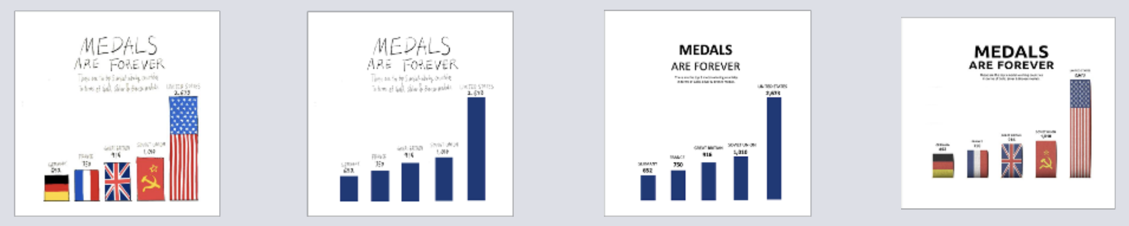
Embellishment and Trust
Comic-style visualizations perceived as less credible
Image-like visualizations were perceived as similarly credible compared to standard visualizations.
Plain bars in a bar chart perceived as more credible than cartoon-style bars, while both plain bars and image bars were perceived as similarly credible
Less Trustworthy
More Trustworthy
H. Song, A. Cho, C. X. Bearfield and J. Stasko, "Visualizing Trust: How Chart Embellishments Influence Perceptions of Credibility," in IEEE Transactions on Visualization and Computer Graphics, vol. 32, no. 1, pp. 1306-1316, Jan. 2026, doi: 10.1109/TVCG.2025.3634785

Slide 27
Your Turn!
Choose some subset of data from the Smith common dataset: https://www.smith.edu/your-campus/offices-services/institutional-research/data-about-smith
Draw a plain / simple visualization
Add embellishment to the visualization that you think will add memorability so prospective students remember Smith and apply
Add embellishment to the visualization that you think will add memorability so readers remember specific data points from the visualization

