Slide 1
Communicating with Data – Color
Dr. Ab Mosca (they/them)
Slides based off slides courtesy of Jordan Crouser (https://jcrouser.github.io/)

Slide 2
Plan for Today
How we see color
Color for visual encoding
More perceptual problems

Slide 3
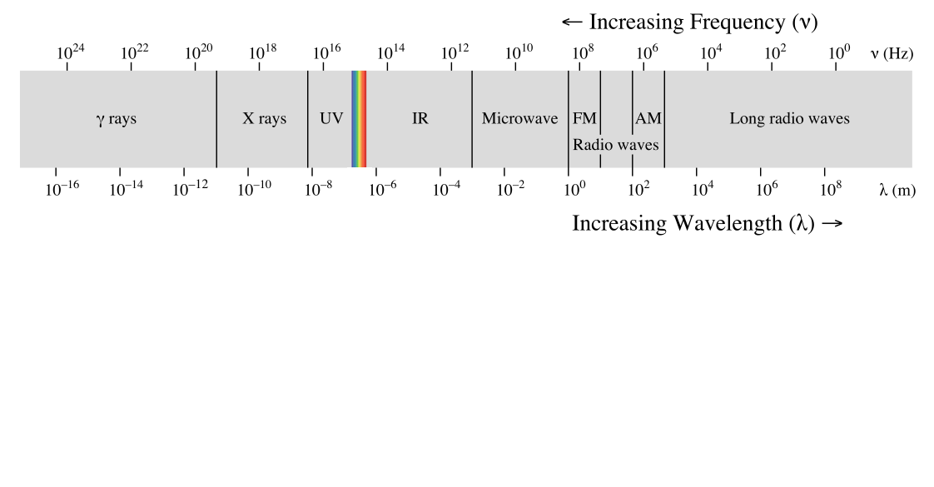
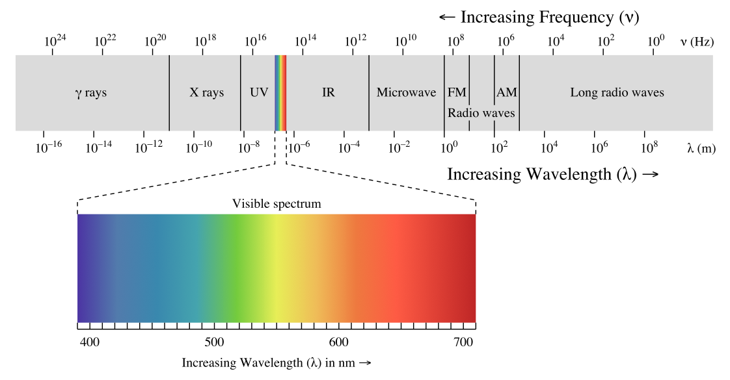

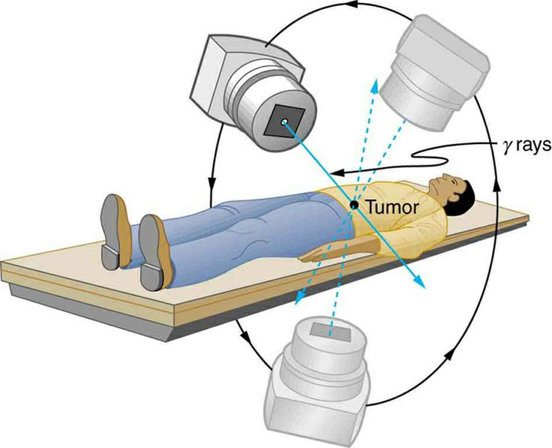
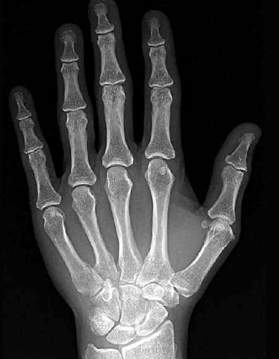

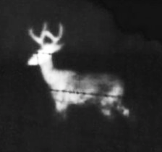
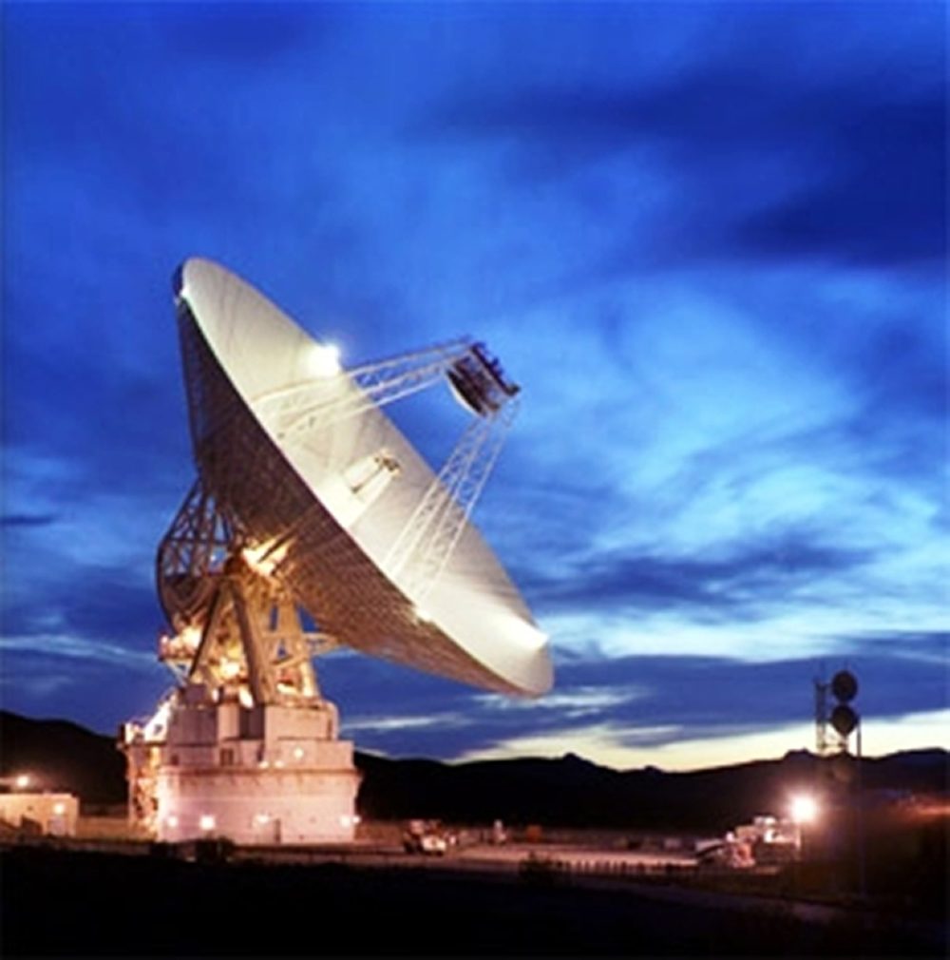
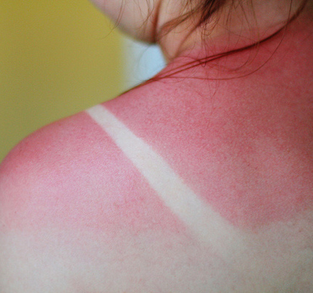
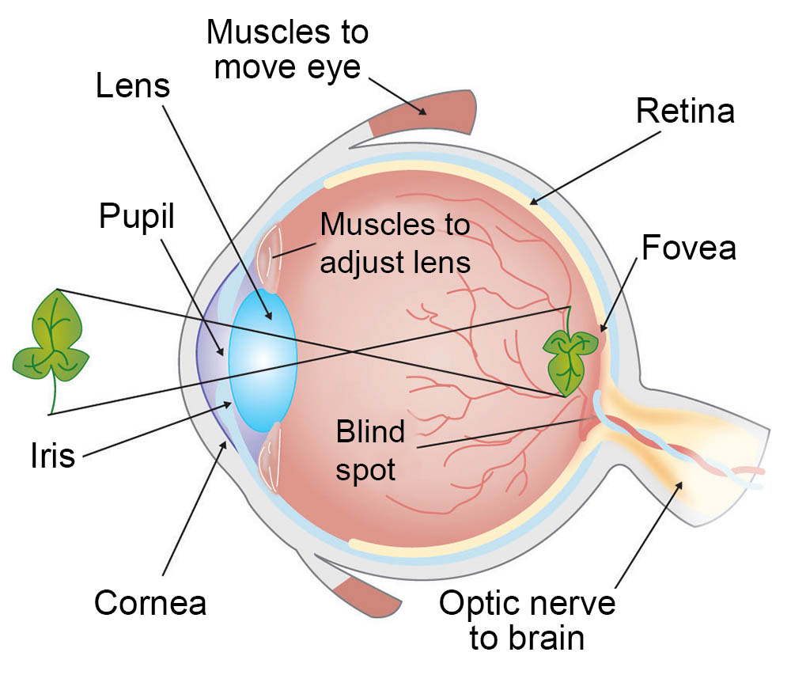
Kinds of light
Eye diagram courtesy ASU

Slide 4
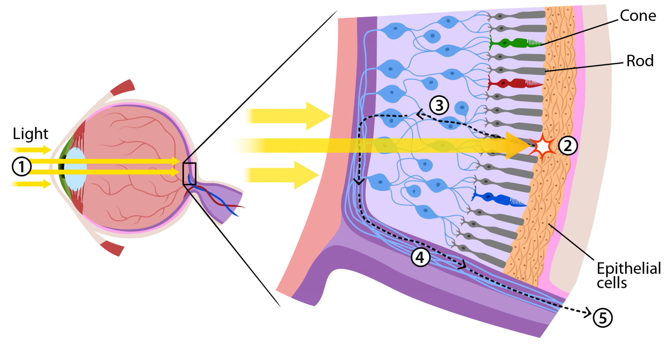
~ 6 million
How we see color
~ 100 million
https://askabiologist.asu.edu/rods-and-cones
Notes:
Rods work at very low levels of light. We use these for night vision because only a few bits of light (photons) can activate a rod. Rods don't help with color vision, which is why at night, we see everything in a gray scale. The human eye has over 100 million rod cells.
Cones require a lot more light and they are used to see color. We have three types of cones: blue, green, and red. The human eye only has about 6 million cones. Many of these are packed into the fovea, a small pit in the back of the eye that helps with the sharpness or detail of images.

Slide 5
What is expressiveness of a visual channel?
What is effectiveness of a visual channel?
Recall
Notes:
Using the correct visual channel type for the correct variable type is called expressiveness
Effectiveness refers to how well a channel supports:
Accuracy
Discriminability
Separability
Visual popout
Grouping

Slide 6
If we use color to represent our data, an important question to ask is: “How can we choose effective colors that provide good differentiation between data elements during the visualization task?”
Color for Visual Encoding
C. G. Healey, "Choosing effective colours for data visualization," Proceedings of Seventh Annual IEEE Visualization '96, San Francisco, CA, USA, 1996, pp. 263-270, doi: 10.1109/VISUAL.1996.568118.

Slide 7
If we use color to represent our data, an important question to ask is: “How can we choose effective colors that provide good differentiation between data elements during the visualization task?”
How can we allow rapid and accurate identification of individual data elements through the use of color?
What factors determine whether a “target” element’s color will make it easy to find, relative to differently colored “nontarget” elements?
How many colors can we display at once, while still allowing for rapid and accurate target identification?
Color for Visual Encoding
C. G. Healey, "Choosing effective colours for data visualization," Proceedings of Seventh Annual IEEE Visualization '96, San Francisco, CA, USA, 1996, pp. 263-270, doi: 10.1109/VISUAL.1996.568118.

Slide 8
One approach—Control:
  Color Distance
  Linear separation of colors
  Color category similarity
Color for Visual Encoding
C. G. Healey, "Choosing effective colours for data visualization," Proceedings of Seventh Annual IEEE Visualization '96, San Francisco, CA, USA, 1996, pp. 263-270, doi: 10.1109/VISUAL.1996.568118.

Slide 9
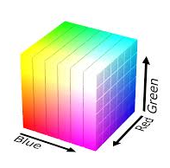
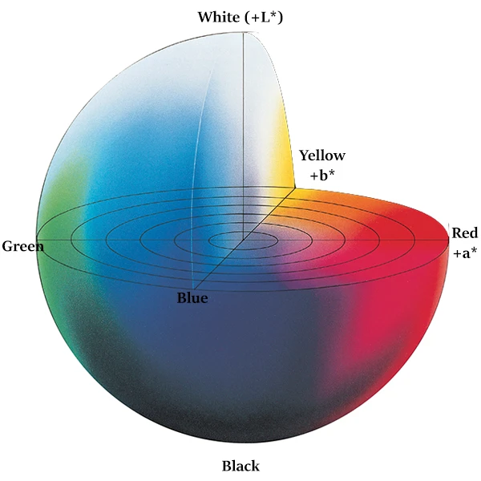
Color Distance: the Euclidean distance between different colors as measured in a perceptually balanced color model
Color for Visual Encoding
C. G. Healey, "Choosing effective colours for data visualization," Proceedings of Seventh Annual IEEE Visualization '96, San Francisco, CA, USA, 1996, pp. 263-270, doi: 10.1109/VISUAL.1996.568118.

Slide 10
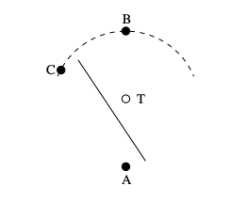
Linear Separation: the ability to linearly separate targets from non-targets in the color model being used
Color for Visual Encoding
C. G. Healey, "Choosing effective colours for data visualization," Proceedings of Seventh Annual IEEE Visualization '96, San Francisco, CA, USA, 1996, pp. 263-270, doi: 10.1109/VISUAL.1996.568118.
Notes:
Results showed that when the target could be separated by a straight line from its non-targets in colour space (Figure 1, target T and non-targets A and C), the time required to determine the target’s presence or absence was constant, and independent of the total number of elements being displayed.

Slide 11
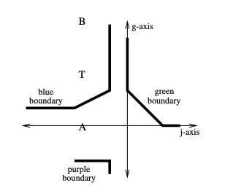
Color Category: the named color regions occupied by both the target and non-target elements
Color for Visual Encoding
C. G. Healey, "Choosing effective colours for data visualization," Proceedings of Seventh Annual IEEE Visualization '96, San Francisco, CA, USA, 1996, pp. 263-270, doi: 10.1109/VISUAL.1996.568118.
Notes:
His results showed that search times decreased dramatically whenever the non-target was moved outside the target’s colour region. For example, finding a target coloured T in a set of non-targets coloured B was significantly more difficult than than finding T in a set of non-targets coloured A

Slide 12
One approach—Control:
  Color Distance
  Linear separation of colors
  Color category similarity
What potential issues or oversights do you see with this approach?
Color for Visual Encoding
C. G. Healey, "Choosing effective colours for data visualization," Proceedings of Seventh Annual IEEE Visualization '96, San Francisco, CA, USA, 1996, pp. 263-270, doi: 10.1109/VISUAL.1996.568118.

Slide 13
Another approach—Control:
  Perceptual Distance (CIEDE2000)
  Name Difference
  Pair Preference
Color for Visual Encoding
C. G. Healey, "Choosing effective colours for data visualization," Proceedings of Seventh Annual IEEE Visualization '96, San Francisco, CA, USA, 1996, pp. 263-270, doi: 10.1109/VISUAL.1996.568118.

Slide 14
Another approach—Control:
  Perceptual Distance (CIEDE2000)
  Name Difference
  Pair Preference
The idea behind this approach is to prioritize aesthetically pleasing colormaps
Color for Visual Encoding
C. C. Gramazio, D. H. Laidlaw and K. B. Schloss, "Colorgorical: Creating discriminable and preferable color palettes for information visualization," in IEEE Transactions on Visualization and Computer Graphics, vol. 23, no. 1, pp. 521-530, Jan. 2017, doi: 10.1109/TVCG.2016.2598918.

Slide 15
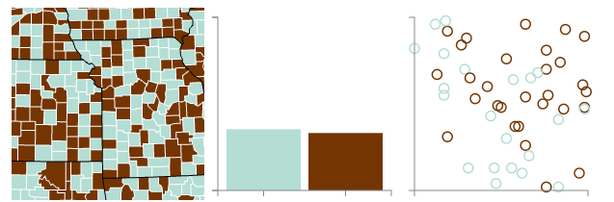
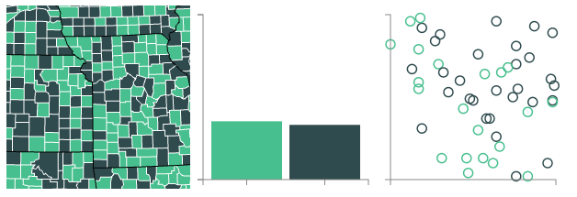
Perceptual Distance: A measure of how perceptually distinct two colors are. They use one based off CIEDE2000
Color for Visual Encoding
High Perceptual Distance
Low Perceptual Distance
C. C. Gramazio, D. H. Laidlaw and K. B. Schloss, "Colorgorical: Creating discriminable and preferable color palettes for information visualization," in IEEE Transactions on Visualization and Computer Graphics, vol. 23, no. 1, pp. 521-530, Jan. 2017, doi: 10.1109/TVCG.2016.2598918.

Slide 16
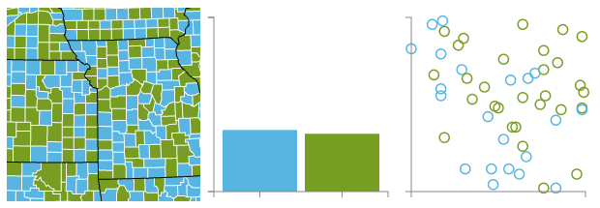
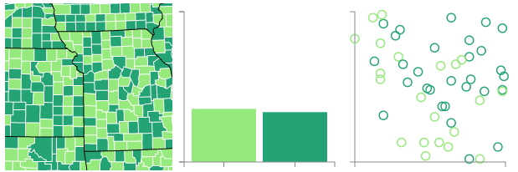
Name Difference: captures the degree to which two colors have distinct color-name association frequency distributions
Color for Visual Encoding
High Name Difference
Low Name Difference
C. C. Gramazio, D. H. Laidlaw and K. B. Schloss, "Colorgorical: Creating discriminable and preferable color palettes for information visualization," in IEEE Transactions on Visualization and Computer Graphics, vol. 23, no. 1, pp. 521-530, Jan. 2017, doi: 10.1109/TVCG.2016.2598918.

Slide 17
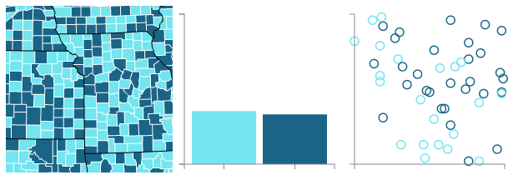
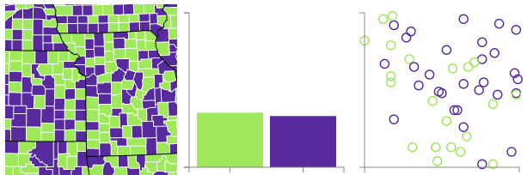
Pair Preference: reflects people’s preference for color combinations that contain cool colors that differ in lightness and are similar in hue
Color for Visual Encoding
High Pair Preference
Low Pair Preference
C. C. Gramazio, D. H. Laidlaw and K. B. Schloss, "Colorgorical: Creating discriminable and preferable color palettes for information visualization," in IEEE Transactions on Visualization and Computer Graphics, vol. 23, no. 1, pp. 521-530, Jan. 2017, doi: 10.1109/TVCG.2016.2598918.

Slide 18
Another approach—Control:
  Perceptual Distance (CIEDE2000)
  Name Difference
  Pair Preference
Try for yourself: http://vrl.cs.brown.edu/color
What do you notice?
Color for Visual Encoding
C. C. Gramazio, D. H. Laidlaw and K. B. Schloss, "Colorgorical: Creating discriminable and preferable color palettes for information visualization," in IEEE Transactions on Visualization and Computer Graphics, vol. 23, no. 1, pp. 521-530, Jan. 2017, doi: 10.1109/TVCG.2016.2598918.

Slide 19
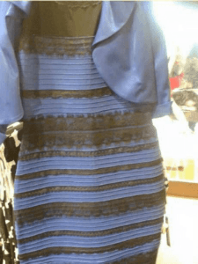

Color phenomena

Slide 20
Caveat 1: color is perceived in context
Color phenomena
Which small square is darker green?
R.B. Lotto, & D. Purves, An empirical explanation of color contrast, Proc. Natl. Acad. Sci. U.S.A. 97 (23) 12834-12839, https://doi.org/10.1073/pnas.210369597 (2000).

Slide 21


Caveat 2: difference is relative
Color phenomena
R.B. Lotto, & D. Purves, An empirical explanation of color contrast, Proc. Natl. Acad. Sci. U.S.A. 97 (23) 12834-12839, https://doi.org/10.1073/pnas.210369597 (2000).
Notes:
Is the difference between top and bottom rectangle the same in all cases?

Slide 22
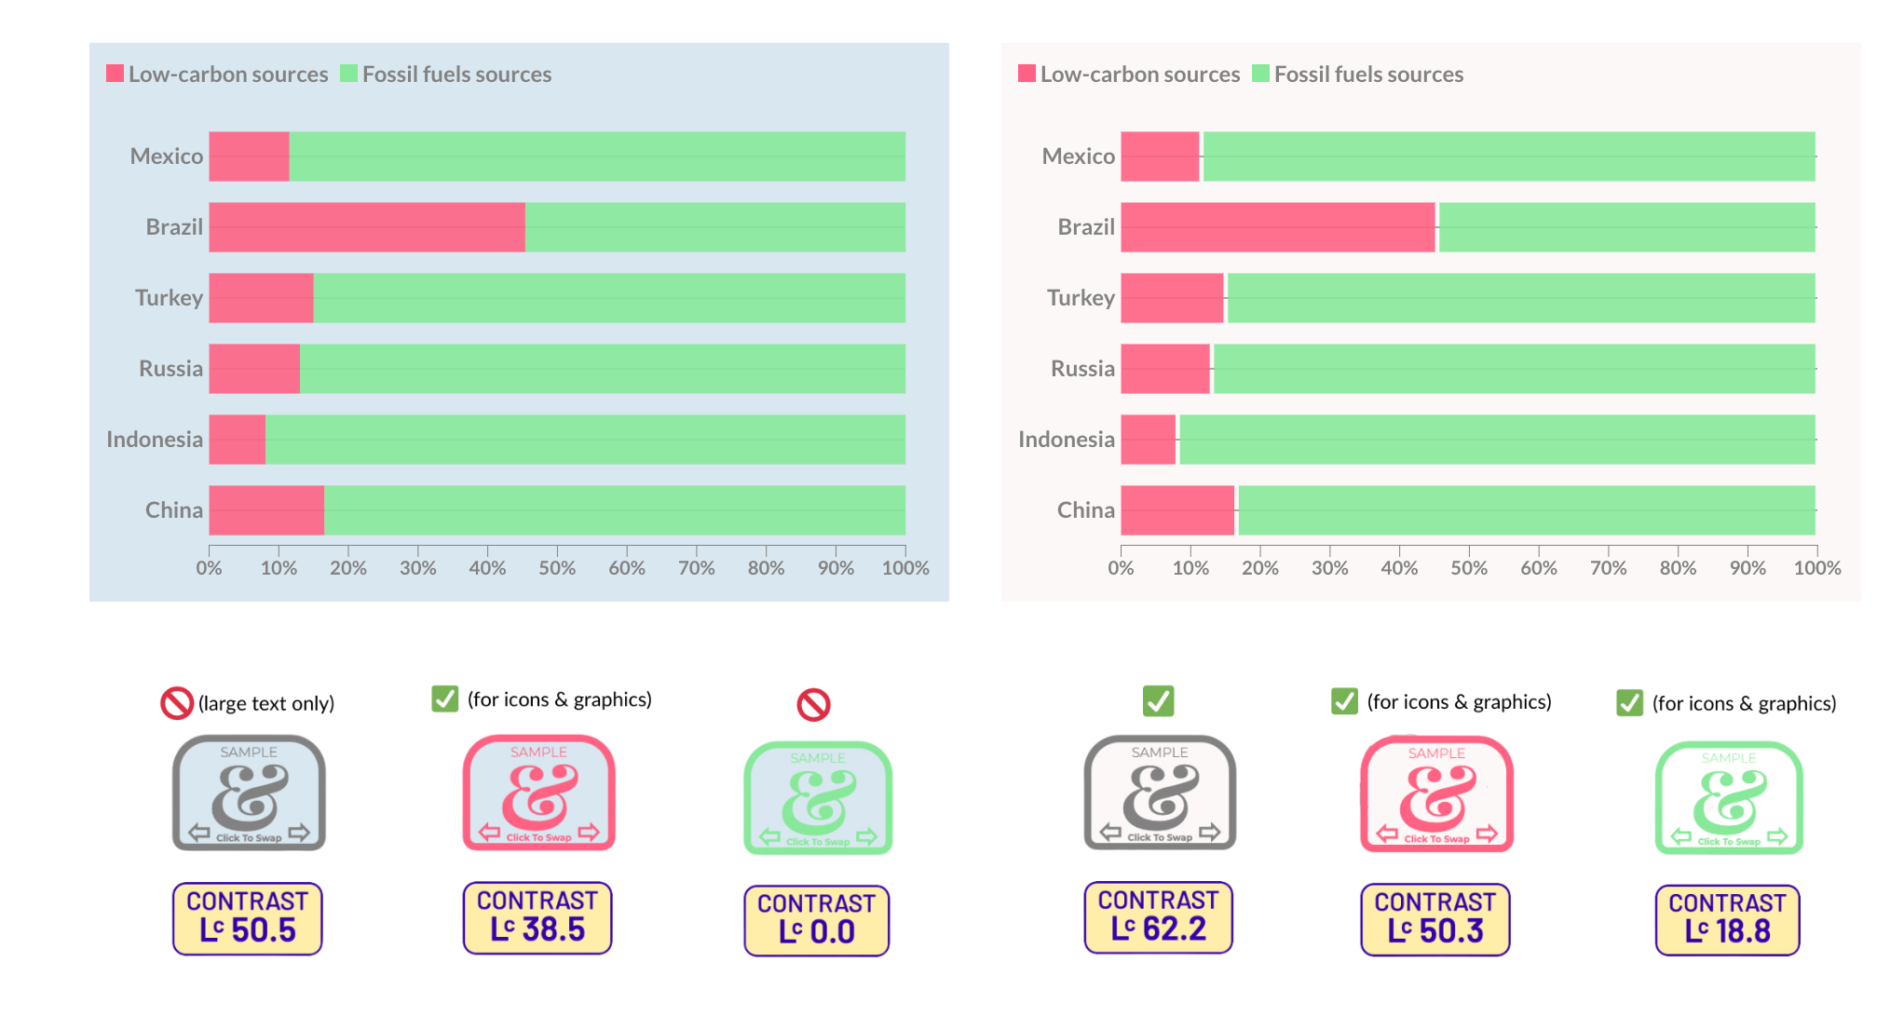
Be careful when layering colors
Color phenomenon
https://clauswilke.com/dataviz/color-basics.html
Notes:
Green and text fade into background; pink pops

Slide 23

Caveat 2a: so are brightness and contrast
Color phenomena
Ware, Colin. (1988). Color sequences for univariate maps: theory, experiments and principles. IEEE Computer Graphics and Applications. 8. 41-49. 10.1109/38.7760.

Slide 24
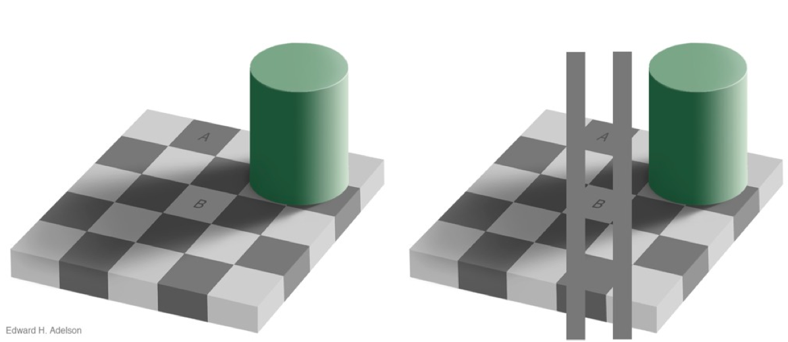
Caveat 3: mental models > perception
Color phenomena
Adelson, Edward H. 1995. “Checkershadow Illusion.”

Slide 25
Color Problems
Using a poor color scheme can also cause issues with your visualization

Slide 26
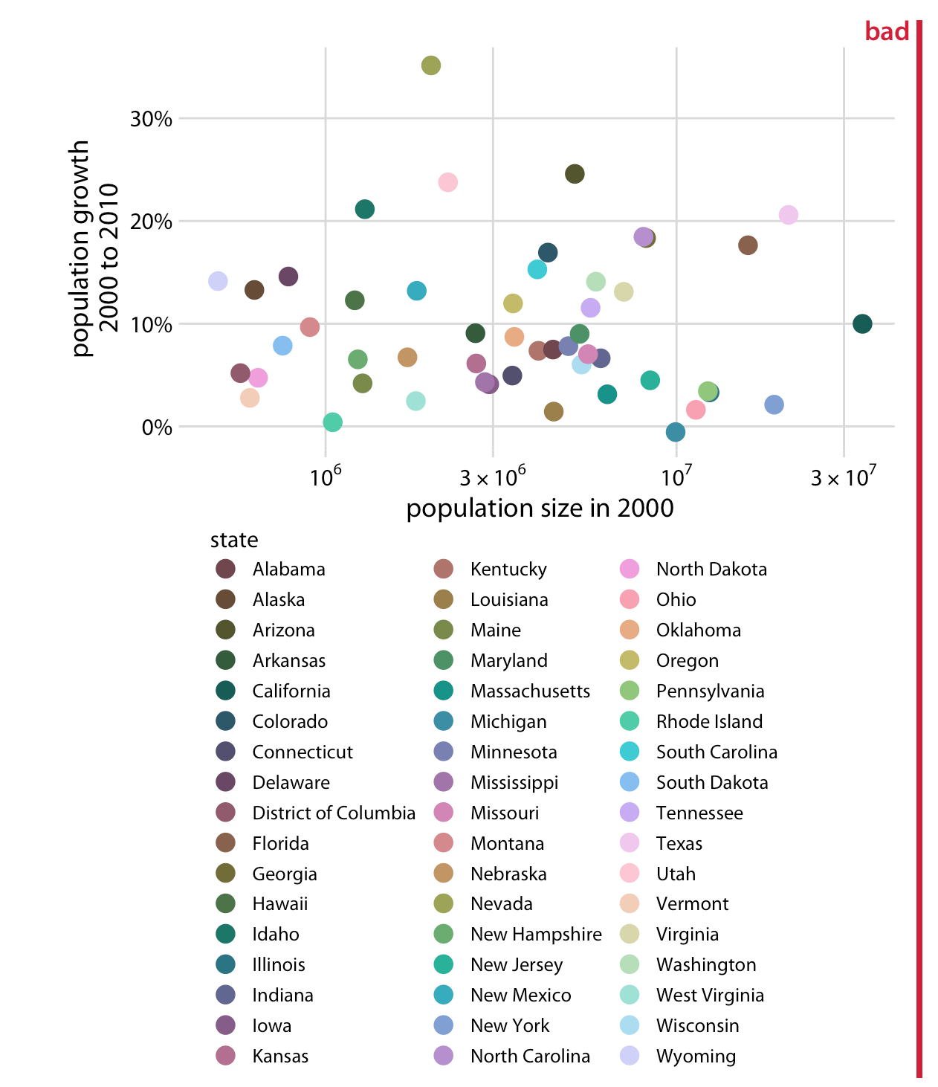
Hue mapped to too many categories
Color Problems
https://clauswilke.com/dataviz/color-basics.html

Slide 27
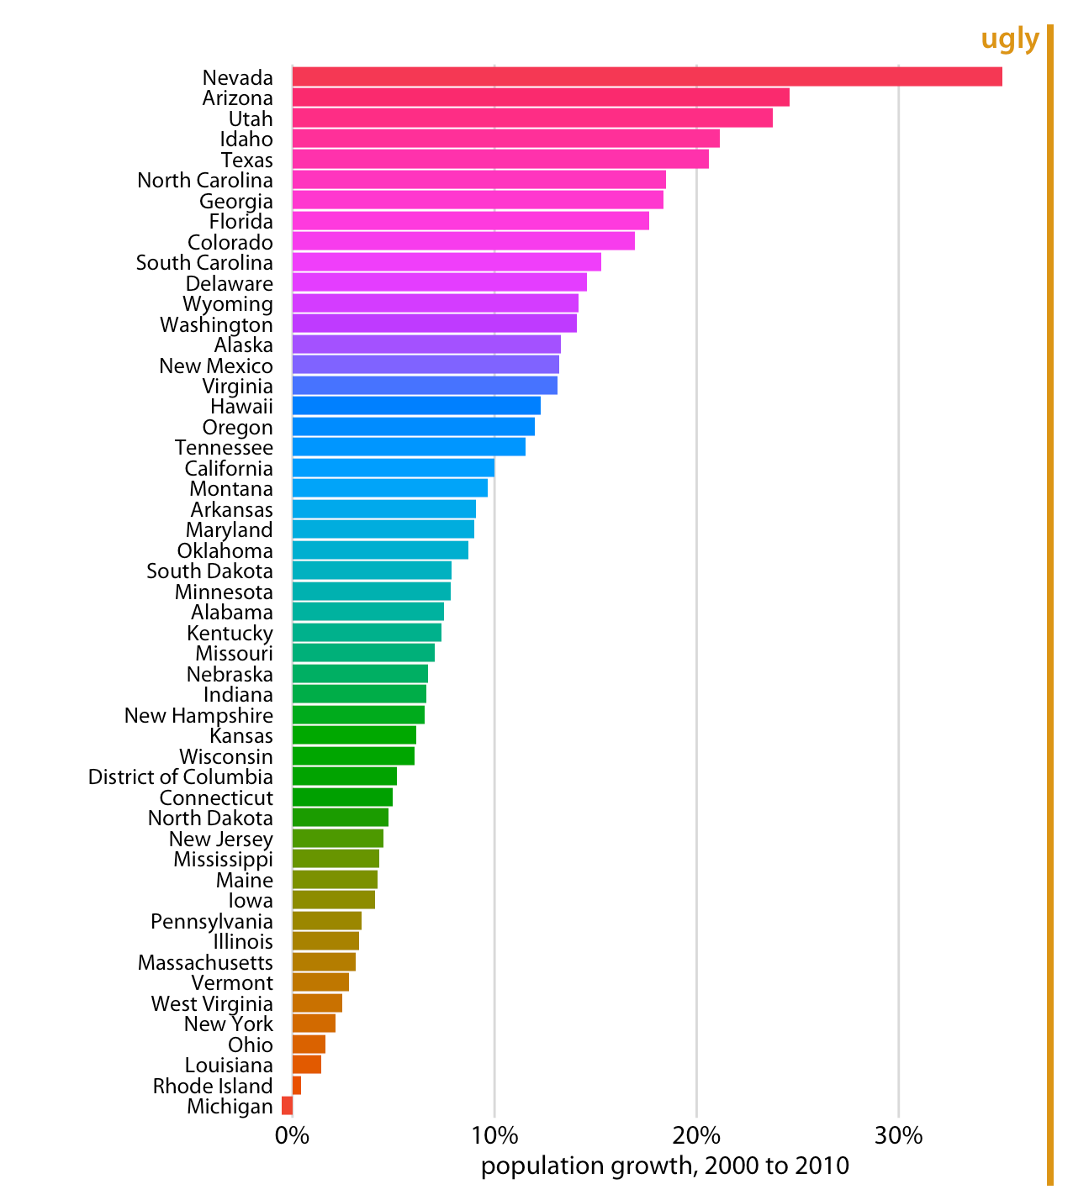
Hue not mapped to data
Color Problems
https://clauswilke.com/dataviz/color-basics.html

Slide 28
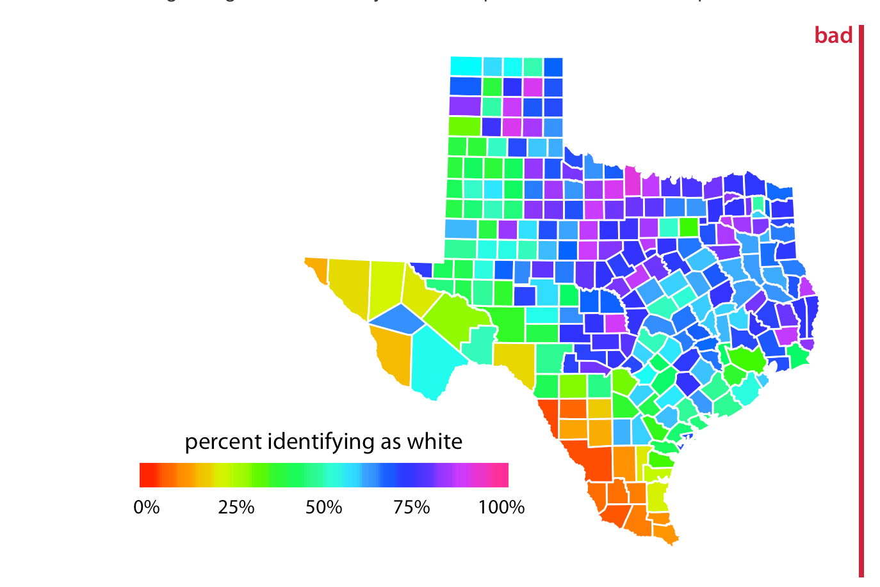
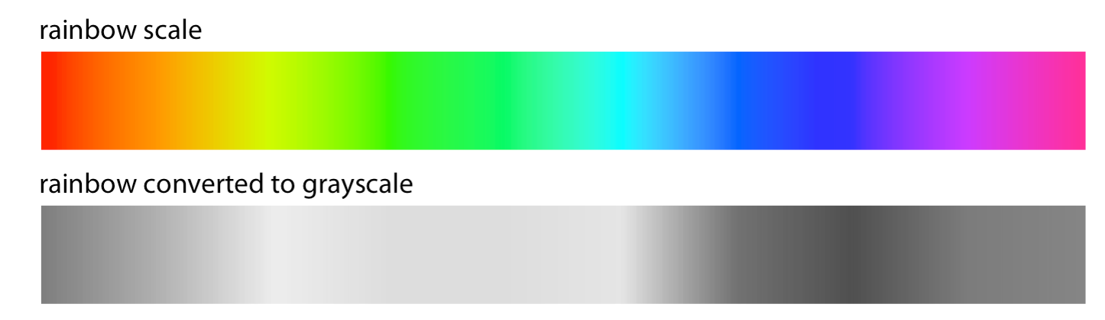
Rainbow obscures real patterns (it is not monotonic)
Color Problems
https://clauswilke.com/dataviz/color-basics.html

Slide 29
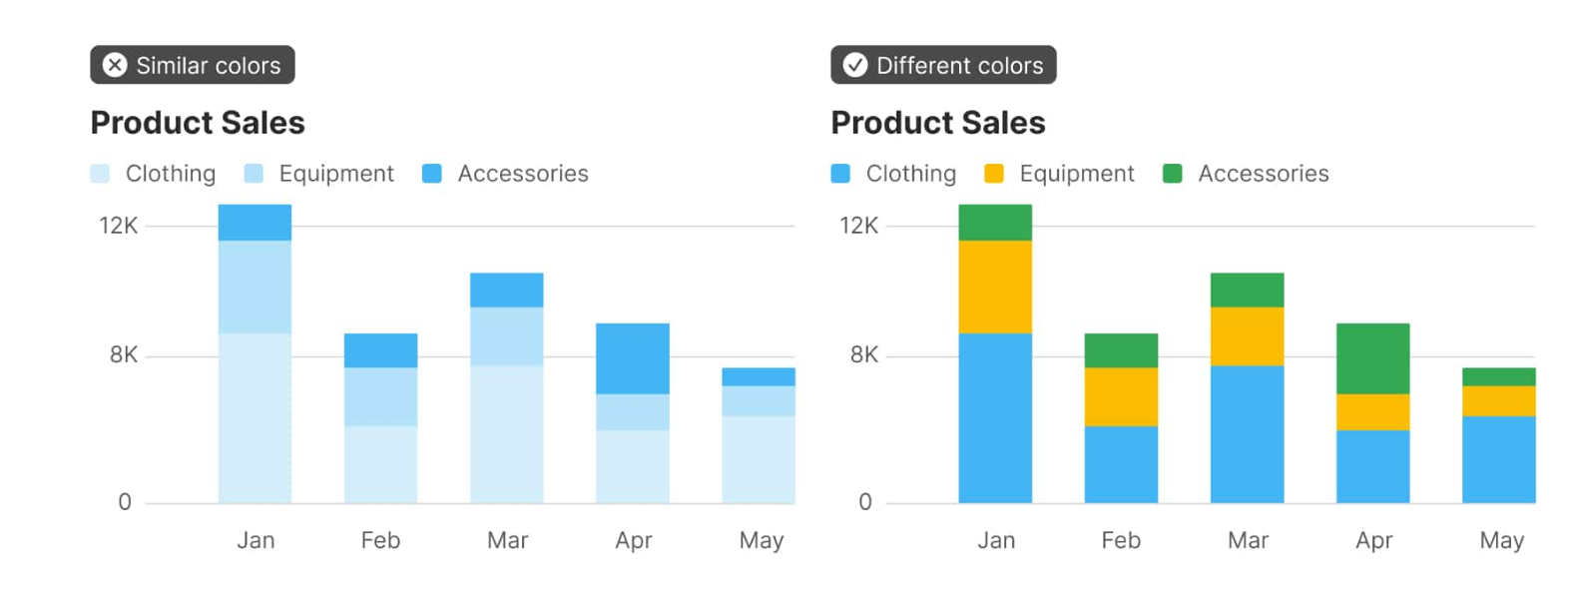
Similar colors are hard to differentiate
Color Problems
https://matthewstrom.com/writing/how-to-pick-the-least-wrong-colors/
Notes:
Similar colors – one jumps out bc most saturated
Hard to distinguish

Slide 30
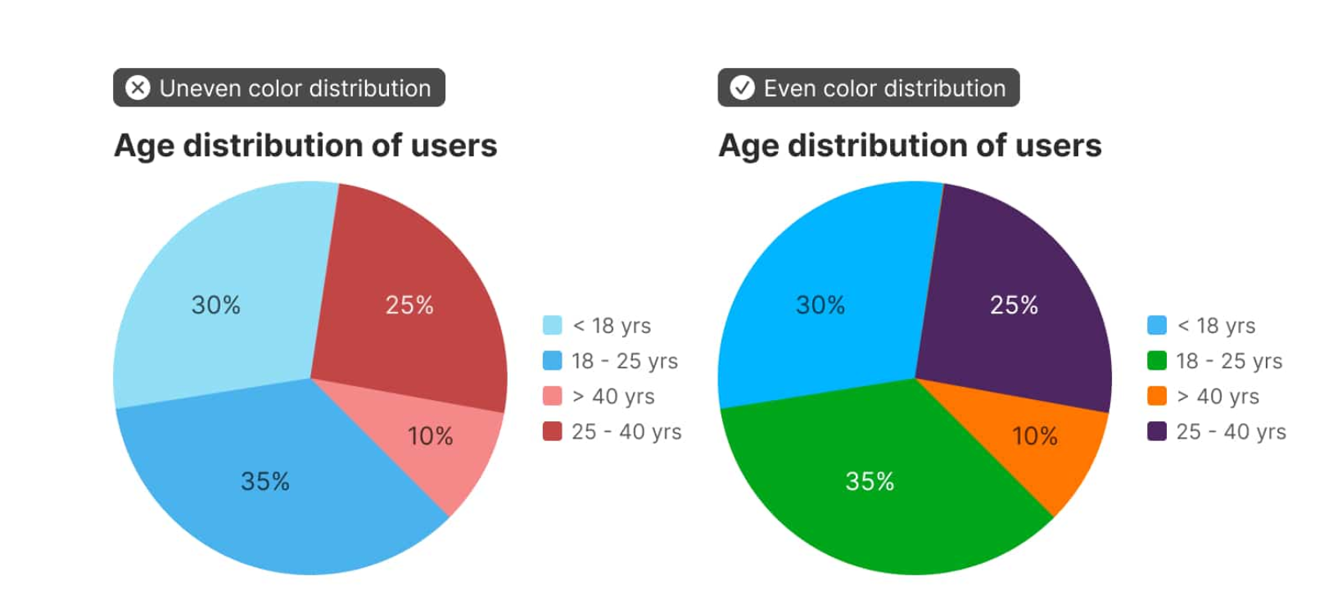
Similar colors imply relationships
Color Problems
https://matthewstrom.com/writing/how-to-pick-the-least-wrong-colors/
Notes:
Similar colors – one jumps out bc most saturated
Hard to distinguish

Slide 31
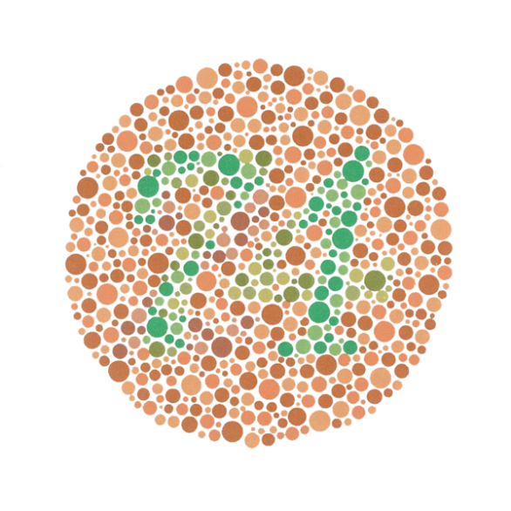
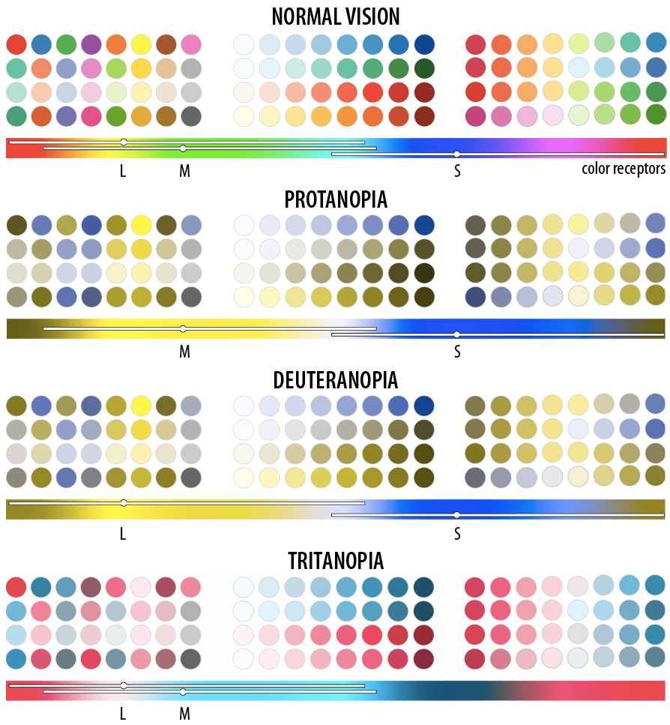
“colorblindness”
1 out of every 8 people has just 2 types of color receptors (rather than 3)

Slide 32
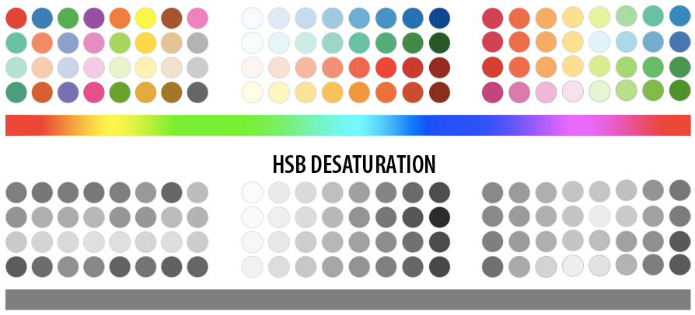
What happens when you print?
Need color scheme that converts well to grey scale

Slide 33
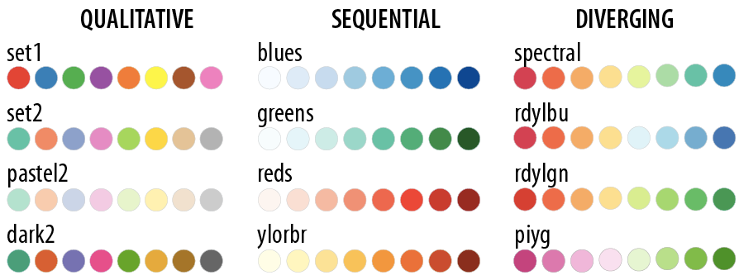
colorbrewer.org provides a whole bunch of palettes that can help us avoid these issues
This makes life a lot easier for us!
Colorbrewer palettes

Slide 34
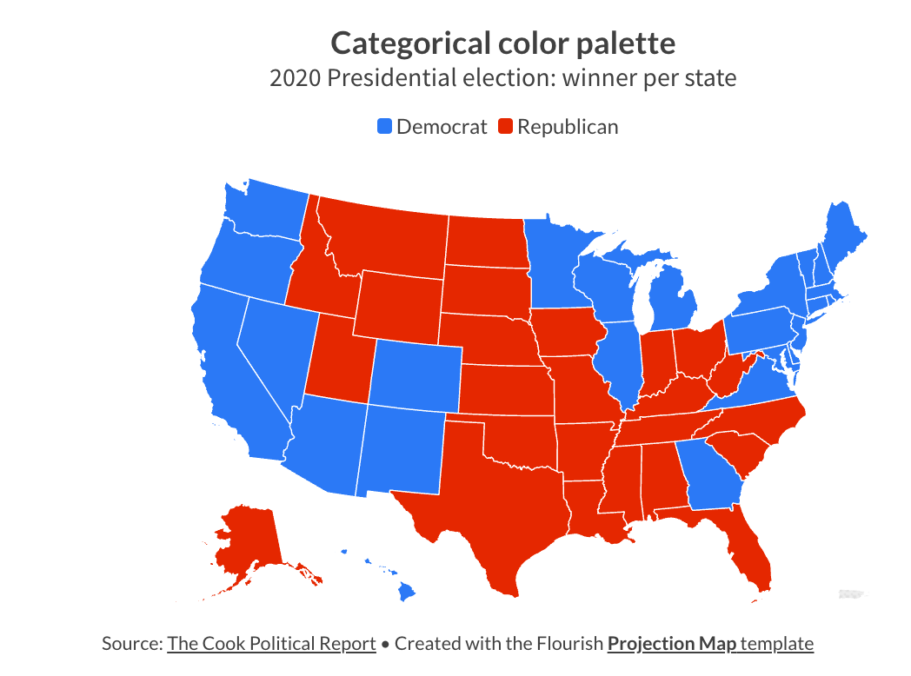
Good for nominal data
Colorbrewer palettes

Slide 35
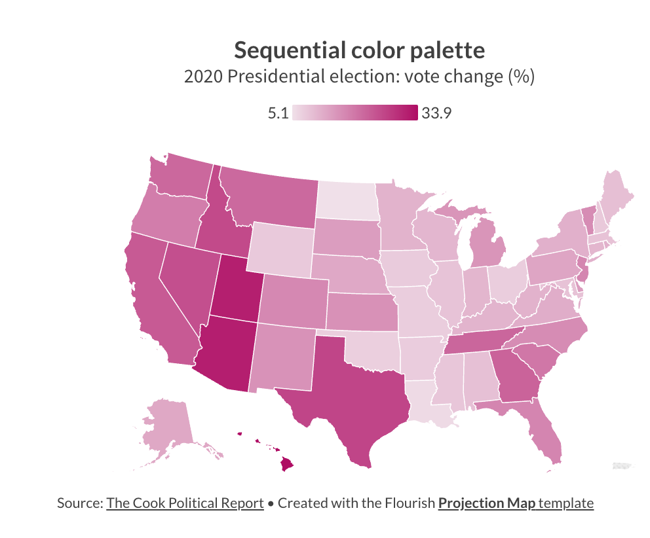
Good for sequential ordinal & quantitative data
Colorbrewer palettes

Slide 36
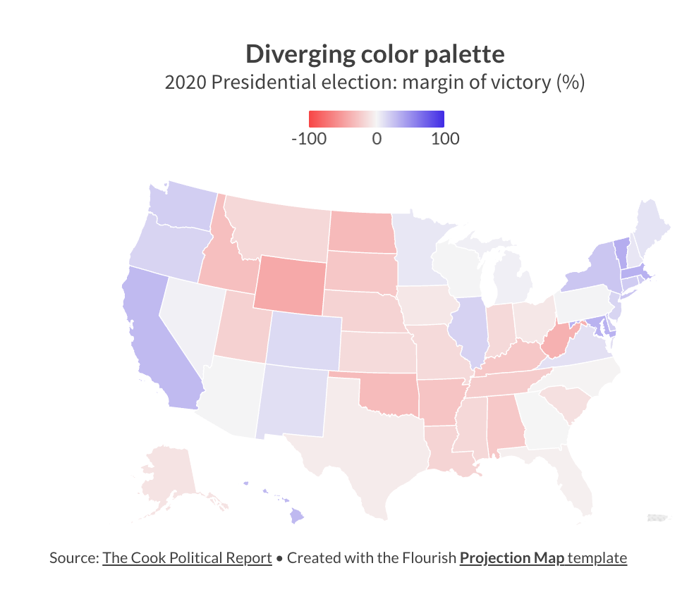
Good for diverging ordinal & quantitative data
Colorbrewer palettes

Slide 37
Visualization is about more than just aesthetics
There are compelling cognitive reasons why some visualization techniques are helpful and others aren’t
The choices we make about visual mappings can have a significant effect on performance
Takeaways: Perception

Slide 38
Work with a classmate or 2
Find a two visualizations from trusted sources the visually encode data via color. One should use hue and the other saturation.
Assess the use of color:
  Is it perceptually accurate and easy to read?
  Is it aesthetically pleasing?
  Are there any optical illusions?
  What would you change if you were to re-design the visualization?
Your turn!

