Slide 1
Communicating with Data – Visualization Literacy
Dr. Ab Mosca (they/them)

Slide 2
Plan for Today
Define Visualization Literacy
  As a set of skills
  As a model / concept
Testing Visualization Literacy
Barriers to Visualization Literacy

Slide 3
Brainstorm
What is visualization literacy?
How can we measure it?
Why is it useful?

Slide 4
Exploring Definitions– Visualization Literacy as a Skillset
No agreed upon definition of visualization literacy. Many conceptualizations exist
The next 9 slides present proposed definitions for visualization literacy through skill conceptualizations.
Make 10 groups and count off, read the definition numbered the same as your group number.
Pair up: Groups 1&6, 2&7, 3&8, 4&9, 5&10
  What are the similarities and differences between your definitions?
Pair up: Groups 1&6&5, 2&7&4, 3&8&9&10
  What are the similarities and differences between your definitions?
Whole class: What are the similarities and differences between your definitions?
What aspects of these definitions do we like? Which do we disagree with?

Slide 5
Skill Definitions (1)
Vermeersch & Vandenbroucke define visualization literacy as:
Perception
  cultivating a ‘‘good eye’’ in experiencing the visual
  being curious, sensitive, focused, selective, and deriving pleasure from it
Imagination and creation, Conceptualization
  Using perceived images to generate something new, based on the capacity to understand image structure (ex. points, lines, angles, open and closed figures)
  Transforming concrete perceptions into abstract representations
Analysis of images
  identifying structures or patterns within a visualization
S. Beschi, D. Falessi, S. Golia and A. Locoro, "Characterizing Data Visualization Literacy for Standardization: A Systematic Literature Review," in IEEE Access, vol. 13, pp. 65704-65725, 2025, doi: 10.1109/ACCESS.2025.3559298.

Slide 6
Skill Definitions (2)
Kendra defines visualization literacy as:
Visual reading
  Ability to interpret, analyze, understand, evaluate, and translate visualizations
Visual writing
  Ability to create a produce visualizations
Other visual literacy skills
  Ability to think visually and learn visually
S. Beschi, D. Falessi, S. Golia and A. Locoro, "Characterizing Data Visualization Literacy for Standardization: A Systematic Literature Review," in IEEE Access, vol. 13, pp. 65704-65725, 2025, doi: 10.1109/ACCESS.2025.3559298.

Slide 7
Skill Definitions (3)
Rybarczyk et al. define visualization literacy as:
Basic
  Ability to identify patterns and trends in data
  Ability to connect source of data
Advanced
  Ability to synthesize conclusions from data
  Ability to propose follow up experiments and predict results
S. Beschi, D. Falessi, S. Golia and A. Locoro, "Characterizing Data Visualization Literacy for Standardization: A Systematic Literature Review," in IEEE Access, vol. 13, pp. 65704-65725, 2025, doi: 10.1109/ACCESS.2025.3559298.

Slide 8
Skill Definitions (4)
Arneson and Offerdahl et al. define visualization literacy as:
Knowledge
  Ability to memorize, recognize, recall, and retrieve data
Comprehension
  Ability to understand, interpret, infer, exemplify, and classify
Application
  Ability to execute, implement, and apply visualization
Analysis
  Ability to differentiate, discriminate, organize, integrate, and deconstruct visualization
Evaluation
  Ability to check, critique, judge, and test visualization
Synthesis
  Ability to generate, hypothesize, plan, design, construct, reorganize, and produce visualization
S. Beschi, D. Falessi, S. Golia and A. Locoro, "Characterizing Data Visualization Literacy for Standardization: A Systematic Literature Review," in IEEE Access, vol. 13, pp. 65704-65725, 2025, doi: 10.1109/ACCESS.2025.3559298.

Slide 9
Skill Definitions (5)
Kalaf-Hughes defines visualization literacy as:
Information literacy
  Ability to retrieve and organize information
Visual literacy
  Ability to perceive, analyze, represent, and use multi-modality
Critical thinking
  Ability to think analytically for problem solving and decision making
Communication
  Ability to communicate effectively, collaborate with peers, speak publicly
Adaptability and lifelong learning
  Ability to adapt and learn for life
S. Beschi, D. Falessi, S. Golia and A. Locoro, "Characterizing Data Visualization Literacy for Standardization: A Systematic Literature Review," in IEEE Access, vol. 13, pp. 65704-65725, 2025, doi: 10.1109/ACCESS.2025.3559298.

Slide 10
Skill Definitions (6)
Mnguni et al. define visualization literacy as:
Internalization
  Ability to arrange, order, organize, classify, reorganize, find, locate, focus, ground, and perceive visual stimuli such as luminance, color, and motion
Conceptualization
  Ability to analyze, interpret, asses, evaluate, examine, investigate, compare, relate, critique, imagine, describe, discuss, explain, discriminate, judge, manipulate objects using geometrical properties and operations, recall, and retrieve
Externalization
  Ability to complete, illustrate, infer, predict, outline, propose, develop, formulate, devise, construct, create, produce, invent, use, and define the need for an image
S. Beschi, D. Falessi, S. Golia and A. Locoro, "Characterizing Data Visualization Literacy for Standardization: A Systematic Literature Review," in IEEE Access, vol. 13, pp. 65704-65725, 2025, doi: 10.1109/ACCESS.2025.3559298.

Slide 11
Skill Definitions (7)
Reddy et al. define visualization literacy as:
the ability to find images, interpret and analyze images, evaluate images, use images effectively, create visual medial, and use images ethically citing visuals
S. Beschi, D. Falessi, S. Golia and A. Locoro, "Characterizing Data Visualization Literacy for Standardization: A Systematic Literature Review," in IEEE Access, vol. 13, pp. 65704-65725, 2025, doi: 10.1109/ACCESS.2025.3559298.

Slide 12
Skill Definitions (8)
Krejci et al. define visualization literacy as:
Elementary
  Ability to interpret visualization
Intermediate
  Ability to reason, explain, and evaluate visualization
Advanced
  Ability to synthesize, reflect, and judge visualization
S. Beschi, D. Falessi, S. Golia and A. Locoro, "Characterizing Data Visualization Literacy for Standardization: A Systematic Literature Review," in IEEE Access, vol. 13, pp. 65704-65725, 2025, doi: 10.1109/ACCESS.2025.3559298.

Slide 13
Skill Definitions (9)
Hedayati and Kay define visualization literacy as:
  the ability to deconstruct visualization, and design empathy for visualization
S. Beschi, D. Falessi, S. Golia and A. Locoro, "Characterizing Data Visualization Literacy for Standardization: A Systematic Literature Review," in IEEE Access, vol. 13, pp. 65704-65725, 2025, doi: 10.1109/ACCESS.2025.3559298.

Slide 14
Exploring Definitions– Visualization Literacy as a Model / Construct
No agreed upon definition of visualization literacy. Many conceptualizations exist
The next 7 slides present proposed definitions for visualization literacy through models or constructs.
Make 7 groups and count off, read the definition numbered the same as your group number.
Pair up: Groups 1&7, 2&6, 3&5&4
  What are the similarities and differences between your definitions?
Pair up: Groups 1&7&2, 3&5&4&6
  What are the similarities and differences between your definitions?
Whole class: What are the similarities and differences between your definitions?
What aspects of these definitions do we like? Which do we disagree with?
S. Beschi, D. Falessi, S. Golia and A. Locoro, "Characterizing Data Visualization Literacy for Standardization: A Systematic Literature Review," in IEEE Access, vol. 13, pp. 65704-65725, 2025, doi: 10.1109/ACCESS.2025.3559298.

Slide 15
Model/ Construct Definitions (1)
Borner et al. define visualization literacy as:
DVL-Framework typology
  Defines core concepts of visualization: insights, data scales, kinds of analyses, kind of visualization, graphic symbols, encoding variables, interactions
DVL-Framework process
  Defines steps for constructing and interpreting a visualization: identification of stakeholders’ insights, relevant datasets, data pre-processing and visualization, deployment, and interpretation of results
S. Beschi, D. Falessi, S. Golia and A. Locoro, "Characterizing Data Visualization Literacy for Standardization: A Systematic Literature Review," in IEEE Access, vol. 13, pp. 65704-65725, 2025, doi: 10.1109/ACCESS.2025.3559298.

Slide 16
Model/ Construct Definitions (2)
Bresciani and Eppler define visualization literacy as:
Potential pitfalls
  Poor encoding (designer errors) through—
    ambiguity, breaking conventions, cryptic encoding, hiding/obscuring, over-complexity, over-simplification, redundancy, task-visualization fit, unclear, etc.
    disturbing or boring content, ugly, wrong use of color
    exercise of power, inhibit conversation, unequal participation
  Poor decoding (user errors) through–
    channel thinking, poor perceptual skills, focus on low-relevance items, high reliance on training and resources, misuse, overload
    visual stress, personal likes and dislikes, prior knowledge and experience
    altered behavior, cultural and cross-cultural differences, recency effect, hiding differences of opinion
S. Beschi, D. Falessi, S. Golia and A. Locoro, "Characterizing Data Visualization Literacy for Standardization: A Systematic Literature Review," in IEEE Access, vol. 13, pp. 65704-65725, 2025, doi: 10.1109/ACCESS.2025.3559298.

Slide 17
Model/ Construct Definitions (3)
Davis et al. define visualization literacy as:
Visualization tasks
  Estimate and compare values
  judge correlations
  identify trends and outliers
  spot suitability
S. Beschi, D. Falessi, S. Golia and A. Locoro, "Characterizing Data Visualization Literacy for Standardization: A Systematic Literature Review," in IEEE Access, vol. 13, pp. 65704-65725, 2025, doi: 10.1109/ACCESS.2025.3559298.

Slide 18
Model/ Construct Definitions (4)
Galesic and Garcia-Retamero define visualization literacy as:
Graph literacy levels
  Level 1: Read the data
  Level 2: Read between the data
  Level 3: Read beyond the data
S. Beschi, D. Falessi, S. Golia and A. Locoro, "Characterizing Data Visualization Literacy for Standardization: A Systematic Literature Review," in IEEE Access, vol. 13, pp. 65704-65725, 2025, doi: 10.1109/ACCESS.2025.3559298.

Slide 19
Model/ Construct Definitions (5)
Lee et al. define visualization literacy as:
Cognitive characteristics
  Numeracy
  need for cognition
  visualizer-verbalizer capacity
S. Beschi, D. Falessi, S. Golia and A. Locoro, "Characterizing Data Visualization Literacy for Standardization: A Systematic Literature Review," in IEEE Access, vol. 13, pp. 65704-65725, 2025, doi: 10.1109/ACCESS.2025.3559298.

Slide 20
Model/ Construct Definitions (6)
Locoro et al. define visualization literacy as:
Construct levels of VIL
  Map
  Integrate
  Compute
  Reason
  Infer
  Explain
S. Beschi, D. Falessi, S. Golia and A. Locoro, "Characterizing Data Visualization Literacy for Standardization: A Systematic Literature Review," in IEEE Access, vol. 13, pp. 65704-65725, 2025, doi: 10.1109/ACCESS.2025.3559298.

Slide 21
Model/ Construct Definitions (7)
Lundgard and Satyanarayan define visualization literacy as:
Model levels of DVL
  Enumerating visualization construction properties
  Reporting statistical concepts and relations
  Identifying perceptual and cognitive phenomena
  Elucidating domain specific insights
S. Beschi, D. Falessi, S. Golia and A. Locoro, "Characterizing Data Visualization Literacy for Standardization: A Systematic Literature Review," in IEEE Access, vol. 13, pp. 65704-65725, 2025, doi: 10.1109/ACCESS.2025.3559298.

Slide 22
Brainstorm
Those are a LOT of different ways to think about visualization literacy.
If you think about assessing visualization literacy, do any of those definitions lend themselves well to creating an assessment? Which ones? Why?

Slide 23
Brainstorm
Choose one definition. Outline a test, based on the definition you chose, to determine someone’s visualization literacy level.

Slide 24
Assessing Visualization Literacy
Most widely used assessment is VLAT (Visualization Literacy Assessment Test)
VLAT includes 12 data visualizations and 53. multiple choice questions
Demo: https://revisit.dev/study/library-vlat/SURHUmJIblo3Uk4xUUhNUHQ1VTRIQT09
  Click “Next” at the bottom of the page to take the assessment
S. Lee, S.-H. Kim, and B. C. Kwon, "VLAT: Development of a Visualization Literacy Assessment Test," IEEE Transactions on Visualization and Computer Graphics, vol. 23, no. 1, pp. 551-560, Jan. 2017

Slide 25
Assessing Visualization Literacy
There is also a minVLAT!
Much, much shorter than the long-form VLAT
  12 items instead of 53
Demo: https://tools.visualdata.wustl.edu/experiment/#/
  Click “I agree to participate” at the bottom of the page to take the assessment
Pandey, S. and Ottley, A. (2023), Mini-VLAT: A Short and Effective Measure of Visualization Literacy. Computer Graphics Forum, 42: 1-11. https://doi.org/10.1111/cgf.14809

Slide 26
Barriers to Visualization Literacy
Answering a question with data visualization can be thought of as 5 parts:
  Posing the question
  Translating the question into a visual query
  Grasping the visualization’s layout and visual encoding
  Decoding the relevant values
  Synthesizing an answer
Carolina Nobreet al. 2024. Reading Between the Pixels: Investigating the Barriers to Visualization Literacy. In Proceedings of the 2024 CHI Conference on Human Factors in Computing Systems (CHI '24). Association for Computing Machinery, New York, NY, USA, Article 197, 1–17. https://doi.org/10.1145/3613904.3642760

Slide 27
Barriers to Visualization Literacy
Answering a question with data visualization can be thought of as 5 parts:
  Posing the question
  Translating the question into a visual query
  Grasping the visualization’s layout and visual encoding
  Decoding the relevant values
  Synthesizing an answer
  Barriers in these stages are either (a) translation, (b) encoding, or (c) decoding barriers.
  Some barriers are conceptual (resulting from the viewer’s understanding of the task of visualization), others are operational (resulting from misreading the question or elements in a visualization)
Carolina Nobreet al. 2024. Reading Between the Pixels: Investigating the Barriers to Visualization Literacy. In Proceedings of the 2024 CHI Conference on Human Factors in Computing Systems (CHI '24). Association for Computing Machinery, New York, NY, USA, Article 197, 1–17. https://doi.org/10.1145/3613904.3642760

Slide 28
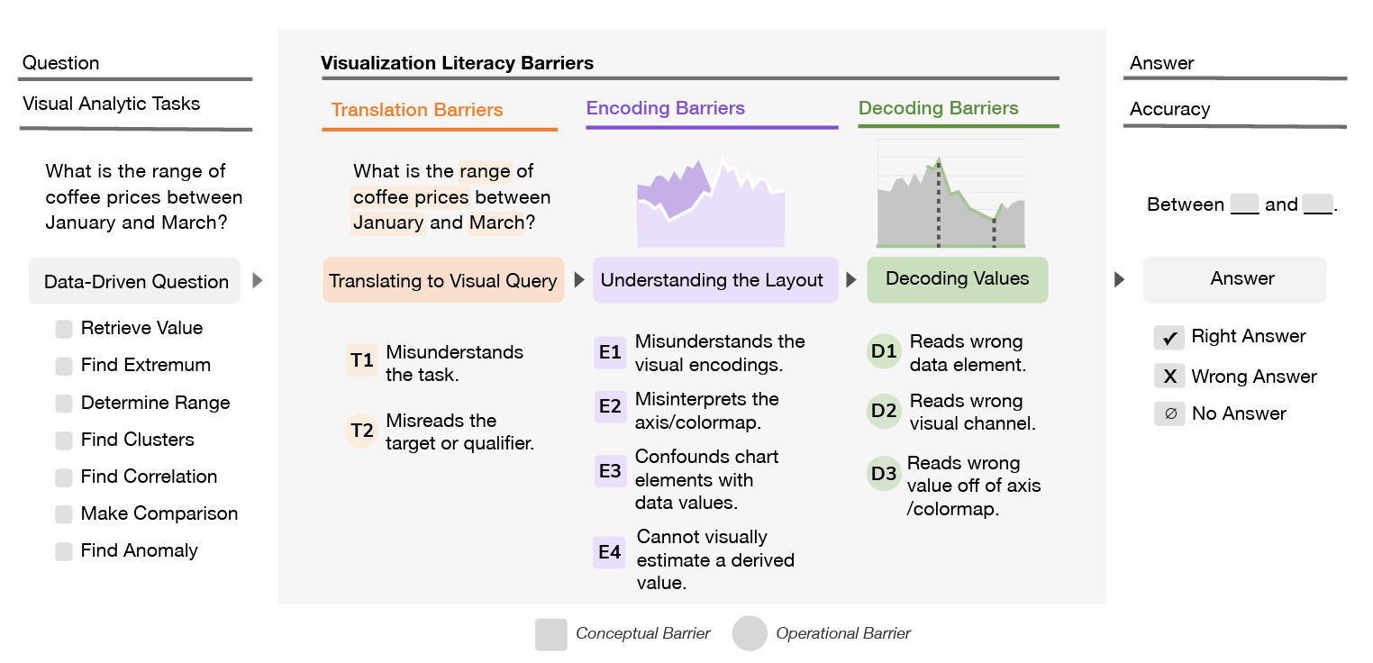
Barriers to Visualization Literacy
Carolina Nobreet al. 2024. Reading Between the Pixels: Investigating the Barriers to Visualization Literacy. In Proceedings of the 2024 CHI Conference on Human Factors in Computing Systems (CHI '24). Association for Computing Machinery, New York, NY, USA, Article 197, 1–17. https://doi.org/10.1145/3613904.3642760

Slide 29
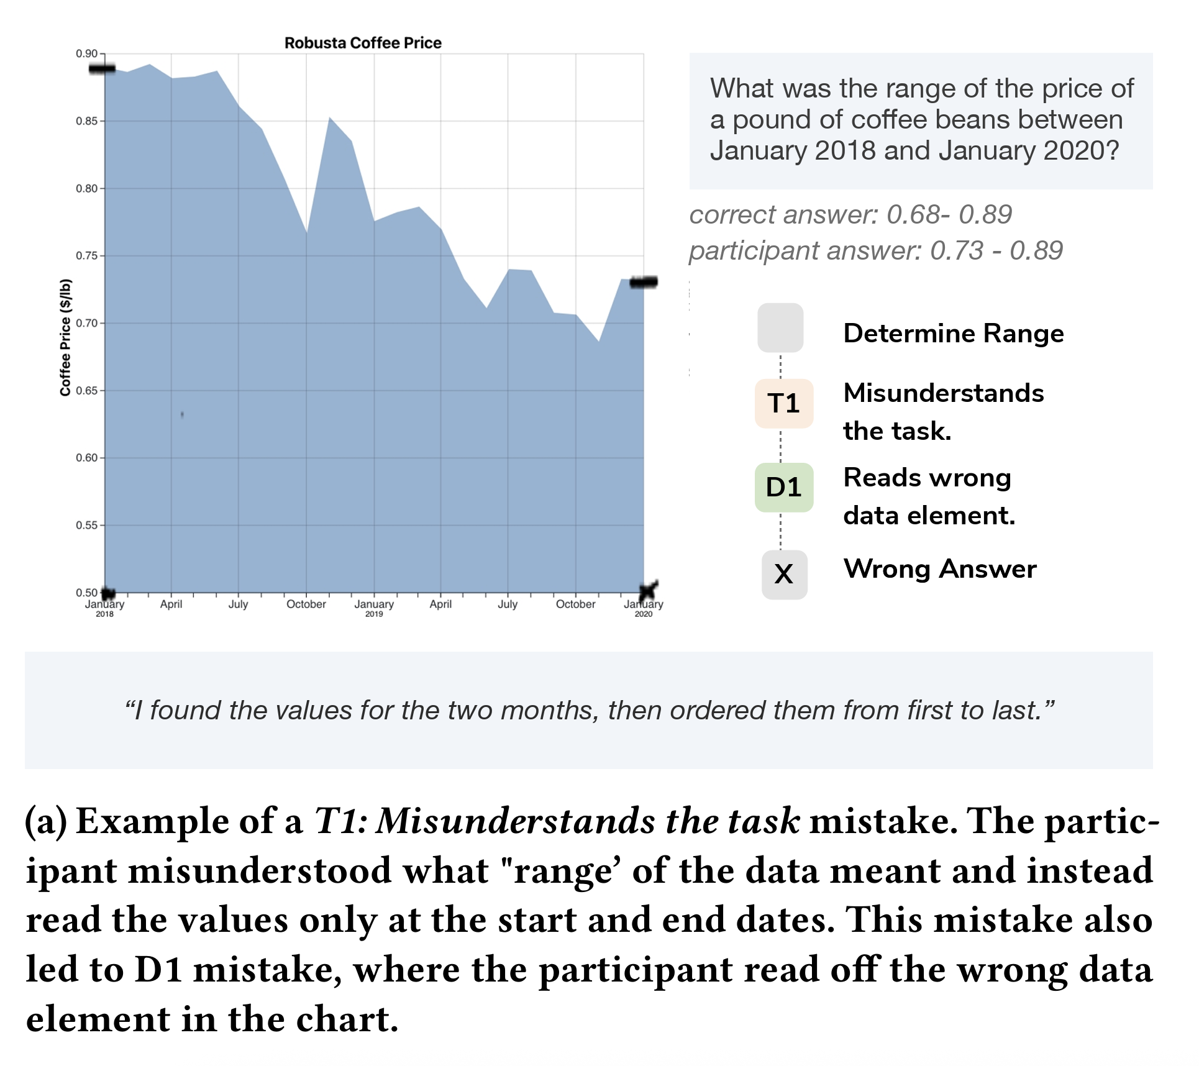
Barriers to Visualization Literacy
Translation barrier –
misreads task
Decoding barrier –
reads wrong element
Carolina Nobreet al. 2024. Reading Between the Pixels: Investigating the Barriers to Visualization Literacy. In Proceedings of the 2024 CHI Conference on Human Factors in Computing Systems (CHI '24). Association for Computing Machinery, New York, NY, USA, Article 197, 1–17. https://doi.org/10.1145/3613904.3642760

Slide 30
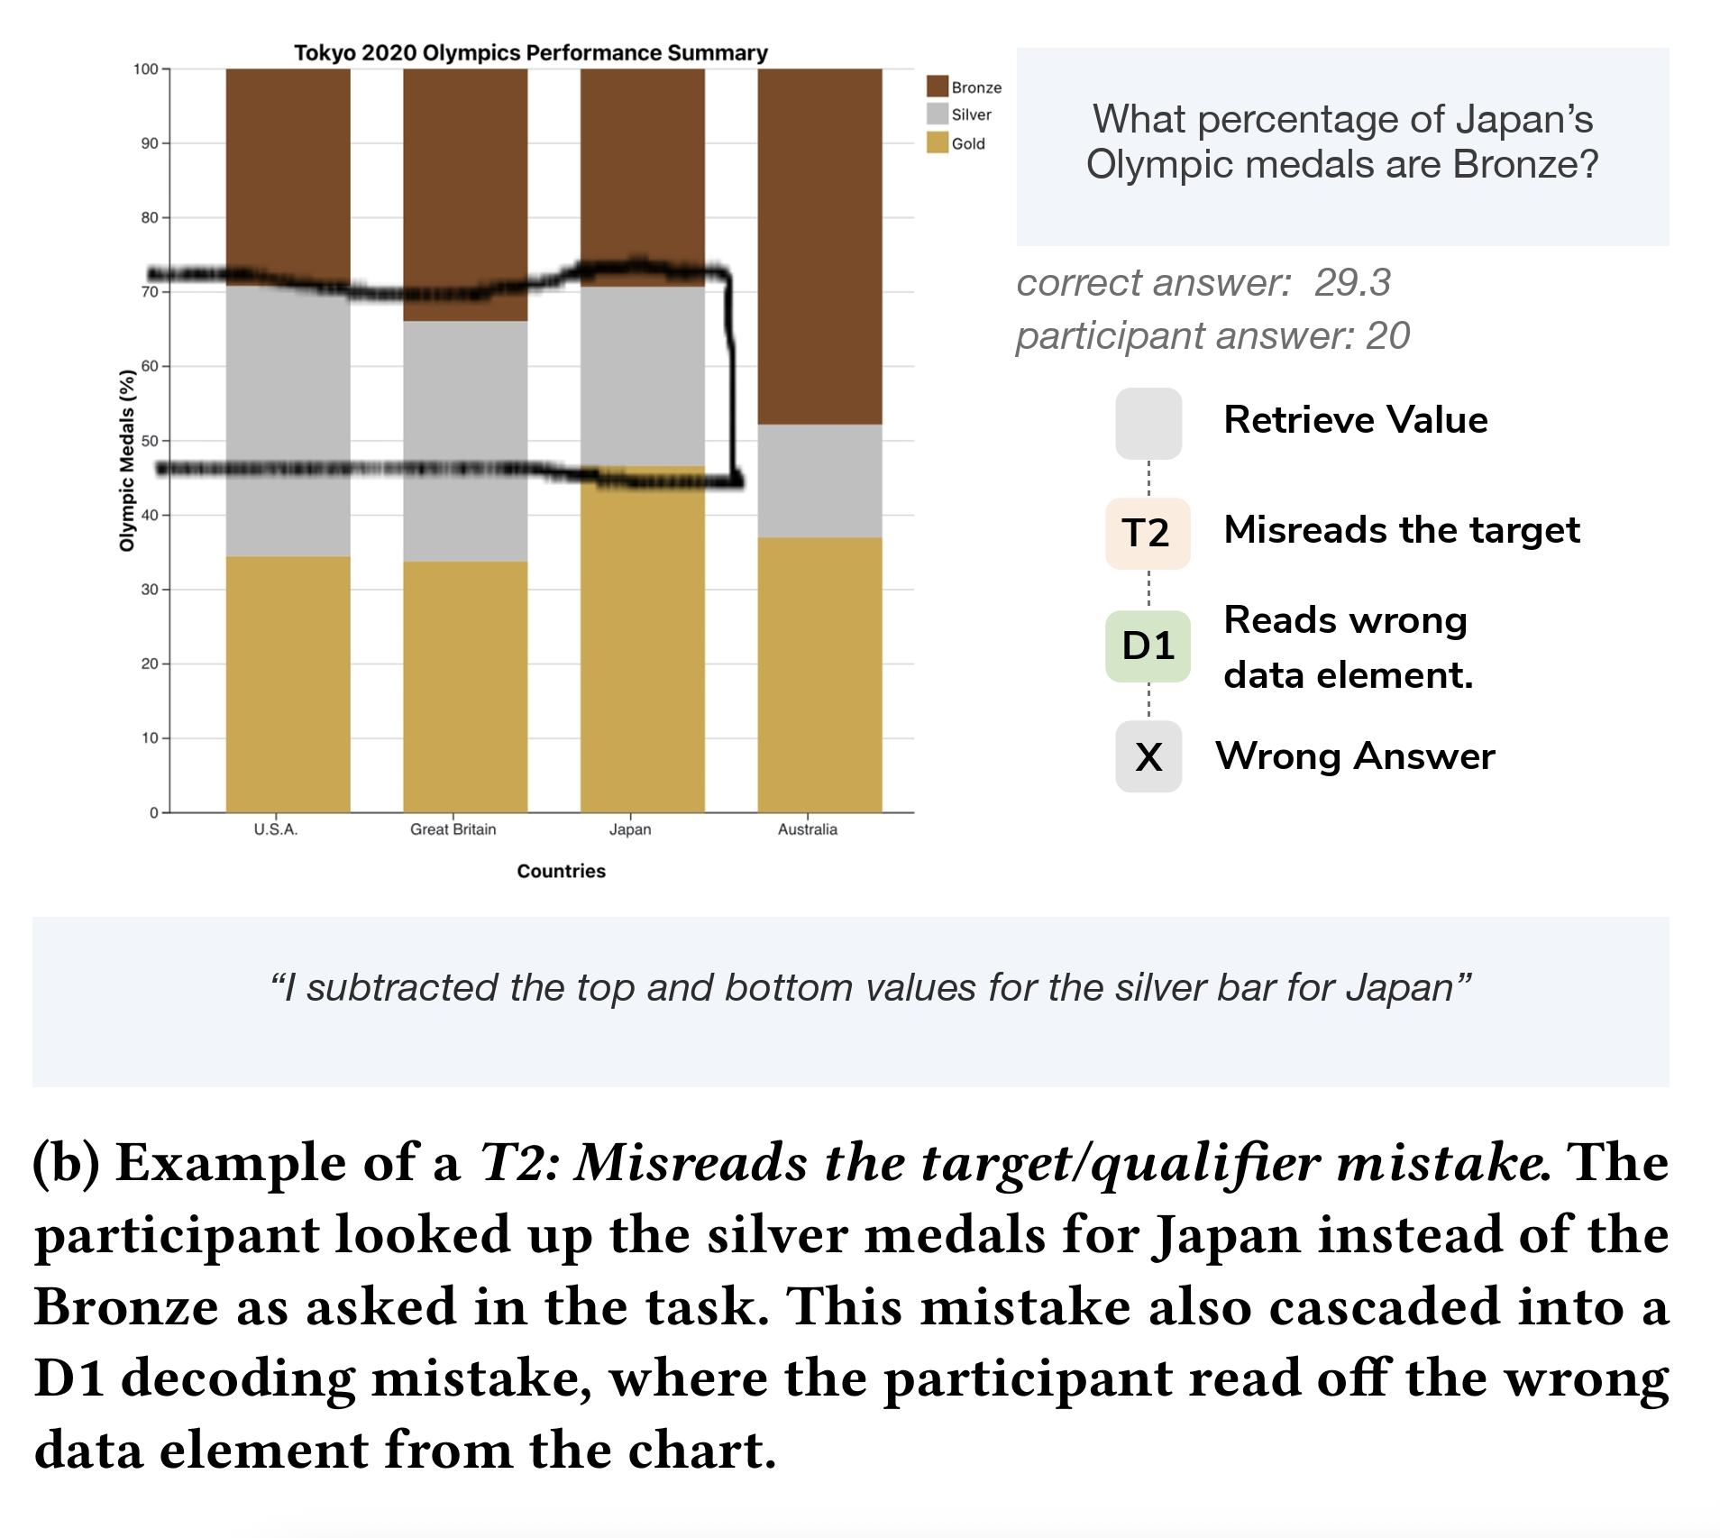
Barriers to Visualization Literacy
Translation barrier–
misreads target
Decoding barrier –
reads wrong data
element
Carolina Nobreet al. 2024. Reading Between the Pixels: Investigating the Barriers to Visualization Literacy. In Proceedings of the 2024 CHI Conference on Human Factors in Computing Systems (CHI '24). Association for Computing Machinery, New York, NY, USA, Article 197, 1–17. https://doi.org/10.1145/3613904.3642760

Slide 31
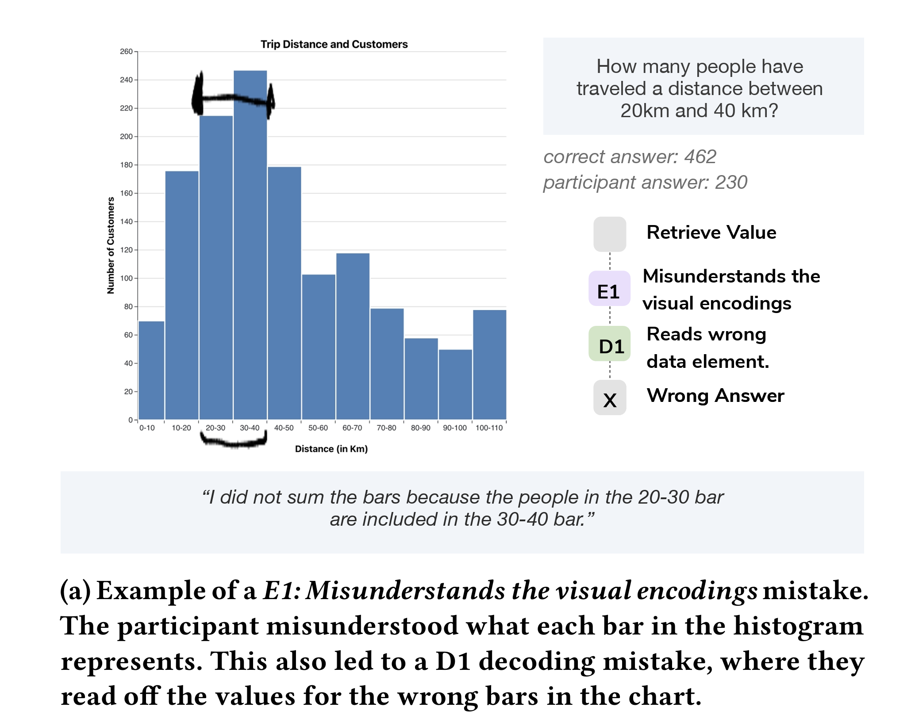
Barriers to Visualization Literacy
Encoding barrier—
misunderstands
visual encoding
Decoding barrier–
reads wrong value
Carolina Nobreet al. 2024. Reading Between the Pixels: Investigating the Barriers to Visualization Literacy. In Proceedings of the 2024 CHI Conference on Human Factors in Computing Systems (CHI '24). Association for Computing Machinery, New York, NY, USA, Article 197, 1–17. https://doi.org/10.1145/3613904.3642760

Slide 32
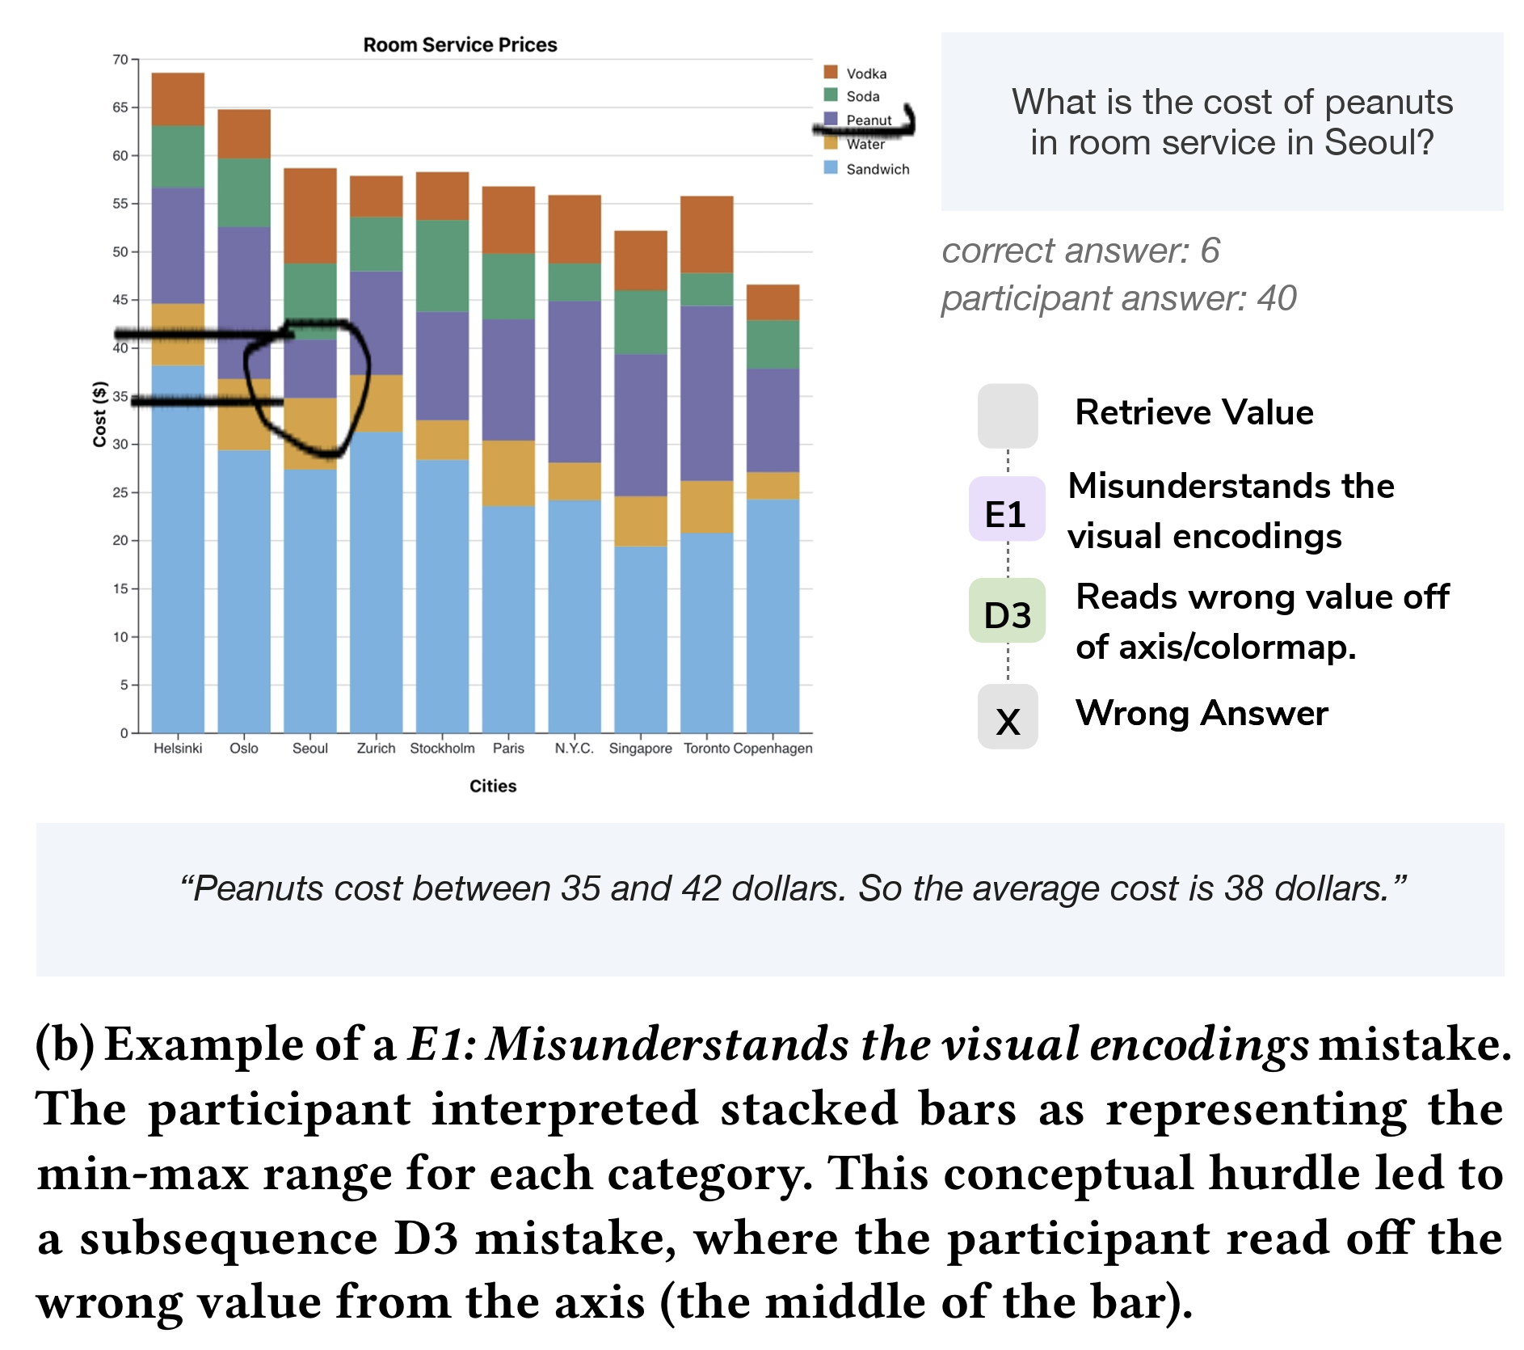
Barriers to Visualization Literacy
Encoding barrier–
misunderstands
visual encoding
Decoding barrier—
reads wrong bars
Carolina Nobreet al. 2024. Reading Between the Pixels: Investigating the Barriers to Visualization Literacy. In Proceedings of the 2024 CHI Conference on Human Factors in Computing Systems (CHI '24). Association for Computing Machinery, New York, NY, USA, Article 197, 1–17. https://doi.org/10.1145/3613904.3642760

Slide 33
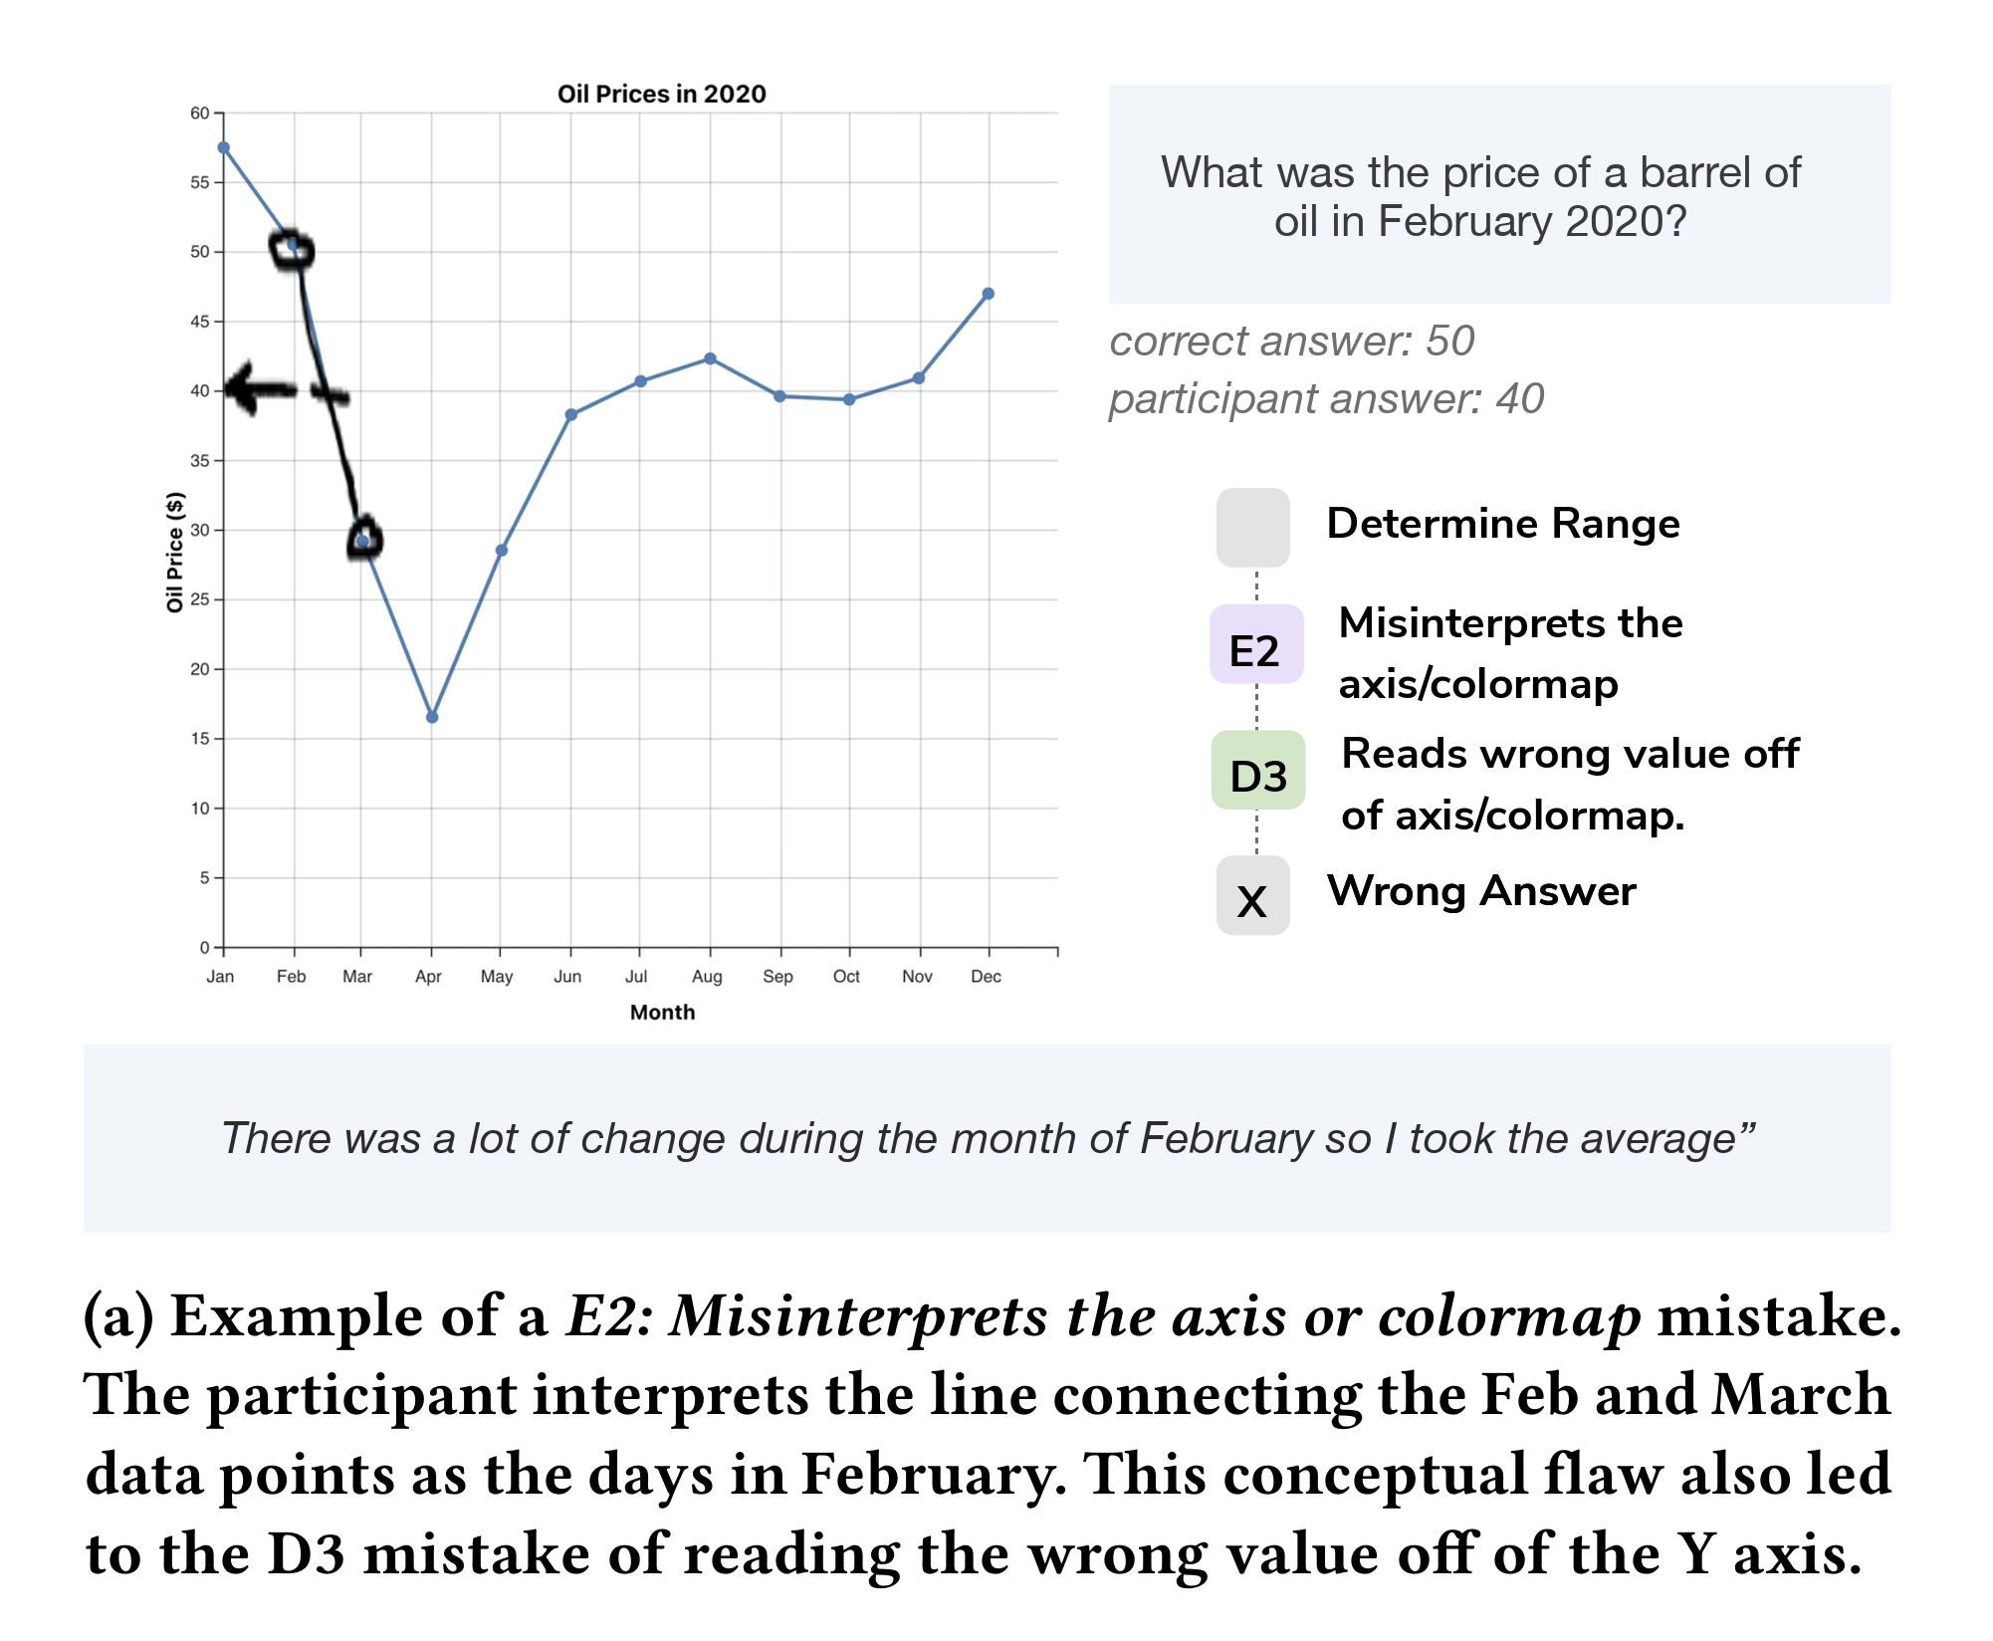
Barriers to Visualization Literacy
Encoding barrier—
misinterprets axis
or colormap
Decoding barrier–
reads wrong value
Carolina Nobreet al. 2024. Reading Between the Pixels: Investigating the Barriers to Visualization Literacy. In Proceedings of the 2024 CHI Conference on Human Factors in Computing Systems (CHI '24). Association for Computing Machinery, New York, NY, USA, Article 197, 1–17. https://doi.org/10.1145/3613904.3642760

Slide 34
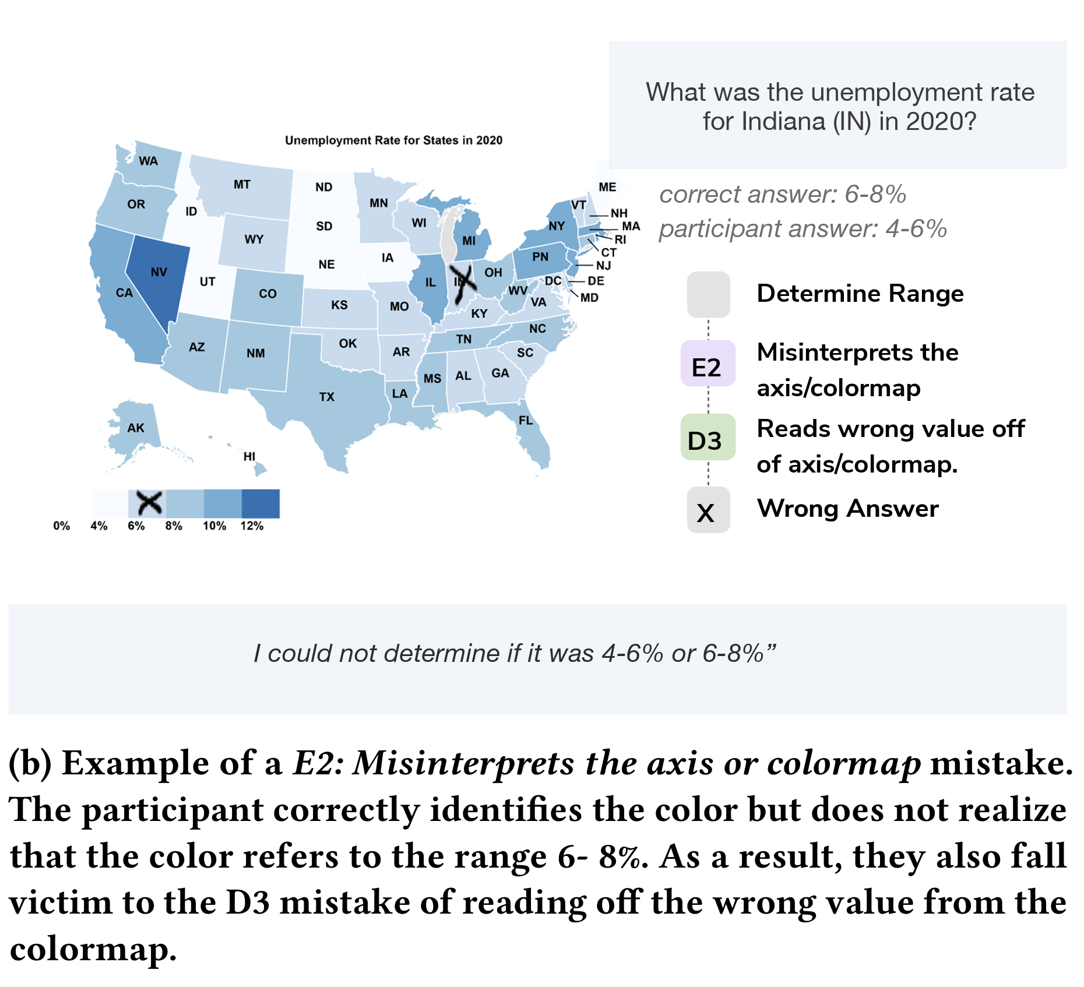
Barriers to Visualization Literacy
Encoding barrier—
misinterprets axis
or colormap
Decoding barrier—
reads wrong value
Carolina Nobreet al. 2024. Reading Between the Pixels: Investigating the Barriers to Visualization Literacy. In Proceedings of the 2024 CHI Conference on Human Factors in Computing Systems (CHI '24). Association for Computing Machinery, New York, NY, USA, Article 197, 1–17. https://doi.org/10.1145/3613904.3642760

Slide 35
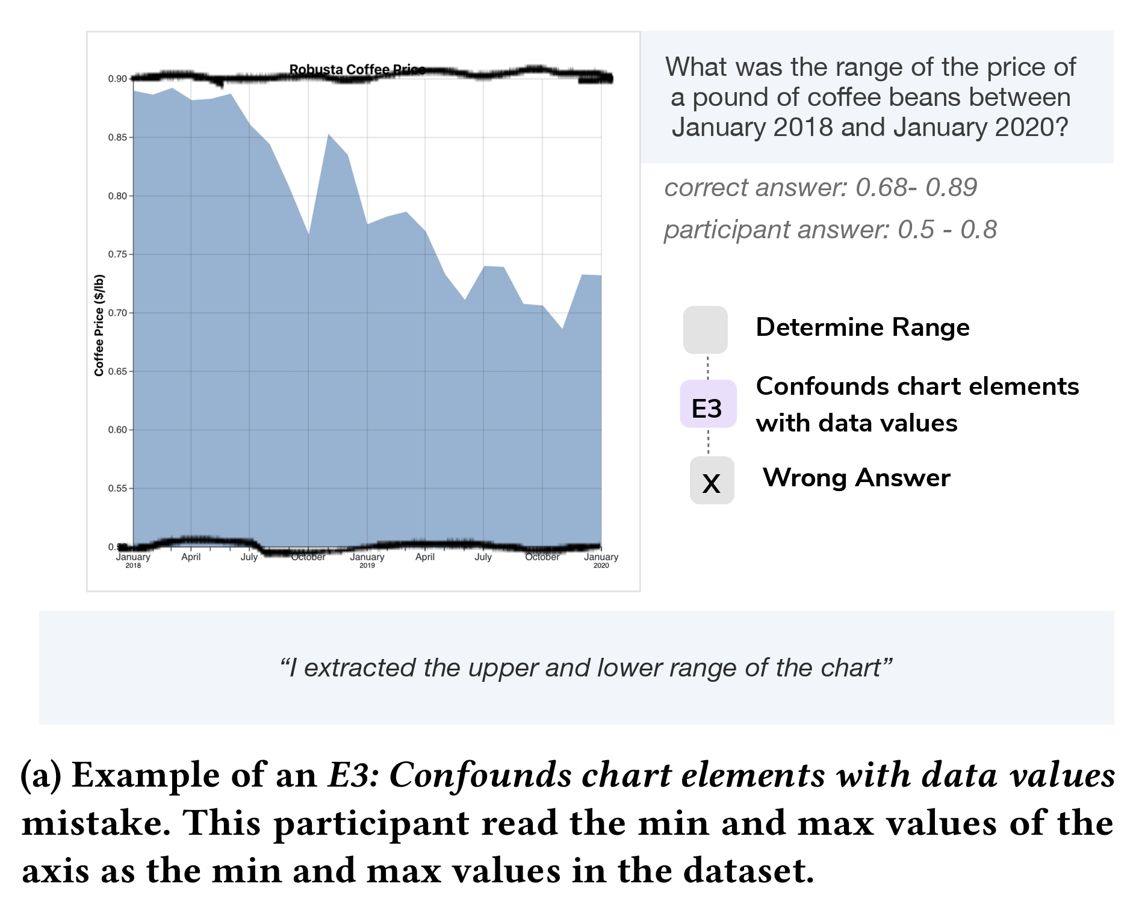
Barriers to Visualization Literacy
Encoding barrier—
confounds chart
and data values
Carolina Nobreet al. 2024. Reading Between the Pixels: Investigating the Barriers to Visualization Literacy. In Proceedings of the 2024 CHI Conference on Human Factors in Computing Systems (CHI '24). Association for Computing Machinery, New York, NY, USA, Article 197, 1–17. https://doi.org/10.1145/3613904.3642760

Slide 36
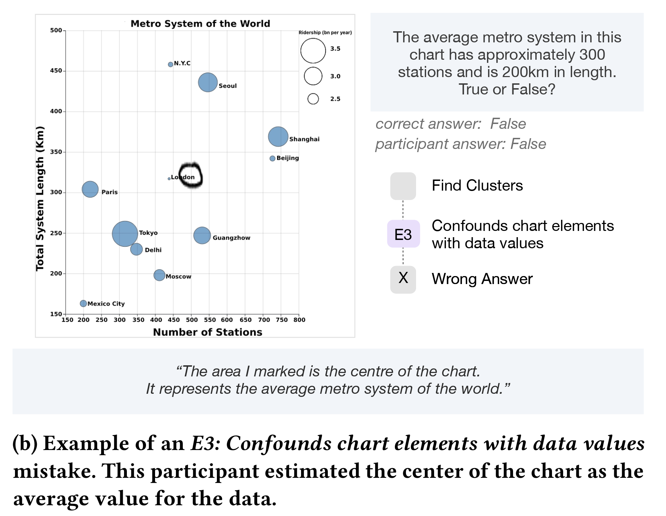
Barriers to Visualization Literacy
Encoding barrier—
confounds chart
and data values
Carolina Nobreet al. 2024. Reading Between the Pixels: Investigating the Barriers to Visualization Literacy. In Proceedings of the 2024 CHI Conference on Human Factors in Computing Systems (CHI '24). Association for Computing Machinery, New York, NY, USA, Article 197, 1–17. https://doi.org/10.1145/3613904.3642760

Slide 37
Your Turn!
Sketch two visualizations
  One should be designed for an audience with low visualization literacy
  One should be designed for an audience with high visualization literacy
Swap with someone
  Without any hints, can you guess which visualization is for low visualization literacy, and which is for high visualization literacy?

Slide 38
Brainstorm
Is it possible to create a visualization that increases a reader’s visualization literacy? Why or why not?
If you were forced to try, how would you design it? Why?

