Slide 1
Visual Analytics: network analysis
Ab Mosca (they/them)

Slide 2
Today’s plan
Mathematical intuition
Modeling with graphs
Visual analysis of networks

Slide 3
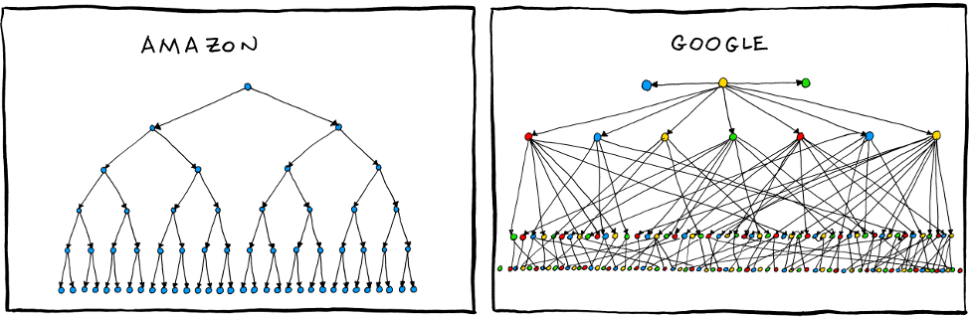
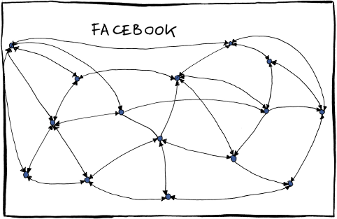
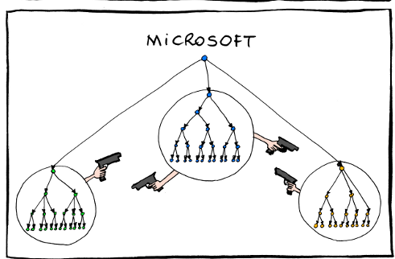
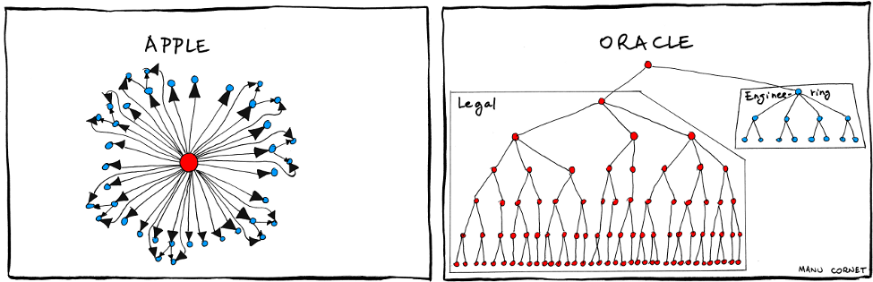
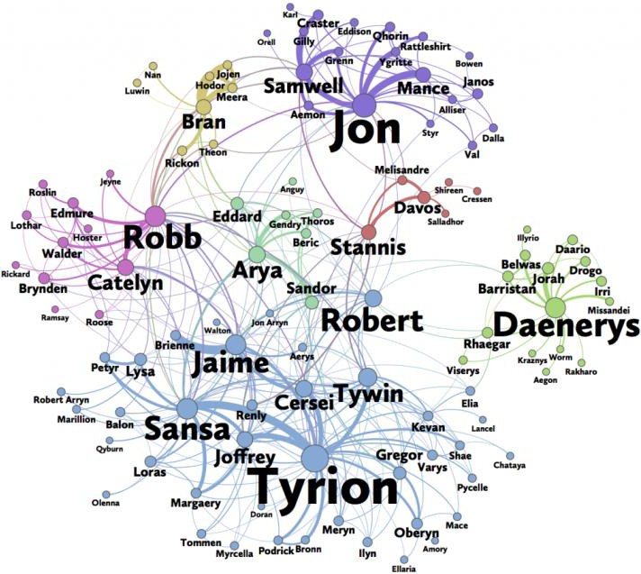
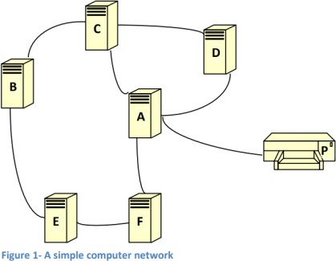
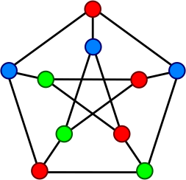
Definition: graph
In the mathematical sense a graph is a model for representing items and the relationships between those items. Ex:
Social / friendship networks
Computer networks
Energy or transportation grids
Organizational structures

Slide 4
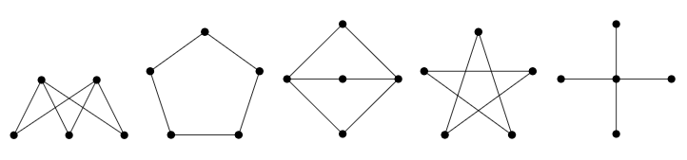
Mathematical intuition
Are any of the graphs below the same? If you said yes, which ones and why?

Slide 5
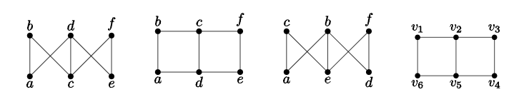
Mathematical intuition
How about these with labels?
Are any of the graphs below the same? If you said yes, which ones and why?

Slide 6

Mathematical intuition
These examples are drawings of graphs.
Mathematically, a graph is an ordered pair, $G=(V,E)$, consisting of a nonempty set, $V$ (called vertices), and a set $E$ (called edges) of two-elements subsets of $V$.
(Vertices are also called nodes.)

Slide 7
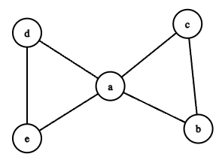
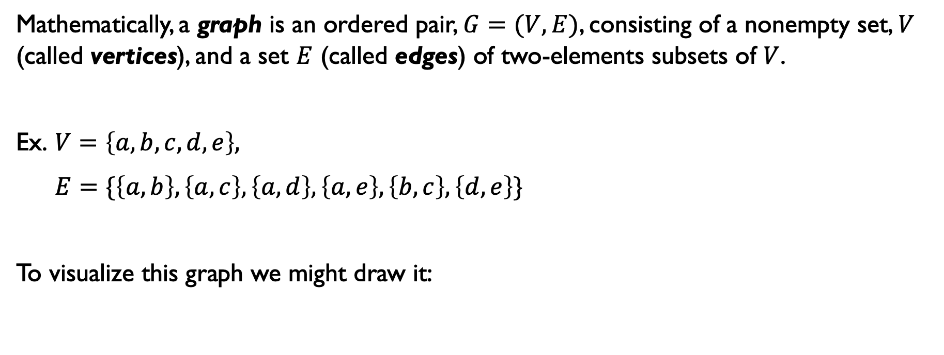
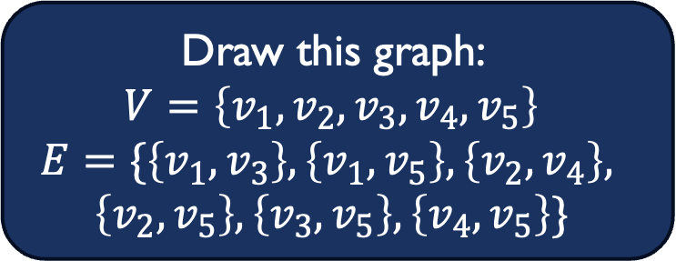
Mathematical intuition
Mathematically, a graph is an ordered pair, $G=(V,E)$, consisting of a nonempty set, $V$ (called vertices), and a set $E$ (called edges) of two-elements subsets of $V$.
Ex. $V=\left\{a, b, c, d, e\right\},$
$E=\{\left\{a, b\right\}, \left\{a, c\right\}, \left\{a, d\right\}, \left\{a, e\right\}, \left\{b, c\right\}, \left\{d, e\right\}\}$
To visualize this graph we might draw it:
Draw this graph:
$$V=\left\{v_{1},v_{2},v_{3},v_{4},v_{5}\right\}$$
$$E=\{\left\{v_{1},v_{3}\right\}, \left\{v_{1},v_{5}\right\}, \left\{v_{2}, v_{4}\right\},$$
$\left\{v_{2}, v_{5}\right\}, \left\{v_{3}, v_{5}\right\}, \left\{v_{4}, v_{5}\right\}\}$

Slide 8
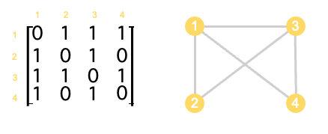


Mathematical intuition
Mathematically, a graph is an ordered pair, $G=(V,E)$, consisting of a nonempty set, $V$ (called vertices), and a set $E$ (called edges) of two-elements subsets of $V$.
We can also represent a graph using an adjacency matrix:
What is the adjacency matrix for this graph?
$$V=\left\{v_{1},v_{2},v_{3},v_{4},v_{5}\right\}$$
$$E=\{\left\{v_{1},v_{3}\right\}, \left\{v_{1},v_{5}\right\},$$
$$\left\{v_{2}, v_{4}\right\}, \left\{v_{2}, v_{5}\right\},$$
$\left\{v_{3}, v_{5}\right\}, \left\{v_{4}, v_{5}\right\}\}$

Slide 9
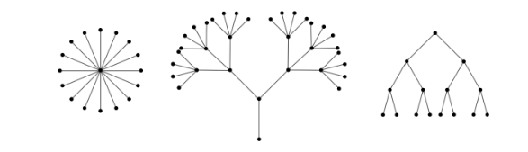
Mathematical intuition
A tree is a connected graph containing no cycles.
A forest is a graph containing no cycles.
https://ptwiddle.github.io/Graph-Theory-Notes/s_intro_trees.html

Slide 10
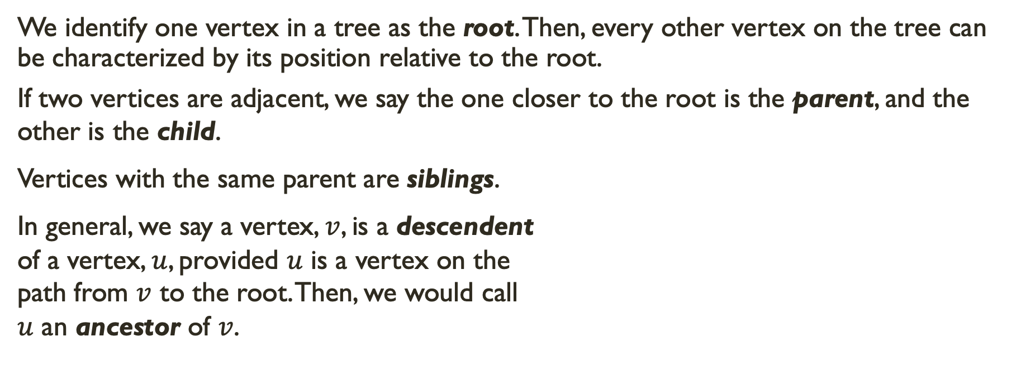
Mathematical intuition
We identify one vertex in a tree as the root. Then, every other vertex on the tree can be characterized by its position relative to the root.
If two vertices are adjacent, we say the one closer to the root is the parent, and the other is the child.
Vertices with the same parent are siblings.
In general, we say a vertex, $v$, is a descendent
of a vertex, $u$, provided $u$ is a vertex on the
path from $v$ to the root. Then, we would call
$u$ an ancestor of $v$.
siblings
root
parent
ancestor
child
descendant

Slide 11
Recall -- Definition: graph
In the mathematical sense a graph is a model for representing items and the relationships between those items. Ex:
Social / friendship networks
Computer networks
Energy or transportation grids
Organizational structures

Slide 12

Modeling with graphs
Node data: There may be many attributes associated with each node
Sam
1
Abigail
Vertex id | Name | Favorite color | Popularity
1 | Sam | Blue | 6
2 | Sebastian | Green | 7
3 | Abigail | Purple | 9
4 | Haley | Pink | 2
5 | Shane | Orange | 4
6 | Leah | Purple | 7
3
1
2
1
4
Haley
Sebastian
Leah
6
5
Shane

Slide 13
Modeling with graphs
Edge data: There may be many attributes associated with each edge
Sam
1
Abigail
3
Edge id | Source | Target | Friend value
1 | Sam | Sebastian | 10
2 | Sam | Abigail | 6
3 | Sebastian | Haley | 1
4 | Abigail | Haley | 2
5 | Haley | Shane | 1
6 | Shane | Leah | 2
1
2
1
4
Haley
Sebastian
Leah
6
5
Shane

Slide 14
Visual analysis
What might visual analysis of networks reveal?

Slide 15
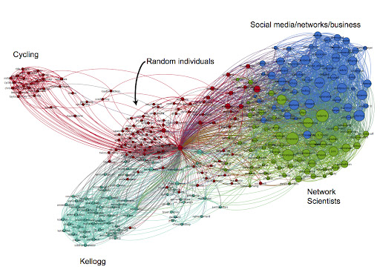
Visual analysis: insights
Highlight communities
5
https://www.google.com/url?sa=i&url=http%3A%2F%2Fsocial-dynamics.org%2Ftag%2Fnetwork-visualization%2F&psig=AOvVaw1csnV4he0ey3cU3srQTMiE&ust=1724861687547000&source=images&cd=vfe&opi=89978449&ved=0CBQQjRxqFwoTCOij7NPIlYgDFQAAAAAdAAAAABA5

Slide 16

Visual analysis: insights
Illustrate hierarchy
5
https://www.google.com/url?sa=i&url=https%3A%2F%2Fslideuplifts.medium.com%2Fmust-have-org-charts-to-visualize-your-project-team-structure-d61df5eb00f5&psig=AOvVaw2MFNBDY9jaG6RGpyqTDuKD&ust=1724861970547000&source=images&cd=vfe&opi=89978449&ved=0CBgQ3YkBahcKEwiYpfLayZWIAxUAAAAAHQAAAAAQCQ

Slide 17
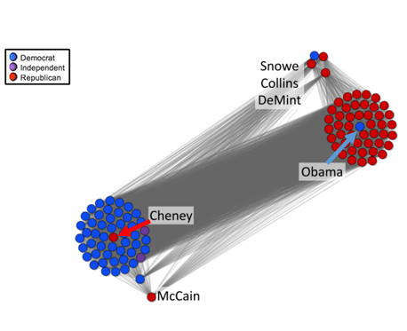
Visual analysis: insights
Reveal outliers
A. Suh, M. Hajij, B. Wang, C. Scheidegger and P. Rosen, "Persistent Homology Guided Force-Directed Graph Layouts," in IEEE Transactions on Visualization and Computer Graphics, vol. 26, no. 1, pp. 697-707, Jan. 2020, doi: 10.1109/TVCG.2019.2934802.
5

Slide 18
Visual analysis: techniques
There are many ways to encode and layout graph visualizations.
The correct one depends on what tasks you need to support or what features of the data need to be highlighted.
5

Slide 19
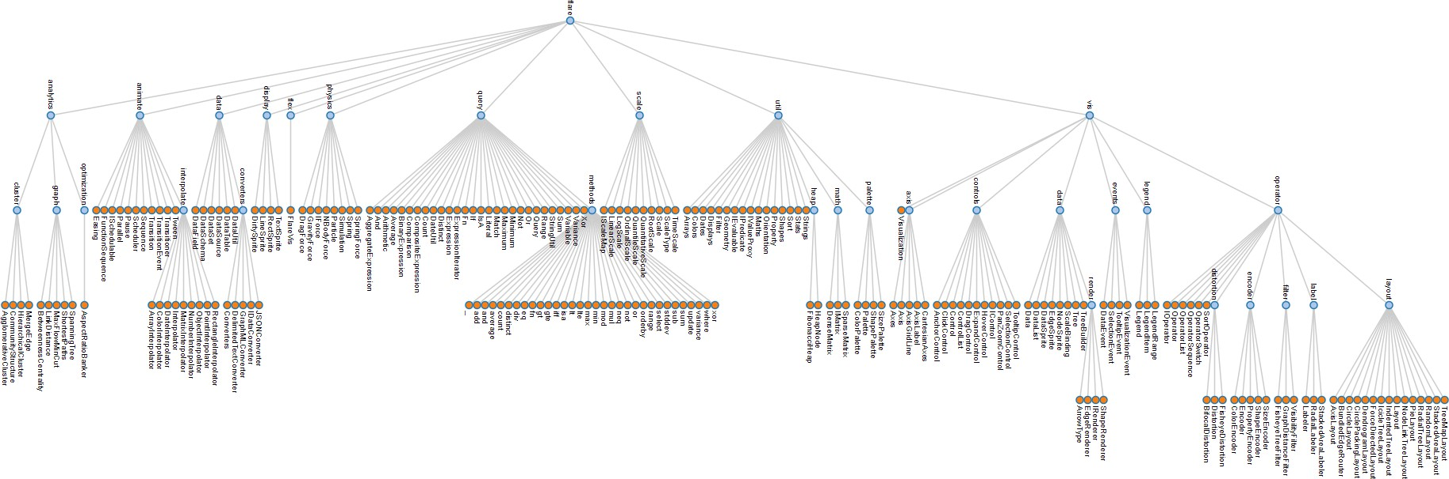
Visual analysis: techniques
Node-link tree diagrams
Nodes are distributed in space, connected by straight or curved lines
Typical approach is to use 2D space to break apart breadth and depth
Often, position is used to communicate hierarchical orientation
5

Slide 20
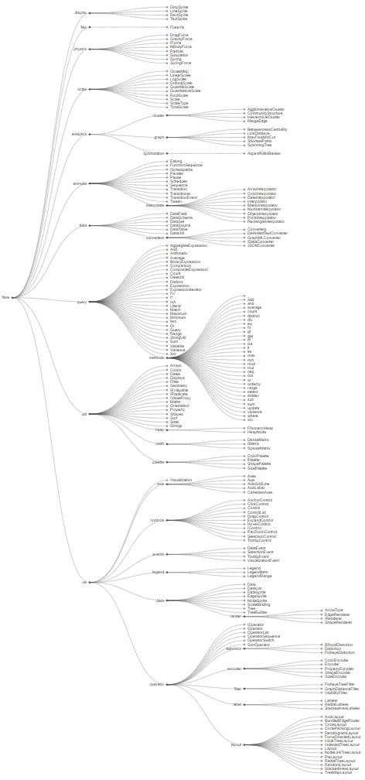
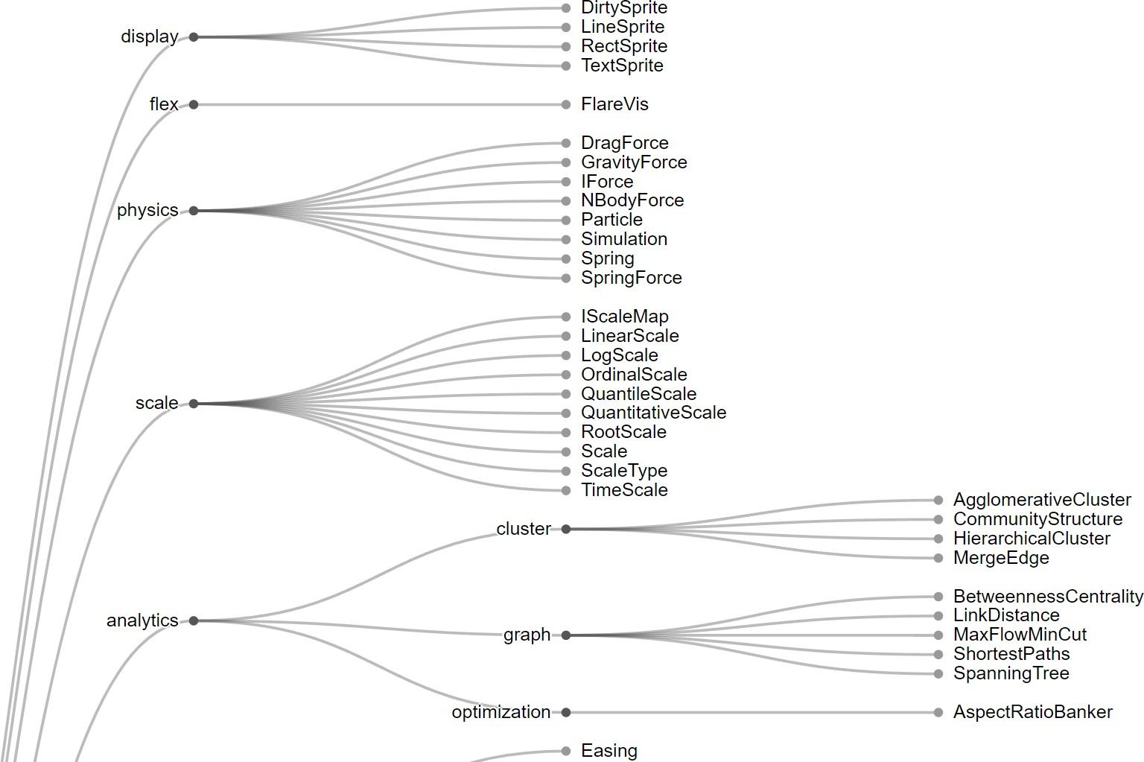
Visual analysis: techniques
Node-link tree diagrams
Algorithms, such as the Reingold-Tilford algorithm, efficiently calculate optimal layout
5
https://bl.ocks.org/mbostock/4339184

Slide 21
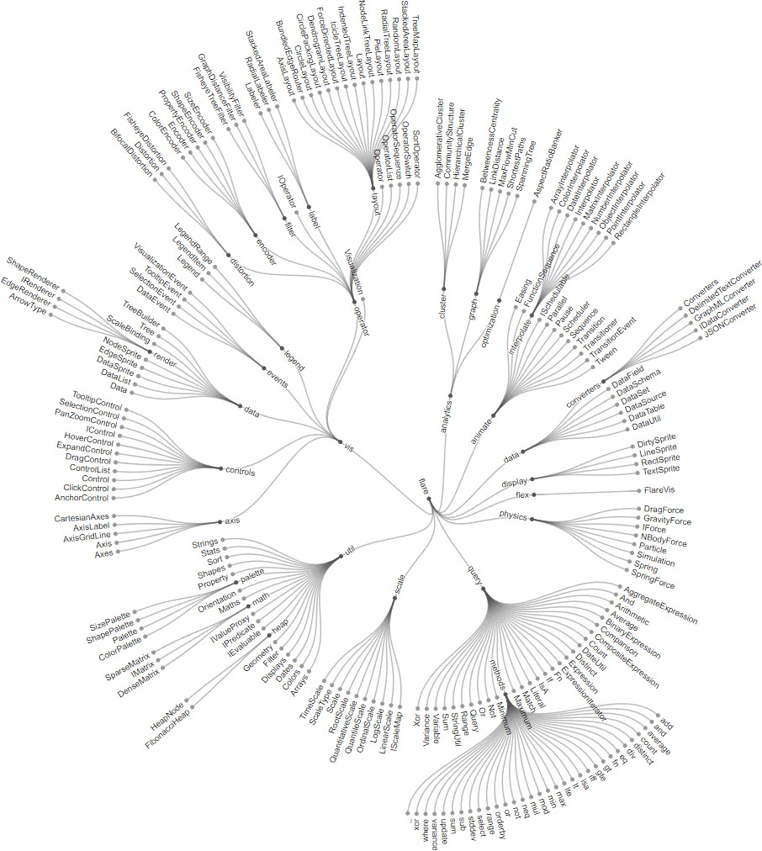
Visual analysis: techniques
https://bl.ocks.org/mbostock/4063550
Node-link tree diagrams
Layout can also be radial
5
https://bl.ocks.org/mbostock/4063550

Slide 22


Visual analysis: techniques
Node-link tree diagrams
Reingold-Tilford algorithm
Bottom-up recursive approach
Repeatedly divide space by leaf count
For each parent, make sure subtrees are drawn
Make smarter use of space
Maximize density and symmetry
Clearly encode depth level
No edge crossings
Pack subtrees as closely as possible
Centers parent over subtrees

Slide 23
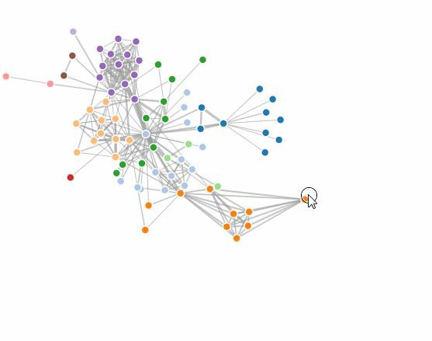
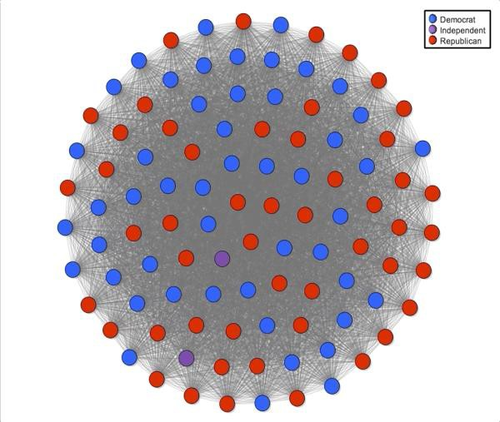
Visual analysis: techniques
Node-link tree diagrams
Force-directed layouts model layout with attraction (via edges) and repulsion (between nodes) to optimize layout
However, many edges can cause visual clutter
5

Slide 24
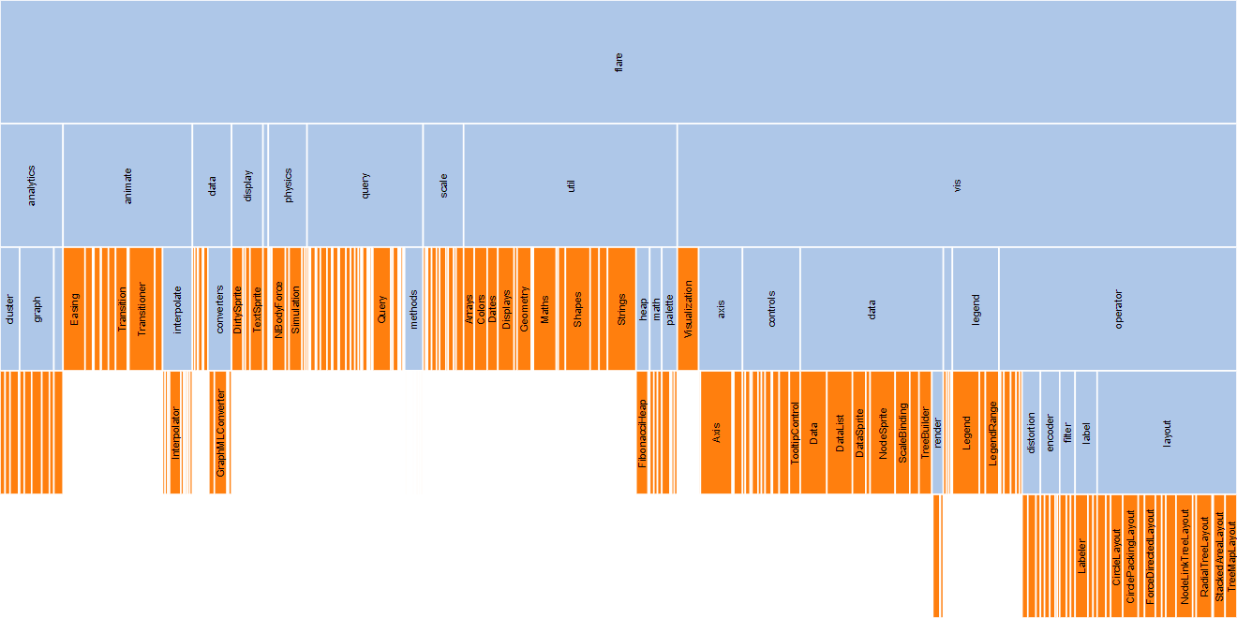
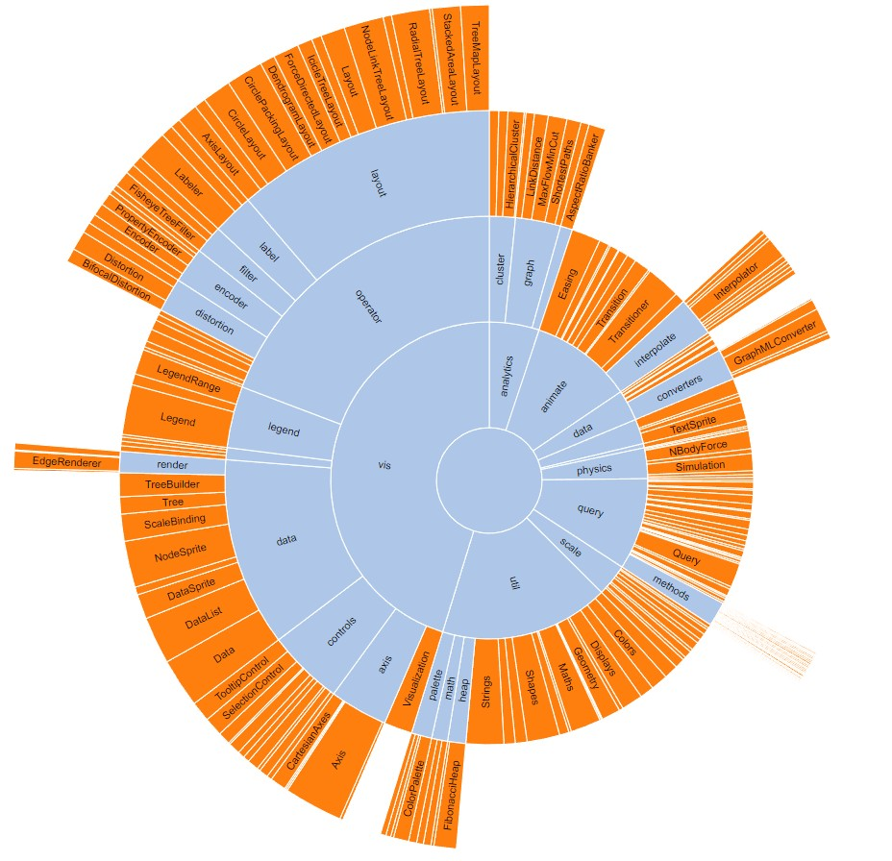
Visual analysis: techniques
Layered (adjacency) Diagrams
Space-filling variant of node-link diagrams
Nodes drawn as solid areas (arcs or bars)
Placement relative to adjacent nodes reveals place in hierarchy
Root node at top / center
Leaf nodes at bottom
5

Slide 25
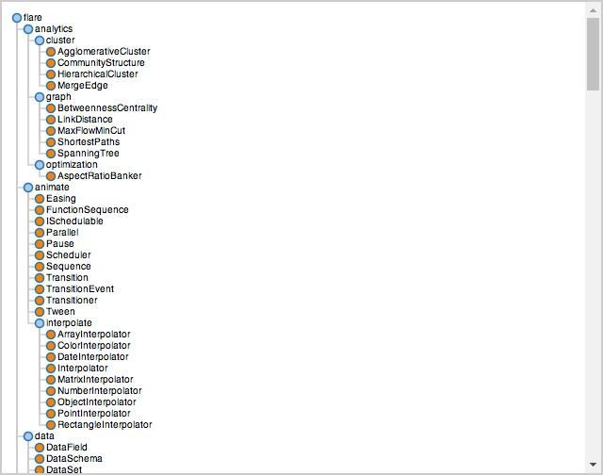
Visual analysis: techniques
Indented List
Highlights parent / child relationships
Simple to compute
Potentially a lot of scrolling
5

Slide 26
Visual analysis: techniques
Enclosure (treemap) Diagram
Encodes tree structure using spatial enclosure
Enclosure indicates hierarchy
Provides a single view of entire tree
Easier to spot small / large nodes (i.e. node with many or few descendants)
A
A
B
C
=
D
B
C
E
D
E
5

Slide 27
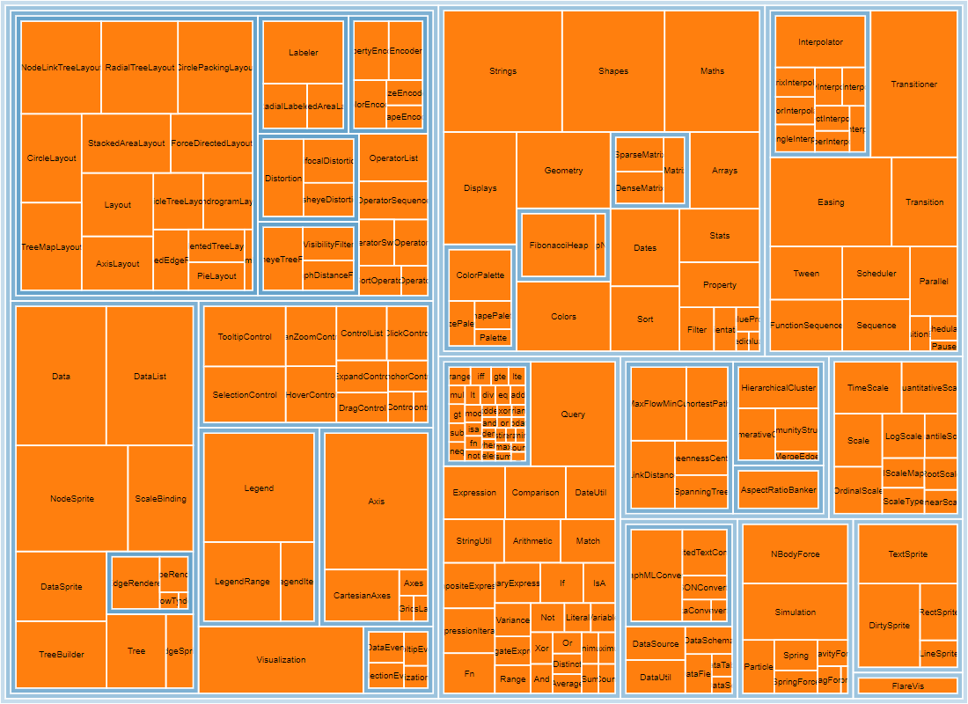
Visual analysis: techniques
Enclosure (treemap) Diagram
Can obscure depth
5

Slide 28
Visual analysis: techniques
Creating an effective visualization depends on the primary goal of analysis
Each method of visual analysis has tradeoffs
5

Slide 29
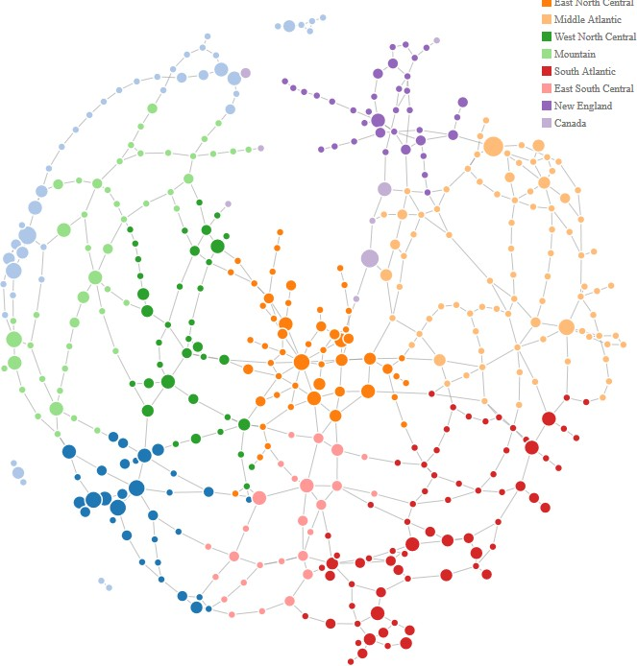
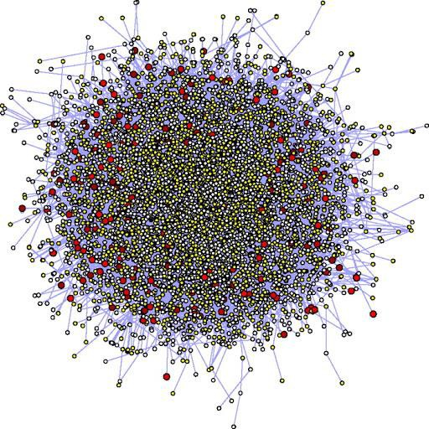
Visual analysis: techniques
Each method of visual analysis has tradeoffs
Reingold-Tilford algorithm
PROS:
understandable visual mapping
shows overall structure, clusters, paths
flexible, many variations / layouts
CONS:
most trivial algorithms are slow
not good for dense (very connected) graphs
5

Slide 30
Visual analysis: techniques
Each method of visual analysis has tradeoffs
Force-directed Layout
PROS:
aesthetically-pleasing
interactive (pull & drag!)
automatic & flexible
CONS:
forces are computationally expensive ~ O(n2)
doesn’t work well on dense graphs
5

Slide 31
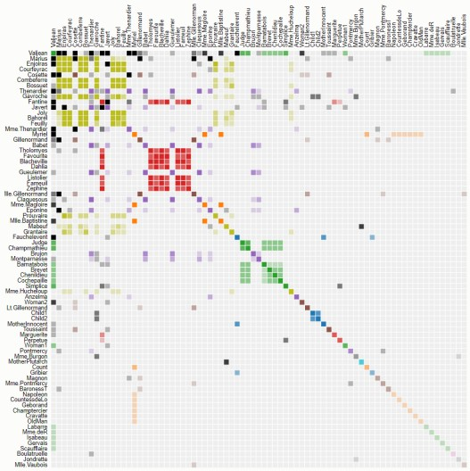
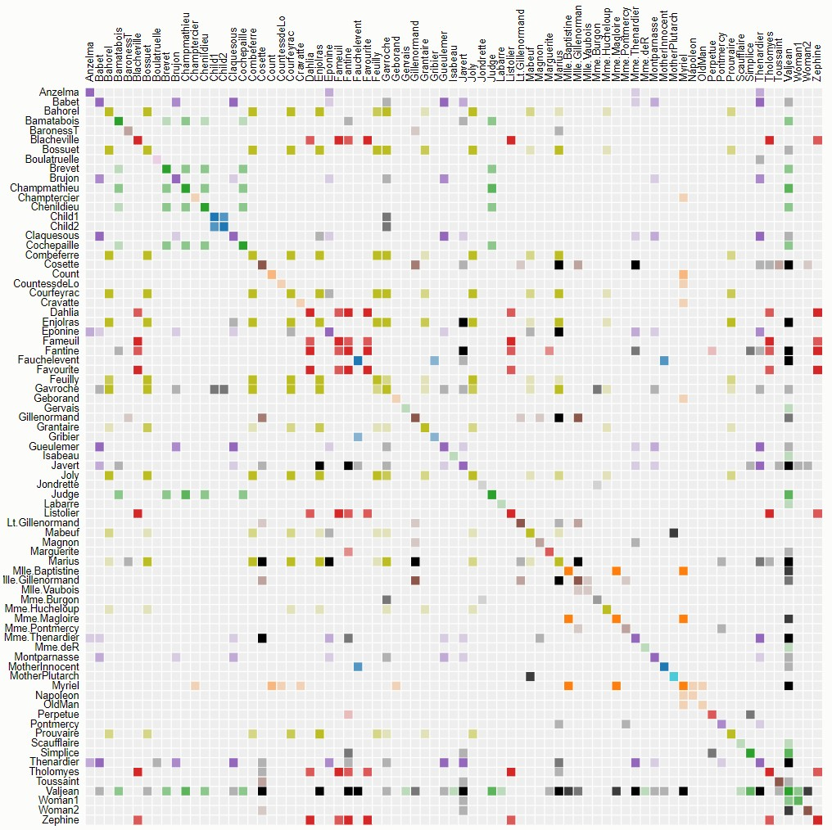
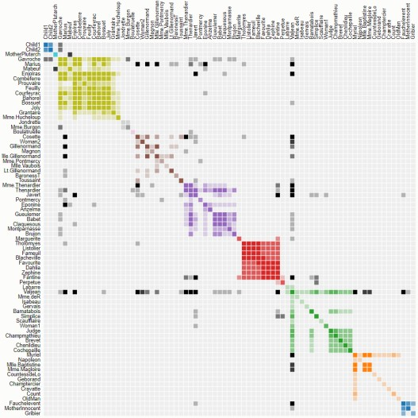
Visual analysis: techniques
Each method of visual analysis has tradeoffs
Adjacency Diagram
PROS:
great for dense graphs
visually scalable
can spot clusters
CONS:
row order affects what you can see
abstract visualization
hard to follow paths
Why does ordering matter?
(above) layout ordered by Name
(left, top) layout ordered by Frequency (left, bot) layout ordered by Cluster
5

Slide 32
activity
Your Turn:
Find a visualization of network data
Re-draw the visualization using a different method than the original
Does anything become apparent in the re-draw that was hidden in the original? Which do you think is more effective? Why?
5

