Slide 1
Visual Analytics: Intro to HTML, CSS, and JavaScript
Ab Mosca (they/them)

Slide 2
Today’s plan
Front end web development for visualization:
Modeling a webpage
Creating a webpage
Styling a webpage
Adding interaction to a webpage

Slide 3
Modeling a webpage
Go to: smith.edu
Right click anywhere, select “inspect” from the menu
Start on the “Elements” pane of the inspection panel, explore the webpage
How do you think this webpage is made?

Slide 4
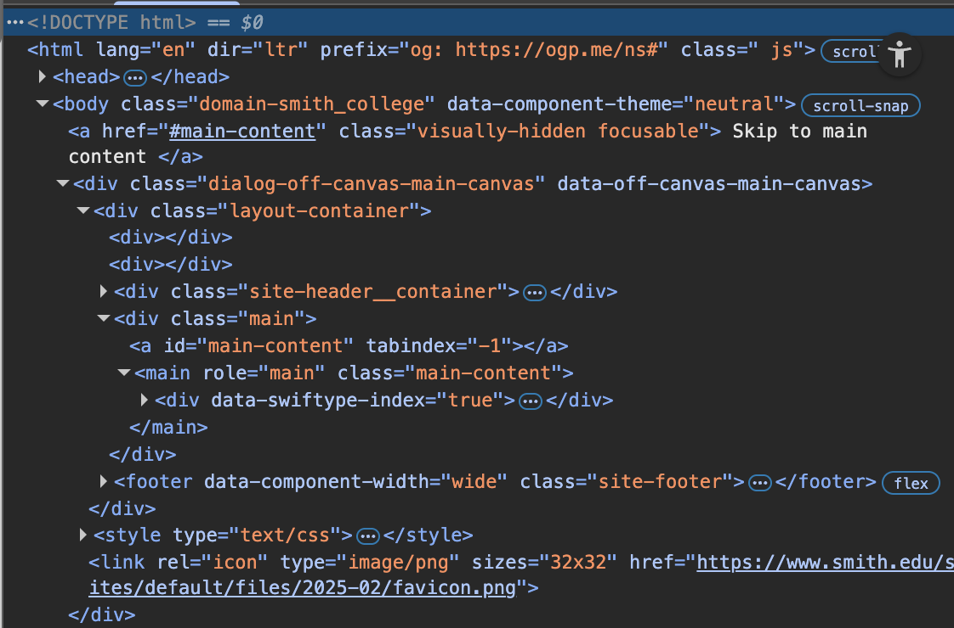
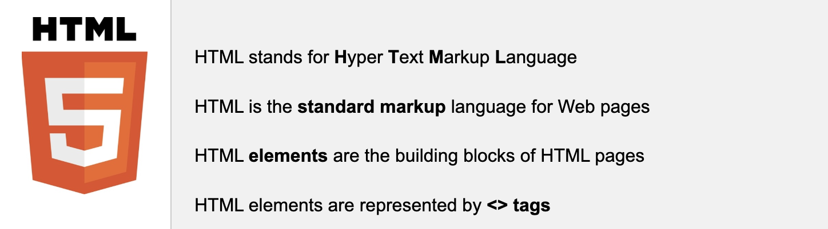
Modeling a webpage
A webpage is defined through HTML
https://www.w3schools.com/whatis/whatis_html.asp

Slide 5
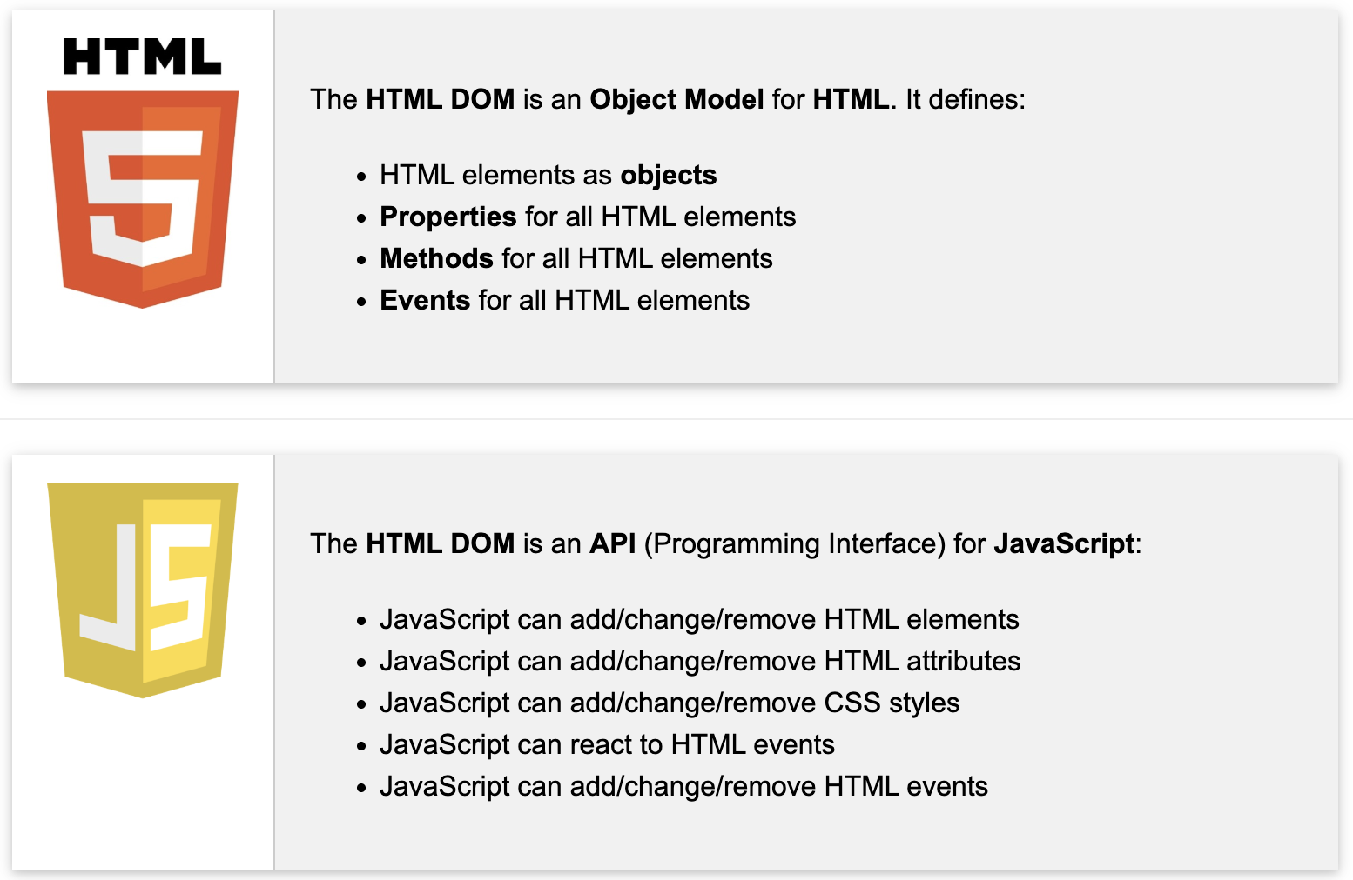
Modeling a webpage
DOM = Document Object Model
When a webpage is loaded, the browser (ex. Chrome) creates a DOM of the page
The DOM model of a webpage is a tree of HTML objects
https://www.w3schools.com/whatis/whatis_htmldom.asp

Slide 6
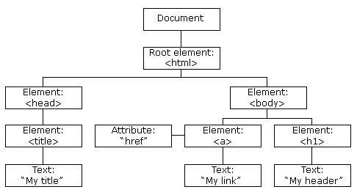
Modeling a webpage
DOM = Document Object Model
When a webpage is loaded, the browser (ex. Chrome) creates a DOM of the page
The DOM model of a webpage is a tree of HTML objects
https://www.w3schools.com/whatis/whatis_htmldom.asp

Slide 7
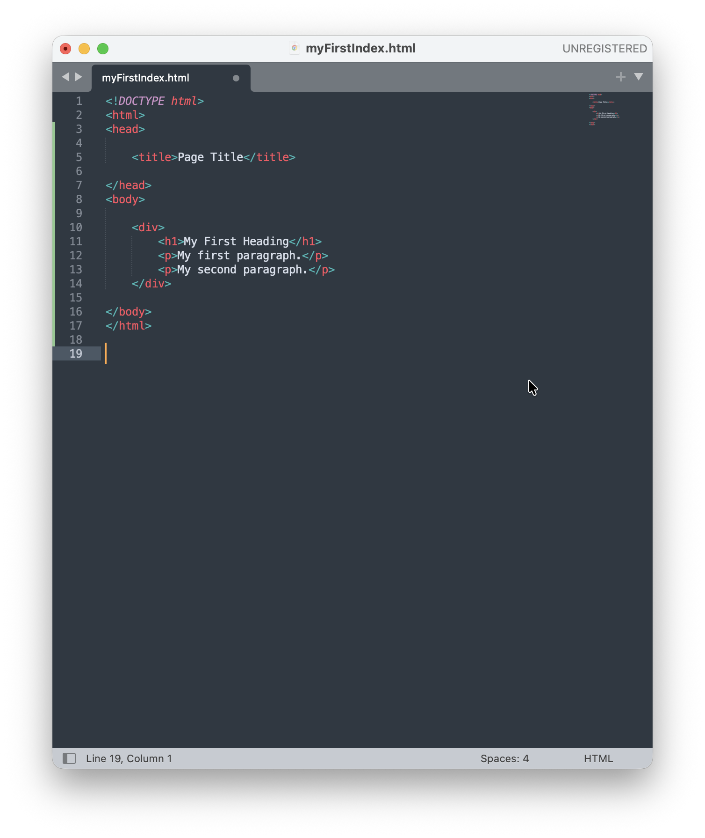
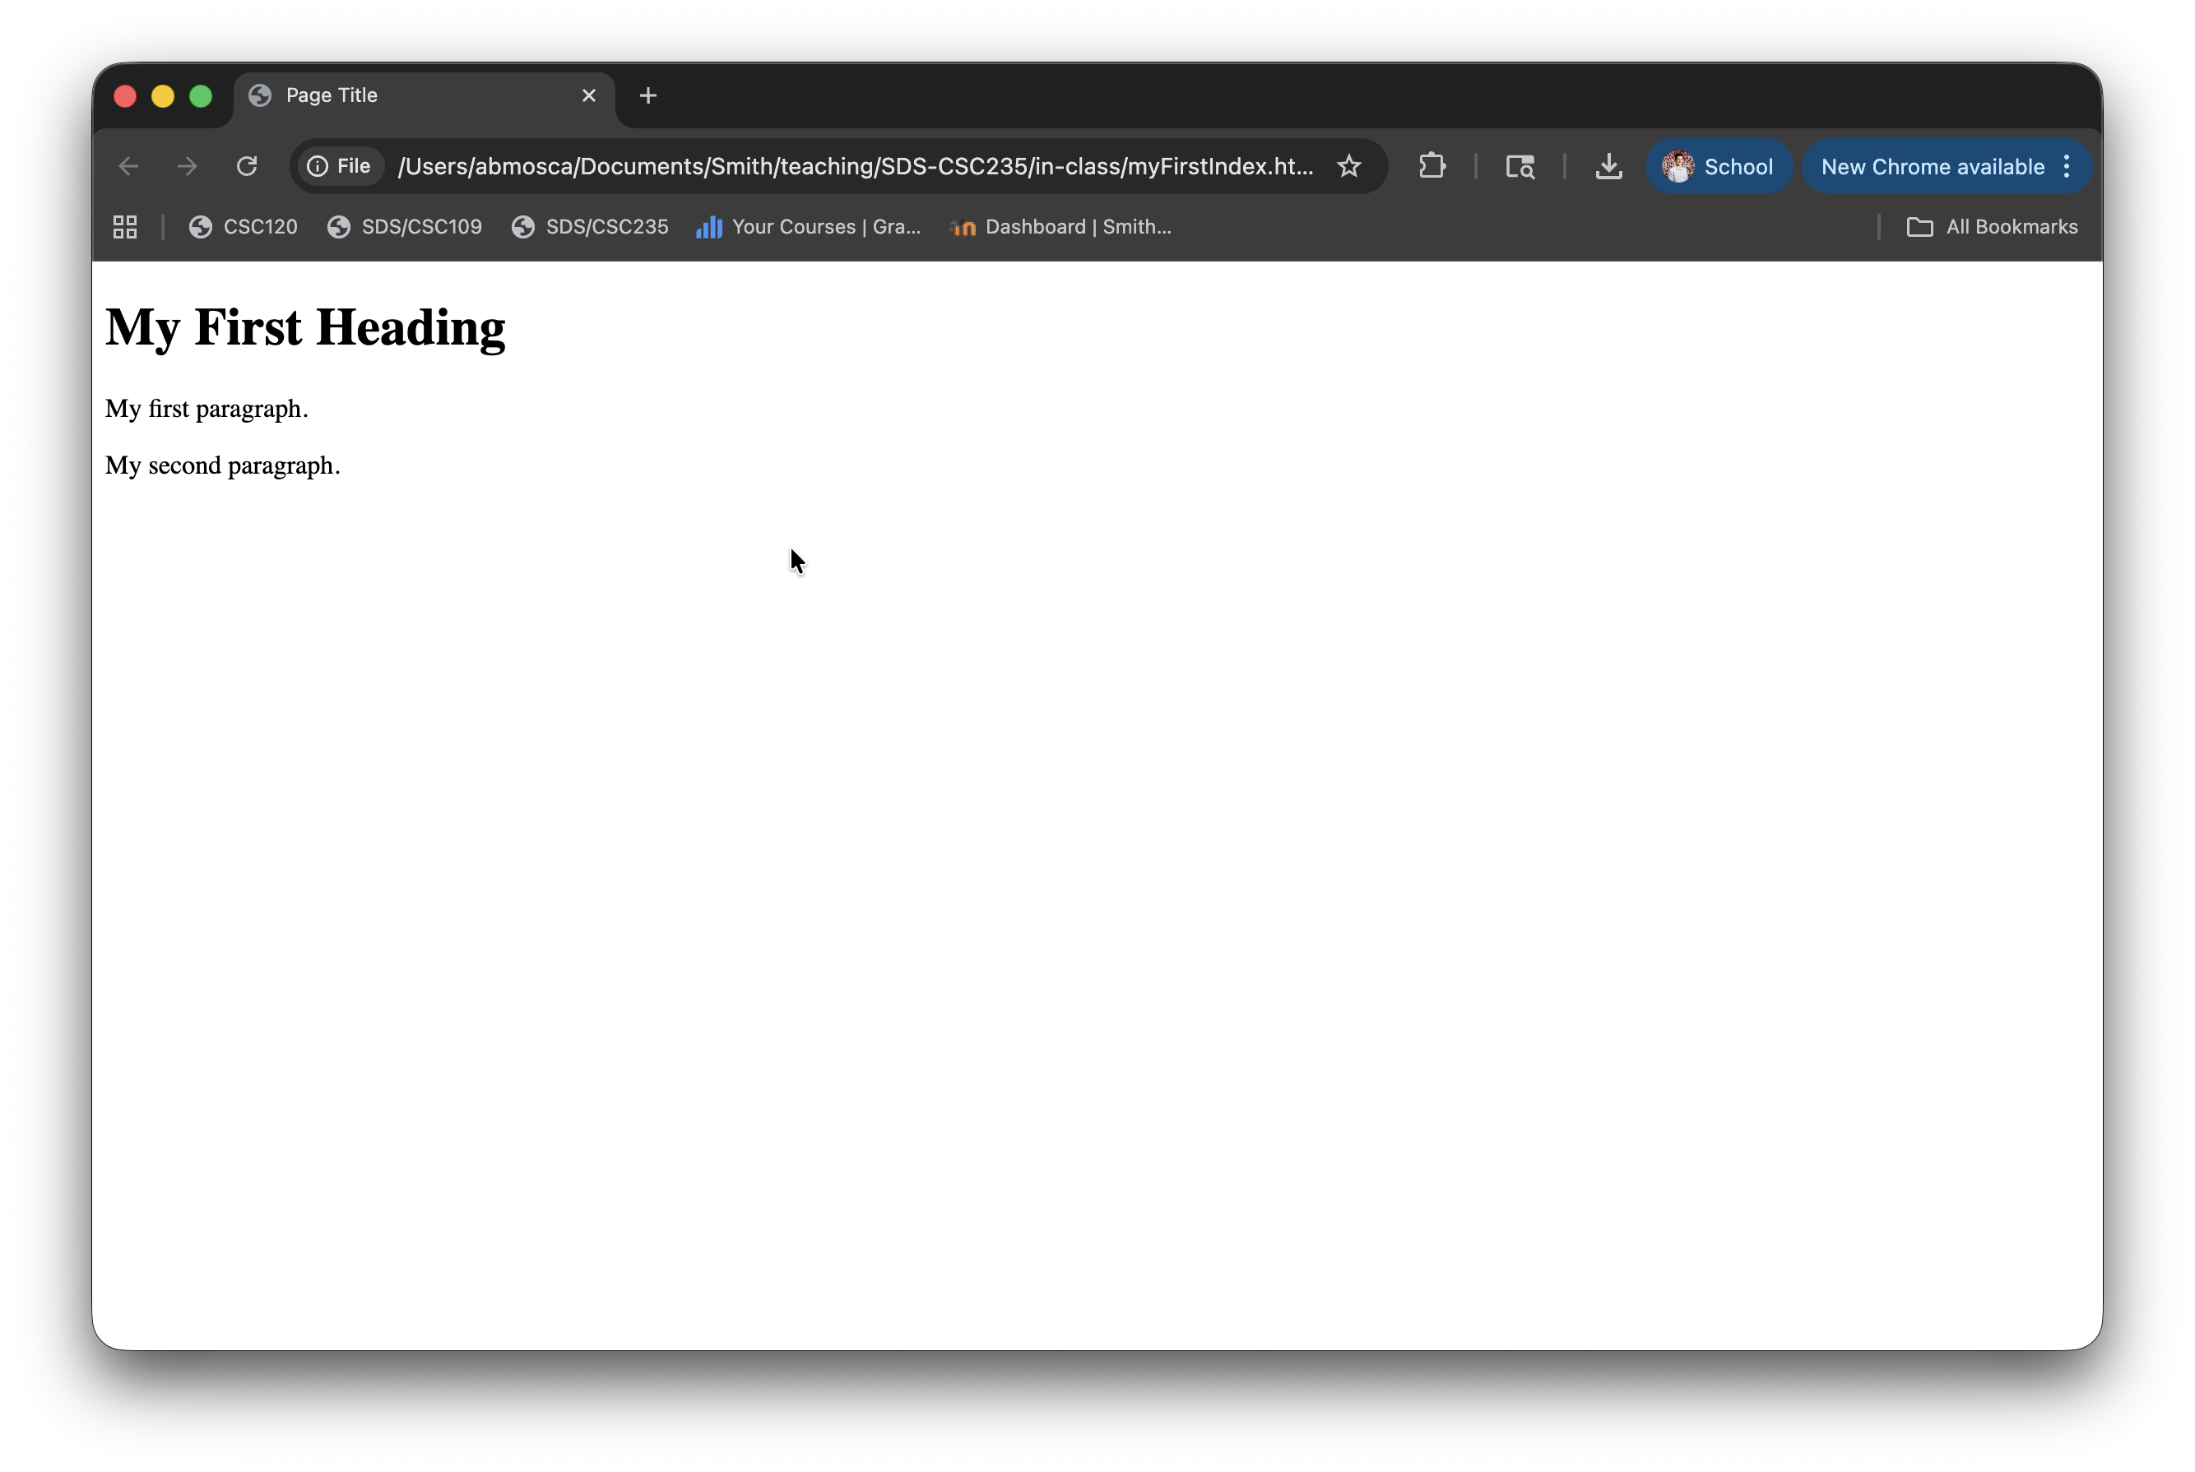
Building a webpage: HTML
https://www.w3schools.com/html/html_intro.asp

Slide 8
Building a webpage: HTML
Document
<head>
<body>
<title>
Text: Page Title
<div>
<h1>
Text: My First Heading
<p>
Text: My first paragraph.
<p>
Text: My second paragraph.
<html>
https://www.w3schools.com/html/html_intro.asp

Slide 9
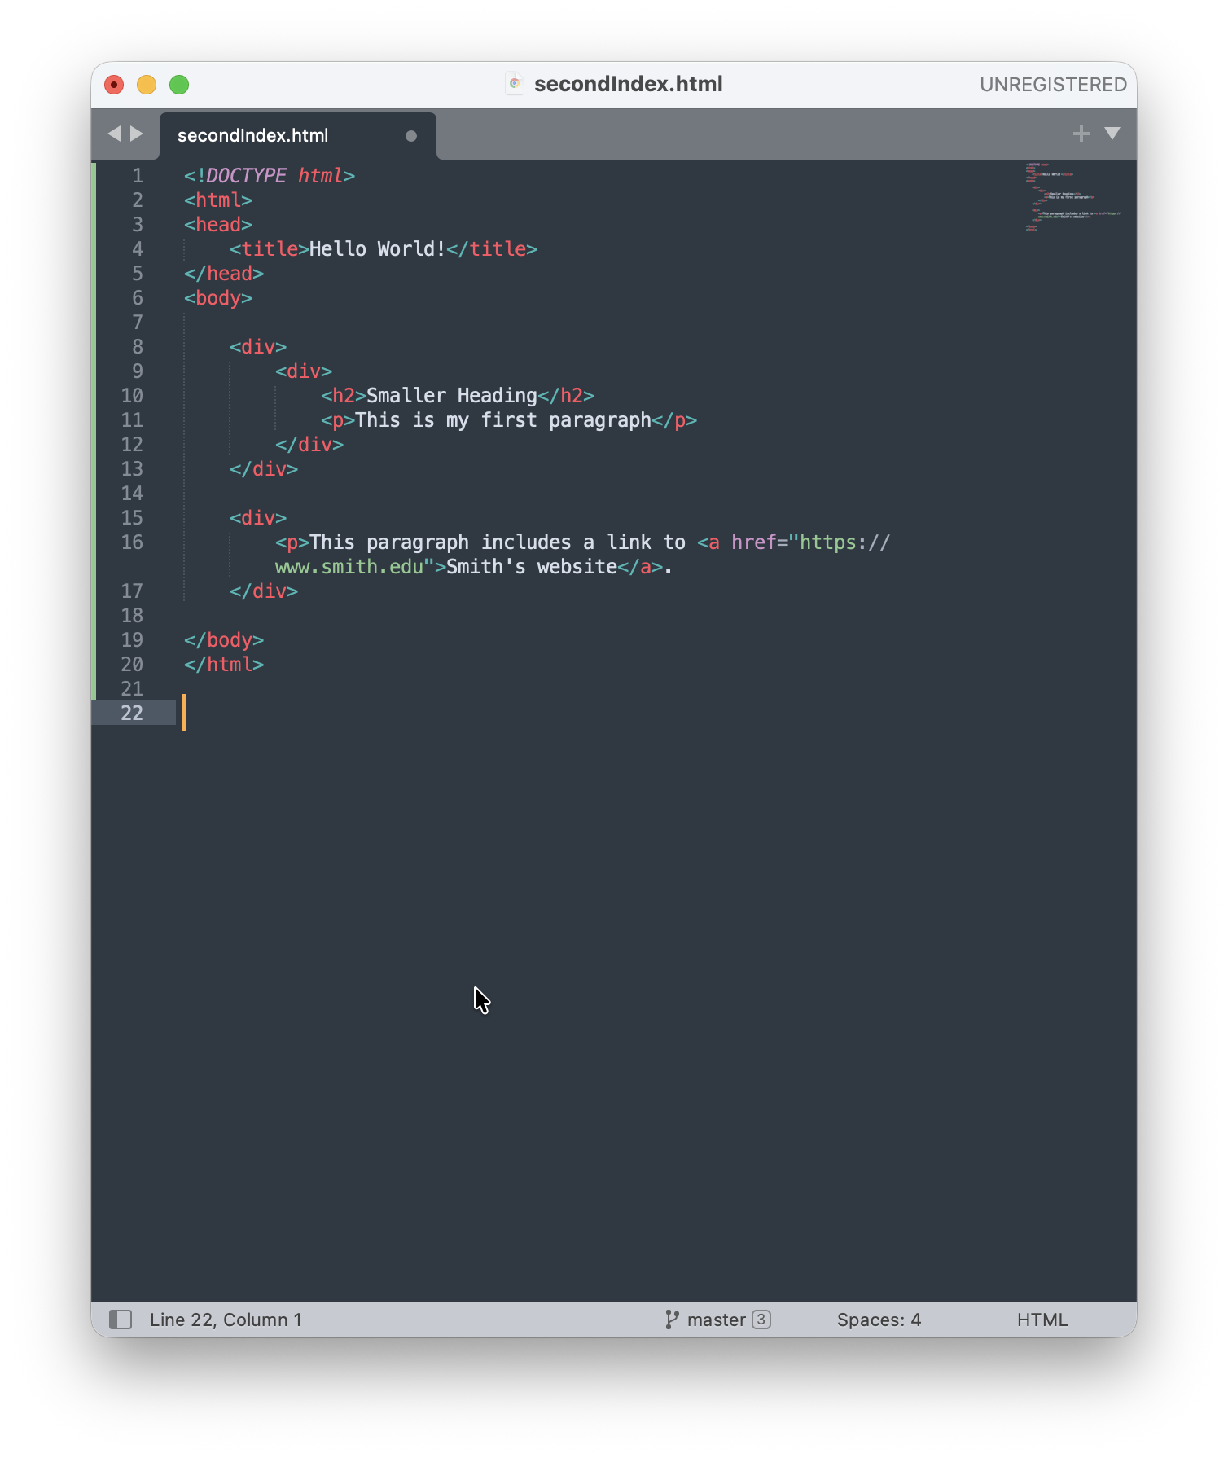
Building a webpage: HTML
Your turn: Draw the DOM for this webpage
https://www.w3schools.com/html/html_intro.asp

Slide 10
Building a webpage: HTML
The <!DOCTYPE html> declaration defines that this document is an HTML5 document
The <html> element is the root element of an HTML page
The <head> element contains meta information about the HTML page
The <title> element specifies a title for the HTML page (shown in the browser's title bar or in the page's tab)
The <body> element defines the document's body, and is a container for all the visible contents
The <h1> element defines a large heading
The <p> element defines a paragraph
Complete tag reference: https://www.w3schools.com/tags/default.asp
https://www.w3schools.com/html/html_intro.asp

Slide 11
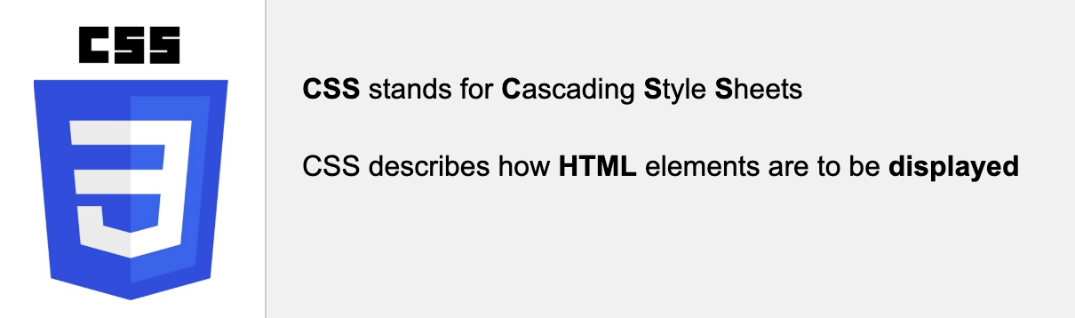
Styling a webpage: CSS
A webpage is styled through CSS
https://www.w3schools.com/html/html_intro.asp

Slide 12
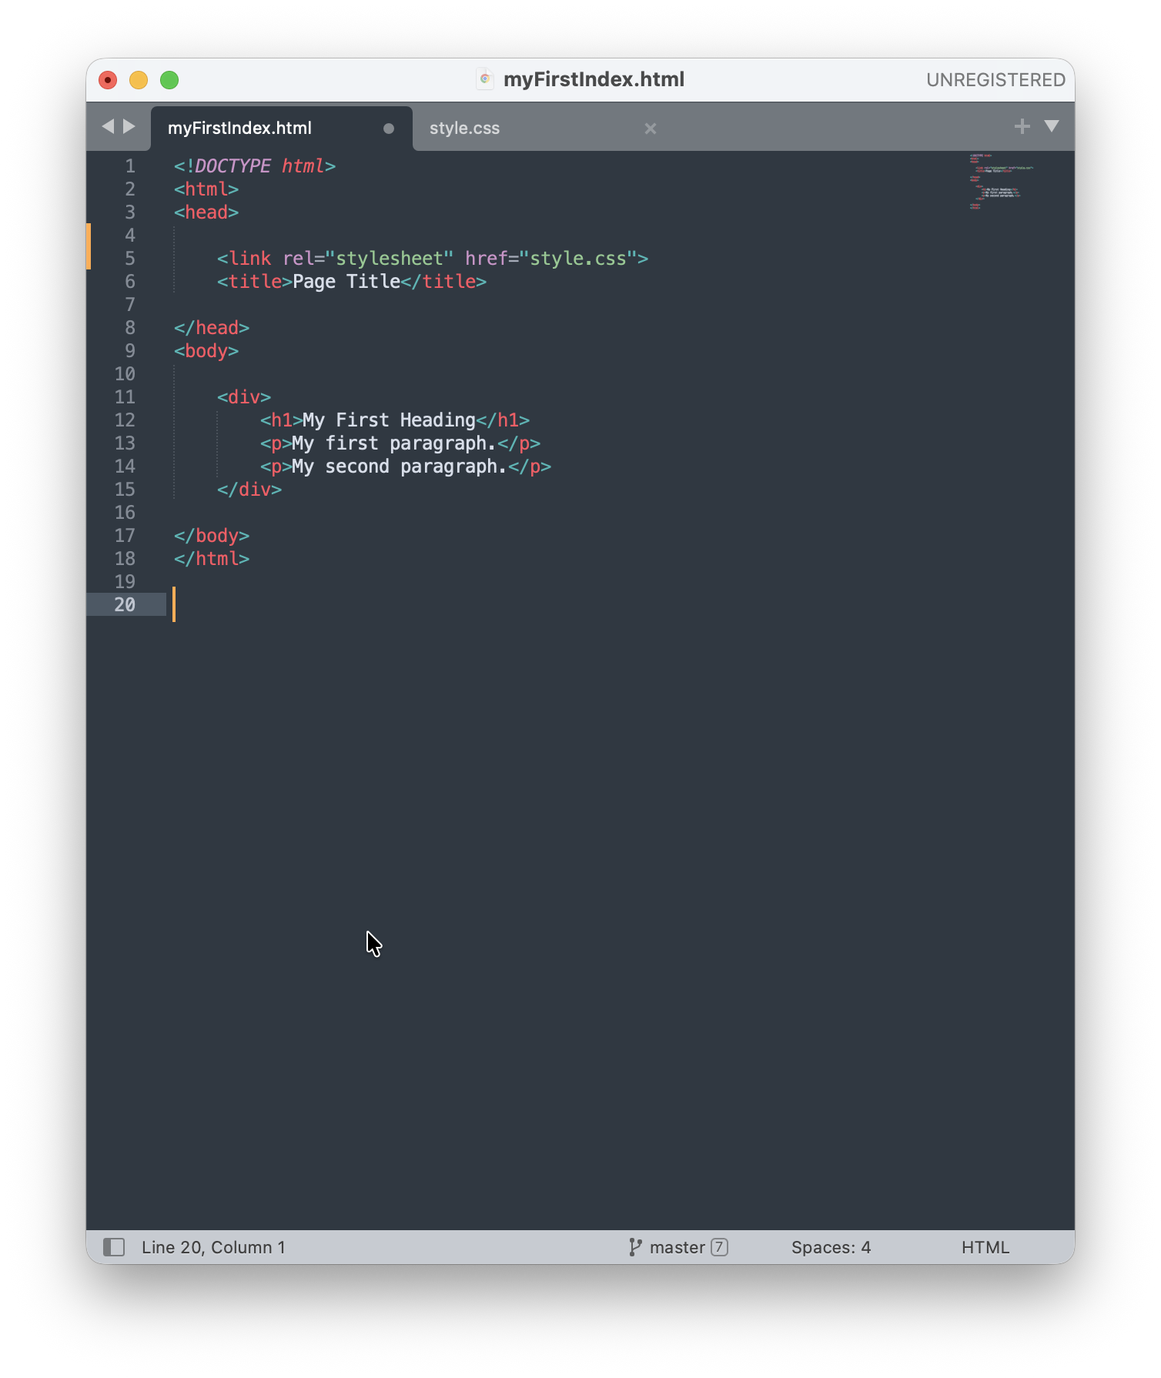
Styling a webpage: CSS
An HTML file is is linked to a CSS file
You can also style in-line
and with internal CSS, but
it is not best practice
https://www.w3schools.com/css/css_howto.asp

Slide 13
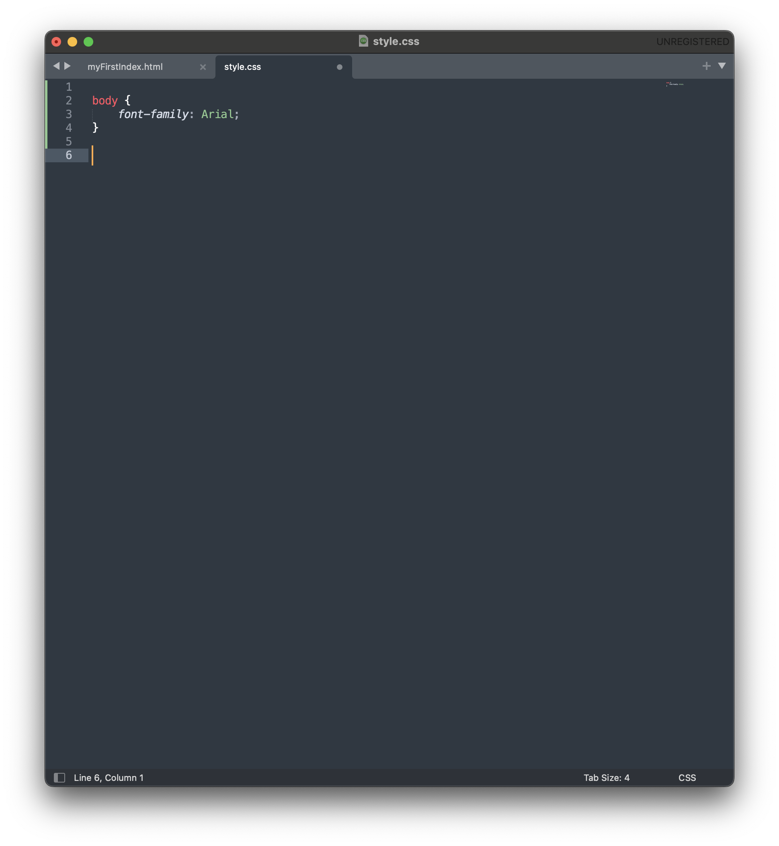
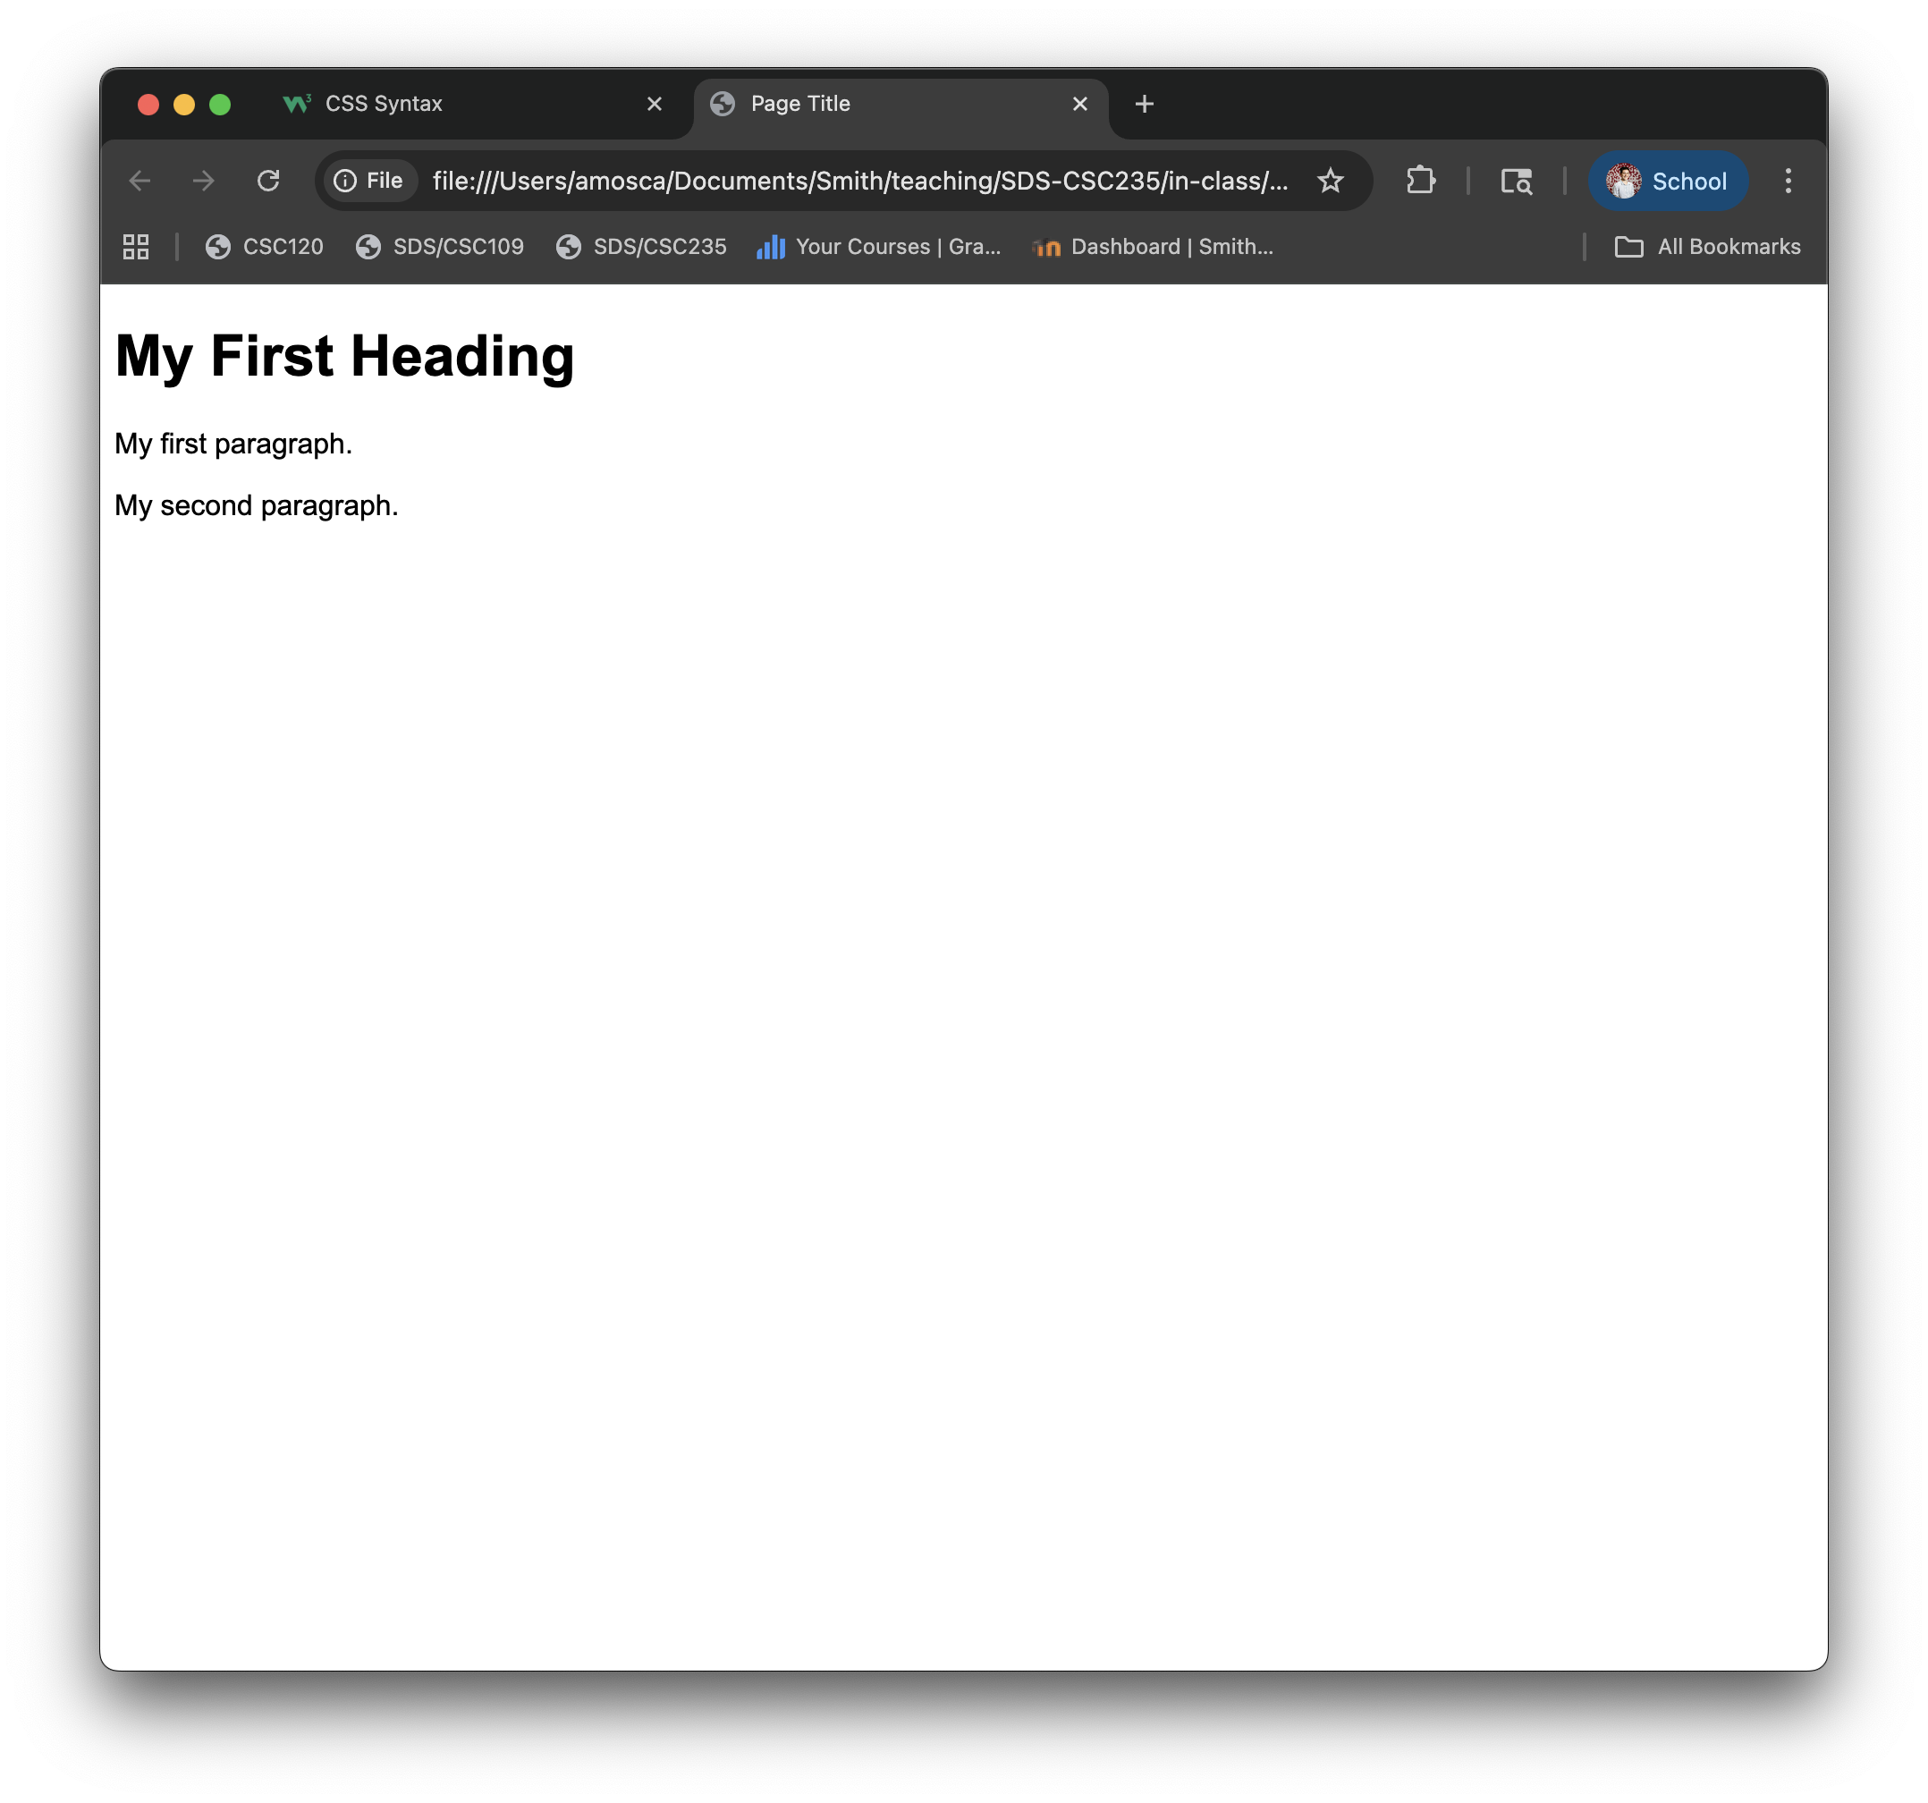
Styling a webpage: CSS
CSS files are sets of rules with specific syntax:
selector {
property : value;
property2 : value2;
…
}
https://www.w3schools.com/css/css_syntax.asp

Slide 14
Styling a webpage: CSS
A CSS selector can be an
element
The selector p indicates style for all paragraphs
class
An HTML element can be assigned a class
Ex. <h1 class=“title”>
The selector .title indicates style for all elements with class “title”
id
An HTML element can be assigned an id
Ex. <div id=“landing”>
The selector #landing indicates style for the element with id “landing”
https://www.w3schools.com/css/css_syntax.asp

Slide 15
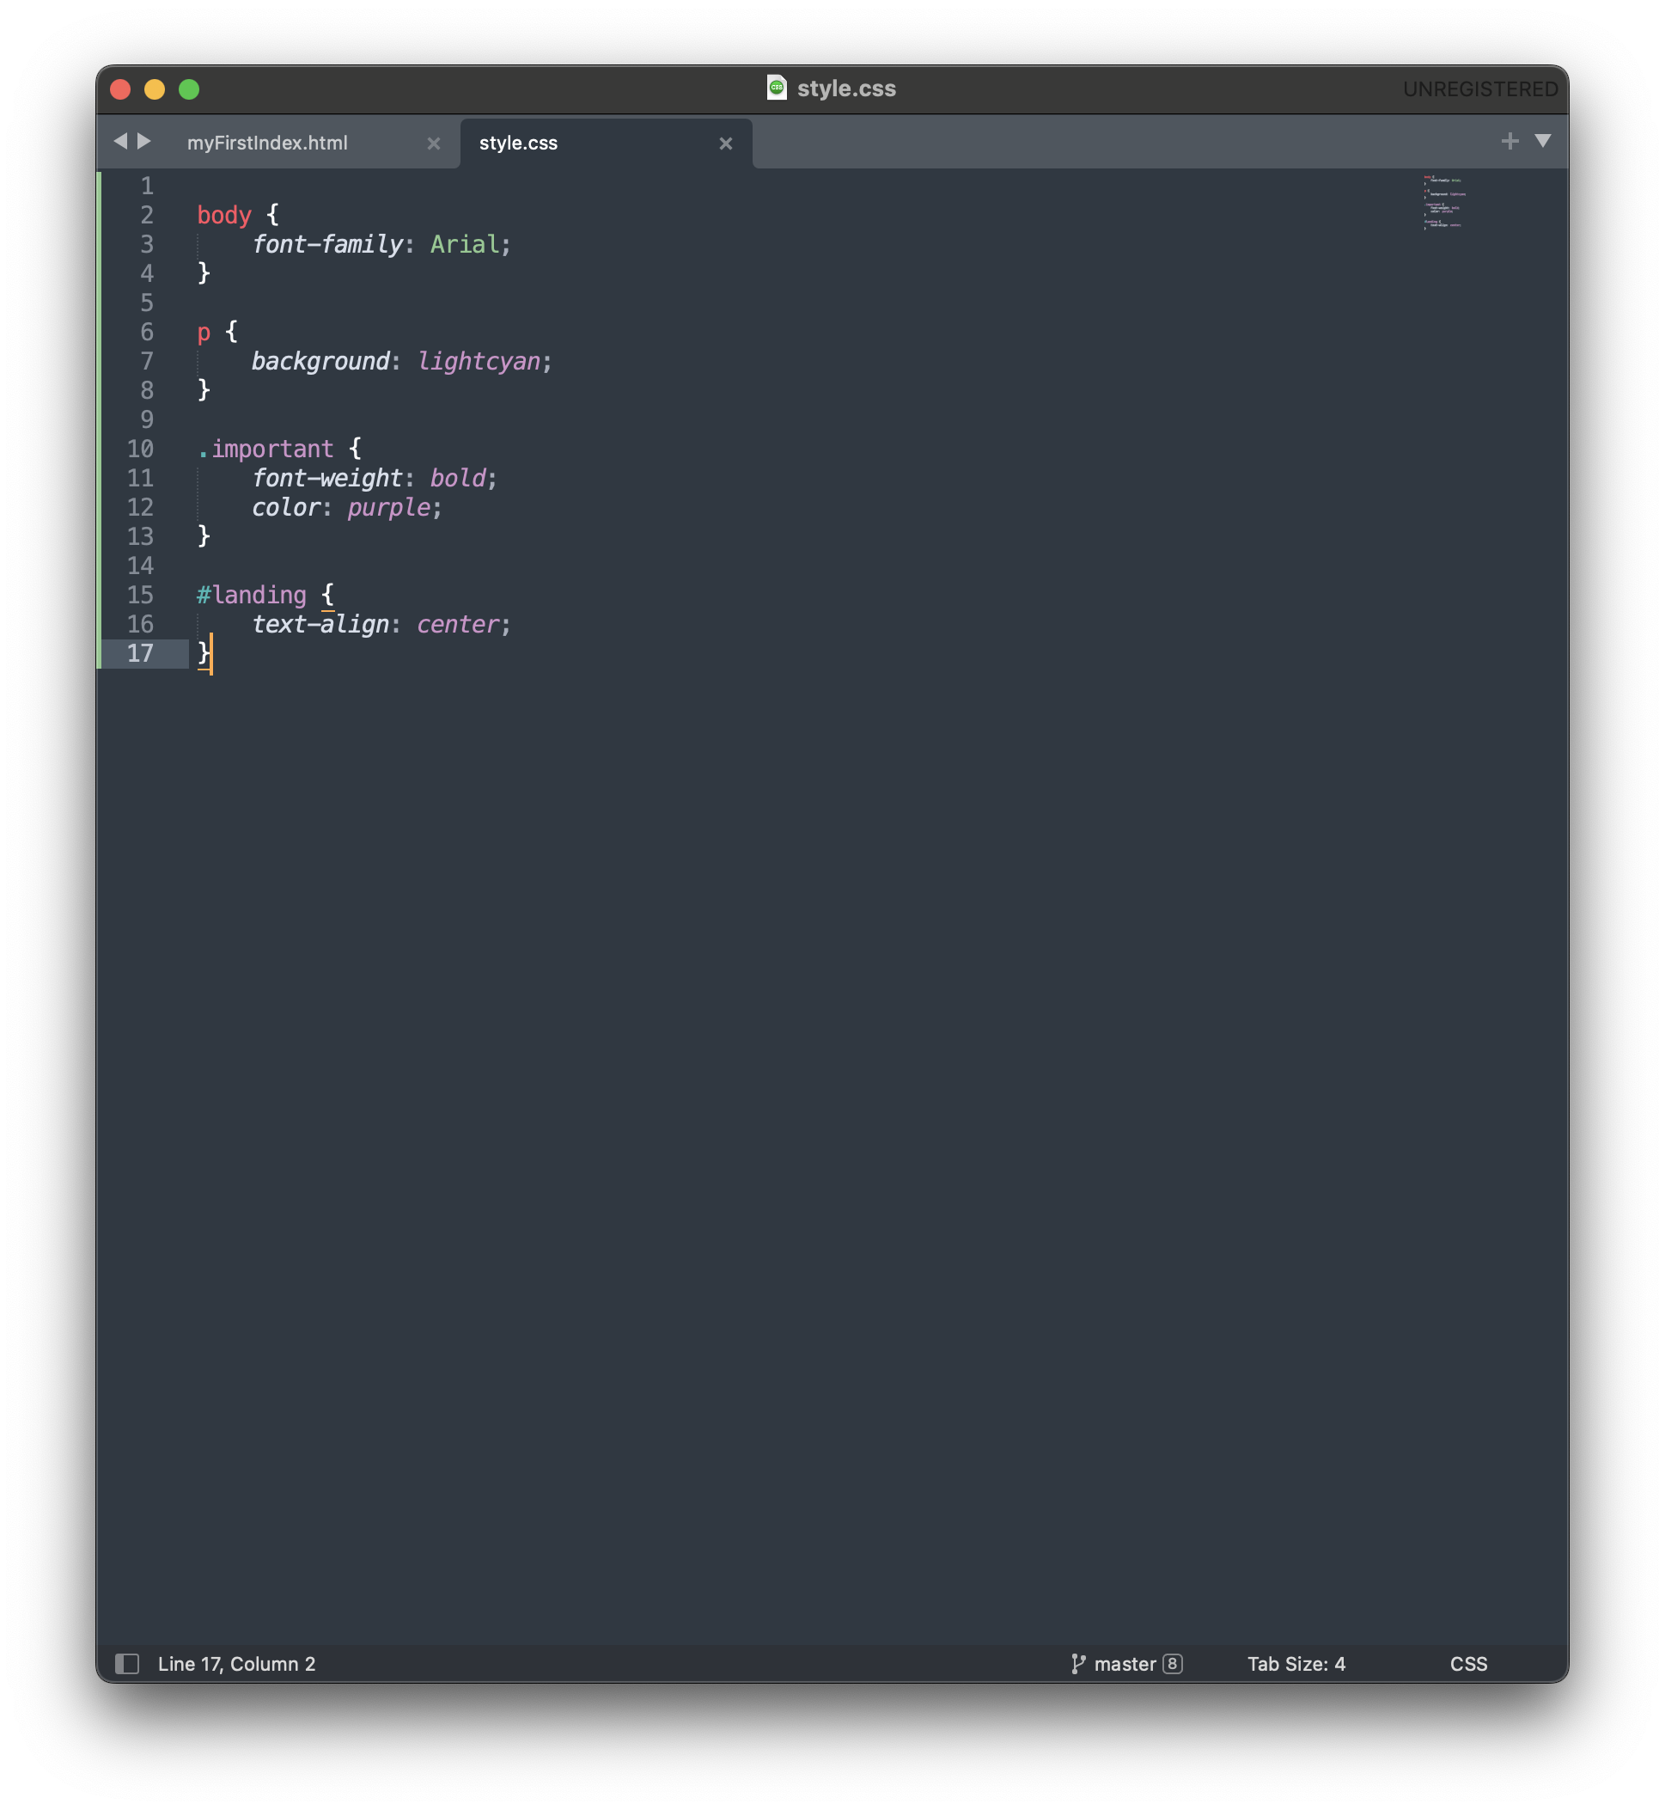
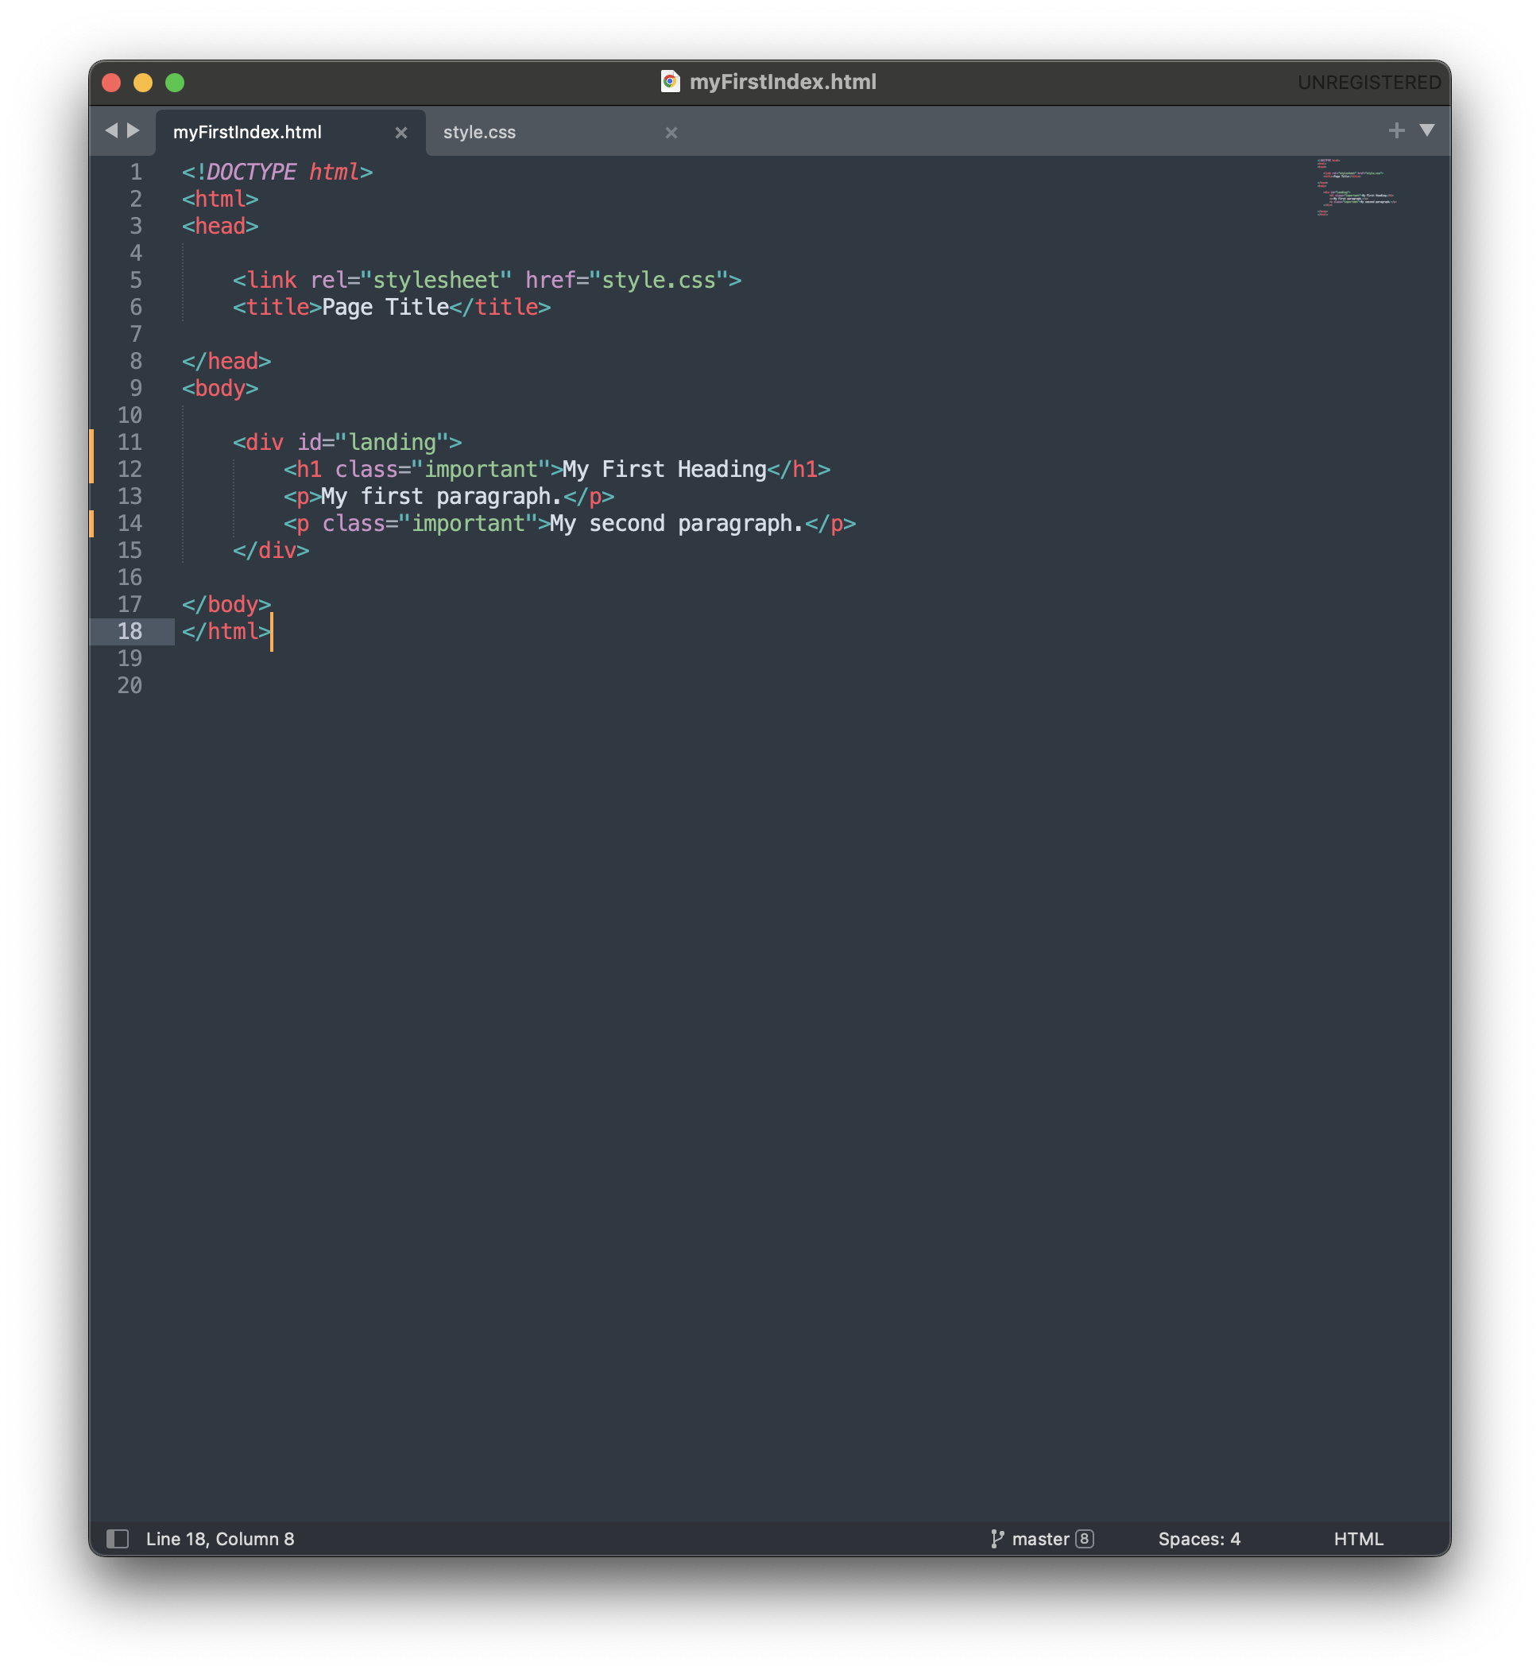
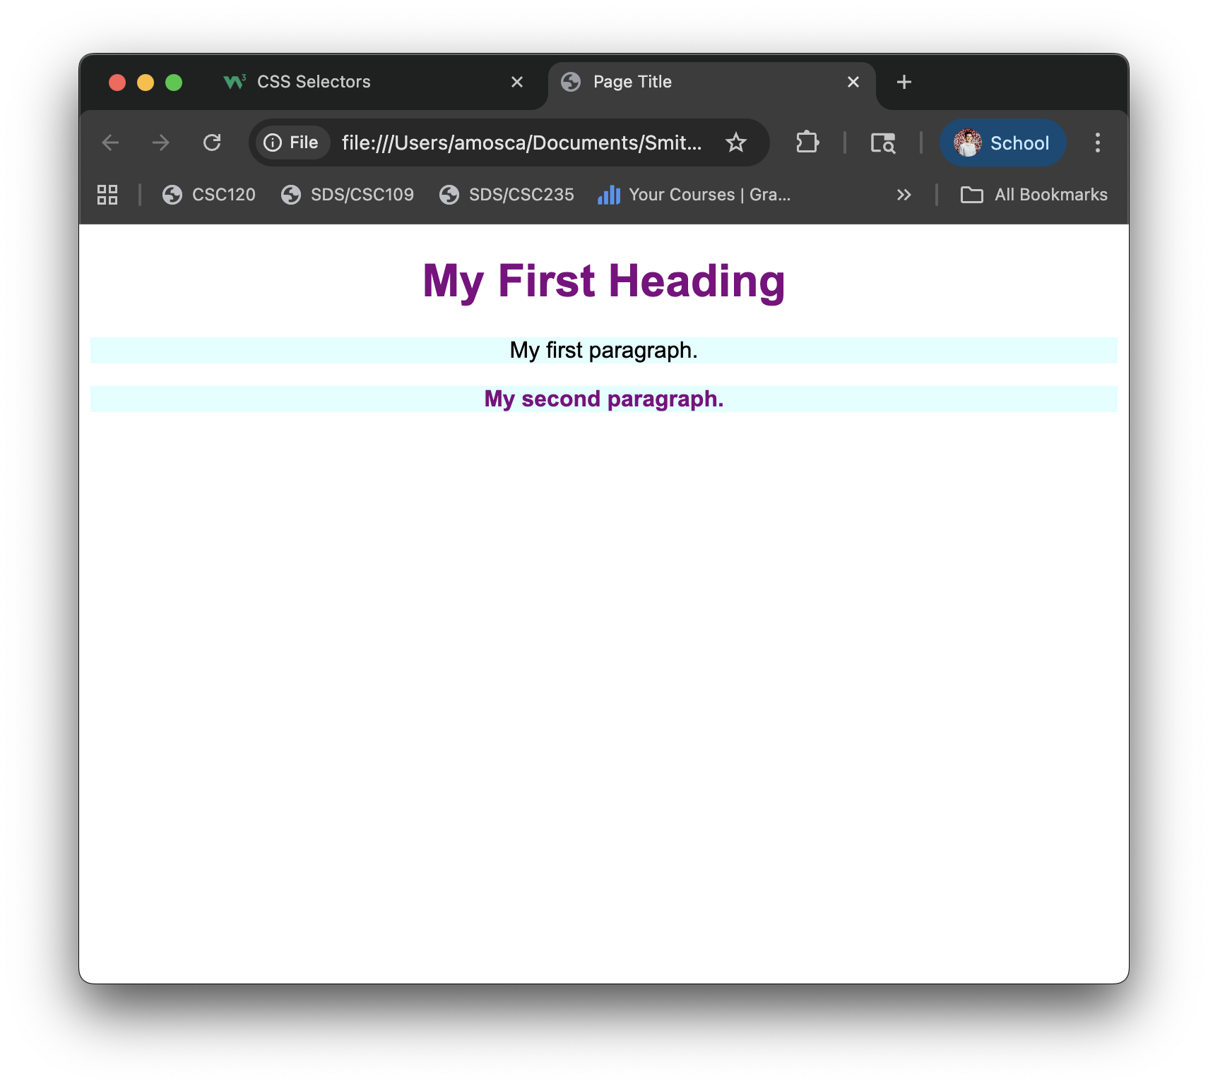
Styling a webpage: CSS

Slide 16
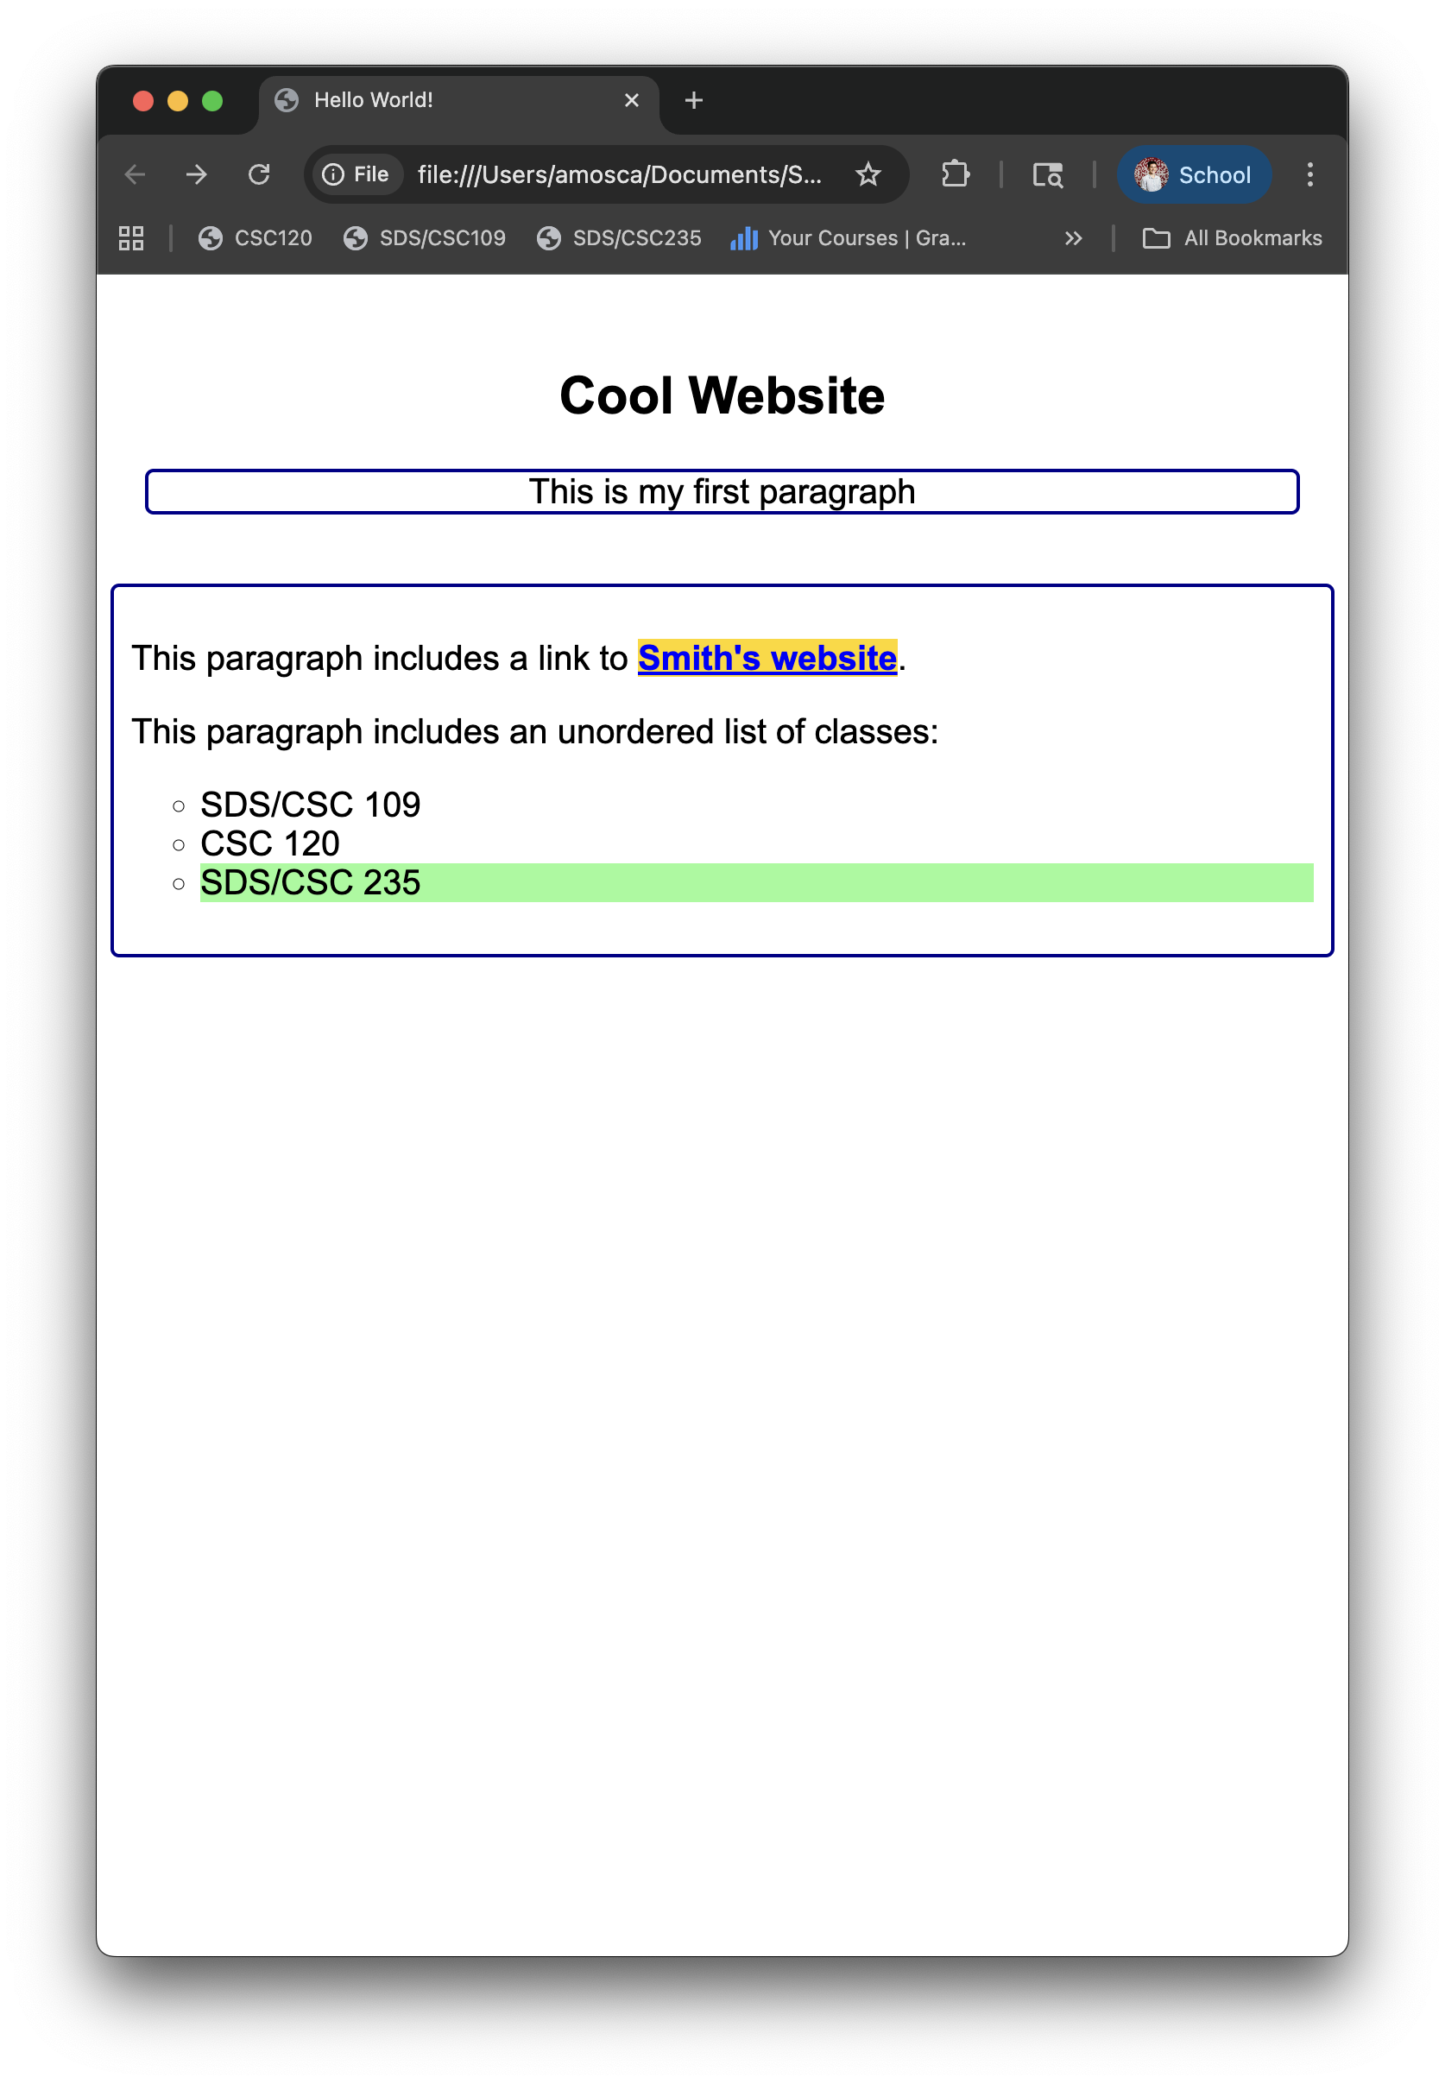
Styling a webpage: CSS
Your turn:
Modify the HTML in secondIndex.html: link an external CSS file to create a webpage that looks like this →
Helpful Resources:
https://www.w3schools.com/html/
https://www.w3schools.com/css/

Slide 17
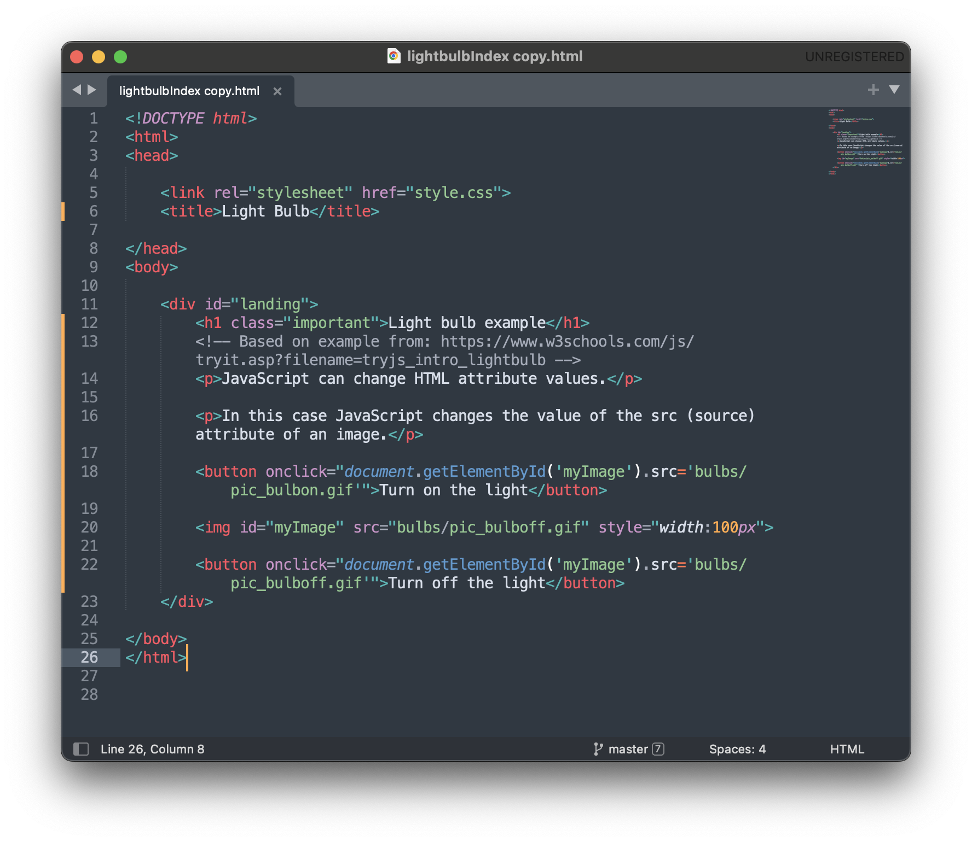
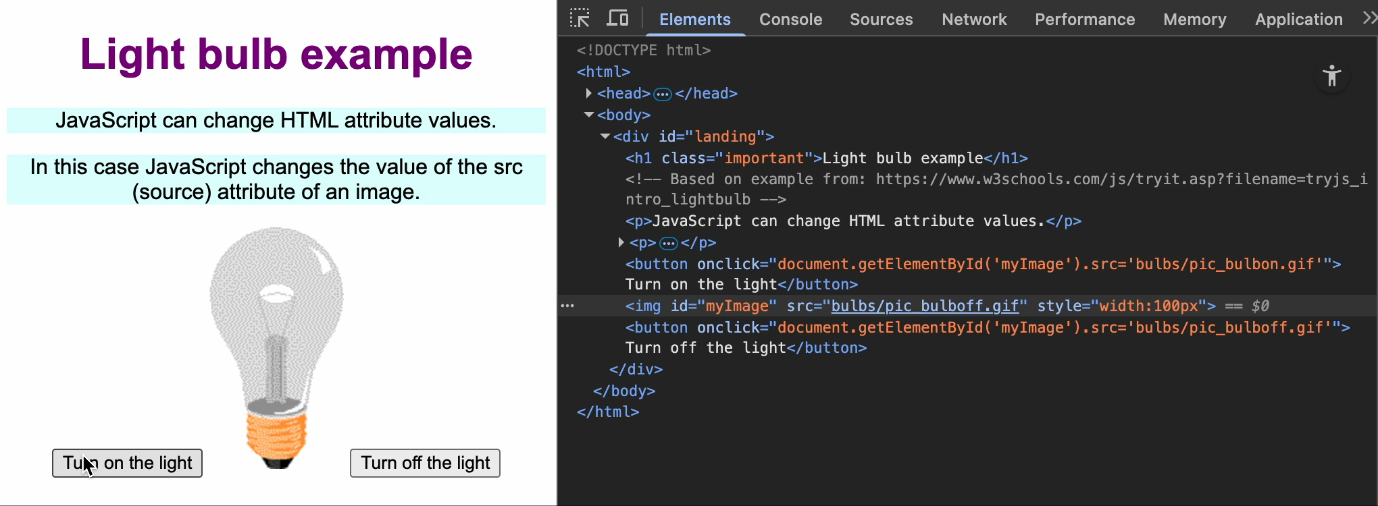
Interactive webpages: js
A webpage is made interactive through JavaScript (JS)
JS can update and change HTML and CSS

Slide 18
Interactive webpages: js
Syntax:
Literals: numbers, strings
Ex. 10.0, 10, “ten”, ‘10’
Declaring variables:
let x = 4;
const PI = 3.14;
Typically, lowerCamelCase is used
Semicolons separate JS statements
JS ignores whitespace
// for single line comments
/* for multi-line comments */

Slide 19
Interactive webpages: js
HTML events are “things” that happen to HTML elements
Ex. Webpage finished loading, input field was changed, button was clicked
JavaScript can “react” on these events
How?
Assign an HTML element an event handler attribute with JS code

Slide 20
Interactive webpages: js
HTML events:
onchange
onclick
onmouseover
onmouseout
onkeydown
onload
More: https://www.w3schools.com/jsref/dom_obj_event.asp

Slide 21
Interactive webpages: js
JS + HTML
JS can be included as an HTML attribute Ex. onclick=“doSomething();”
JS can be included between <script></script> tags
You can have multiple
They can be in the <body>, <head>, or both
You can write JS between the <script> tags in the .html file OR use an external file with the src attribute

Slide 22
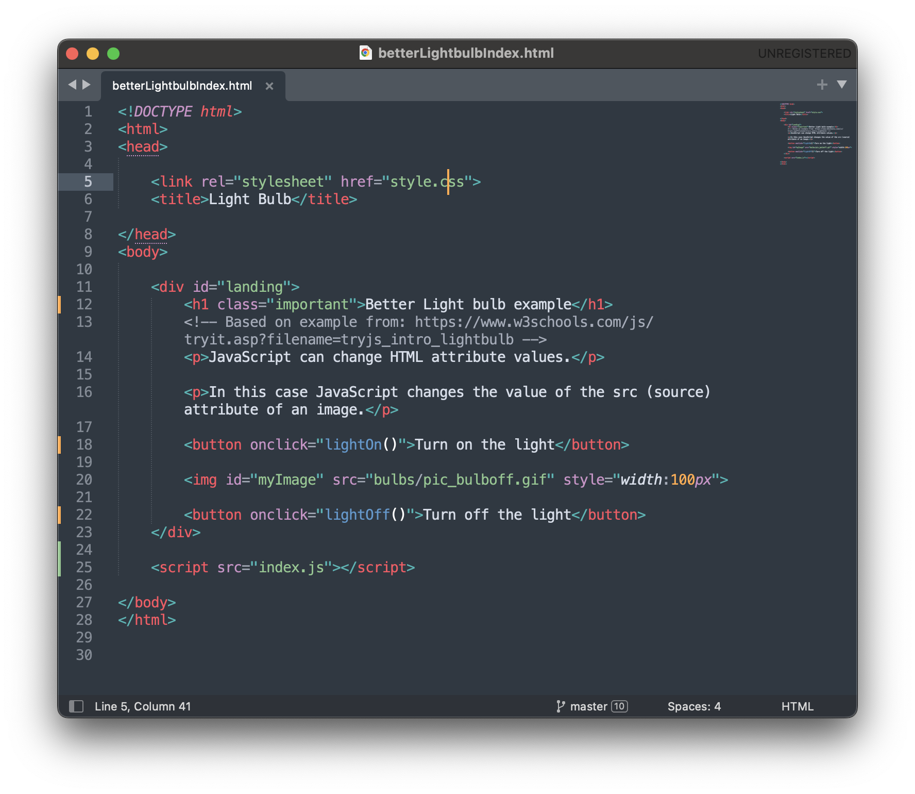
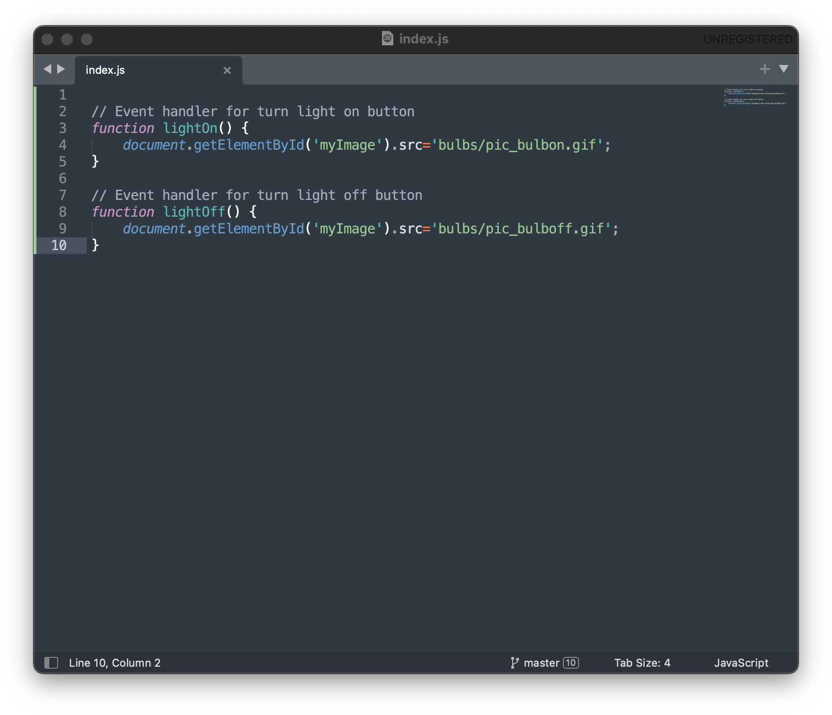
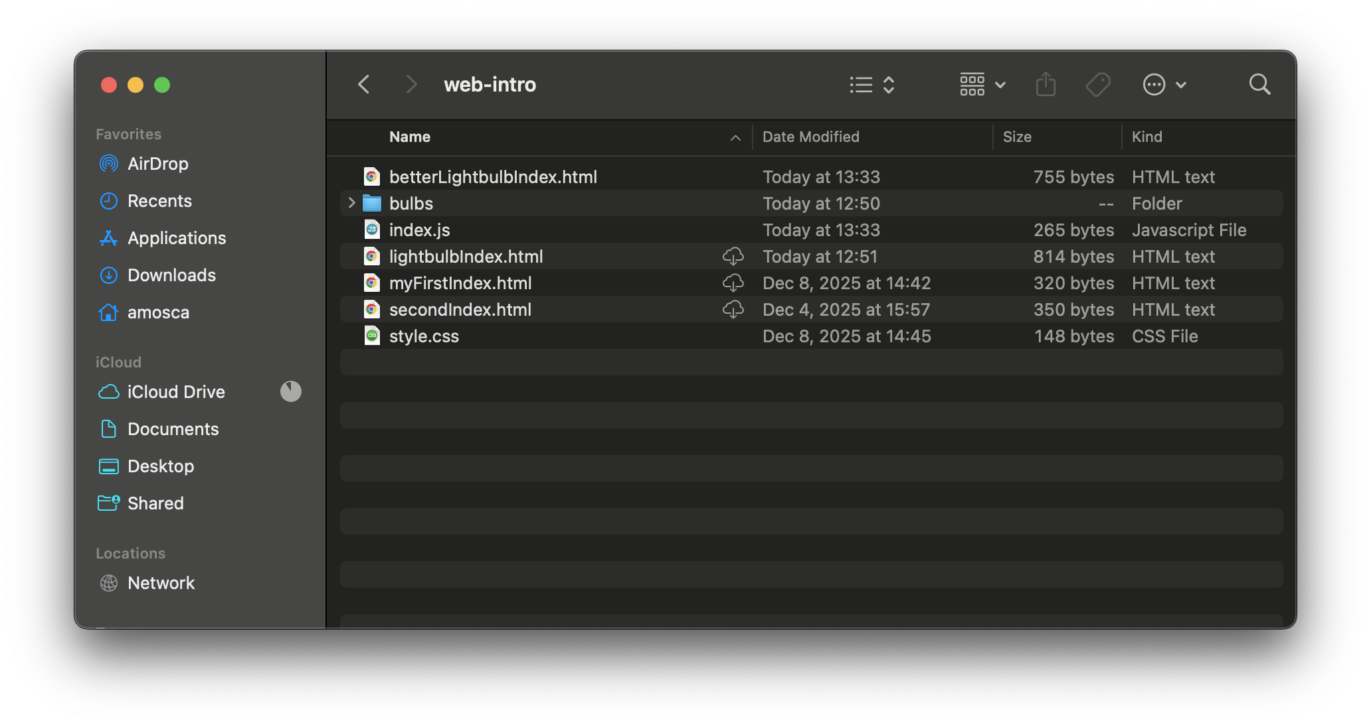
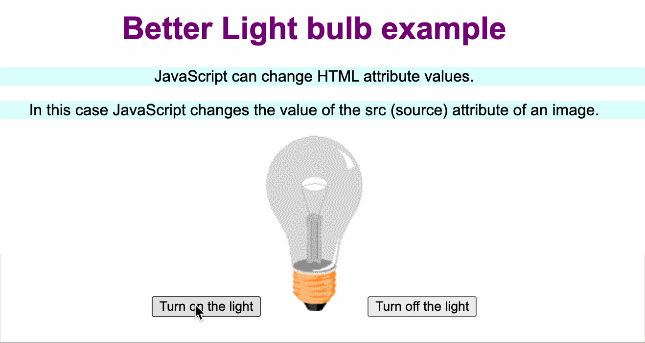
Interactive webpages: js
JS + HTML

Slide 23
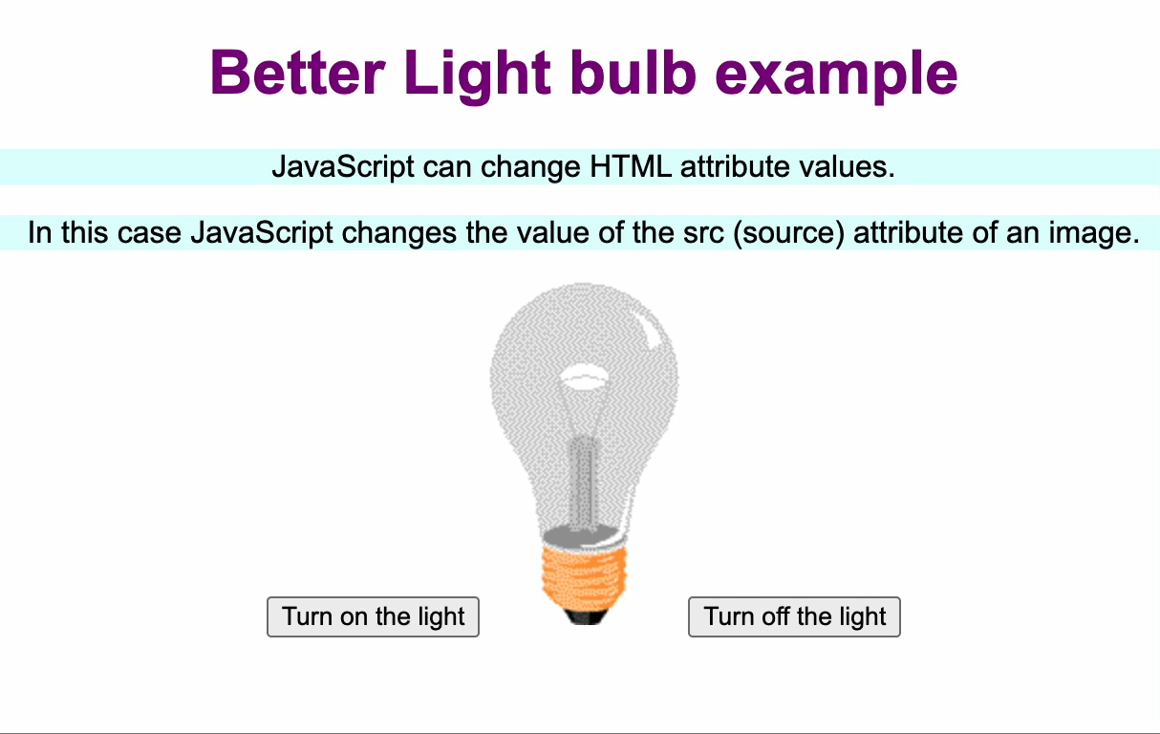
Interactive webpages: js
Your turn:
Modify betterLightbulbIndex.html, myStyle.css, and index.js as needed to create a webpage that looks and functions like this →
Helpful Resources:
https://www.w3schools.com/html/
https://www.w3schools.com/css/
https://www.w3schools.com/js/

