Slide 1
Visual Analytics: explainable ai
Ab Mosca (they/them)

Slide 2
Today’s plan
Why XAI Matters
XAI and Visualization
Open Areas

Slide 3
why xai matters
Power describes the current configuration of structural privilege and structural oppression, in which some groups experience unearned advantages—because various systems have been designed by people like them and work for people like them—and other groups experience systematic disadvantages—because those same systems were not designed by them or with people like them in mind
Who has structural privilege in data science / computer science?
Who is structurally oppressed by data science / computer science?
D’Ignazio, C., & Klein, L. (2020). 1. The Power Chapter. In Data Feminism. Retrieved from https://data-feminism.mitpress.mit.edu/pub/vi8obxh7

Slide 4
why xai matters
Name three examples of how AI is used for decision making
What recourse do the people impacted by these decisions have if they disagree?
Notes:
Housing
Career opportunities
healthcare
credit
education
legalities
police surveillance

Slide 5
why xai matters
One method by which we can reduce the power discrepancies in AI decision making is by revealing the algorithmic process behind the decisions, or in other words developing methods to explain AI output (Explainable AI)
XAI focuses on topics including:
Trust
Interpretability
Explainability
A. Chatzimparmpas, "Visual Analytics for Explainable and Trustworthy Artificial Intelligence,” 2025, doi: 10.1109/MCG.2025.3533806

Slide 6
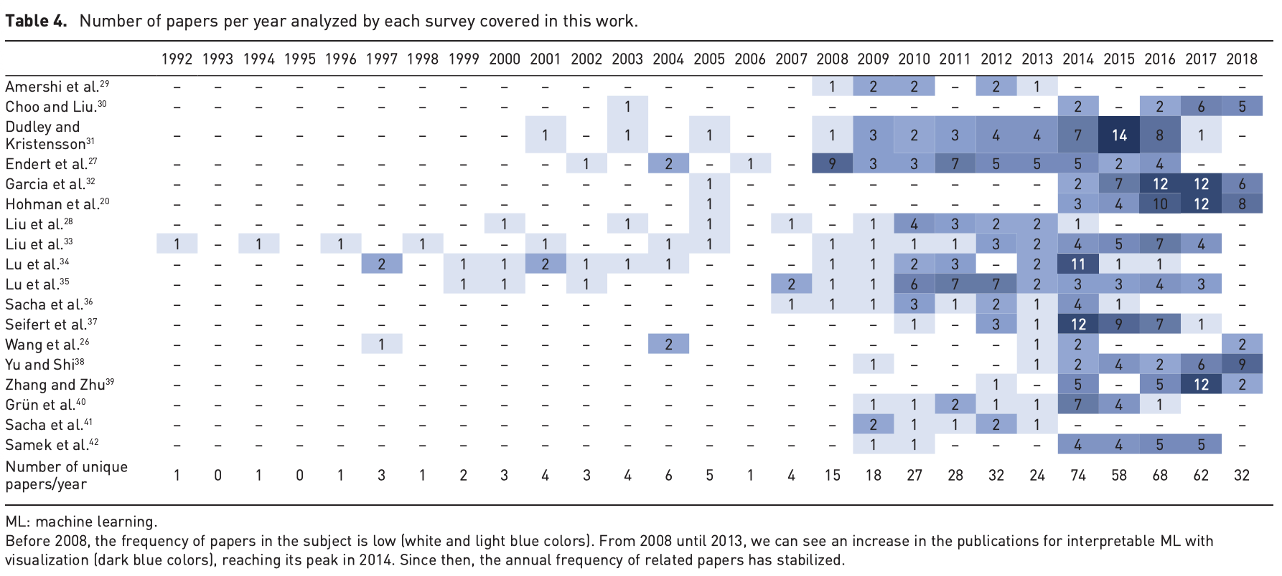
xai and Visualization
A. Chatzimparmpas et al., " A survey of surveys on the use of visualization for interpreting machine learning models,” 2020, doi: 10.1177/1473871620904671
Notes:
Increasing drastically as time passes

Slide 7
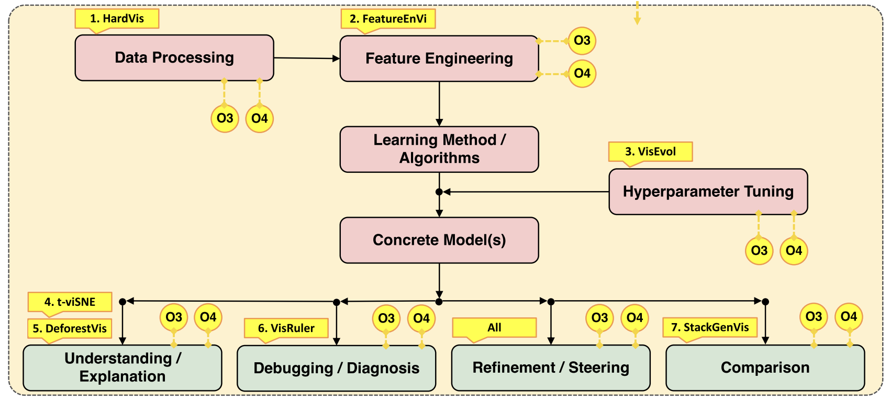
xai and Visualization: design space
A. Chatzimparmpas, "Visual Analytics for Explainable and Trustworthy Artificial Intelligence,” 2025, doi: 10.1109/MCG.2025.3533806
Notes:
The red boxes present a typical AI pipeline with four trust components in green. Lastly, the vivid yellow nodes refer to the research objectives (O1–O4) associated with the related results

Slide 8
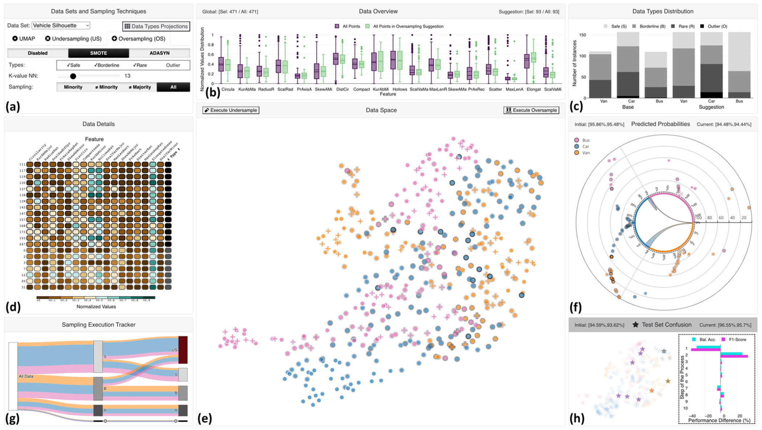
xai and Visualization: data processing
HardVis
https://vimeo.com/772796696
Chatzimparmpas, et al. (2022). HardVis: Visual Analytics to Handle Instance Hardness Using Undersampling and Oversampling Techniques. 42. 10.1111/cgf.14726.
Notes:
VA dashboard designed to address instance hardness by employing highly configurable undersampling and oversampling methods
dashboard provides multiple coordinated views, enabling users to determine the optimal distribution of data types iteratively, selectively remove safe-to-discard samples, and interactively oversample others as needed.
It also supports the analysis of algorithmic recommendations by using diverse visual cues to validate the safety of proposed removals or additions.
This VA approach makes the entire process transparent by being effective in tackling instance hardness and class imbalance problems

Slide 9
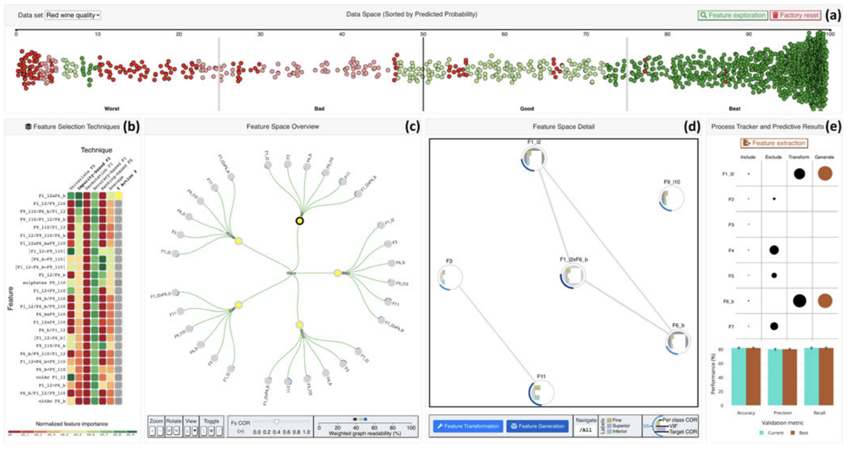
xai and Visualization: feature engineering
FeatureEnVi
https://vimeo.com/662536366
A. Chatzimparmpas, et al., "FeatureEnVi: Visual Analytics for Feature Engineering Using Stepwise Selection and Semi-Automatic Extraction Approaches," 2022, doi: 10.1109/TVCG.2022.3141040
Notes:
FeatureEnVi13 is a
VA dashboard designed to support users in engineering features through stepwise feature selection and semiautomatic feature extraction methods
The dashboard employs multiple coordinated views to assist users in selecting, transforming, and creating new features as part of a highly iterative workflow.
By examining the impact of features using various statistical metrics and automated feature selection techniques, users can enhance predictive performance, minimize computational resource requirements, and shorten training time.
This VA approach increases adaptability and transparency by improving the feature engineering process.

Slide 10
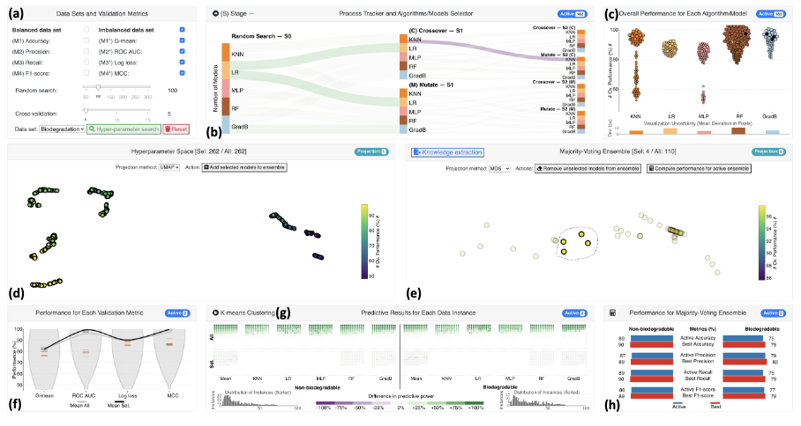
xai and Visualization: hyperparameter tuning
VisEvol
https://diglib.eg.org/items/df6b539d-af1e-4a1a-b507-35a6d23c2d6f
A. Chatzimparmpas, "Visual Analytics for Explainable and Trustworthy Artificial Intelligence,” 2025, doi: 10.1109/MCG.2025.3533806
Notes:
VisEvol14 is
VA dashboard designed to facilitate hyperparameter search using evolutionary optimization
By using multiple coordinated views, the dashboard enables users to create new hyperparameter sets and preserve robust ones within a majority-voting ensemble.
Examining the effects of adding or removing algorithms and models in a majority-voting ensemble from various perspectives, along with monitoring the crossover and mutation processes, provides users with clarity on selecting hyperparameters for a single model or complex ensembles that require a balance of performance and diversity

Slide 11
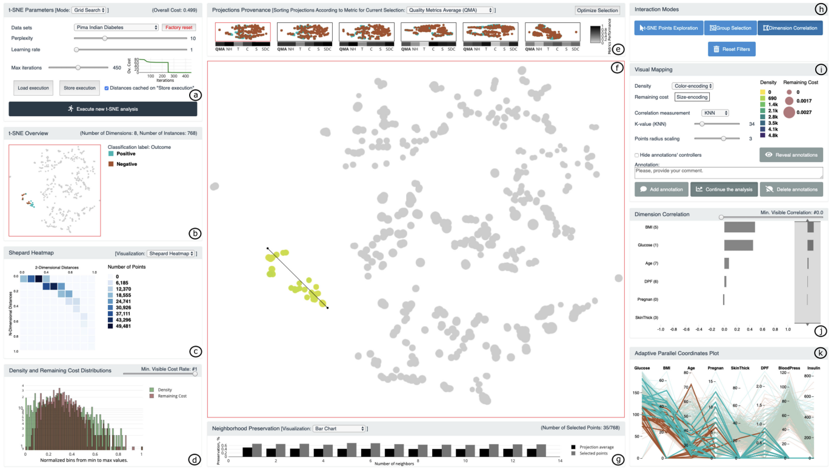
xai and Visualization: model understanding
t-viSNE
https://ieeexplore.ieee.org/document/9064929/media#media
A. Chatzimparmpas, et al. " t-viSNE: Interactive Assessment and Interpretation of t-SNE Projections,” 2020, doi: 10.1109/TVCG.2020.2986996
Notes:
t-SNE is a widely used method for visualizing multidimensional data, with numerous successful applications across various fields. However, interpreting t-SNE projections can be challenging and, at times, misleading, which can undermine the reliability of the results. Gaining insight into the workings of t-SNE and the underlying causes of specific patterns in its output can be particularly difficult, especially for those unfamiliar with dimensionality reduction techniques
t-viSNE15 is a VA dashboard designed for exploring t-SNE projections visually by partially unveiling the inner workings of the t-SNE algorithm

Slide 12
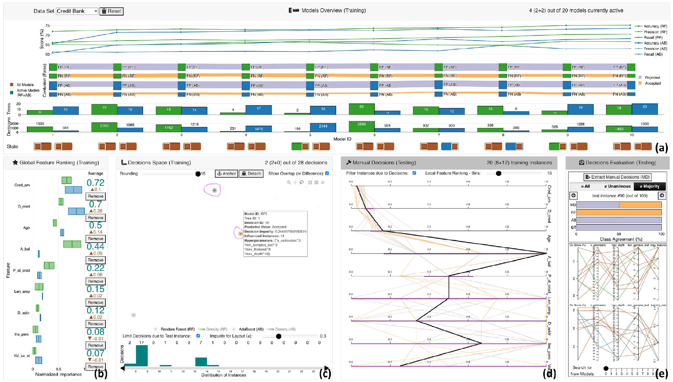
xai and Visualization: model debugging
VisRuler
https://journals.sagepub.com/doi/10.1177/14738716221142005#supplementary-materials
A. Chatzimparmpas, et al." VisRuler: Visual analytics for extracting decision rules from bagged and boosted decision trees,” 2023, doi: 10.1177/14738716221142005
Notes:
Bagging and boosting are widely used ensemble techniques in AI that generate multiple individual decision trees. Because of their ensemble nature, these methods often achieve better predictive performance compared to single decision trees or other AI models. However, each decision tree creates numerous decision paths, increasing the model’s complexity and limiting its application in fields requiring reliable and explainable outcomes. Therefore, as the number of decisions increases, the interpretability of algorithms, such as random forest and AdaBoost, diminishes
VA dashboard that enables users to examine a range of rules derived from bagged and boosted decision trees in order to reach a consensus on the final decision for each case
The dashboard’s multiple coordinated views support the selection of various high-performance models, analysis of feature contributions, management of multiple decisions, exploration of global decisions, and facilitation of case-based reasoning

Slide 13
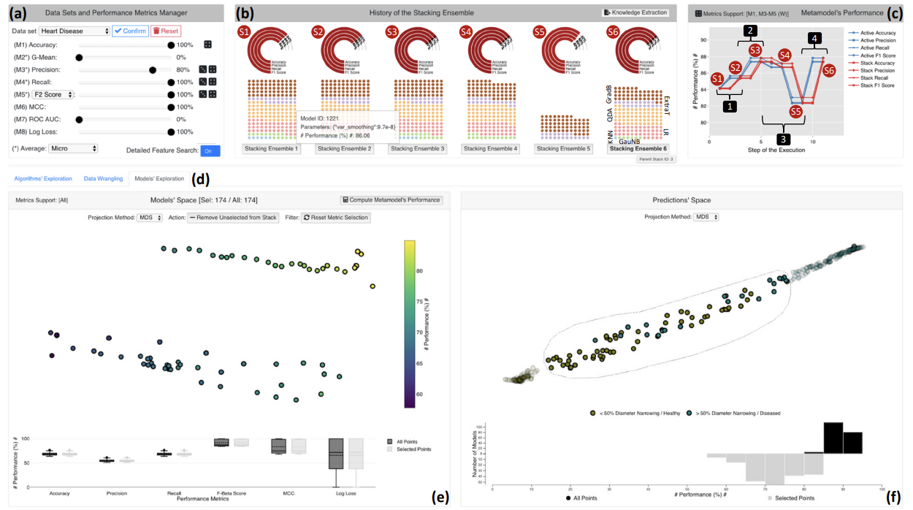
xai and Visualization: model comparisons
StackGenVis
https://ieeexplore.ieee.org/document/9222343/media#media
A. Chatzimparmpas, et al. " StackGenVis: Alignment of Data, Algorithms, and Models for Stacking Ensemble Learning Using Performance Metrics,” 2021, doi: 10.1109/TVCG.2020.3030352
Notes:
Stacking is an ensemble method that integrates various base models, organized in at least one layer, and uses a metamodel to aggregate their predictions. While it can significantly improve the predictive accuracy of AI, creating a model stack from the ground up often involves a time-consuming trial-and-error process. This difficulty arises due to the vast range of possible solutions, including varying sets of data instances and features for training, a wide selection of algorithms, and different parameter settings (i.e., models) that yield different performances based on various metrics.
VA dashboard designed for aligning data, algorithms, and models in stacking ensemble. Through multiple coordinated views, users can create an effective stacking ensemble from scratch.
By exploring the algorithms, data, and models from various perspectives and monitoring the training process, users can confidently determine the next steps in developing complex stacks of models, requiring a combination of both the highest performing and the most diverse individual AI models.

Slide 14
open areas: over focus on Neural nets
The majority of XAI work in the VA community focuses on NNs for image data
Out of 542 visualization papers surveyed on enhancing trust in AI, 345 primarily addressed NN models, while only 114 concentrated on ensembles.
Although image analysis is undeniably an important research domain—especially in fields, such as medicine, where NNs excel with high-dimensional data—other application areas should not be overlooked
Tabular data still represent the majority of datasets employed in AI workflows, where ensemble learning models often surpass NNs in performance
A. Chatzimparmpas, "Visual Analytics for Explainable and Trustworthy Artificial Intelligence,” 2025, doi: 10.1109/MCG.2025.3533806

Slide 15
open areas: Underexplored opportunities
VA dashboards for boosting and stacking ensemble learning methods are notably scarce
Multilabel and regression problems are less explored compared to classification
In the realm of unsupervised learning, association and pattern mining remain underrepresented
Reinforcement learning also receives minimal attention
Lastly, more emphasis is needed on addressing the needs of beginners and users with varying levels of experience who aim to analyze their data broadly
A. Chatzimparmpas, "Visual Analytics for Explainable and Trustworthy Artificial Intelligence,” 2025, doi: 10.1109/MCG.2025.3533806

Slide 16
your turn!
Navigate to: https://trustmlvis.lnu.se/
Notice the “Target Group” filter option at the bottom of the page
Inspect some tools for Beginners, Practitioners, and Developers
What similarities and differences do you see?
Do the tools you seem seem appropriate for the target group?
Sketch out how you would redesign a beginner tool for a practitioner and vice versa
A. Chatzimparmpas, "Visual Analytics for Explainable and Trustworthy Artificial Intelligence,” 2025, doi: 10.1109/MCG.2025.3533806

