Slide 1
Visual Analytics: network analysis Lab
Ab Mosca (they/them)

Slide 2
announcements / reminders
Thursday 02/26 is Rally Day
No class
Make up office hours 10:30-12:00
Mid-semester project released – start early
Next week (03/03 & 03/05)
Geospatial analysis with SAL
03/03 in our regular classroom
03/05 in the SAL (Sabin-Reed 104)

Slide 3
Today’s plan
Warm up
Data
Visualization

Slide 4
Warm Up: graph data
What is the mathematical definition of graph data?
What does graph data model?
What insights might we gain from analyzing graph data?
Name two ways to visualize graph data. What are the pros and cons to each?

Slide 5
data
We will work with the Les Misérables Co-Occurrence dataset today
Raw Data: https://gist.github.com/abkunal/98d35b9b235312e90f3e43c9f7b6932b
Example Vis: https://bost.ocks.org/mike/miserables/
Wiki: https://en.wikipedia.org/wiki/Les_Mis%C3%A9rables
Familiarize yourself with the data:
How is the raw data formatted?
What information does the raw data contain?
What questions do you have about the data?

Slide 6
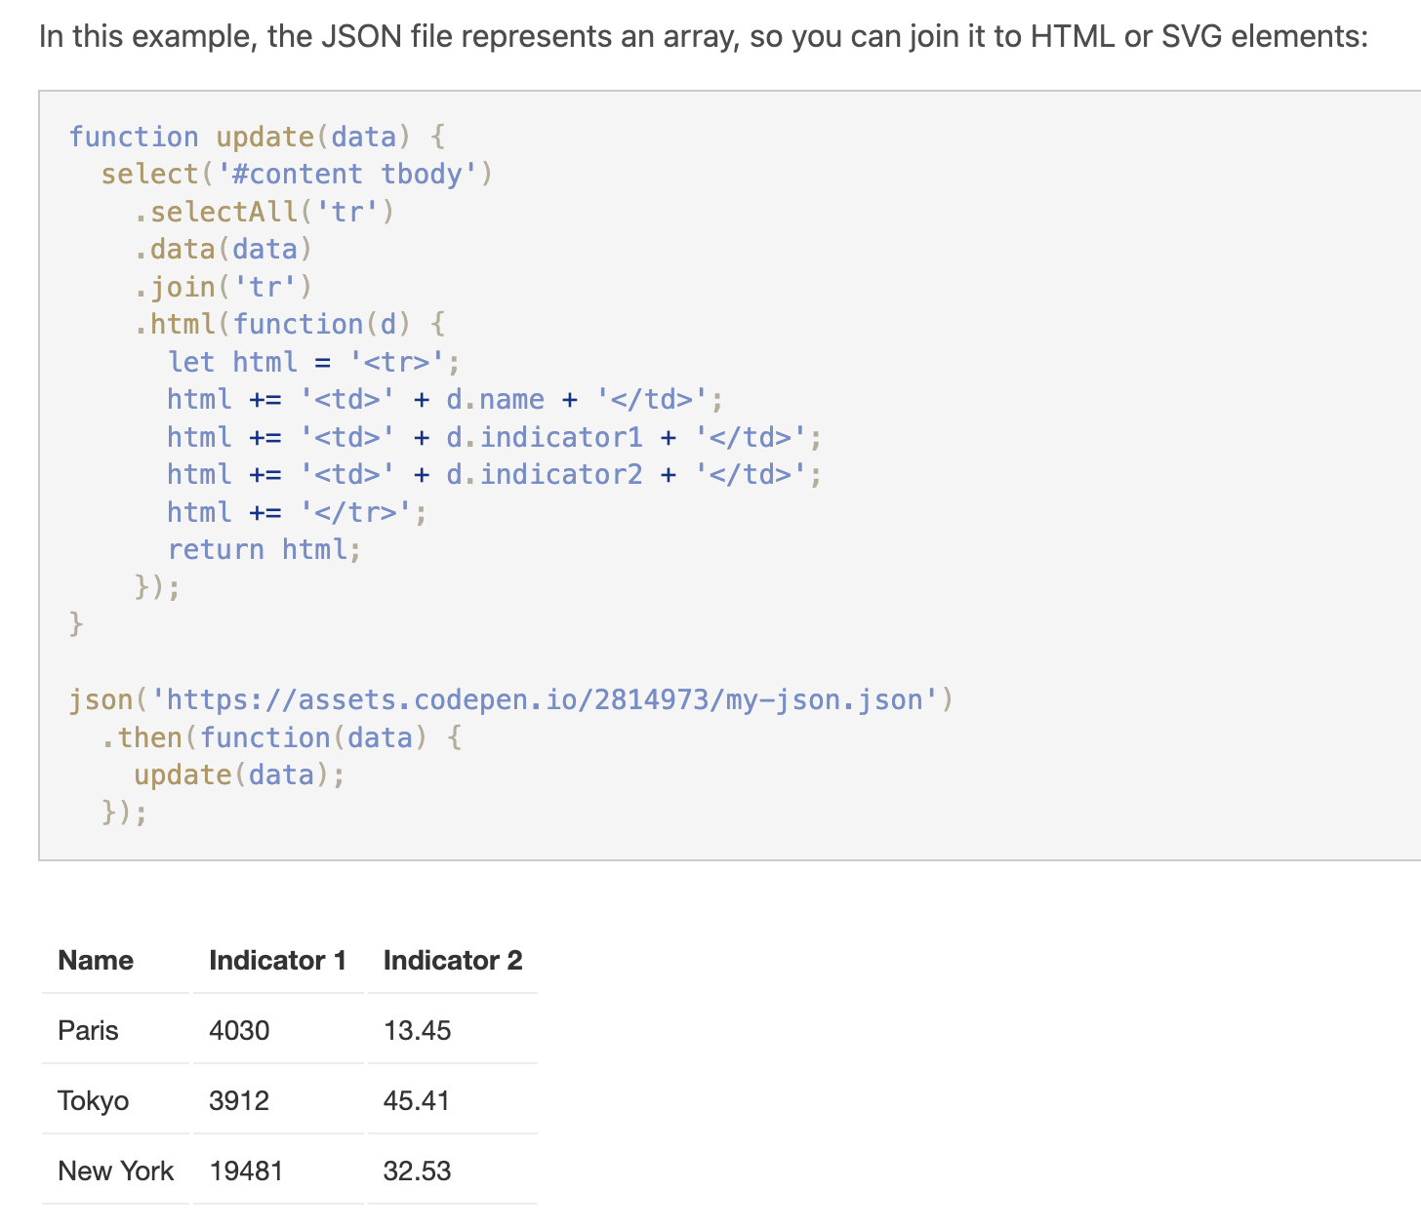
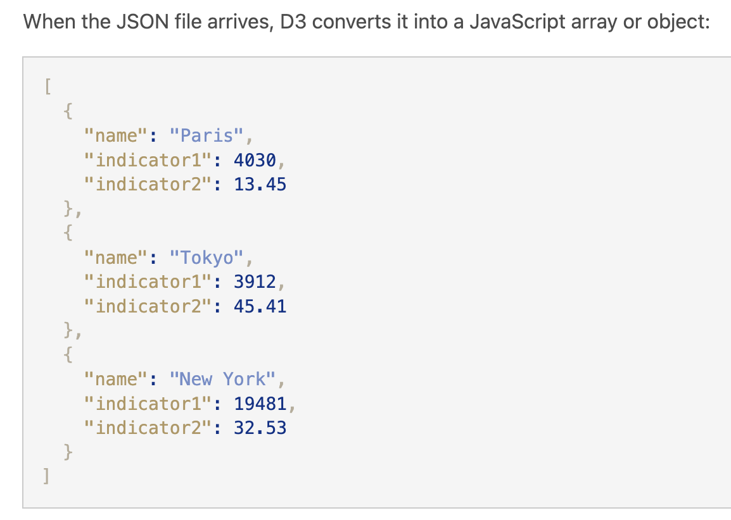
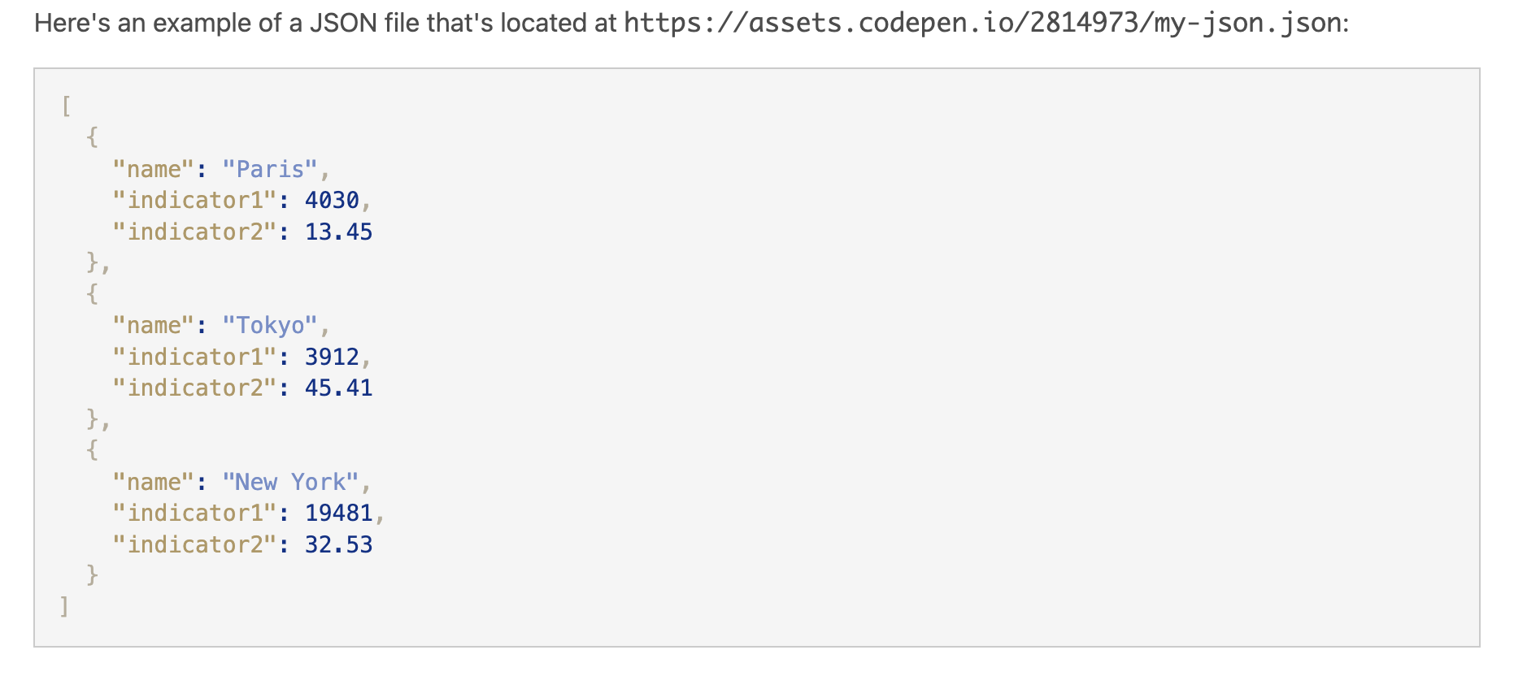
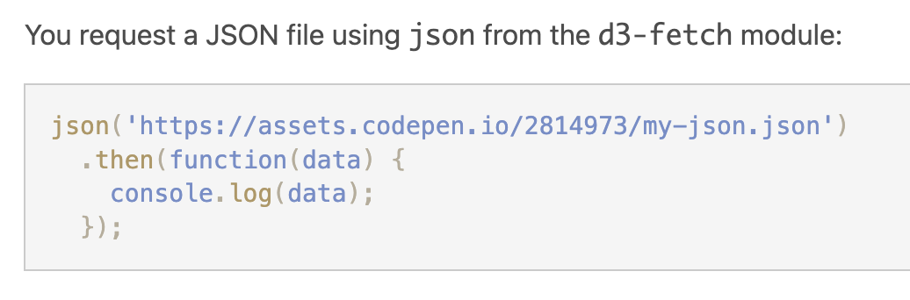
D3: Requesting data
Typically, the data we visualize will be in an external file or database
To load external data, your program must make a request (https://www.d3indepth.com/requests/):

Slide 7
Your turn
Create a folder and add starter html, css, and js files to it. Add the D3 library to your folder
Download the Les Misérables Co-Occurrence data and save it in the same folder as your starter files
Use d3 to request the Les Mis data and print the data to the console

Slide 8
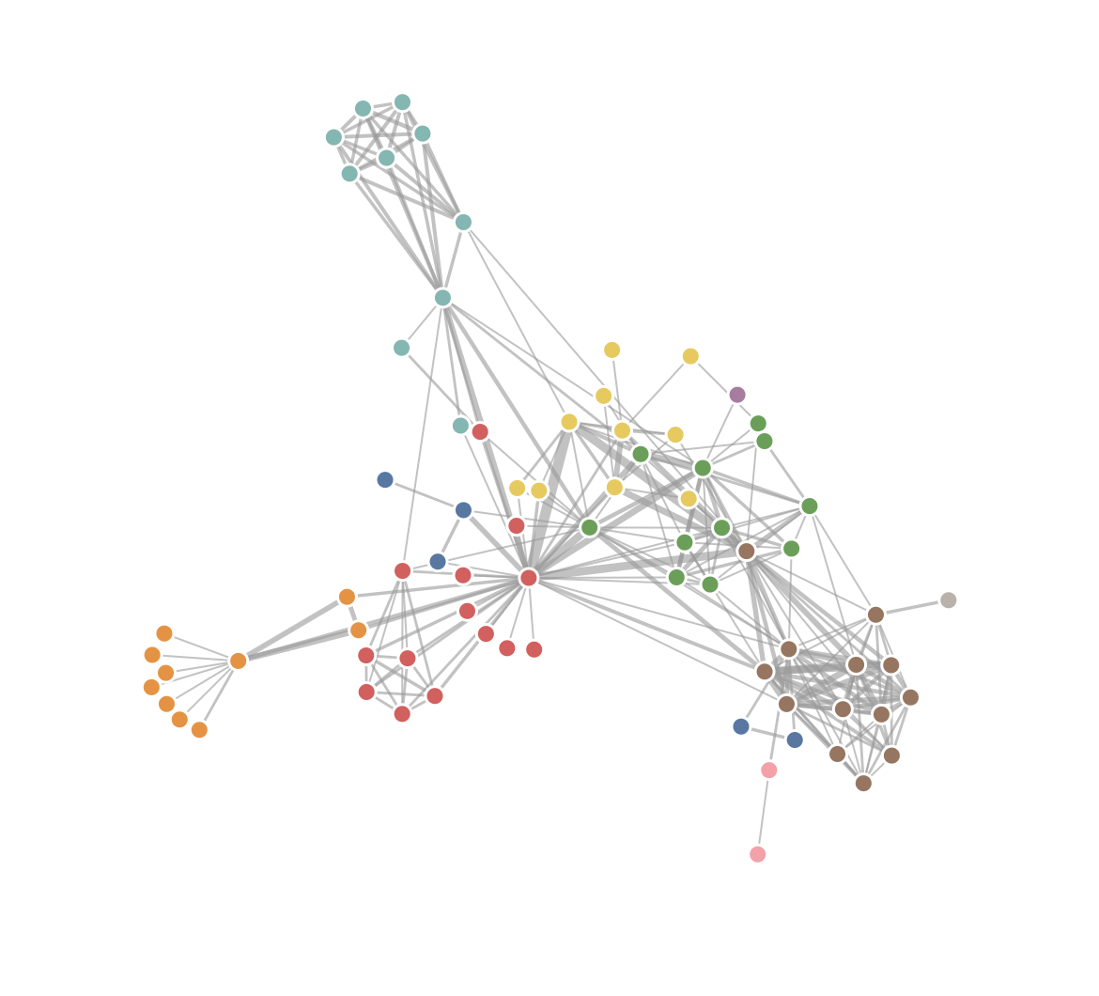
Your turn
Review the D3 overview for force-directed layouts: https://www.d3indepth.com/force-layout/
Write a program to visualize the Les Mis data with a force directed layout

