Slide 1
Visual Analytics: big data lab
Ab Mosca (they/them)

Slide 2
Today’s plan
Full stack basics
Architecture
Required packages
Dynamic visualization

Slide 3

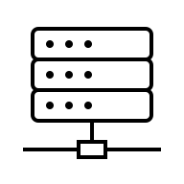
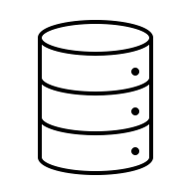
full stack basics
Front End
Back End
Client
Server
Database

Slide 4
Required packages
Front End
Back End
Client
Server
Database
Front-end JS
Node.js
MongoDB

Slide 5
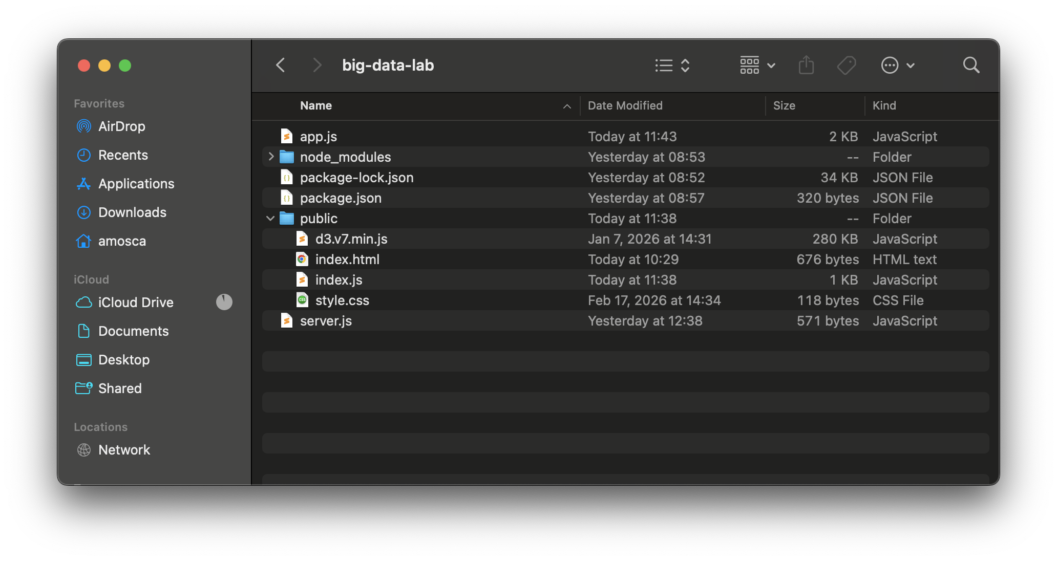
Architecture
Front End
Back End
Client
Server
Database
Front-end JS
Node.js
MongoDB

Slide 6
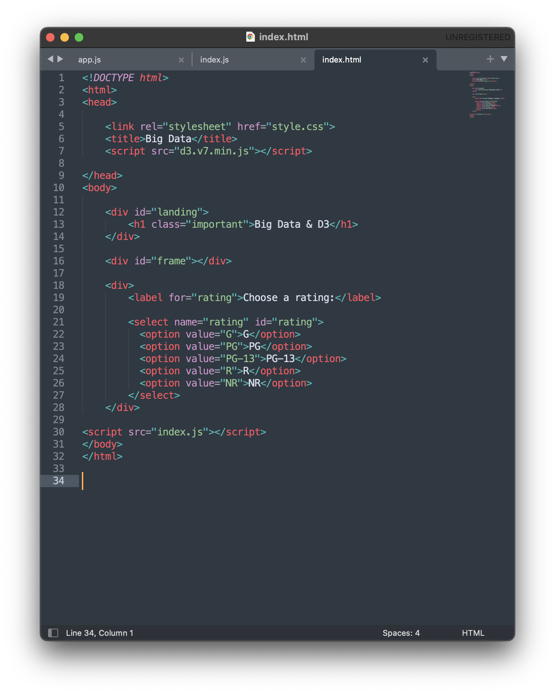
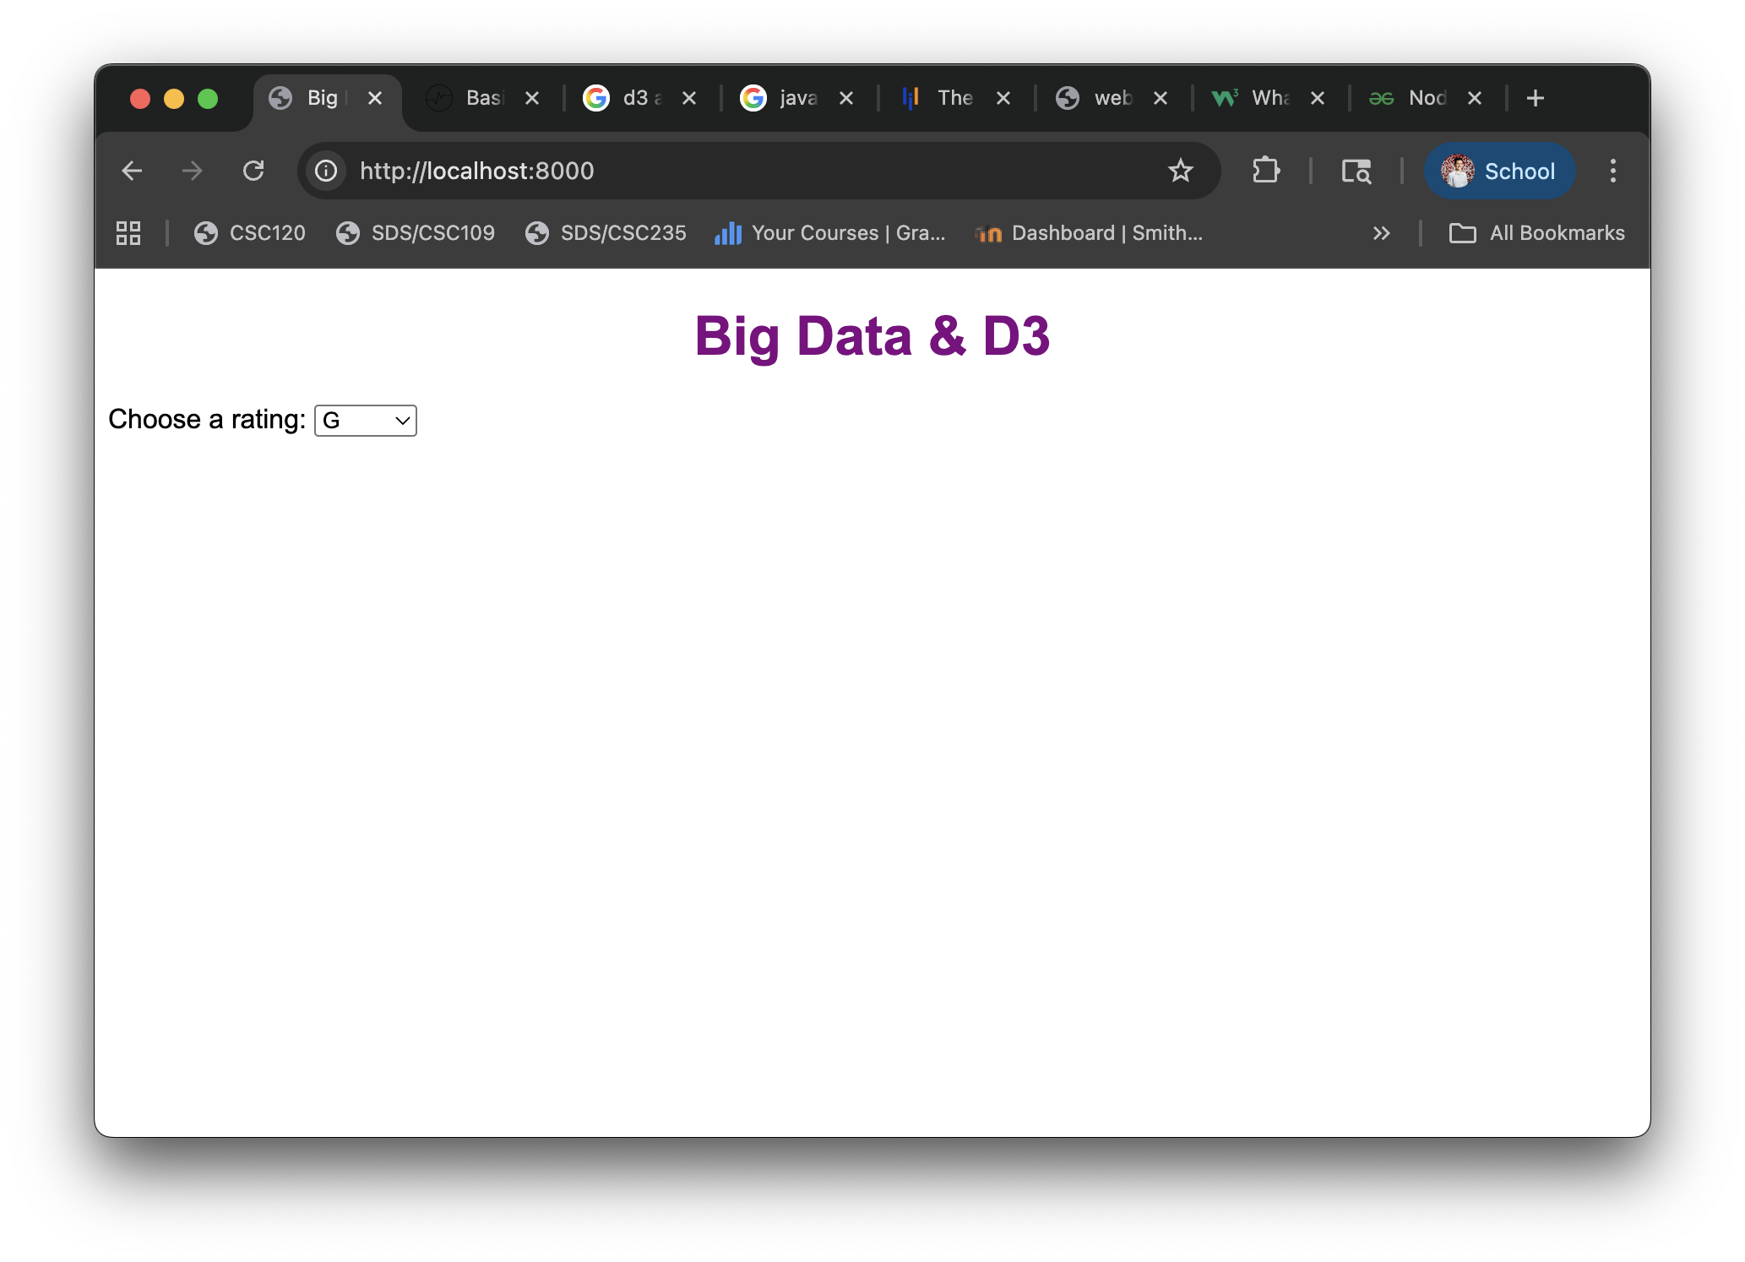
Architecture
Front End
Back End
Client
Server
Database
Front-end JS
Node.js
MongoDB

Slide 7
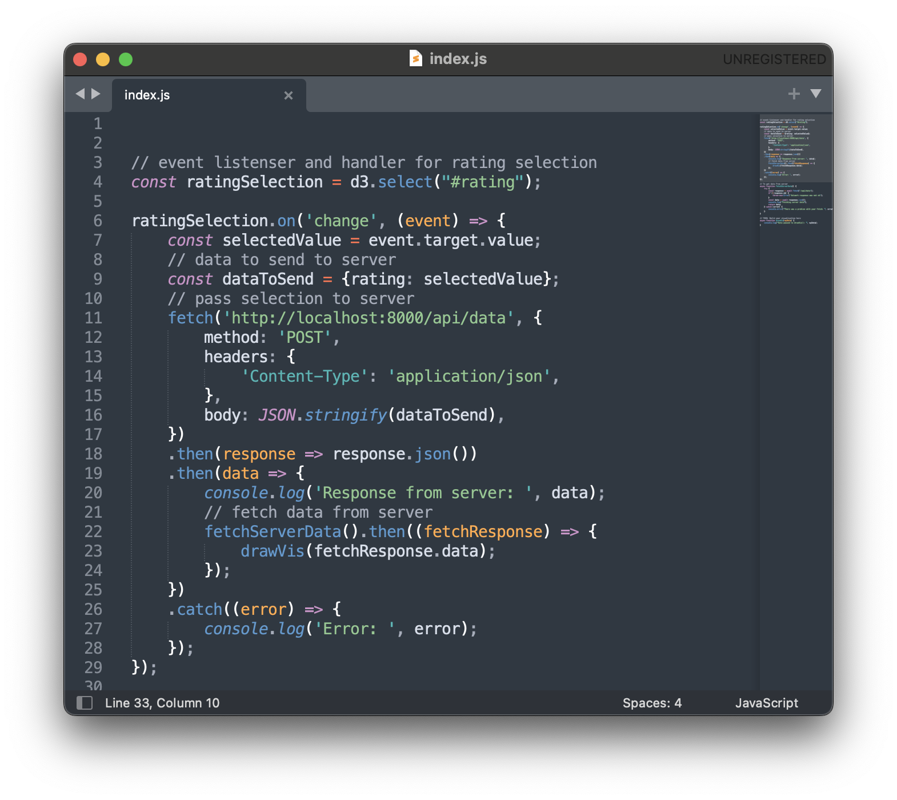
Architecture
Front End
Back End
Client
Server
Database
Front-end JS
Node.js
MongoDB

Slide 8
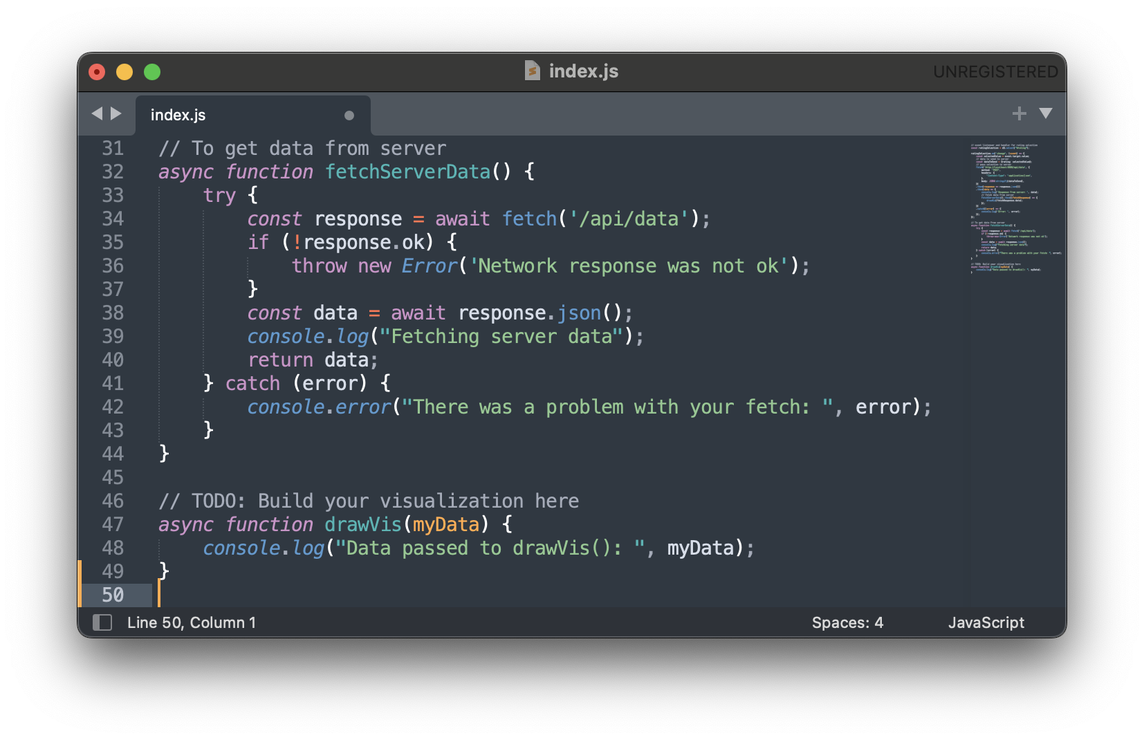
Architecture
Front End
Back End
Client
Server
Database
Front-end JS
Node.js
MongoDB

Slide 9
Architecture
Front End
Back End
Client
Server
Database
Front-end JS
Node.js
MongoDB

Slide 10
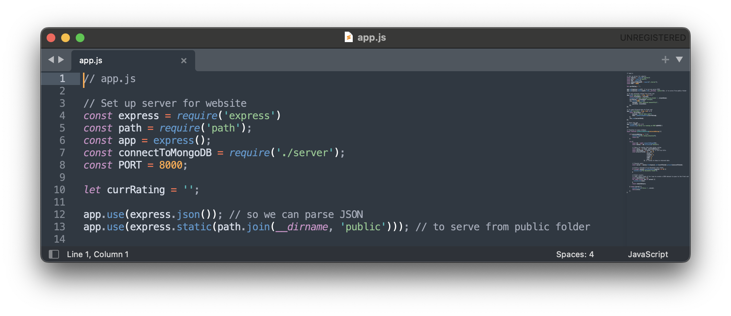
Architecture
Back End
Server
Database
Node.js
MongoDB

Slide 11
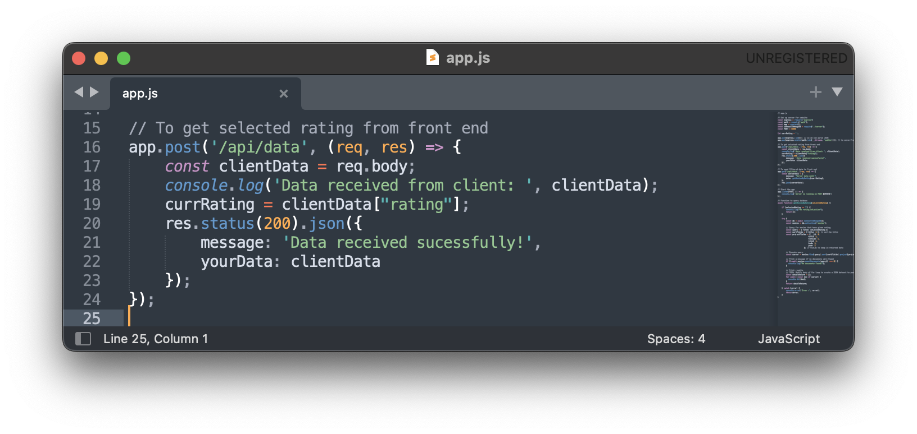
Architecture
Back End
Server
Database
Node.js
MongoDB

Slide 12
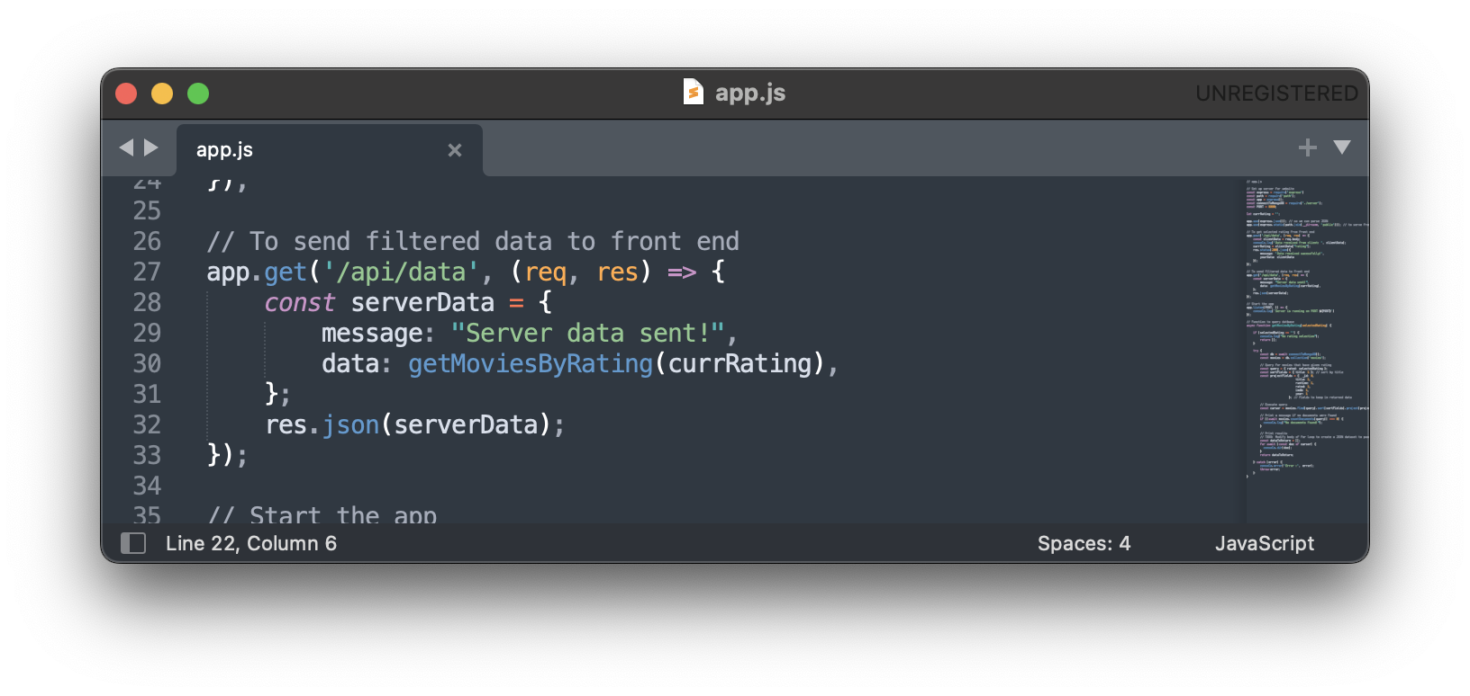
Architecture
Back End
Server
Database
Node.js
MongoDB

Slide 13
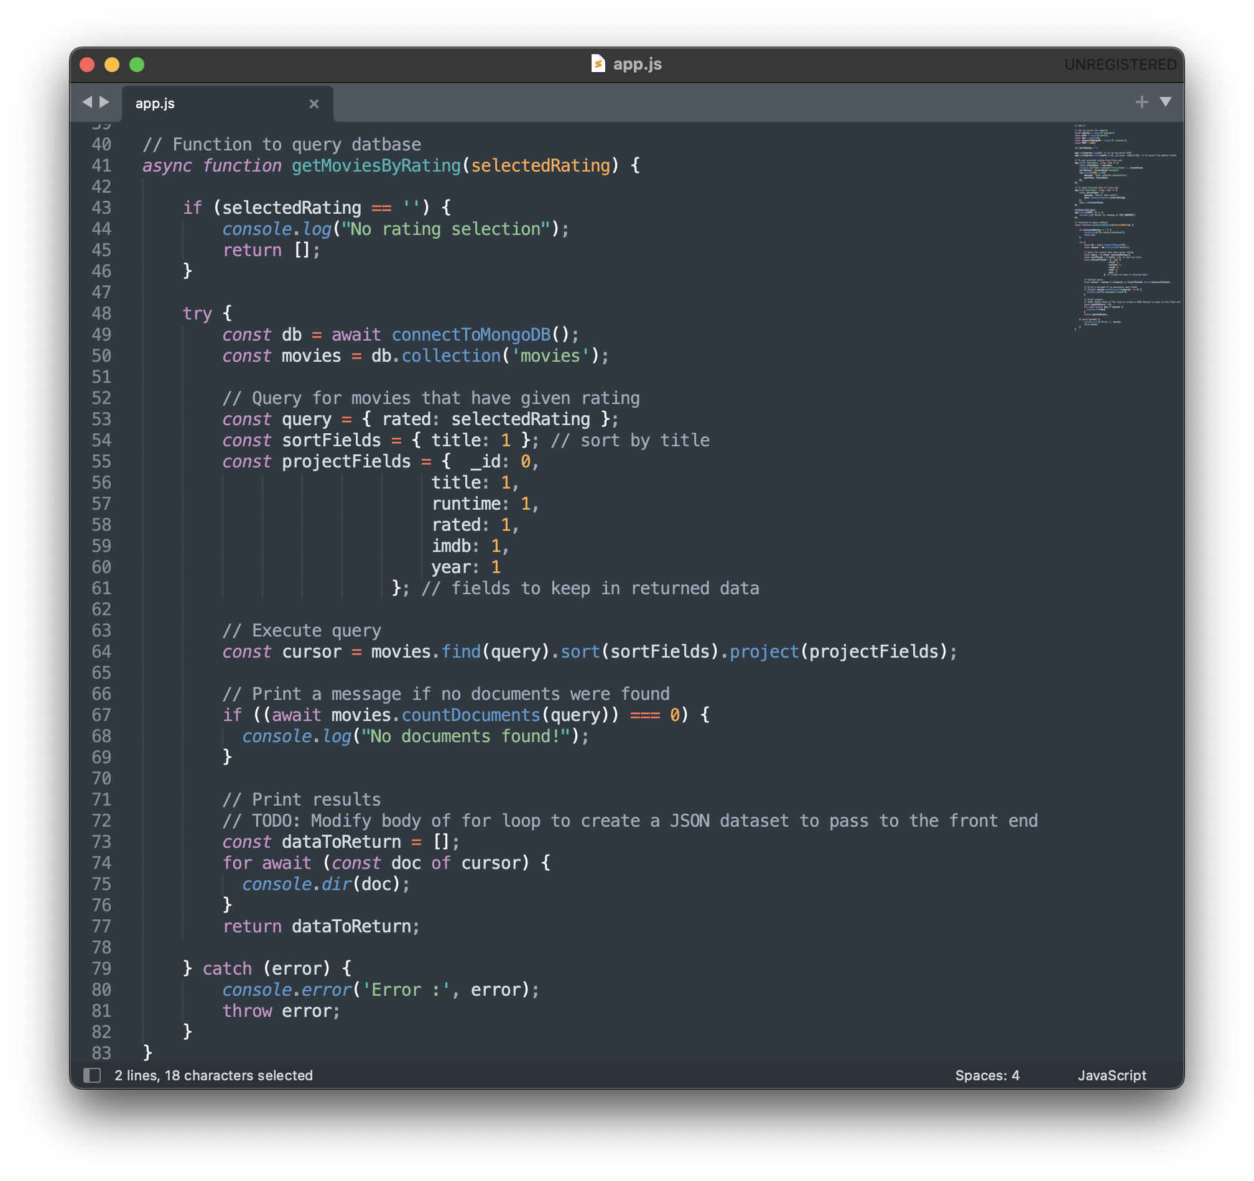
Architecture
Back End
Server
Database
Node.js
MongoDB

Slide 14
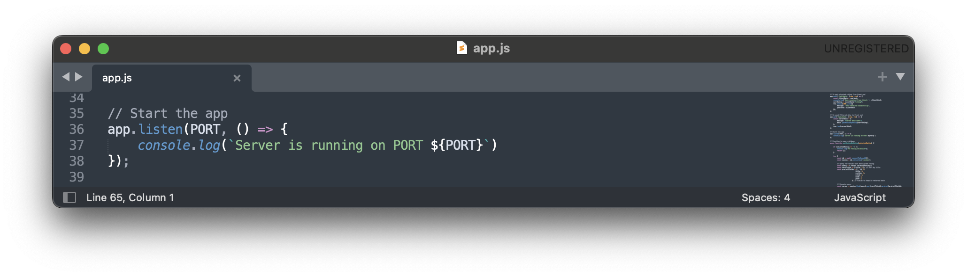
Architecture
Back End
Server
Database
Node.js
MongoDB

Slide 15
Architecture
Front End
Back End
Client
Server
Database
Front-end JS
Node.js
MongoDB

Slide 16
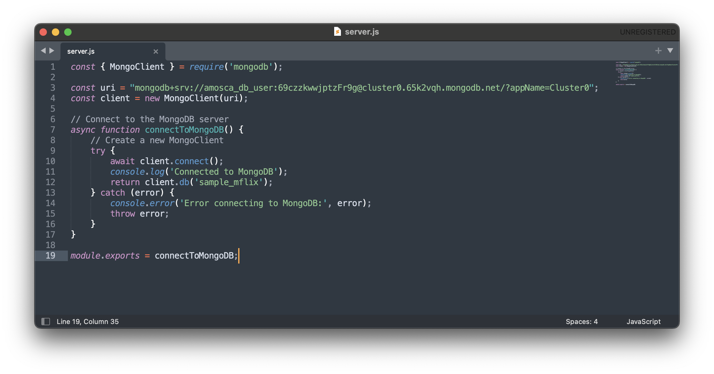
Architecture
Front End
Back End
Client
Server
Database
Front-end JS
Node.js
MongoDB

Slide 17
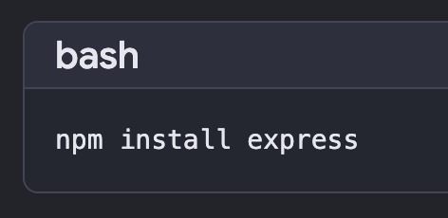
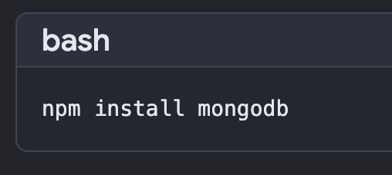
required packages
Install Node.js and npm (https://nodejs.org/en/download)
Navigate to big-data-lab folder and install:
Express.js
MongoDB Node.js driver

Slide 18
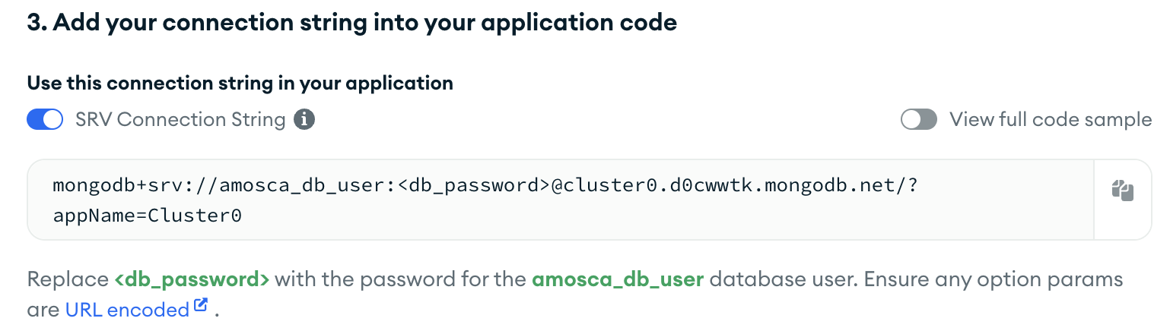
Set Up a database
Make a MongoDB account (https://www.mongodb.com/)
Add a cluster (choose the free option)
Once the cluster is created, click “Connect”
Select “Drivers”
Scroll to section 3:
Copy the connection string (circled above in red). Make sure <db_password> is a password, or reset the database user password manually and fill it in
Paste your connection string into server.js, replacing the existing string for uri

Slide 19
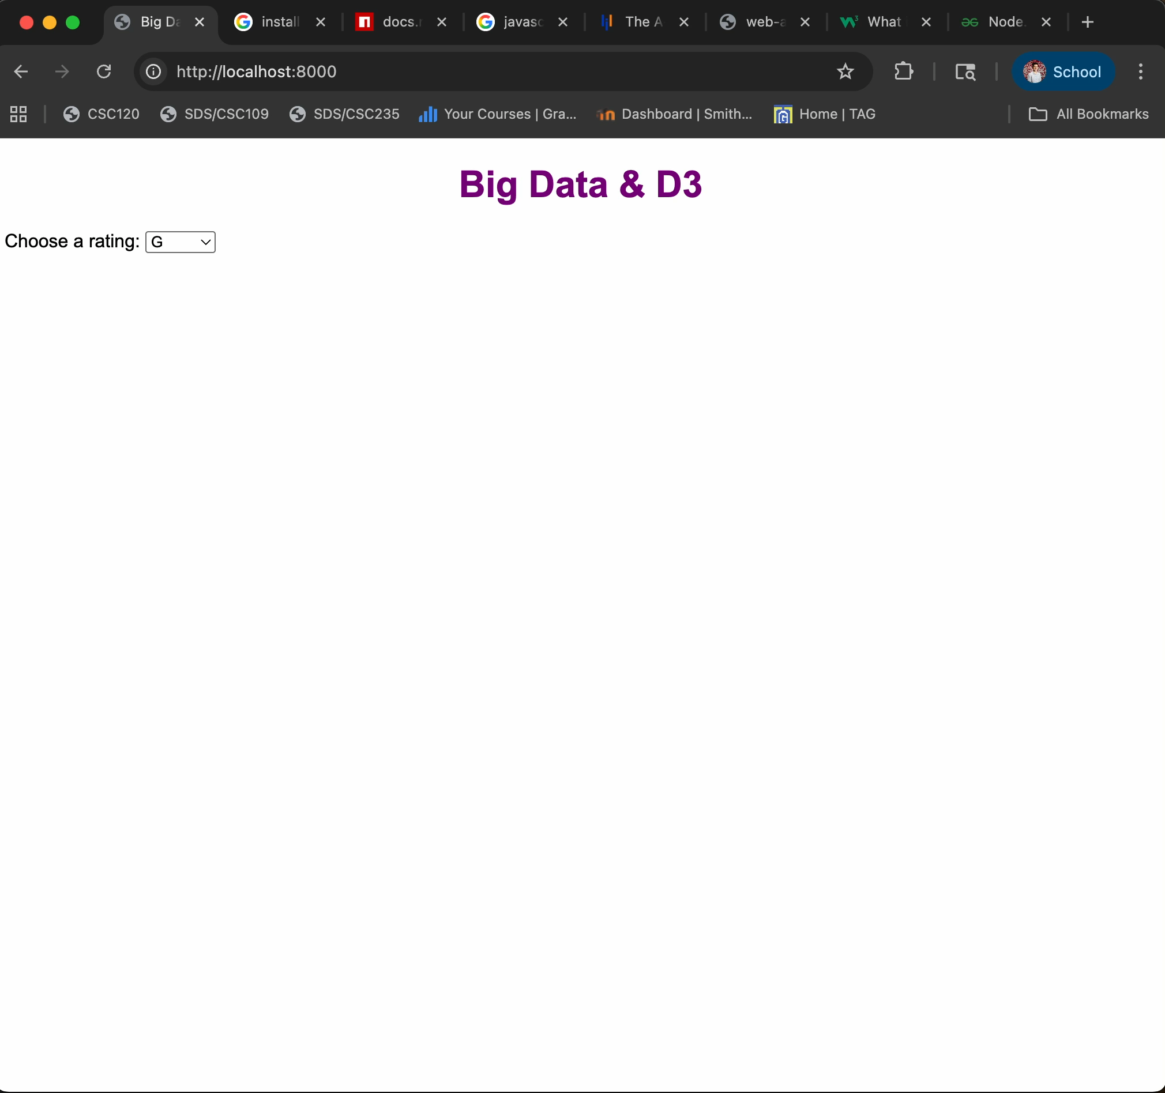
Dynamic visualization
cd <path>/big-data-lab
node app.js

