Slide 1
Visual Analytics: interaction Science
Ab Mosca (they/them)

Slide 2
Today’s plan
Science of interaction
Define interaction for visualization
Leveraging interaction

Slide 3
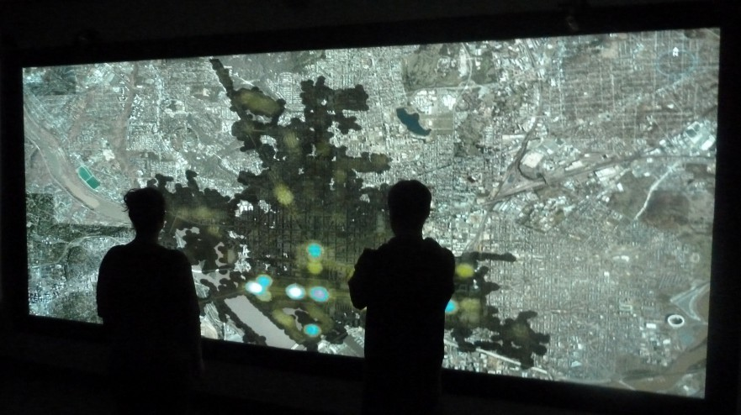
Recall: What is visual analytics?
discovery and communication of meaningful patterns in data
“The science of analytical reasoning
facilitated by interactive visual interfaces”¹
¹Thomas, James J., and Kristin A. Cook, eds. Illuminating the path: The research and development agenda for visual analytics. IEEE Computer Society Press, 2005.
visual representations of data that reinforce human cognition

Slide 4
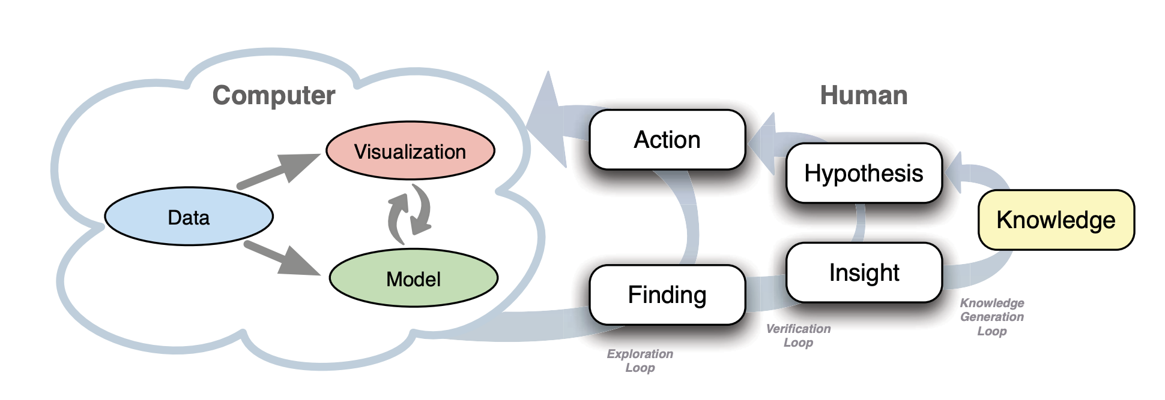
Recall: What is visual analytics?
Big Idea: Leverage complimentary strengths of humans and computers
D. Sacha, A. Stoffel, F. Stoffel, B. C. Kwon, G. Ellis and D. A. Keim, "Knowledge Generation Model for Visual Analytics," in IEEE Transactions on Visualization and Computer Graphics, vol. 20, no. 12, pp. 1604-1613, 31 Dec. 2014, doi: 10.1109/TVCG.2014.2346481.
Notes:
Knowledge generation model for visual analytics: The model consists of computer and human parts. The left hand side illustrates a visual analytics system, whereas the right hand side illustrates the knowledge generation process of the human. The latter is a reasoning process composed of exploration, verification, and knowledge generation loops. Visual analytics pursues a tight integration of human and machine by enabling the user to interact with the system.

Slide 5
Science of interaction
Science of interaction is the study of methods by which humans create knowledge through manipulation of an interface
Interaction refers to:
Set of controls through which a user can manipulate an interface
Cognitive act between the user and the problem space facilitated by computational tools
More concrete concept
Abstract concept
Pike, W. A., Stasko, J., Chang, R., & O’Connell, T. A. (2009). The Science of Interaction. Information Visualization, 8(4), 263-274. https://doi.org/10.1057/ivs.2009.22

Slide 6
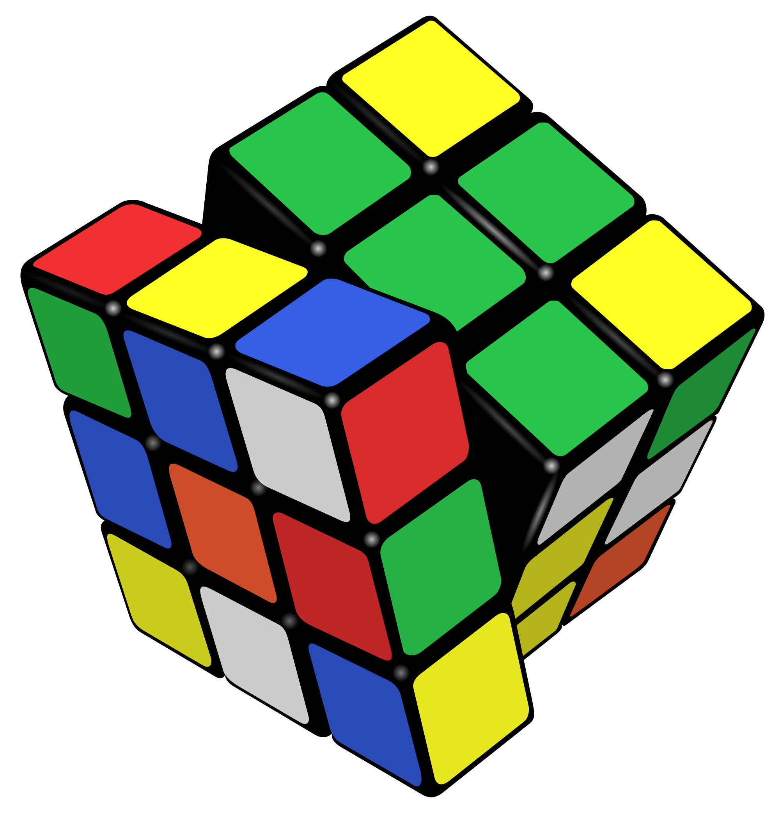
Science of interaction
Ex. Suppose you implement a program that simulates solving a Rubik’s cube
When someone uses your program:
What abstract problem space are they interacting with?
What are the concrete ways they interact with the program?

Slide 7
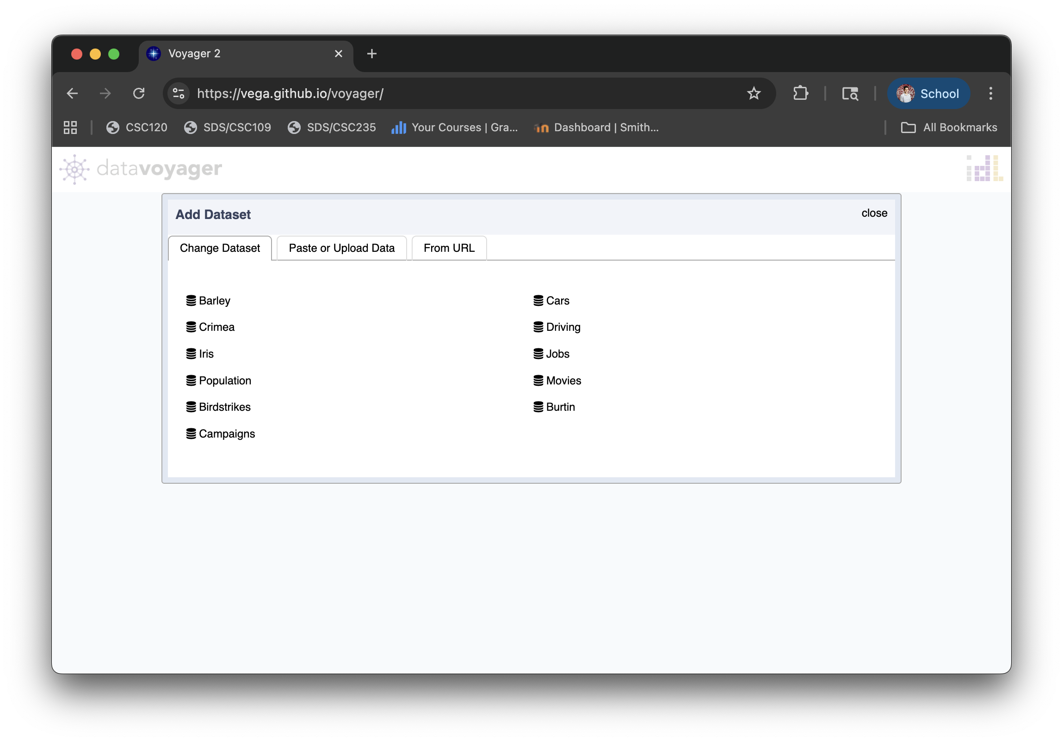
Science of interaction
Ex. Use DataVoyager to find two variables in the Movies dataset with a negative correlation
When you perform this task:
What abstract problem space are you interacting with?
What are the concrete ways you interact with DataVoyager?

Slide 8
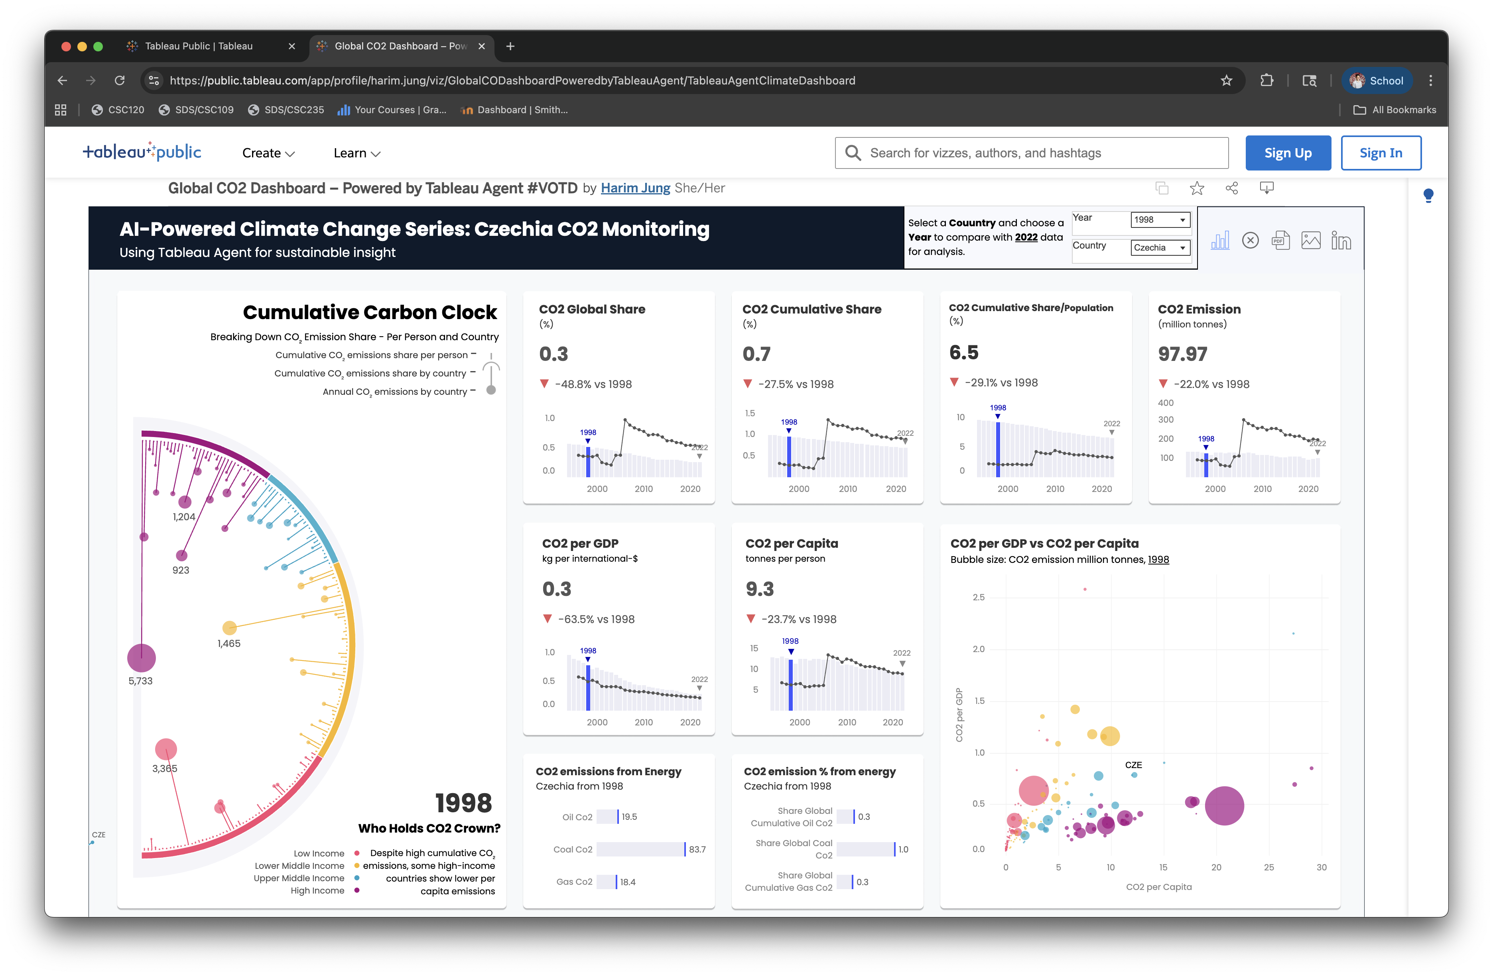
Science of interaction
Ex. Use Global CO2 Dashboard to find an insight about CO2 emissions in China
When you perform this task:
What abstract problem space are you interacting with?
What are the concrete ways you interact with the dashboard?

Slide 9
Science of interaction
Interaction as a Reasoning Aid
Interactive manipulation of an interface happens in service of the abstract problem space
Ex. I need to rotate parts of a virtual Rubik’s Cube to solve it
Ex. I need to select and drag variables in DataVoyager to analyze correlations
Ex. I need to hover over data points in Global CO2 Dashboard to find China’s emissions
concrete action
abstract problem
concrete action
abstract problem
concrete action
abstract problem
Pike, W. A., Stasko, J., Chang, R., & O’Connell, T. A. (2009). The Science of Interaction. Information Visualization, 8(4), 263-274. https://doi.org/10.1057/ivs.2009.22

Slide 10
Science of interaction
Interaction as a Reasoning Aid
Interactive manipulation of an interface happens in service of the abstract problem space
Interaction is part of the reasoning process; it is an inquiry
Insight emerges out of the experience of manipulating information; the more ways a user can ‘hold’ their data (ex. exploring from different angles, changing the data’s form) the more insight will accumulate
Acts of conceptual manipulation are called situation: the joining of background context and current observations, and analyses towards a goal
Pike, W. A., Stasko, J., Chang, R., & O’Connell, T. A. (2009). The Science of Interaction. Information Visualization, 8(4), 263-274. https://doi.org/10.1057/ivs.2009.22

Slide 11
Science of interaction
Interaction as a Reasoning Aid: situation
Lemke calls situation an ‘ecology’, evoking the dynamic interaction between concepts and thinkers in the process of knowledge construction
Situated cognition theorizes cognition as an emergent property of interactions between people and their environment through perception and action
In other words… cognition is not a purely mental activity; it requires interaction with artifacts
Interaction supports dialogical inquiry; the user and tool each posses questions and answers, as the user interacts to answer one question, they may encounter new ones
Pike, W. A., Stasko, J., Chang, R., & O’Connell, T. A. (2009). The Science of Interaction. Information Visualization, 8(4), 263-274. https://doi.org/10.1057/ivs.2009.22

Slide 12
Defining Interaction for Visualization
Interaction for visualization is the interplay between a person and a data interface involving a data-related intent, at least one action from the person and an interface reaction that is perceived as such.
E. Dimara and C. Perin, "What is Interaction for Data Visualization?," in IEEE Transactions on Visualization and Computer Graphics, vol. 26, no. 1, pp. 119-129, Jan. 2020, doi: 10.1109/TVCG.2019.2934283.
Notes:
INTERPLAY: We frame the definition via a dialogue metaphor as it is the common schema we observed in both visualization and HCI.
PERSON: We replace the commonly reported entity of human “user” with the term person.
DATA INTERFACE: The data interface is a system containing a set of controls that are perceivable by the person, and linked to a data entity. The data interface can contain other entities (e.g., a computer). The data entity itself is an abstracted intangible source that, like other abstracted notions such as “knowledge”, cannot physically constitute an actor in a two-way communication. Technically, the person interacts with the data interface (not the data entity), as the data interface is the one capable of providing a response.
ACTION: We include any action, physical or mental, and regardless of modality, that causes the reaction of the data interface.
ACTION-REACTION: Visualization and HCI agree that the interaction dialogue requires that the interface responds to a person’s action.
REACTION PERCEIVED AS SUCH: Visualization and HCI agree that the interaction dialogue requires that the person perceives the reaction of the data interface
DATA-RELATED INTENT: Visualization and HCI agree that interaction involves a teleological determination (i.e. a norm or goal of interaction). What differs is that the visualization intent (Sect. 5.1) is tied to a data source and is formed iteratively within the interaction cycle.

Slide 13
Defining Interaction for Visualization
Interaction for visualization is the interplay between a person and a data interface involving a data-related intent, at least one action from the person and an interface reaction that is perceived as such.
Interaction?
Joe is staring at a visualization without performing any action that is interpretable by the visualization. He is reasoning (mentally) about the visualized data. There are further (computer initiated) animations, real time changes that show important information that Joe takes into account in his reasoning process.
E. Dimara and C. Perin, "What is Interaction for Data Visualization?," in IEEE Transactions on Visualization and Computer Graphics, vol. 26, no. 1, pp. 119-129, Jan. 2020, doi: 10.1109/TVCG.2019.2934283.
Notes:
No. While there were several actions from the person, the
visualization did not return any reaction as a response to those actions.

Slide 14
Defining Interaction for Visualization
Interaction for visualization is the interplay between a person and a data interface involving a data-related intent, at least one action from the person and an interface reaction that is perceived as such.
Interaction?
Joe wants to focus on a cluster of data points. Using a mouse, he traces a lasso to select the data points. The visualization draws the lasso with the exact same color as the background.
E. Dimara and C. Perin, "What is Interaction for Data Visualization?," in IEEE Transactions on Visualization and Computer Graphics, vol. 26, no. 1, pp. 119-129, Jan. 2020, doi: 10.1109/TVCG.2019.2934283.
Notes:
No. While there was an action-reaction, the reaction of the
system was not perceived by the person.

Slide 15
Defining Interaction for Visualization
Interaction for visualization is the interplay between a person and a data interface involving a data-related intent, at least one action from the person and an interface reaction that is perceived as such.
Interaction?
Joe notices a slider widget. He intends to filter out some data points. He moves the slider and the visualization is zoomed-in. He does not understand what is going on.
E. Dimara and C. Perin, "What is Interaction for Data Visualization?," in IEEE Transactions on Visualization and Computer Graphics, vol. 26, no. 1, pp. 119-129, Jan. 2020, doi: 10.1109/TVCG.2019.2934283.
Notes:
Yes. Because the reaction of the visualization (although not
understood) was perceived by the person.

Slide 16
Defining Interaction for Visualization
Interaction for visualization is the interplay between a person and a data interface involving a data-related intent, at least one action from the person and an interface reaction that is perceived as such.
Interaction?
An airport provides a visualization that updates automatically to show all departure gate data. Jack looks for his gate number, but the visualization changes too quickly. A gaze detector tracks Jack’s unfocused gaze attempts and slows down the rate at which the visualization changes. Jack now locates his gate number.
E. Dimara and C. Perin, "What is Interaction for Data Visualization?," in IEEE Transactions on Visualization and Computer Graphics, vol. 26, no. 1, pp. 119-129, Jan. 2020, doi: 10.1109/TVCG.2019.2934283.
Notes:
Yes. There was an action-reaction perceived by the person.
Such gazing action was not interpretable by the interface in scenario 1.

Slide 17
Defining Interaction for Visualization
Interaction for visualization is the interplay between a person and a data interface involving a data-related intent, at least one action from the person and an interface reaction that is perceived as such.
Interaction?
Averell cannot remember where he parked his car. In the parking a screen shows car CO2 emission data to motivate car drivers to use their car less. Averell is not careful and he bumps his head on the screen. Because the screen is touch-enabled, this contact rearranges the data points. Averell sees some graphics moving around but does not pay attention. He ignores the screen and continues his search.
E. Dimara and C. Perin, "What is Interaction for Data Visualization?," in IEEE Transactions on Visualization and Computer Graphics, vol. 26, no. 1, pp. 119-129, Jan. 2020, doi: 10.1109/TVCG.2019.2934283.
Notes:
No. While there was an action-reaction perceived by the
person, there was no data-related intent (unless the designer, having
such intent, had caused Averell to non-consciously process some data).

Slide 18
Defining Interaction for Visualization
Interaction for visualization is the interplay between a person and a data interface involving a data-related intent, at least one action from the person and an interface reaction that is perceived as such.
Interaction?
Like Averell, William bumps his head on the display. But when he sees the graphics move around he gets curious and starts touching the display to explore what these graphic things are about.
E. Dimara and C. Perin, "What is Interaction for Data Visualization?," in IEEE Transactions on Visualization and Computer Graphics, vol. 26, no. 1, pp. 119-129, Jan. 2020, doi: 10.1109/TVCG.2019.2934283.
Notes:
Yes. Although the interaction was not initiated by an explicit
intent, there was an implicit data-related intent involved in the process

Slide 19
Leveraging Interaction
Recall: Interaction is a reasoning aid to the user; it enables situated cognition
Question: Can interaction also benefit the visual interface? How?

Slide 20
Leveraging Interaction
Predicting User Intent
A visual interface can track user interactions and use that data to build predictive models of user goals and needs.
Given an accurate prediction or user goals and needs, an interface can proactively update to support them.

Slide 21
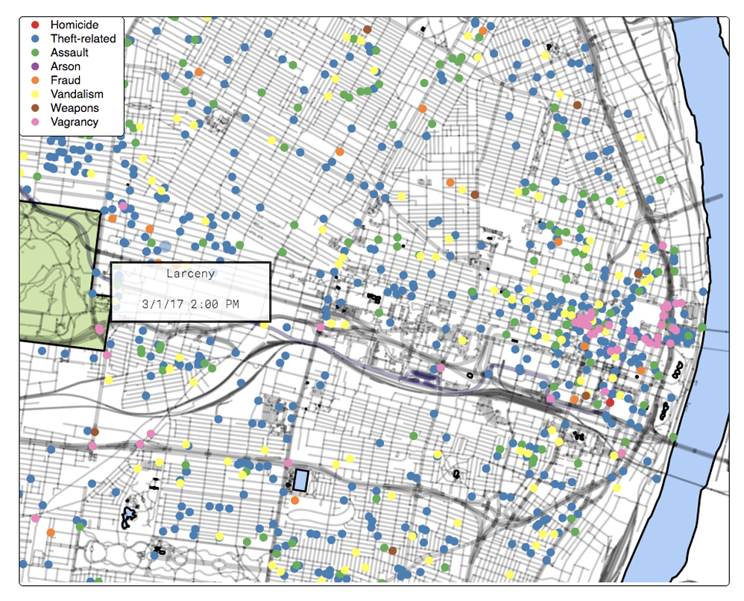
Leveraging Interaction
Predicting User Intent: Ex. Inferring Interest based on Clicks
Ottley, A., Garnett, R. and Wan, R. (2019), Follow The Clicks: Learning and Anticipating Mouse Interactions During Exploratory Data Analysis. Computer Graphics Forum, 38: 41-52. https://doi.org/10.1111/cgf.13670
Notes:
the machine can proactively perform tasks such as prefetching, calculation of summaries statistics, suggestion formation, bias or error identification, and target selection assistance for overcrowded interfaces.

Slide 22
Leveraging Interaction
Illuminating Potential Bias
Bias in data analysis can look like over-analysis of some subset(s) of data and under-analysis of others.
Interaction can illuminate patters of exploration and highlight over-/under-analysis patterns.

Slide 23
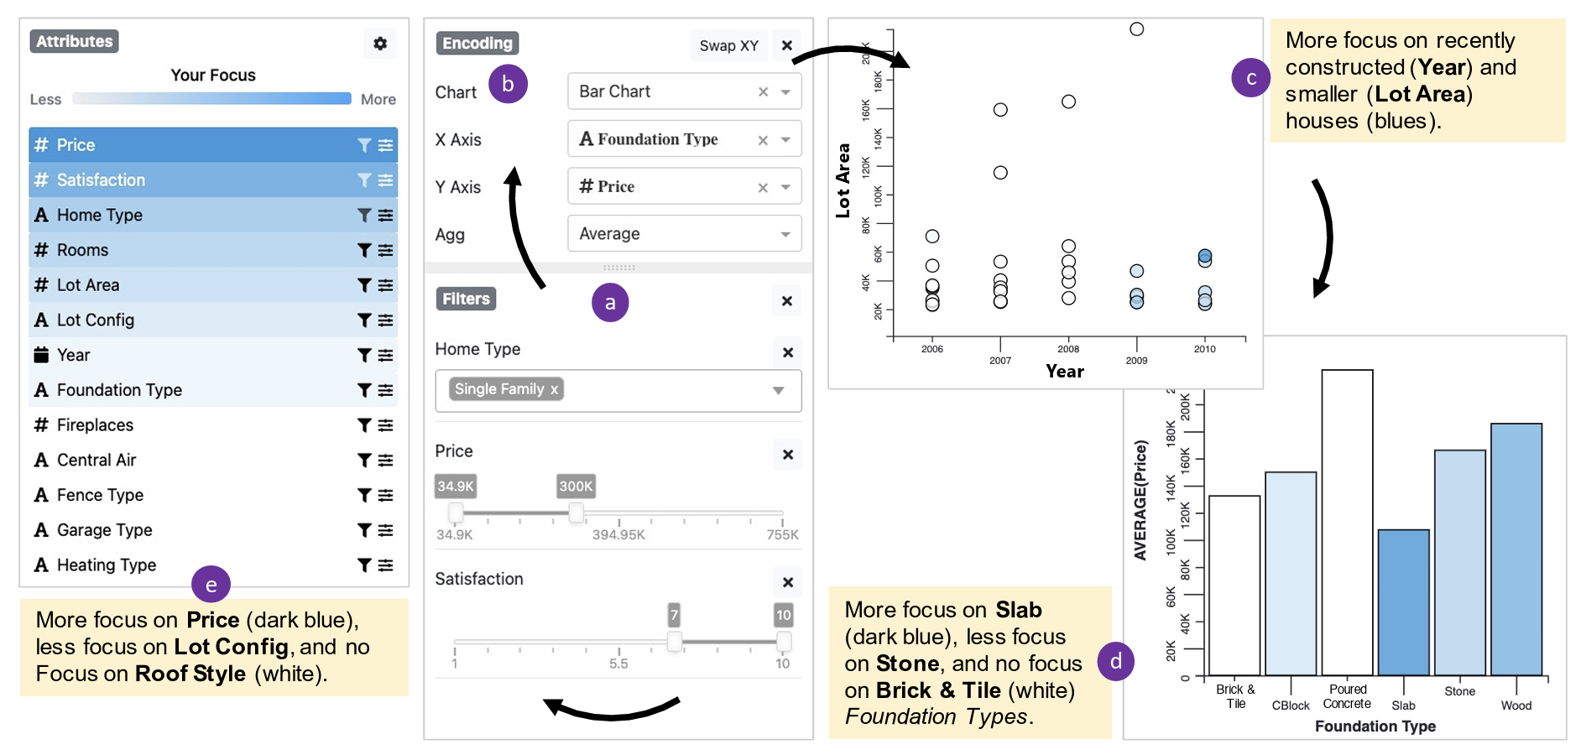
Leveraging Interaction
Illuminating Potential Bias: Ex. Lumos
Arpit Narechania, Adam Coscia, Emily Wall, and Alex Endert. 2022. Lumos: Increasing Awareness of Analytic Behavior during Visual Data Analysis. IEEE Transactions on Visualization and Computer Graphics 28, 1 (Jan. 2022), 1009–1018. https://doi.org/10.1109/TVCG.2021.3114827

Slide 24
Leveraging Interaction
Update Underlying Models
Advanced modeling is used to analyze data, subject matter experts can evaluate analysis results for anomalies and mistakes, but may not have the technical skills to tune a model
Interaction can be used to allow subject matter experts to tune model parameters without requiring technical skills

Slide 25
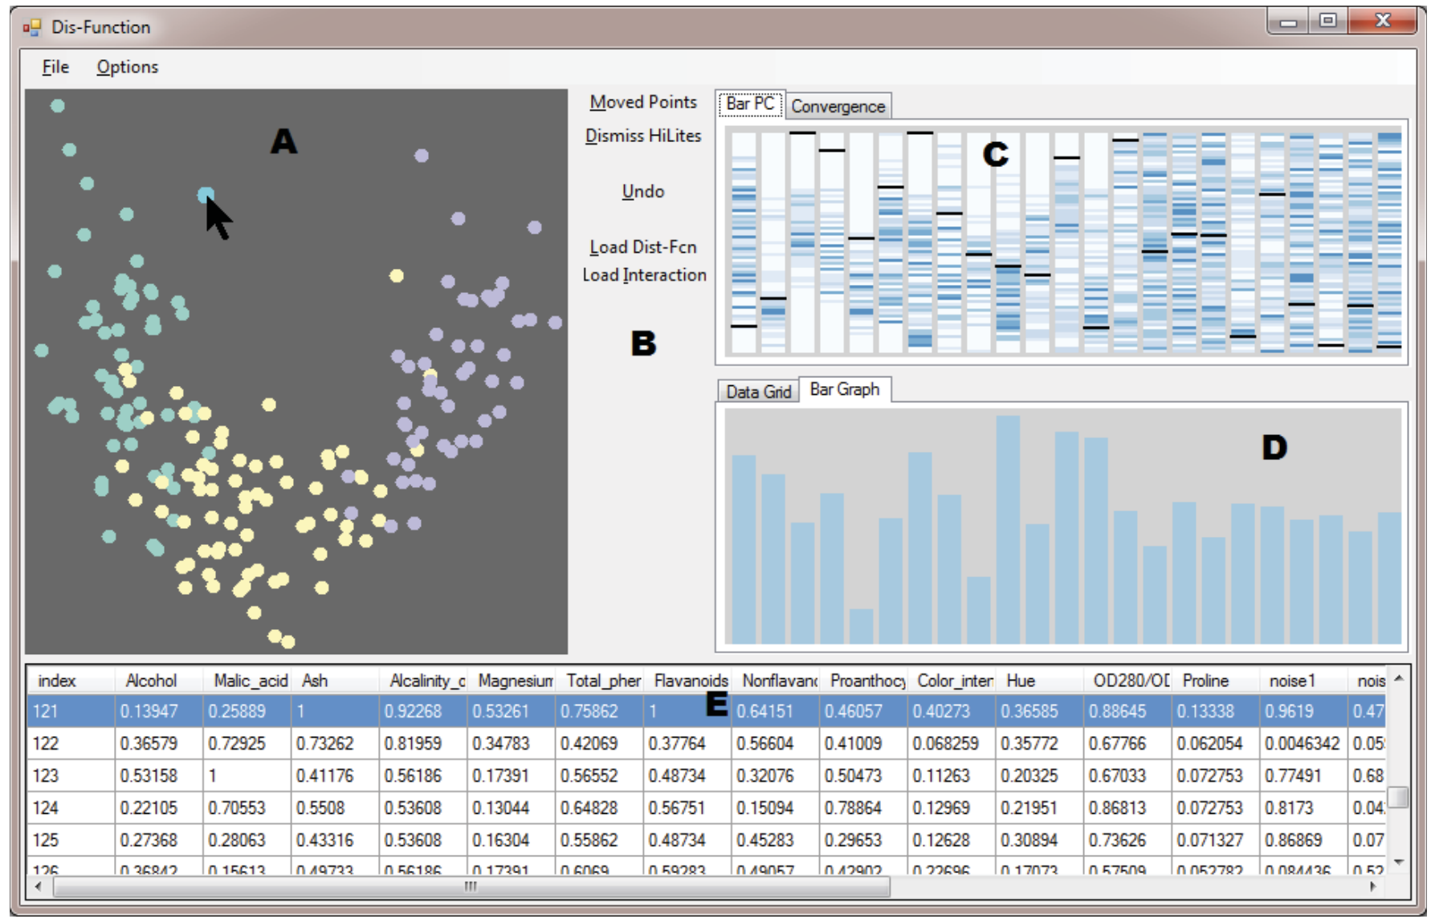
Leveraging Interaction
Update Underlying Models: Ex. Dis-Function
E. T. Brown, J. Liu, C. E. Brodley and R. Chang, "Dis-function: Learning distance functions interactively," 2012 IEEE Conference on Visual Analytics Science and Technology (VAST), Seattle, WA, USA, 2012, pp. 83-92, doi: 10.1109/VAST.2012.6400486.
Notes:
the MDS scatterplot visualization of the data;
the buttons for recalculating the projection, undoing unsatisfying input, loading custom distance functions and user input data, etc.;
the Parallel Bars visualization described in Section 4;
a bar graph of the current distance function (obscured ’Data Grid’ tab shows a tabular version);
the original data.
All these views are tightly coordinated such that interactions with one view are immediately reflected on the others. For example, in the figure above, the mouse cursor is over a point in the scatterplot, and thus the corresponding point in the data table at the bottom is highlighted and the black lines on (C) highlight the values of the data point in each dimension as they relate to other data points.

Slide 26
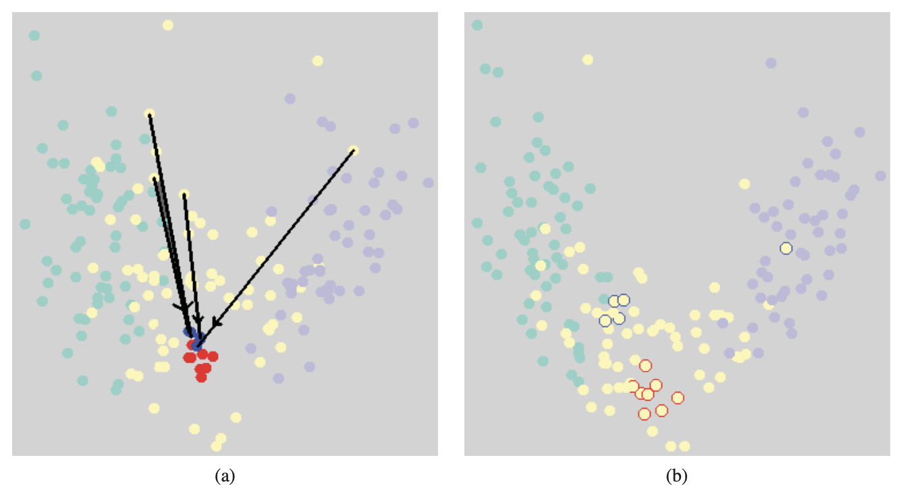
Leveraging Interaction
Update Underlying Models: Ex. Dis-Function
E. T. Brown, J. Liu, C. E. Brodley and R. Chang, "Dis-function: Learning distance functions interactively," 2012 IEEE Conference on Visual Analytics Science and Technology (VAST), Seattle, WA, USA, 2012, pp. 83-92, doi: 10.1109/VAST.2012.6400486.
Notes:
A handful of points have been marked in blue and dragged closer to another set of points, marked in red. After the update (on the right), the points in those groups are closer together, and the clustering with respect to different colors is more compact. The same red and blue points marked on the left are indicated in their new positions on the right with red and blue halos.

Slide 27
Leveraging Interaction
Question: If you were to build a system that tracks user interactions, how might you do it? What data would you collect?

