Slide 1
Visual Analytics: Novel visualizations with d3.js
Ab Mosca (they/them)

Slide 2
Today’s plan
Overview
SVG
D3 Basics

Slide 3
D3.js overview
D3 → Data Driven Documents; it is a JavaScript library for creating custom, novel, interactive visualizations on the web
Good resource: https://www.d3indepth.com/introduction/
D3 includes built in functions to bind data with HTML SVG elements

Slide 4
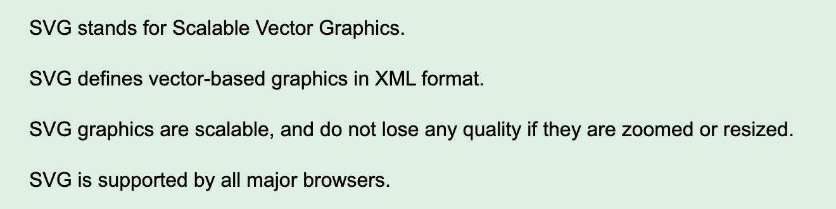
SVG
https://www.w3schools.com/graphics/svg_intro.asp

Slide 5
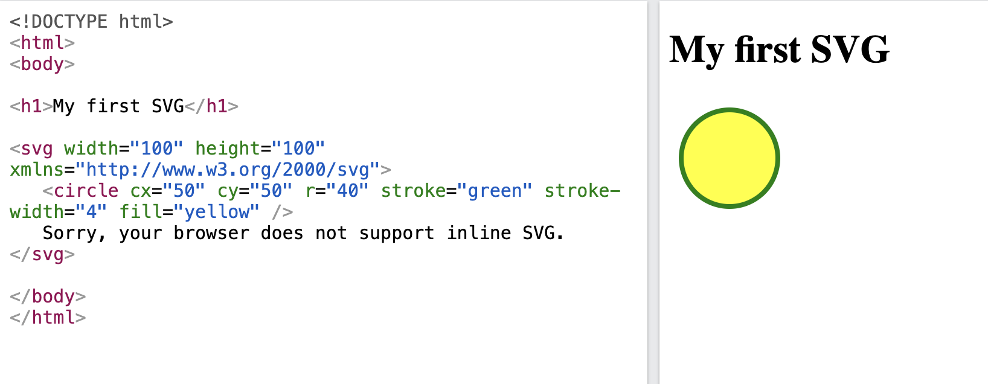
SVG
https://www.w3schools.com/graphics/svg_intro.asp

Slide 6
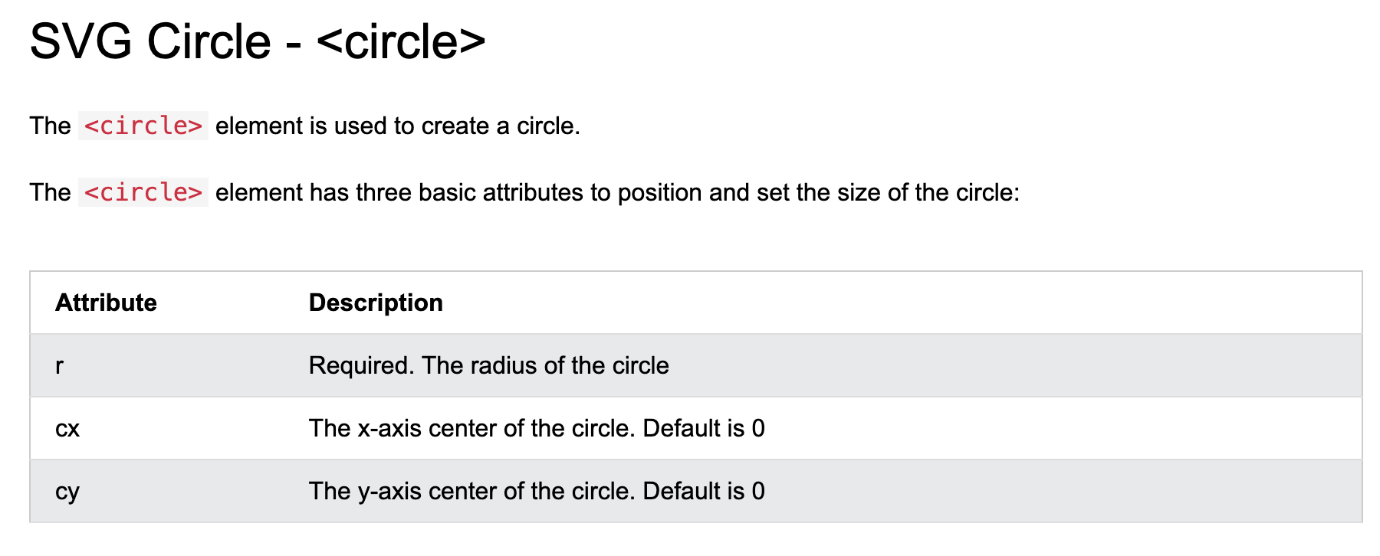
SVG
https://www.w3schools.com/graphics/svg_intro.asp

Slide 7
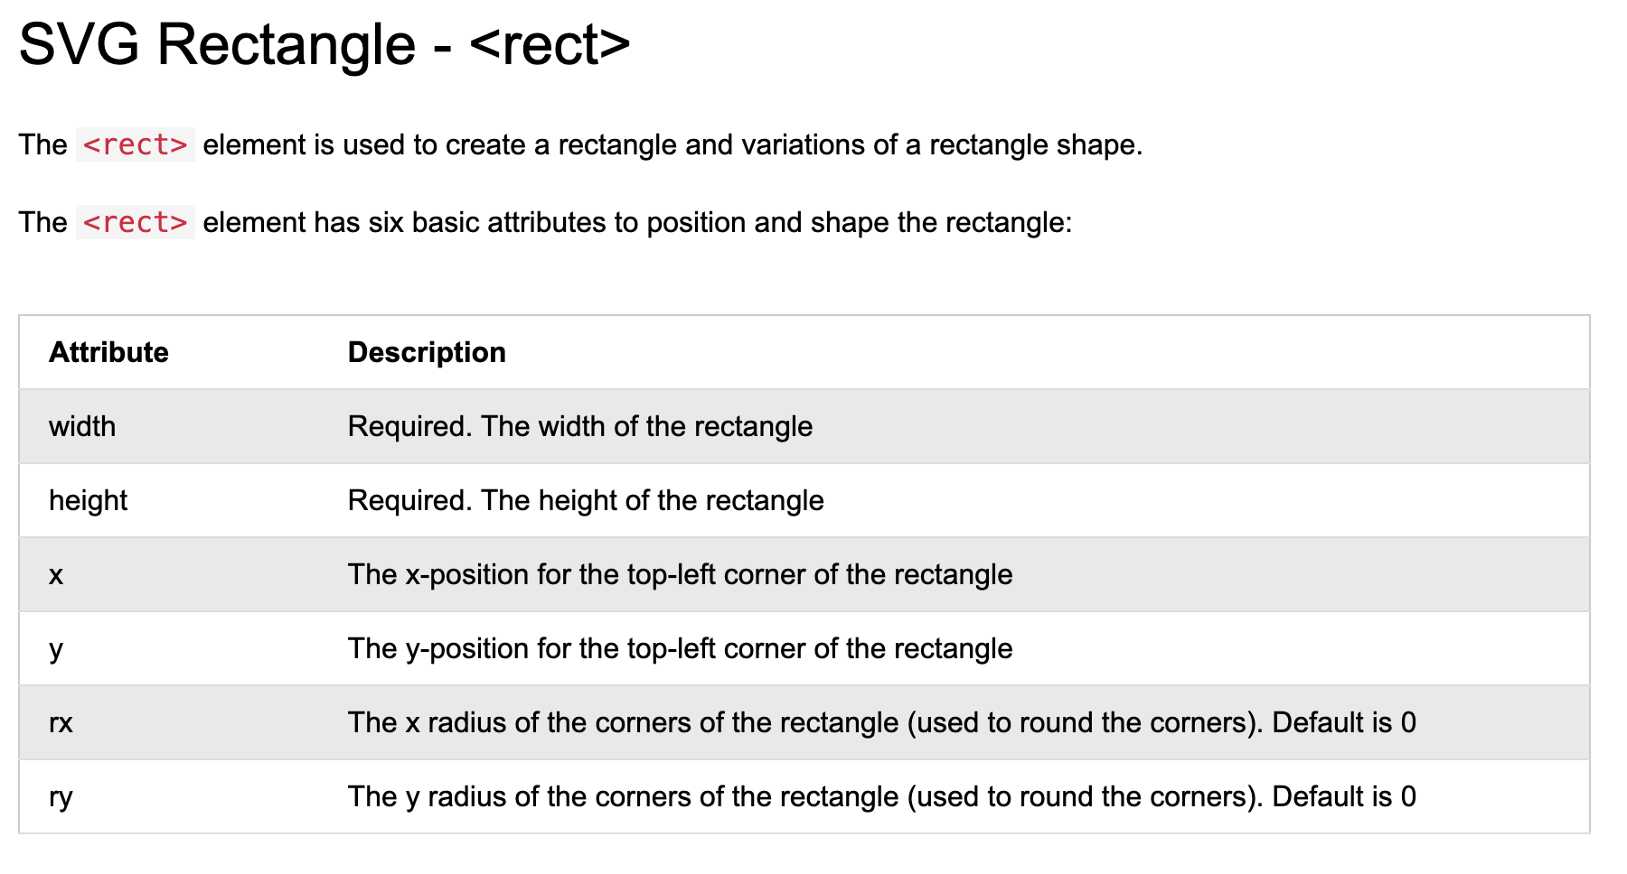
SVG
https://www.w3schools.com/graphics/svg_intro.asp

Slide 8
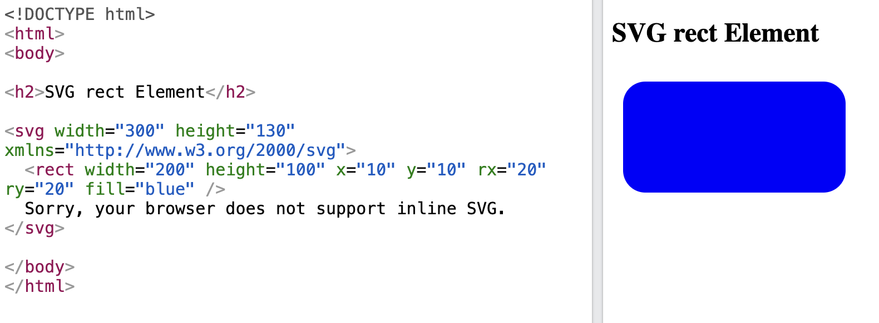
SVG
https://www.w3schools.com/graphics/svg_intro.asp

Slide 9
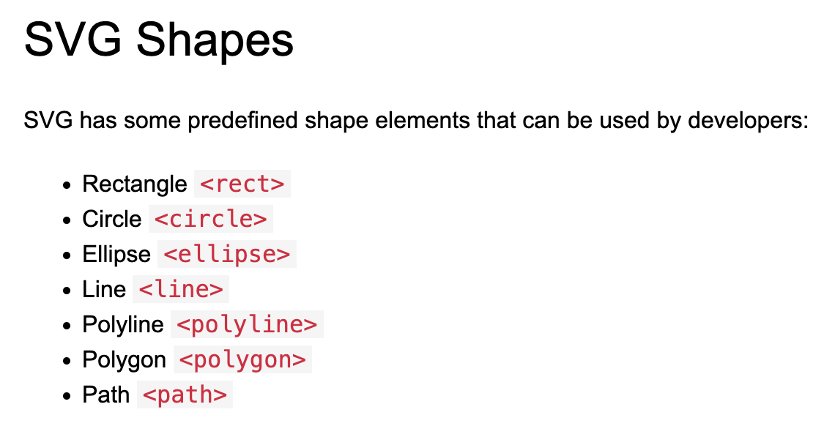
SVG
https://www.w3schools.com/graphics/svg_intro.asp

Slide 10
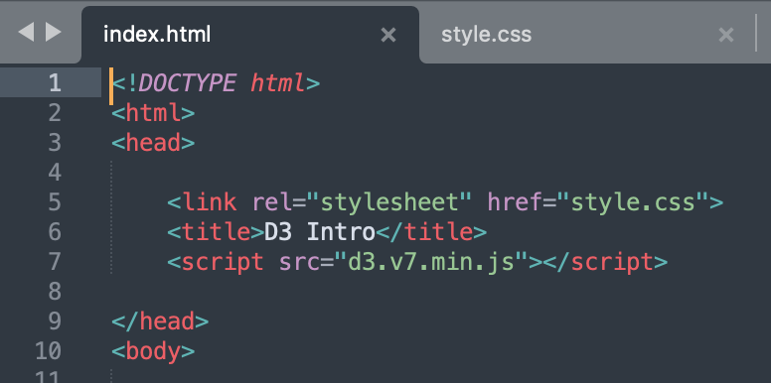
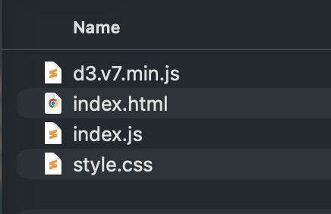
D3 Basics
Starter code on the website
Final code also on the website
d3.js is a code library
To use the library, include d3.js in your html with the <script> tags
https://www.d3indepth.com/introduction/

Slide 11
D3 Basics: selections
Use selectAll() to select a group of SVGs
Specify what to select vis CSS selectors – Ex. selectAll(‘circle’), or selectAll(“.myCircle”)
Use select() to select just the first matching element
https://www.d3indepth.com/introduction/

Slide 12
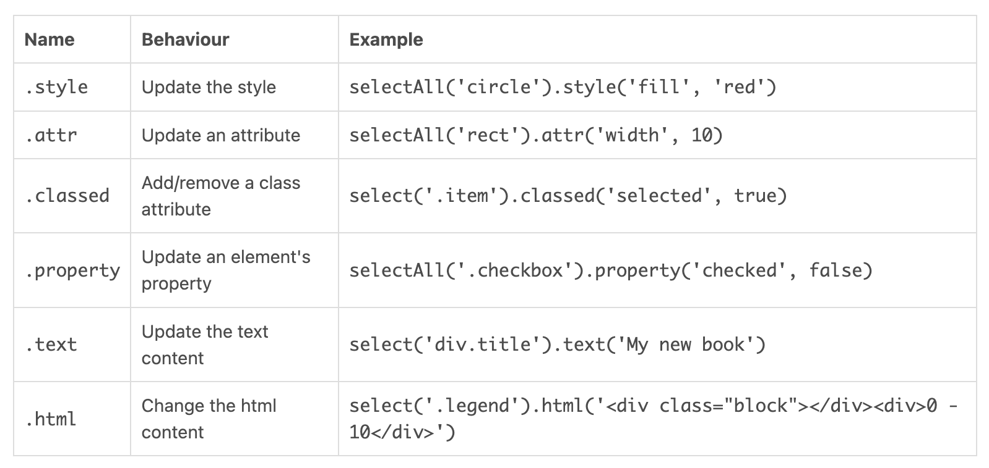
D3 Basics: selections
After selecting elements, use D3 methods to modify them
https://www.d3indepth.com/introduction/

Slide 13
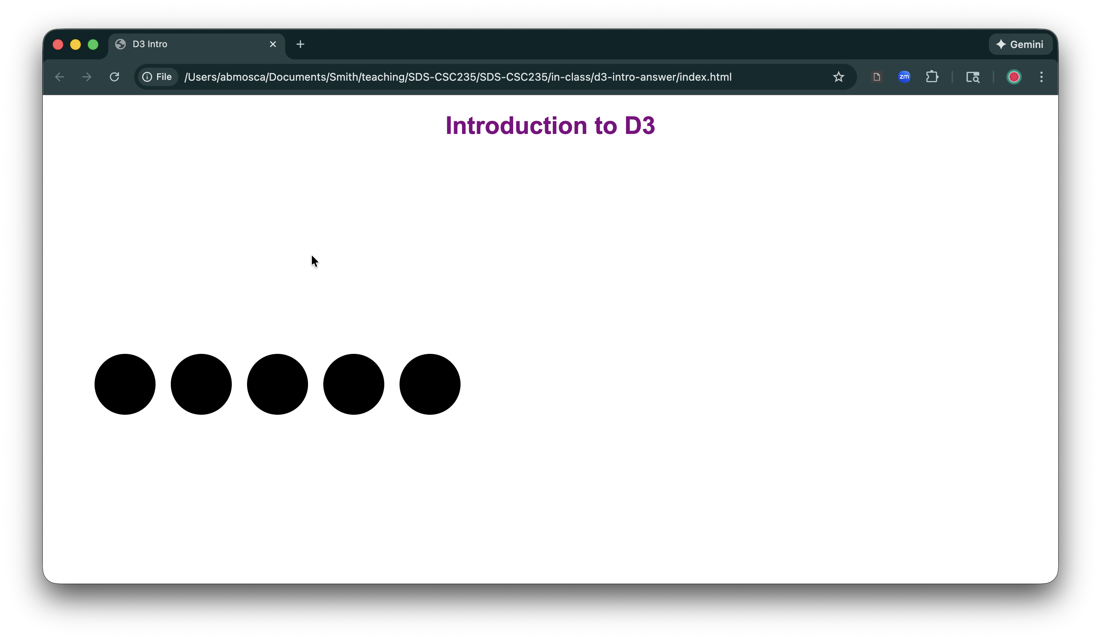
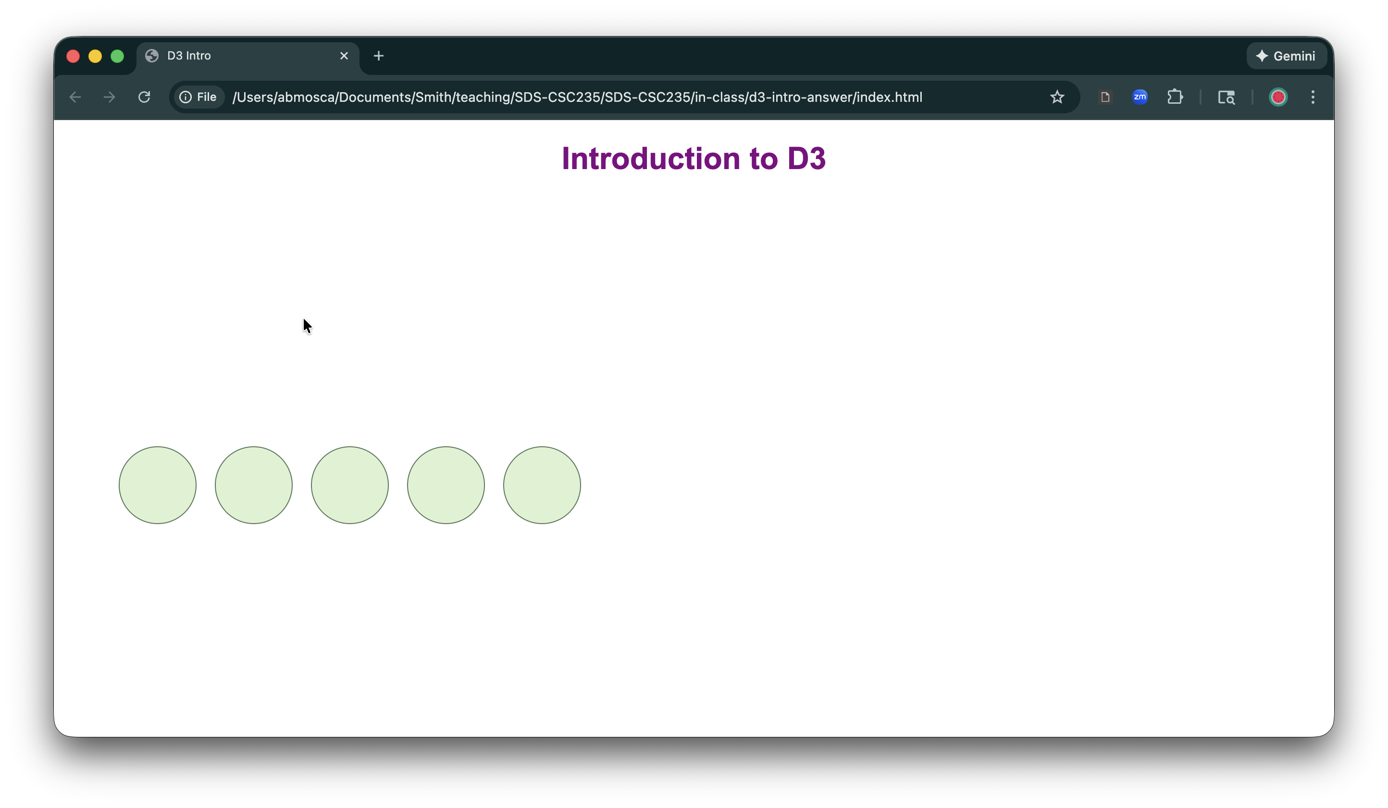
D3 Basics: selections
Your turn:
Use D3 selections to select all circles in the starter code and assign them the class ‘selected’
Use CSS to style selected elements such that they are light green with a dark green border
https://www.d3indepth.com/introduction/

Slide 14
D3 Basics: data Joins
A data join creates a correspondence between an array of data and a selection of HTML or SVG elements.
Joining an array to HTML/SVG elements means that:
HTML (or SVG) elements are added or removed such that each array element has a corresponding HTML (or SVG) element
each HTML/SVG element may be positioned, sized and styled according to the value of its corresponding array element
https://www.d3indepth.com/introduction/

Slide 15
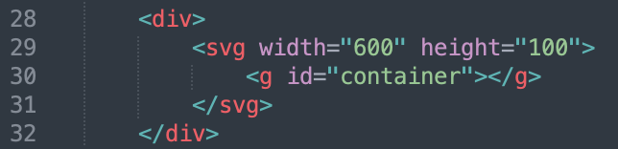
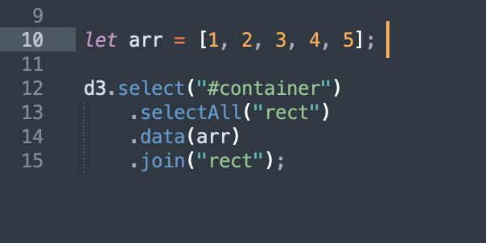
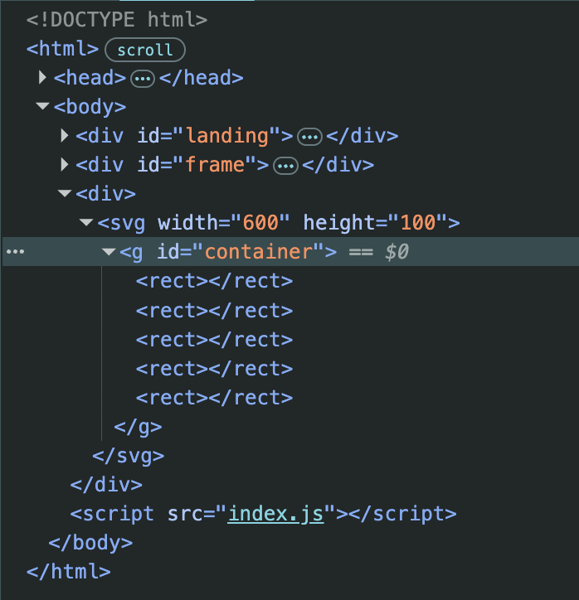
D3 Basics: data Joins
Typically, four methods are used in a data join:
.select defines the element that'll act as a container (or parent) to the joined HTML/SVG elements
.selectAll defines the type of element that'll be joined to each array element
.data defines the array that's being joined
.join performs the join. This is where HTML or SVG elements are added and removed
https://www.d3indepth.com/introduction/

Slide 16
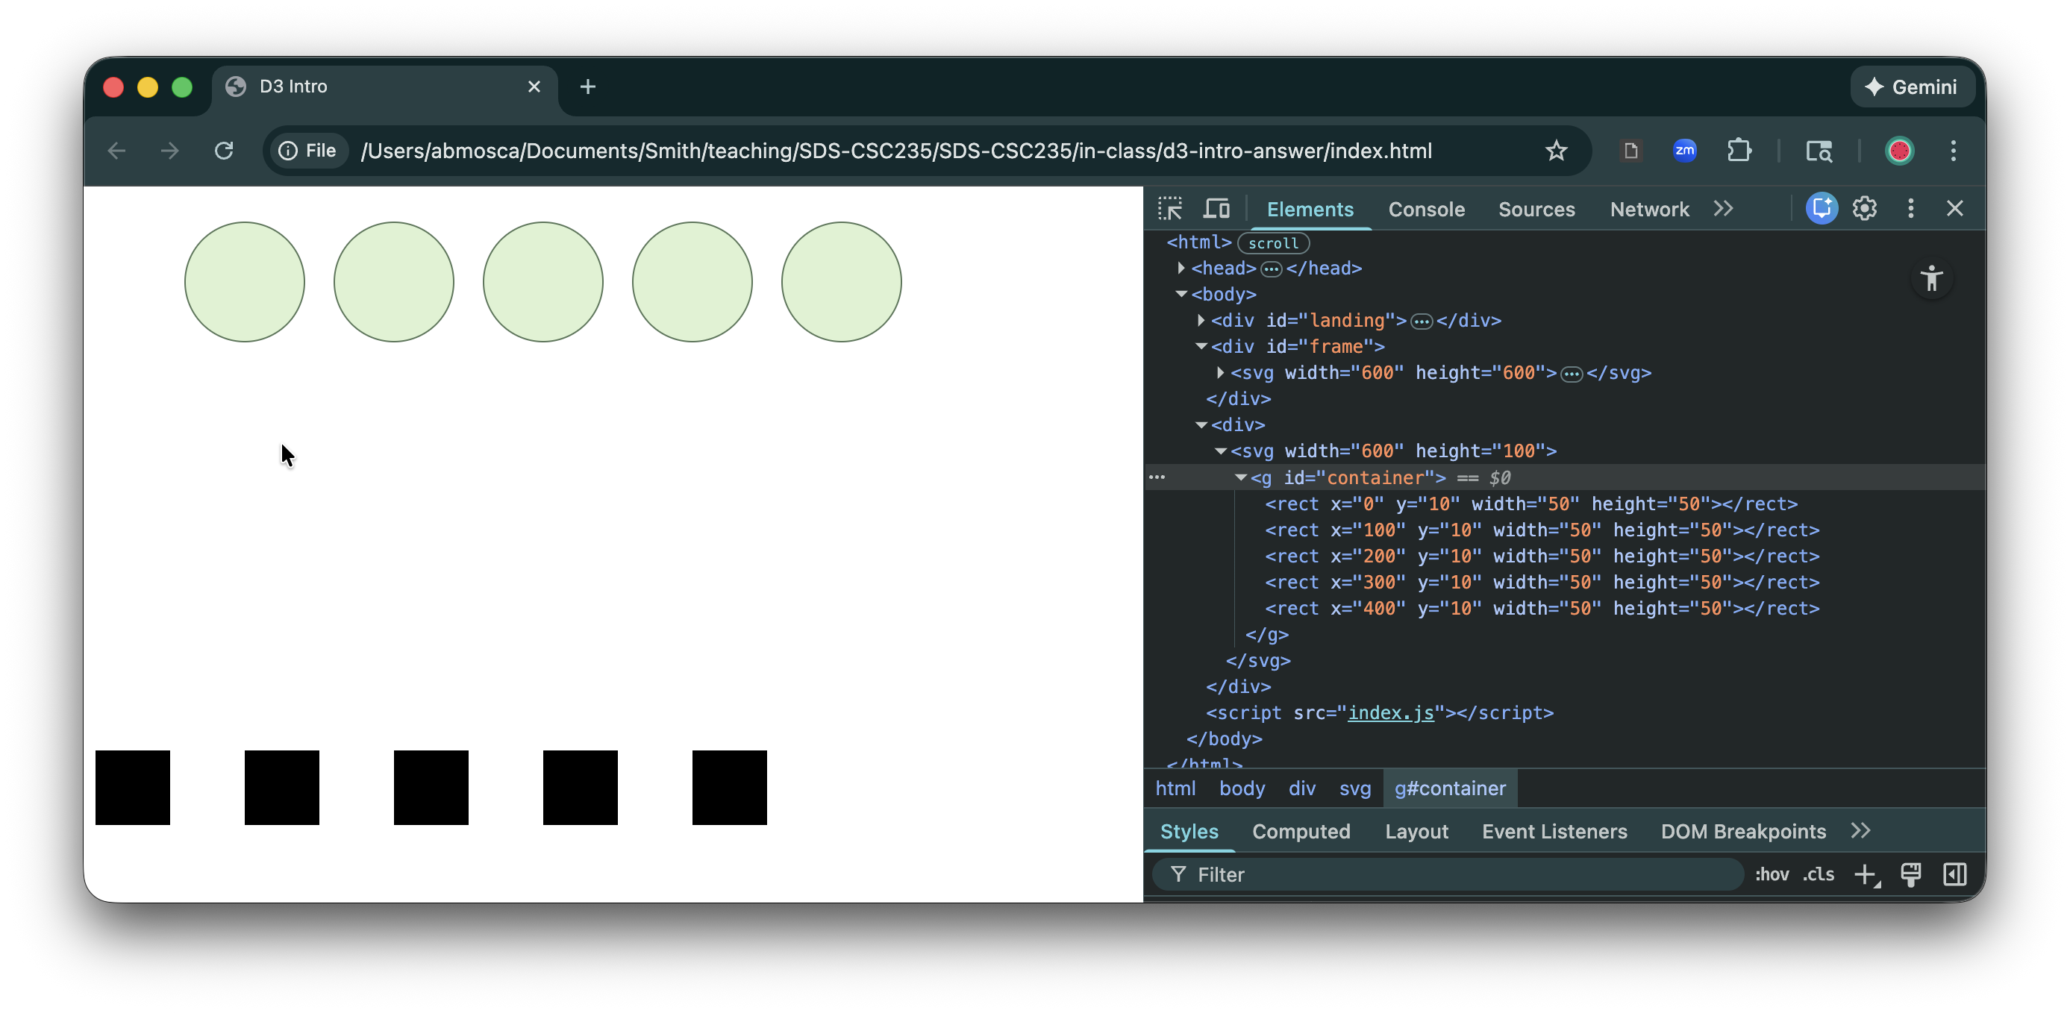
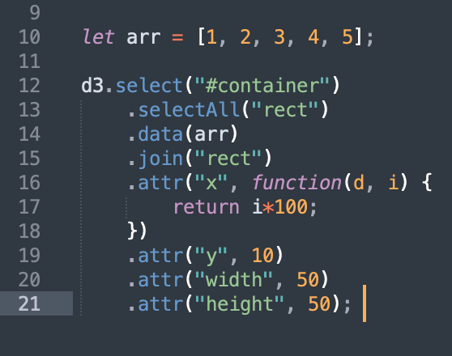
D3 Basics: data Joins
Once data and HTML/SVG elements are joined, we can use the data to dynamically set properties of the elements
https://www.d3indepth.com/introduction/

Slide 17
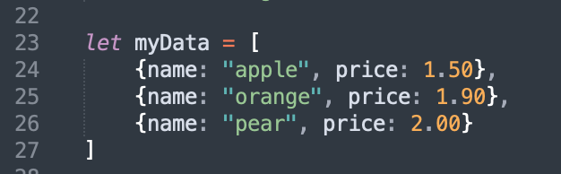
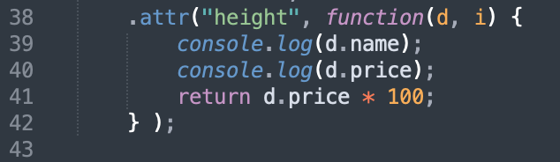
D3 Basics: data Joins
Data will typically be in JSON format
In this format, each observation is an object. Data is accessed as properties of the object
https://www.d3indepth.com/introduction/

Slide 18
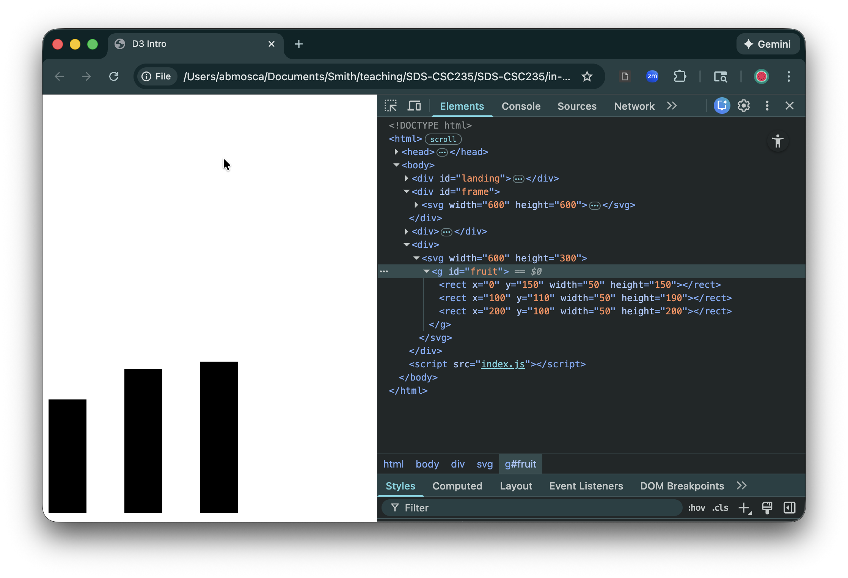
D3 Basics: data Joins
Your turn:
Add a rectangle for each observation in myData to your HTML
Use even horizontal spacing, and map height to price
https://www.d3indepth.com/introduction/

Slide 19
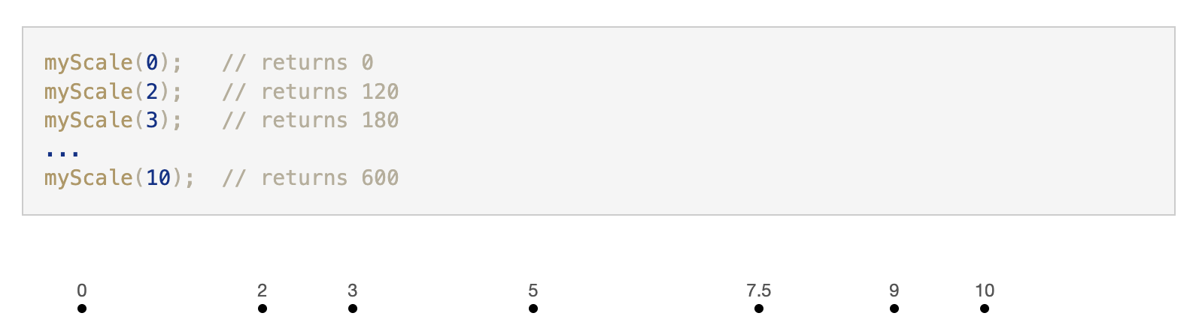
D3 Basics: axes
To make perceptually accurate visualizations, we need to map data values to visual channels such as position, color, length, etc.
D3 has built in scale methods to make this easier
Scale methods:
take an input (usually a number, date or category) and
return a value (such as a coordinate, a color, a length, or a radius)
Ex.
https://www.d3indepth.com/introduction/

Slide 20
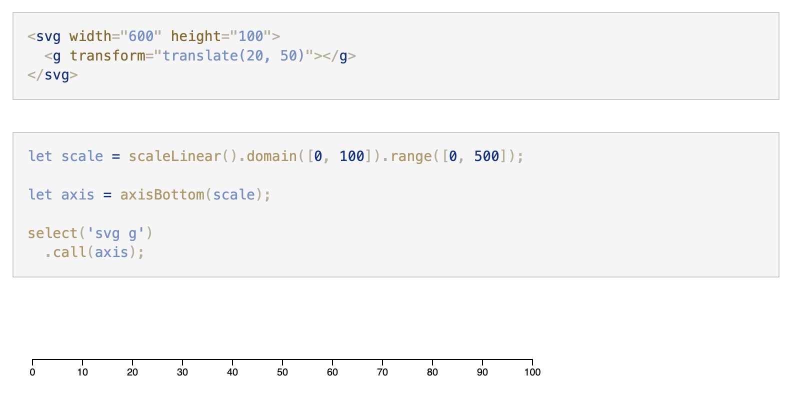
D3 Basics: axes
To create an axis we need:
an SVG element to contain the axis (usually a g element)
a D3 scale function
.call takes a function that operates on a selection as a parameter
https://www.d3indepth.com/introduction/

Slide 21
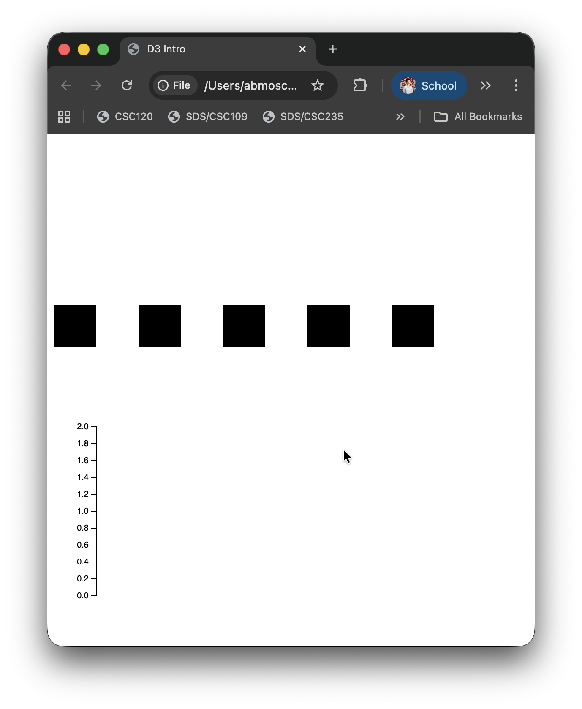
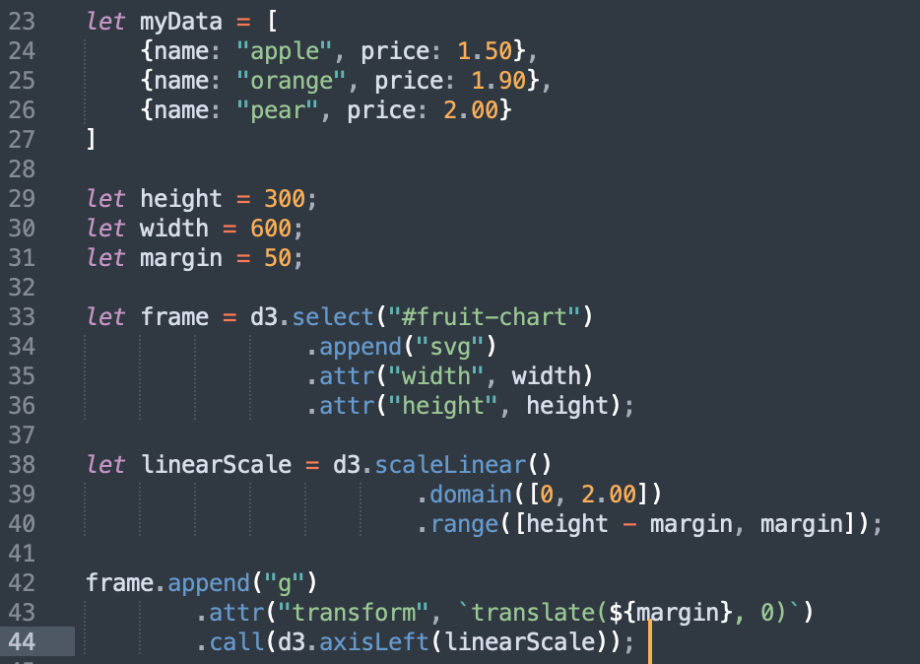
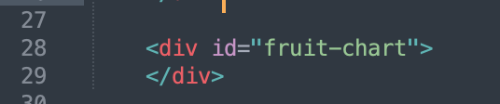
D3 Basics: axes
Aside: we can dynamically add SVG containers to HTML using D3
https://www.d3indepth.com/introduction/

Slide 22
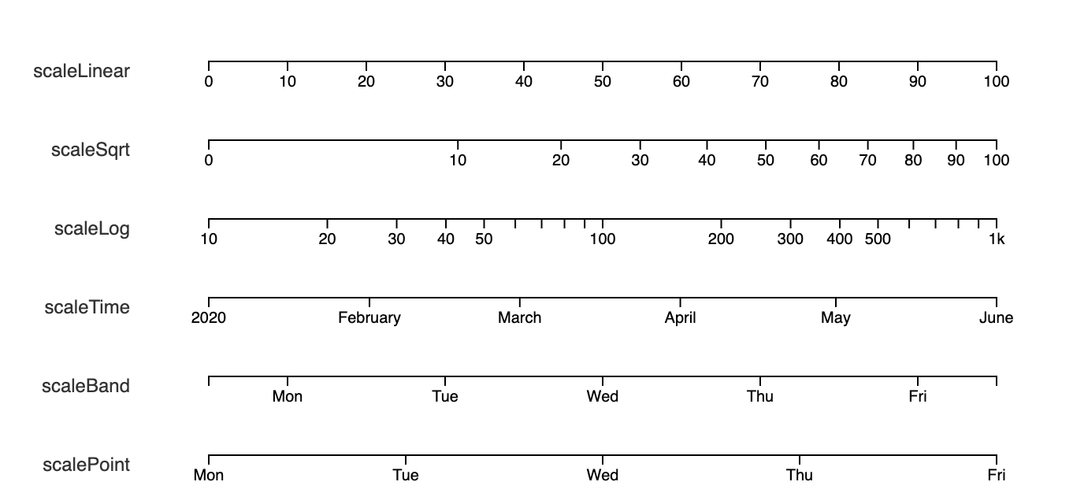
D3 Basics: axes
Many types of scale methods available
https://www.d3indepth.com/introduction/

Slide 23
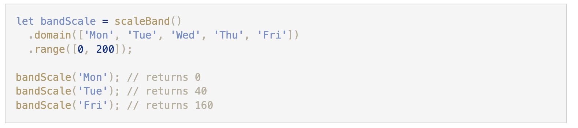
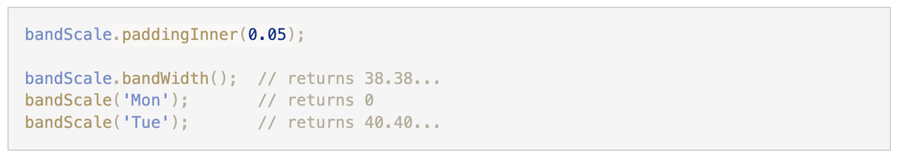
D3 Basics: axes
scaleBand is particularly useful for bar charts
.bandwidth() will return the width of each band in the scale
.paddingInner(percentage) will set padding between bands
https://www.d3indepth.com/introduction/

Slide 24
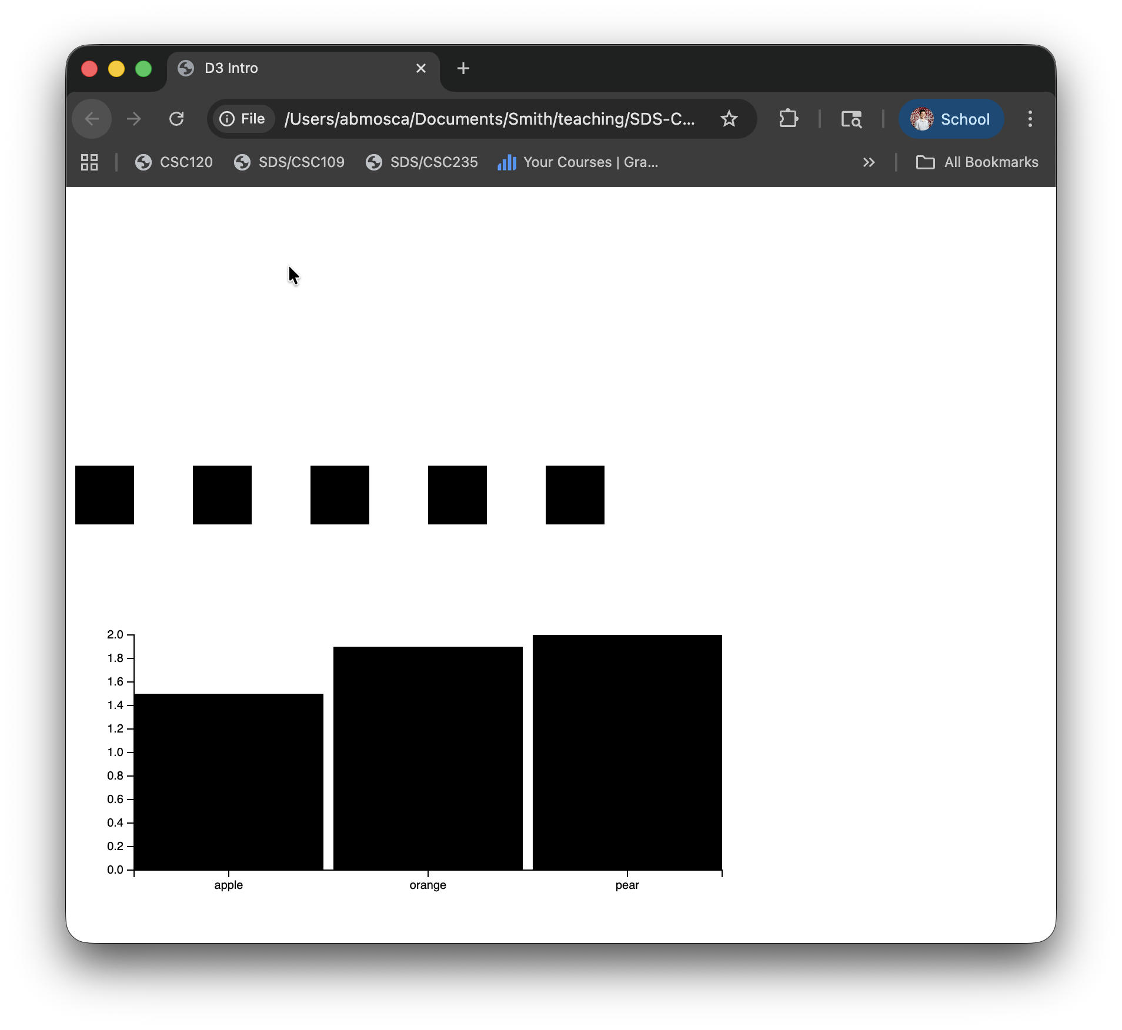
D3 Basics: Axes
Your turn:
Add a horizontal axis to the fruit bars to identify which bar is which fruit
https://www.d3indepth.com/introduction/

