Slide 1
Visual Analytics: uncertainty and bias lab
Ab Mosca (they/them)

Slide 2
Today’s plan
Refresh: HOPS
HOPS Algorithm
Refresh: Bias in visual analyses
Visualizing bias in dataset exploration

Slide 3
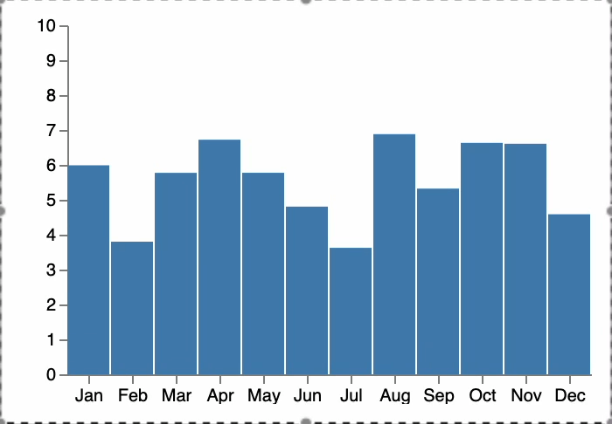
Hypothetical outcome plots
https://medium.com/hci-design-at-uw/hypothetical-outcomes-plots-experiencing-the-uncertain-b9ea60d7c740
https://vega.github.io/vega/examples/hypothetical-outcome-plots/

Slide 4
Hypothetical outcome plots
HOP Algorithm
Draw a sample of hypothetical outcomes (draws) from a distribution
Bootstrapping (resample original data with replacement)
Infer a distribution model
For each, make a plot that becomes one frame in an animation
Function to plot data with consistent axes, encoding, etc.
Function to update (animate) between hypothetical outcomes

Slide 5
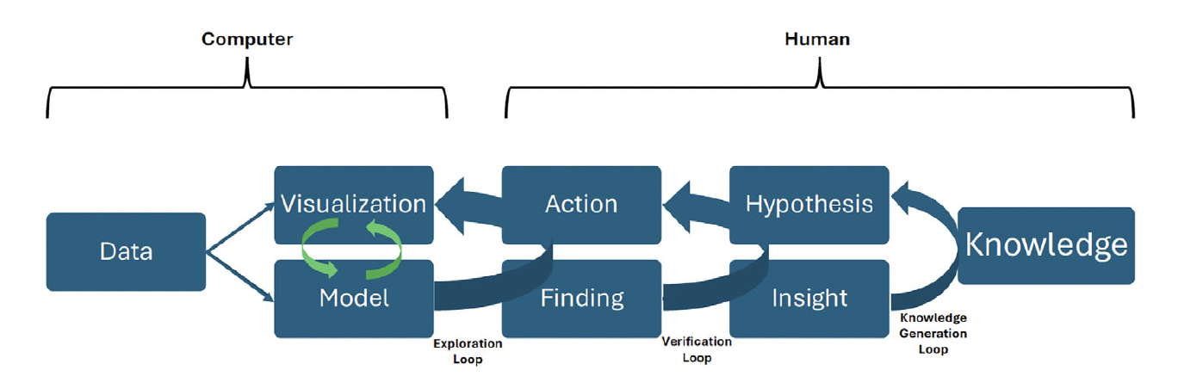
bias in visual analytics
What do you remember? Write down 3 specific things.
Wall, Emily. (2026). Human Bias in Visual Data Analysis: A Synthesis of Research to Empower Decision Makers. 10.1007/978-3-032-09307-3.

Slide 6
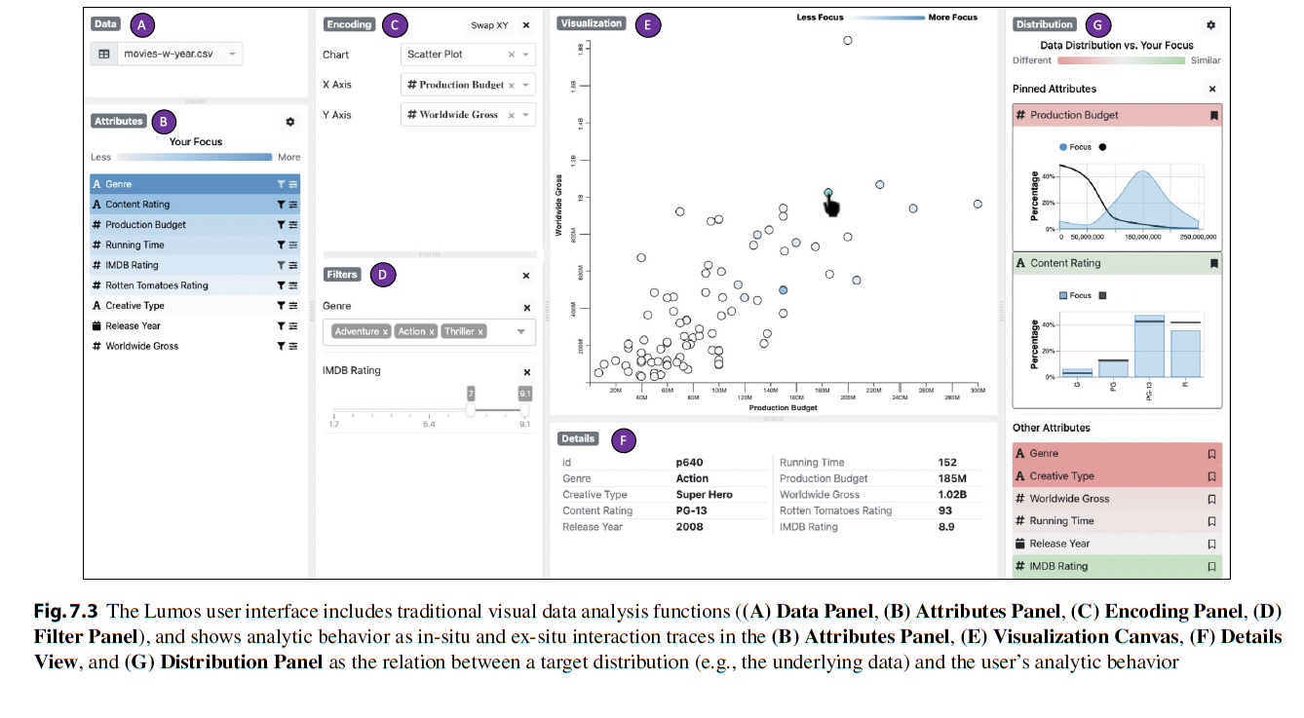
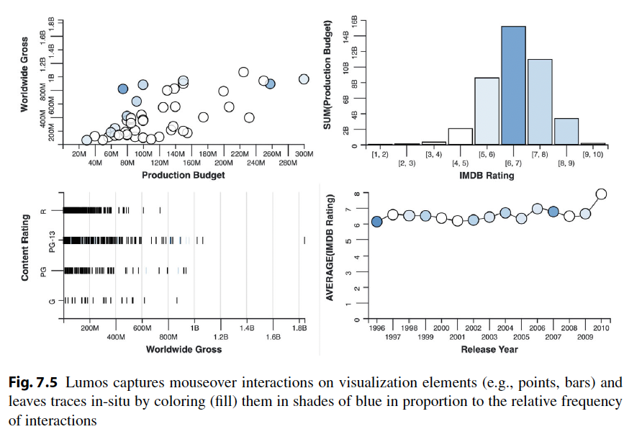
Bias in visual analytics
Real-Time interventions
Wall, Emily. (2026). Human Bias in Visual Data Analysis: A Synthesis of Research to Empower Decision Makers. 10.1007/978-3-032-09307-3.

Slide 7
Visualizing dataset exploration
In the starter code for today’s lab, you will find a coordinated multiple view (CMV) visualization of the palmer’s penguins dataset
On the left scatterplot, there is a brush that allows the user to select a subset of points
Selected points are highlighted in red on both plots
Modify the starter code such that:
Interaction traces are shown. In other words, how can you keep track of and visualize which points have been selected previously?
Add a bar plot that shows number of each penguin species in a selection

