Slide 1
Visual Analytics– Welcome!
Dr. Ab Mosca (they/them)
Slides based off slides courtesy of Jordan Crouser (https://jcrouser.github.io/)

Slide 2
Plan for Today
Intros
Big problem
Quick history lesson
Visual analytics: definition
Discussion: how does it help?
Structure of this course

Slide 3



Who Am I?

Slide 4


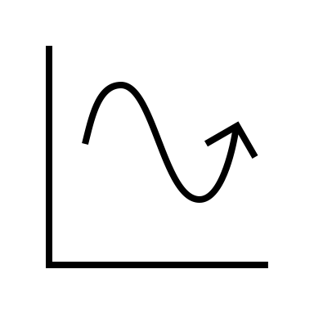
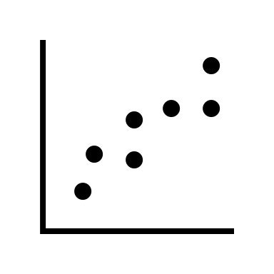

Who Am I?
Dr.

Slide 5



Who Am I?
Dr.

Slide 6
Who Are You?
Form groups of 3
Introduce yourselves (name, pronouns)
Share:
A highlight of your summer break
Find 1 thing that your entire group has in common (favorite color? hometown? left-handed? Be creative!)
After about 5 minutes we will go around, introduce ourselves, and share what each group has in common

Slide 7
Who Are You?
Form new groups of 3 (move around!)
Introduce yourselves (name, pronouns)
Share:
Would you rather live with Cheeto dust on your fingers forever no matter what OR live with slightly damp clothes?
After about 5 minutes we will go around, introduce ourselves, and share our would you rather answers

Slide 8
Who Are You?
Form new new groups of 3 (move around!)
Introduce yourselves (name, pronouns)
Share:
Would you rather be able to touch a book and instantly read it but have your current retention OR read at your current speed but remember everything?
After about 5 minutes we will go around, introduce ourselves, and share our would you rather answers

Slide 9
Name tags!

Slide 10
About this course
What are some non-traditional forms of data?

Slide 11



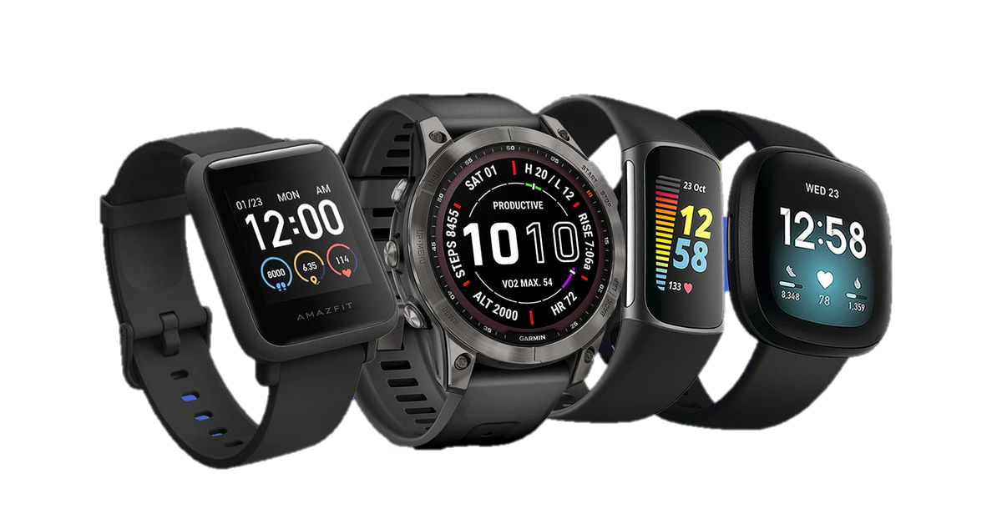
About this course
What are some non-traditional forms of data?

Slide 12
About this course
The problem:
We’re collecting and generating data faster than traditional methods can keep up– our data is unmanageably big

Slide 13
Example
Zork (make map, compare to actual map)
Then say, what if we don’t have the actual map?

Slide 14
About this course
The problem:
We’re collecting and generating data faster than traditional methods can keep up
Not only is the data unmanageably big, it’s usually noisy and ambiguous too

Slide 15


About this course
What are the strengths of each wrt data?

Slide 16
EXAMPLES OF VA SHOW VIDEOS?

Slide 17

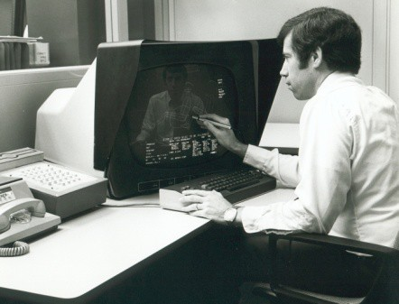
(Incomplete) History of Visual Analytics: 1970s
CAD/CAM, building cars, planes, chips
Starting to think about: 3D, animation, edu, medicine

Slide 18
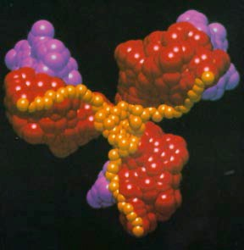
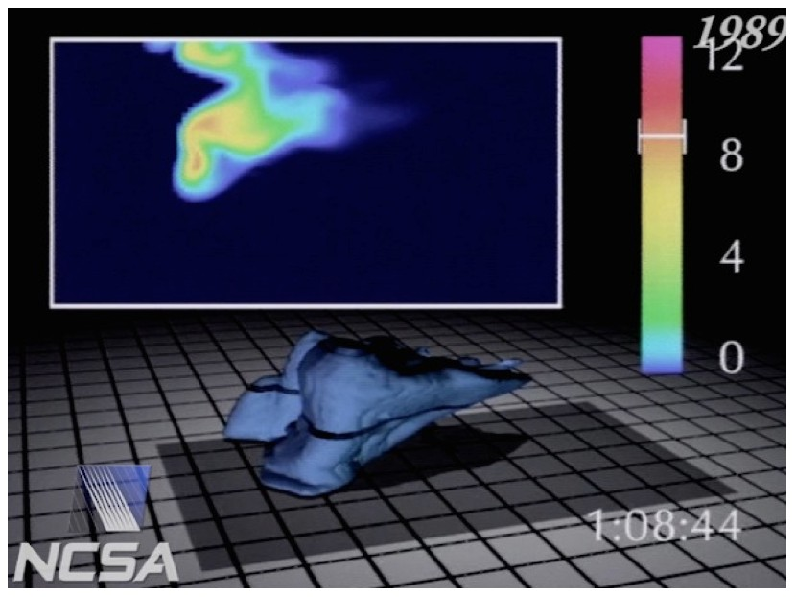
(Incomplete) History of Visual Analytics: 1980s
Scientific visualization, physical phenomena
Starting to think about: photorealism, entertainment

Slide 19
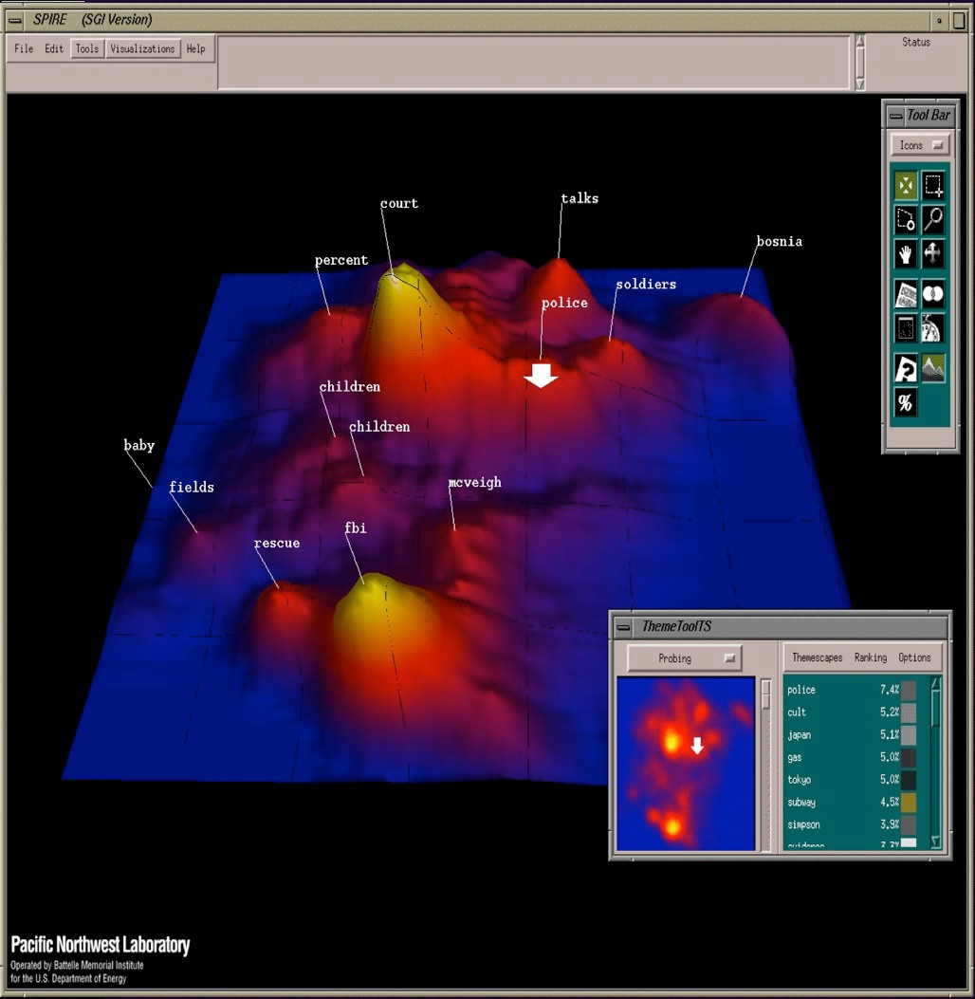
(Incomplete) History of Visual Analytics: 1990s
Information visualization, storytelling
Starting to think about: online spaces, interaction

Slide 20
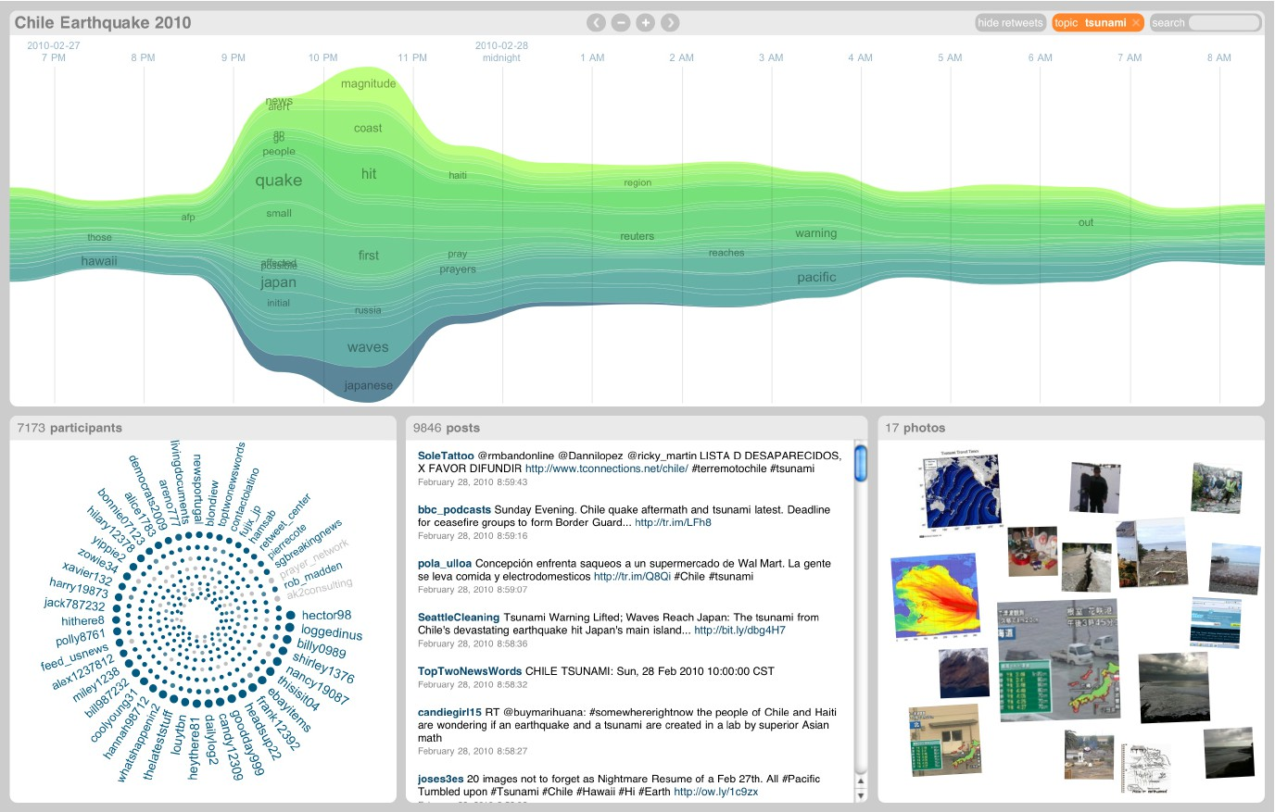
(Incomplete) History of Visual Analytics: 2000s
Coordination across multiple views, interaction
Starting to think about: sensemaking, provenance

Slide 21
(Incomplete) History of Visual Analytics
Early 2000s: US is reacting to 9/11
2003: Dept. of Homeland Security (DHS) est.
DHS objectives:
Prevent terrorist attacks within the US
Reduce US vulnerability to terrorism
Minimize damage / aid recovery from attacks that do occur
2005: DHS charters the National Visualization and Analytics Center (NVAC) at PNNL

Slide 22
(Incomplete) History of Visual Analytics
NVAC mission:
Develop advanced information technologies to support the Homeland Security mission with data that is massive, complex, incomplete, and uncertain in scenarios requiring human judgment.
Challenges:
How do we support analytical reasoning under complex, changing circumstances?
How do we make use of domain expertise, when domain experts are not computer scientists?
New idea: (visualization) ∩ (analytics)

Slide 23
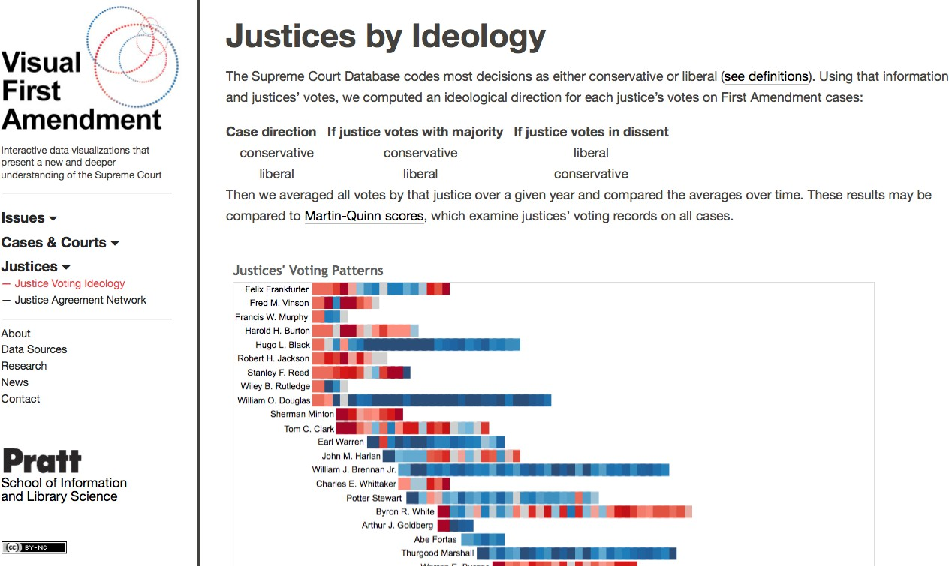
(Incomplete) History of Visual Analytics: 2010s
Human-machine collaboration, machine learning
Starting to think about: evaluation, new media, DH

Slide 24
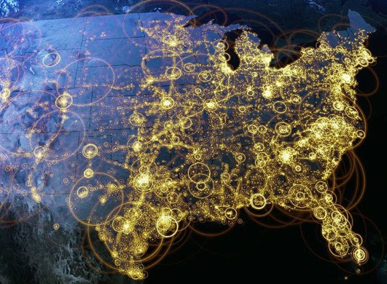
Visualization (def.)
Creating visual representations of data to reinforce human cognition

Slide 25

Analytics (def.)
Discovery and communication of meaningful patterns in data

Slide 26
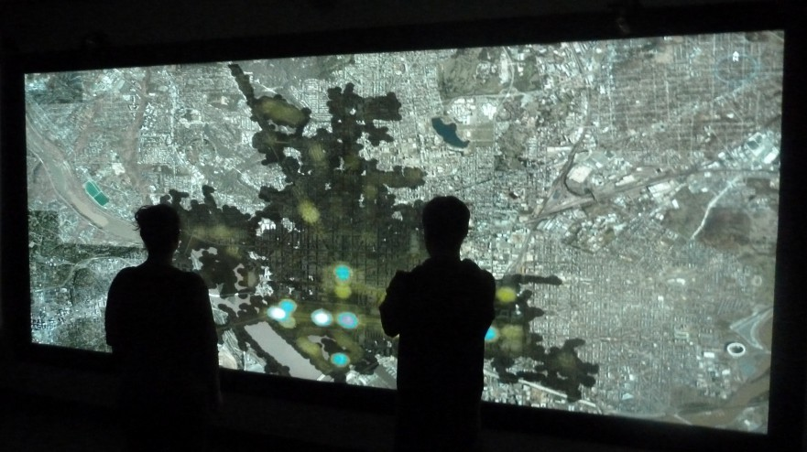
Visual Analytics (def.)
“The science of analytical reasoning
facilitated by interactive visual interfaces”¹
¹Thomas, James J., and Kristin A. Cook, eds. Illuminating the path: The research and development agenda for visual analytics. IEEE Computer Society Press, 2005.

Slide 27


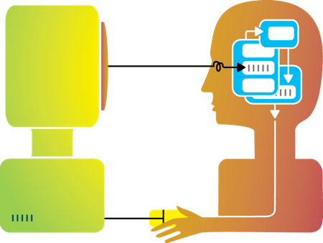
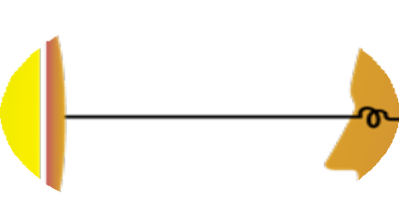
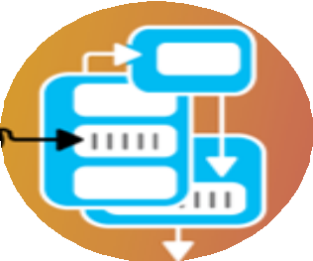




Big idea
Humans and machines have complimentary strengths
Visualization
Perception
and context
Interaction
Computational power
Image credit: Ali Ansari

Slide 28
VA: Human + Machine Collaboration
Make use of what both humans and machine strengths using interactive visual interfaces to facilitate the “conversation”
Key considerations:
Traditional analytics (stats, machine learning) can help make massive data tractable
Use what we know about cognition and perception
to help humans put data in context

Slide 29
How does this help?
Idea 1:
do things more efficiently

Slide 30



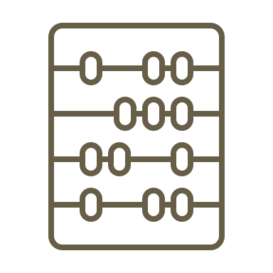


















How does this help?
Subject Matter Experts
Advanced Analytics
Defining and Analysis: A Study of Client-Facing Data Scientists. Mosca, Robinson, Clarke, Redelmeier, Coates, Cashman, Chang.

Slide 31

How does this help?
Subject Matter Experts
Data Scientist
Advanced Analytics
Defining and Analysis: A Study of Client-Facing Data Scientists. Mosca, Robinson, Clarke, Redelmeier, Coates, Cashman, Chang.

Slide 32


How does this help?
Q1
Prove millennials have more apps than other age groups
Q2
Q3
Should I target millennials with mobile banking app ads?
Tell me about millennials
Defining and Analysis: A Study of Client-Facing Data Scientists. Mosca, Robinson, Clarke, Redelmeier, Coates, Cashman, Chang.

Slide 33
How does this help?
Working backwards
NLP
XAI
Probing
AutoML
Recommending
Defining and Analysis: A Study of Client-Facing Data Scientists. Mosca, Robinson, Clarke, Redelmeier, Coates, Cashman, Chang.

Slide 34
How does this help?
Idea 2:
See the bigger picture

Slide 35
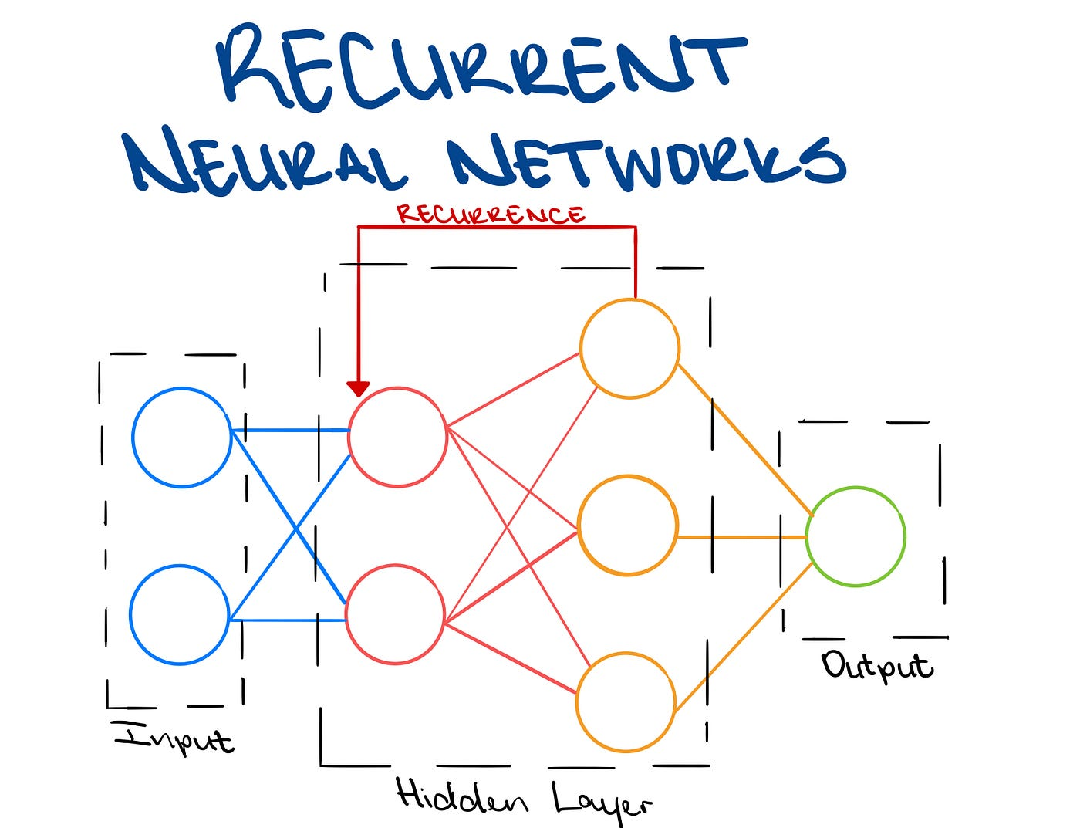
How does this help?
https://towardsdatascience.com/introducing-recurrent-neural-networks-f359653d7020

Slide 36

How does this help?
https://towardsdatascience.com/introducing-recurrent-neural-networks-f359653d7020
Notes:
Input shakespear
Output model that predicts next word in a sentence

Slide 37

How does this help?
https://towardsdatascience.com/introducing-recurrent-neural-networks-f359653d7020
Notes:
Input linux kernel
Output model that predicts next character in a sequence of code

Slide 38
How does this help?
https://towardsdatascience.com/introducing-recurrent-neural-networks-f359653d7020
Notes:
Learning in ANNs is typically accomplished via gradient descent, a method which minimizes loss over a training set by iteratively updating parameters in the direction dictated by the gradient of that loss. Thus, to analyze how the network is learning (or if it is learning at all), we must inspect the gradients.

Slide 39
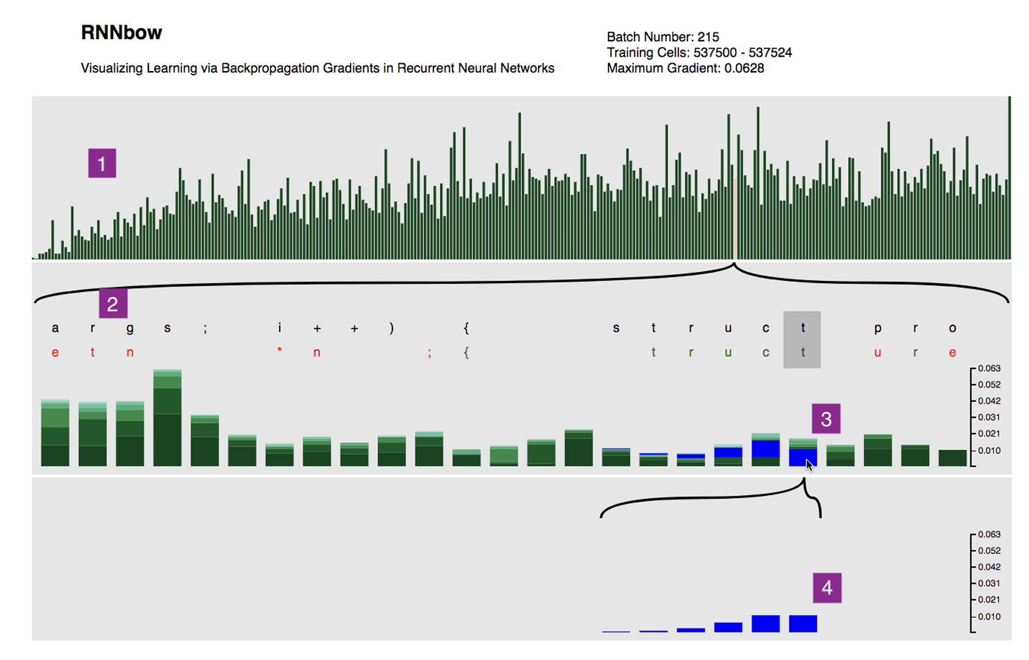
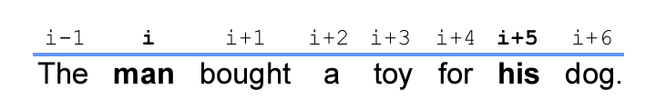
How does this help?
RNNbow: Visualizing Learning via Backpropagation Gradients in Recurrent Neural Networks. Cashman, Patterson, Mosca, Watts, Robinson, Chang.
Notes:
Learning in ANNs is typically accomplished via gradient descent, a method which minimizes loss over a training set by iteratively updating parameters in the direction dictated by the gradient of that loss. Thus, to analyze how the network is learning (or if it is learning at all), we must inspect the gradients.
Want the gradient to be big enough to remember back

Slide 40
How does this help?
Idea 3:
Avoid getting stuck

Slide 41
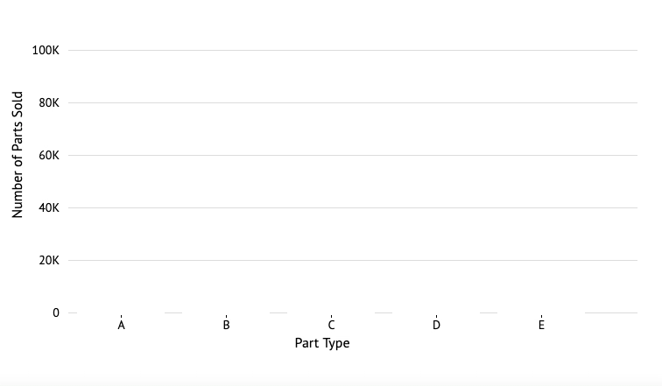



How does this help?
Impact Of Cognitive Biases On Progressive Visualization. Procopio, Mosca, Scheidegger, Wu, Chang.

Slide 42




How does this help?
Fisher et al. 2012, Zgraggen et al. 2017
Angelini et al. 2018, Schulz et al. 2016
Ex. Turkay et al. 2017, Moritz et al. 2017
Badam 2017
Impact Of Cognitive Biases On Progressive Visualization. Procopio, Mosca, Scheidegger, Wu, Chang.
Notes:
Time savings
Gain understanding of the computation process
Perform real time steering of computation or query processing
Gain trust in analysis results

Slide 43



How does this help?
Moritz et al. 2017,
Turkay et al. 2017
Impact Of Cognitive Biases On Progressive Visualization. Procopio, Mosca, Scheidegger, Wu, Chang.

Slide 44








How does this help?
Micallef et al. 2019
Pitfalls
Cognitive Biases
Uncertainty
Illusion
Control
Anchoring
Impact Of Cognitive Biases On Progressive Visualization. Procopio, Mosca, Scheidegger, Wu, Chang.

Slide 45
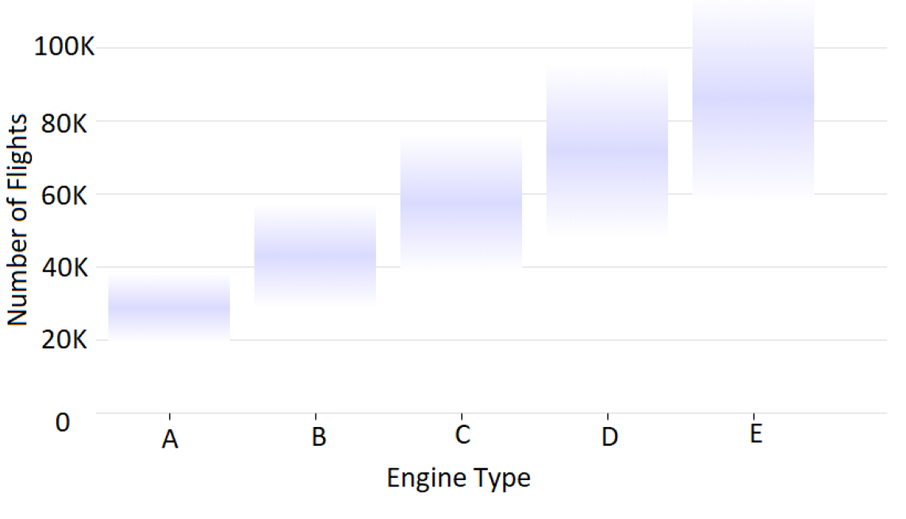
How does this help?
Reading something in incomplete results that is not there
Impact Of Cognitive Biases On Progressive Visualization. Procopio, Mosca, Scheidegger, Wu, Chang.

Slide 46

How does this help?
Reading something in incomplete results that is not there
Impact Of Cognitive Biases On Progressive Visualization. Procopio, Mosca, Scheidegger, Wu, Chang.

Slide 47



Structure of this course
Disclaimer:
this class is an experiment in constructionism
(the idea that people learn most effectively
when they’re building personally-meaningful things)
Our job as instructors:
Notes:
Expose you to some foundational principles and available tools
Ask questions that build your intuitions about identifying problems where visualization techniques can help
Most important: help you find opportunities to solve real problems in areas YOU care about (and hopefully learn some cool stuff about visualization along the way…)

Slide 48
What we’ll cover
Unit 1: Foundations
Next Class: Mental and Visualization Models
Data Wrangling and Modeling 101
Data Visualization 101
Interaction
Coordinating Multiple Views
Unit 2: The Real Fun Starts
Quirky data (time-varying data, geospatial data, networks)
Scalability
Color and Visual Channels
High-dimensional data
Unit 3: Ongoing Research
Provenance
Uncertainty
Prediction and Recommendation

Slide 49
What we WON’T cover
CSC foundations:
Editors (vim, emacs, etc.)
Version control (git)
Debugging and profiling
Python basics
SDS foundations:
Data collection
Databases and storage
Regression, etc.
R basics
Important note: VA systems are rarely built by a single person! You don’t need to have mastered all these skill, just try to make some friends who have complementary experience !

Slide 50
General information
Course website:
https://amosca01.github.io/SDS-CS235/

Slide 51
What you’ll get
By the end of this course, you will:
Understand what Visual Analytics is
Know the foundational methods and tools available
Be familiar with some ongoing research in VA
Be able to perform analyses and report your findings
Have (marketable!) experience developing useful visual analytics applications for real data

Slide 52
What I expect from you
You enjoy grappling with difficult problems, and you’re excited about “figuring stuff out”
You are (or are willing to work to become) proficient in programming and debugging
We’ll do crash courses in a few key topics, but this is NOT a course intended to teach you general programming techniques
You’re welcome to work in whatever language(s) you prefer, but I’m more helpful in the ones I know
You’re comfortable asking questions

Slide 53
What you can expect from me
I’m flexible w.r.t. the topics we cover:
This course is a collaboration
If there’s something you want to learn that’s not on the agenda, speak up!
If I’m doing something that doesn’t work for you (Font too small on presentations? Speaking too quickly? Using a marker or color you can’t see?), please let me know!
I’m here to help you succeed, and I believe you all have the ability to succeed

Slide 54
Course project
Goals:
Learn how to break big, unwieldy questions down into clear, manageable problems
Figure out if/how the techniques we cover in class apply to
your specific problems
Build VA systems to address them
Several (graded) milestones along the way
Demos and discussion on the final day of class
gain real experience | solve real problems
build real relationships

Slide 55
Questions?

