Slide 1
Visual Analytics– Role of Interaction
Dr. Ab Mosca (they/them)
Slides based off slides courtesy of Jordan Crouser (https://jcrouser.github.io/)

Slide 2
HW01
Checking in:
How is it going?
Any big hurdles?

Slide 3
Plan for Today
Interaction and Analysis
Definition
Interaction with data and problem space
Interaction with visual interfaces
Practice: plotly

Slide 4


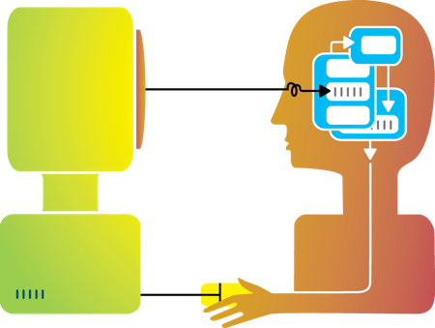
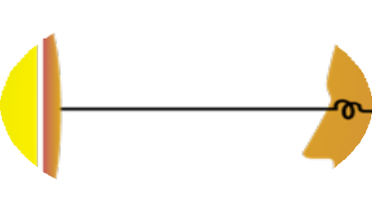
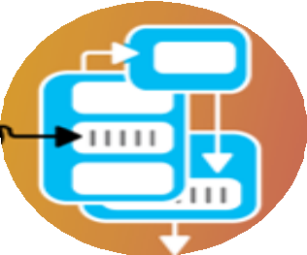




Rewind
Humans and machines have complimentary strengths
Visualization
Perception
and context
Interaction
Computational power
Image credit: Ali Ansari

Slide 5
Interaction
Visualization
Conceptualized as a dialogue between a human user and the visualization system over a central object of interest: the data
HCI
Characterize via seven concepts
Dialogue
Transmission
Control
Tool Use
Optimal Behavior
Embodiment
Experience
What is Interaction for Data Visualization? Evanthia Dimara, Charles Perin. 2020
Notes:
Dialogue
Cycle of communication acts
Input and output from a computer, and user perception
Transmission
Transmission of information between human and computer
Good interaction minimizes transmission error
Control
Minimizes distance user needs to travel for their goal and errors along the way
Tool Use
Set of tools that allow the user to interact with the computer
Optimal Behavior
Sees interaction as an adaptive behavior under user capabilities, task, interface, and environment constraints
Based on rationality paradigm and adaptation theories, like information foraging
Embodiment
User sees interaction as an extension of self
Experience
Phenomenon shaped by user expectations, momentary reactions and recall
Non-utilitarian focus

Slide 6
Interaction (def.)
“Interaction for visualization is the interplay between a person and a data interface involving a data-related intent, at least one action from the person and an interface reaction that is perceived as such.”
Mandatory Components
Interplay
Person
Data Interface
Action
Action-Reaction
Reaction Perceived as Such
Data-Related Intent
What is Interaction for Data Visualization? Evanthia Dimara, Charles Perin. 2020
Notes:
Interplay – “dialogue”
Person -
Data Interface– the vis
Action – Any action, physical or mental, regardless of modality that causes the reaction of the data interface
Action-Reaction– cause effect between entities
Reaction Perceived as Such – person must perceive the reaction in the data interface
Data-Related Intent – intent is tied to a data source and is formed iteratively throughout the interaction cycle

Slide 7
Methods by which humans create knowledge through the manipulation of an interface
Low level: between human and interface
the set of operations available
the relationship between the human and the visualization
High level: between human and problem space
a cognitive act enabled by the tool
does not need to take place exclusively within them
might be distributed across multiple tools
Interaction

Slide 8
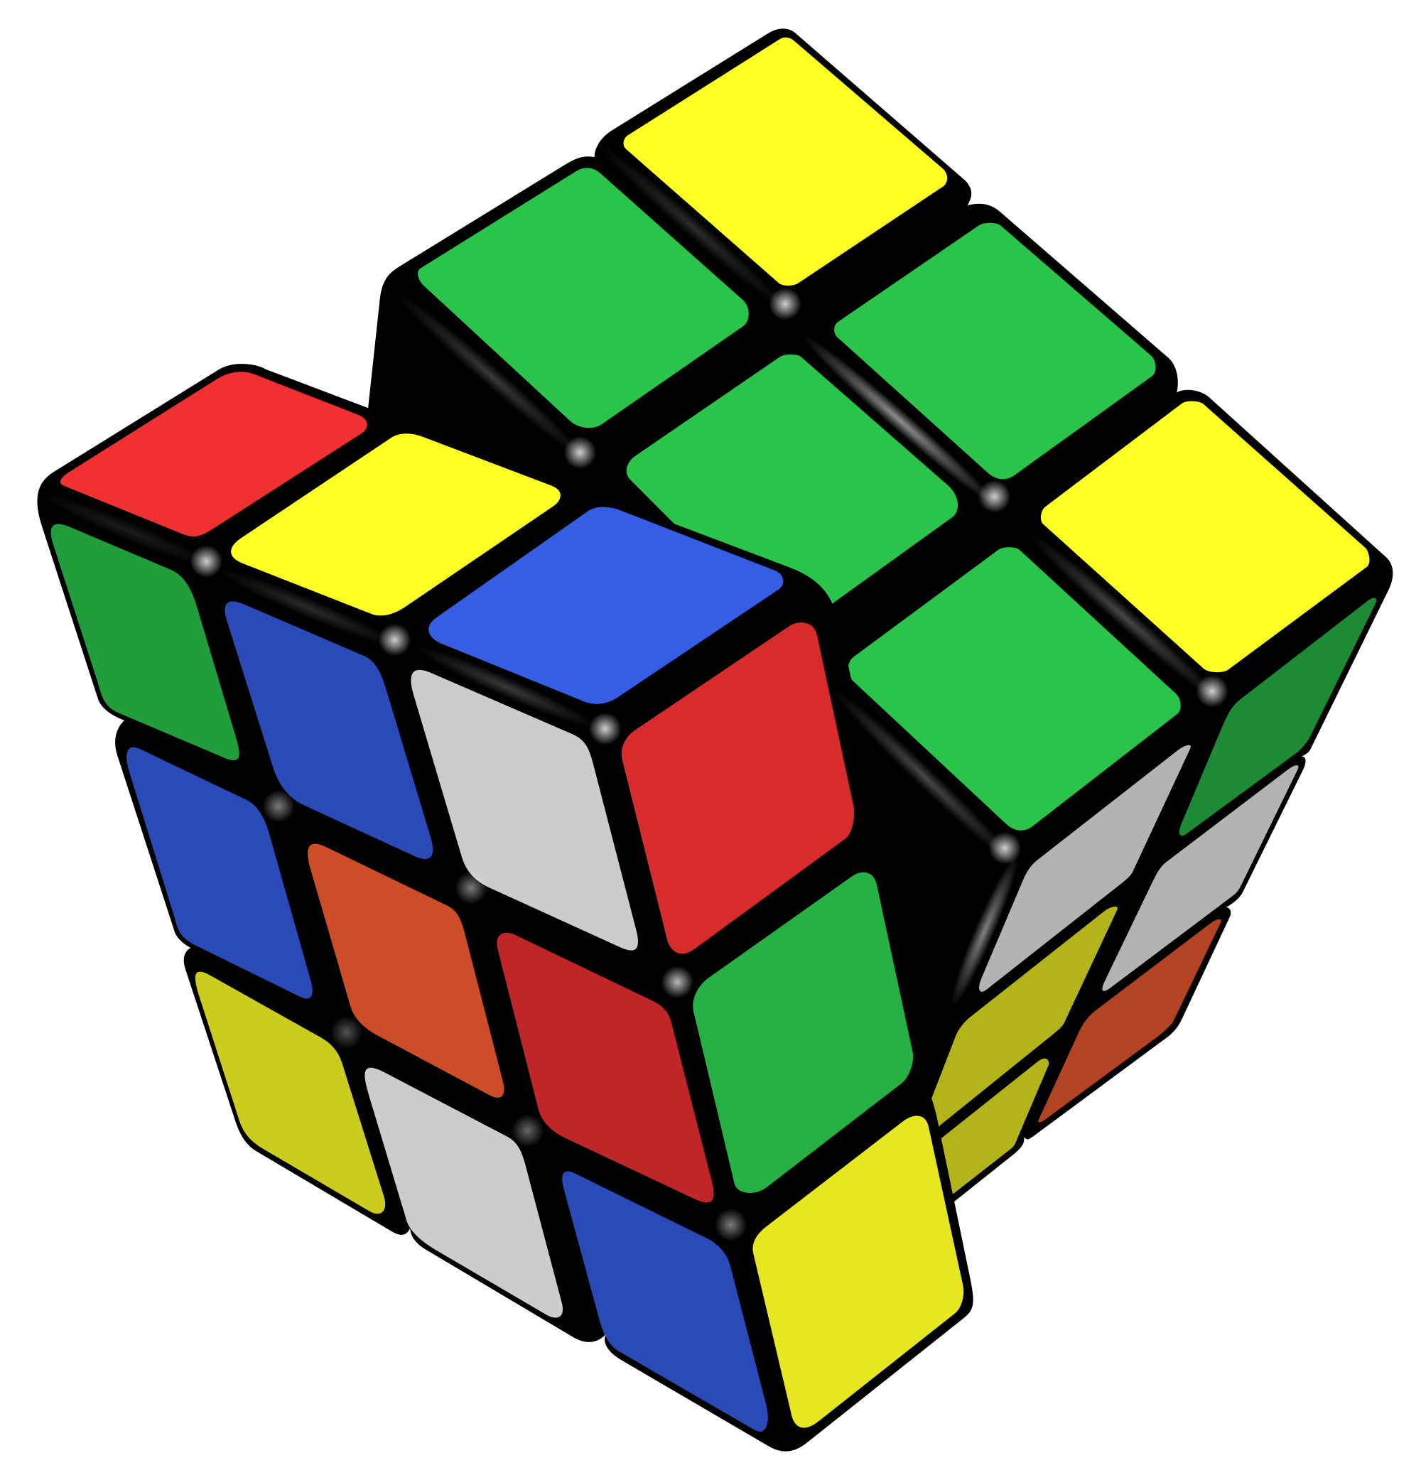
Example: Rubik’s Cube
What low-level interactions can you have?
What high-level interactions can you have?

Slide 9
Part I: High Level
Interaction with
Data / Problem Space

Slide 10
Interaction and analysis
Interaction is the observable result of a cognitive process: “an externalization of thought”
In visualization, there is a growing belief that interaction and analysis are actually the same thing!
Analytic discourse: the idea that knowledge is constructed, tested, refined, and shared through the interactive manipulation of an interface¹
¹Pike, W. A., Stasko, J., Chang, R., & O'Connell, T. A. (2009).
The science of interaction. Information Visualization, 8(4), 263-274.

Slide 11
Interaction happens in the context of a problem or goal-directed activity
This context helps the human identify relevant concepts and link them into appropriate structures
Interaction brings together background contexts and current observations
This is known as “situated cognition”
Interaction as a reasoning aid
Notes:
Situated cognition is a theory that posits that knowing is inseparable from doing^{[1]} by arguing that all knowledge is situated in activity bound to social, cultural and physical contexts.^{[2]}

Slide 12
Hypothesis: the more ways a user can ‘touch’ their data (by changing their form or exploring them from different perspectives), the more insight will accumulate.
True or False?
Discussion

Slide 13

Requires human time and attention
Increases perceptual and exploration costs
Implementation costs
Multiple user studies find no increase in performance
Reality Check
Benefits
Costs

Slide 14

Interaction as Distributed Cognition
Visualization is often used as a tool to “offload” storage or computation from the human’s brain
In order for this to be useful, we have to be able to “reload” parts of the data and operate on it
Internal (in your head) vs.
external (on the screen) representations
Consider the impact of the affordances
of the interface
Distributed Cognition as a Theoretical Framework for Information Visualization Zhicheng Liu, Nancy J. Nersessian, and John T. Stasko
Notes:
From this traditional perspective, artifacts are scaffolds for cognition, i.e. they make cognitive tasks easier or more efficient, and in some instances they provide a means of accomplishing cognitive tasks that could not be performed without the tools. However, cognition involves only the manipulation of information abstracted and represented “in the head”, and artifacts serve to assist these processes.
When we remember something by writing it on a piece of paper and reading it later, our memory is not amplified. Instead we are using a different set of cognitive skills including writing, reading and interpreting. If we look only the product of the cognitive work, it seems that cognition is amplified since we can do things that we could not do without them. However, if we look at the process of accomplishing the task, none of our cognitive abilities has been amplified. Hutchins puts it this way: “tools permit us to transform difficult tasks into ones that can be done by pattern matching, by the manipulation of simple physical systems, or by mental simulations of manipulations of simple physical systems. Tools are useful precisely because the cognitive processes required to manipulate them are not the computational processes accomplished by their manipulation
Thus, DCog proposes that ascribing “cognition” to mental activities alone is misplaced. The environment provides affordances as well as constraints that essentially shape human cognition and behavior: “[culture, context and history] are fundamental aspects of human cognition and cannot be comfortably integrated into a perspective that privileges abstract properties of isolated individual minds” ([18], p.354). From this environmental perspective, cognition is more an emergent property of interactions between an individual and the environment through perception and action rather than a property bounded inside an individual. In the rest of this paper, the term “cognition” will be used with this connotation

Slide 15
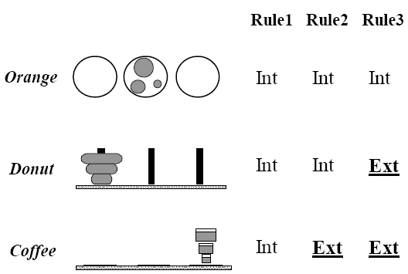
Example: Tower of Hanoi
Only one disk can be transferred at a time.
A disk can only be transferred to a pole on which it will be the largest.
Only the largest disk on a pole can be transferred to another pole.
Notes:
In the donut version, rule 3 is external in the sense that the physical constraints in the representation guarantee that the rule is followed: a smaller donut cannot be moved without moving a larger one on top of it first.
In the coffee version, cups filled with coffee replace the donuts. In addition to rule 3, rule 2 also becomes external as a smaller cup cannot be placed on top of a larger cup without the coffee spilling out of the cup.
In the orange version, no rules are incorporated into the physical constraints since one can freely move any oranges from one plate to another, and so all the rules have to be represented in human memory.

Slide 16
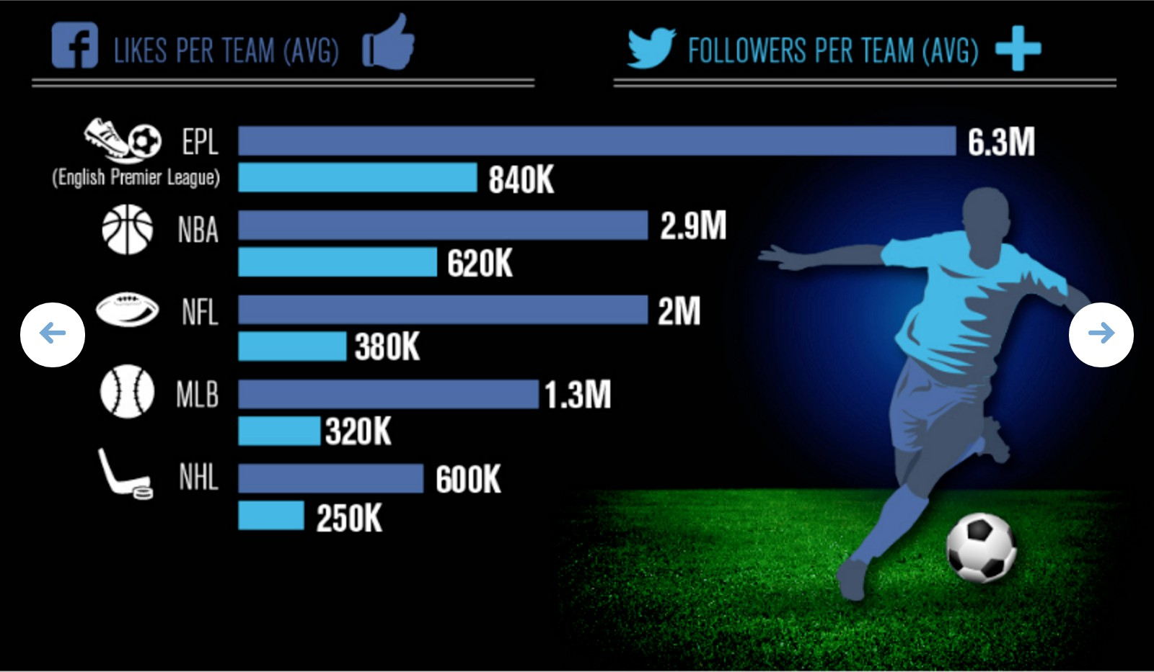
Example
Is changing the page internal or external?

Slide 17
Pragmatic actions move a person and their analysis closer to the desired destination
Epistemic actions enable humans to leverage environmental structures to link internal structures
The purpose of some actions is not for the effect they have on the environment but for the effect they have on the humans
Pragmatic vs. Epistemic Action
Notes:
In their study of how people play the Tetris game, however, they discovered that players performed a variety of actions that were not of immediate pragmatic value. Players often have little time to determine where to place a Tetrazoid, yet they rotate it multiple times more than necessary. The extra rotation appears to play a functional role in the player’s computation of the goal placement, and it is distinct from pragmatic actions that advance them toward a goal state. Kirsh and Maglio call this kind of action an “epistemic action” [20] (Figure 3). Epistemic actions enable humans to make use of environmental structures or to create structures in the environment that link with internal structures so that a coordinated interplay between internal and external representations is achieved. Hence the purpose of taking some actions is not for the effect they have on the environment but for the effect they have on the humans. Coordination, as a result, is not the discovery of an external a priori rule or schema but an emergent property, achieved by moment-by-moment pragmatic actions and epistemic actions.

Slide 18
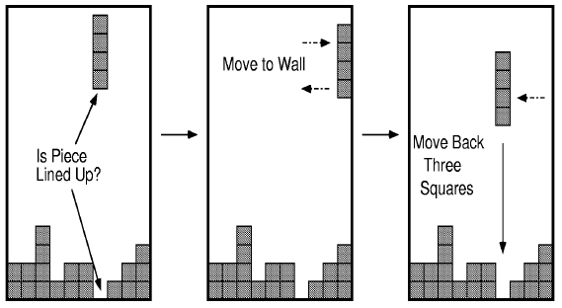
Example: Tetris Behavior

Slide 19
Part II
Interaction with
a Visual Interface

Slide 20
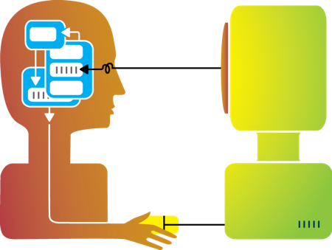
So far…
Visualization

Slide 21
Flashback: interaction as a reasoning aid
Interaction is situated in the context of a problem or goal-directed activity
Question: what kinds of things might someone want to do using a visualization?

Slide 22
Yi, Kang, Stasko and Jacko (2007)
Select: mark something as interesting
Explore: show me something else
Reconfigure: show me a different arrangement
Encode: show me a different representation
Abstract/Elaborate: show me more or less detail
Filter: show me something conditionally
Connect: show me related items
Yi, J. S., ah Kang, Y., Stasko, J. T., & Jacko, J. A. (2007). Toward a deeper understanding of the role of interaction in information visualization. Visualization and Computer Graphics, IEEE Transactions on, 13(6), 1224-1231.

Slide 23
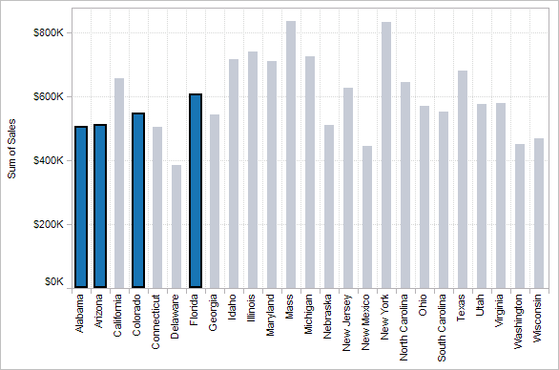
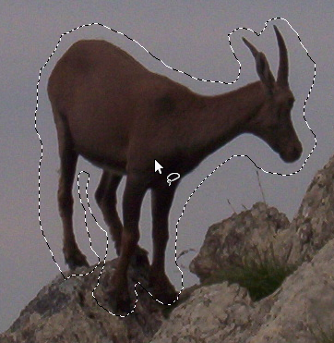

1. Select
Mark something as interesting: direct

Slide 24
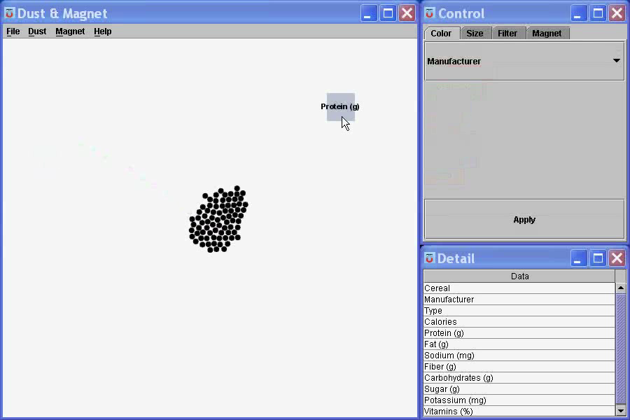
Mark something as interesting: indirect
1. Select
Notes:
What are you selecting? One item at a time?
Selecting of a value?
Selecting of a range?
Selecting of a position on the screen?

Slide 25
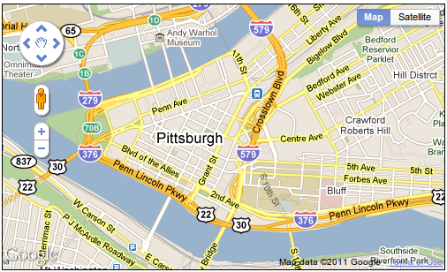
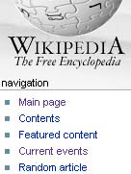
Show me something else
Scroll bars
Panning
Direct-Walk (e.g. hyperlink traversal)
2. Explore

Slide 26
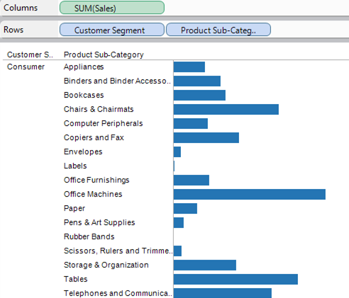
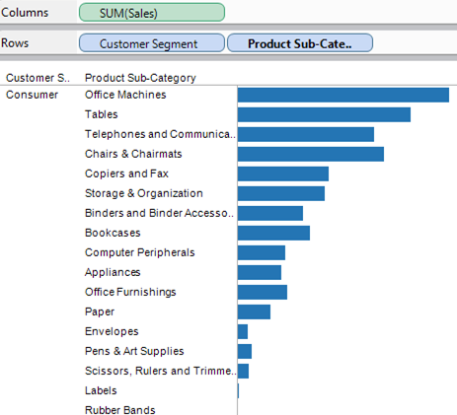
3. Reconfigure
Show me a different arrangement: sorting

Slide 27
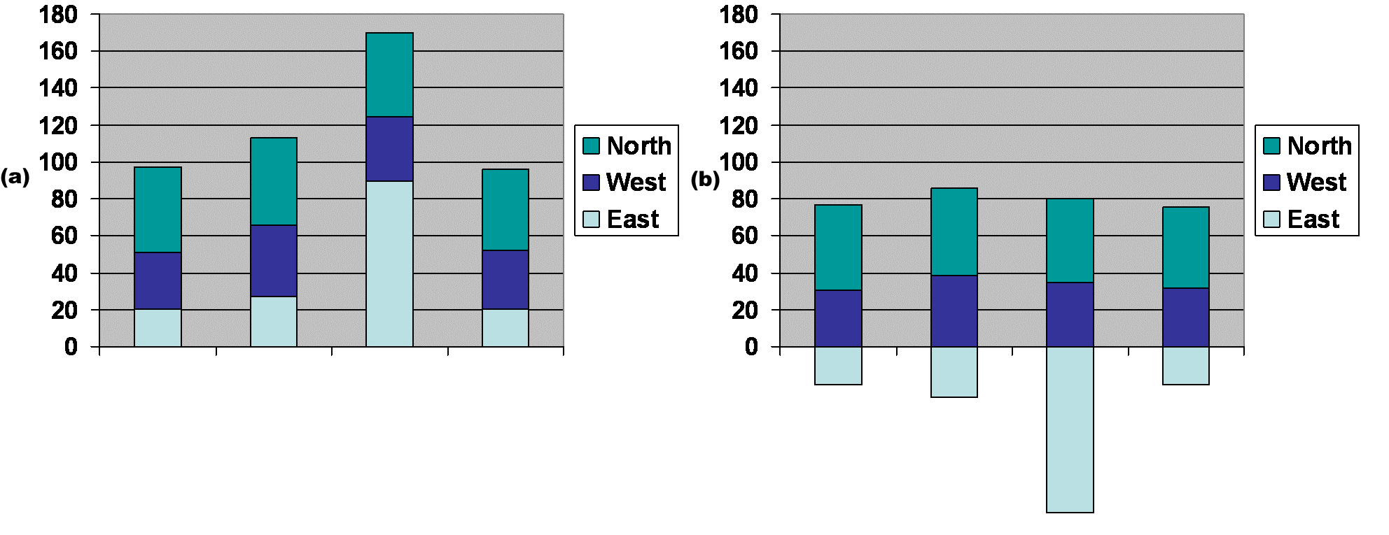
3. Reconfigure
Show me a different arrangement: baseline adjustment

Slide 28
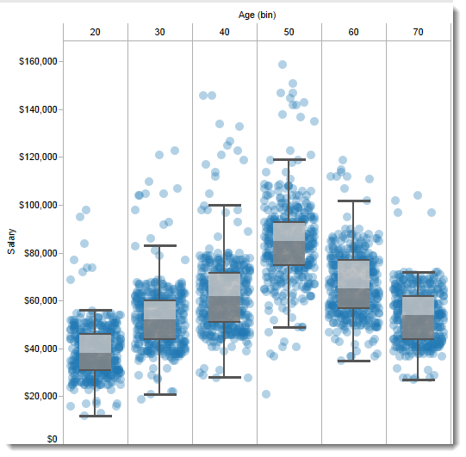
Show me a different arrangement: reduce occlusion (jitter)
3. Reconfigure

Slide 29
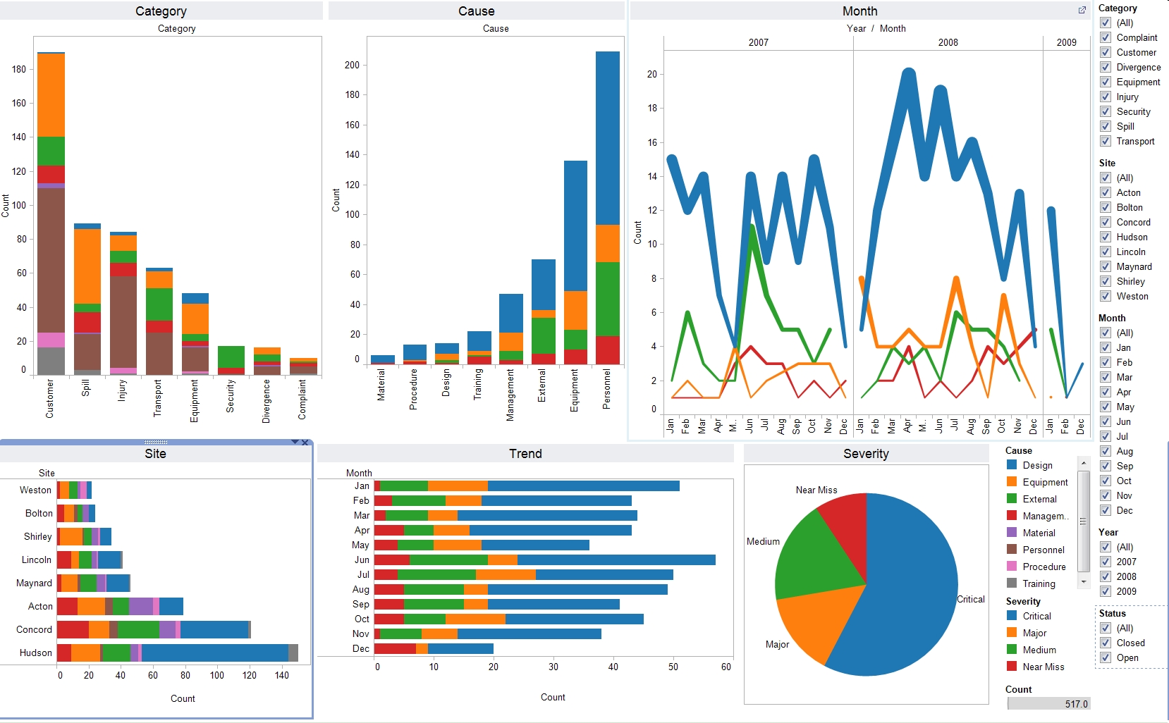
4. Encode
Show me a different representation: visualization type, color, size, orientation, etc.

Slide 30
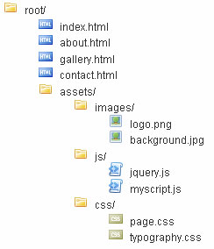
5. Abstract / Elaborate
Show me more or less detail: drill up/down

Slide 31
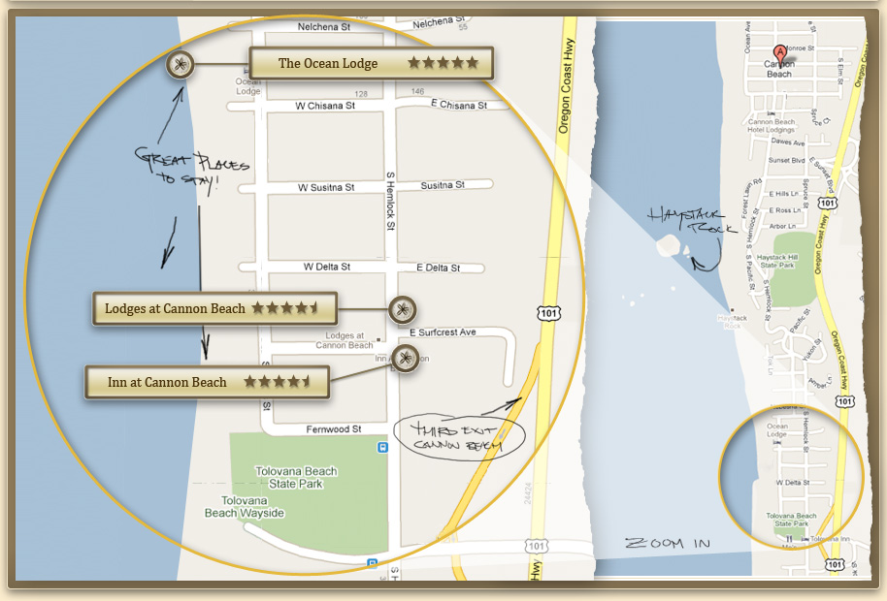
5. Abstract / Elaborate
Show me more or less detail: zooming

Slide 32
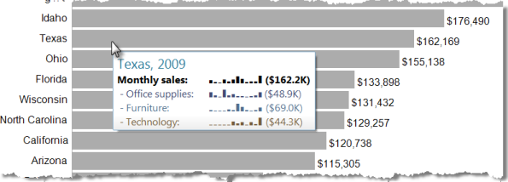
5. Abstract / Elaborate
Show me more or less detail: tooltips

Slide 33
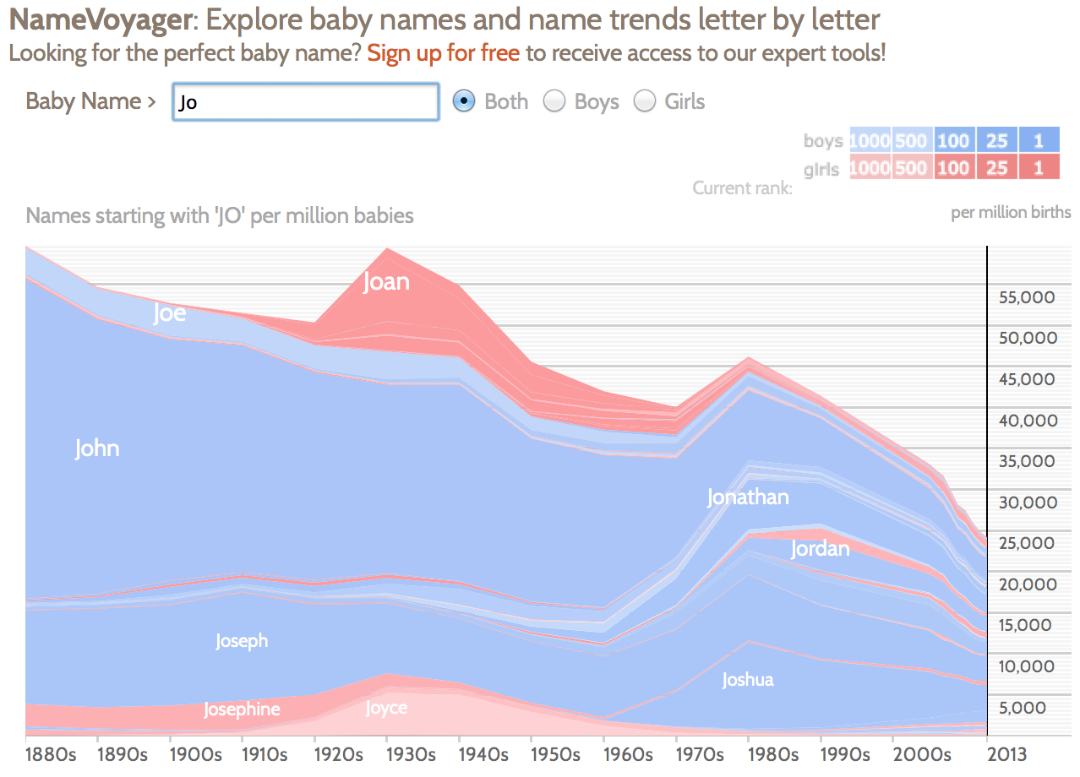
Show me something conditionally
6. Filter

Slide 34
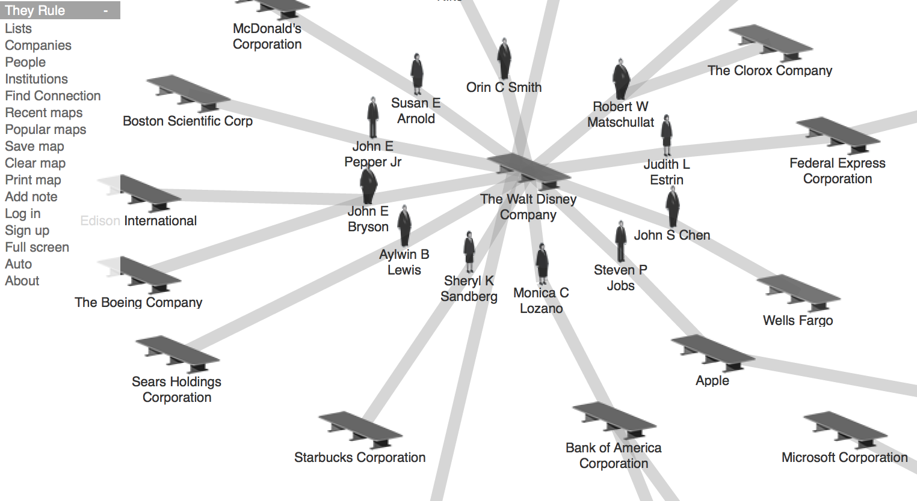
7. Connect
Show me related items: build-out

Slide 35
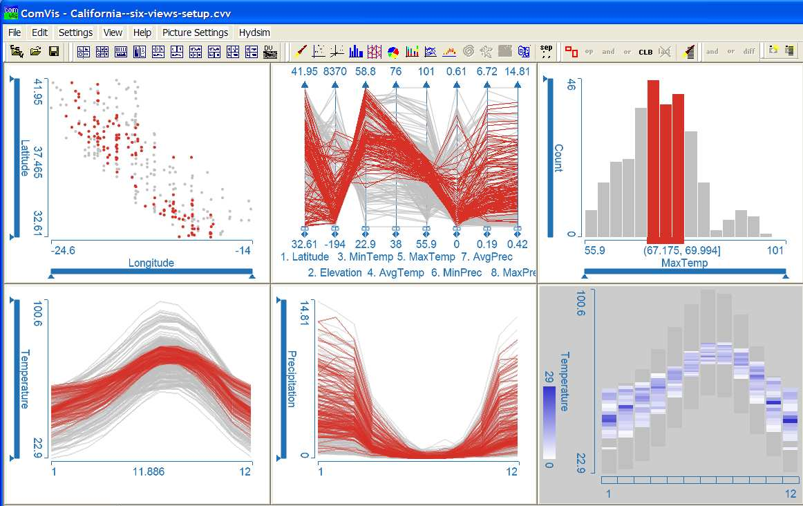
Show me related items: coordinated multiple views (CMV)
7. Connect

Slide 36
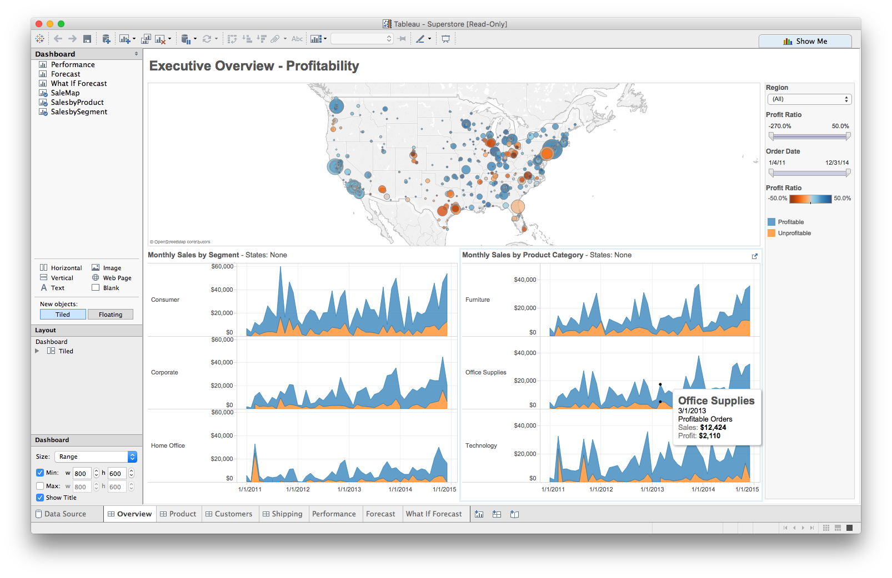
Foreshadowing: Multiple views
Different
representations
Different
data
Systems that use two or more distinct views
to support the exploration of a single concept or domain

Slide 37
Discussion
What would we need to make this work?

Slide 38
Suggested questions to ask when designing
What is the goal of the analysis?
Decision-making
Better understand a domain or a problem
Identify the trends of a phenomenon
Forecast the future
…etc.
What kinds of operations do we need to enable?
How can the visualization support those operations?

Slide 39
Plotly Practice
Work with a partner on the ploylt in-class activity (R or Python).

