Slide 1
Visual Analytics– Networks
Dr. Ab Mosca (they/them)
Slides based off slides courtesy of Ashley Suh

Slide 2
Notes
Hw04
Do we need to push the due date back?
Next week…
I will be here, but class will still be reserved for you to start working on midsemester projects

Slide 3
Plan for Today
What is graph data
Example visualizations
Common vis problems & solutions

Slide 4
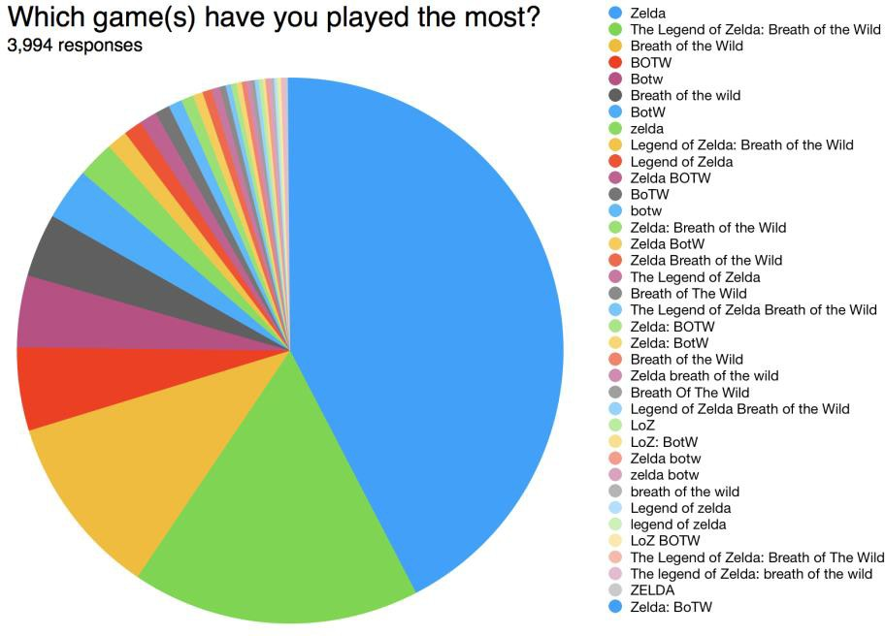
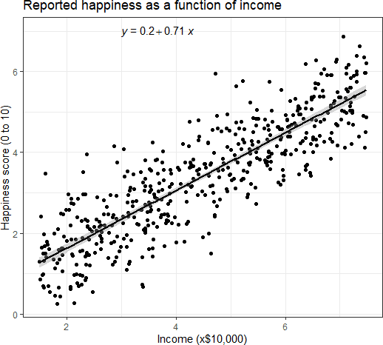
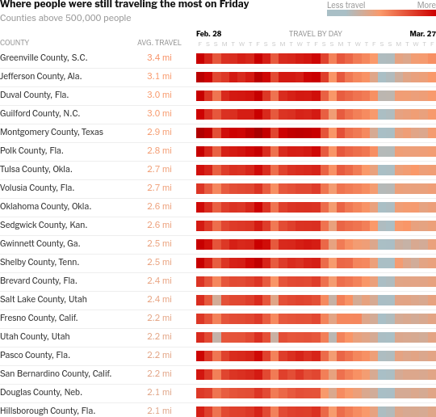
Graph (defn.)
Common charts that represent data are often
referred to as “graphs”, or “graph visualizations”
Bar charts
Line charts
Pie charts
Etc.
However, graph is also a type of data.

Slide 5
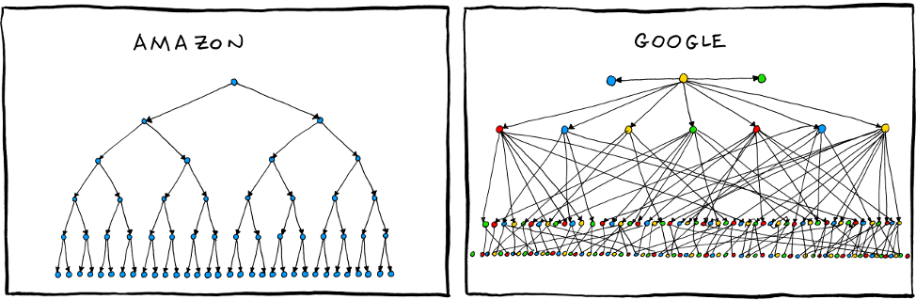
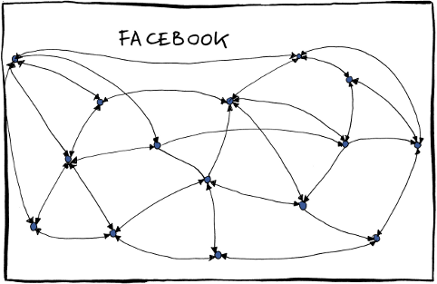
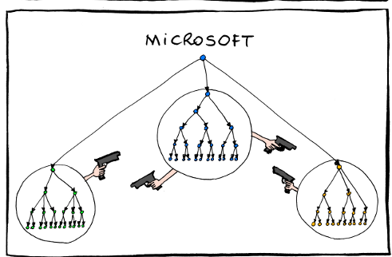
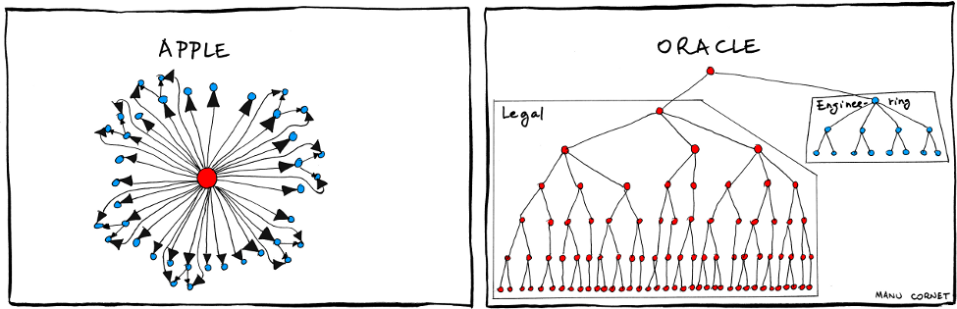
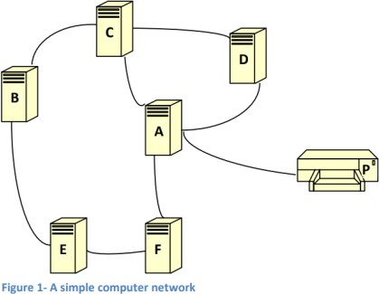
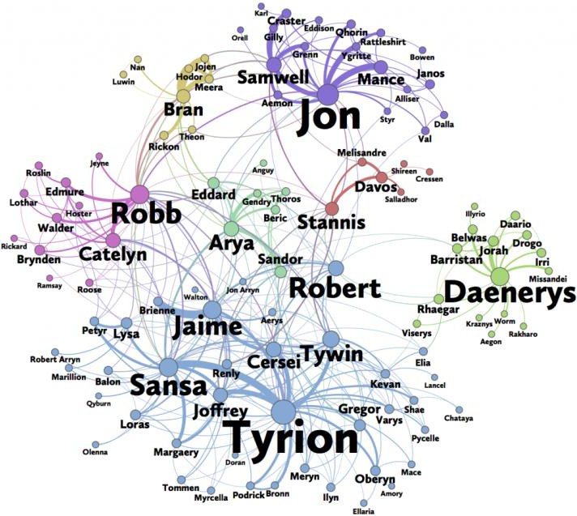
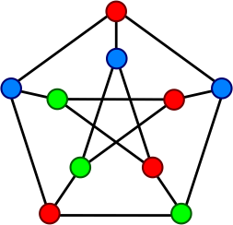
Graph (defn.)
In the mathematical sense a graph is a model for representing items and the relationships between those items
Social / friendship networks
Computer networks
Energy or transportation grids
Organizational structures
Etc.

Slide 6
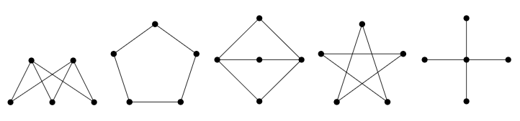
Are any of the graphs below the same? If you said yes, which ones and why?
Building Intuition
Notes:
a_0 = 8, d = 6

Slide 7
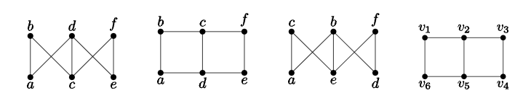
How about these with labels?
Are any of the graphs below the same? If you said yes, which ones and why?
Building Intuition
Notes:
a_0 = 8, d = 6

Slide 8

Graph (defn.)
These examples are drawings of graphs.
Mathematically, a graph is an ordered pair, $G=(V,E)$, consisting of a nonempty set, $V$ (called vertices), and a set $E$ (called edges) of two-elements subsets of $V$.
Notes:
a_0 = 8, d = 6

Slide 9

Graph (defn.)
These examples are drawings of graphs.
Mathematically, a graph is an ordered pair, $G=(V,E)$, consisting of a nonempty set, $V$ (called vertices), and a set $E$ (called edges) of two-elements subsets of $V$.
Note: you may also hear vertices called nodes.
Notes:
a_0 = 8, d = 6

Slide 10

Graph (defn.)
Mathematically, a graph is an ordered pair, $G=(V,E)$, consisting of a nonempty set, $V$ (called vertices), and a set $E$ (called edges) of two-elements subsets of $V$.
Ex. Graph 1:
$V=\left\{a, b, c, d, e\right\},$
$E=\{\left\{a, b\right\}, \left\{a, c\right\}, \left\{a, d\right\}, \left\{a, e\right\}, \left\{b, c\right\}, \left\{d, e\right\}\}$
Notes:
a_0 = 8, d = 6

Slide 11
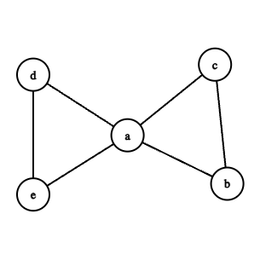
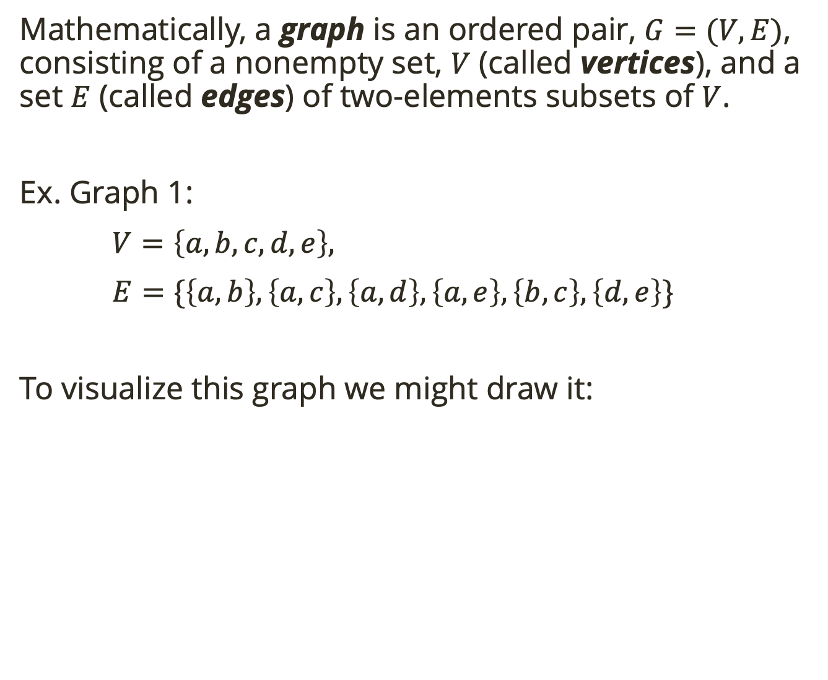
Graph (defn.)
Mathematically, a graph is an ordered pair, $G=(V,E)$, consisting of a nonempty set, $V$ (called vertices), and a set $E$ (called edges) of two-elements subsets of $V$.
Ex. Graph 1:
$V=\left\{a, b, c, d, e\right\},$
$E=\{\left\{a, b\right\}, \left\{a, c\right\}, \left\{a, d\right\}, \left\{a, e\right\}, \left\{b, c\right\}, \left\{d, e\right\}\}$
To visualize this graph we might draw it:
Notes:
a_0 = 8, d = 6

Slide 12

Graph (defn.)
Mathematically, a graph is an ordered pair, $G=(V,E)$, consisting of a nonempty set, $V$ (called vertices), and a set $E$ (called edges) of two-elements subsets of $V$.
Ex. Graph 1:
$V=\left\{a, b, c, d, e\right\},$
$E=\{\left\{a, b\right\}, \left\{a, c\right\}, \left\{a, d\right\}, \left\{a, e\right\}, \left\{b, c\right\}, \left\{d, e\right\}\}$
To visualize this graph we might draw it:
Draw this graph:
$$V=\left\{v_{1},v_{2},v_{3},v_{4},v_{5}\right\}$$
$$E=\{\left\{v_{1},v_{3}\right\}, \left\{v_{1},v_{5}\right\}, \left\{v_{2}, v_{4}\right\},$$
$\left\{v_{2}, v_{5}\right\}, \left\{v_{3}, v_{5}\right\}, \left\{v_{4}, v_{5}\right\}\}$
Notes:
a_0 = 8, d = 6

Slide 13
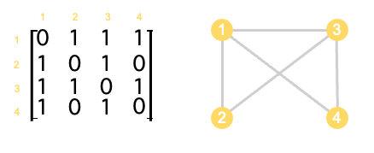
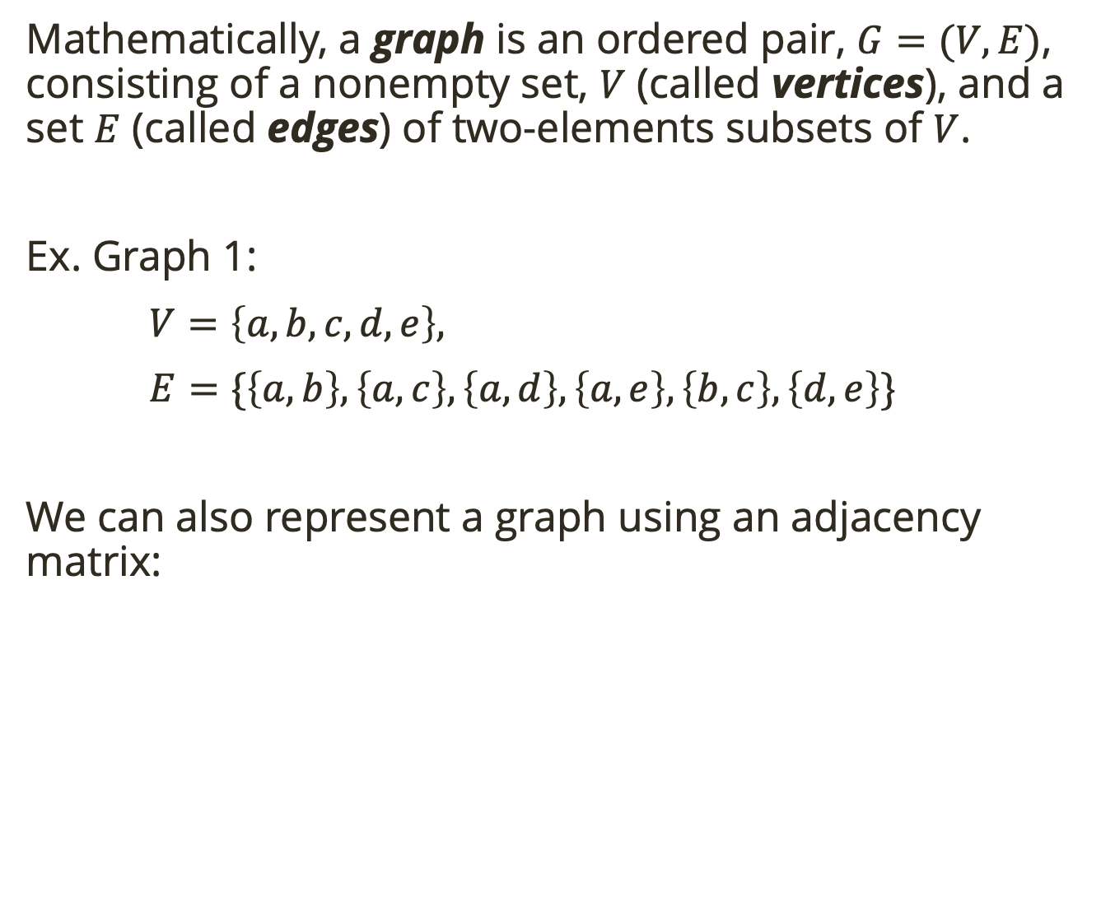
Graph (defn.)
Mathematically, a graph is an ordered pair, $G=(V,E)$, consisting of a nonempty set, $V$ (called vertices), and a set $E$ (called edges) of two-elements subsets of $V$.
Ex. Graph 1:
$V=\left\{a, b, c, d, e\right\},$
$E=\{\left\{a, b\right\}, \left\{a, c\right\}, \left\{a, d\right\}, \left\{a, e\right\}, \left\{b, c\right\}, \left\{d, e\right\}\}$
We can also represent a graph using an adjacency matrix:
Notes:
a_0 = 8, d = 6

Slide 14
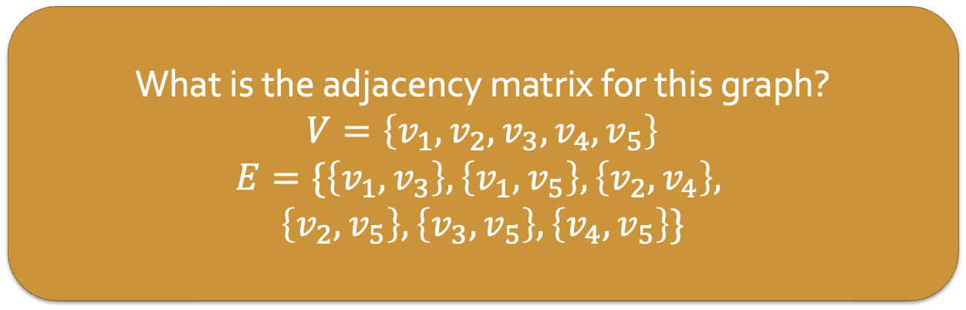
Graph (defn.)
Mathematically, a graph is an ordered pair, $G=(V,E)$, consisting of a nonempty set, $V$ (called vertices), and a set $E$ (called edges) of two-elements subsets of $V$.
Ex. Graph 1:
$V=\left\{a, b, c, d, e\right\},$
$E=\{\left\{a, b\right\}, \left\{a, c\right\}, \left\{a, d\right\}, \left\{a, e\right\}, \left\{b, c\right\}, \left\{d, e\right\}\}$
We can also represent a graph using an adjacency matrix:
What is the adjacency matrix for this graph?
$$V=\left\{v_{1},v_{2},v_{3},v_{4},v_{5}\right\}$$
$$E=\{\left\{v_{1},v_{3}\right\}, \left\{v_{1},v_{5}\right\}, \left\{v_{2}, v_{4}\right\},$$
$\left\{v_{2}, v_{5}\right\}, \left\{v_{3}, v_{5}\right\}, \left\{v_{4}, v_{5}\right\}\}$
Notes:
a_0 = 8, d = 6

Slide 15
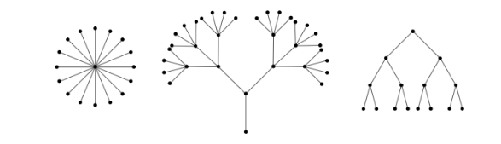
Tree (defn.)
A tree is a connected graph containing no cycles.
A forest is a graph containing no cycles.
Note: this means a connected forest is a tree.
https://ptwiddle.github.io/Graph-Theory-Notes/s_intro_trees.html

Slide 16
Rooted Trees
We can identify one vertex in a tree as the root. Then, every other vertex on the tree can be characterized by its position relative to the root.
Root

Slide 17
Rooted Trees
We can identify one vertex in a tree as the root. Then, every other vertex on the tree can be characterized by its position relative to the root.
If two vertices are adjacent, we say the one closer to the root is the parent, and the other is the child.
The root of a tree is a parent, but not a child of any vertex. All non-root vertices have exactly one parent.
parent
child

Slide 18
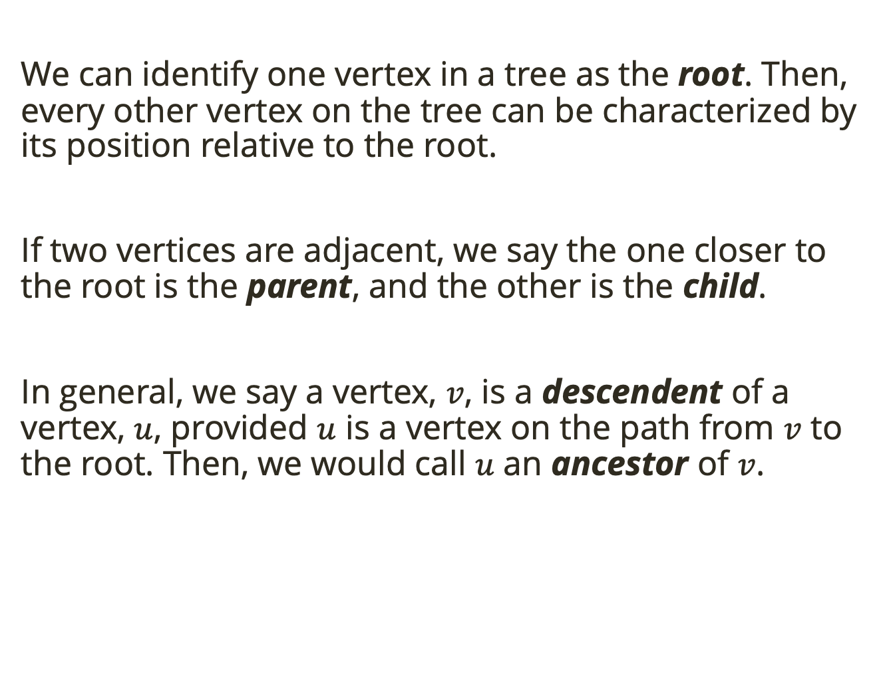
Rooted Trees
We can identify one vertex in a tree as the root. Then, every other vertex on the tree can be characterized by its position relative to the root.
If two vertices are adjacent, we say the one closer to the root is the parent, and the other is the child.
In general, we say a vertex, $v$, is a descendent of a vertex, $u$, provided $u$ is a vertex on the path from $v$ to the root. Then, we would call $u$ an ancestor of $v$.
ancestor
descendent

Slide 19
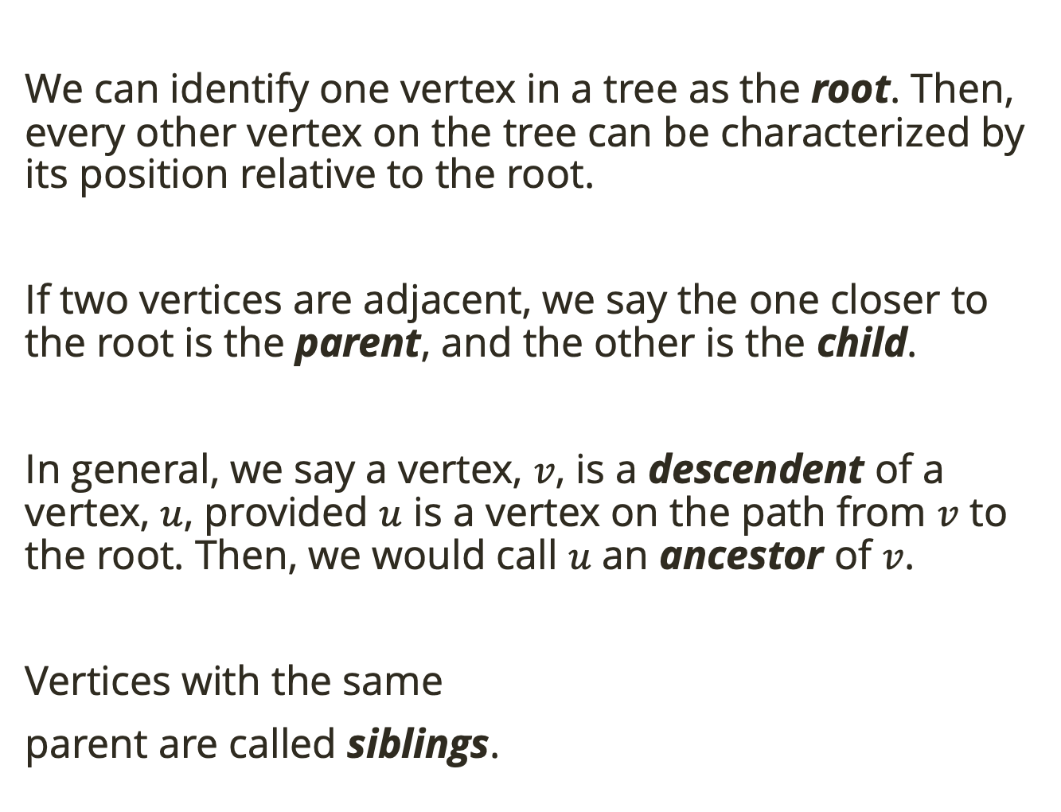
Rooted Trees
We can identify one vertex in a tree as the root. Then, every other vertex on the tree can be characterized by its position relative to the root.
If two vertices are adjacent, we say the one closer to the root is the parent, and the other is the child.
In general, we say a vertex, $v$, is a descendent of a vertex, $u$, provided $u$ is a vertex on the path from $v$ to the root. Then, we would call $u$ an ancestor of $v$.
Vertices with the same
parent are called siblings.
siblings

Slide 20
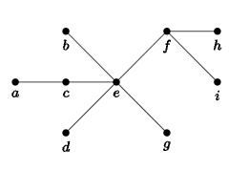

Rooted Trees
We can identify one vertex in a tree as the root. Then, every other vertex on the tree can be characterized by its position relative to the root.
If two vertices are adjacent, we say the one closer to the root is the parent, and the other is the child.
In general, we say a vertex, $v$, is a descendent of a vertex, $u$, provided $u$ is a vertex on the path from $v$ to the root. Then, we would call $u$ an ancestor of $v$.
Vertices with the same
parent are called siblings.
Let $f$ be the root. Label the other vertices.

Slide 21
Flashback: Graph (defn.)
In the mathematical sense a graph is a model for representing items and the relationships between those items
Social / friendship networks
Computer networks
Energy or transportation grids
Organizational structures
Etc.

Slide 22

Additional Node Data
Sam
We may have additional data (attributes) about the nodes in the graph (i.e. the items in the graph)
1
Abigail
3
1
2
1
4
Haley
Sebastian
Leah
6
5
Shane
Vertex id | Name | Favorite color | Popularity
1 | Sam | Blue | 6
2 | Sebastian | Green | 7
3 | Abigail | Purple | 9
4 | Haley | Pink | 2
5 | Shane | Orange | 4
6 | Leah | Purple | 7

Slide 23
Additional Edge Data
Sam
We may have additional data (attributes) about the edges in the graph (i.e. the connections between items)
1
Abigail
3
1
2
1
4
Haley
Sebastian
Leah
6
5
Shane
Edge id | Source | Target | Friend value
1 | Sam | Sebastian | 10
2 | Sam | Abigail | 6
3 | Sebastian | Haley | 1
4 | Abigail | Haley | 2
5 | Haley | Shane | 1
6 | Shane | Leah | 2

Slide 24
Visualizing
What might be the benefits of visualizing graphs?

Slide 25
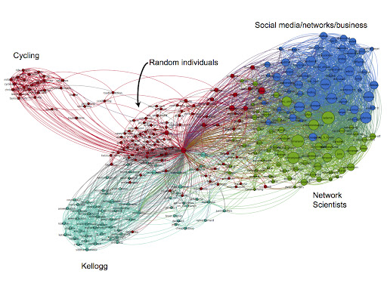
Visualizing
Highlight communities
https://www.google.com/url?sa=i&url=http%3A%2F%2Fsocial-dynamics.org%2Ftag%2Fnetwork-visualization%2F&psig=AOvVaw1csnV4he0ey3cU3srQTMiE&ust=1724861687547000&source=images&cd=vfe&opi=89978449&ved=0CBQQjRxqFwoTCOij7NPIlYgDFQAAAAAdAAAAABA5
Notes:
Conference attendees

Slide 26

Visualizing
Highlight hierarchy
https://www.google.com/url?sa=i&url=https%3A%2F%2Fslideuplifts.medium.com%2Fmust-have-org-charts-to-visualize-your-project-team-structure-d61df5eb00f5&psig=AOvVaw2MFNBDY9jaG6RGpyqTDuKD&ust=1724861970547000&source=images&cd=vfe&opi=89978449&ved=0CBgQ3YkBahcKEwiYpfLayZWIAxUAAAAAHQAAAAAQCQ

Slide 27
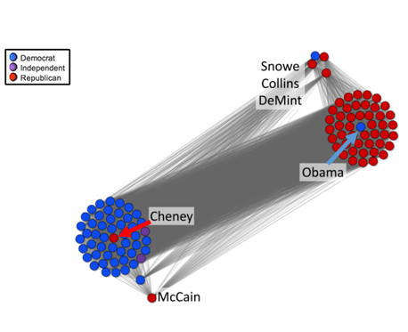
Visualizing
Show outliers and anomalies

Slide 28
Visualization Techniques
There are many different ways to encode and layout graph visualizations.
The correct one depends on what tasks you need to support or what features of the data need to be highlighted.

Slide 29
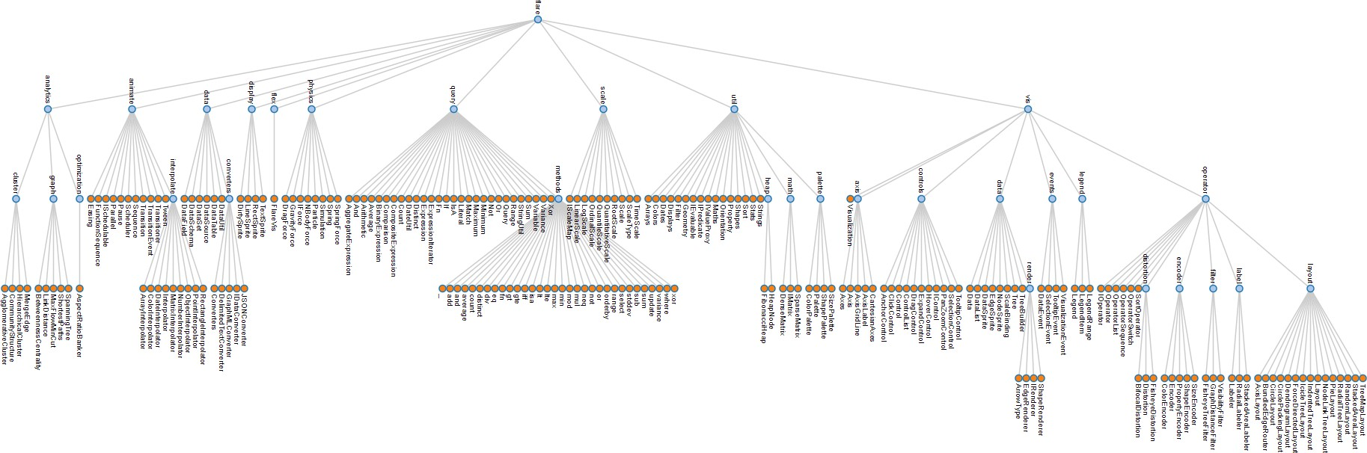
Node-link tree diagrams
Nodes are distributed in space, connected by
straight or curved lines
Typical approach is to use 2D space to break apart breadth and depth
Often, space is used to communicate hierarchical orientation

Slide 30
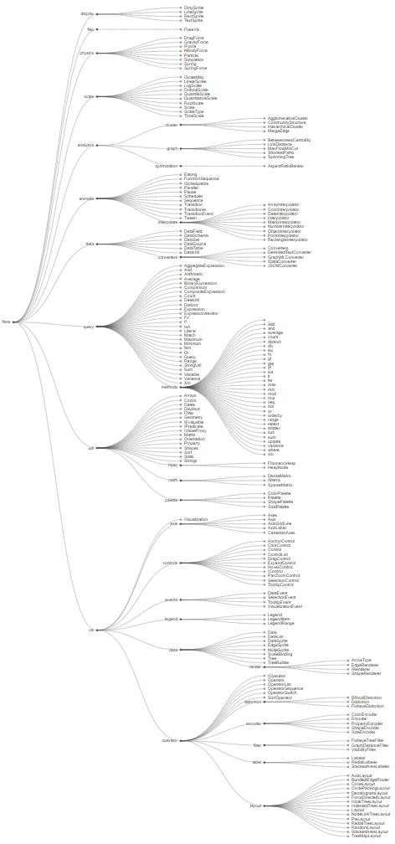
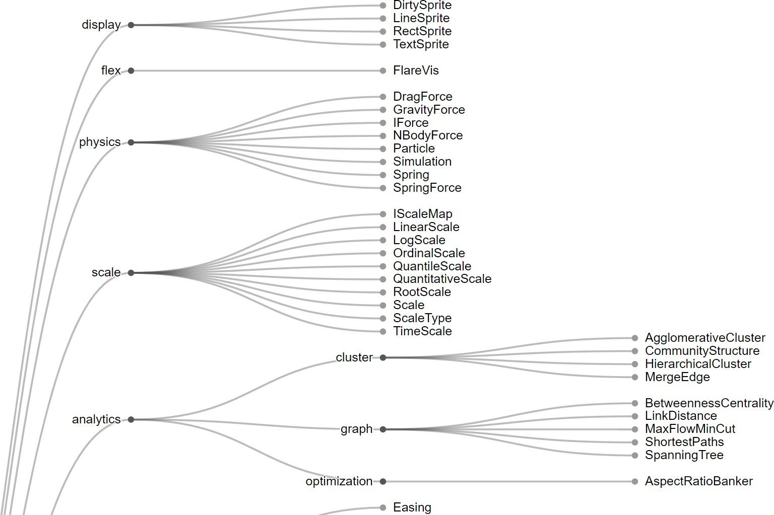
Tidy Tree
https://bl.ocks.org/mbostock/4339184
Implements the Reingold-Tilford algorithm for efficient, tidy arrangement of layered nodes
Depth of nodes computed by distance from the root, leading to a ragged appearance.
Tidy Tree

Slide 31
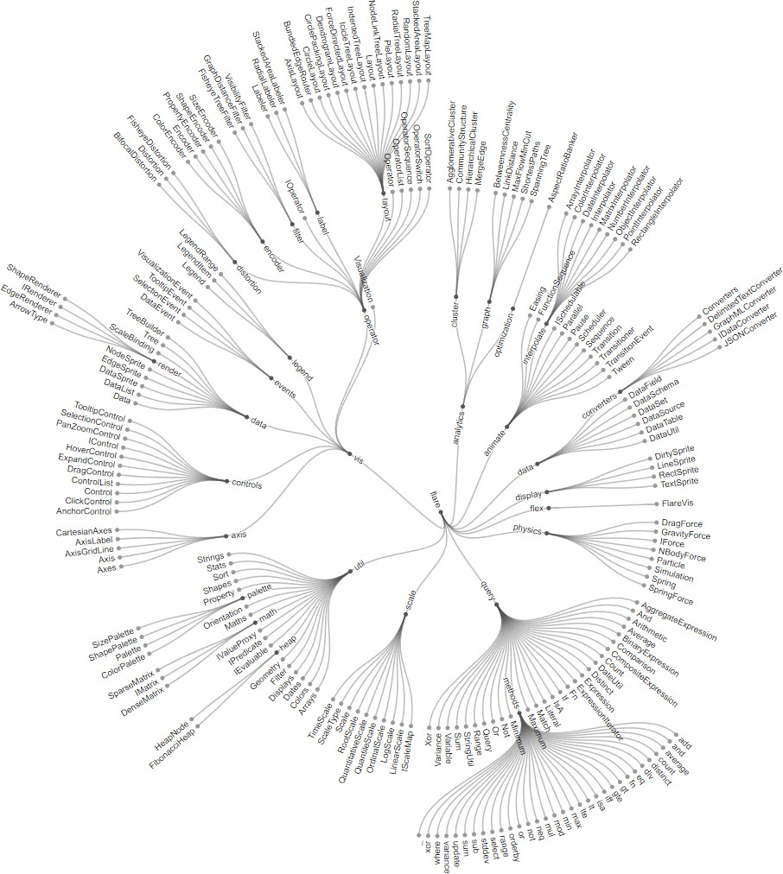
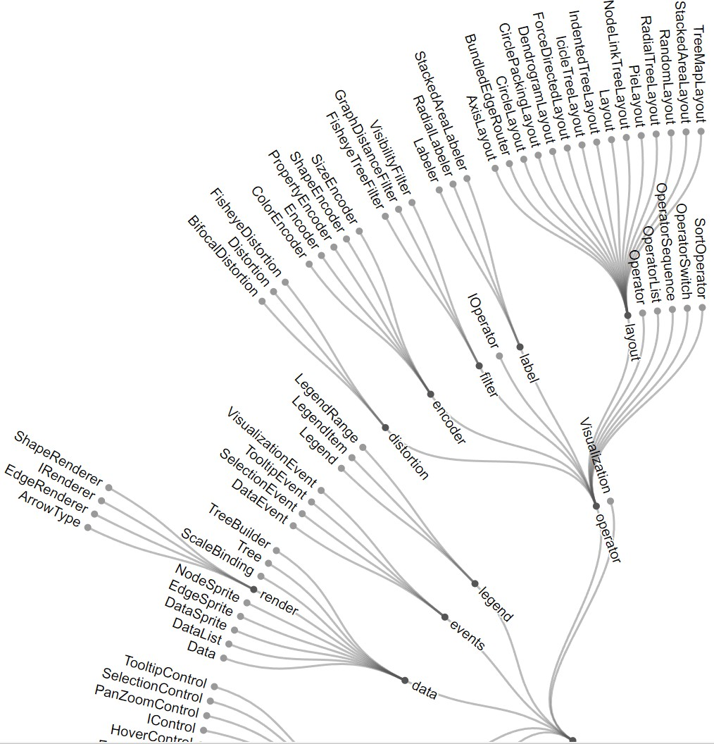
Radial Tidy Tree
https://bl.ocks.org/mbostock/4063550

Slide 32


Reingold-Tilford algorithm
Bottom-up recursive approach
Repeatedly divide space by leaf count
For each parent, make sure subtrees are drawn
Make smarter use of space
+ Maximize density and symmetry
+ Clearly encode depth level
+ No edge crossings
+ Pack subtrees as closely as possible
+ Centers parent over subtrees

Slide 33
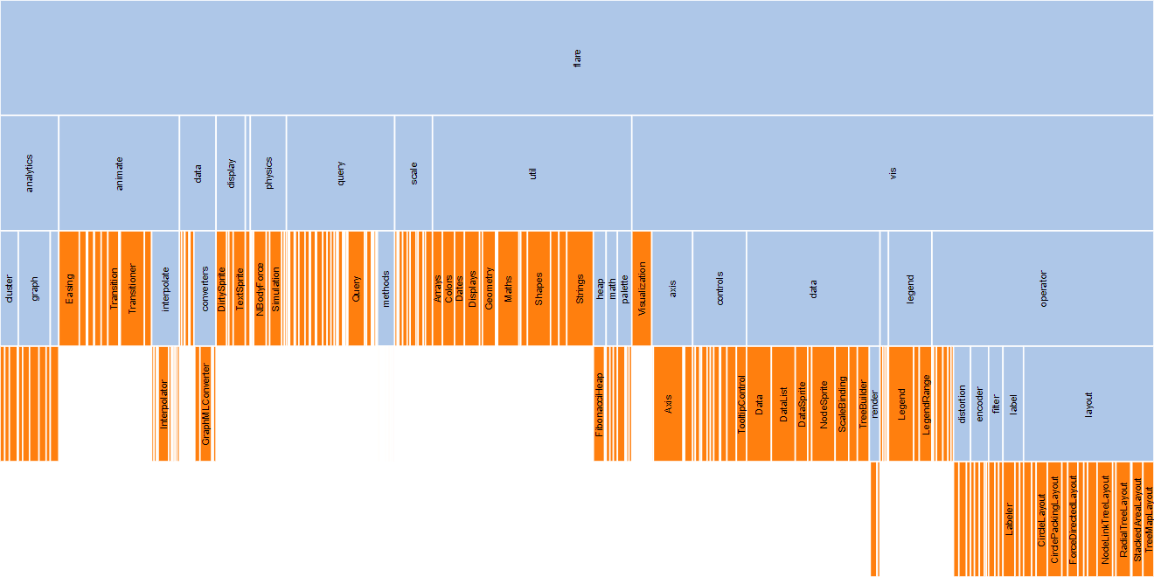
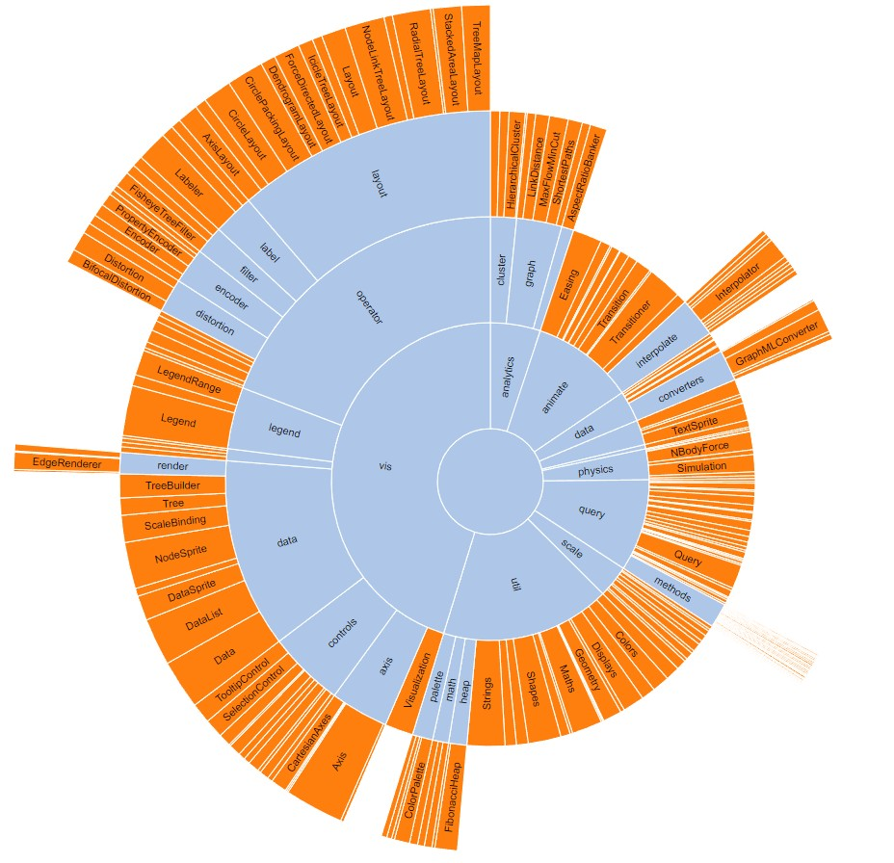
Space-filling variant of node-link
diagrams
Nodes drawn as solid areas (arcs or bars)
Placement relative to adjacent nodes reveals place in hierarchy
Root node at top / center
Leaf nodes at bottom
Layered (adjacency) diagrams
Icicle layout (above)
Potential problem: can we run out of (screen) space?
Sunburst layout (left)

Slide 34
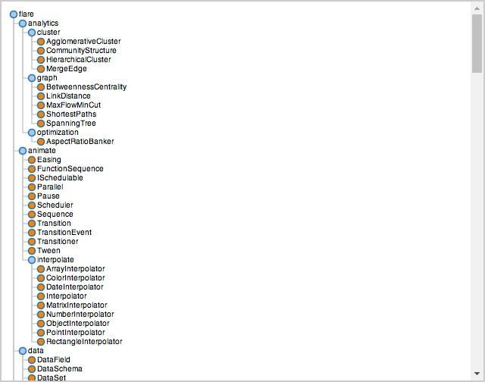
Used to show parent / child
relationships
Potentially a lot of scrolling!
Indentation
Question: where does this indented tree representation appear often?

Slide 35
Encodes tree structure using
spatial enclosure
Enclosure indicates hierarchy
Benefits:
Provides single view of entire tree
Easier to spot small / large nodes
Enclosure (treemap) diagrams
A
A
B
C
=
D
B
C
E
D
E

Slide 36
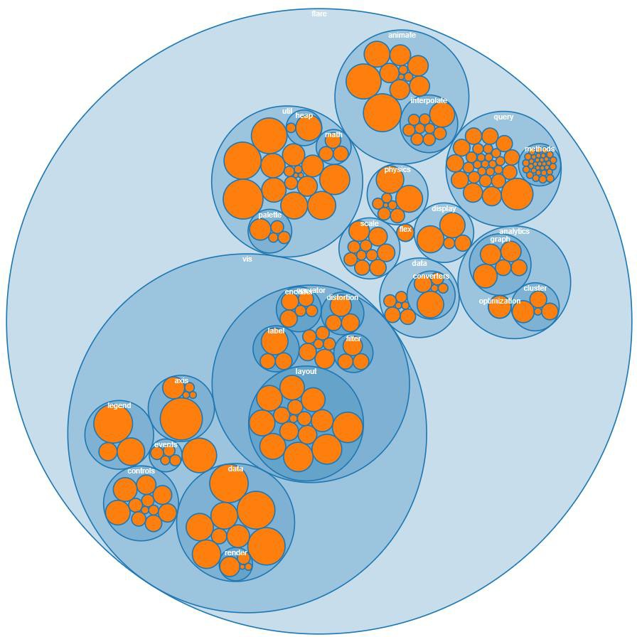
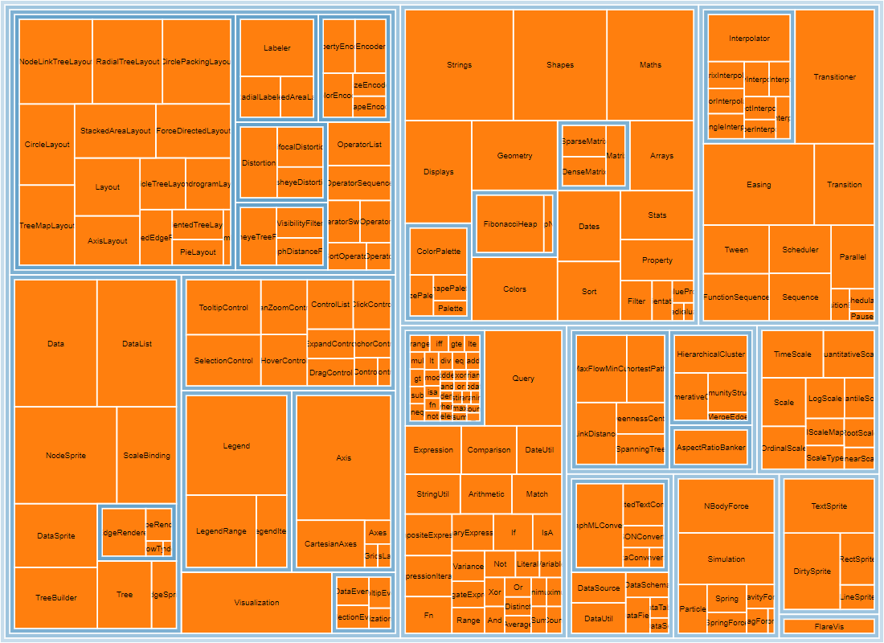
Enclosure (treemap) diagrams
Circle-packing layout
Enclosure diagram (treemap)
Potential problem: is it easy for you to visually discern the depth of the tree?

Slide 37
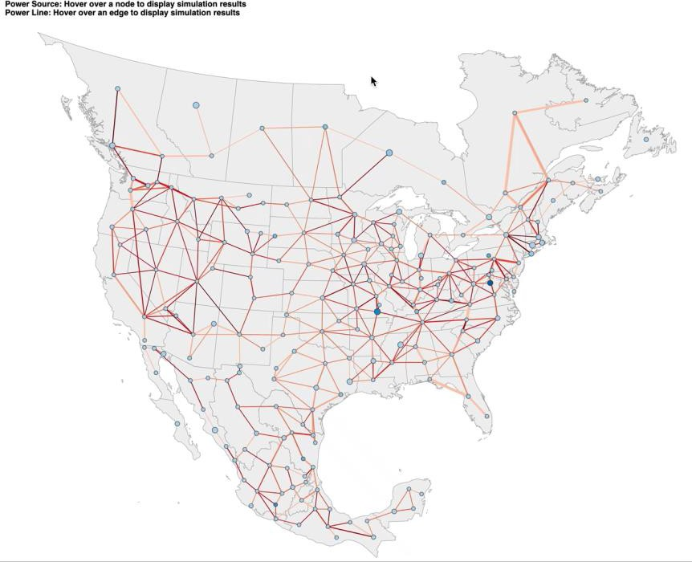
How do we draw graphs effectively?
Primary concern: the spatial layout of vertices and edges
Often (but not always) the goal is to effectively depict the graph structure
Connectivity, path-following
Network distance
Clustering
Ordering (e.g., hierarchy level)
Visualizing the Reliability and Security of the
North American Power Grid System in 2050
Work done for the National Renewable Energy Laboratory
code can be found @ https://github.com/ashleysuh/nerc-visualization

Slide 38
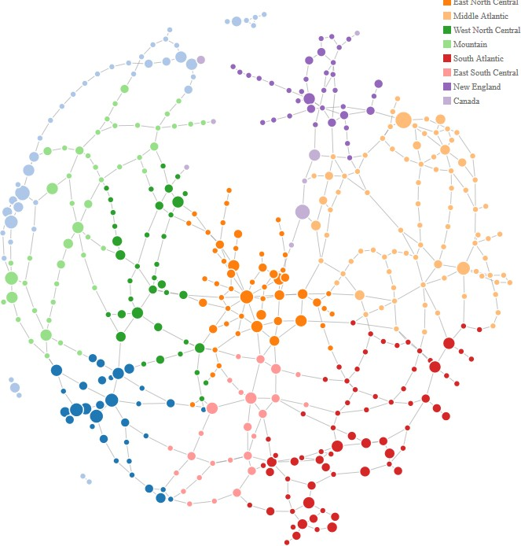
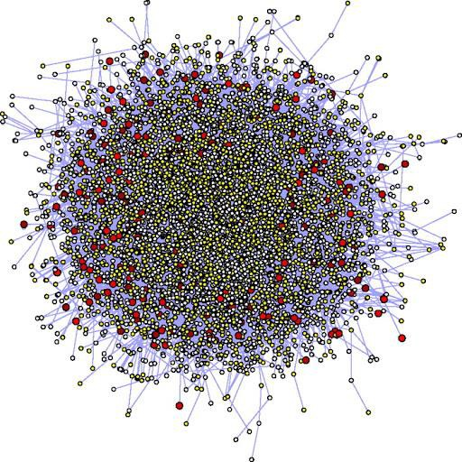
Node-link diagrams (again)
draw these graphs using https://gephi.org/
Reingold-Tilford algorithm
PROS:
understandable visual mapping
shows overall structure, clusters, paths
flexible, many variations / layouts
How do we draw graphs effectively?
(left) a nice, decluttered node-link diagram
CONS:
most trivial algorithms are slow
not good for dense (very connected) graphs
(right) a dense,
“hairball”-like graph

Slide 39
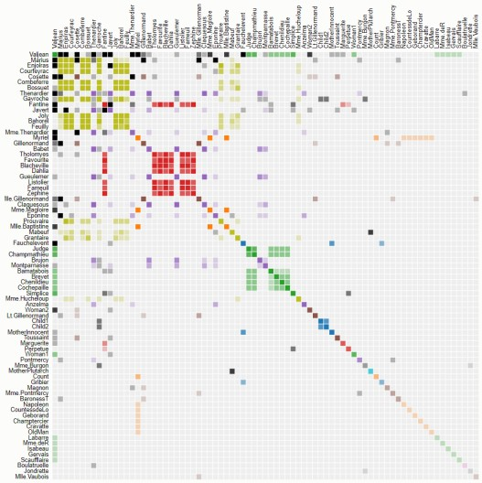
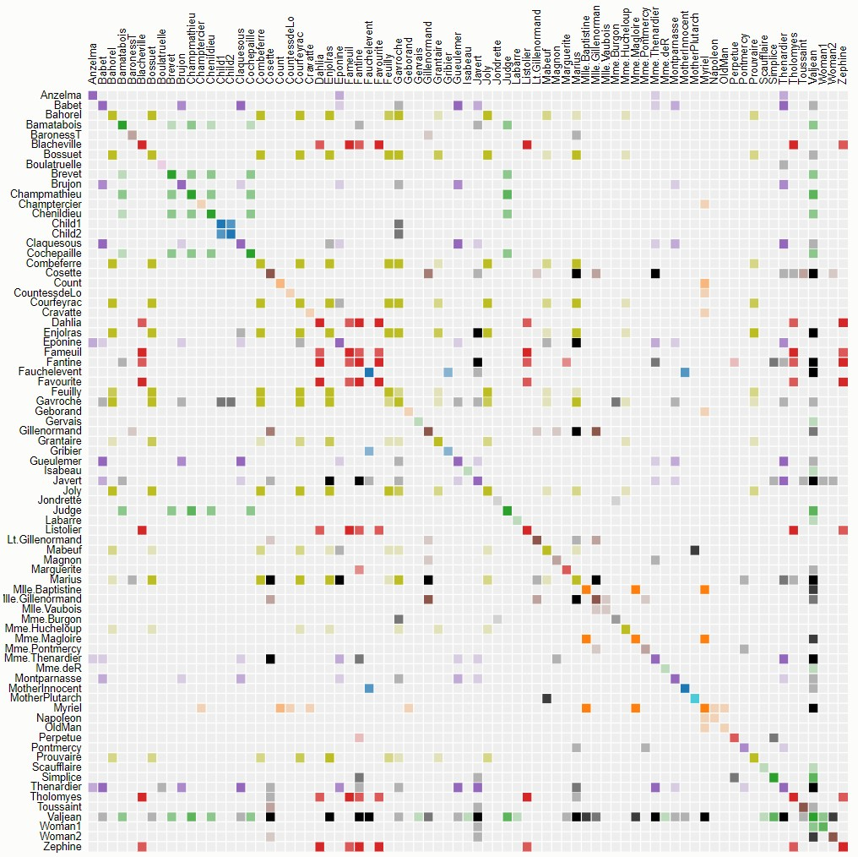
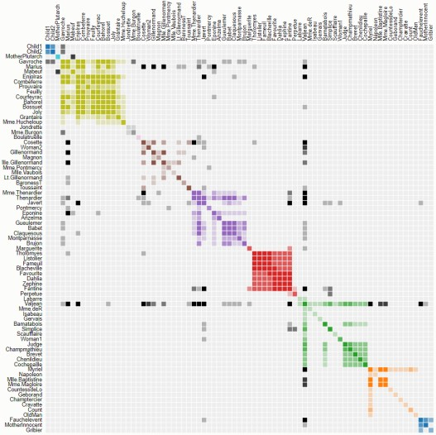
Adjacency Diagram
try this interactively using https://bost.ocks.org/mike/miserables/
PROS:
great for dense graphs
visually scalable
can spot clusters
How do we draw graphs effectively?
CONS:
row order affects what you can see
abstract visualization
hard to follow paths
Why does ordering matter?
(above) layout ordered by Name
(left, top) layout ordered by Frequency (left, bot) layout ordered by Cluster

Slide 40
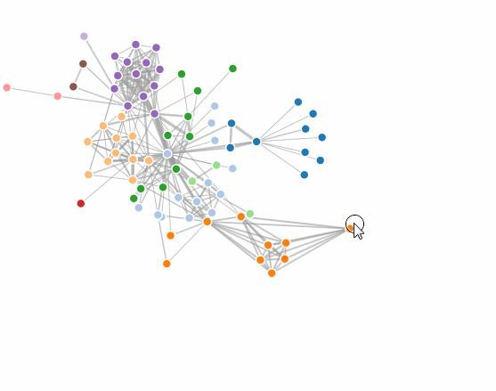
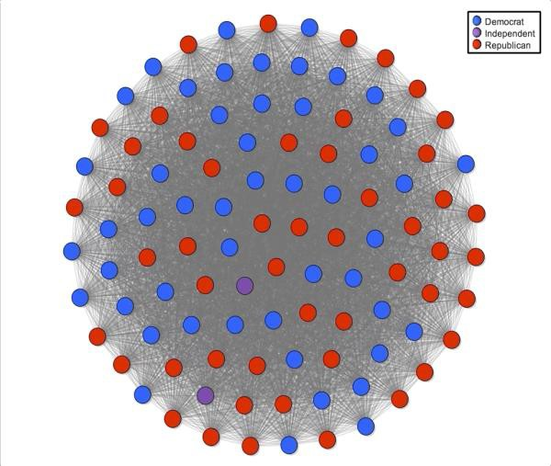
Force-directed graph drawing
try it interactively at https://observablehq.com/@d3/force-directed-graph
Physical-based model (attractive & repulsive forces)
PROS:
aesthetically-pleasing layout
interactive (pull & drag!)
automatic & flexible layout
How do we draw graphs effectively?
Interactive force-directed layouts
(above) Les Mis dataset (below) Voting network
CONS:
forces are computationally expensive ~ O(n²)
doesn’t work well on dense graphs
Potential problem: how can we interact with a force-directed graph if it’s highly connected?

Slide 41
Practice
Exercise: draw the following graph data as an adjacency matrix & node-link diagram
V = {1, 2, 3, 4, 5}
E = {(1,2), (1,3), (2,3), (3,4), (4,1), (5,1)}
Edge weights = {(1), (7), (4), (2), (2), (1)}
Node Classes = {A, B, A, A, B}
Draw a node-link diagram in two ways:
Bad layout
Aesthetically-pleasing layout
Be creative with your attribute encodings! Think about:
What are the advantages / disadvantages to these methods? Which do you prefer?
Why is your bad layout ‘bad’, and your good layout ‘good’?

Slide 42
Tools for Graph Analysis
Network Analysis Tools
Gephi - an interactive graph analysis application
NodeXL - a graph analysis plug-in for Excel
GUESS - a combined visual/scripting interface for graph analysis
Pajek - another popular network analysis tool
NetworkX - graph analysis library for Python
SNAP - graph analysis library for C++

Slide 43
Network Visualization Coding References
Python
https://plotly.com/python/network-graphs/
https://towardsdatascience.com/visualizing-networks-in-python-d70f4cbeb259
https://pyvis.readthedocs.io/en/latest/
R
https://schochastics.github.io/netVizR/
https://r-graph-gallery.com/network.html
https://yunranchen.github.io/intro-net-r/advanced-network-visualization.html

