Slide 1
Visual Analytics– Color
Dr. Ab Mosca (they/them)
Slides based off slides courtesy of Jordan Crouser (https://jcrouser.github.io/)

Slide 2
Notes
Nice job on the mid-semester project!
How was reading an academic paper?
What did you learn from looking at VA systems?

Slide 3

Notes

Slide 4
Plan for Today
Color
How we see it
Spaces
Phenomenon
Pallets
Lab

Slide 5
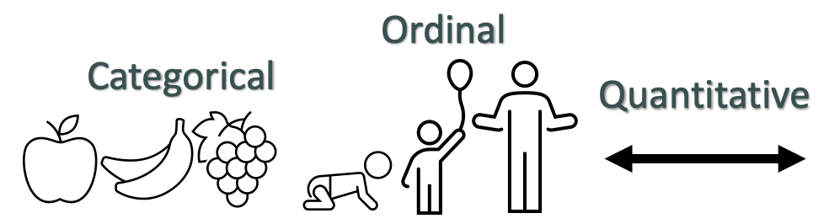
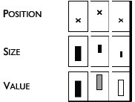

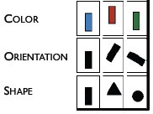
Flashback: Mapping to visual dimensions
Remember… Big idea behind visualization
Map data dimensions to visual dimensions in a principled way
Not all visual dimensions can represent all data types
Jacques Bertin, Semiologie Graphique
(Semiology of Graphics), 1967.

Slide 6
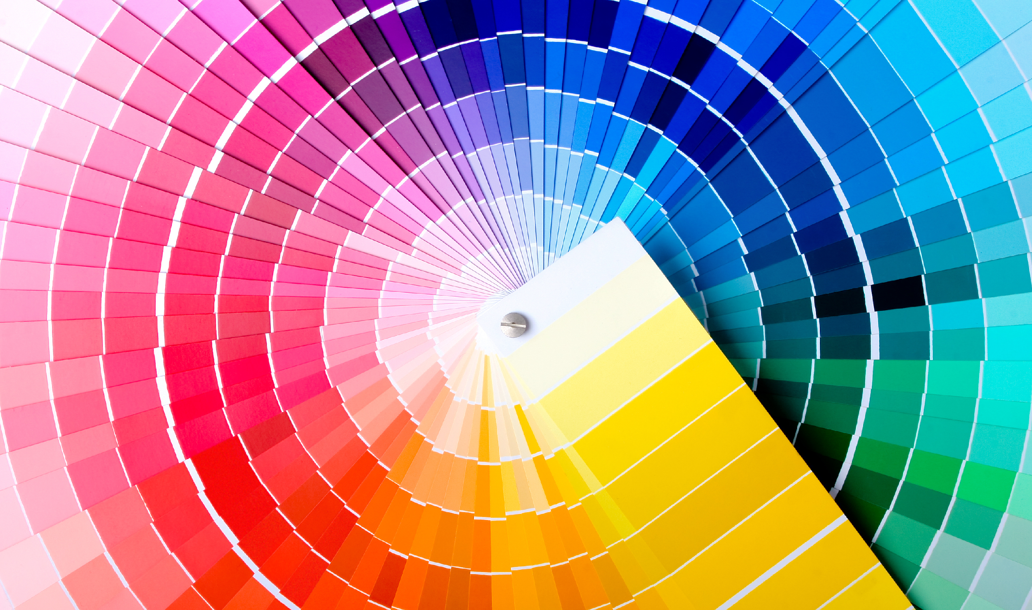
Color 101

Slide 7
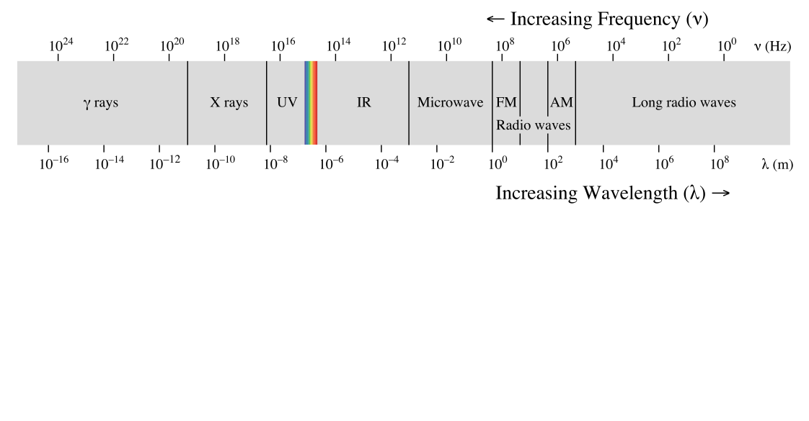
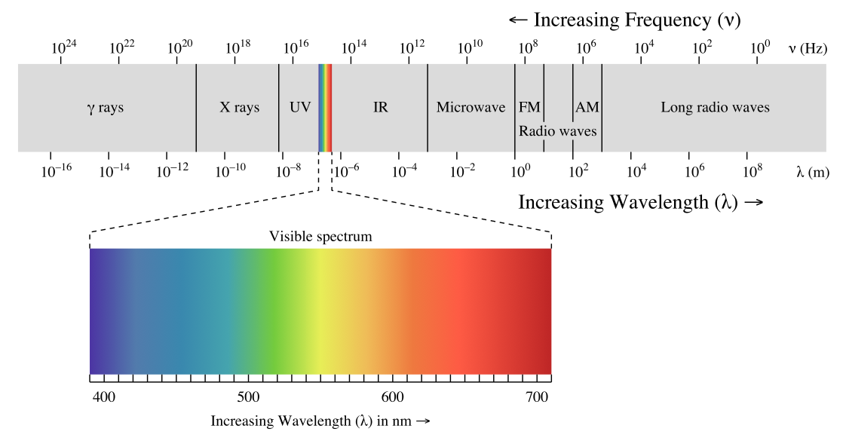

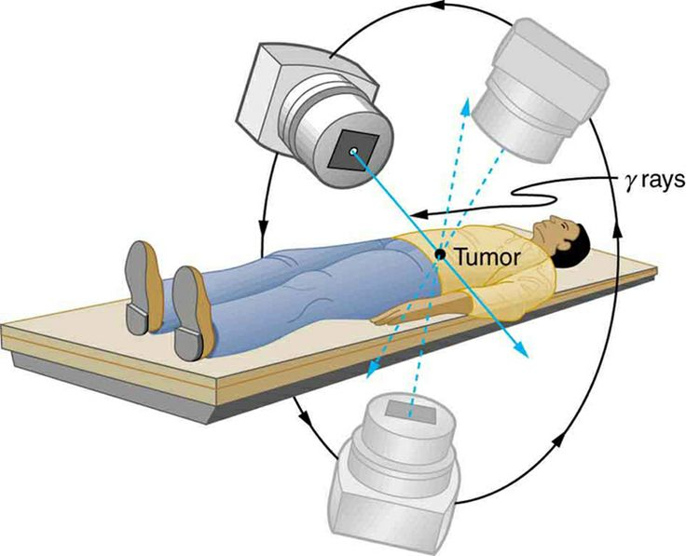
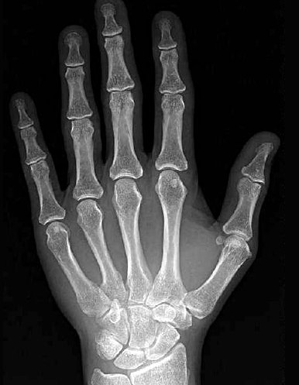

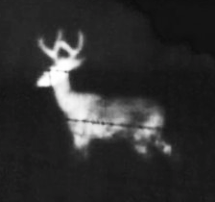
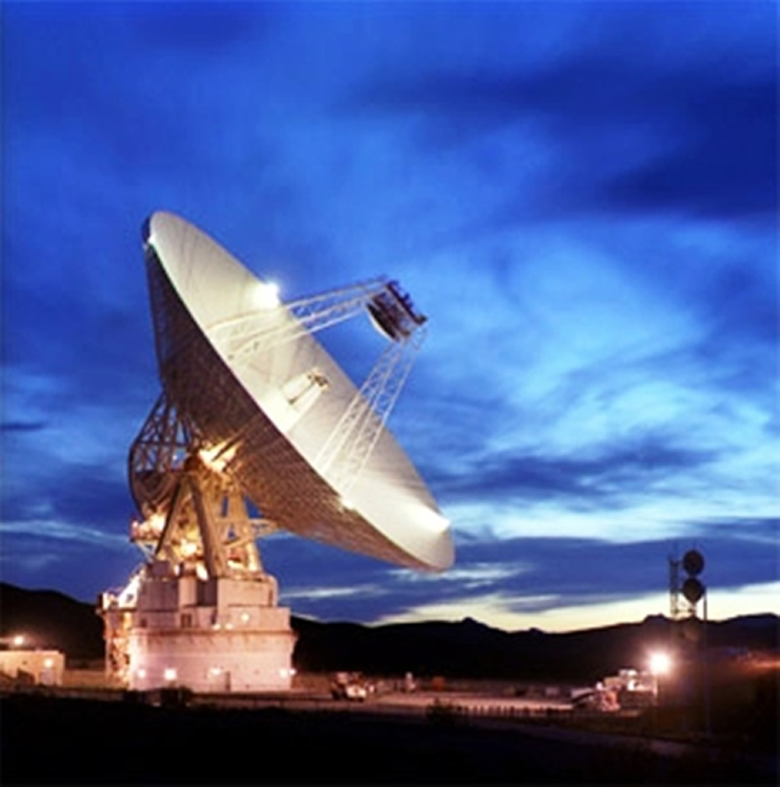
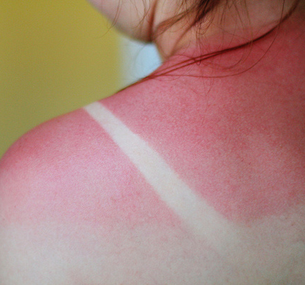
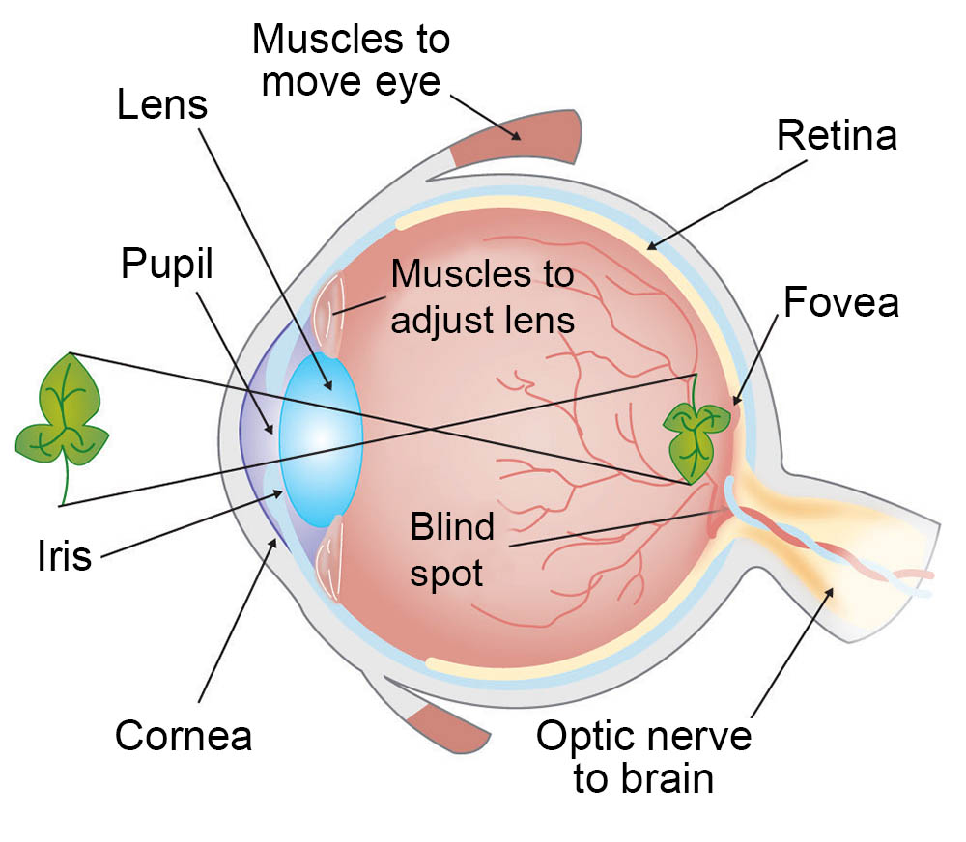
Kinds of light
Eye diagram courtesy ASU

Slide 8
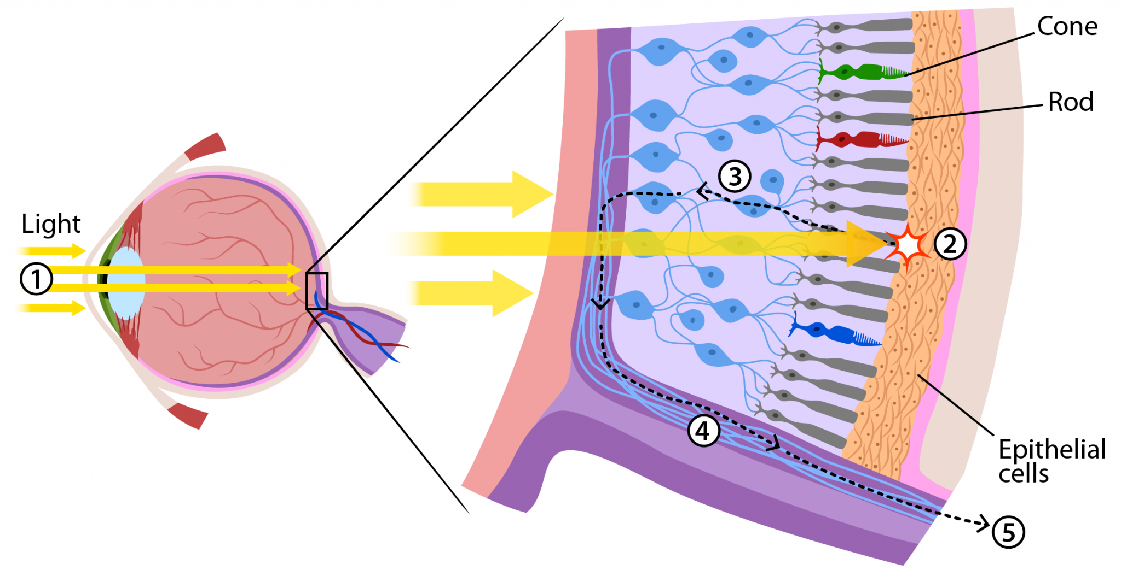
~ 6 million
How we see color
~ 100 million
https://askabiologist.asu.edu/rods-and-cones
Notes:
Rods work at very low levels of light. We use these for night vision because only a few bits of light (photons) can activate a rod. Rods don't help with color vision, which is why at night, we see everything in a gray scale. The human eye has over 100 million rod cells.
Cones require a lot more light and they are used to see color. We have three types of cones: blue, green, and red. The human eye only has about 6 million cones. Many of these are packed into the fovea, a small pit in the back of the eye that helps with the sharpness or detail of images.

Slide 9
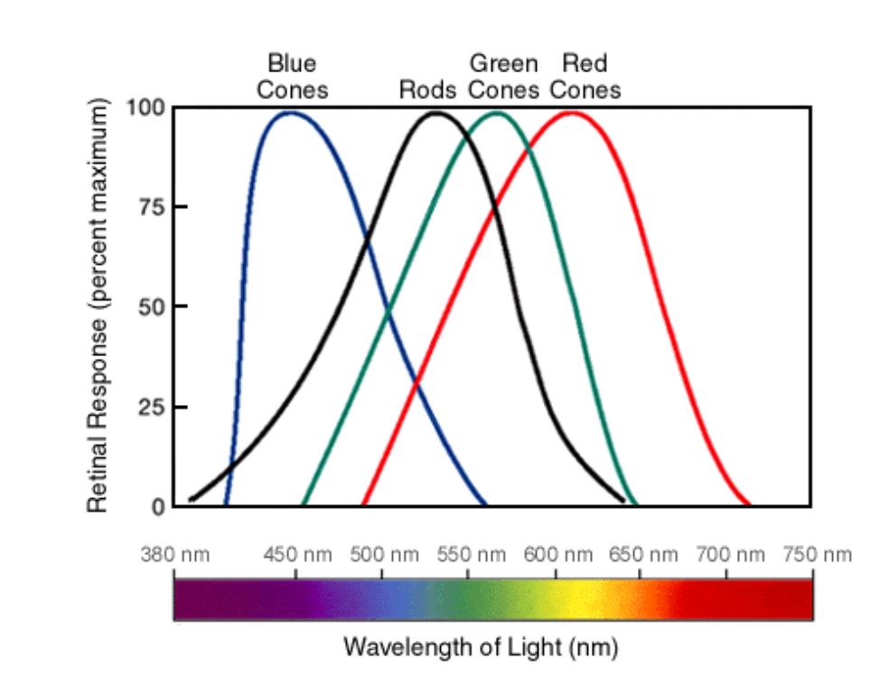
What do you notice here?
How we see color
https://askabiologist.asu.edu/rods-and-cones
Notes:
Rods work at very low levels of light. We use these for night vision because only a few bits of light (photons) can activate a rod. Rods don't help with color vision, which is why at night, we see everything in a gray scale. The human eye has over 100 million rod cells.
Cones require a lot more light and they are used to see color. We have three types of cones: blue, green, and red. The human eye only has about 6 million cones. Many of these are packed into the fovea, a small pit in the back of the eye that helps with the sharpness or detail of images.

Slide 10
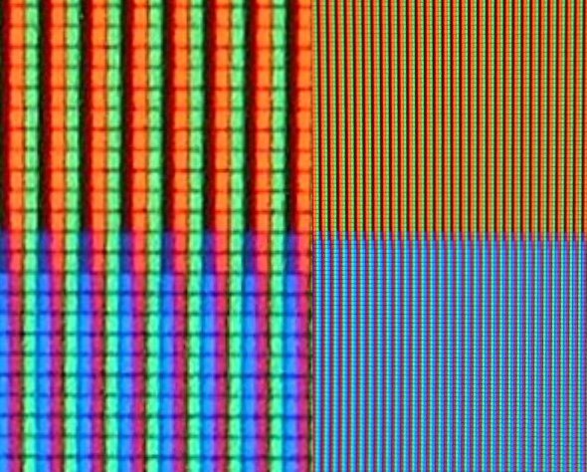
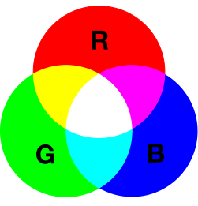

How we represent color
RGB

Slide 11
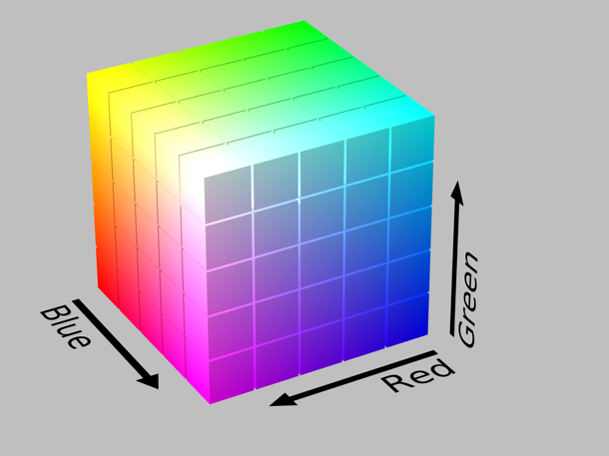




Issues
Distance between colors nowhere near how we perceive differences
How we represent color
RGB
A: (5, 7, 15) B: (15, 17, 25)
rgb(0, 128, 0) rgb(10, 138, 10)
rgb(128, 0, 0) rgb(138, 10, 10)

Slide 12
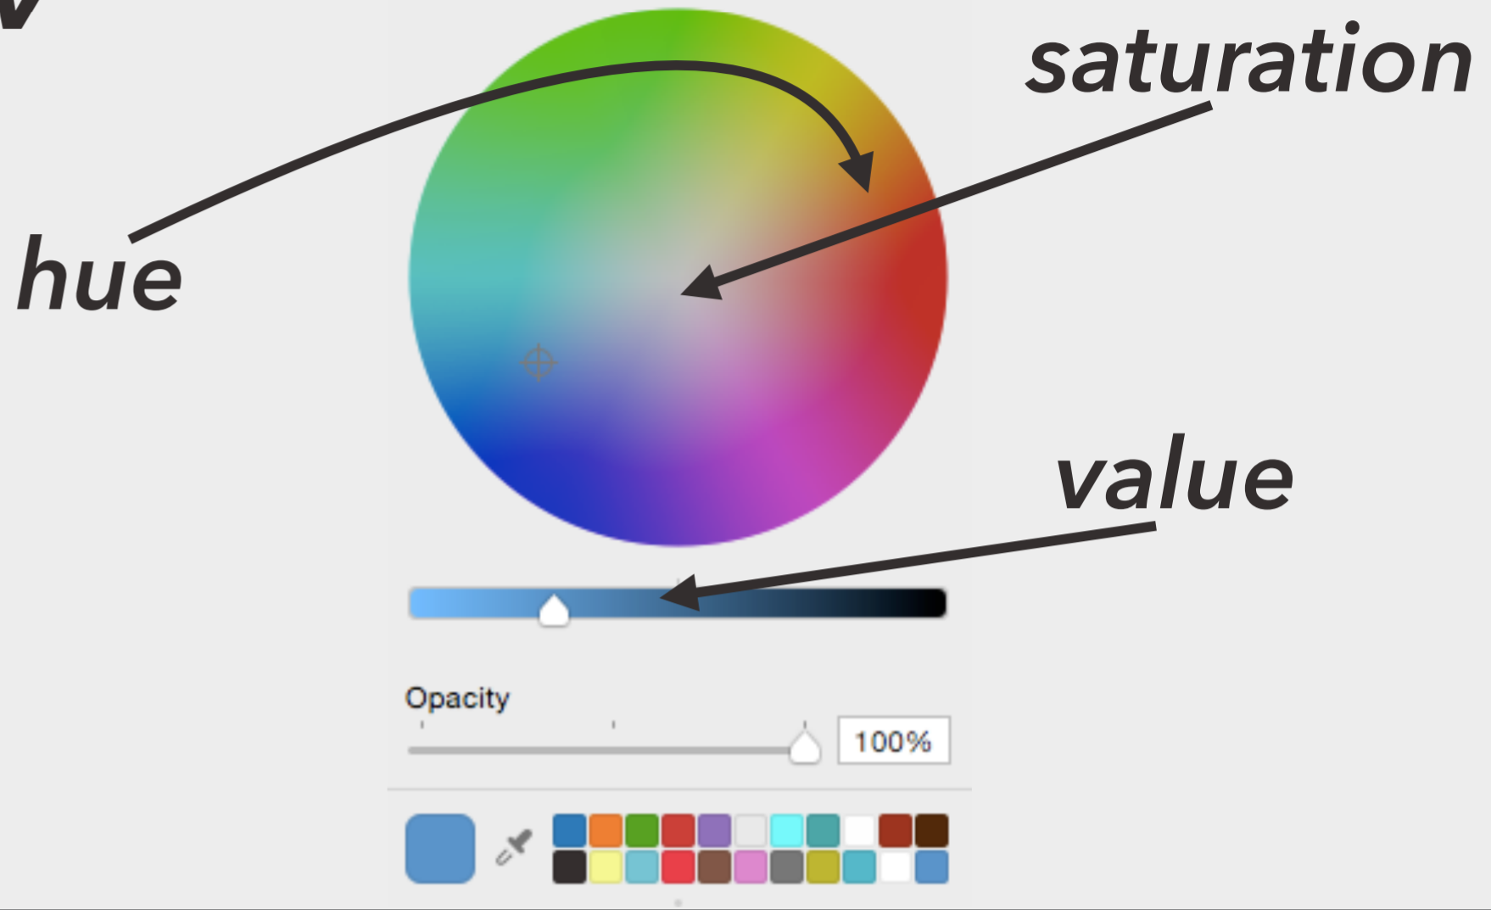
How we represent color
HSV/L
Hue = Pure colors (not mixed with white or black)
Saturation = Amount of white mixed with pure color
Value/Lightness = Amount of black mixed with pure color
Notes:
HSV/L (Hue-Saturation-Value/Lightness)

Slide 13


Issues
Distance between colors is closer, but not identical to how we perceive differences
How we represent color
HSV/L
A: (5, 7, 15) B: (15, 17, 25)
hsv(120, 100, 50) hsv(130, 110, 60)
hsv(0, 100, 50) hsv(10, 110, 60)
Notes:
HSV/L (Hue-Saturation-Value/Lightness)

Slide 14
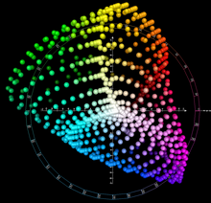
How we represent color
CIELAB
L* = Perceptual lightness
a* = unique color (red – green)
b* = unique color (blue – yellow)
Notes:
Given

Slide 15
Issues
Given numerical change corresponds to perceived change in color, but is computationally complex
How we represent color
CIELAB
A: (5, 7, 15) B: (15, 17, 25)
lab(46.05, -51.55, 49.76) lab(56.05, -41.55, 59.76)
lab(25.42, 47.91, 37.91) lab(35.42, 57.91, 47.91)
Notes:
Given

Slide 16
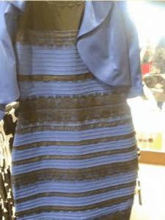

Color phenomena

Slide 17
Caveat 1: color is perceived in context
Color phenomena
Which small square is darker green?

Slide 18


Caveat 2: difference is relative
Color phenomena

Slide 19

Caveat 2a: so are brightness and contrast
Color phenomena

Slide 20
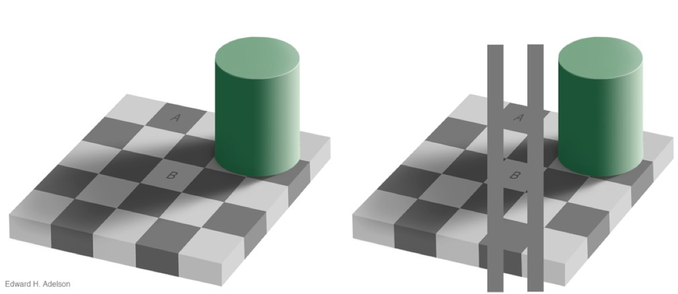
Caveat 3: mental models > perception
Color phenomena

Slide 21
Color palettes
Using a poor color scheme can also cause issues with your visualization

Slide 22
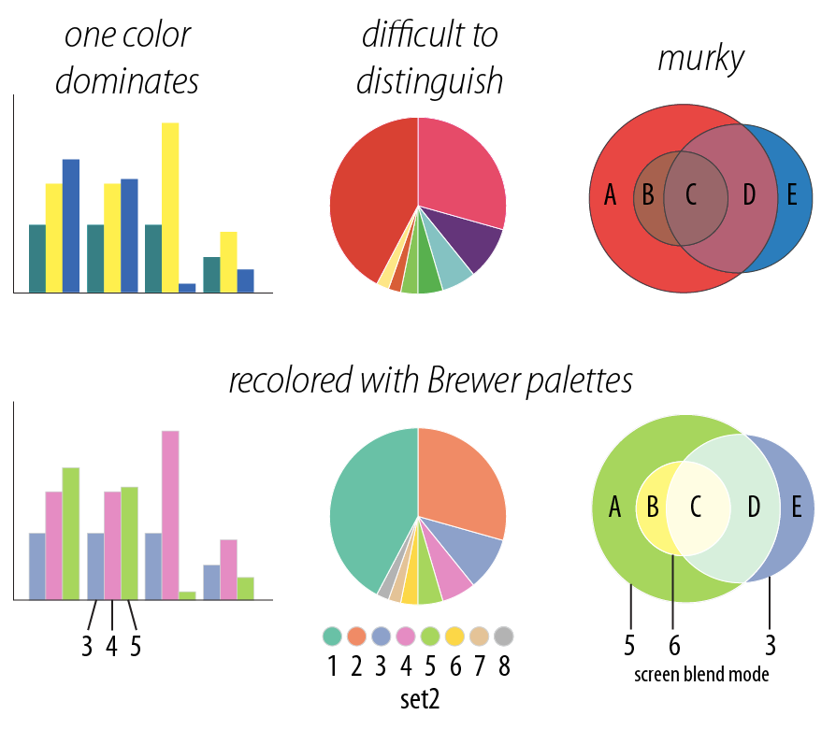
One color dominates
Difficult to distinguish
Color Problems
Murky

Slide 23
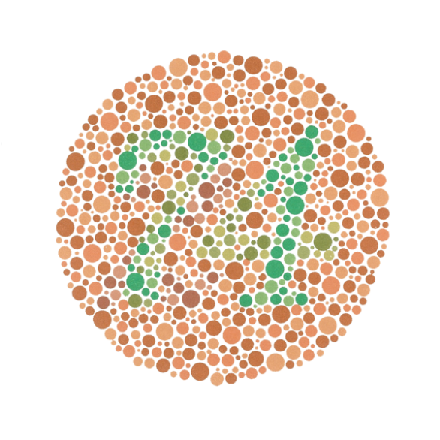
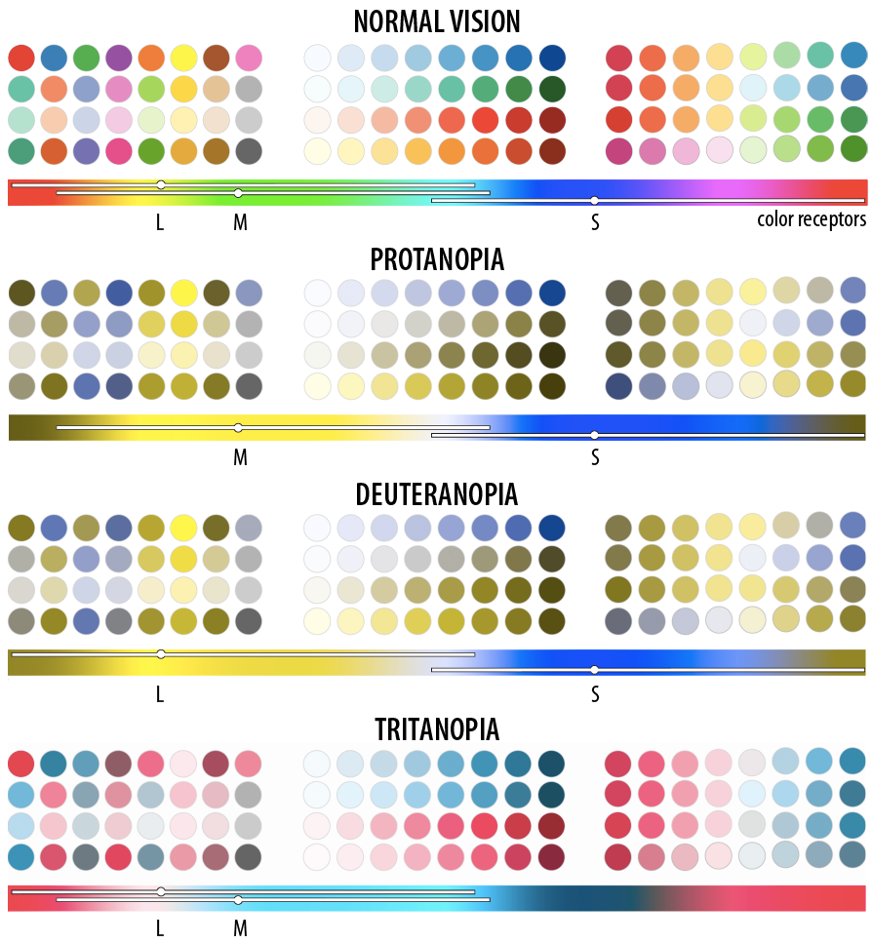
Fun fact: “colorblindness”
1 out of every 8 people has just 2 types of color receptors (rather than 3)

Slide 24
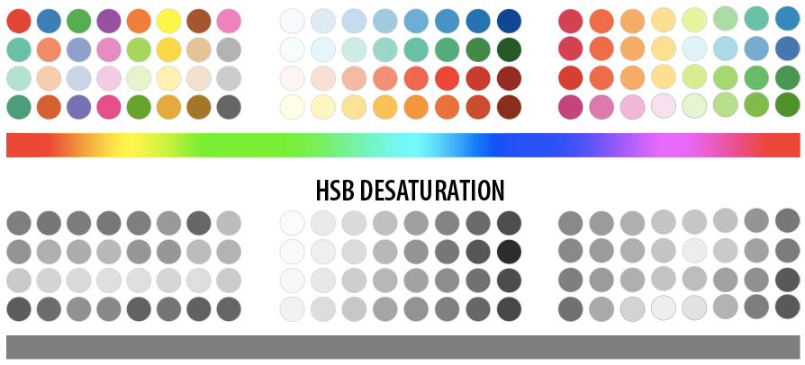
What happens when you print?
Need color scheme that converts well to grey scale

Slide 25
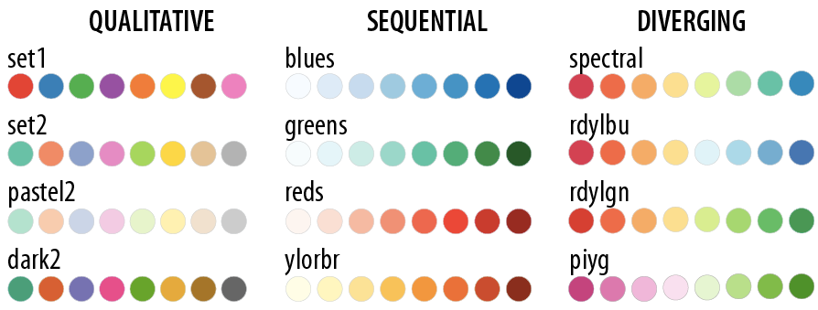
colorbrewer.org provides a whole bunch of palettes that can help us avoid these issues
This makes life a lot easier for us!
Colorbrewer palettes

Slide 26
colorbrewer.org provides a whole bunch of palettes that can help us avoid these issues
This makes life a lot easier for us!
Colorbrewer palettes
When should we use each type of color palette?

Slide 27
Find a partner
Open a dataset of your choosing
Build two visualizations on this dataset
One that tells the “real” story in the data (as you understand it), using color to represent at least one variable
One that uses color in an intentionally misleading way
Mini-lab: color tricks

Slide 28
What did you try?
What did you learn about the data?
Can you imagine a scenario that might incline someone to choose your “bad” visualization instead of a better one?
Discussion

