Slide 1
Visual Analytics– Analytic Provenance
Dr. Ab Mosca (they/them)
Slides based off slides courtesy of Jordan Crouser (https://jcrouser.github.io/)

Slide 2
Plan for Today
What is provenance?
Why are we interested?

Slide 3
Provenance: Definitions
Provenance (according to Webster):
origin, source
the history of ownership of a valued object or work of art or literature
Example: Has anyone traced the provenances of these paintings?

Slide 4
Provenance: Computer Science
Examples in CS relating to provenance:
Undo / Redo
Diff / Revision history
History logging (e.g., Wikipedia)
Interaction logging
Data annotation
Database queries and results (Oracle Flashback)
Screen capturing?
Knowledge management
Etc.

Slide 5
What is “Analytic Provenance”?
Analytic Provenance (AP): similar to workflow, is the provenance of the analysis (the steps of the analysis). This includes:
The record of the data and data manipulation
The record of the user’s interactions
The record of what the user sees
The record of the computational products (both the visualization and the data)
The record of the user’s analysis results

Slide 6
Discussion
As Visual Analysis tool developers, why would we care about analytic provenance?
What are two things you imagine we gain from it?

Slide 7
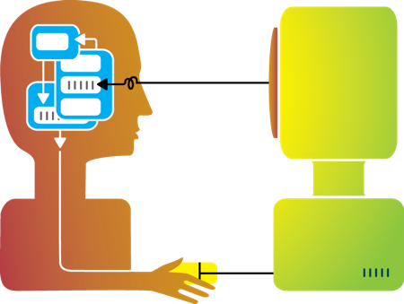

Types of Human-Visualization Interactions
Word editing (input heavy, little output)
Browsing, watching a movie (output heavy, little input)
Visual analysis (closer to 50-50?)

Slide 8
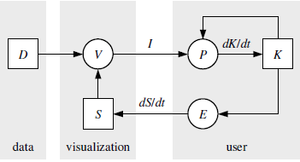




Van Wijk’s model of visualization
(1)
(2)
(3)
D = Data
V = visualization
S = specification (params)
I = image
P = perception
K = knowledge
E = exploration
(4)
(5)

Slide 9
Discussion: interaction as a data source
What drives user interaction?
What gets encoded during the interaction?
What might it tell us about their reasoning process?

Slide 10

Example: Detecting Financial Fraud

Slide 11
Example: Detecting Financial Fraud

Slide 12
Example: Detecting Financial Fraud

Slide 13
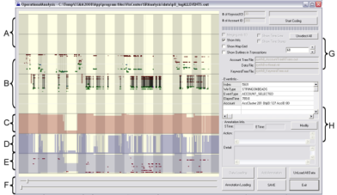
Experiment
Grad
Students
(Coders)
Analysts
Compare!
(manually)
Strategies
Methods
Findings
Guesses of
Analysts’ thinking
Logged
(semantic)
Interactions
WireVis
Interaction-Log Vis

Slide 14
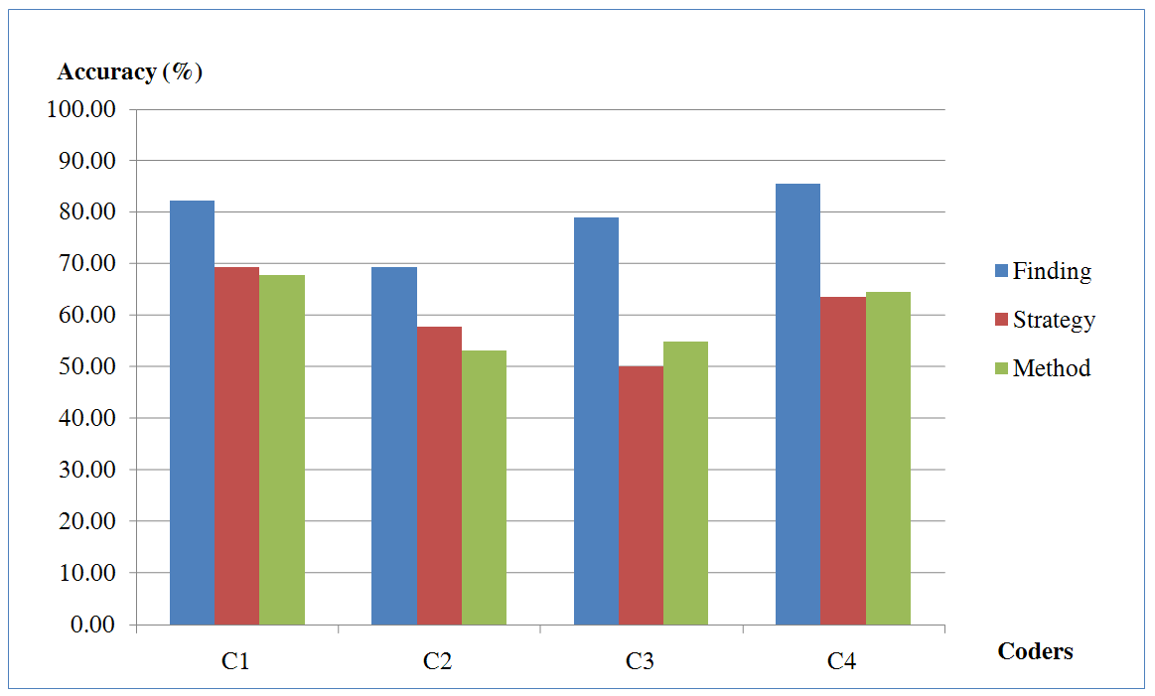
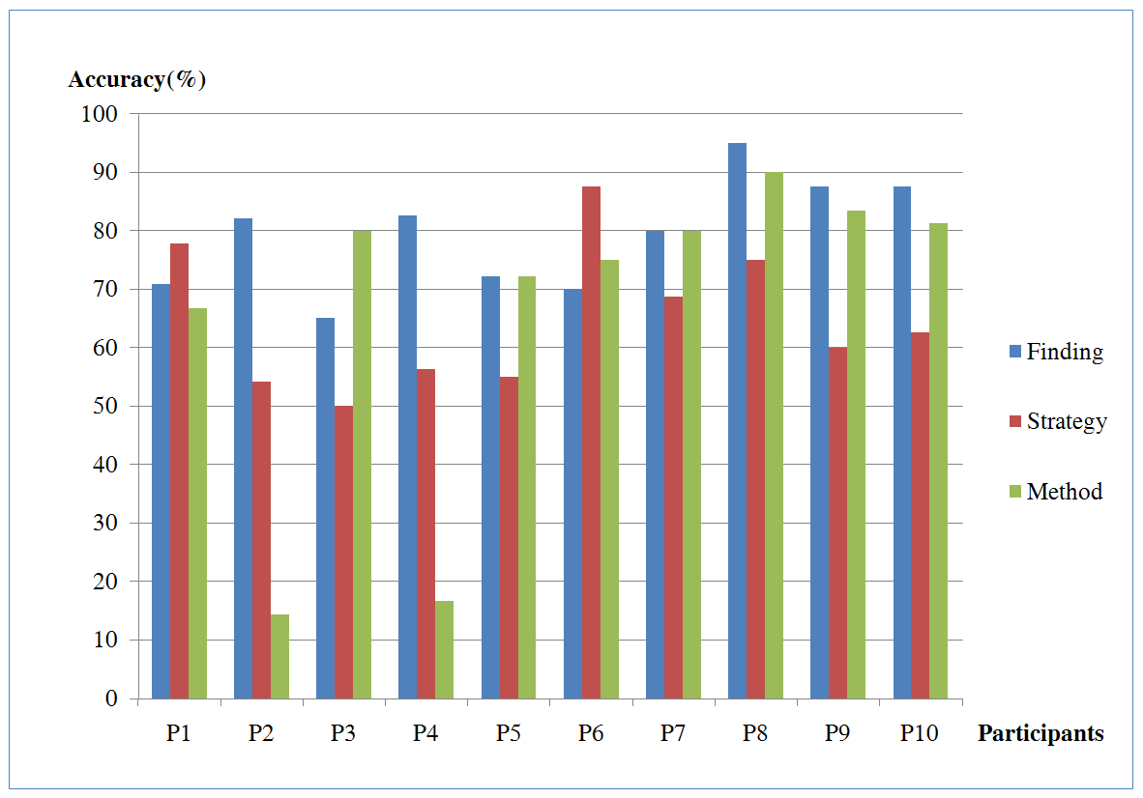
What’s in a user’s interactions?
Why are these two so much lower than others?
(recovering “methods” at about 15%)
R. Chang et al., Recovering Reasoning Process From User Interactions. IEEE Computer Graphics and Applications, 2009.
R. Chang et al., Evaluating the Relationship Between User Interaction and Financial Visual Analysis. IEEE Symposium on VAST, 2009.

Slide 15
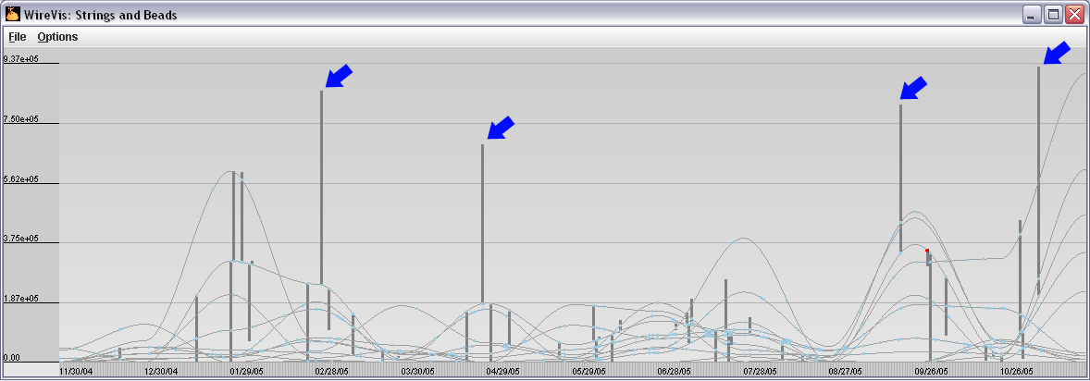
What’s in a user’s interactions?
In this case, only recording a user’s
explicit interaction is insufficient.

Slide 16
Five Stages of Provenance
Perceive: what does the user see?
Capture: which interactions to record, and how?
Encode: how do we want to store the interactions
Recover: how do we translate to something meaningful
Reuse: how can we reapply the interaction to a different problem or dataset?

Slide 17
Five Stages of Provenance
Perceive: what does the user see?
Capture: which interactions to record, and how?
Encode: how do we want to store the interactions
Recover: how do we translate to something meaningful
Reuse: how can we reapply the interaction to a different problem or dataset?

Slide 18
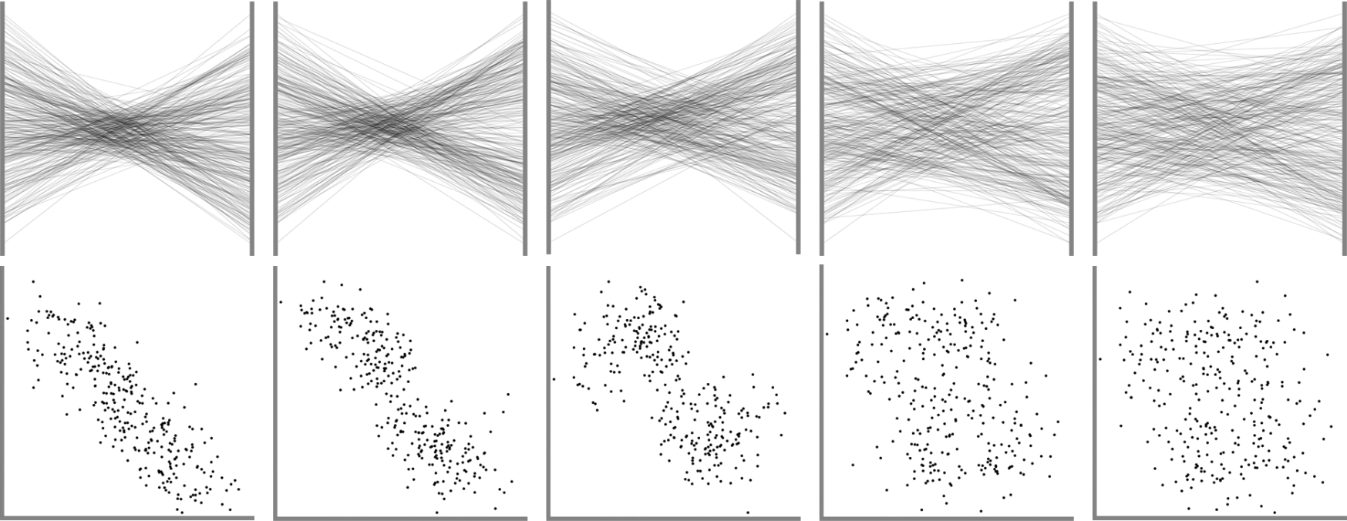
Perceive
What did the user see that prompted the subsequent actions?
Johansson et al. Perceiving patterns in parallel coordinates: determining thresholds for identification of relationships. InfoVis 2008.

Slide 19
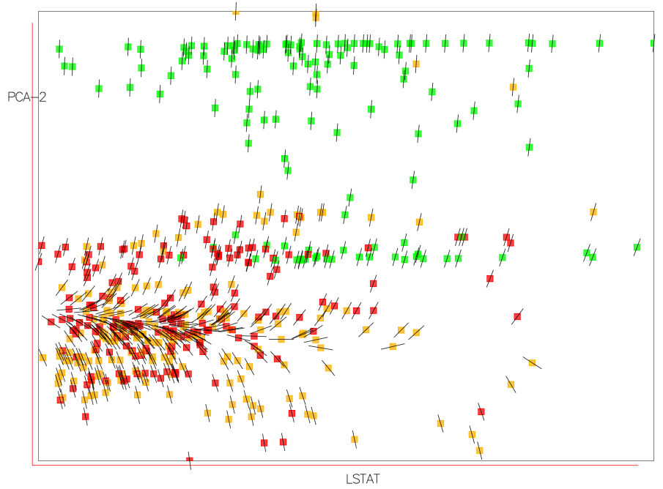
Perceive - Uncertainty
Correa et al. A Framework for Uncertainty-Aware Visual Analytics. VAST 2009.

Slide 20
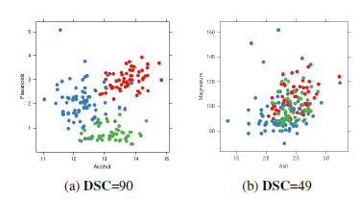
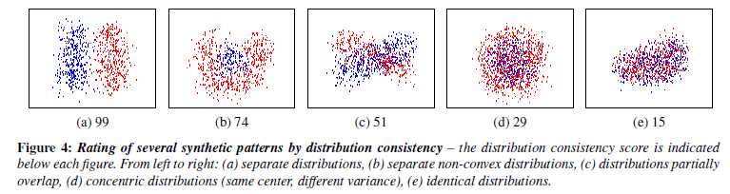
Perceive – Visual Quality
Sipps et al. Selecting good views of high-dimensional data using class consistency. Eurovis 2009.

Slide 21
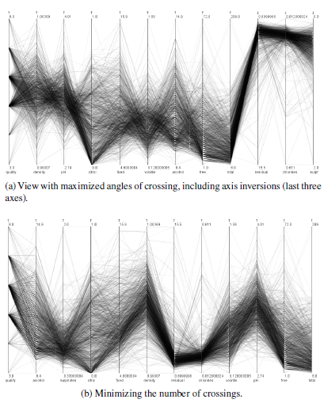
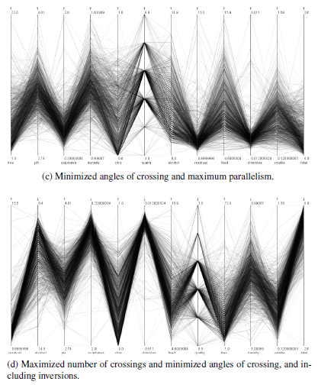
Perceive – Visual Quality
Dasgupta and Kosara. Pargnostics: Screen-Space Metrics for Parallel Coordinates. InfoVis 2010.

Slide 22
Discussion
What other types of visual perceptual characteristics should we (as designers and developers) be aware of?
As a developer, if you know these characteristics, how can you control them in an open exploratory visualization system?

Slide 23
Capture
The “bread and butter” of analytic provenance
Need to choose carefully about “what” to capture
Capturing at too low level → cannot decipher the intent
Capturing at too high level → not usable for other applications

Slide 24
Manual Capturing
When in doubt, ask the user:
Annotations: directly edited text
Structured diagrams: illustrating analytical steps
Reasoning graph: reasoning artifacts and relationships

Slide 25
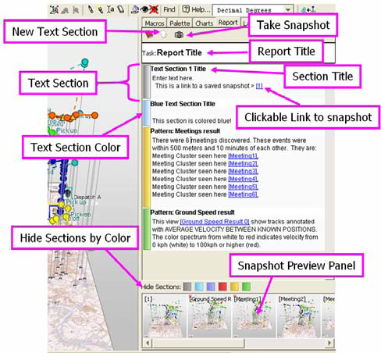
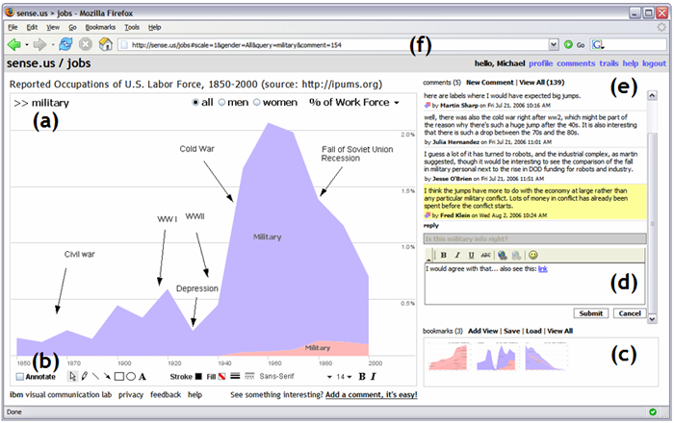
Annotations

Slide 26
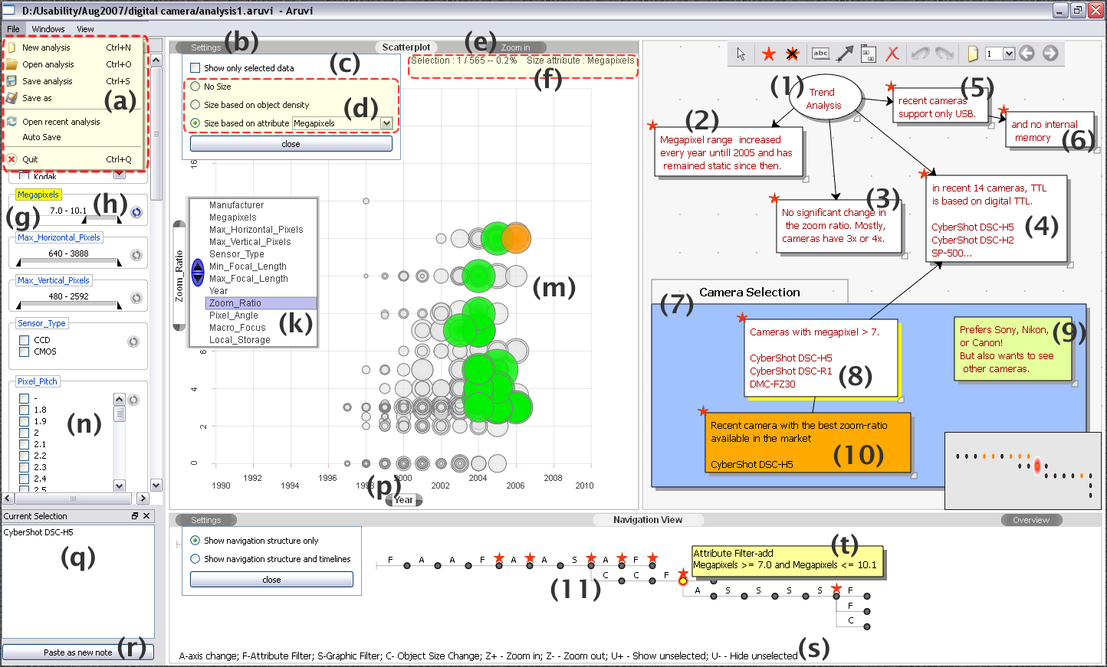
Structured diagrams
Shrinivasan and van Wijk. Supporting the Analytical Reasoning Process in Information Visualization. CHI 2008.

Slide 27
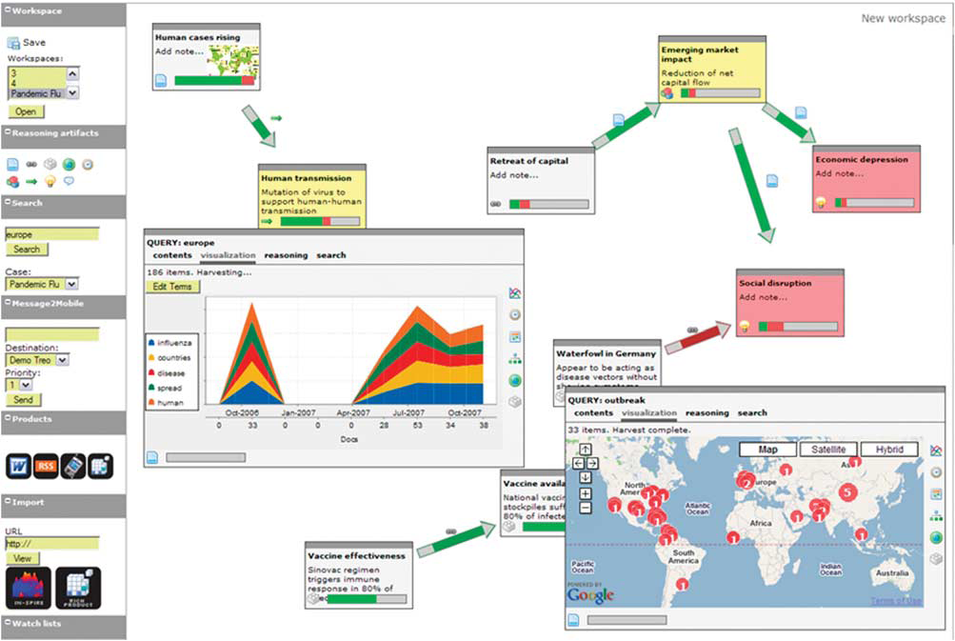
Reasoning graphs

Slide 28
Automatic capturing
Option 1: capture the mouse and key strokes
Option 2: capture the state of the visualization

Slide 29
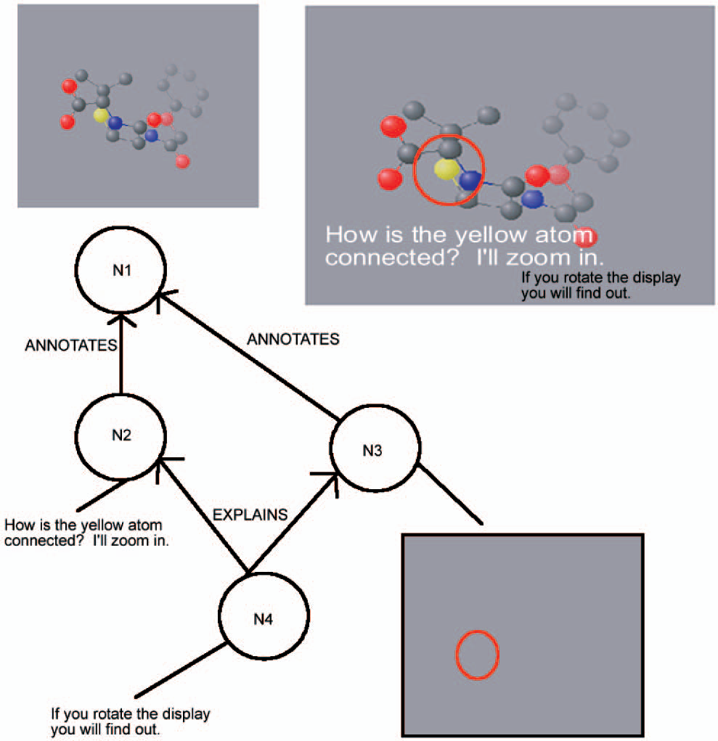
Capturing interaction in a single application
Groth and Streefkerk. Provenance and Annotation for Visual Exploration Systems. TVCG 2006.

Slide 30
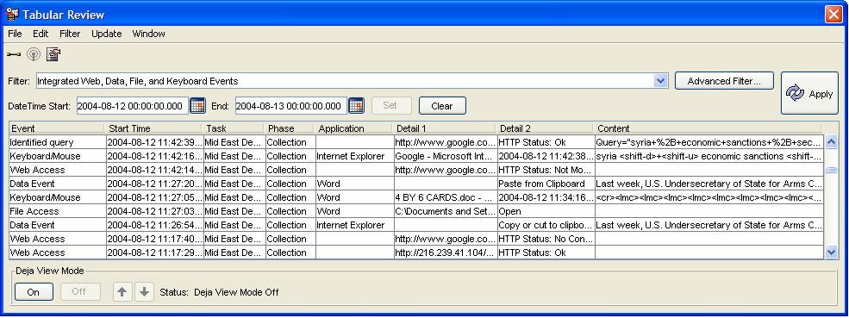
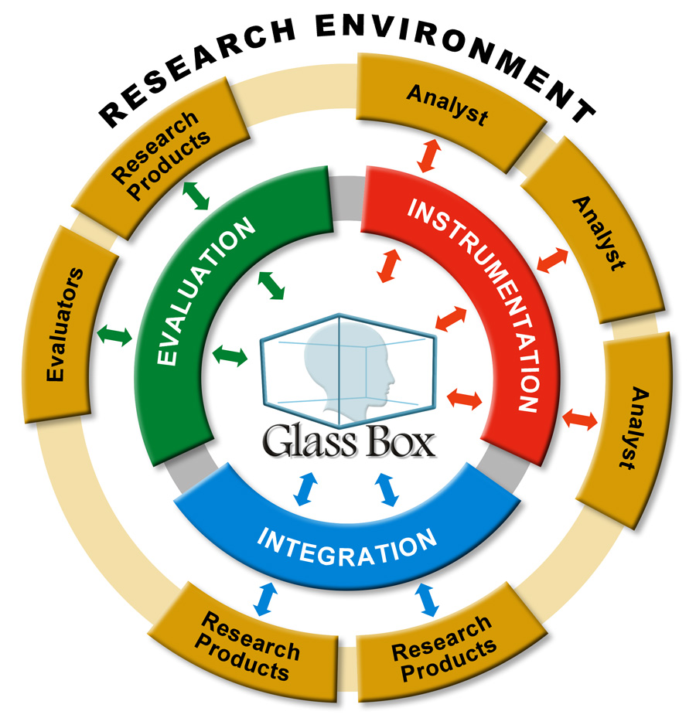
Interaction across multiple platforms
Cowley PJ, JN Haack, RJ Littlefield, and E Hampson. 2006. "Glass Box: Capturing, Archiving, and Retrieving Workstation Activities." In The 3rd ACM Workshop on Capture, Archival and Retrieval of Personal Experiences, CARPE 2006, October 27, 2006, Santa Barbara, California, USA, pp. 13-18 ACM, New York, NY.

Slide 31
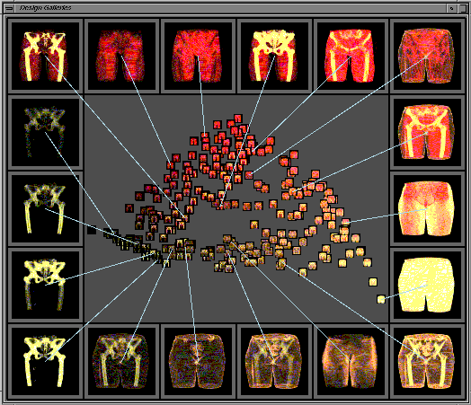
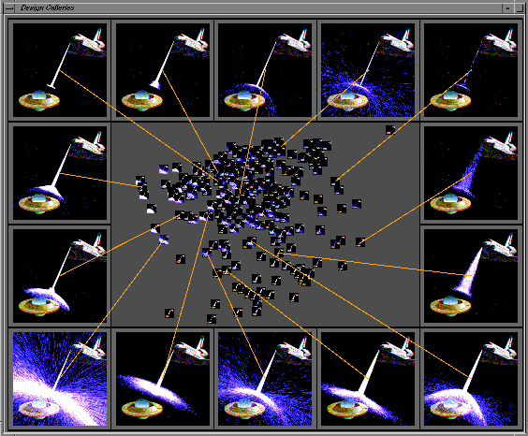
Capturing visualization state (periodic)
Marks et al. Design Gallaries. Siggraph 1997.

Slide 32
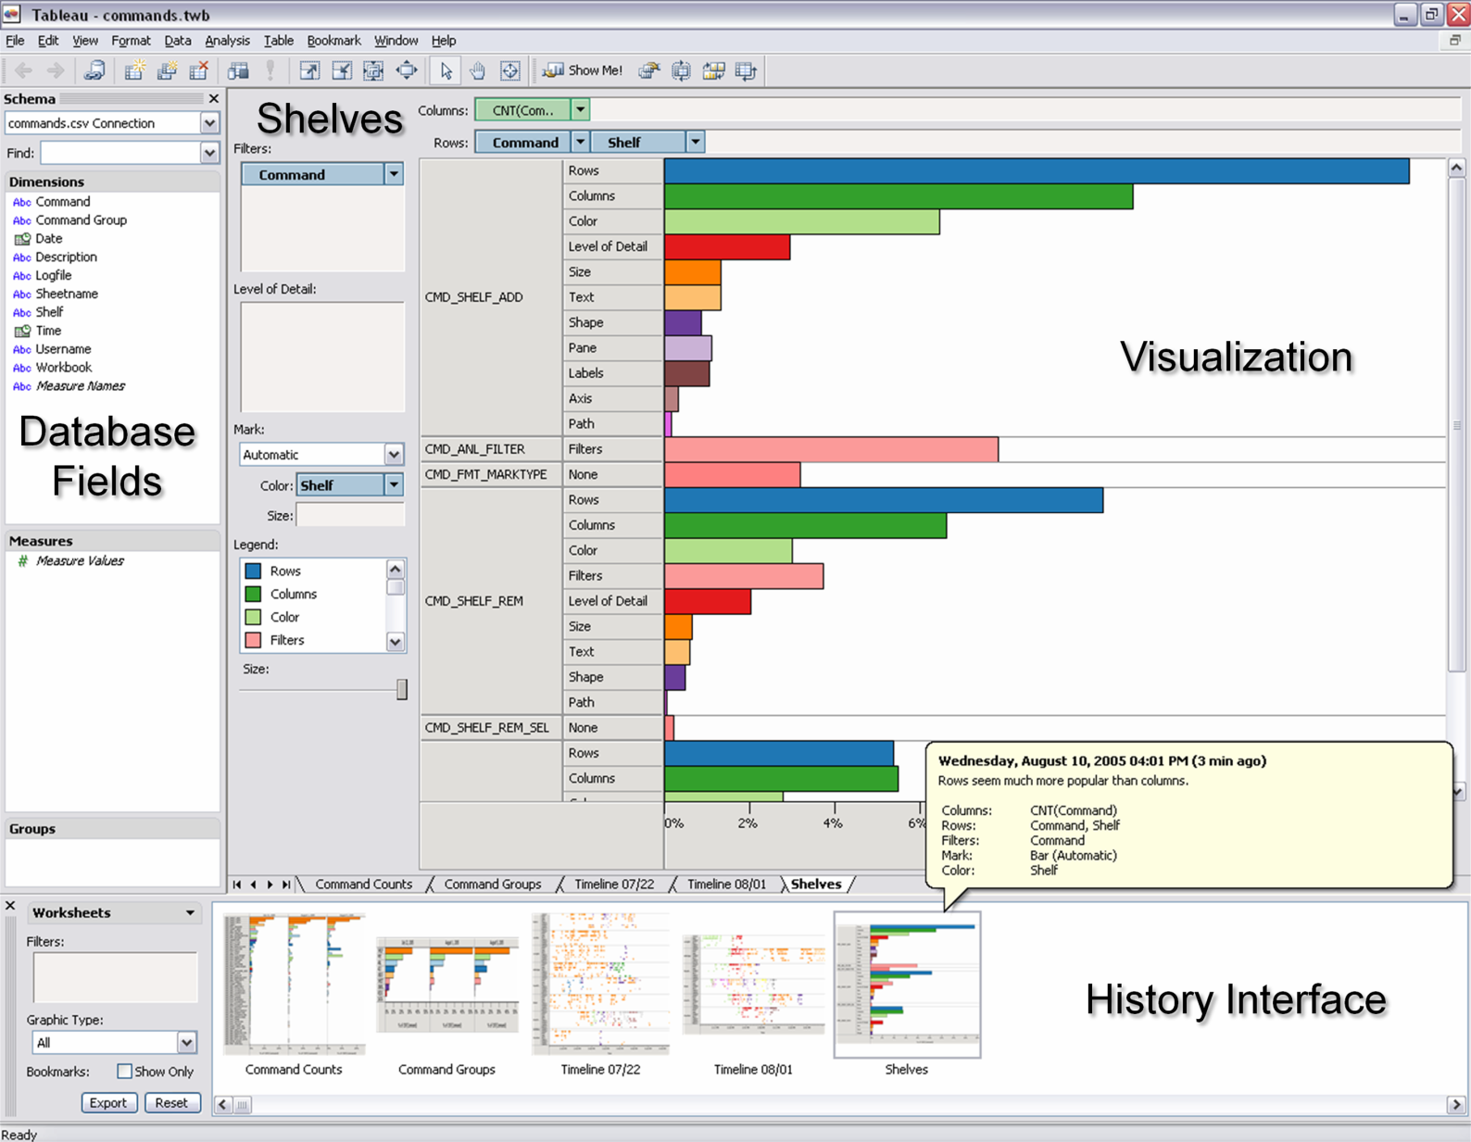
Capturing visualization state (transitions)
Heer et al. Graphical Histories for Visualization: Supporting Analysis, Communication, and Evaluation. InfovVis 2008.

Slide 33
Discussion
How many different levels are there between low level interactions (e.g. mouse x, y) to high level interactions?
What are the pros and cons of manual capturing vs. automatic capturing?
Single application vs. multiple?

Slide 34
Encode
How do we store the captured interactions or visualization states?
Encoding manually captured interactions: could be issues with different “languages”
Encoding automatically captured interactions: more robust description of event sequences and patterns

Slide 35
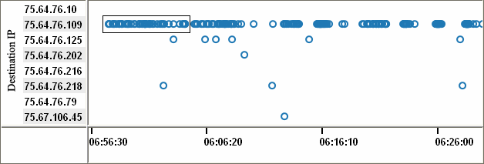

Encoding manual captures
Xiao et al. Enhancing Visual Analysis of Network Traffic Using a Knowledge Representation. VAST 2007.

Slide 36
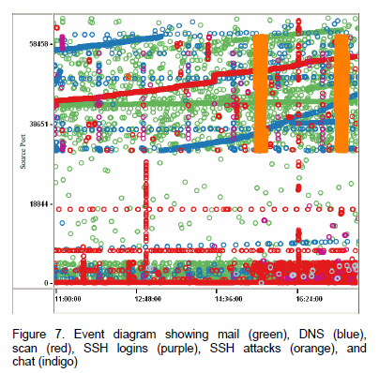
Encoding manual captures

Slide 37
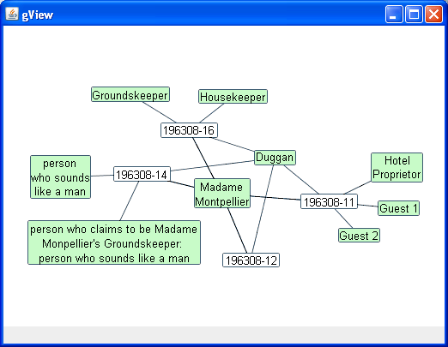
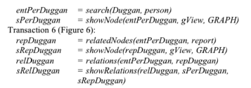
Encoding automatic captures
Kadivar et al. Capturing and Supporting the Analysis Process. VAST 2009.

Slide 38
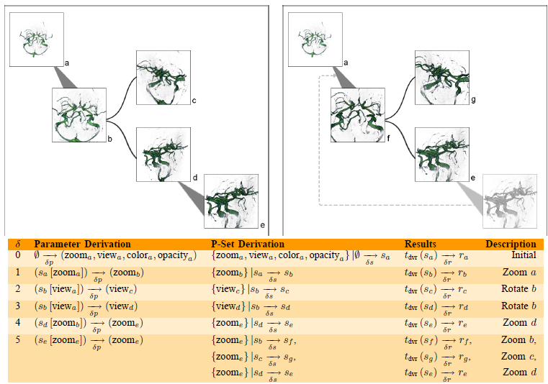
Encoding automatic captures
Jankun-Kelly et al. A Model and Framework for Visualization Exploration. TVCG 2006.

Slide 39
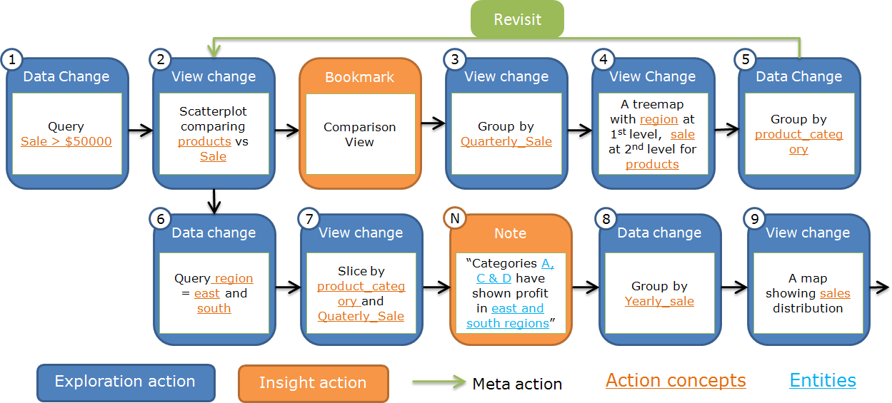
Encoding automatic captures
Shrinivasan et al. Connecting the Dots in Visual Analysis. VAST 2009.

Slide 40
Discussion
Is the use of predicates or inductive logic programming generalizable? Does it scale?
How could we integrate interaction logging and perceptual logging?

Slide 41
Recover
Given all the stored interactions, derive meaning, reasoning processes, and intent
Manually: ask other humans to interpret a user’s interactions
Automatically: ask a computer to interpret a human’s interactions

Slide 42
Manual recovery
From this experiment, we find that interactions contains at least:
60% of the (high level) strategies
60% of the (mid level) methods
79% of the (low level) findings

Slide 43
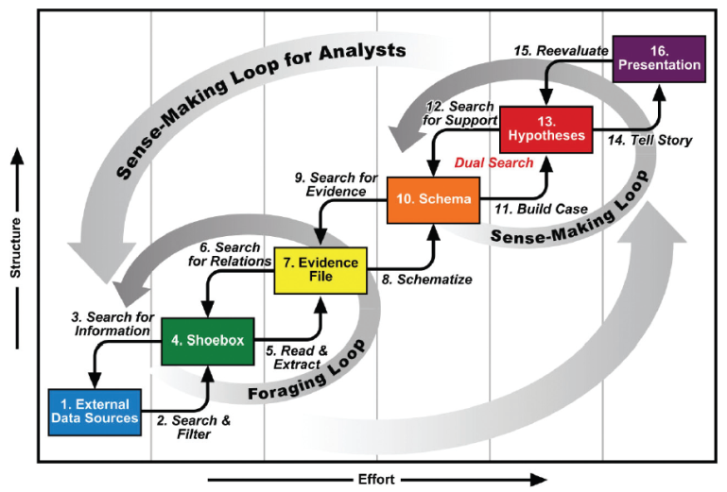
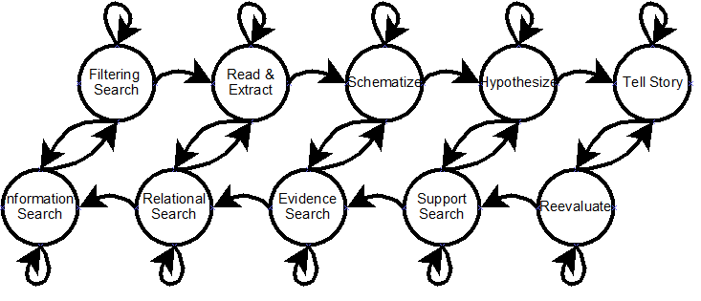
Automatic recovery
Perry et al. Supporting Cognitive Models of Sensemaking in Analytics Systems DIMACS Technical Report 2009.

Slide 44
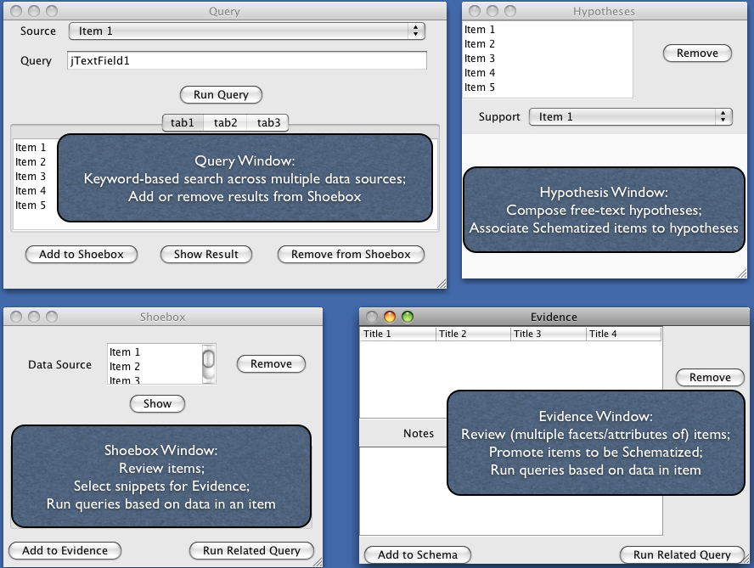
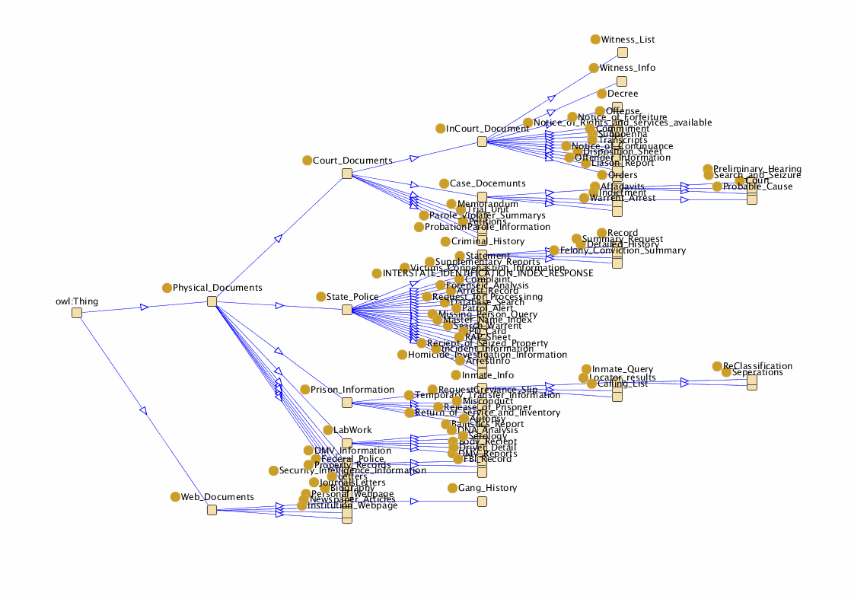
Automatic recovery
Perry et al. Supporting Cognitive Models of Sensemaking in Analytics Systems DIMACS Technical Report 2009.

Slide 45
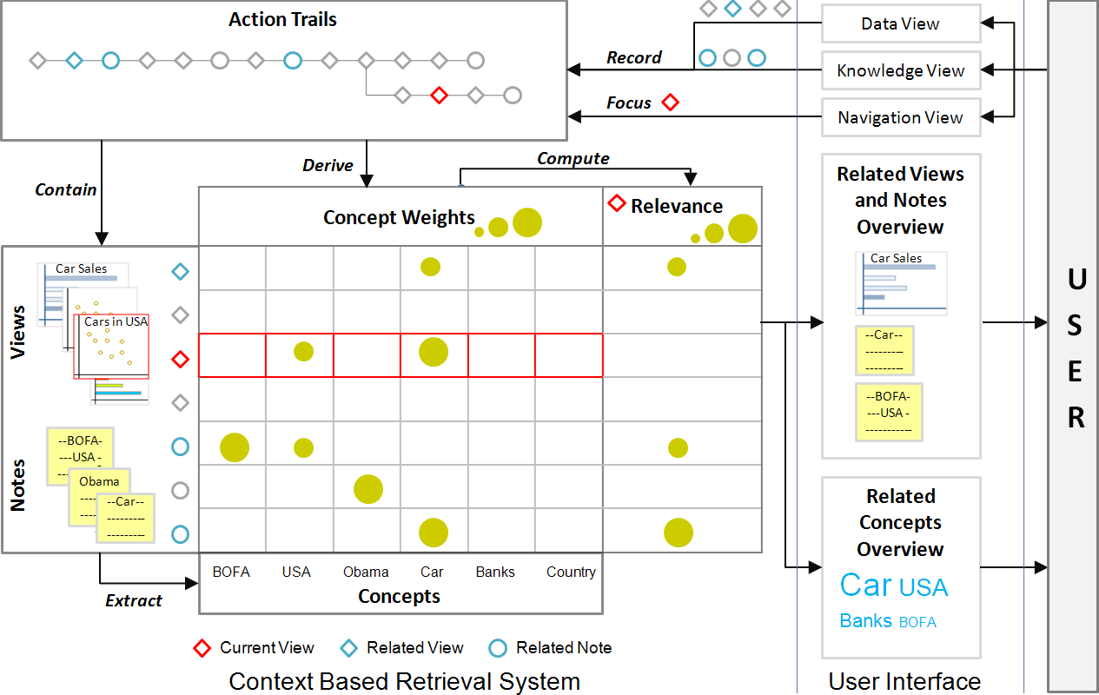
Automatic recovery
Shrinivasan et al. Connecting the Dots in Visual Analysis. VAST 2009.

Slide 46
Discussion
Could we integrate a manually constructed model with automated learning?
What would that entail?

Slide 47
Reuse
Reapply the recovered user interactions, intent, reasoning process, etc. to a different dataset or problem
Reuse user interactions: reapply the recorded interactions with some ability to recover from failures
Reuse analysis patterns: reapply the “rules” learned from previous analysis

Slide 48
Reuse user interactions

Slide 49
Reuse analysis patterns

Slide 50
Discussion
Reuse is only applicable when some combinations of the previous stage(s) are successful
More broadly speaking, does it make sense?
(Familiar) example of reuse

Slide 51
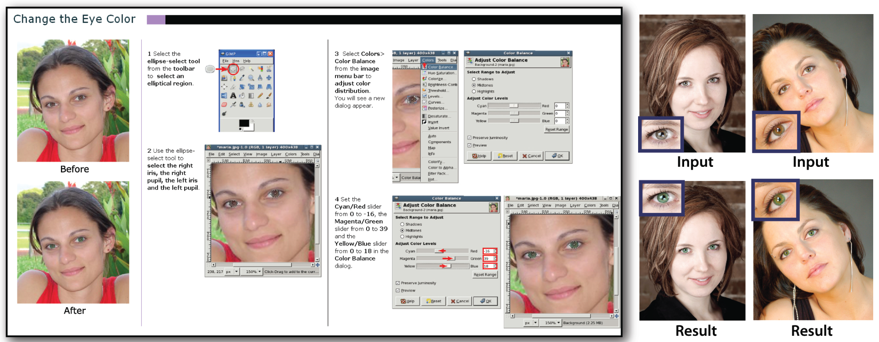
Generating tutorials
Grabler et al. Generating Photo Manipulation Tutorials by Demonstration. SIGGRAPH 2009.

Slide 52
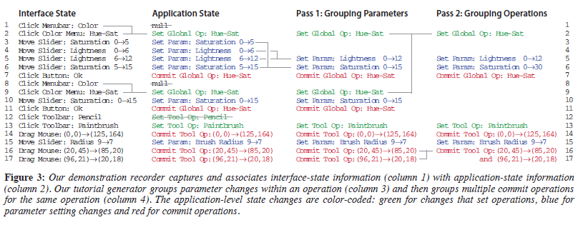
Generating tutorials

Slide 53


Ongoing research
So far: interaction as window into what a user does (when faced with a specific problem)
Recent work: can interaction patterns also be a window into who a user is?

Slide 54
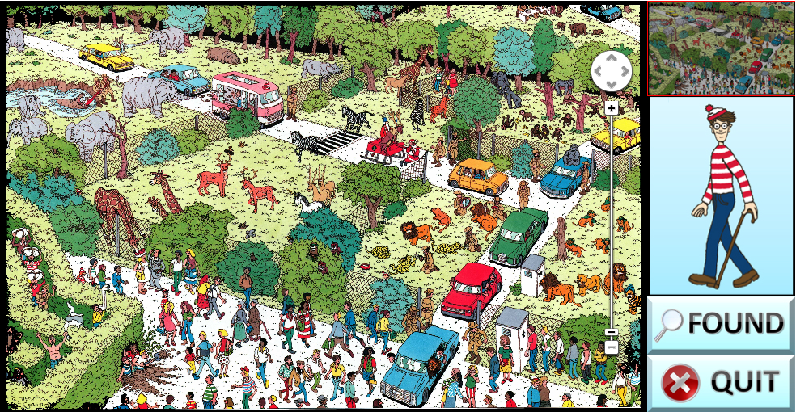
Learning about users from interaction
Brown, Eli T., et al. "Finding Waldo: Learning about Users from their Interactions." (2014).

Slide 55
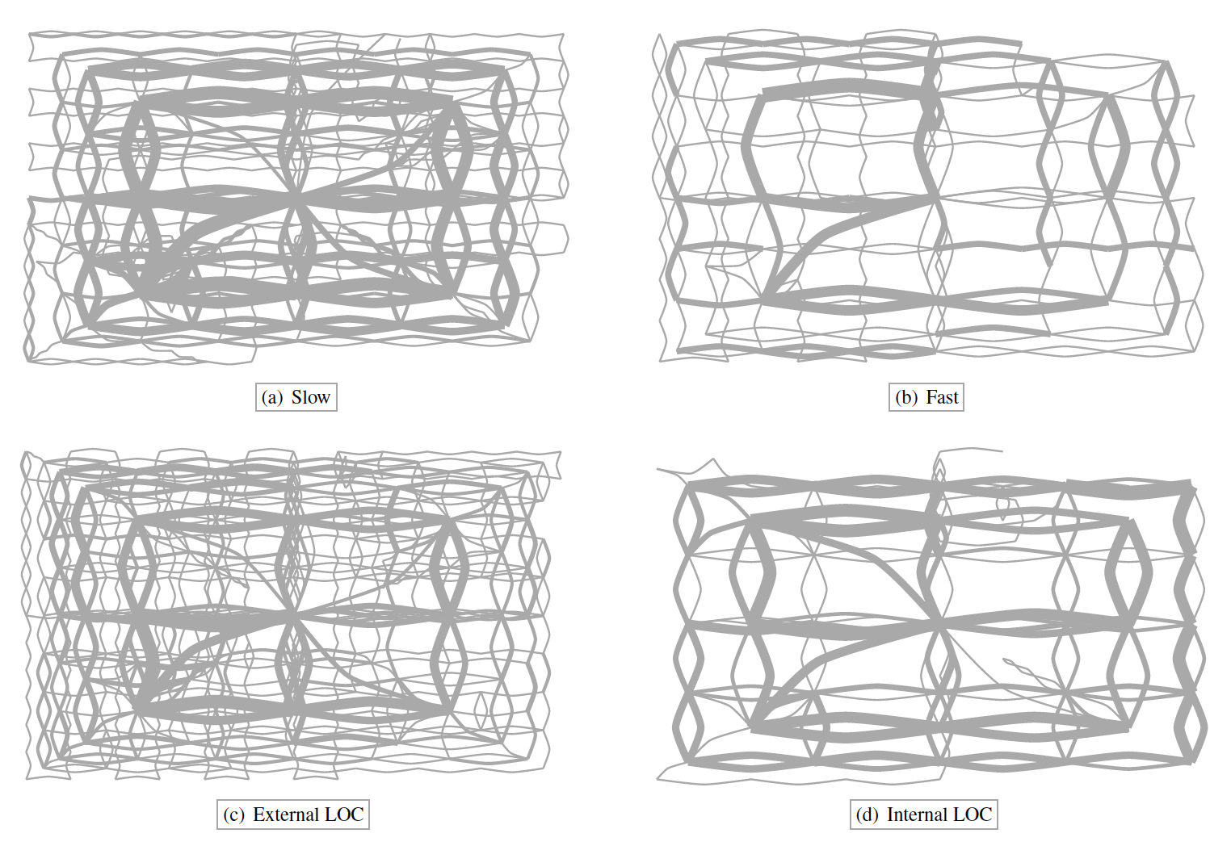
Learning about users from interaction
Brown, Eli T., et al. "Finding Waldo: Learning about Users from their Interactions." (2014).

