Slide 1
Visual Analytics: explainable ai lab
Ab Mosca (they/them)

Slide 2
Today’s plan
Warm up
Intro to “explainables / explorables”
Create your own

Slide 3
Warm up
What is the design space for XAI?
What is one XAI visualization technique we looked at last class?
What is an open area in XAI research?

Slide 4
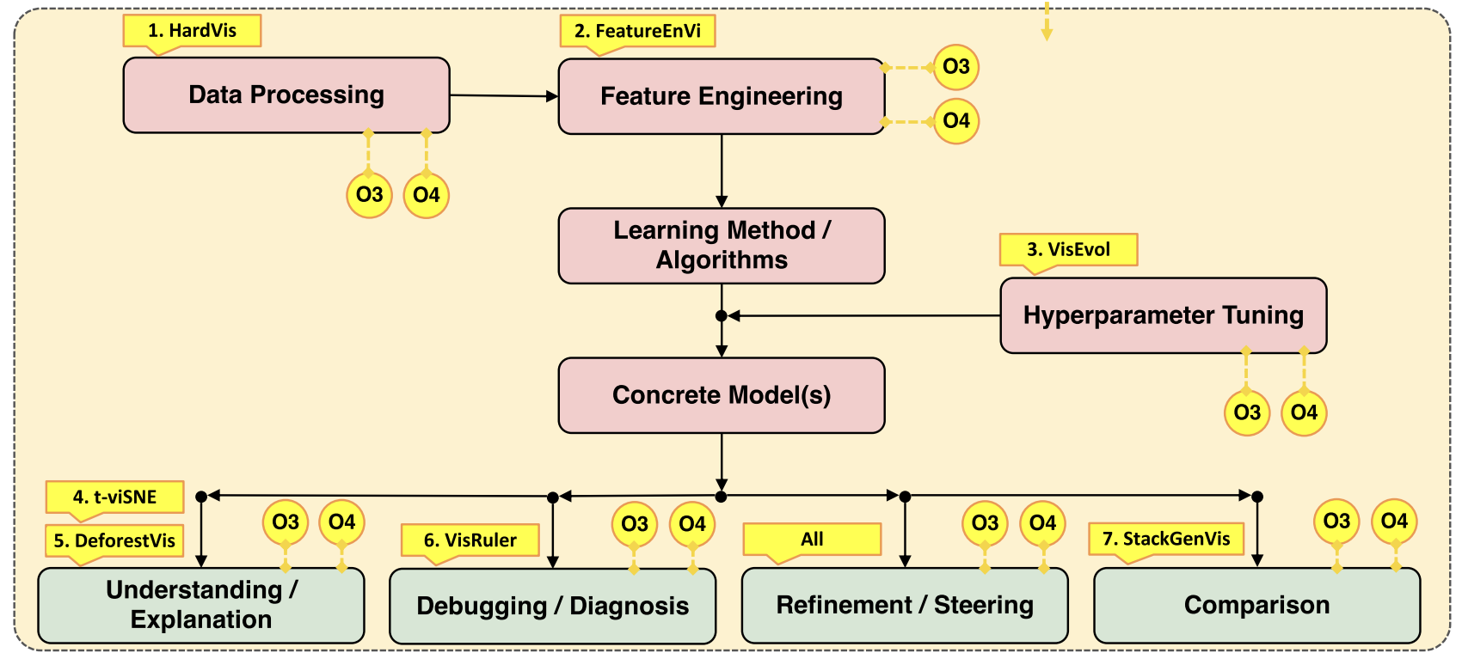
xai and Visualization: design space
A. Chatzimparmpas, "Visual Analytics for Explainable and Trustworthy Artificial Intelligence,” 2025, doi: 10.1109/MCG.2025.3533806
Notes:
The red boxes present a typical AI pipeline with four trust components in green. Lastly, the vivid yellow nodes refer to the research objectives (O1–O4) associated with the related results

Slide 5
Ai Explainables / explorables
VISxAI is a workshop focused on using visualization to explain AI algorithms / techniques
Each year, participants submit web-based visualizations that walk through the inner workings of an AI algorithm
Check out one of the Hall of Fame submissions: https://visxai.io/#hall-of-fame; prepare to report back to the class what you learned

Slide 6
create an Ai Explainable / explorable
Choose an AI or ML technique that interests you. It does not have to be extremely complex, for example you could pick logistic regression
If you don’t know much about the technique, look up the basics of how it works
Sketch an outline to an explainable you could make for the technique you chose
Implement your idea as a webpage

