Slide 1
Visual Analytics: systems for modeling
Ab Mosca (they/them)

Slide 2
Today’s plan
Modeling overview
VA systems for model:
Explanation
Debugging
Construction and steering
Comparison
Exploratory model analysis (EMA)
Definition
Contrast with EDA
Workflow

Slide 3
modeling overview: warm up
Give an example of a predictive model
What is the goal of a predictive model?
How are predictive models generated?
How are predictive models evaluated?

Slide 4
modeling overview
In machine learning, a model is what is being learned from the data to solve a specific task
Tasks include:
Classification
Regression
Clustering
Association discovery
Flach P. Machine Learning: The Art and Science of Algorithms That Make Sense of Data. Cambridge University Press; 2012.

Slide 5
modeling overview
Three general types of models
Geometric
Use geometric concepts (ex. lines, planes, distance) to classify input
Ex. Basic linear classifiers, Nearest-neighbor classifiers
Probabilistic
Attempts to uncover underlying probability distributions that determine how variables are related
Ex. Bayes classifier
Logical
Algorithmic in nature; a series of if-then statements
Ex. Decision tree
Flach P. Machine Learning: The Art and Science of Algorithms That Make Sense of Data. Cambridge University Press; 2012.

Slide 6
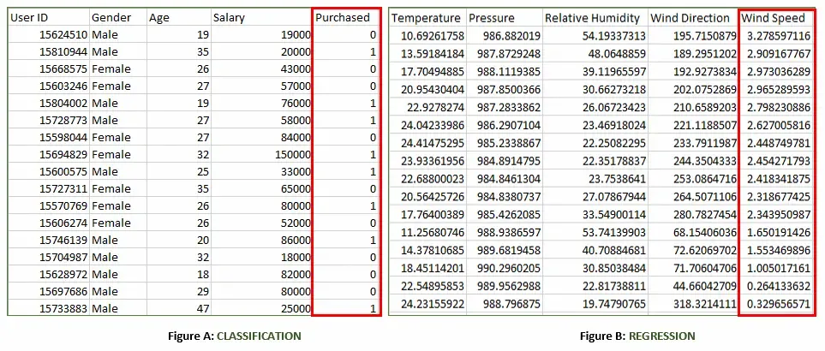
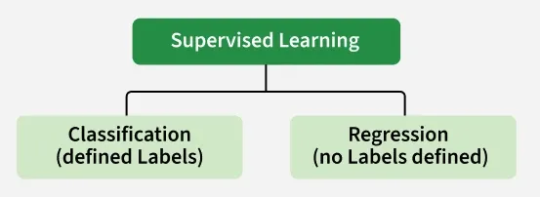
modeling overview
We will focus on supervised machine learning
https://www.geeksforgeeks.org/machine-learning/supervised-machine-learning/
Notes:
Figure A:
It is a dataset of a shopping store that is useful in predicting whether a customer will purchase a particular product under consideration or not based on his/her gender, age and salary.
Input: Gender, Age, Salary
Output: Purchased i.e. 0 or 1; 1 means yes the customer will purchase and 0 means that the customer won't purchase it.

Slide 7
modeling overview
We will focus on supervised machine learning
https://www.geeksforgeeks.org/machine-learning/supervised-machine-learning/
Notes:
Figure B:
It is a Meteorological dataset that serves the purpose of predicting wind speed based on different parameters.
Input: Dew Point, Temperature, Pressure, Relative Humidity, Wind Direction
Output: Wind Speed

Slide 8
modeling overview
We will focus on supervised machine learning
Process:
Collect Labeled Data
Split the Dataset
Train the Model
Validate and Test the Model
Deploy and Predict on New Data
https://www.geeksforgeeks.org/machine-learning/supervised-machine-learning/
Notes:
Collect Labeled Data
Gather a dataset where each input has a known correct output (label).
Example: Images of handwritten digits with their actual numbers as labels.
2. Split the Dataset
Divide the data into training data (about 80%) and testing data (about 20%).
The model will learn from the training data and be evaluated on the testing data.
3. Train the Model
Feed the training data (inputs and their labels) to a suitable supervised learning algorithm (like Decision Trees, SVM or Linear Regression).
The model tries to find patterns that map inputs to correct outputs.
4. Validate and Test the Model
Evaluate the model using testing data it has never seen before.
The model predicts outputs and these predictions are compared with the actual labels to calculate accuracy or error.
5. Deploy and Predict on New Data

Slide 9
modeling overview
We will focus on supervised machine learning
Use cases:
Fraud Detection in Banking
Parkinson Disease Prediction
Customer Churn Prediction
Cancer cell classification
Stock Price Prediction
Where is modeling used for decision making?
https://www.geeksforgeeks.org/machine-learning/supervised-machine-learning/
Notes:
Fraud Detection in Banking: Utilizes supervised learning algorithms on historical transaction data, training models with labeled datasets of legitimate and fraudulent transactions to accurately predict fraud patterns.
Parkinson Disease Prediction: Parkinson’s disease is a progressive disorder that affects the nervous system and the parts of the body controlled by the nerves.
Customer Churn Prediction: Uses supervised learning techniques to analyze historical customer data, identifying features associated with churn rates to predict customer retention effectively.
Cancer cell classification: Implements supervised learning for cancer cells based on their features and identifying them if they are ‘malignant’ or ‘benign.
Stock Price Prediction: Applies supervised learning to predict a signal that indicates whether buying a particular stock will be helpful or not.

Slide 10
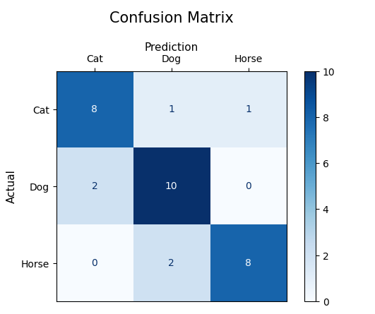
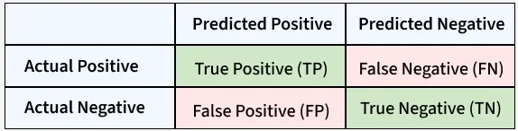
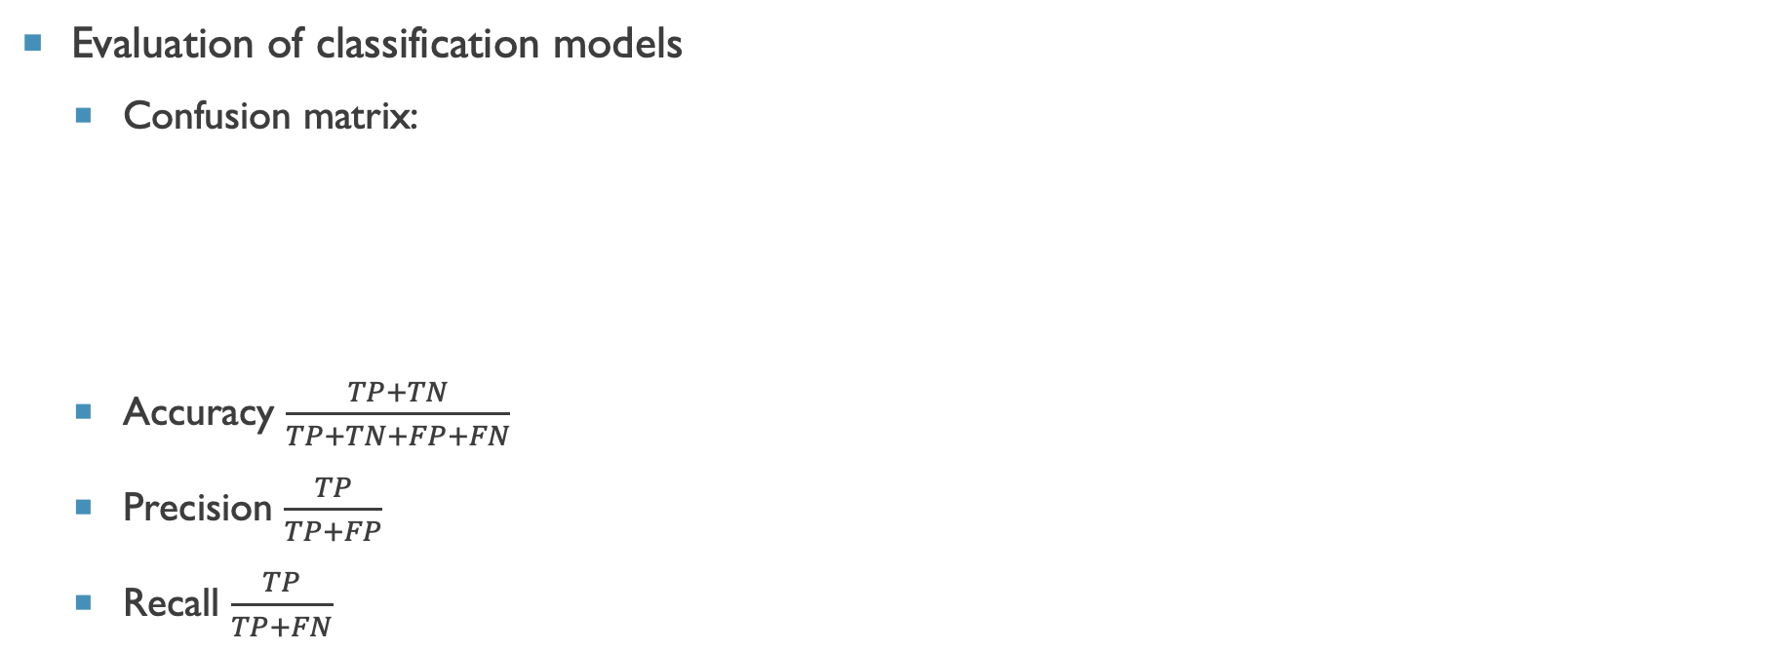
modeling overview
Evaluation of classification models
Confusion matrix:
Accuracy $\frac{TP+TN}{TP+TN+FP+FN}$
Precision $\frac{TP}{TP+FP}$
Recall $\frac{TP}{TP+FN}$
https://www.geeksforgeeks.org/machine-learning/confusion-matrix-machine-learning/
Notes:
Accuracy shows how many predictions the model got right out of all the predictions. It gives idea of overall performance but it can be misleading when one class is more dominant over the other. For example a model that predicts the majority class correctly most of the time might have high accuracy but still fail to capture important details about other classes.
Precision focus on the quality of the model’s positive predictions. It tells us how many of the "positive" predictions were actually correct. It is important in situations where false positives need to be minimized such as detecting spam emails or fraud
Recall measures how how good the model is at predicting positives. It shows the proportion of true positives detected out of all the actual positive instances. High recall is essential when missing positive cases has significant consequences like in medical tests

Slide 11
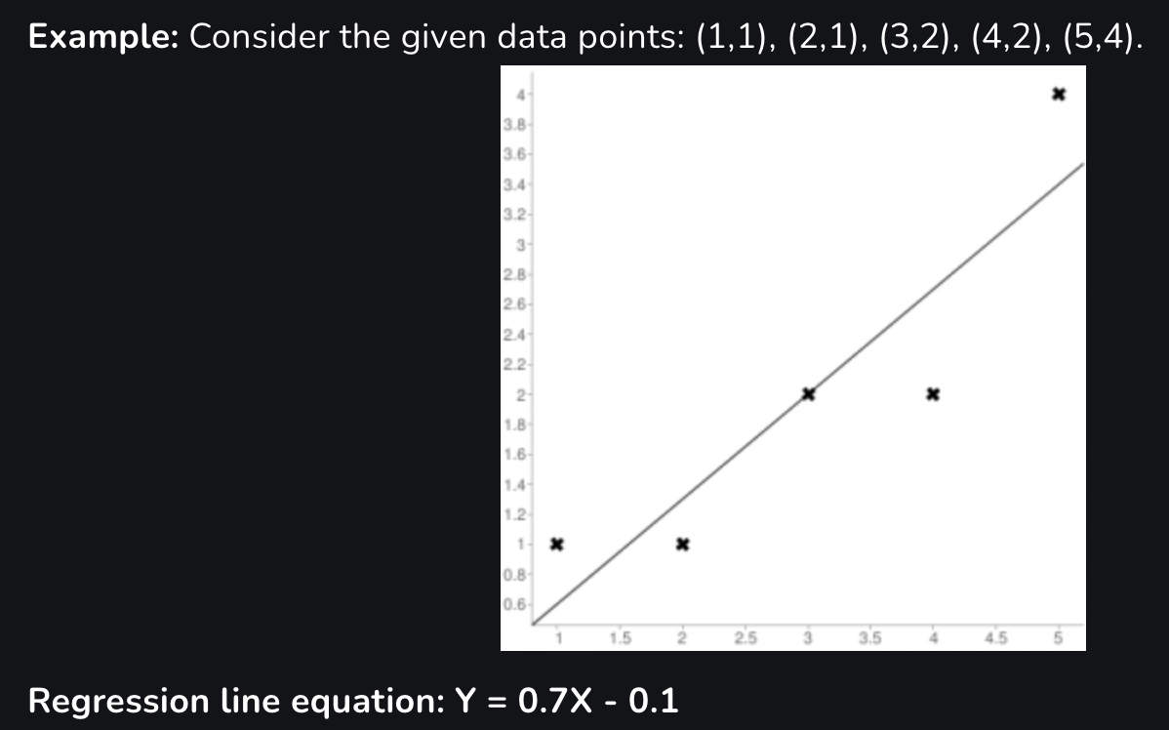

modeling overview
Evaluation of regression models
Mean Squared Error: $\frac{1}{n}\sum_{j=1}^{n}{{\left(y_{j}−\hat{y_{j}}\right)}^{2}}$
R-Squared: $1 − \frac{\sum_{j=1}^{n}{{\left(y_{j}−\hat{y_{j}}\right)}^{2}}}{\sum_{j=1}^{n}{{\left(y_{j}−\overline{y}\right)}^{2}}}$
https://www.geeksforgeeks.org/machine-learning/metrics-for-machine-learning-model/
Notes:
MSE calculates the average of the squared differences between the predicted and actual values. Squaring the differences ensures that larger errors are penalized more heavily helps in making it sensitive to outliers. This is useful when large errors are undesirable but it can be problematic when outliers are not relevant to the model’s purpose.
hat == predicted
R2 score represents the proportion of the variance in the dependent variable that is predictable from the independent variables. An R² value close to 1 shows a model that explains most of the variance while a value close to 0 shows that the model does not explain much of the variability in the data. R² is used to assess the goodness-of-fit of regression models

Slide 12
Systems for model explanation
The explainability of a model is not only important to the model builder themselves, but to anyone else affected by that model, as required by ethical and legal guidelines such as the European Union's General Data Protection Regulation (GDPR)
Approaches:
Systems have been built to provide insight into how a machine learning model makes predictions by highlighting individual data instances that the model predicts poorly
Simplified classes of models could be used in a VA application to trade off some performance in exchange for a more explainable analysis
Instance-level explanations of output
How might you explain a model’s decision to someone without analytic expertise?
Cashman et al.. (2019), A User-based Visual Analytics Workflow for Exploratory Model Analysis. https://doi.org/10.1111/cgf.13681

Slide 13
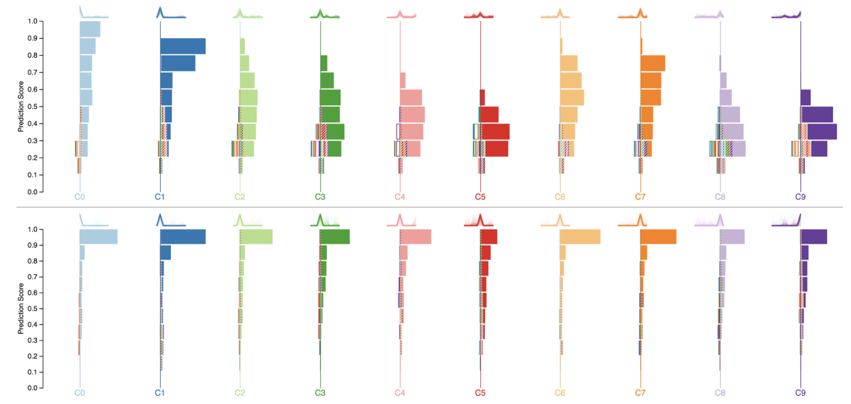
Systems for model explanation
Ex. Squares
https://www.microsoft.com/en-us/research/video/squares-supporting-interactive-performance-analysis-multiclass-classifiers-2/
D. Ren, et al.. "Squares: Supporting Interactive Performance Analysis for Multiclass Classifiers," 2017, doi: 10.1109/TVCG.2016.2598828

Slide 14
Systems for model debugging
While the calculations used in machine learning models can be excessively complicated, endemic properties of models that cause poor predictions can sometimes be diagnosed visually relatively easily
These tools allow a model builder to view how and where their model is breaking, on specified data instances
Cashman et al.. (2019), A User-based Visual Analytics Workflow for Exploratory Model Analysis. https://doi.org/10.1111/cgf.13681

Slide 15
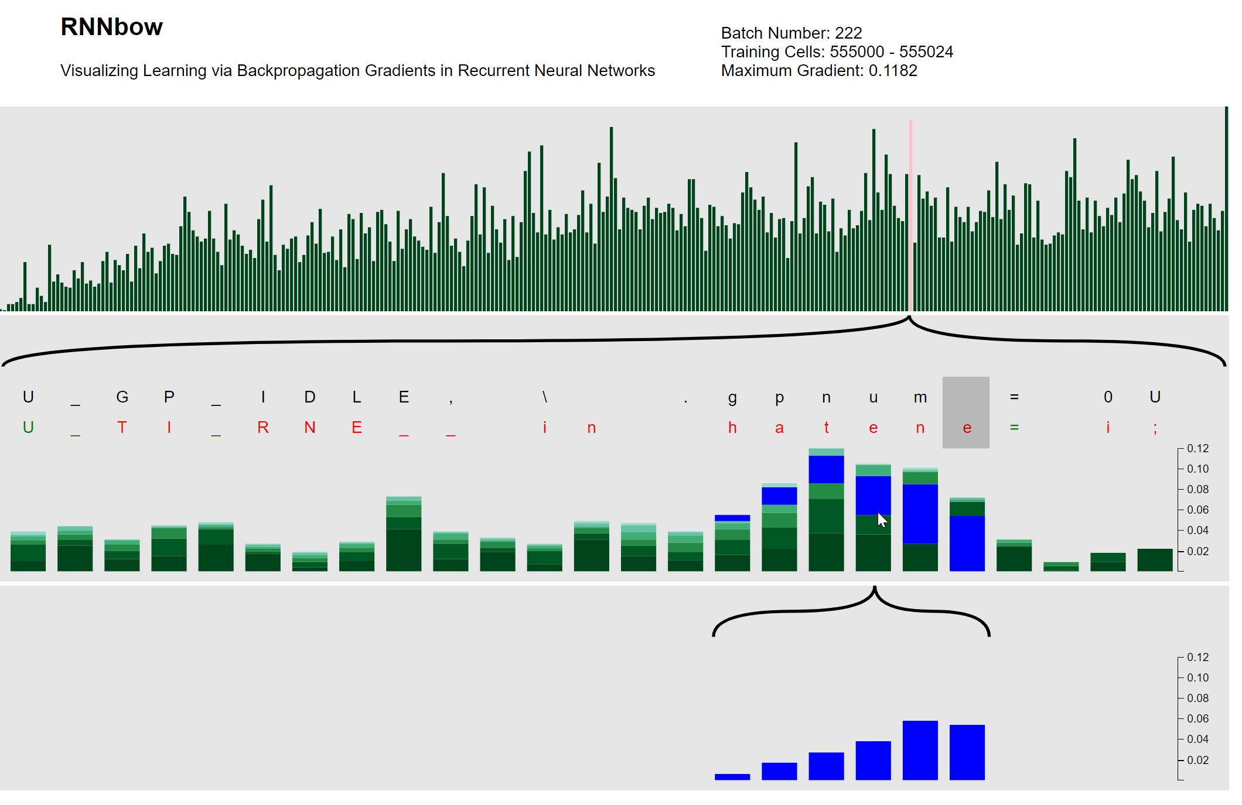
Systems for model debugging
Ex. RNNbow
Cashman et al.. (2019), RNNbow: Visualizing Learning Via Backpropagation Gradients in RNNs.
Notes:
RNNbow is a visual analytics tool that illustrates if a recurrent neural network is learning temporal dependencies by inspecting gradients during training
What is the insight – what is the key thing you would learn from this visualization. What is the punchline. Visualizing the gradient of the hidden state to show both what we’re learning from in the training set and how long term dependencies are being learned.
let’s you see memory
The gradient dictates how much the network is changing during training
The propagation of the gradient throughout the network is a proxy for how long a memory the network has learned
By visually exploring the evolution of the gradient in the context of training data, a model builder can tell whether their model is learning temporal dependencies and what parts of the training set it learns from the most

Slide 16
Systems for model construction and steering
When building a model, a modeling expert modifies various hyperparameters to maximize some utility function, whether explicitly or implicitly defined
Visual analytics systems can assist domain experts to control the model fitting process by allowing the user to directly manipulate the model's hyperparameters or by inferring the model's hyperparameters through observing and analyzing the user's interactions with the visualization
Cashman et al.. (2019), A User-based Visual Analytics Workflow for Exploratory Model Analysis. https://doi.org/10.1111/cgf.13681
Notes:
A utility function in machine learning quantifies the desirability of different outcomes, guiding agents to maximize rewards, such as a self-driving car maximizing safety and speed while minimizing energy.

Slide 17
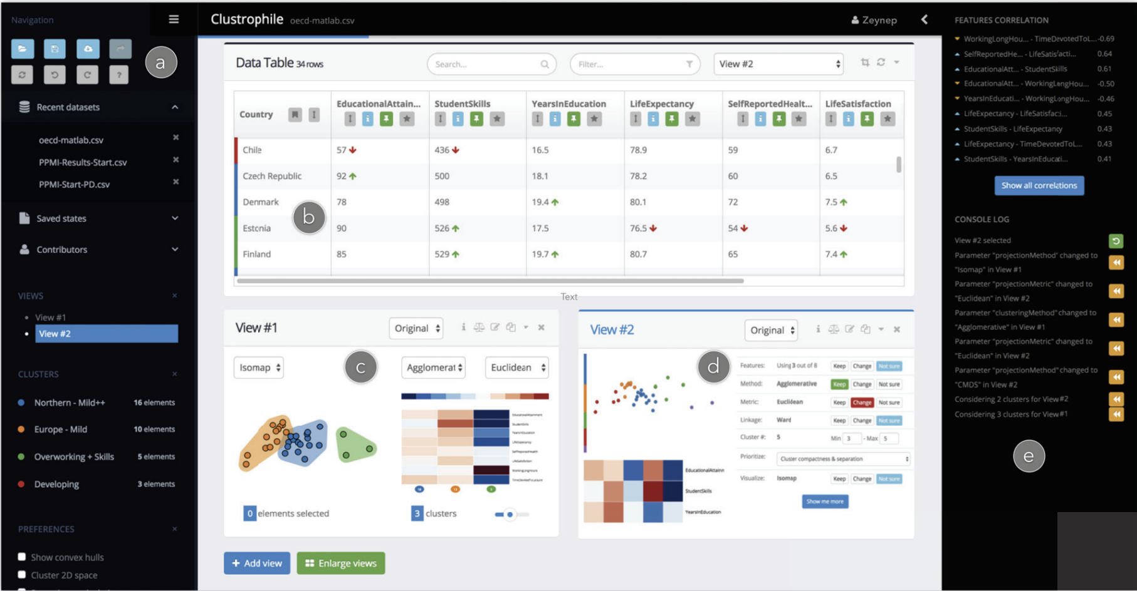
Systems for model construction and steering
https://www.youtube.com/watch?v=UJzgrG1KMMI
Ex. Clustophile
Cavallo and Cagatay.. (2019), Clustrophile 2: Guided Visual Clustering Analysis. doi: 10.1109/TVCG.2018.2864477
Notes:
Clustrophile 2 is an interactive tool for guided exploratory clustering analysis.
Its interface includes two collapsible sidebars (a, e) and a main view where users can perform operations on the data.
Clustrophile 2 tightly couples b) a dynamic data table that supports a rich set of filtering interactions and statistics and c) multiple resizable Clustering Views, which can be used to work simultaneously on different clustering instances. Each Clustering View provides several ways to guide users during their analysis, such as d) the Clustering Tour.

Slide 18
Systems for model comparison
The choice of which model to use from a set of candidate models is highly dependent on the needs of the user and the deployment scenario of a model
For example, when might we want to minimize false positives vs false negatives?
Cashman et al.. (2019), A User-based Visual Analytics Workflow for Exploratory Model Analysis. https://doi.org/10.1111/cgf.13681

Slide 19
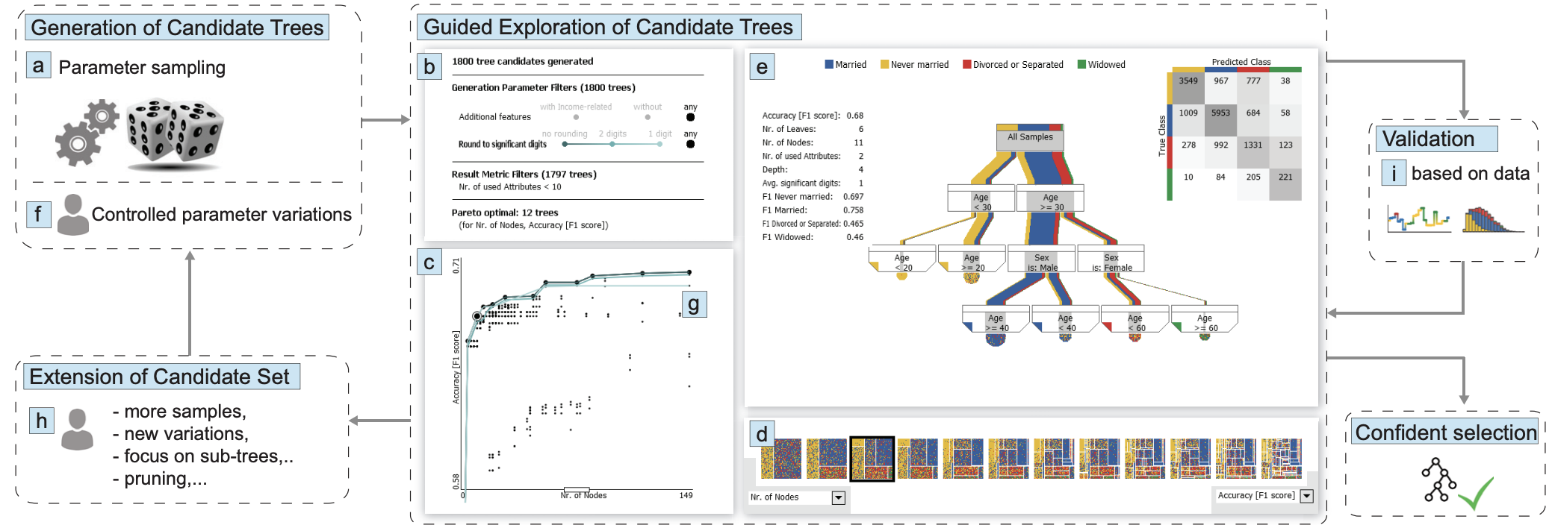
Systems for model comparison
Ex. TreePOD
Muhlbacher et al.. (2018), TreePOD: Sensitivity-Aware Selection of Pareto-Optimal Decision Trees. https://doi.org/10.1109/TVCG.2017.2745158
Notes:
DEMO ON DESKTOP
Selection of decision trees explaining marital status in the UCI Census Income 1994 dataset [21].
Candidate trees are generated by sampling the parameters of decision tree algorithms. Linked visualizations guide the selection from this set by providing
a summary of tree candidates and parameter variations,
a sensitivity-aware overview of the trade-off between the conflicting objectives accuracy and number of nodes,
a qualitative comparison of Pareto-optimal trees, and
details of a selected decision tree.
Applying controlled parameter variations to every tree conveys the effect of parameter changes on tree characteristics, e.g., how rounding of decision boundaries affects accuracy
Users can extend the set of candidate trees at any time,
(h) and validate trees based on data using linked views.

Slide 20
EMA: definition
In the modern era of big data, machine learning, and AI, visual analytics systems have begun to take on a new role: to help the user in refining machine learning models
Exploratory Model Analysis (EMA) is the process of exploring the set of potential models that can be trained on a given set of data
The goal of EMA is twofold:
Discover variables in the dataset on which reliable predictions can be made
Find the most suitable and robust types of models to predict these variables
Cashman et al.. (2019), A User-based Visual Analytics Workflow for Exploratory Model Analysis. https://doi.org/10.1111/cgf.13681

Slide 21
ema vs. eda
Broker performing EDA
Goal:
Understand current patterns in financial data; i.e. current market landscape
Outcomes:
Decision
Data item (ex. an anomaly)
Interesting pattern in the data
Data is the focus
Quantitative analyst performing EMA
Goal:
Understand what types of predictions are possible given the collected financial data
Outcomes:
Model (or set of models)
Hyperparameters
Properties of predictions on hold out data
Model is the focus
Cashman et al.. (2019), A User-based Visual Analytics Workflow for Exploratory Model Analysis. https://doi.org/10.1111/cgf.13681

Slide 22
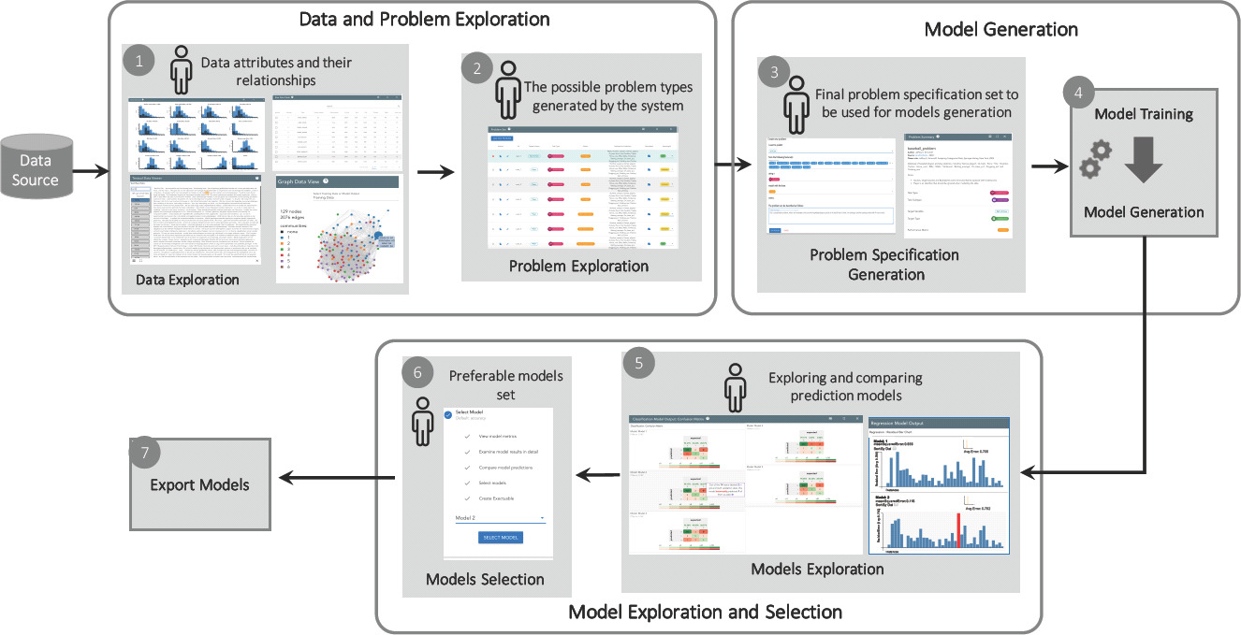
ema workflow
Cashman et al.. (2019), A User-based Visual Analytics Workflow for Exploratory Model Analysis. https://doi.org/10.1111/cgf.13681
Notes:
step 1, the system uses interactive visualizations (such as histograms or graphs) to provide an initial data overview
step 2 The system then generates a number of possible modeling problems based on analyzing the data set
step 3 the user analyzes and selects one possible model to try
step 4 an automated ML system trains and generates candidate models based on the data set and given problem
step 5, the system shows comparisons of the generated prediction models through interactive visualizations of their predictions on a holdout set.
step 6, users can select a number of preferable models, which are then exported by the system
step 7 export models for predictions on unseen test data

Slide 23
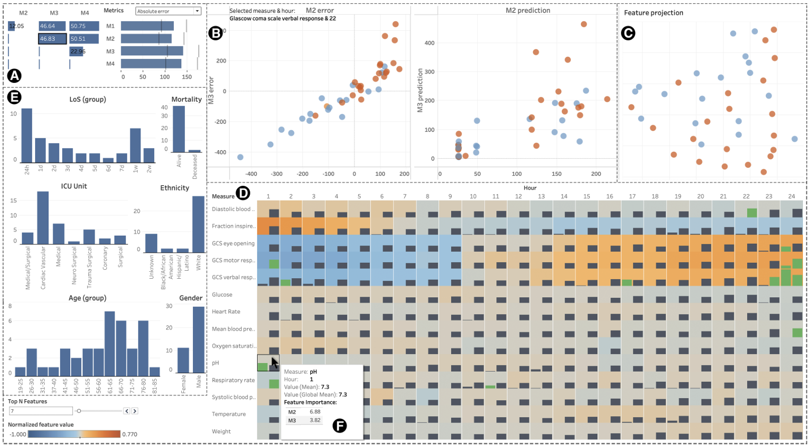
ema: Ex.
VMS
He et al.. (2024), VMS: Interactive Visualization to Support the Sensemaking and Selection of Predictive Models. https://doi.org/10.1145/3640543.3645151
Notes:
DEMO ON DESKTOP
(Visualization for Model Sensemaking and Selection) VMS comparing four machine learning models.
(A) Model performance chart and prediction similarity matrix;
(B) Individual prediction errors and values by the two models selected from (A);
(C) Instance projection view;
(D) Feature value & importance view on global/local scales;
(E) Instance attributes as filters.
(F) A tooltip on hovering indicates the feature information.

Slide 24
Your turn!
Choose a system from this visual survey of VA+ML systems: https://trustmlvis.lnu.se/
Dig more deeply into what the system visualizes
What model technique(s) is it built for?
What does it visualize and how?
Would you make any changes to the design? Why or why not?

