Slide 1
Visual Analytics: What is this class?
Ab Mosca (they/them)

Slide 2
Today’s plan
Name tags
Introductions
What is visual analytics?
Course structure

Slide 3








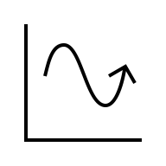
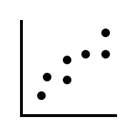

Who am I?
Dr.

Slide 4
Who are you?
Form groups of ~3
Introduce yourselves
Share:
One thing you are excited about learning in this class
One thing that makes you nervous for this class
Find:
One thing that the entire group has in common (favorite color? left handed? everyone hates kale?)

Slide 5
Who are you?
Form new groups of ~3
Introduce yourselves
Share:
One thing you are excited about learning in this class
One thing that makes you nervous for this class
Debate:
Would you rather (a) be able to touch a book and instantly read it but retain your current reading memory, OR (b) retain your current reading speed but remember everything you’ve read perfectly forever?

Slide 6
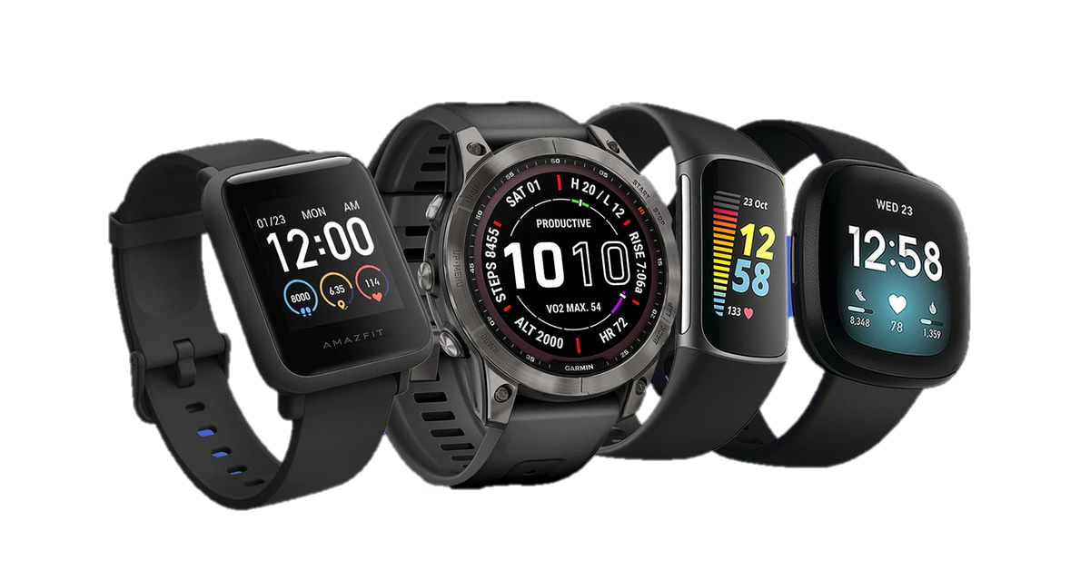



What is visual analytics?
What are some non-traditional forms of data?

Slide 7
What is visual analytics?
How can we analyze this data? What make analysis hard?

Slide 8
What is visual analytics?
How can we analyze this data? What make analysis hard?
We’re collecting and generating data faster than traditional methods can keep up– our data is unmanageably big
Not only is the data unmanageably big, but it is also usually noisy and ambiguous too
As analysis techniques advance, they become harder to understand and communicate

Slide 9
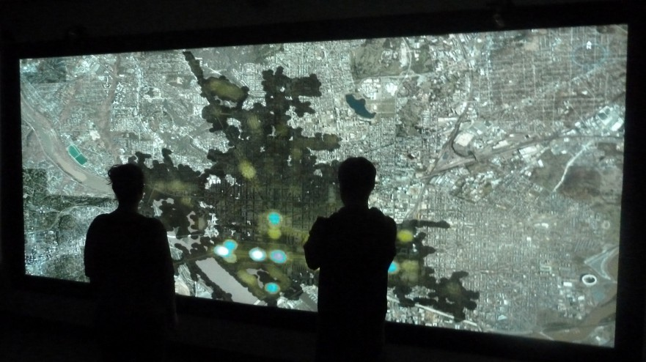
What is visual analytics?
“The science of analytical reasoning
facilitated by interactive visual interfaces”¹
¹Thomas, James J., and Kristin A. Cook, eds. Illuminating the path: The research and development agenda for visual analytics. IEEE Computer Society Press, 2005.

Slide 10
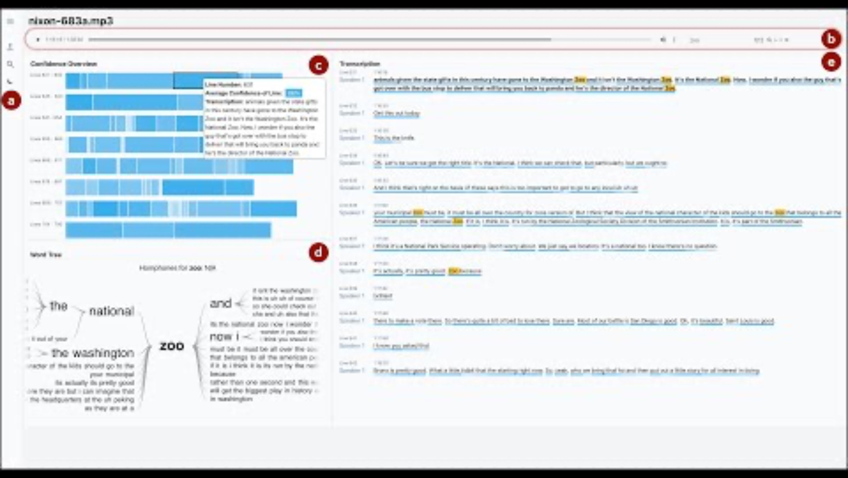
What is visual analytics?
Ex. ConFides
For analyzing audio data
https://www.youtube.com/watch?v=hbeDn5D-GCg

Slide 11
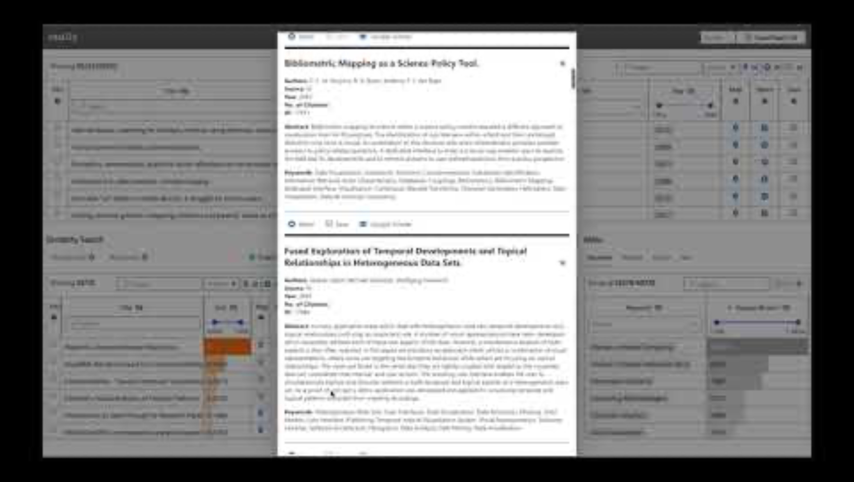
What is visual analytics?
Ex. VitaLITy
For analyzing academic papers
https://www.youtube.com/watch?v=x93tMYQvZn8

Slide 12
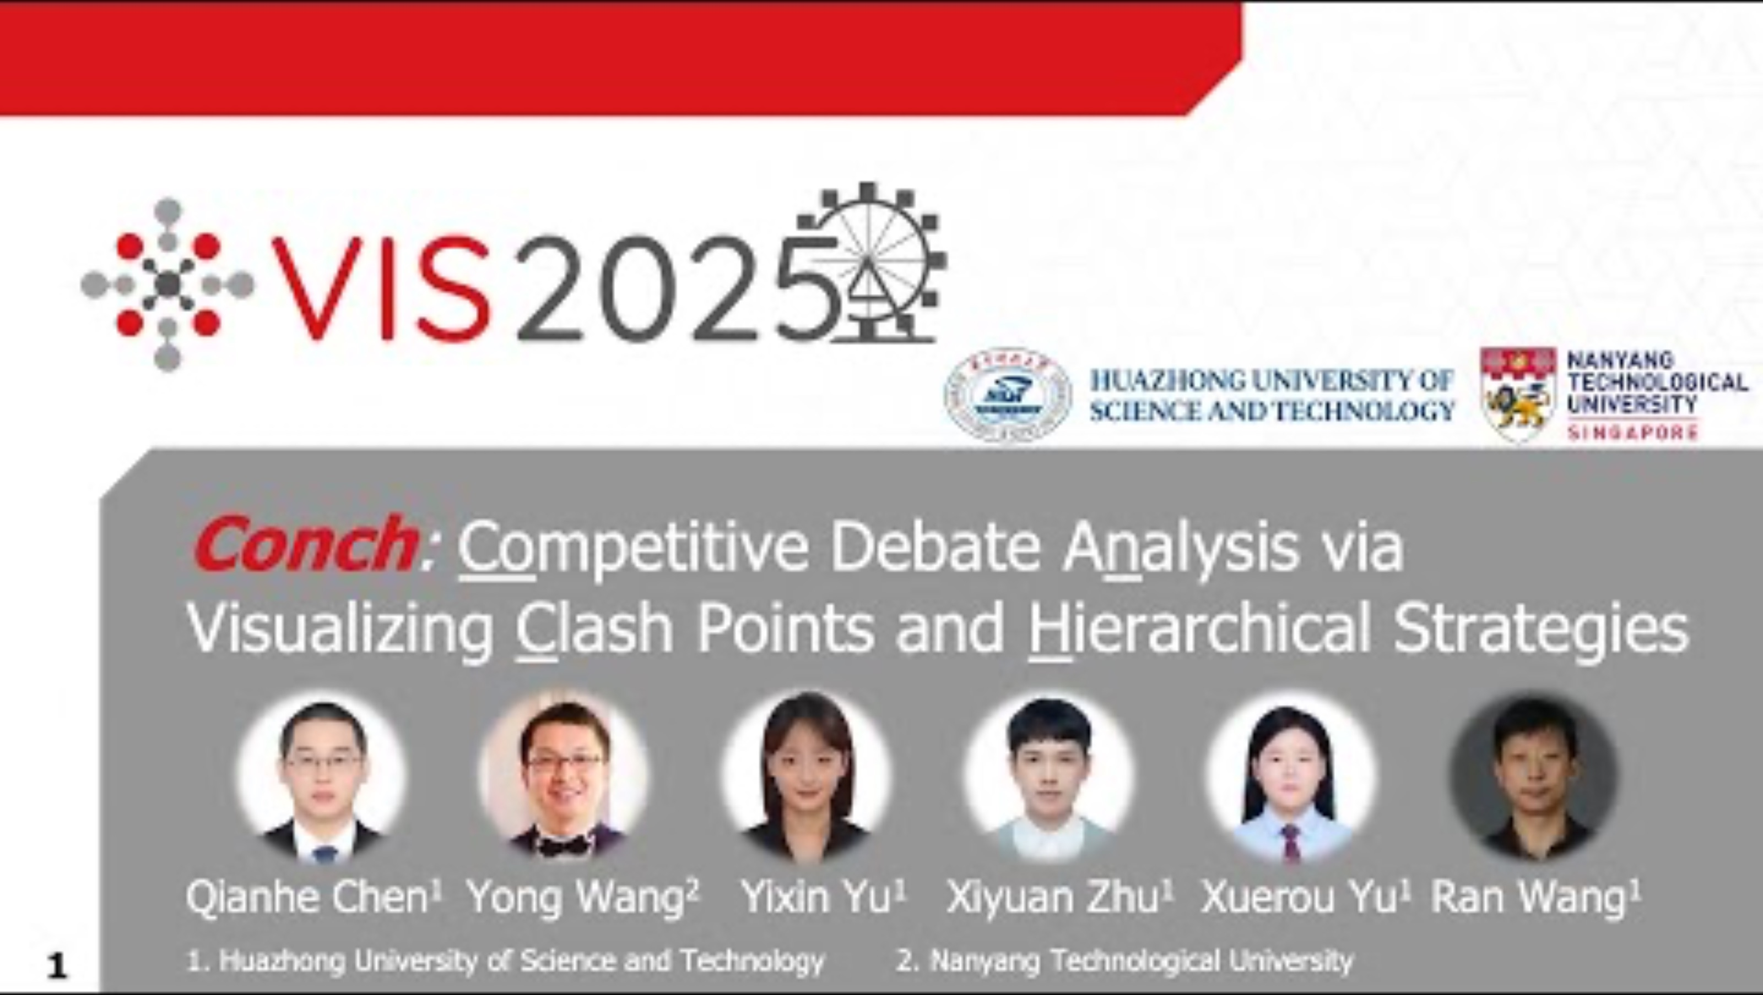
What is visual analytics?
Ex. Conch
For analyzing debates
https://www.youtube.com/watch?v=kTC33Ta6W2A

Slide 13
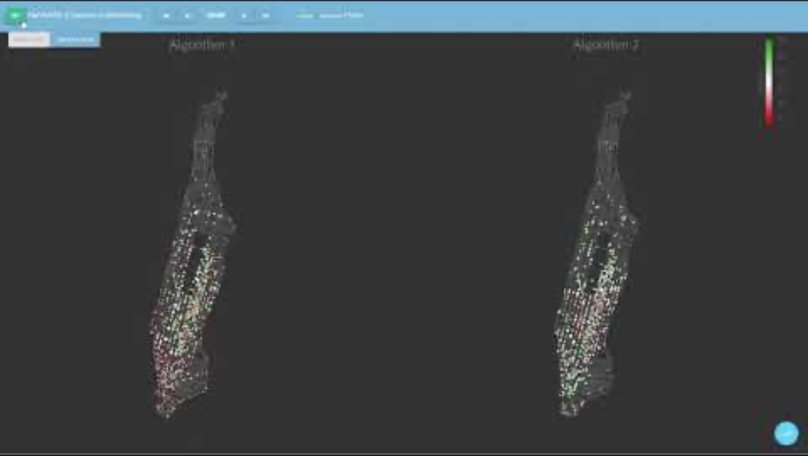
What is visual analytics?
Ex. FairVizARD
For comparing algorithms
https://www.youtube.com/watch?v=0-G-o4E0gKM

Slide 14
What is visual analytics?
discovery and communication of meaningful patterns in data
“The science of analytical reasoning
facilitated by interactive visual interfaces”¹
¹Thomas, James J., and Kristin A. Cook, eds. Illuminating the path: The research and development agenda for visual analytics. IEEE Computer Society Press, 2005.
visual representations of data that reinforce human cognition

Slide 15
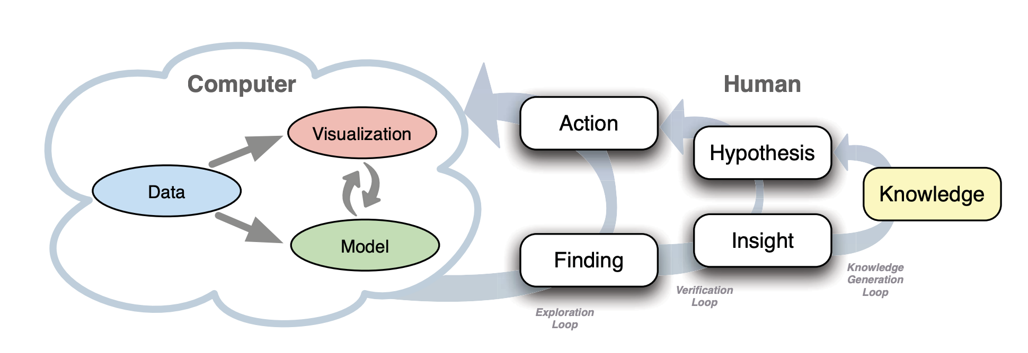
What is visual analytics?
Big Idea: Leverage complimentary strengths of humans and computers
D. Sacha, A. Stoffel, F. Stoffel, B. C. Kwon, G. Ellis and D. A. Keim, "Knowledge Generation Model for Visual Analytics," in IEEE Transactions on Visualization and Computer Graphics, vol. 20, no. 12, pp. 1604-1613, 31 Dec. 2014, doi: 10.1109/TVCG.2014.2346481.
Notes:
Knowledge generation model for visual analytics: The model consists of computer and human parts. The left hand side illustrates a visual analytics system, whereas the right hand side illustrates the knowledge generation process of the human. The latter is a reasoning process composed of exploration, verification, and knowledge generation loops. Visual analytics pursues a tight integration of human and machine by enabling the user to interact with the system.

Slide 16
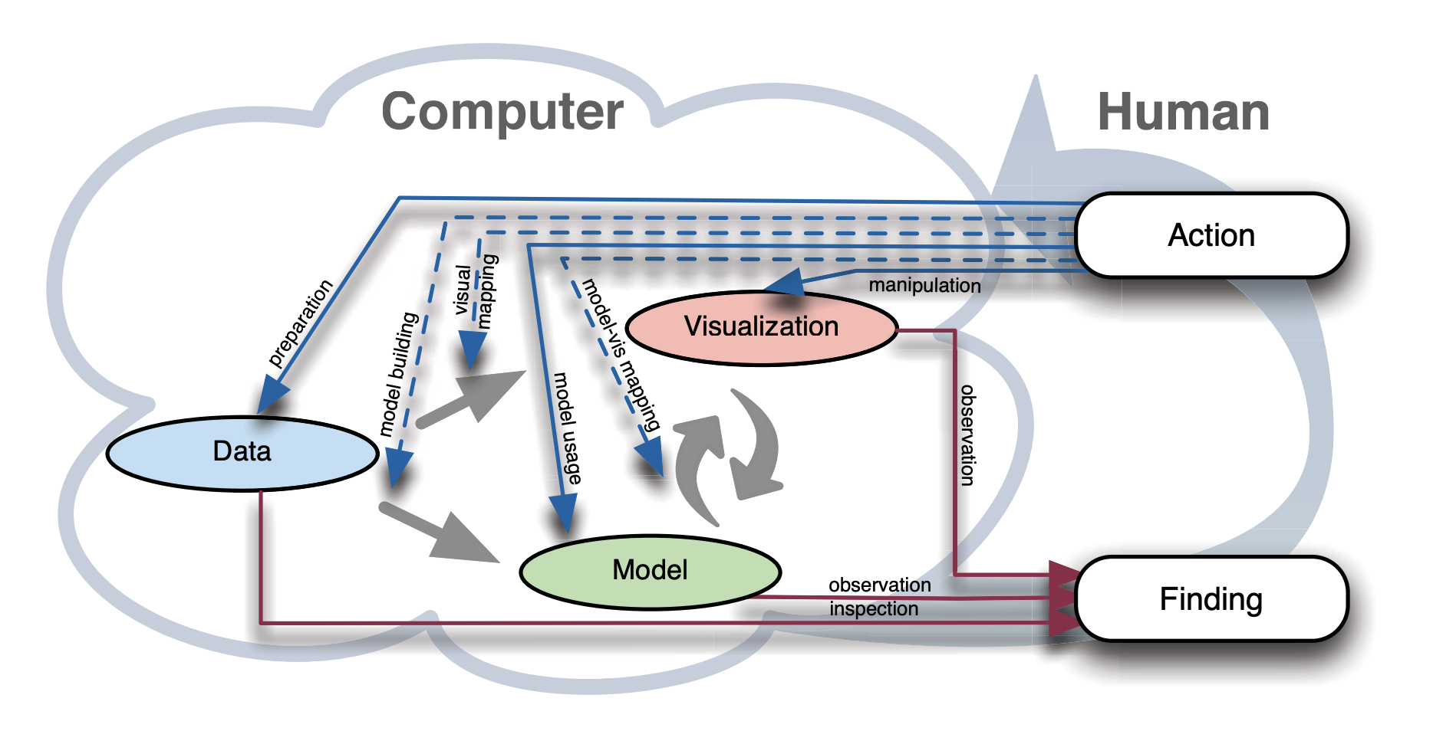
What is visual analytics?
Big Idea: Leverage complimentary strengths of humans and computers
D. Sacha, A. Stoffel, F. Stoffel, B. C. Kwon, G. Ellis and D. A. Keim, "Knowledge Generation Model for Visual Analytics," in IEEE Transactions on Visualization and Computer Graphics, vol. 20, no. 12, pp. 1604-1613, 31 Dec. 2014, doi: 10.1109/TVCG.2014.2346481.
Notes:
Detailed part of the process model including action and cognition paths. Actions can either lead directly to visual analytic components (blue arrows) or to their mappings (blue, dashed arrows). Humans can observe reactions of the system (red arrows) in order to generate findings.
We name actions dealing with data gathering or data selection as preparation action because these actions are used to prepare data for the visual analytics process (Figure 2). Actions taken to create models are summarized as model building actions which in turn are related to the KDD process and its configuration. Application of a model is termed as model usage, which refers to actions such as calculating a statistic or cluster data. Visual mapping actions are used to create data visualizations, and model-vis mapping actions are those which map models into visualizations. Manipulation of a visualization changes the viewport or highlights interesting data in the visualization without changing the mapping of data to the visualization. All these actions are observable as interactions between analysts and a visual analytics system.
A finding is an interesting observation made by an analyst using the visual analytics system. The finding leads to further interaction with the system or to new insights. For example, findings from data inspection can be missing values or other data properties affecting the further analysis and require special data processing. In the case of visualizations or models, a finding can be a pattern, a conspicuous model result, or an unusual behavior of the system

Slide 17
What will you learn in this class?
Big Idea: Leverage complimentary strengths of humans and computers
(1) How to create bespoke visualizations using HTML/CSS/JS
(2) Ways to include humans in the analysis loop
(3) Integration of visualization and modeling
D. Sacha, A. Stoffel, F. Stoffel, B. C. Kwon, G. Ellis and D. A. Keim, "Knowledge Generation Model for Visual Analytics," in IEEE Transactions on Visualization and Computer Graphics, vol. 20, no. 12, pp. 1604-1613, 31 Dec. 2014, doi: 10.1109/TVCG.2014.2346481.

Slide 18
What won’t you learn in this class?
Intro to coding (you should be an intermediate level coder)
Intro to statistics (you should have basic statistical knowledge)
Intro to data science (you should be comfortable wrangling data)
Deeper understanding of information visualization (take CSC/SDS 109 for this)

Slide 19
Today’s plan
Name tags
Introductions
What is visual analytics?
Course structure

Slide 20
Course website
https://amosca01.github.io/SDS-CSC235/
Overview (course syllabus and policies)
Schedule of topics and assignments
Slides (posted before class)
Assignment instructions
Additional materials (ex. data, handouts)
Useful links

Slide 21
Time management
Federal guidelines suggest 3 hours of work per credit per week. This is a 4 credit course, so you should expect to spend 12 hours on it per week:
2.5 hours in class
1-2 hours preparing for class
7.5-8.5 hours on homework and outside study
The purpose of class time is to introduce and explore new topics. To complete assignments, you will often need to look up, learn, and practice material that extends beyond that covered during class meeting times.

Slide 22
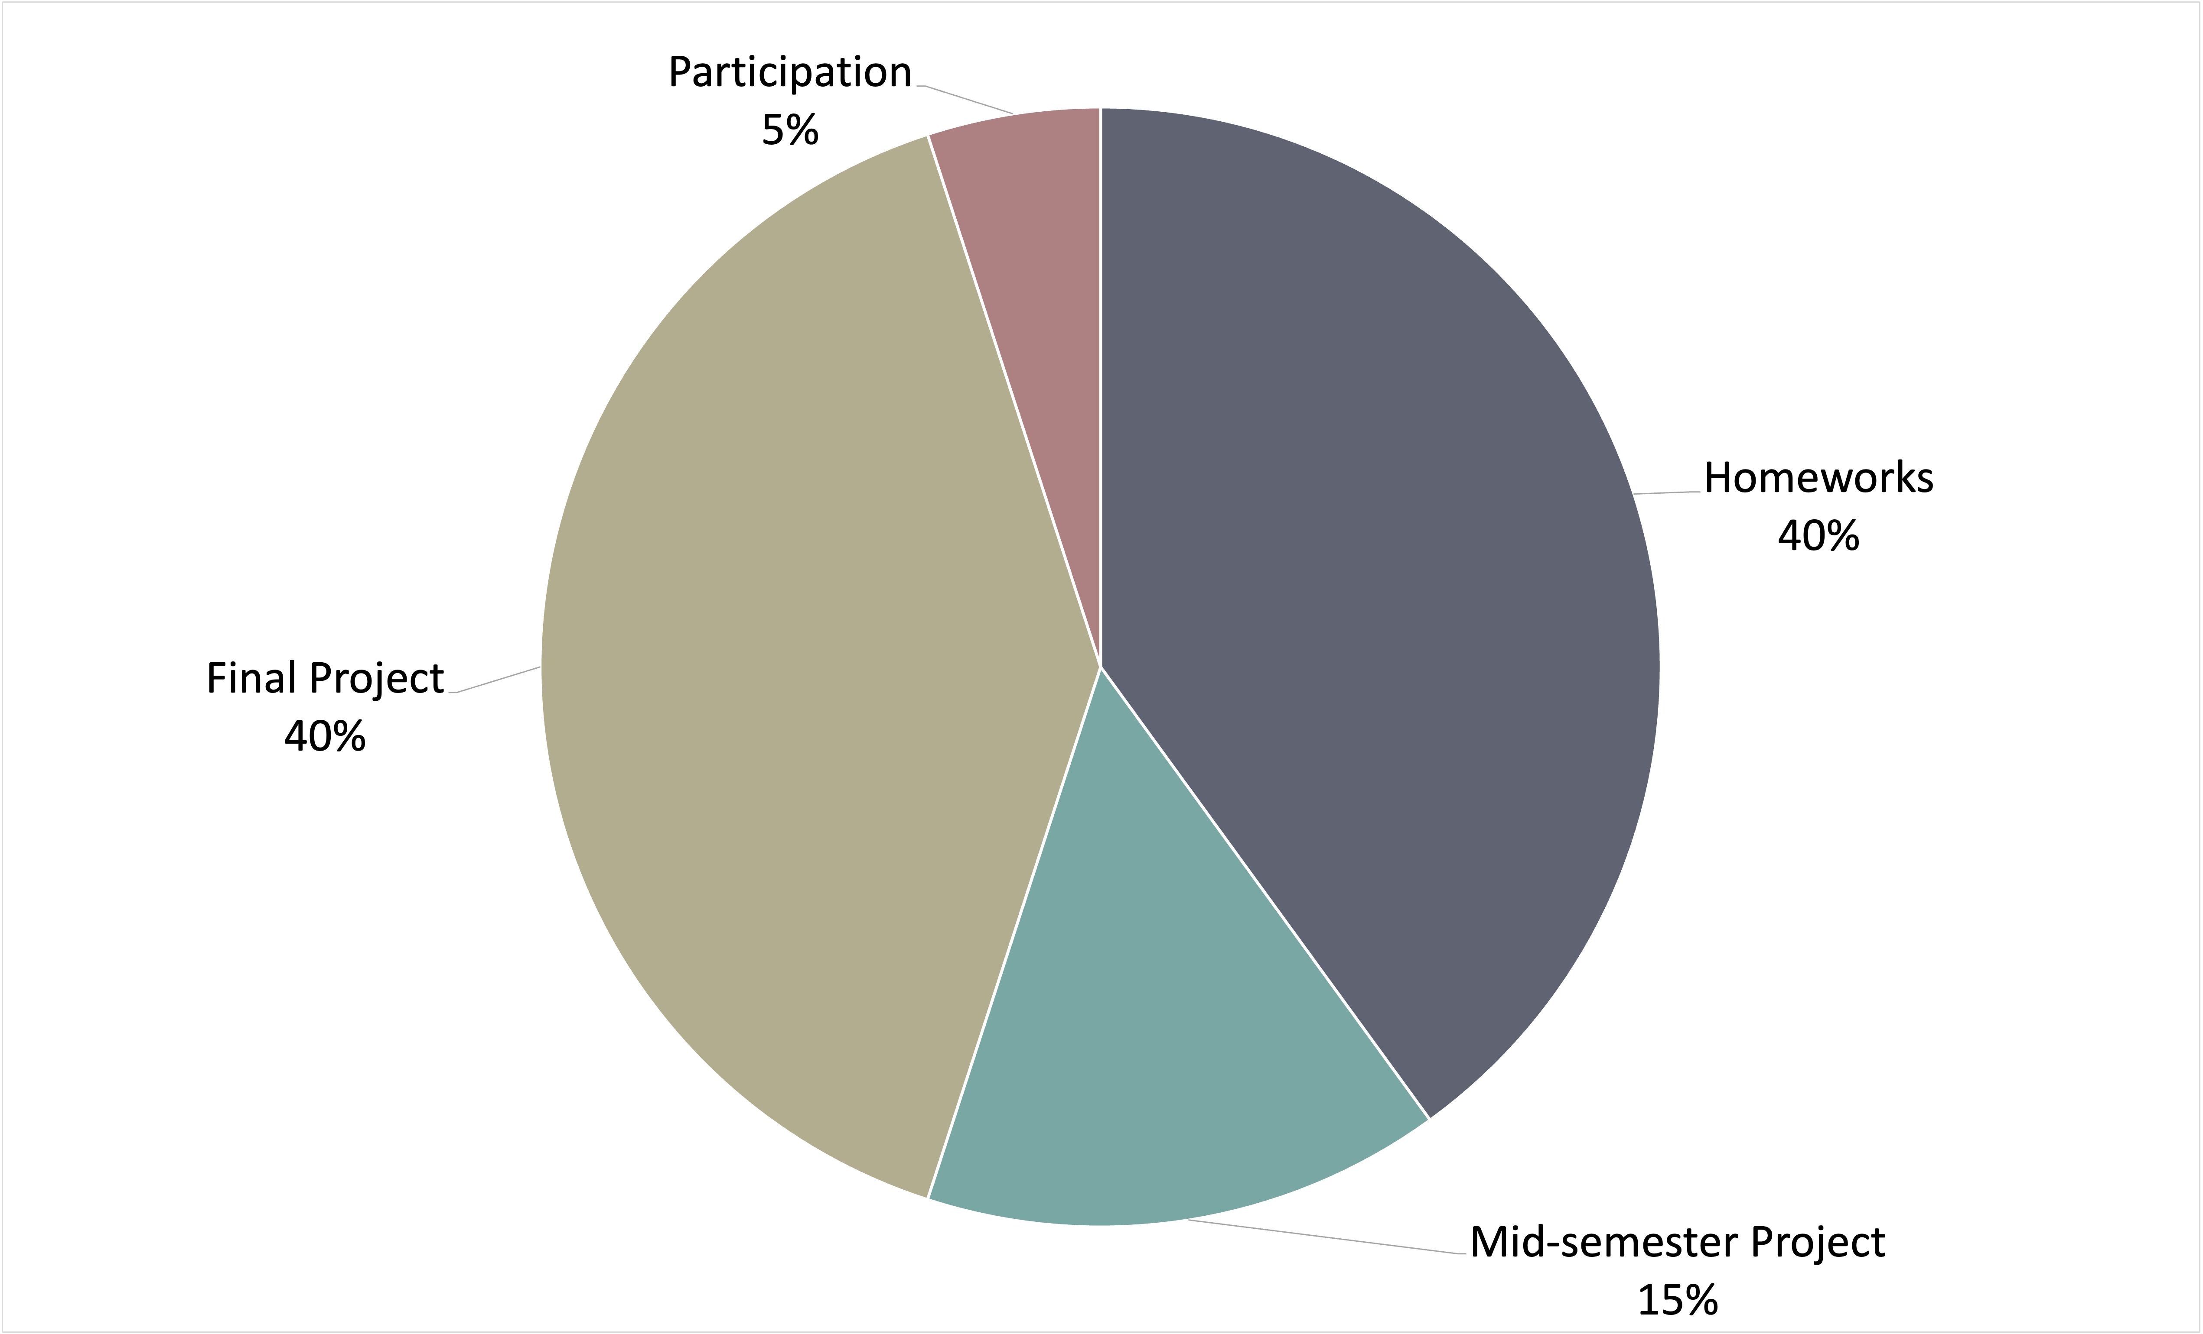
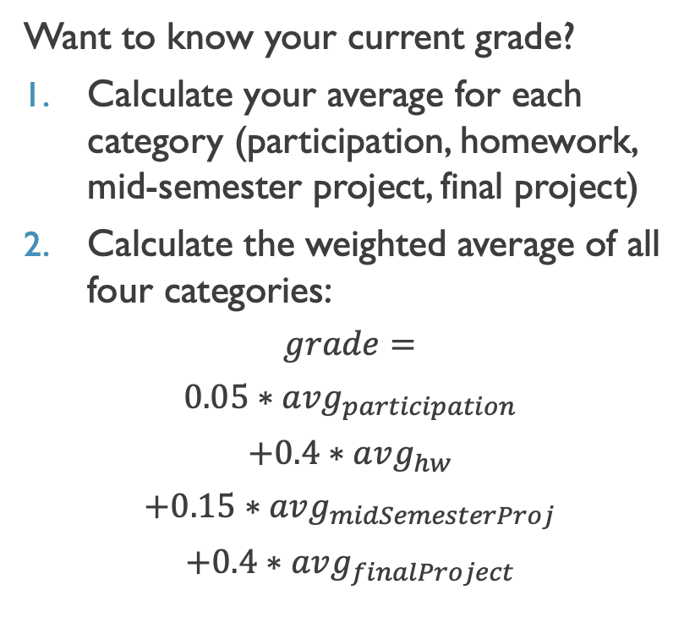
Assessment
Want to know your current grade?
Calculate your average for each category (participation, homework, mid-semester project, final project)
Calculate the weighted average of all four categories:
$$grade=$$
$$0.05∗avg_{participation}$$
$$+0.4∗avg_{hw}$$
$$+0.15∗avg_{midSemesterProj}$$
$$+0.4∗avg_{finalProject}$$

Slide 23
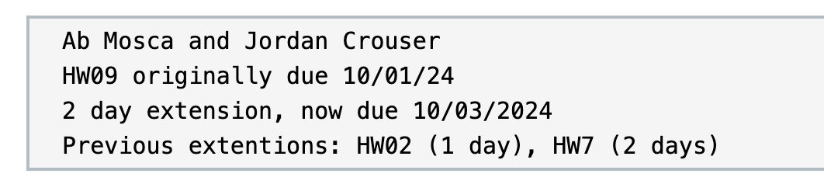
Late Policy
We develop skills through practice and assignments build on one another AND life happens.
You have unlimited extensions in this class
Extensions must be requested before assignment due date
For an extension, submit a file with:
Your name (and group members' names)
Assignment number and original due date
Duration of extension and new due date
Review of any prior extension requests
Ex.
Late work receives lowest priority for grading

Slide 24
Revise and resubmit
We develop skills through repeated practice and learn from mistakes.
You have unlimited revise and resubmits in this class
You cannot revise and resubmit an assignment on which you earned a 0
Your resubmission must include a changelog
resubmits that do not include a changelog will not be graded
Highest grade will prevail
Resubmitted work receives lowest priority for grading

Slide 25
Comfy classroom
Need to stand up and leave for a minutes? Do it.
Want to sit somewhere other than a chair? Go for it.
Have a concentration aid? Use it.
Hungry? Thirsty? Eat and drink (be careful of spills!).
Have kids and no childcare? Bring your kids.
Do what you need to do to learn, just be respectful of other learners.

Slide 26
Communication
All communication will occur via Slack (if you email me I will likely not respond)
Ask questions in the #questions channel
Check for announcements etc. in the #general channel
DM for specific-to-you questions

Slide 27
Academic integrity
Generative AI can be a useful learning tool, however using gen AI to do the intellectual work of your assignments:
Violates the academic integrity policy of this course (see course overview for details)
Will negatively impact your learning
Is not going to result in an A (trust me, at this point gen AI is not good at visual analytics)

Slide 28
What I expect from you
You like to be challenged and are excited about “figuring stuff out”
You understand that temporary discomfort is part of learning
You are willing to get comfortable asking questions and sharing your ideas
You are dedicated to being part of a community of learners

Slide 29
What you can expect from me
I see class as a collaboration
I am happy to add/change topics (as possible)
I want to make adjustments (as possible) to accommodate everyone
My number one goal is to see all of you succeed, and I believe that you each have what it takes to do so

Slide 30
Questions?

