Slide 1
Visual Analytics: Exploratory Data Analysis (EDA)
Ab Mosca (they/them)

Slide 2
Today’s plan
HW notes
Motivation
Define EDA
Techniques
Practice

Slide 3
Hw notes
Starter code for coding assignments will be on Github
Ex. https://github.com/amosca01/SDS-CSC-235-hw02
Fork the starter code repo and then work out of your fork
You can submit on Gradescope by linking your repository once you’ve pushed your final submission

Slide 4
Motivation
TMDB 5000 Movie Dataset: https://www.kaggle.com/datasets/tmdb/tmdb-movie-metadata?resource=download&select=tmdb_5000_movies.csv
What would you do if someone handed you this dataset and asked you to analyze it?

Slide 5
Definition
Exploratory Data Analysis (EDA) is an approach of analyzing datasets that focuses on summarizing their main characteristics.
Main objectives:
Enable unexpected discoveries in the data
Suggest hypotheses
Assess modeling assumptions
Support selection of appropriate modeling tools
Provide a basis for further exploration
John Tukey, Exploratory Data Alaysis, 1977. https://en.wikipedia.org/wiki/Exploratory_data_analysis#cite_note-Tukey1977-6
Notes:
Introduced by John Tukey in the 1970s
Differs from Confirmatory Data Analysis (CDA) i.e. hypothesis testing

Slide 6
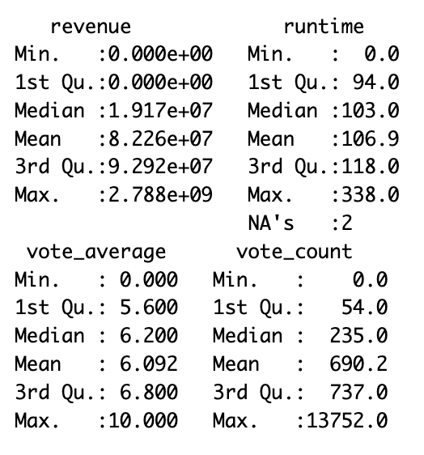
EDA Techniques
Five number summary (for quantitative variables)
Notes:
What do you learn from these summaries?

Slide 7
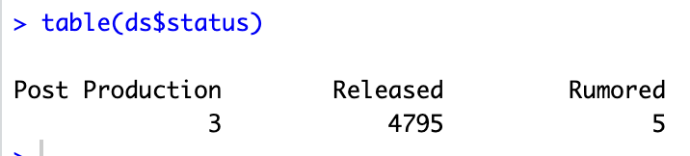
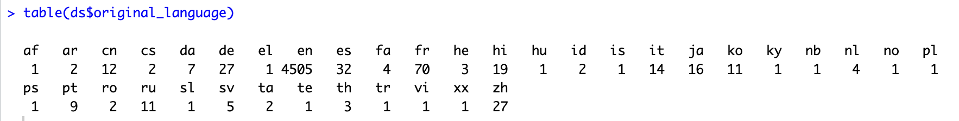
EDA Techniques
Frequency Tables (categorical / ordinal variables)
Notes:
What do we learn from this?

Slide 8
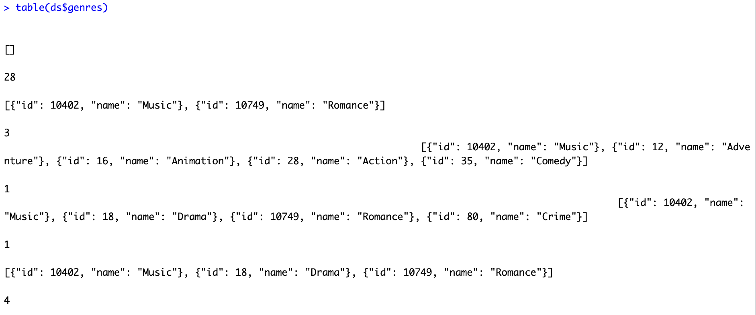
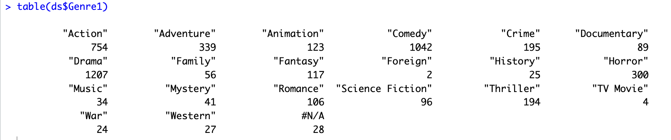
EDA Techniques
Frequency Tables (categorical / ordinal variables)
Notes:
What do we learn from this?
Looks like we need some data cleaning

Slide 9
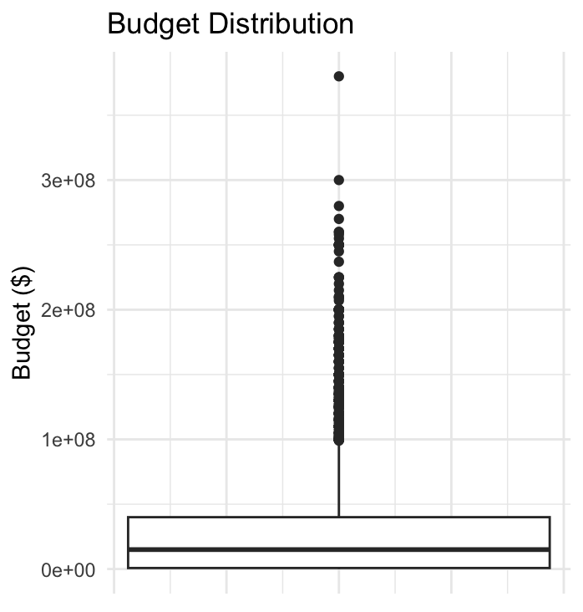
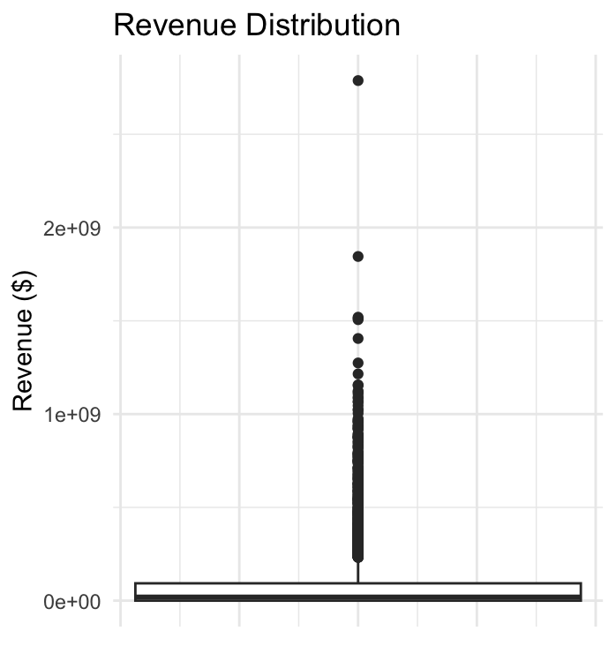
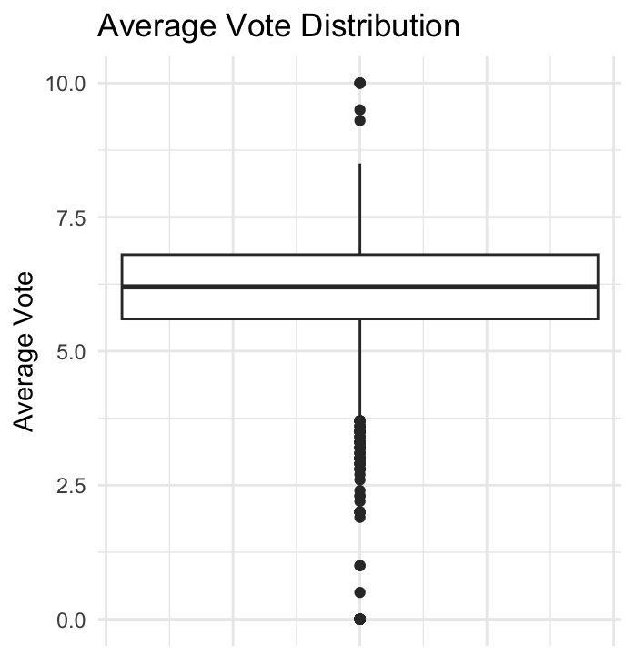
EDA Techniques
Distributions (quantitative variables)

Slide 10
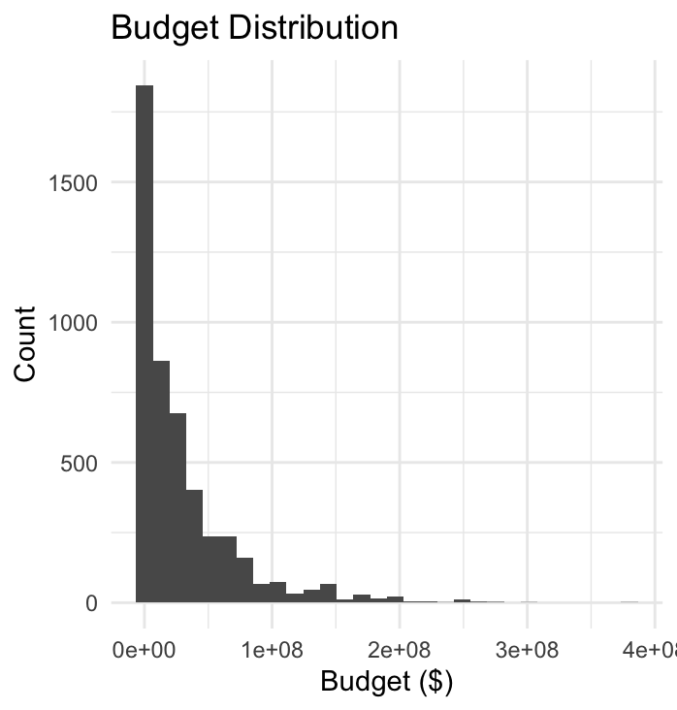
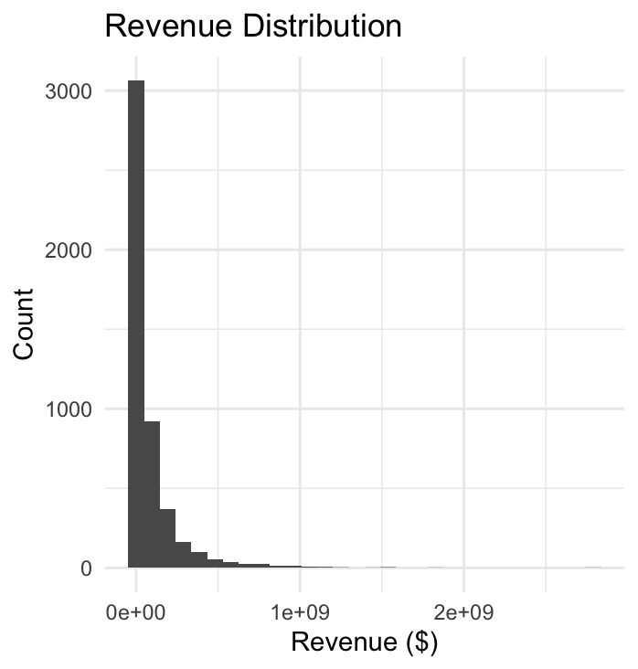
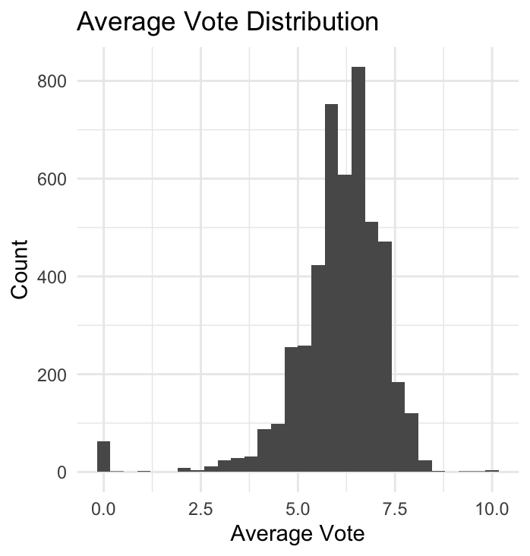
EDA Techniques
Distributions (quantitative variables)

Slide 11
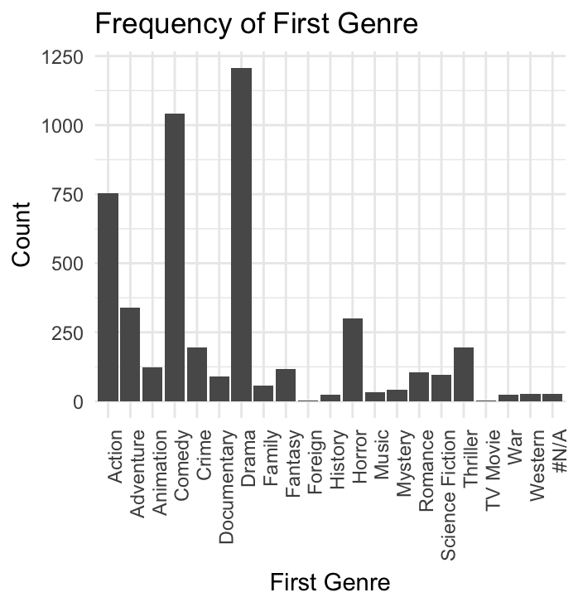
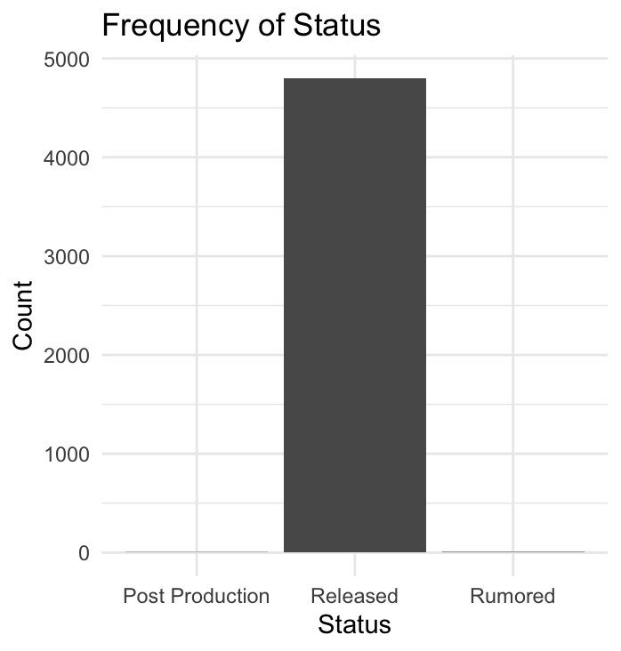
EDA Techniques
Frequency (categorical / ordinal variables)

Slide 12
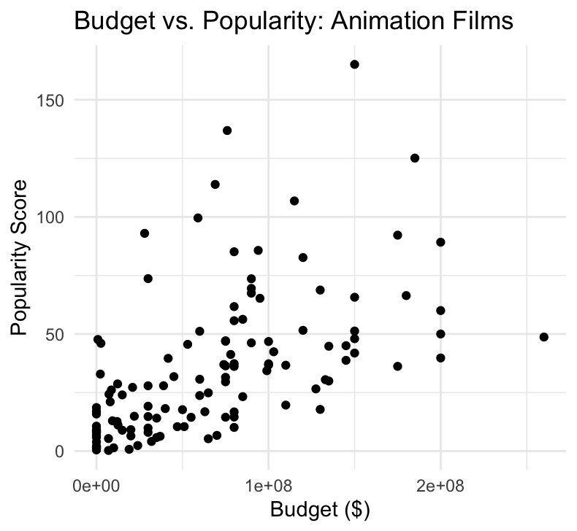
EDA Techniques
Correlations (between quantitative variables)

Slide 13
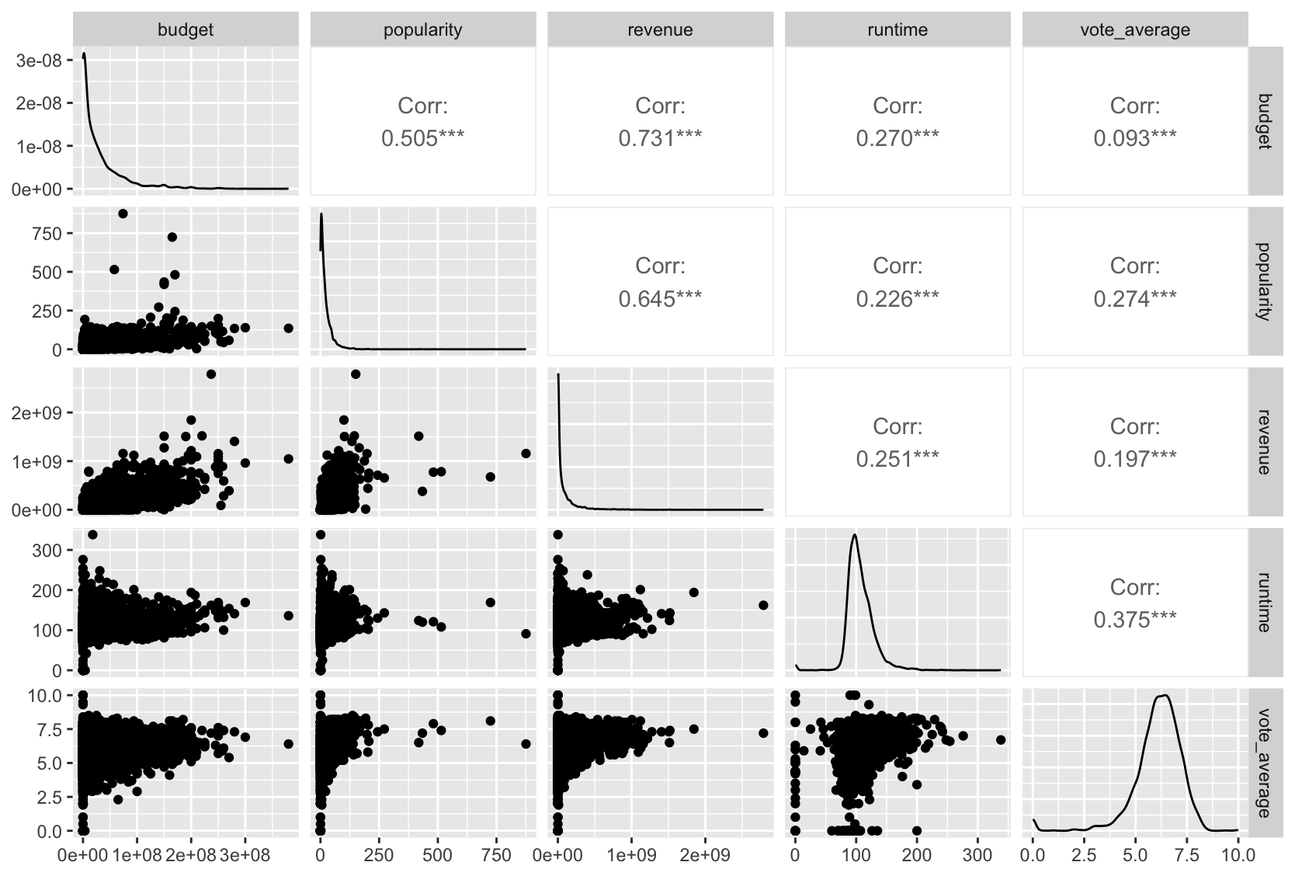
EDA Techniques
Correlations (between many quantitative variables)

Slide 14
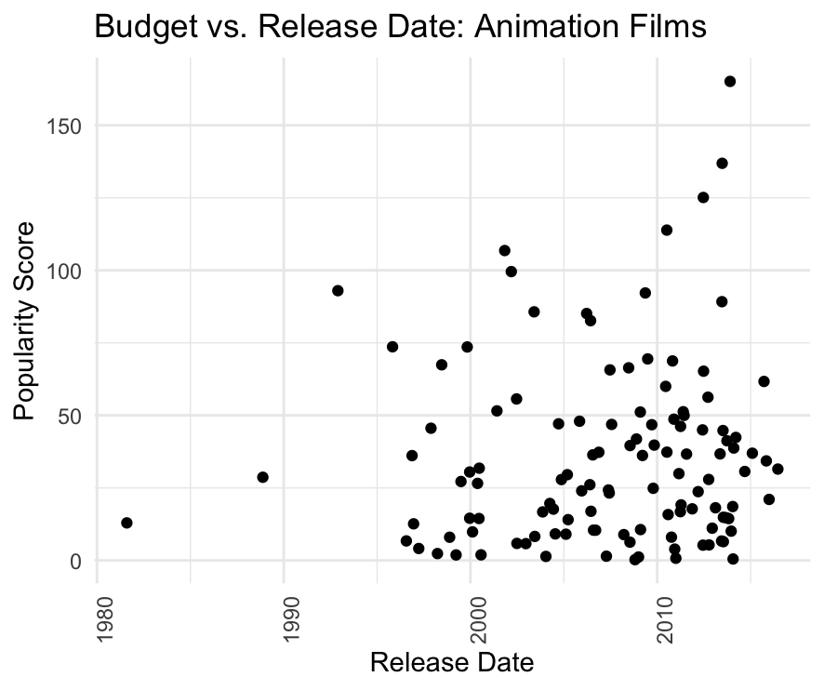
EDA Techniques
Correlations (between quantitative / ordinal and quantitative variables)

Slide 15
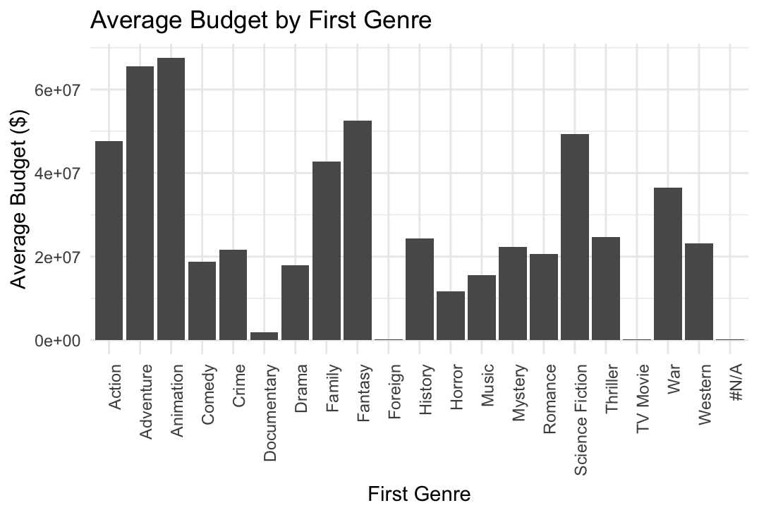
EDA Techniques
Correlations (between quantitative / categorical variables)

Slide 16
Practice
Data: Real Estate Sales 2001-2023 GL
https://catalog.data.gov/dataset/real-estate-sales-2001-2018
Use whatever tool you like (ex. R, python) to perform EDA on the dataset
As you perform EDA, do any necessary data cleaning / wrangling
Identify:
Distributions of variables
Outliers
Correlations
Brainstorm:
Three specific analysis questions you could answer with this dataset

