Slide 1
Visual Analytics: uncertainty and bias
Ab Mosca (they/them)

Slide 2
Notes
Mid-semester project (mp) due Thursday
hw04 released Thursday, but you have plenty of time to work on it before/after break

Slide 3
Today’s plan
Uncertainty
Definition
Visualizing
Bias
Definition
Visualizing

Slide 4
Definition: Uncertainty
Three types of uncertainty:
Aleatoric: irreducible randomness inherent in a process
Epistemic: uncertainty from a lack of knowledge that could theoretically be reduced given more information
Ontological: uncertainty about how accurately the modeling describes reality, which can only be described subjectively
In visualization, when we refer to uncertainty, we typically mean quantified uncertainty that can be visualized
Padilla, L., Kay, M. and Hullman, J. (2026). Uncertainty Visualization. In Wiley StatsRef: Statistics Reference Online (eds N. Balakrishnan, T. Colton, B. Everitt, W. Piegorsch, F. Ruggeri and J.L. Teugels). https://doi.org/10.1002/9781118445112.stat08296

Slide 5
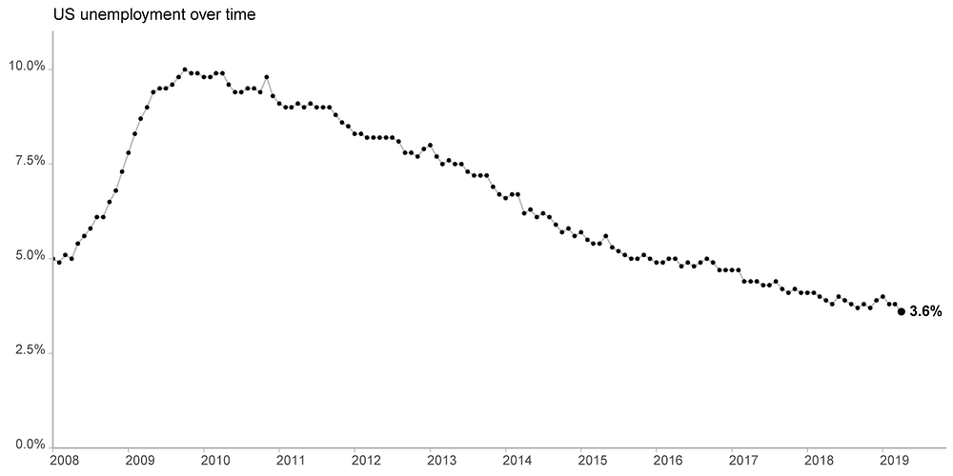
Definition: Uncertainty
(Visualization based on data from the Bureau of Labor Statistics)
How is this value calculated?
Jessica Hullman and Matthew Kay (https://medium.com/multiple-views-visualization-research-explained/uncertainty-visualization-explained-67e7a73f031b )
Notes:
monthly jobs figures, as shown in this visualization based on data from the Bureau of Labor Statistics (BLS):
At first glance, we might interpret the values in the chart as the outcome of asking every person in the country if they are unemployed, or perhaps some proxy we imagine would capture that information, like the proportion of workers in the U.S. on unemployment insurance. In reality, the government relies on the Current Population Survey (CPS), which is a survey of 60,000 eligible households — roughly 110,000 people — that are selected to be representative of the U.S. population. Employment information from this sample is weighted by demographics to give an estimate of the unemployment rate in the U.S. population at large

Slide 6
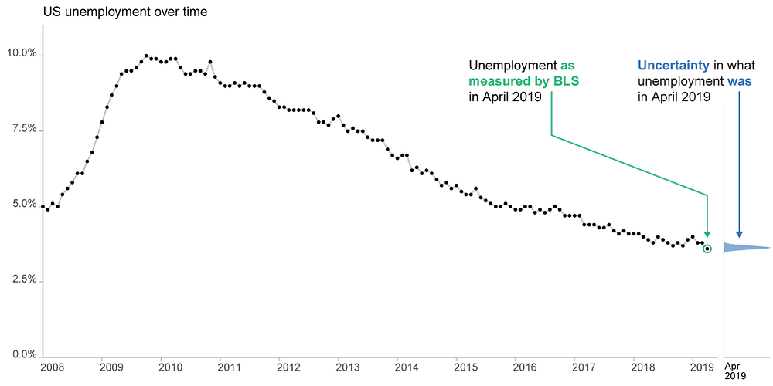
Definition: Uncertainty
(Visualization based on data from the Bureau of Labor Statistics)
A statistical model is used to estimate a parameter
The model quantifies the uncertainty around the estimate by considering all values it could be (and how likely each is)
Hence, a parameter’s uncertainty can be characterized by a probability distribution
Jessica Hullman and Matthew Kay (https://medium.com/multiple-views-visualization-research-explained/uncertainty-visualization-explained-67e7a73f031b )

Slide 7
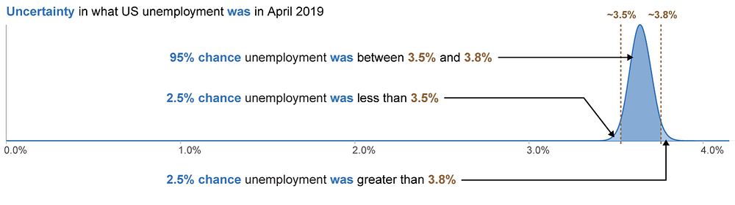
Definition: Uncertainty
(Visualization based on data from the Bureau of Labor Statistics)
A statistical model is used to estimate a parameter
The model quantifies the uncertainty around the estimate by considering all values it could be (and how likely each is)
Hence, a parameter’s uncertainty can be characterized by a probability distribution
Jessica Hullman and Matthew Kay (https://medium.com/multiple-views-visualization-research-explained/uncertainty-visualization-explained-67e7a73f031b )
Notes:
For the sake of explaining uncertainty, we created a statistical model that allows us to point to intervals, like 3.5% — 3.8%, and say that there is 95% chance that the interval contains the true unemployment value. Unfortunately, many intervals that we see, including from the BLS, are not so easily interpreted: the 95% instead refers to a property of the process used to construct the interval, not the chance that it contains the true value

Slide 8
Visualizing uncertainty
A statistical model is used to estimate a parameter
The model quantifies the uncertainty around the estimate by considering all values it could be (and how likely each is)
Hence, a parameter’s uncertainty can be characterized by a probability distribution
Why is it important to communicate uncertainty?
Jessica Hullman and Matthew Kay (https://medium.com/multiple-views-visualization-research-explained/uncertainty-visualization-explained-67e7a73f031b )

Slide 9
Visualizing uncertainty
There are two broad categories of uncertainty visualization techniques:
Graphical annotations that show properties of a distribution
Ex. error bars, animating between possible values
Mapping probability or confidence to a visual encoding channel
Ex. Make a mark more transparent if uncertainty is high
Padilla, L., Kay, M. and Hullman, J. (2026). Uncertainty Visualization. In Wiley StatsRef: Statistics Reference Online (eds N. Balakrishnan, T. Colton, B. Everitt, W. Piegorsch, F. Ruggeri and J.L. Teugels). https://doi.org/10.1002/9781118445112.stat08296

Slide 10
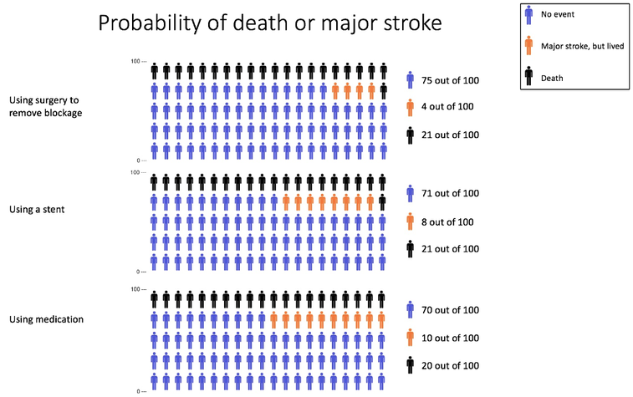
Visualizing uncertainty
Icon Array
Oﬄoad cognition by allowing a viewer’s visual system to compare the denominator and the numerator in a frequency probability format
Visual comparisons of this nature are easier and faster than numerical calculations
Can reduce denominator neglect by allowing people to compare relative ratios visually
Scalia et al. (2021) https://doi.org/10.1371/journal.pone.0253644
Padilla, L., Kay, M. and Hullman, J. (2026). Uncertainty Visualization. In Wiley StatsRef: Statistics Reference Online (eds N. Balakrishnan, T. Colton, B. Everitt, W. Piegorsch, F. Ruggeri and J.L. Teugels). https://doi.org/10.1002/9781118445112.stat08296

Slide 11
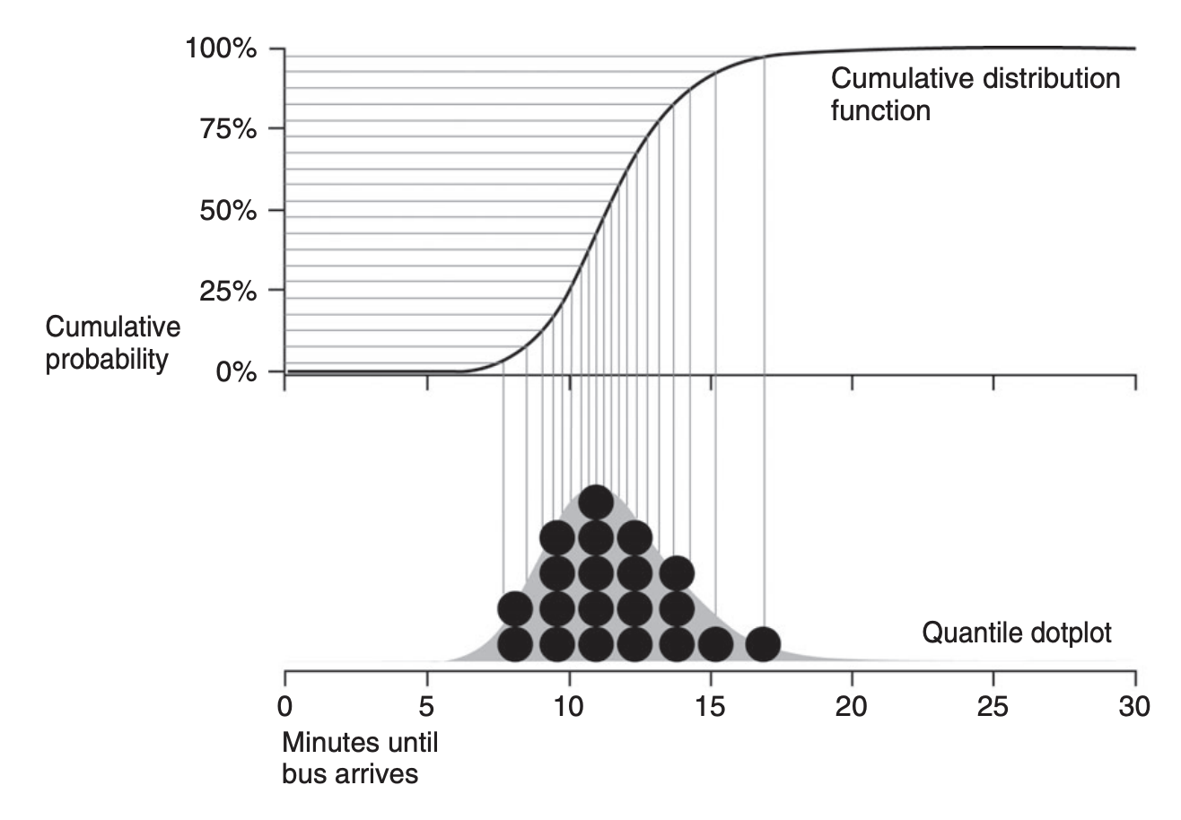
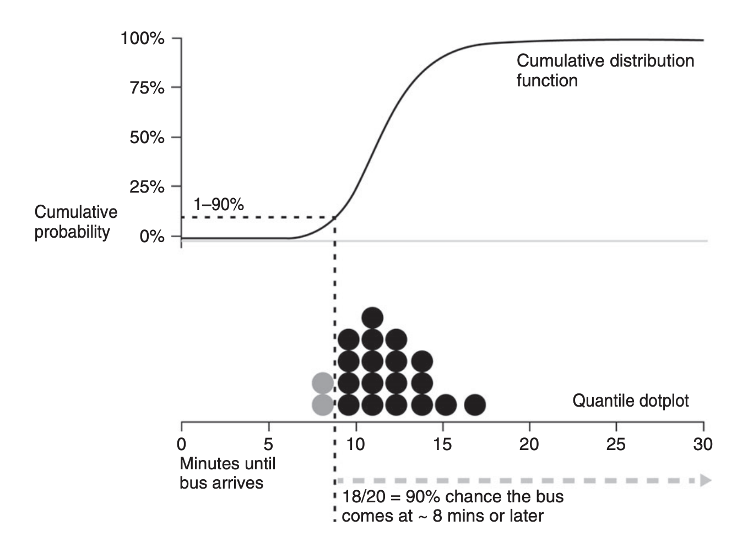
Visualizing uncertainty
Quantile dotplot
Displays uncertainty for a continuous variable
Represents a distribution where dots are sampled proportional to the quantiles of the distribution
Padilla, L., Kay, M. and Hullman, J. (2026). Uncertainty Visualization. In Wiley StatsRef: Statistics Reference Online (eds N. Balakrishnan, T. Colton, B. Everitt, W. Piegorsch, F. Ruggeri and J.L. Teugels). https://doi.org/10.1002/9781118445112.stat08296
Notes:
a quantile dotplot represents a distribution where dots are sampled proportional to the quantiles of the distribution. In this case, each dot depicts a 5% probability. Using this figure as an illustration, imagine that the viewer’s task is to determine if a bus will arrive in 8 min or later. With the quantile dotplot, the viewer can count the dots to determine that there is a 90% chance that the bus will in arrive 8 min or later.

Slide 12
Visualizing uncertainty
Hypothetical outcome plots (HOPs)
Use random draws from a distribution and animates the draws over time
Force viewers to:
account for uncertainty in their understanding of the data
recognize that less probable outcomes do fall within the distribution
Can be applied to most distribution data and visual encoding techniques relatively easily (as long as animation is not already used)
https://medium.com/hci-design-at-uw/hypothetical-outcomes-plots-experiencing-the-uncertain-b9ea60d7c740
Padilla, L., Kay, M. and Hullman, J. (2026). Uncertainty Visualization. In Wiley StatsRef: Statistics Reference Online (eds N. Balakrishnan, T. Colton, B. Everitt, W. Piegorsch, F. Ruggeri and J.L. Teugels). https://doi.org/10.1002/9781118445112.stat08296

Slide 13
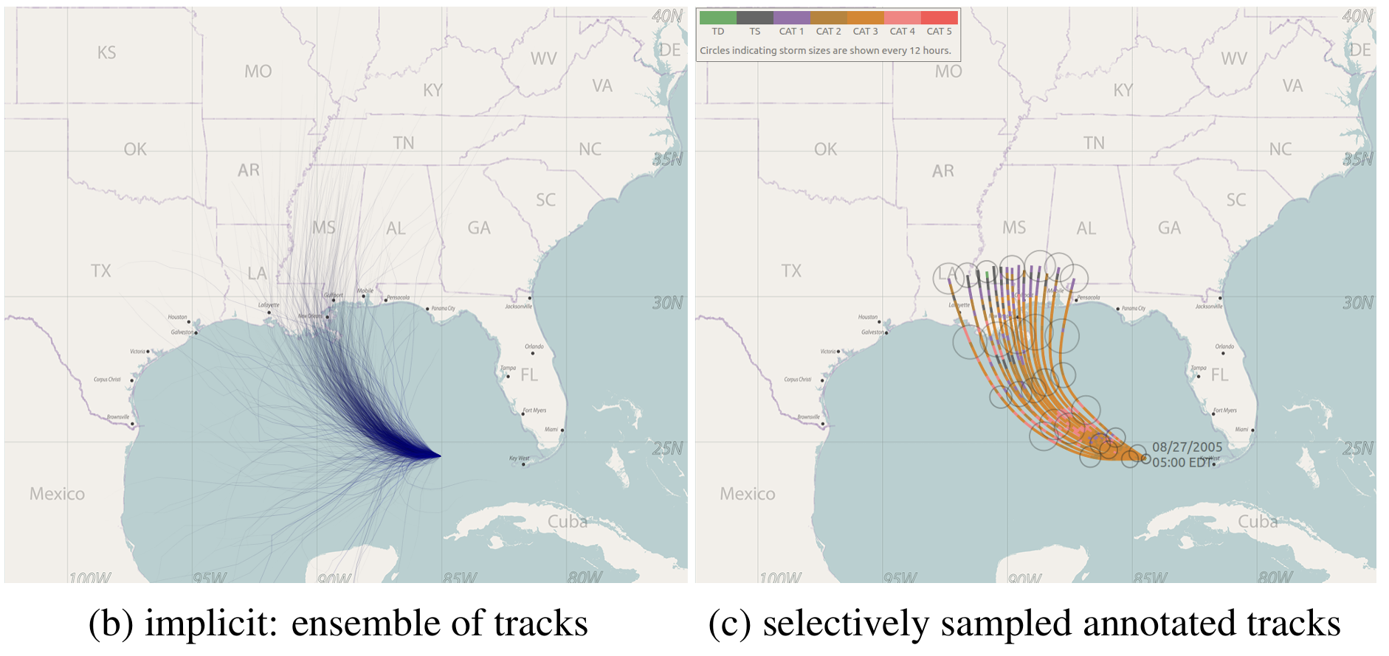
Visualizing uncertainty
Ensemble display
Typically used to illustrate potential storm paths
Traditionally generated by making perturbations to a model’s parameters and plotting the resulting runs on a static display
Studies show people overreact when one model appears to be hitting a point of interest vs. near a point of interest
Padilla, L., Kay, M. and Hullman, J. (2026). Uncertainty Visualization. In Wiley StatsRef: Statistics Reference Online (eds N. Balakrishnan, T. Colton, B. Everitt, W. Piegorsch, F. Ruggeri and J.L. Teugels). https://doi.org/10.1002/9781118445112.stat08296

Slide 14
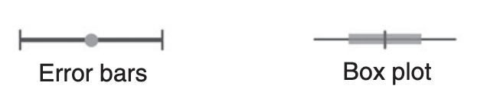
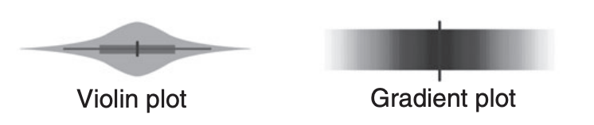
Visualizing uncertainty
Error bars, Box plot
Visual boundaries force people to think differently about the data than a continuous encoding, (visual boundaries=cognitive categories) which can be good or bad, depending on the nature of their decision
Violin plot, Gradient plot
Violin plots (mapping probability to area or width at a given y position) and gradient plots (mapping probability to opacity) lead to more intuitive assessments of value likelihood and “ability to surprise”
Padilla, L., Kay, M. and Hullman, J. (2026). Uncertainty Visualization. In Wiley StatsRef: Statistics Reference Online (eds N. Balakrishnan, T. Colton, B. Everitt, W. Piegorsch, F. Ruggeri and J.L. Teugels). https://doi.org/10.1002/9781118445112.stat08296

Slide 15
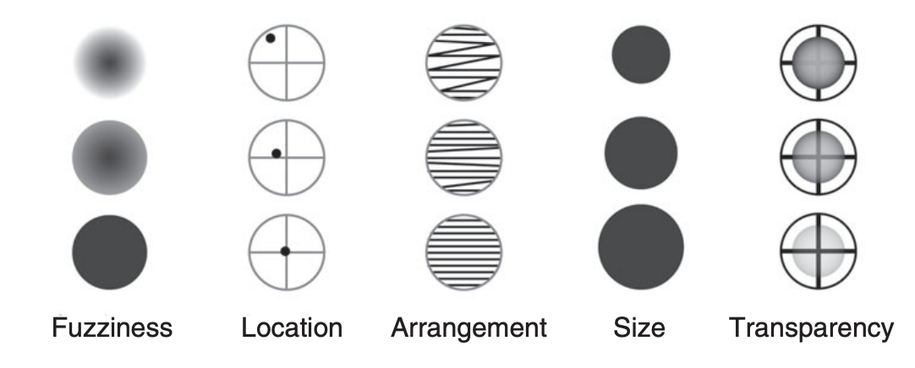
Visualizing uncertainty
Fuzziness, transparency, location, etc.
Encoding techniques that utilize visual metaphors for uncertainty, such as graying out using color saturation, out of focus using blur, fogginess using transparency, adding noise using texture, or sketchiness, are more intuitive ways to communicate uncertainty
Some of the visualizations map probability to visual properties and are designed to inhibit the viewer from resolving the value of a datum when the uncertainty is too high
Padilla, L., Kay, M. and Hullman, J. (2026). Uncertainty Visualization. In Wiley StatsRef: Statistics Reference Online (eds N. Balakrishnan, T. Colton, B. Everitt, W. Piegorsch, F. Ruggeri and J.L. Teugels). https://doi.org/10.1002/9781118445112.stat08296

Slide 16
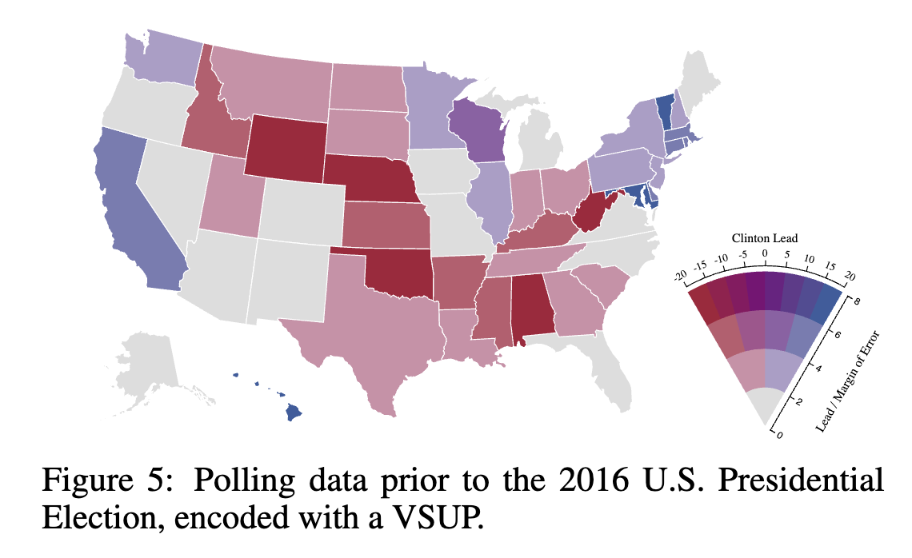
Visualizing uncertainty
Correll et al.. https://doi.org/10.1145/3173574.3174216
Value-suppressing color pallets
Attempt to make perception difficult in proportion to uncertainty
Blends hues denoting value with gray proportional to how uncertain they are. As a result, the most uncertain values all appear as the same shade of gray
Padilla, L., Kay, M. and Hullman, J. (2026). Uncertainty Visualization. In Wiley StatsRef: Statistics Reference Online (eds N. Balakrishnan, T. Colton, B. Everitt, W. Piegorsch, F. Ruggeri and J.L. Teugels). https://doi.org/10.1002/9781118445112.stat08296
Notes:
Wall, Emily. (2026). Human Bias in Visual Data Analysis: A Synthesis of Research to Empower Decision Makers. 10.1007/978-3-032-09307-3.

Slide 17
Your turn
Are these methods used in the “real world”?
Find a visualization on your favorite news source
Does the visualization show uncertainty?
If so, which method does it use?
How could you re-design the visualization to show uncertainty (or to show it better)?

Slide 18
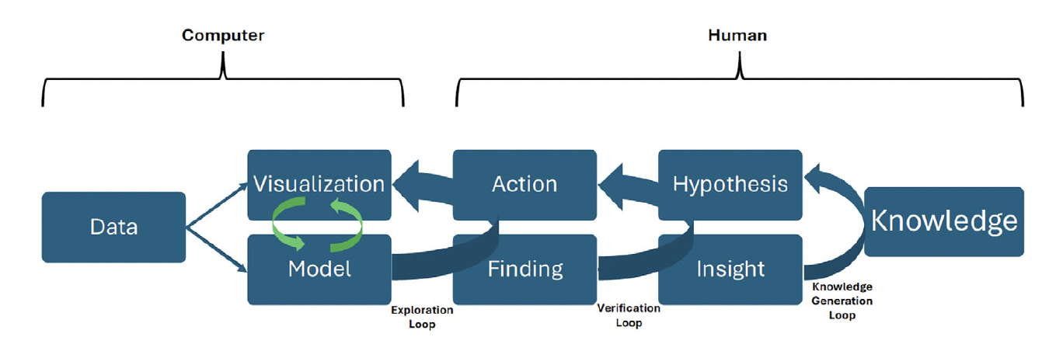
Bias in visual analytics
Measurement precision (ex. effect of gerrymandering on voting records)
Completeness (ex. aggregated or missing values)
Historical bias (ex. hiring decisions, arrest records)
Sampling bias (ex. convenience sampling on college students)
Wall, Emily. (2026). Human Bias in Visual Data Analysis: A Synthesis of Research to Empower Decision Makers. 10.1007/978-3-032-09307-3.

Slide 19
Bias in visual analytics
Simplifications and assumptions about training data
Aggregation bias (one model used for heterogeneous groups)
Evaluation bias (in appropriate training benchmarks)
Wall, Emily. (2026). Human Bias in Visual Data Analysis: A Synthesis of Research to Empower Decision Makers. 10.1007/978-3-032-09307-3.

Slide 20
Bias in visual analytics
Perceptual errors
Aspect scale influencing rate of change
Comparing lengths vs areas
Poor estimation of proportions
Assuming causation given a scatter or bar plot
Wall, Emily. (2026). Human Bias in Visual Data Analysis: A Synthesis of Research to Empower Decision Makers. 10.1007/978-3-032-09307-3.
Notes:
Perceptual biases have also been studied in the context of icon arrays, where data are shown as a series of icons (e.g., filled and unfilled squares arranged in a square grid). Xiong et al. found that the spatial arrangement of filled squares in a grid can impact people’s accu-racy in perceiving the data

Slide 21
Bias in visual analytics
Three perspectives relevant to visual analytics:
bias as a cognitive processing error
bias as a filter for information
bias as a preconception
Wall, Emily. (2026). Human Bias in Visual Data Analysis: A Synthesis of Research to Empower Decision Makers. 10.1007/978-3-032-09307-3.
Notes:
Perceptual biases have also been studied in the context of icon arrays, where data are shown as a series of icons (e.g., filled and unfilled squares arranged in a square grid). Xiong et al. found that the spatial arrangement of filled squares in a grid can impact people’s accu-racy in perceiving the data

Slide 22
Bias in visual analytics
Bias as a cognitive processing error
Two cognitive processes:
Intuition - largely subconscious and prone to making errors (bias)
Reason - intentional deliberation, responsible for recognizing and correcting errors
Cognitive processing errors result from shortcuts in cognition, broadly referred to as heuristics. Bias then is described as the method or mechanism by which the error occurs
Note: the process of heuristic decision-making does not always lead to errors; it usually facilitates fast decision-making
Wall, Emily. (2026). Human Bias in Visual Data Analysis: A Synthesis of Research to Empower Decision Makers. 10.1007/978-3-032-09307-3.

Slide 23
Bias in visual analytics
Bias as a cognitive processing error
Confirmation bias - people tend to accept confirmatory evidence of a pre-existing hypothesis and dismiss contrary information
Availability bias - people tend to rely more heavily on information that is easily remembered (e.g., most recent)
Attraction effect - tendency for a decision to be influenced by an inferior alternative
Anchoring bias - tendency to be heavily reliant on an initial value or anchor
Describe a scenario in which one of these biases could affect a visual analytic analysis
Wall, Emily. (2026). Human Bias in Visual Data Analysis: A Synthesis of Research to Empower Decision Makers. 10.1007/978-3-032-09307-3.
Notes:
Susan’s home-buying scenario, she will likely be subject to anchoring bias during the price negotiation of her purchase. That is, the home’s initial list price forms an anchor point and will thus subconsciously impact the amount she is willing to offer. Susan’s offer for the home might have been very different had she made an offer given a different initial list price. She might even pay more money for the same home due to the tendency not to strongly deviate from the anchor point

Slide 24
Bias in visual analytics
Bias as a filter for information
Information overload, refers to a point beyond people’s cognitive and perceptual limits where performance and decision-making suffer
Under overload conditions, people selectively allocate attention and other mental resources to the tasks or information of highest priority. One’s filter or bias thus determines what information is gathered and how sensory information is distinguished and interpreted
Ex. Participants were shown video footage of people wearing either white or black shirts passing a basketball and asked to count how many times white-shirt basketball players on a team passed the ball. Most participants count the appropriate number of passes but about half fail to perceive a glaringly misfit player walk across the court.
Describe a scenario in which this bias could affect a visual analytic analysis
Wall, Emily. (2026). Human Bias in Visual Data Analysis: A Synthesis of Research to Empower Decision Makers. 10.1007/978-3-032-09307-3.
Notes:
In our home-buying scenario, Susan may experience information overload [52] as she explores homes on the market in a visual data analysis tool. She might see hundreds of homes available in the area, each with dozens of attributes. Thus, her filter or bias will govern which information she perceives and which she dismisses. For example, she may only select to view single-family homes, removing condominiums, town homes, and apart-ments from the visualization. If removed, some options that may be relevant to Susan’s other search criteria will not be visibly available, though still in the underlying data and system.

Slide 25
Bias in visual analytics
Bias as a preconception
Analysts’ analysis are unconsciously shaped by experiences and internal influences
Unconscious bias may arise from
cultural beliefs and traditions
general self-confidence or self-esteem
comfort and familiarity with a machines analytics and interface functions
amount of risk aversion vs. seeking
Describe a scenario in which one of unconscious biase could affect a visual analytic analysis
Wall, Emily. (2026). Human Bias in Visual Data Analysis: A Synthesis of Research to Empower Decision Makers. 10.1007/978-3-032-09307-3.
Notes:
Susan is avoiding listings for houses downtown in the city. Having lived in the suburbs for many years, Susan assumes that neighborhoods near downtown have higher crime rates and lower economic stability. She believes she should not make a housing investment there.

Slide 26
Bias in visual analytics
Asynchronous interventions
Education (ex. about unconscious biases)
Big Limitation:
Education of biases requires that analysts remember information about biases and recall what strategies to apply to mitigate them. In reality, analysts may forget to engage the information in real-time decision-making scenarios
Wall, Emily. (2026). Human Bias in Visual Data Analysis: A Synthesis of Research to Empower Decision Makers. 10.1007/978-3-032-09307-3.

Slide 27
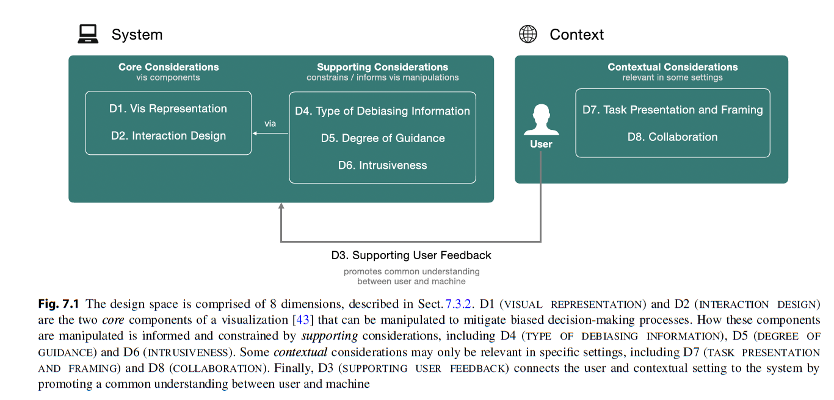
Bias in visual analytics
Real-Time interventions
Wall, Emily. (2026). Human Bias in Visual Data Analysis: A Synthesis of Research to Empower Decision Makers. 10.1007/978-3-032-09307-3.
Notes:
D1 - For bias interventions intended not to impose significant disruption to the user’s natural analytic process, designers may opt for peripheral or ex-situ visualizations. Peripheral visualizations would appear in a separate view of the interface, potentially available on demand, and hence may be less likely to call the user’s attention away from the primary visualization. On the other hand, in-situ visualizations would appear within existing views.
D2 - For example, a designer’s choice between a rectangle or lasso selection may have implications about how a user approaches a problem or task. Similarly, a system could disable interaction with data/views when biased behavior is detected
D3 - In real-world systems that may be able to characterize user bias with limited accuracy, feedback can enable the user to communicate information outside the scope to the underlying model of bias (e.g., that a presumed bias is not due to unconscious error, but rather an external task constraint).
D4 - Types of debiasing information that could promote user awareness includes things like analytic provenance, summative metrics that quantify the analytic process [41, 67], and so on. We could further conceive of future systems that are able to identify specific types of bias the user may be subject to by name (e.g., confirmation bias [86], anchoring bias [40], etc.). Systems should ideally communicate information about potential biases in a way that guides users to counteract them (i.e., they should be informative and actionable).
D5 - It can be thought of as a spectrum that refers to how much the system “helps” the user. On one end of the spectrum, the system provides little intervention, while on the other end, the system more aggressively steers the user.
D6 - Intrusiveness refers to how much the system interrupts or otherwise intrudes on the user’s analysis process. On the low end of the spectrum, bias information may be presented peripherally or even on demand (i.e., user attention optional). Highly intrusive mitigation strategies may present information front and center requiring the user’s attention until the perceived bias is addressed
D7 - For instance, in one study, researchers showed that people chose one treatment (surgery) over another (radiation therapy) when it was described as having a 90% short-term survival rate versus a 10% immediate mortality rate
D8 - Collaborative contexts have potential to mitigate bias by allowing others to check an analyst’s work. By leveraging “wisdom of crowds”, collaboration helps to ensure that a single sub-optimal individual decision does not prevail

Slide 28
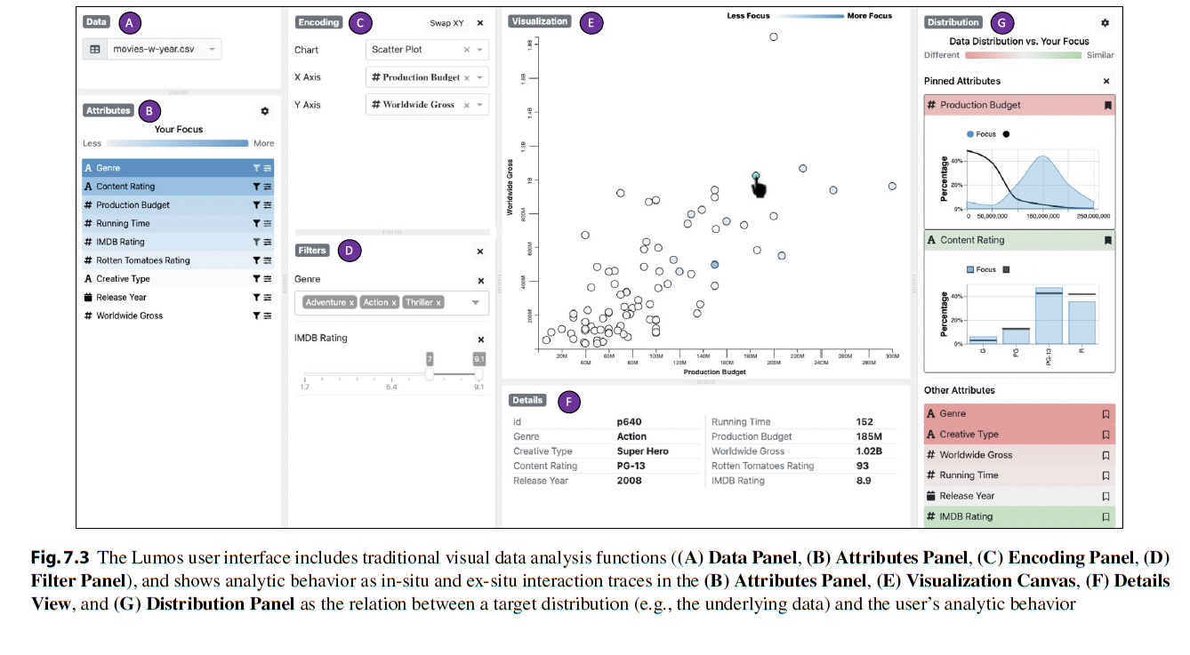
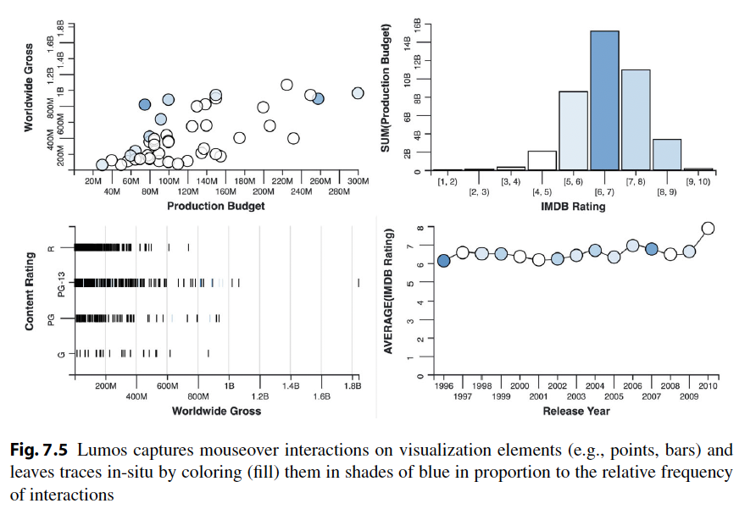
Bias in visual analytics
Real-Time interventions
Wall, Emily. (2026). Human Bias in Visual Data Analysis: A Synthesis of Research to Empower Decision Makers. 10.1007/978-3-032-09307-3.

