Slide 1
Data Wrangling
SSEP 2022 Afternoon Day 1
Dr. Ab Mosca (they/them)
Slides based on slides courtesy of Jordan Crouser: https://jcrouser.github.io/MassMutual-IntroR/, https://jcrouser.github.io/MassMutual-DataVis/, https://beanumber.github.io/sds192/

Slide 2
Data

Slide 3
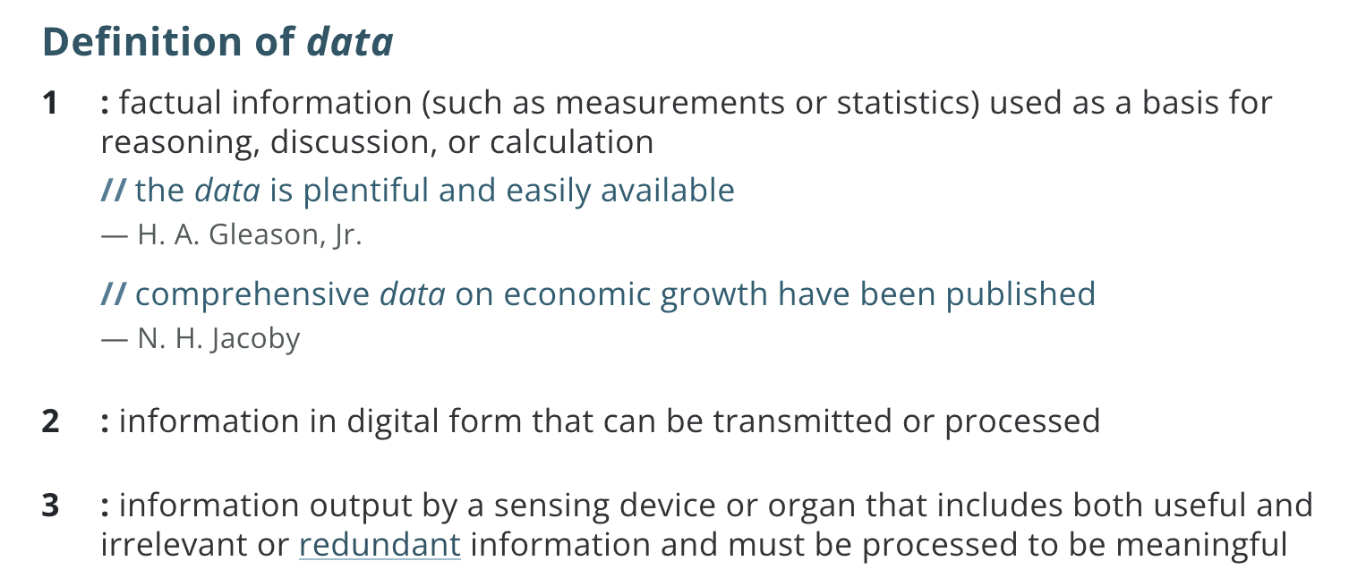
Definition: Data
https://www.merriam-webster.com/dictionary/data

Slide 4
Examples of Data
Work with the person next to you to find some examples of data (on the internet, or from your own life)
Add links to your examples to the data examples Jamboard: Data Examples Jamboard

Slide 5
Using Data
Data Examples Jamboard
What are some things we might want (or need) to do with data in order to analyze it?

Slide 6
Using Data
What are some things we might want (or need) to do with data in order to analyze it?
Select some (but not all) columns
Filter to some (but not all) rows
Mutate the data i.e. add or modify a column
Arrange the rows in a specific order
Summarize column with a single value(s)

Slide 7
The 5 Verbs: dplyr
What are some things we might want (or need) to do with data in order to analyze it?
select() some (but not all) columns
filter() to some (but not all) rows
mutate() the data i.e. add or modify a column
arrange() the rows in a specific order
summarize() column with a single value(s)

Slide 8

dplyr
R package for data wrangling (cleaning, reshaping, and analyzing data)
Big ideas:
Each “verb” (function) takes as input a tbl_df and returns a tbl_df
Verbs can be combined with “chaining” via the pipe operator (%>%)
Cheatsheet: https://www.rstudio.com/resources/cheatsheets/

Slide 9

tbl_df
“tibble”
object of class tbl
re-imagining of data.frame (makes them easier to work with!)
tidyverse (which includes dplyr) works with tibbles

Slide 10
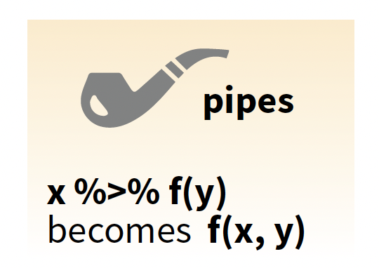
Pipe Operator
Verbs are used with the pipe (%>%) operator

Slide 11
Pipe operator
%>% (pipe operator)
With the pipe operator the expression
becomes
verb(mydata, arguments)
mydata %>%
verb(arguments)

Slide 12
Pipe operator
%>% (pipe operator)
More generally,
becomes
function(x, args)
x %>%
function(args)

Slide 13
Pipe operator
%>% (pipe operator)
This helps A LOT with readability!
Work with the person next to you to rewrite this using pipes:
select(filter(mutate(data, args1), args2), args3)

Slide 14
Pipe operator
%>% (pipe operator)
This helps A LOT with readability!
vs.
select(filter(mutate(data, args1), args2), args3)
data %>%
mutate(args1) %>%
filter(args2) %>%
select(args3)

Slide 15
The 5 Verbs
select()
filter()
mutate()
arrange()
summarize()

Slide 16

The 5 Verbs: dplyr
select() some (but not all) columns
Select column(s) by name. Ex:
a0
a1
b1
b2
c1
a1
b1
c1
data %>%
select(“a1”, “b1”, “c1”)

Slide 17
The 5 Verbs: dplyr
select() some (but not all) columns
Select column(s) by name or use other helper functions. Ex.
contains(match), ends_with(match), matches(match), starts_with(match)
a0
a1
b1
b2
c1
a1
b1
c1
data %>%
select(contains(“1”))
Notes:
some but not all == subset

Slide 18
The 5 Verbs: dplyr
select() some (but not all) columns
Select column(s) by specifying exclusions. Ex.
a0
a1
b1
b2
c1
a1
b1
c1
data %>%
select(-a0, -b2)
Notes:
some but not all == subset

Slide 19

The 5 Verbs: dplyr
filter() to some (but not all) rows
Select rows that meet logical criteria. Ex:
a0
a1
b1
b2
c1
a0
a1
b1
b2
c1
4
2
2
2
2
1
data %>%
filter(a1 == 2)

Slide 20
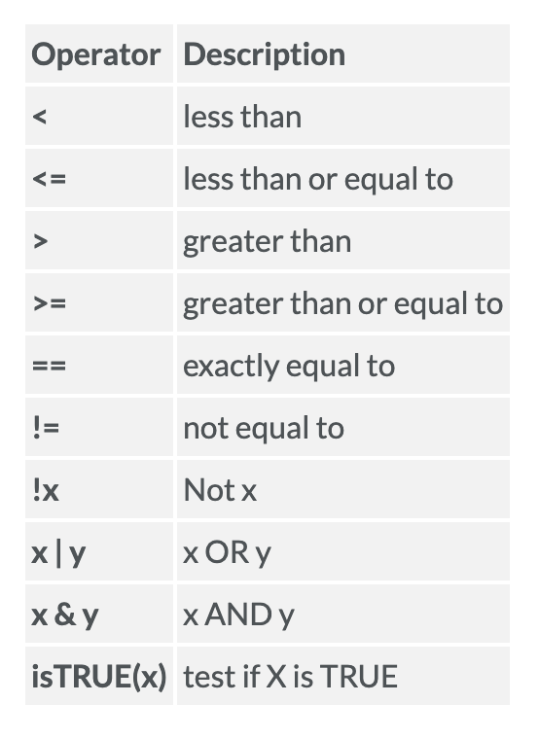
The 5 Verbs: dplyr
filter() to some (but not all) rows
Select rows that meet logical criteria. Ex:
a0
a1
b1
b2
c1
a0
a1
b1
b2
c1
4
2
2
2
2
1
data %>%
filter((a1 < 3) & (a1 > 1))

Slide 21
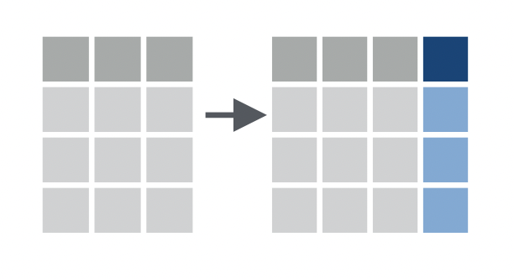
The 5 Verbs: dplyr
mutate() the data i.e. add or modify a column
Add a column to the dataset as a product of existing column(s). Ex.
a0
a1
b1
a0
a1
b1
c1
4
4
8
2
2
4
2
2
4
data %>%
mutate(c1 = a0 * 2)

Slide 22
The 5 Verbs: dplyr
mutate() the data i.e. add or modify a column
Add a column to the dataset as a product of existing column(s). Ex.
a0
a1
b1
a0
a1
b1
c1
4
3
4
3
7
2
7
2
7
9
2
1
2
1
3
data %>%
mutate(c1 = a0 + b1)

Slide 23
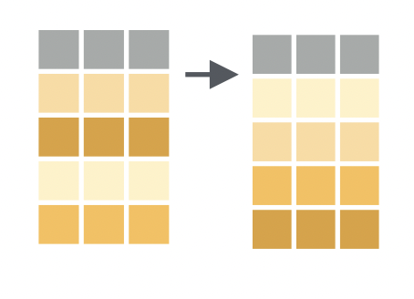
The 5 Verbs: dplyr
arrange() the rows in a specific order
Order rows by value of a column(s) from low to high. Ex.
a0
a1
b1
a0
a1
b1
2
0
5
2
0
3
3
5
data %>%
arrange(a0)

Slide 24
The 5 Verbs: dplyr
arrange() the rows in a specific order
Order rows by value of a column(s) from low to high. Use desc() to go from high to low. Ex.
a0
a1
b1
a0
a1
b1
3
5
0
3
5
2
2
0
data %>%
arrange(desc(a0))

Slide 25
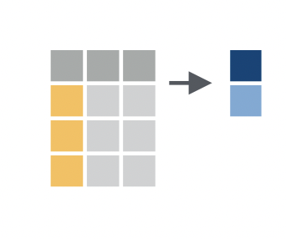
The 5 Verbs: dplyr
summarize() column with a single value(s)
Apply a summary function to a column. Ex.
a0
a1
b1
3
4
4
5
data %>%
summarize(mean(a0))

