Slide 1
Aggregation and Grouping
SSEP 2022 Morning Day 2
Dr. Ab Mosca (they/them)
Slides based on slides courtesy of Jordan Crouser: https://jcrouser.github.io/MassMutual-IntroR/, https://jcrouser.github.io/MassMutual-DataVis/, https://beanumber.github.io/sds192/

Slide 2
Recap: summarize()

Slide 3
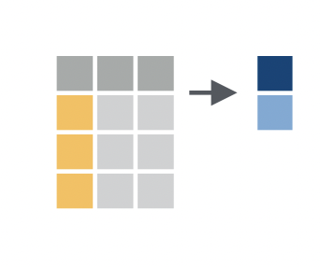
The 5 Verbs: dplyr
summarize() column with a single value(s)
Apply a summary function to a column. Ex.
a0
a1
b1
3
4
4
5
data %>%
summarize(mean(a0))

Slide 4
The 5 Verbs: dplyr
summarize() column with a single value(s)
What if I want to summarize by different groups in the data?
a0
a1
b1
3
4
data %>%
summarize(mean(a0))
4
5

Slide 5
summarize()
What if I want to summarize by different groups in the data?
Ex. What is the average weight of red vs green fruit?
Fruit | Color | Weight
Apple | Green | 150
Pear | Green | 170
Strawberries | Red | 300
Grapes | Green | 225
Cherries | Red | 190
Apple | Red | 165

Slide 6
summarize()
What if I want to summarize by different groups in the data?
Ex. What is the average weight of red vs green fruit?
Fruit | Color | Weight
Apple | Green | 150
Pear | Green | 170
Strawberries | Red | 300
Grapes | Green | 225
Cherries | Red | 190
Apple | Red | 165
data %>%
summarize(avg_weight =
mean(Weight))

Slide 7
summarize()
What if I want to summarize by different groups in the data?
Ex. What is the average weight of red vs green fruit?
Fruit | Color | Weight
Apple | Green | 150
Pear | Green | 170
Strawberries | Red | 300
Grapes | Green | 225
Cherries | Red | 190
Apple | Red | 165
data %>%
summarize(avg_weight =
mean(Weight))
avg_weight
200

Slide 8
summarize()
What if I want to summarize by different groups in the data?
Ex. What is the average weight of red vs green fruit?
We need to group the data and summarize each group…
Fruit | Color | Weight
Apple | Green | 150
Pear | Green | 170
Strawberries | Red | 300
Grapes | Green | 225
Cherries | Red | 190
Apple | Red | 165
data %>%
summarize(avg_weight =
mean(Weight))
avg_weight
200

Slide 9
summarize() by Group
What if I want to summarize by different groups in the data?
Ex. What is the average weight of red vs green fruit?
Fruit | Color | Weight
Apple | Green | 150
Pear | Green | 170
Strawberries | Red | 300
Grapes | Green | 225
Cherries | Red | 190
Apple | Red | 165
data %>%
group_by(Color)

Slide 10
summarize() by Group
What if I want to summarize by different groups in the data?
Ex. What is the average weight of red vs green fruit?
Fruit | Color | Weight
Apple | Green | 150
Pear | Green | 170
Strawberries | Red | 300
Grapes | Green | 225
Cherries | Red | 190
Apple | Red | 165
data %>%
group_by(Color)
Fruit | Color | Weight
Apple | Green | 150
Pear | Green | 170
Grapes | Green | 225
Strawberries | Red | 300
Cherries | Red | 190
Apple | Red | 165

Slide 11
summarize() by Group
What if I want to summarize by different groups in the data?
Ex. What is the average weight of red vs green fruit?
Fruit | Color | Weight
Apple | Green | 150
Pear | Green | 170
Strawberries | Red | 300
Grapes | Green | 225
Cherries | Red | 190
Apple | Red | 165
data %>%
group_by(Color) %>%
summarize(avg_weight =
mean(Weight))
Color | avg_weight
Green | 181.67
Red | 218.33

Slide 12
Grouping Data

Slide 13
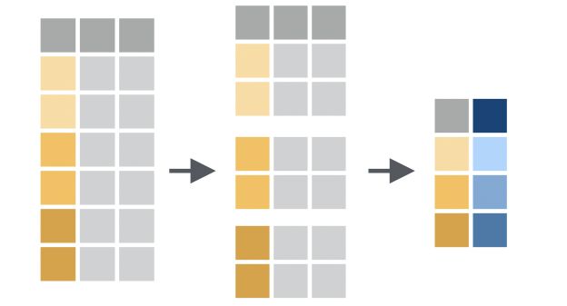
Group Data
group_by()
Creates a grouped version of your dataset
Performs following operations by groups
Take a look at the dplyr cheatsheet for more summarize() helper functions: R Cheatsheets

