Slide 1
Functions and Iteration
SSEP 2022 Afternoon Day 3
Dr. Ab Mosca (they/them)
Slides based on slides courtesy of Jordan Crouser: https://jcrouser.github.io/MassMutual-IntroR/, https://jcrouser.github.io/MassMutual-DataVis/, https://beanumber.github.io/sds192/

Slide 2
Functions

Slide 3
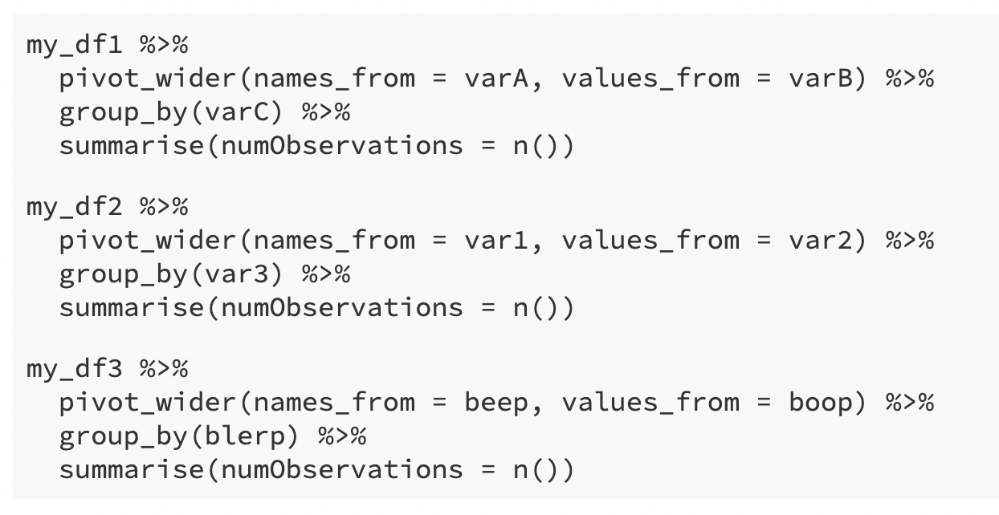
Repetition
Suppose you’re a data scientist given weekly datasets to analyze
The datasets are similar; each is a tbl with three variables
They come un-tidy, so first you must make them tidy
For three weeks use the following code:

Slide 4
Repetition
Work with the person next to you to find similarities in each code chunk above. Is there a common set of steps you take for each dataset?
Record your answer on the Jamboard here: Common Steps

Slide 5
Repetition

Slide 6
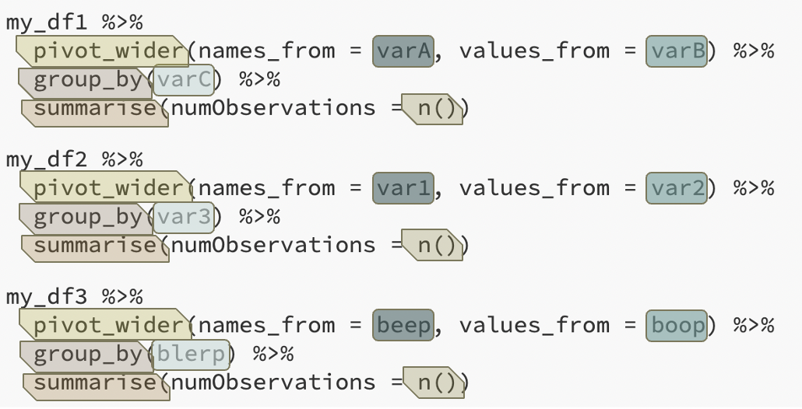
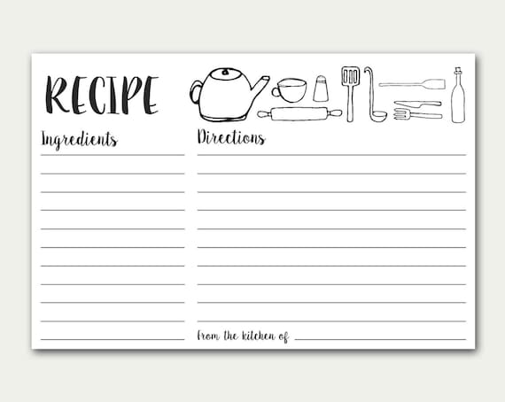
Repetition
tbl
Take tbl and pivot_wider() using names_from v1 and values_from v2
group_by() v3
summarize() using n()
v1, v2, v3

Slide 7
Functions
Format:
function_name(argument1, argument2, …)
Inputs
Arguments
Things like: tbl, string, int, etc.
Output
Things like: tbl, string, int, etc.
We’ve been using built in functions! Ex.
ncol(babynames)
Input = tbl (babynames)
Output = int (number of columns in babynames)

Slide 8
Functions
Format:
function_name(argument1, argument2, …)
Inputs
Arguments
Things like: tbl, string, int, etc.
Output
Things like: tbl, string, int, etc.
We’ve been using built in functions! Ex.
ncol(babynames)
Input = tbl (babynames)
Output = int (number of columns in babynames)
Work with the person next to you to find another example.
Add your answer to the Jamboard here: Function Examples

Slide 9
User-defined Functions
We can (temporarily) add functions to R by defining them ourselves
We call these user-defined functions
This is very useful for repetitive tasks

Slide 10
User-defined Functions
Defining your own functions
name_of_function <- function(data, var = "value") {
...
...
<valid R code>
...
...
return(x)
}

Slide 11
User-defined Functions
Defining your own functions
name_of_function <- function(data, var = "value") {
...
...
<valid R code>
...
...
return(x)
}
What you want the function to be called

Slide 12
User-defined Functions
Defining your own functions
name_of_function <- function(data, var = "value") {
...
...
<valid R code>
...
...
return(x)
}
function is the key word that tells R “I’m creating a function”
<- assigns the function definition to the variable name_of_function

Slide 13
User-defined Functions
Defining your own functions
Inputs
arguments: data, var
data is required
var is optional -- has a default value of "value"
name_of_function <- function(data, var = "value") {
...
...
<valid R code>
...
...
return(x)
}
Input / arguments

Slide 14
User-defined Functions
Defining your own functions
Body
Defines what the function should do
Everything between { and }
name_of_function <- function(data, var = "value") {
...
...
<valid R code>
...
...
return(x)
}
Body

Slide 15
User-defined Functions
Defining your own functions
Output
the return value
by default output of last line in function body
here, explicitly the object x
name_of_function <- function(data, var = "value") {
...
...
<valid R code>
...
...
return(x)
}
Output

Slide 16
User-defined Functions
Work with the person next to you to turn our recipe into a function.
Add your answer to the Jamboard here: Function Examples
tbl
Take tbl and pivot_wider() using names_from v1 and values_from v2
group_by() v3
summarize() using n()
v1, v2, v3
name_of_function <- function(data, var = "value") {
...
<valid R code>
...
return(x)
}

Slide 17
User-defined Functions
Work with the person next to you to turn our recipe into a function.
Add your answer to the Jamboard here: Function Examples
tbl
Take tbl and pivot_wider() using names_from v1 and values_from v2
group_by() v3
summarize() using n()
v1, v2, v3
clean_data <- function(data, v1, v2, v3) {
data %>%
pivot_wider(names_from = v1, values_from = v2) %>%
group_by(v3) %>%
summarize(numObservations = n())
}

Slide 18
User-defined Functions
Defining your own functions
To use a function you defined, you “call” it with the appropriate arguments
Ex. Let’s call clean_data()to make my_df1 from earlier tidy
# Define clean_data
clean_data <- function(data, v1, v2, v3) {
data %>%
pivot_wider(names_from = v1, values_from = v2) %>%
group_by(v3) %>%
summarize(numObservations = n())
}
# Call clean_data
my_tidy_df1 <- clean_data(my_df1, varA, varB, varC)

Slide 19
User-defined Functions
# Define clean_data
clean_data <- function(data, v1, v2, v3) {
data %>%
pivot_wider(names_from = v1, values_from = v2) %>%
group_by(v3) %>%
summarize(numObservations = n())
}
Work with the person next to you call clean_data for my_df2 and my_df3.
Add your answer to the Jamboard here: Function Examples

Slide 20
User-defined Functions
# Define clean_data
clean_data <- function(data, v1, v2, v3) {
data %>%
pivot_wider(names_from = v1, values_from = v2) %>%
group_by(v3) %>%
summarize(numObservations = n())
}
Work with the person next to you call clean_data for my_df2 and my_df3.
Add your answer to the Jamboard here: Function Examples
my_tidy_df2 <- clean_data(my_df2, var1,
var2,
var3)
my_tidy_df3 <- clean_data(my_df3, beep,
boop,
blerp)

Slide 21
User-defined Functions
Scope
Global environment
The general space in which you’re working
Global variable
Variable declared in your script outside of the body of a function
Global variables exist everywhere

Slide 22
User-defined Functions
Scope
Global environment
The general space in which you’re working
Global variable
Variable declared in your script outside of the body of a function
Global variables exist everywhere
Ex.
# global variable
global_var <- mtcars
top_cars <- function() {
# function body has access to global_var
local_var <- head(global_var)
return(local_var)
}
# Can print global_var outside of the function too
global_var

Slide 23
User-defined Functions
Scope
Local environment
Body of a function
Local variable
Variable declared within the body of a function
Local variables exist only within the body of the function in which they are declared

Slide 24
User-defined Functions
Default Values
Local environment
Body of a function
Local variable
Variable declared within the body of a function
Local variables exist only within the body of the function in which they are declared
Ex.
# global variable
global_var <- mtcars
top_cars <- function() {
# declare local_var
local_var <- head(global_var)
return(local_var)
}
# Cannot print local_var outside of the function
local_var # causes error

Slide 25
User-defined Functions
Default Values
When defining a function, you can set default values for the arguments
This can make functions easier to use
Any default value can be overwritten

Slide 26
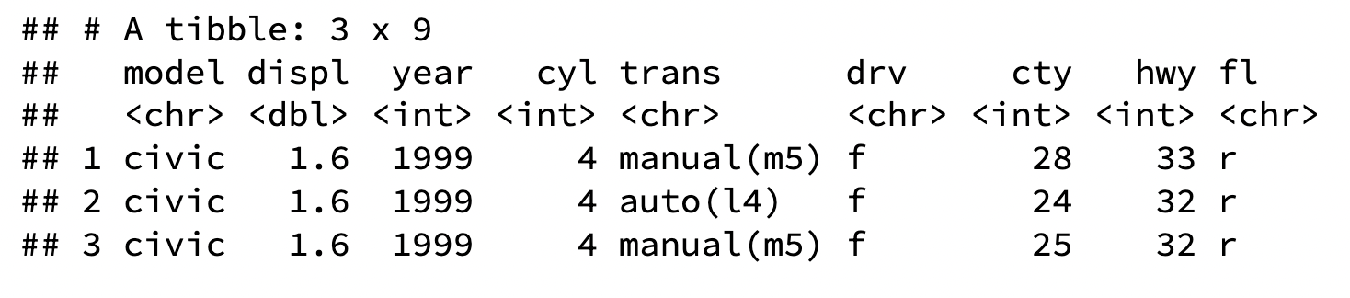
User-defined Functions
Default Values
my_car_info <- function(mod = "civic", n = 3) {
mpg %>%
filter(model == mod) %>%
select(-manufacturer, -class) %>%
head(n)
}
my_car_info()

Slide 27
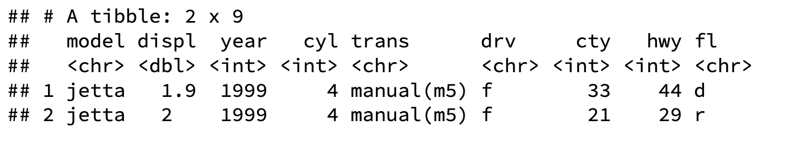
User-defined Functions
Overriding Default Values
my_car_info <- function(mod = "civic", n = 3) {
mpg %>%
filter(model == mod) %>%
select(-manufacturer, -class) %>%
head(n)
}
my_car_info()
my_car_info(mod = “jetta”, n = 2)

Slide 28
User-defined Functions
Naming Arguments
Optional

Slide 29
User-defined Functions
Naming Arguments
Optional
my_car_info(mod = “jetta”, n = 2)
my_car_info( “jetta”, 2)

Slide 30
User-defined Functions
Naming Arguments
Optional
But order matters if arguments are unnamed

Slide 31
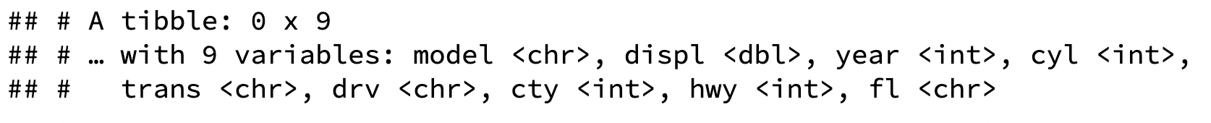
User-defined Functions
Naming Arguments
Optional
But order matters if arguments are unnamed
my_car_info(2, “jetta”)
my_car_info(n = 2, mod = “jetta”)

Slide 32
Iteration

Slide 33
Iteration
Suppose you have f(val), which returns a value, and you want to use this function on values 1 – 100

Slide 34
Iteration
Suppose you have f(val), which returns a value, and you want to use this function on values 1 – 100
One option for doing this would be to call f(val) for 1 – 100
f(1)
f(2)
f(3)
f(4)
f(4)
f(6)
...okay, I’m already bored

Slide 35
Iteration
Suppose you have f(val), which returns a value, and you want to use this function on a vector of values 1 – 100
One option for doing this would be to call f(val) for 1 – 100
f(1)
f(2)
f(3)
f(4)
f(4)
f(6)
...okay, I’m already bored
Uh-oh…not only am I bored, but
I accidentally called f(4) twice and skipped f(5)
and I’m going to get all my results separately, but I’d really like them in a vector

Slide 36
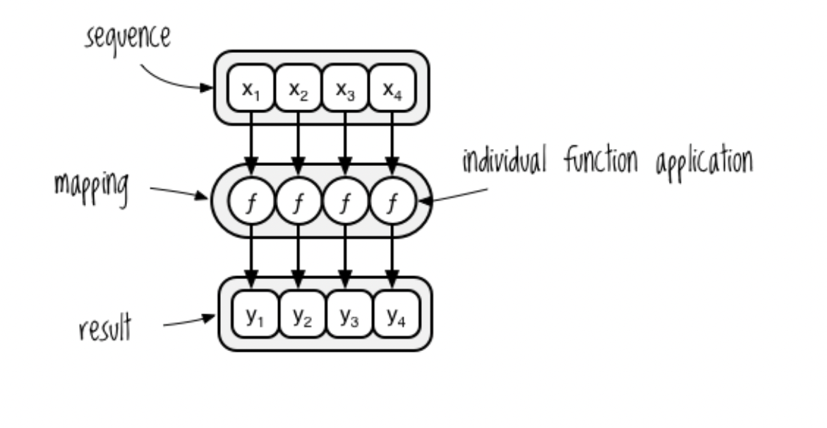
Iteration
What if instead, we could apply f() to our vector of values, and get a vector of results?

Slide 37
Iteration
What if instead, we could apply f() to our vector of values, and get a vector of results?
We call this mapping, and it falls into the category of something called functional programming

Slide 38

The library purrr makes functional programming with R easier
Find the purr cheatsheet here: https://www.rstudio.com/resources/cheatsheets/

Slide 39
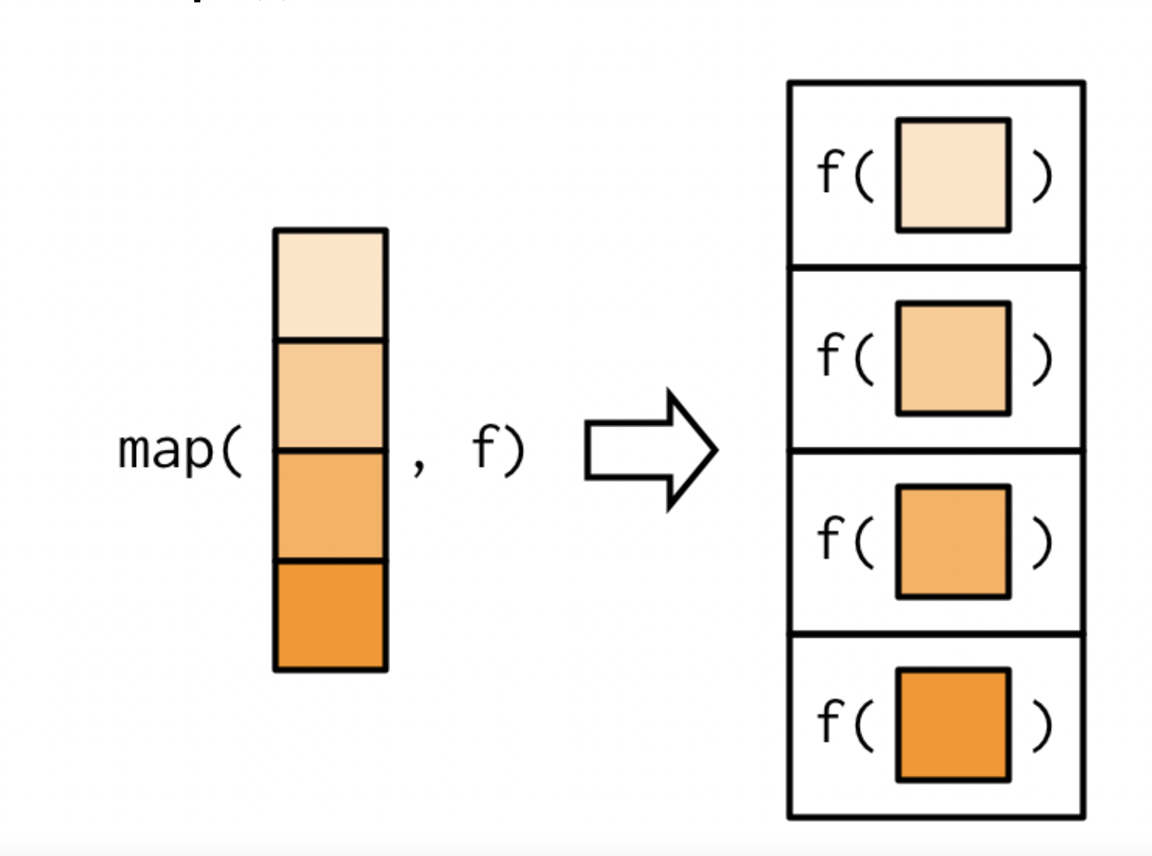
The library purrr makes functional programming with R easier
Find the purr cheatsheet here: https://www.rstudio.com/resources/cheatsheets/
We will mostly use the map() function

Slide 40
The library purrr makes functional programming with R easier
Find the purr cheatsheet here: https://www.rstudio.com/resources/cheatsheets/
We will mostly use the map() function
Output = results vector
Input = vector, function

Slide 41
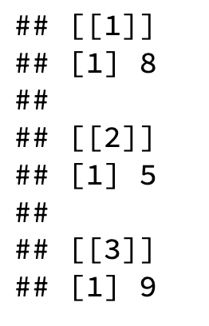

map()
map() example
# vector of values
words <- c("alphabet", "bunny", "cathedral")
# iterate the function over values
# return a list of number of characters per word
map(words, nchar)
# iterate the function over values
# return a vector of number of characters per word
map_int(words, nchar)

Slide 42
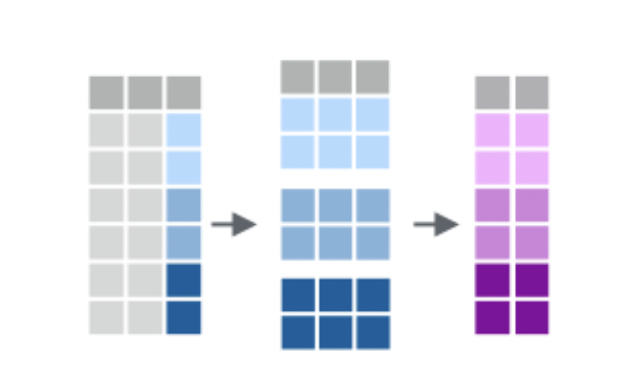
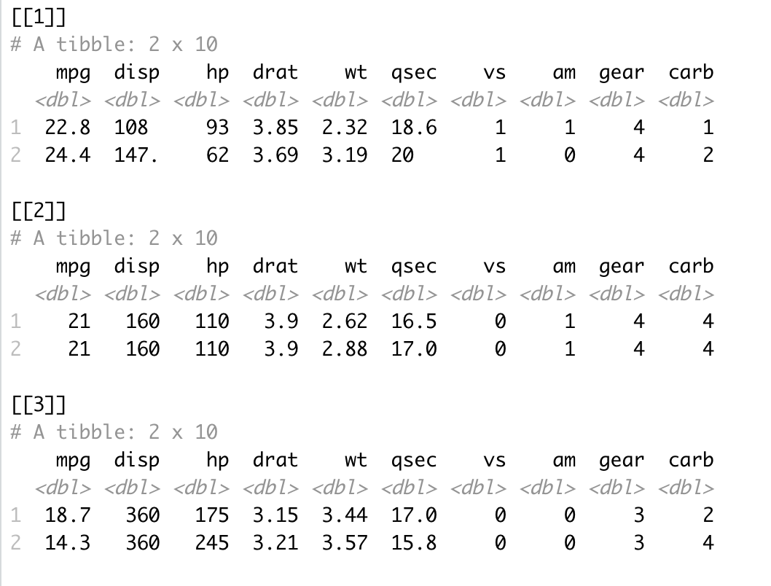
Mapping with and grouping
We can use group_by() and apply different mapping functions to groups within our datasets
Ex. group_by() + group_map()
mtcars %>%
group_by(cyl) %>% # creates a *list* of data frames!
group_map(head, n = 2)

Slide 43
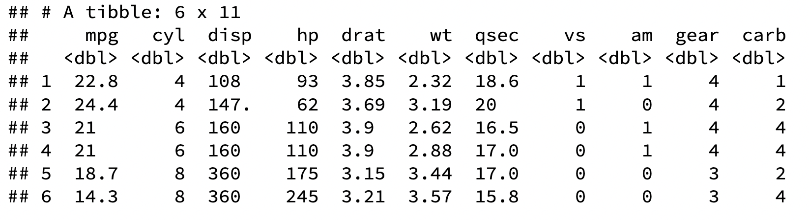
Mapping with and grouping
We can use group_by() and apply different mapping functions to groups within our datasets
Ex. group_split() + map_dfr()
mtcars %>%
group_split(cyl) %>% # creates a grouped data frame
map_dfr(head, n = 2)

