Slide 1
Grammar of Graphics: ggplot2
SSEP 2022 Afternoon Day 4
Dr. Ab Mosca (they/them)
Slides based on slides courtesy of Jordan Crouser: https://jcrouser.github.io/MassMutual-IntroR/, https://jcrouser.github.io/MassMutual-DataVis/, https://beanumber.github.io/sds192/

Slide 2
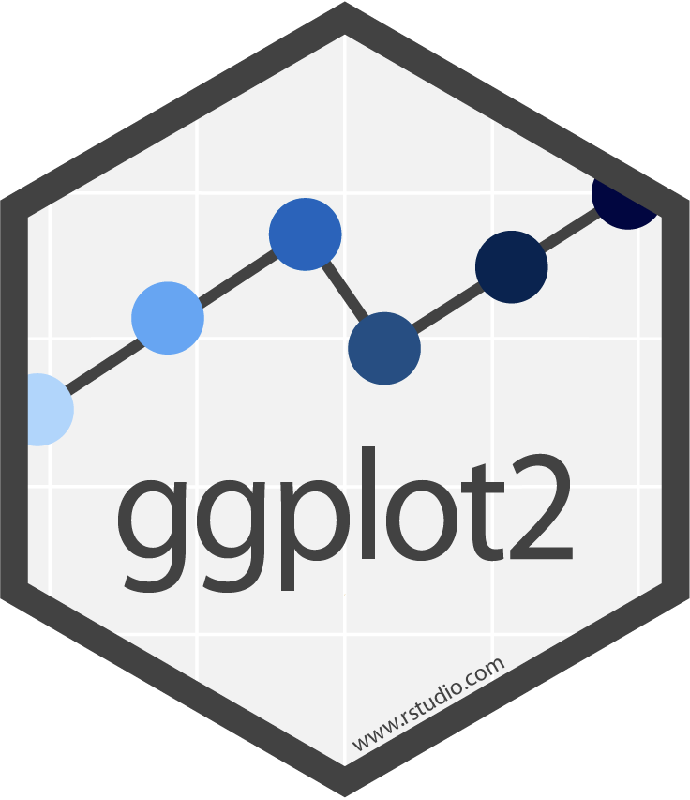
ggplot2
Library for creating plots in R
The “gg” stand for grammar of graphics
Big idea behind a grammar of graphics:
Independently specify plot building blocks and combine them to create graphical displays

Slide 3
ggplot2
Plot building blocks
data (obvi.)
aesthetic mappings (how we draw that stuff)
geometric objects (the literal stuff we draw)
statistical transformations (underlying model)
scales (range of values, colors, etc.)
faceting (small multiples)

Slide 4
ggplot2
Plot building blocks
data (obvi.)
aesthetic mappings (how we draw that stuff)
geometric objects (the literal stuff we draw)
statistical transformations (underlying model)
scales (range of values, colors, etc.)
faceting (small multiples)

Slide 5
ggplot2
Plot building blocks
data (obvi.)
aesthetic mappings (how we draw that stuff)
geometric objects (the literal stuff we draw)
statistical transformations (underlying model)
scales (range of values, colors, etc.)
faceting (small multiples)
ggplot(data, aes()) +
geom_*
data
aesthetic mapping
geometric object

Slide 6
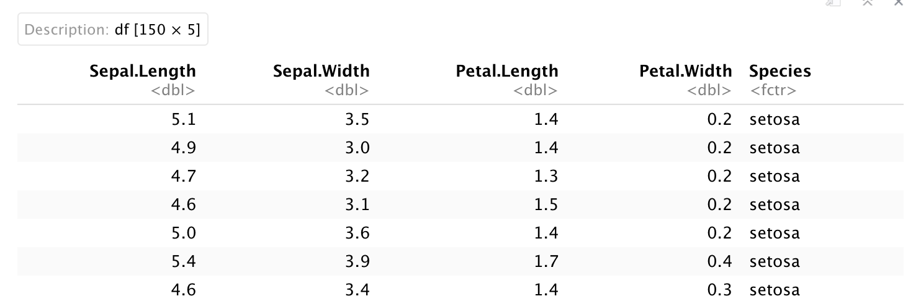

Data
First argument to ggplot is the data you want to plot
ggplot(iris)

Slide 7
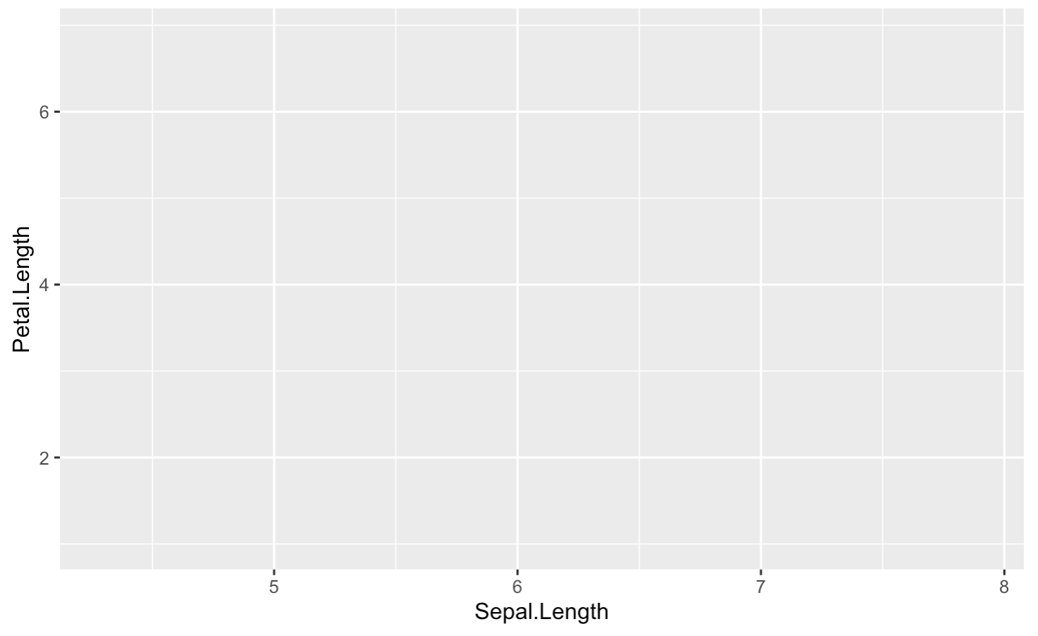
Aesthetic Mapping (aes())
Aesthetic refers to something you can see
Ex. Position on the x and y axes
ggplot(iris, aes(x = Sepal.Length, y = Petal.Length))

Slide 8
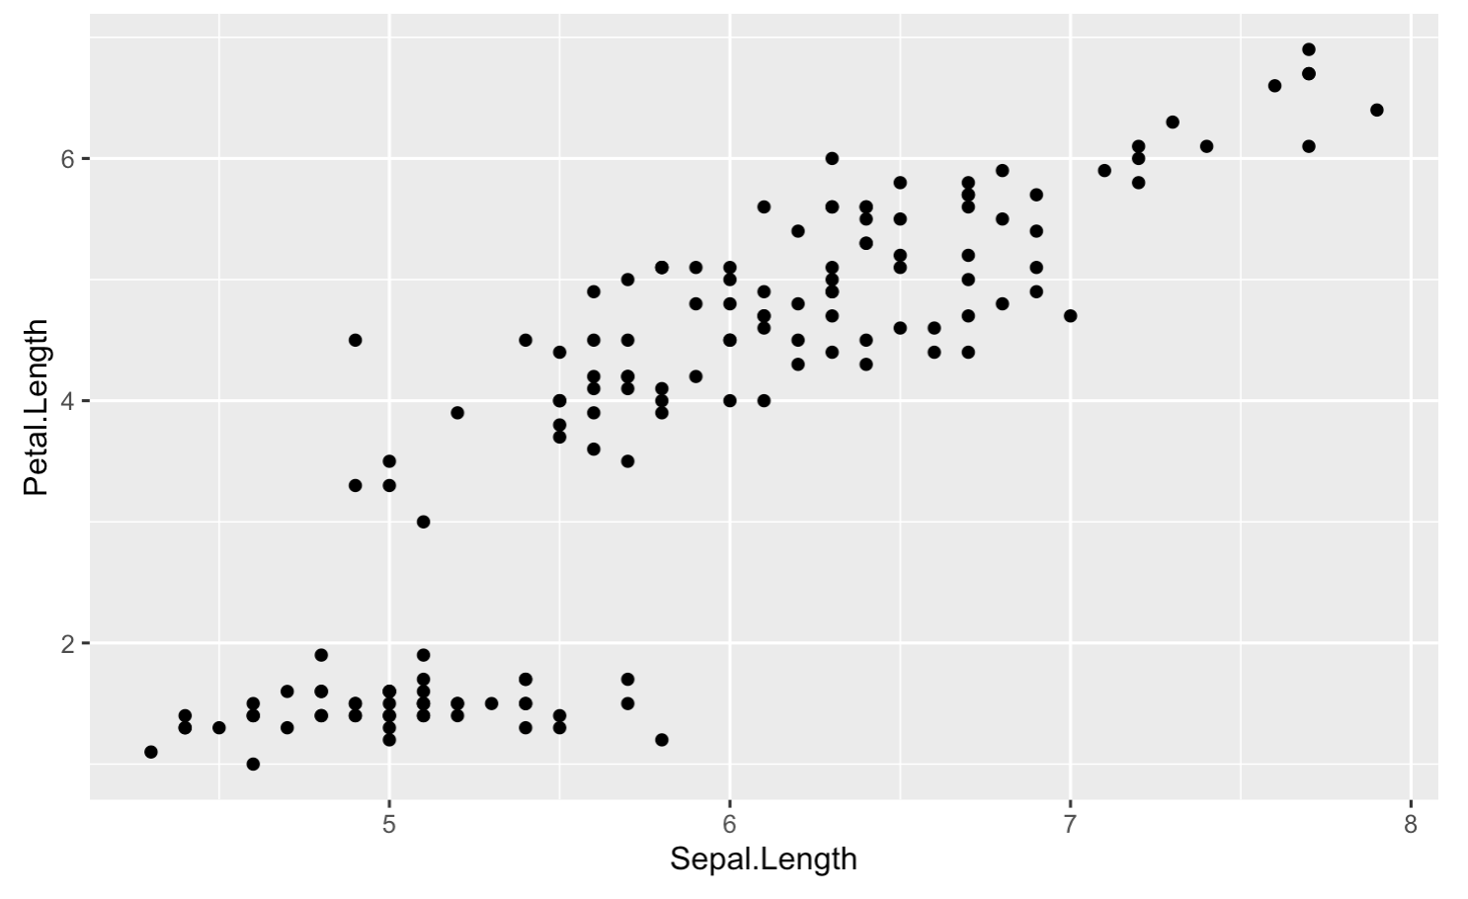
Geometric Objects (geom)
In ggplot2 the actual marks we put on a plot
Ex. points (geom_point)
ggplot(iris, aes(x = Sepal.Length, y = Petal.Length)) +
geom_point()

Slide 9
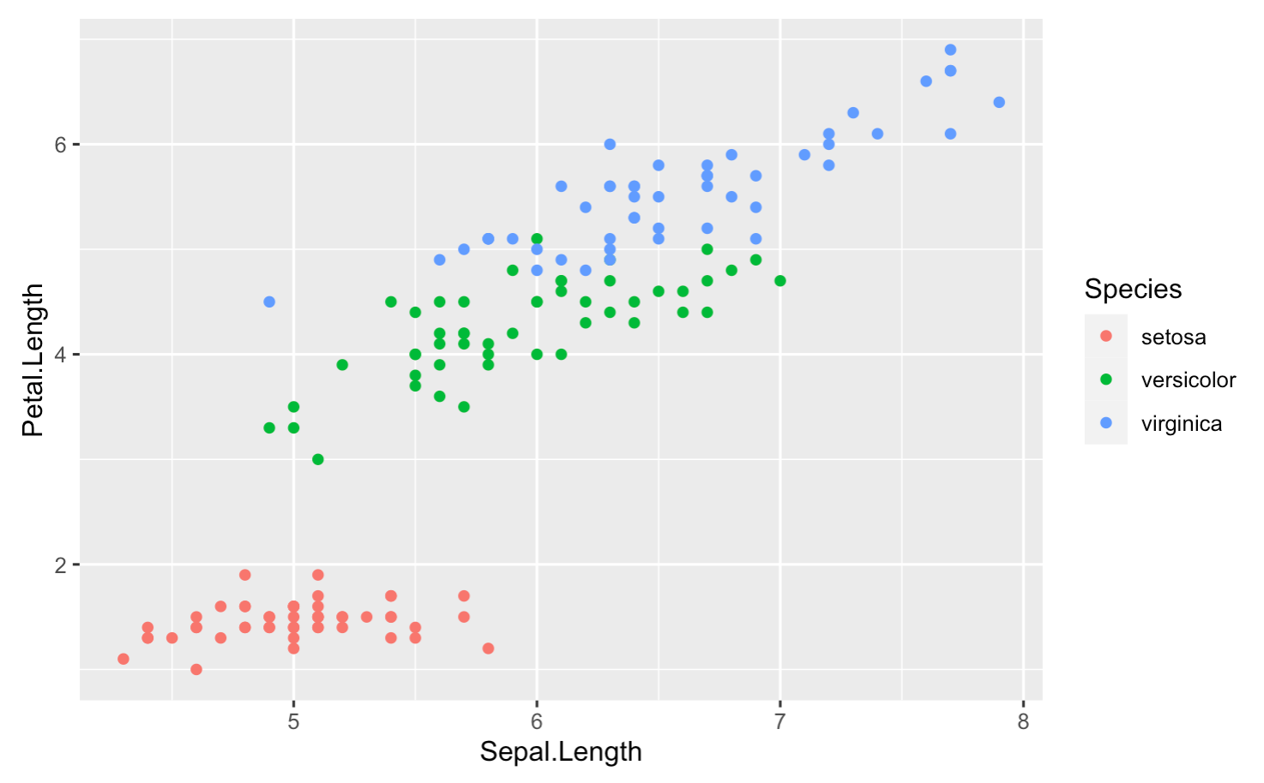
Geometric Objects (geom) + Aesthetics
Apply aesthetics to geometric objects
Ex. Color points
ggplot(iris, aes(x = Sepal.Length, y = Petal.Length)) +
geom_point(aes(color = Species))

Slide 10
ggplot2 tips
Cheatsheet: https://www.rstudio.com/resources/cheatsheets/
Remember building blocks
data
aesthetic mappings
geometric objects
Play around! Try different things in your lab and look at documentation if you get stuck: https://ggplot2.tidyverse.org/

