Slide 1
Follow Me 2
Shuai Fu
25 Mar. 2017

Slide 2
Agenda
Design
Security Properties
Implementation
Source Code

Slide 3
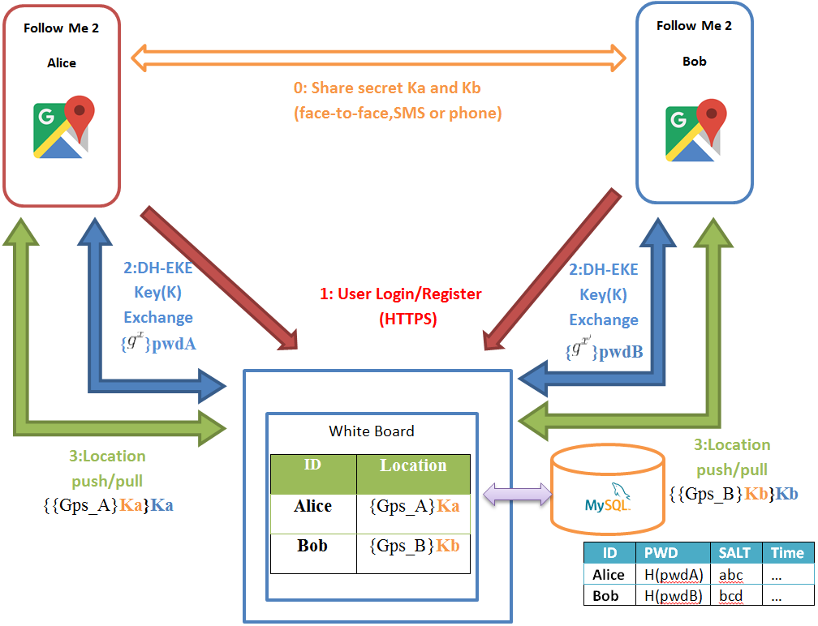

Design

Slide 4
Design
Pull/Push-based lightweight Client-Server Design
No long-connection between C/S (HTTPS)
One-push-serve-many location push
Standard Web App (No socket permission needed)

Slide 5
Agenda
Design
Security Properties
Implementation
Source Code

Slide 6
Security Properties
Always HTTPS C/S communication
Diffie-Hellman Encrypted Key Exchange (DH-EKE)
Always Encrypted Location Information
Minimum Personal Information Required
OpenShift Proxy
Tor

Slide 7
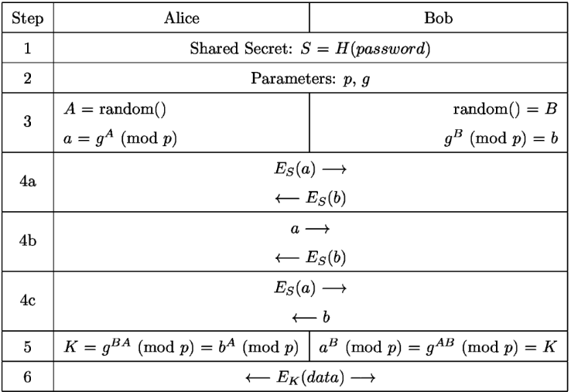
Security Properties
Diffie-Hellman Encrypted Key Exchange

Slide 8
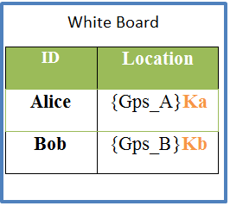

Security Properties
Encrypted Location Information
Location information stored in Server side is cipher
Minimum Personal Information Required
Only ID and password needed
Salted Password Hashing

Slide 9
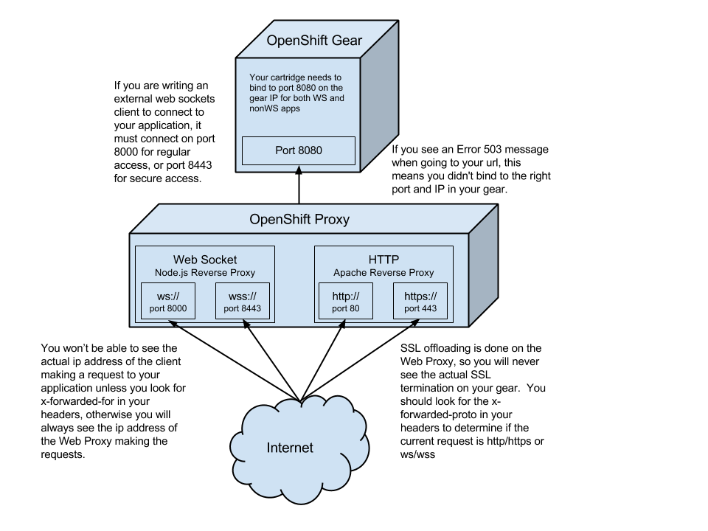
Security Properties
OpenShift Proxy

Slide 10
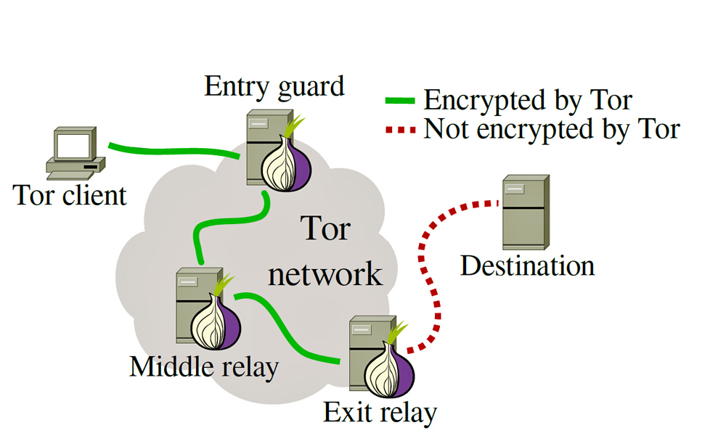
Security Properties
Tor Network
“The Onion Router”

Slide 11
Agenda
Design
Security Properties
Implementation
Source Code

Slide 12
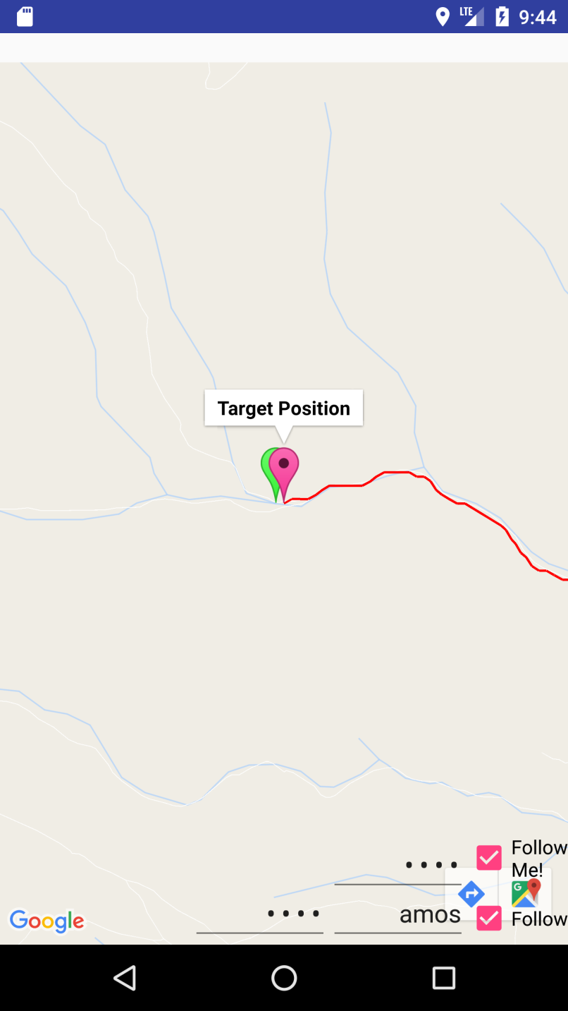
Implementation
Google Map API V2
Zero configuration
One-click operation
Target trace
Online/offline notify
Auto-installation of Tor

Slide 13
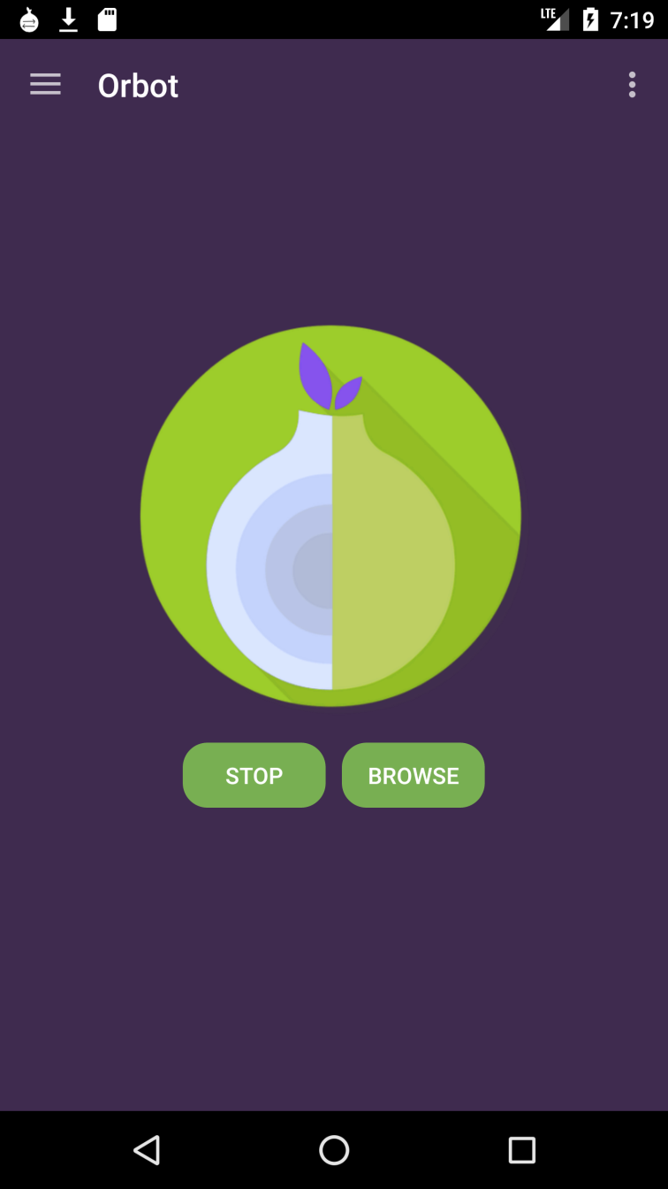
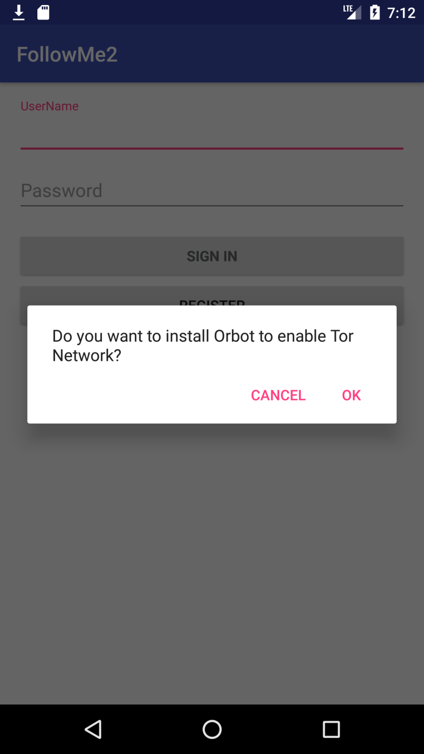
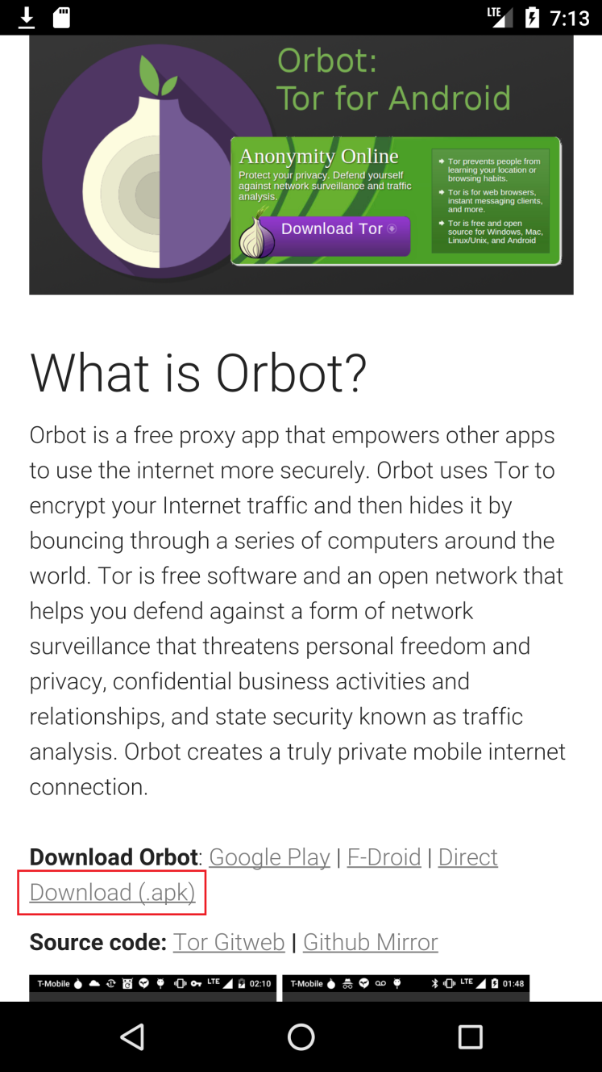
Implementation
Auto-installation of Tor
Orbot + Netcipher

Slide 14
Agenda
Design
Security Properties
Implementation
Source Code

Slide 15
Source Code
FollowMe2
https://github.com/amosfu/FollowMe2
Whiteboard2
https://github.com/amosfu/whiteboard2

Slide 16
Thank you !

