Slide 1
Follow Me 2
Shuai Fu
25 Mar. 2017

Slide 2
Agenda
Design
Security Properties
Implementation
Problem

Slide 3
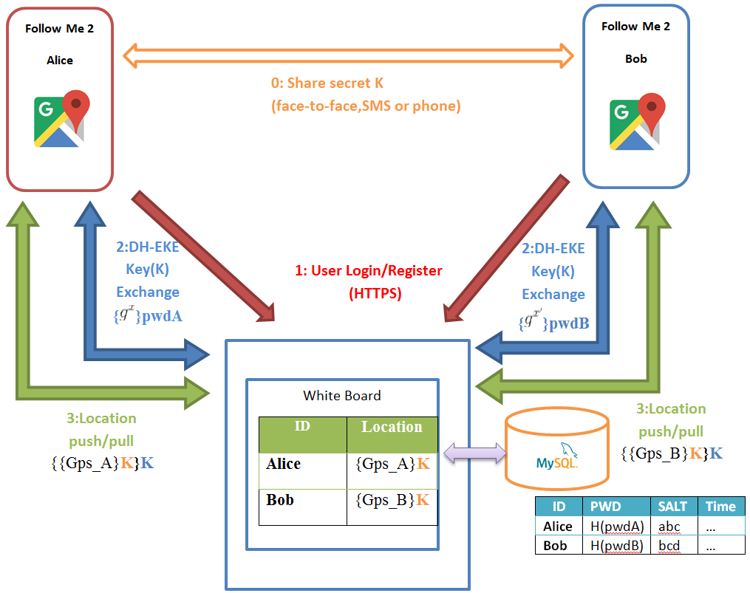
Design

Slide 4
Design
Pull/Push-based lightweight Client-Server Design
No long-connection between C/S (HTTPS)
One-push-serve-many location push
Standard Web App (No socket permission needed)

Slide 5
Agenda
Design
Security Properties
Implementation
Problem

Slide 6
Security Properties
Always HTTPS C/S communication
Diffie-Hellman Encrypted Key Exchange (DH-EKE)
Always Encrypted Location Information
Minimum Personal Information Required
OpenShift Proxy
Tor ?

Slide 7
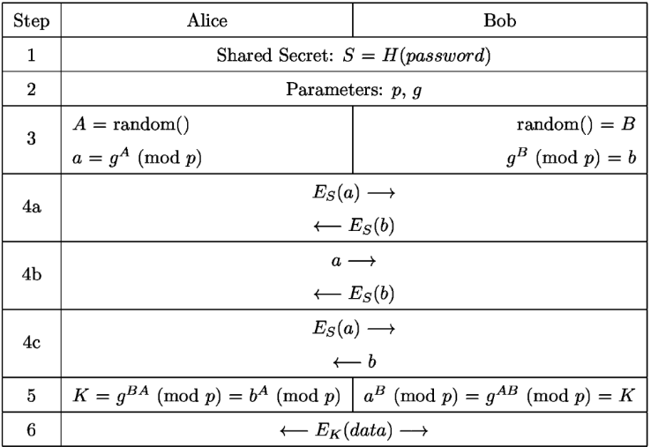
Security Properties
Diffie-Hellman Encrypted Key Exchange

Slide 8
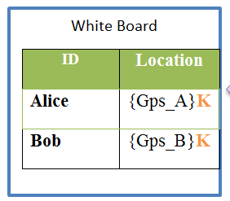

Security Properties
Encrypted Location Information
Location information stored in Server side is cipher
Minimum Personal Information Required
Only ID and password needed
Salted Password Hashing

Slide 9
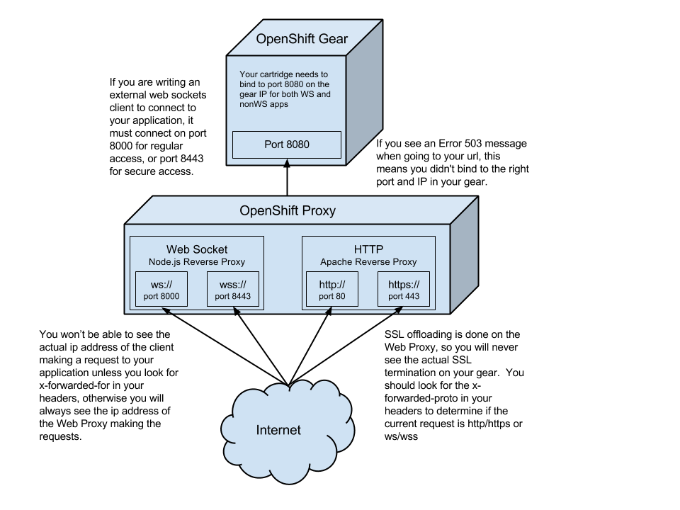
Security Properties
OpenShift Proxy

Slide 10
Agenda
Design
Security Properties
Implementation
Problem

Slide 11
Implementation
Google Map API V2
Zero configuration
One-click operation
Target trace
Online/offline notify

Slide 12
Agenda
Design
Security Properties
Implementation
Problem

Slide 13

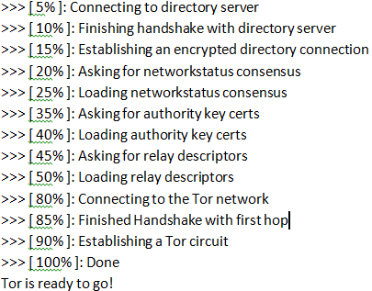
Problem
Tor Network
Tor Network for anonymous HTTP/HTTPS
Orchid Tor client for SDK version <= 22

Slide 14
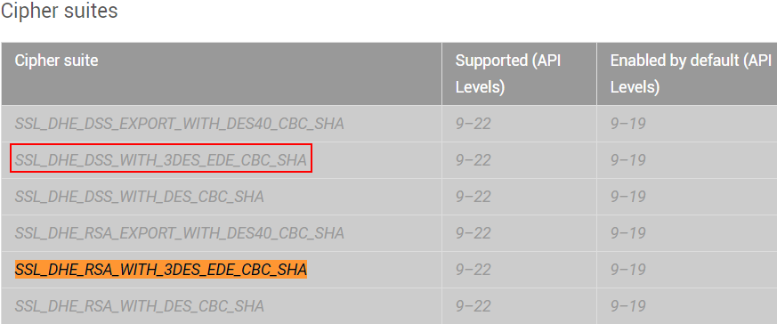
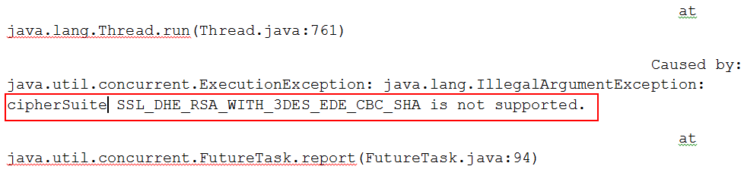
Problem
Tor is too old?
Cipher suites required by Tor are unsupported by Android SDK Version > 22 (Android 6 or higher)

Slide 15
Thank you !

