Slide 1
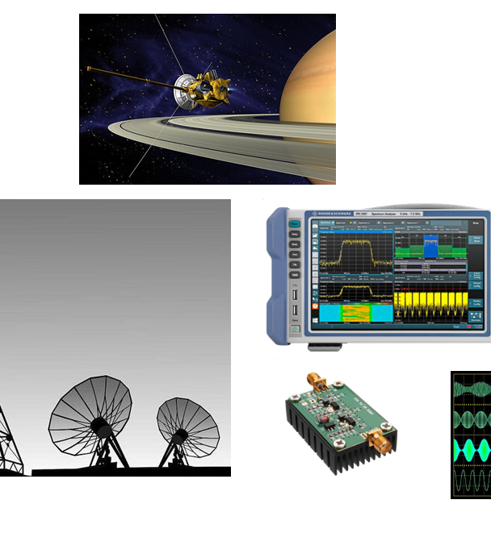
Modelling of doppler-augmented distance estimation
Modulschlussprüfungen
Digital Communication (dcom)
Amos Matter

Slide 2
Outline Subtitle
I - Introduction and Problem Statement
Justification
Time of Flight
Doppler Effect
III - Practical Application
Challenges
Strategy
Results
II - Theoretical Foundation
Kalman Filter
IV – Future Work and Conclusion
Extensions
Conclusion

Slide 3
Introduction and Problem Statement
How can Position Estimates be improved with Frequency shift information?
Linear Kalman Filter with 2 States
Position and Velocity → Signal Time of Flight and Frequency shift
Example usage: Distance Estimation

Slide 4
Theoretical Foundations Kalman Filter
Kalman Filter is a Bayesian, State Space generalization of a Low Pass filter
Such that
1D Kalman Filter with constant state variance = Low Pass filter
Combines information in the optimal way while taking into account
Dynamics + Noise
Measurements + Noise

Slide 5
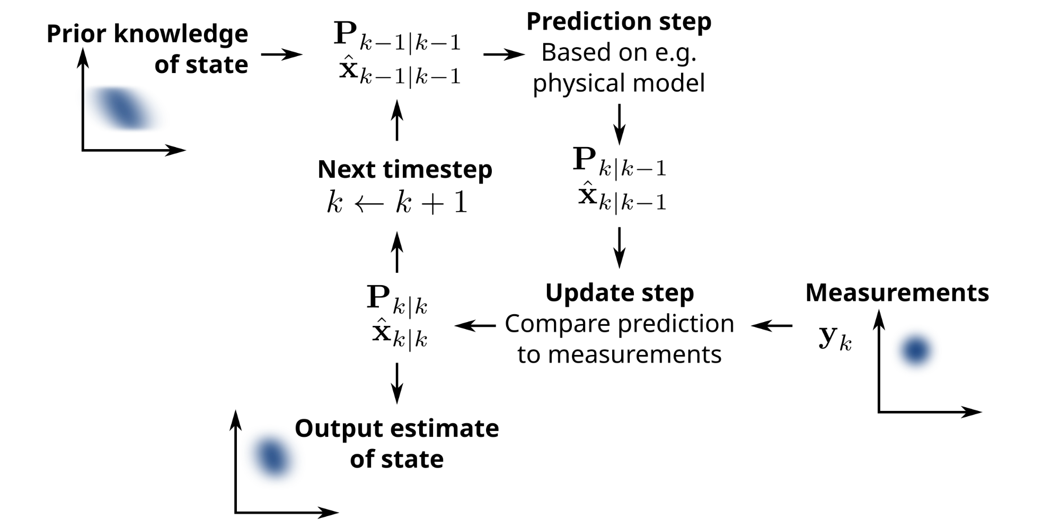
Function
https://en.wikipedia.org/wiki/Kalman_filter#/media/File:Basic_concept_of_Kalman_filtering.svg

Slide 6
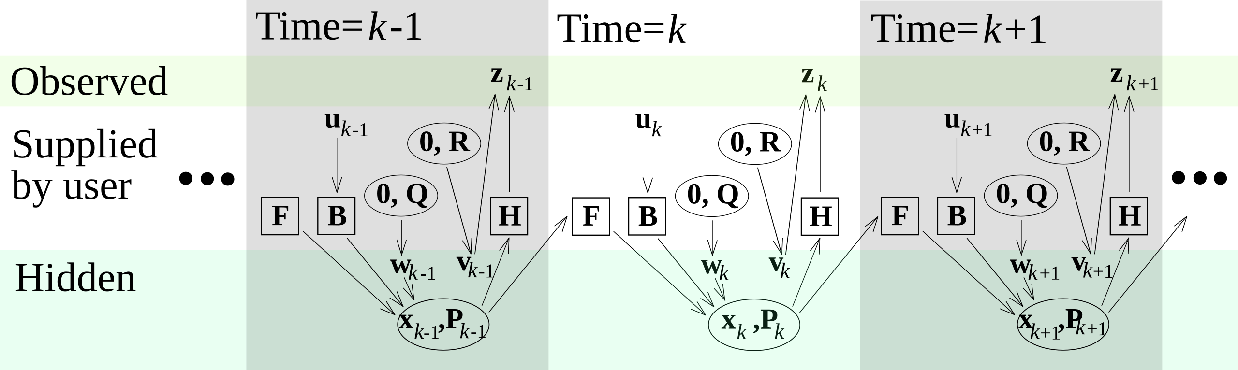
Model
https://en.wikipedia.org/wiki/Kalman_filter#/media/File:Kalman_filter_model_2.svg

Slide 7
Theoretical Foundations Kalman Filter
Kalman Filter is a Bayesian, State Space generalization of a Low Pass filter
Such that
1D Kalman Filter with constant state variance = Low Pass filter
Combines information in the optimal way while taking into account
Dynamics + Noise
Measurements + Noise

Slide 8
Practical Application Challenges
On 1D arrays/Vectors, NumPy does
sometimes does elementwise Multiplication instead of matmul
Always inner products even if the shape suggests outer products
Data sometimes not interesting
How to fairly assess the impact of the doppler information?

Slide 9
Practical Application Solution/Strategy
Use function for vector instantiation such that shape is [n,1] → Forces correct vector interpretation
Define measurement covariances in “state space” instead of “measurement space”
Two runs, one with very high frequency shift covariance → ~ No frequency shift measurement
Modular code architecture

Slide 10
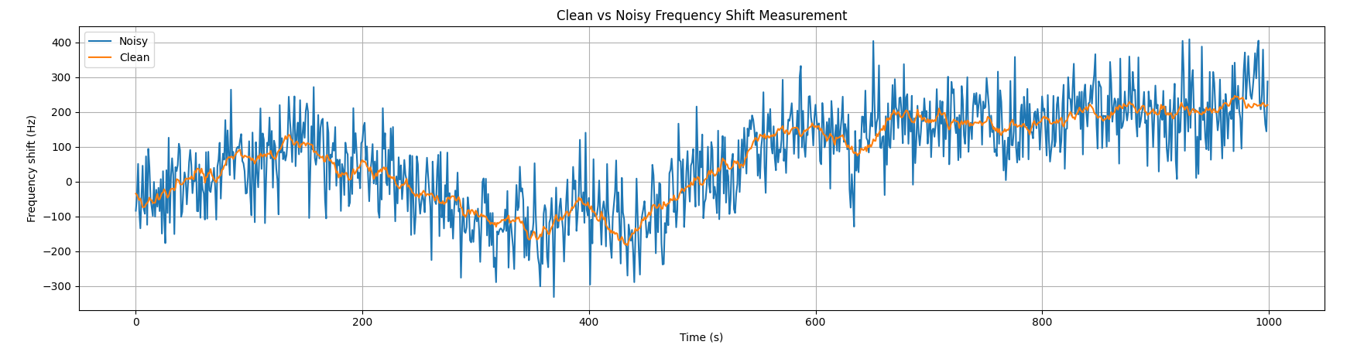
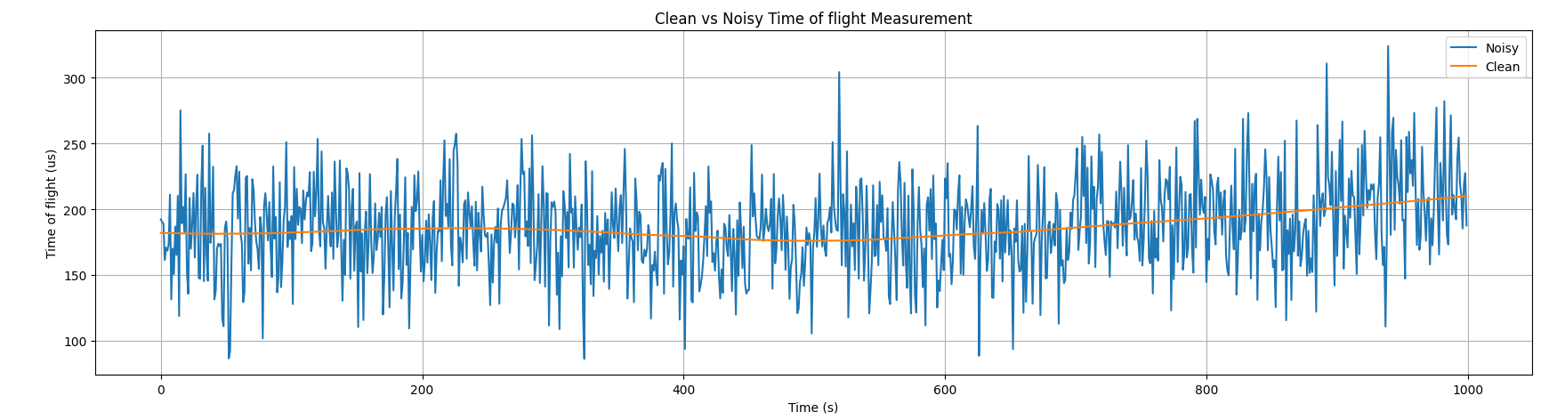
Practical Application Result Measurement Data

Slide 11
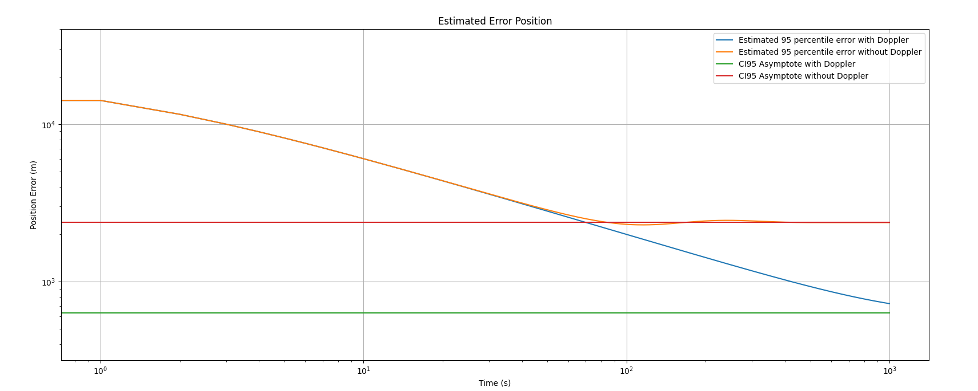
Practical Application Result
Expected Error

Slide 12
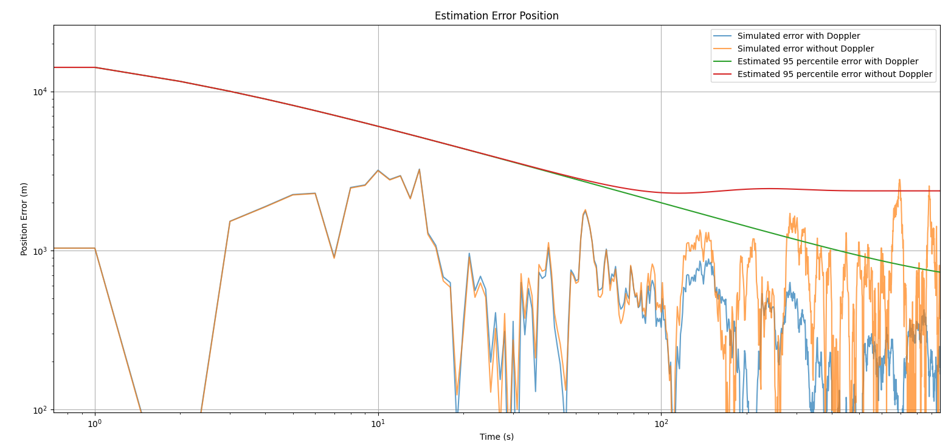
Practical Application Result
Actual Error - Position

Slide 13
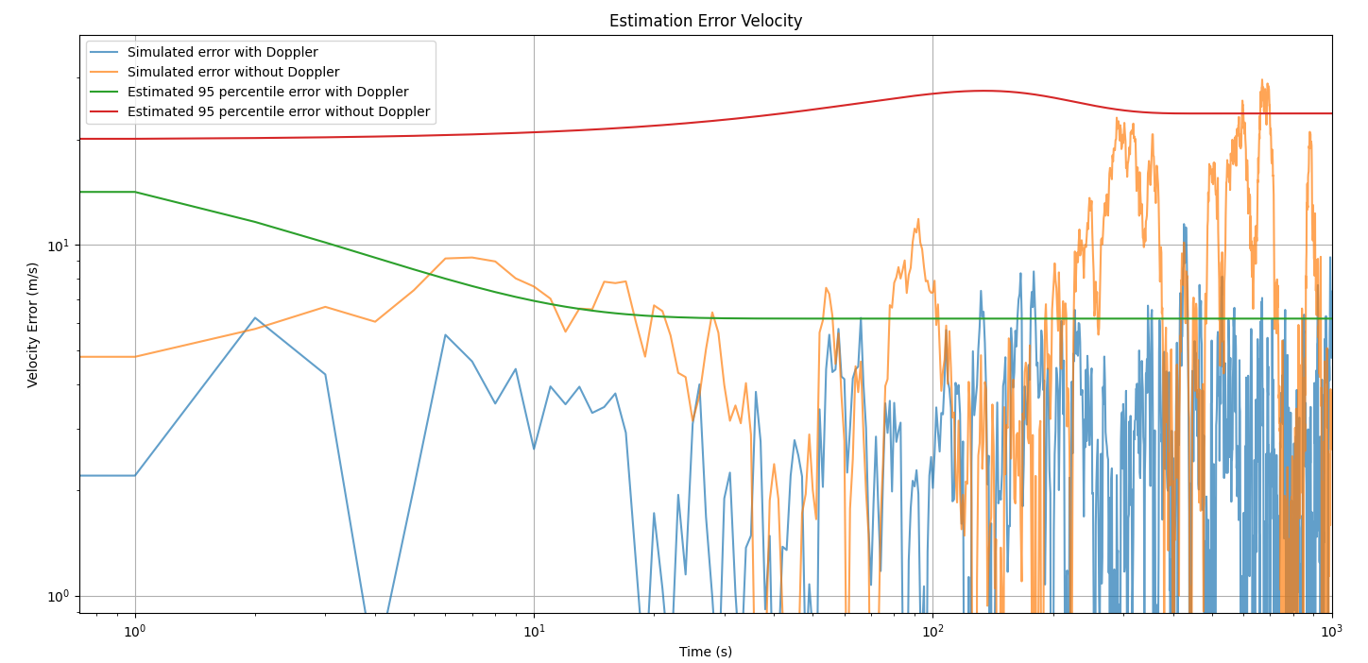
Practical Application Result
Actual Error - Velocity

Slide 14
Conclusion
Interesting to fiddle with ideal, linear and controlled Kalman Filters
Results interesting
Could be used for triangulation of devices

Slide 15
Discussion

