Slide 1

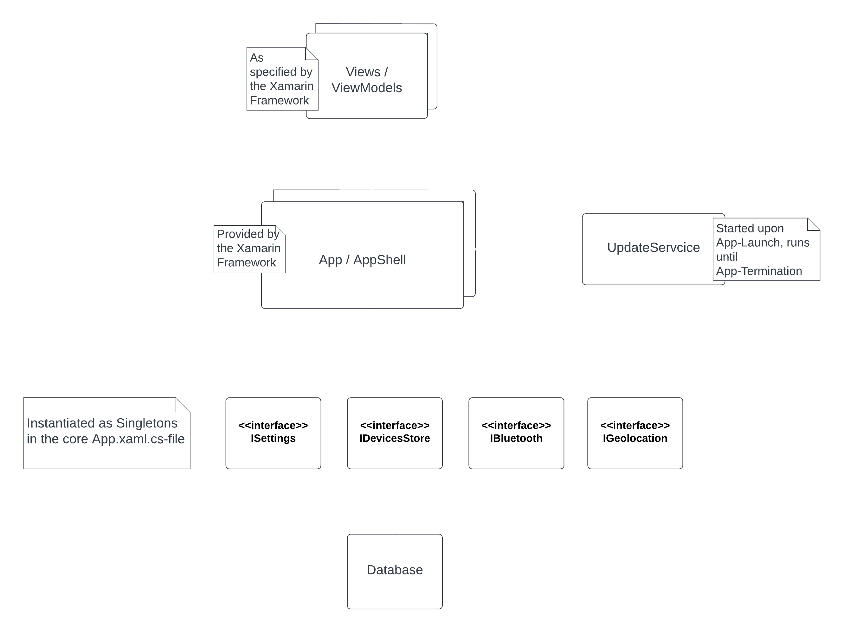



GPS
LE
Hearing Aid 1
…
Hearing Aid n

